Slide 1




WORLD SERVICES
What is
NAWS?
NAWS provides services to support the worldwide Fellowship of NA, including literature publishing, translation, public relations, conference support, and coordination of global Fellowship development.
October 2026

Slide 2

Contents
World Services
WSC
Literature / Carrying the Message
Services & Communication
When We Share
Questions and Answers
Notes:
Overview of session. 50 minutes. We’ll try to save time for questions. You can always write to wb@na.org if you have a question you didn’t get a chance to ask today:
Intro
WSC
Resources / When We Share
Literature / Carrying the Message
Services and Communication
Questions and Answers
There is PR work, legal work, work responding to emails and calls, and much more that is not covered in detail here.

Slide 3
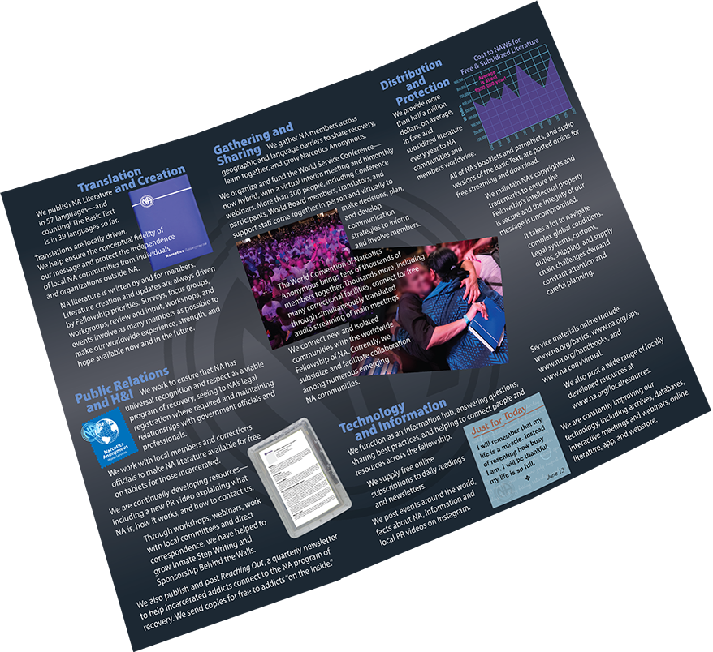
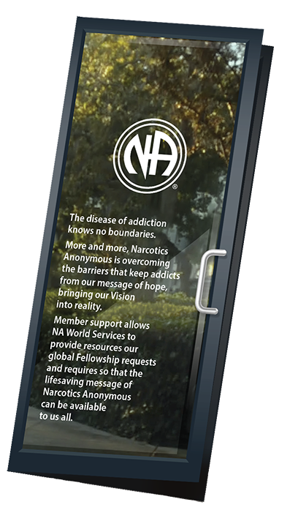
World Services
aka Narcotics Anonymous
World Services
Some of the resources provided by NAWS are in the brochure posted at na.org/what-is-na-world-services
Notes:
NAWS stands for Narcotics Anonymous World Services.
Some of the resources provided by NAWS are in the brochure posted at na.org/what-is-na-world-services

Slide 4
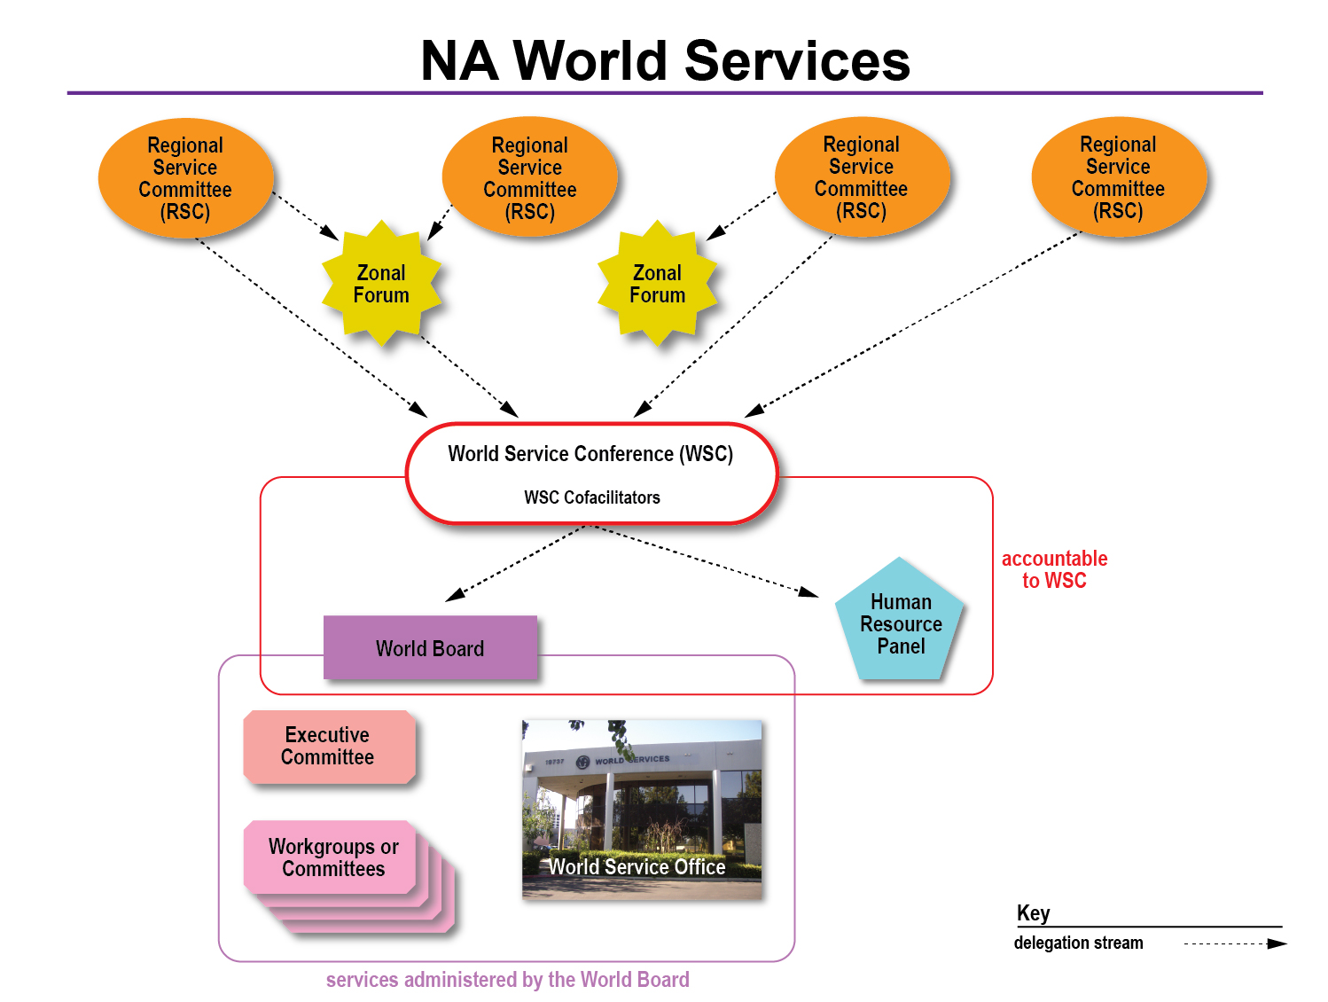
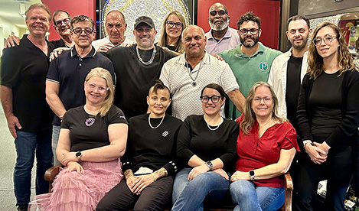
World Board
2026–2029
Notes:
“World services” = the World Service Conference and the World Board (WB), Human Resource Panel (HRP), and WSC Cofacilitators who are elected by the conference, plus the World Service Office, whose activities are overseen by the World Board.
This diagram illustrates that the office and workgroups are accountable to the WB
And the WB and HRP are accountable to the WSC.
The WB, the HRP, and the WSC Cofacilitators are all elected by the conference.
You can find more information about World Services from A Guide to World Services in NA. That’s where this diagram comes from.

Slide 5
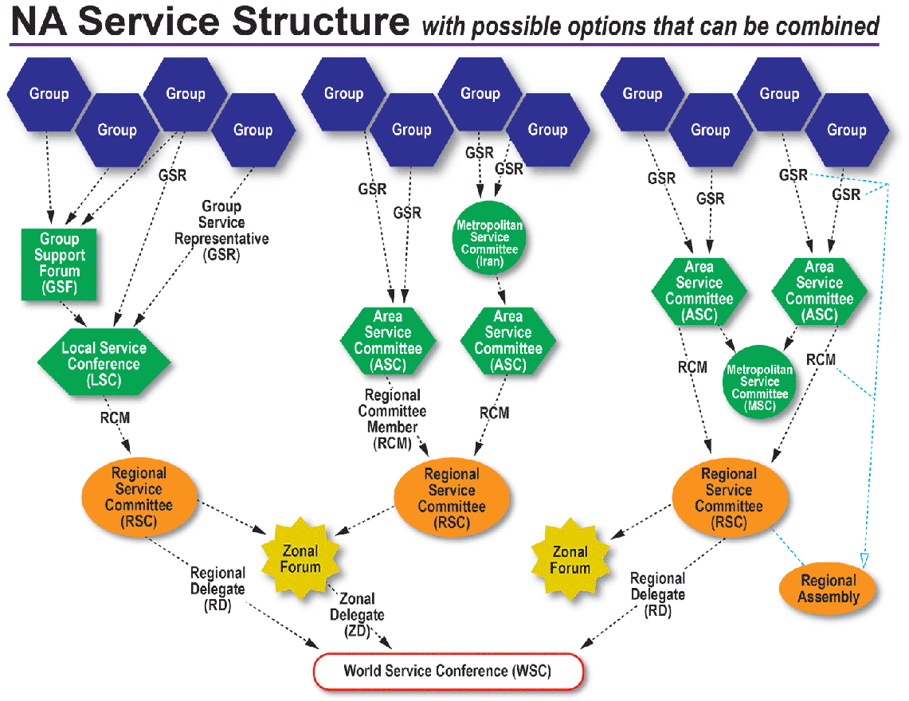
Notes:
The conference is, in turn, accountable to groups. All of the entities in NA World Services are directly accountable to the Fellowship that created them.
This diagram is also from GWSNA. It shows the connection of the groups to the World Service Conference, including some of the diversity that NA communities use to organize their services. This is a great diagram to use as a handout or slide if you need an overview of the structure from group to WSC.

Slide 6

The basic purposes of our World Services are…
communication, coordination,
information,
and guidance.
We provide these services so that our groups and members can more successfully carry the message of recovery and so that our program of recovery can be made more available to addicts everywhere.
A Guide to World Services in NA
Notes:
A Guide to World Services describes the basic purpose of NAWS as “communication, coordination, information, and guidance.” CCIG, for short.
If NAWS had a mission statement, this would pretty much be it. Like the Vision Statement, this informs all of our work--the projects that we work on that are approved by the WSC, as well as the work that continues week in and week out.
The five locations of NA World Services around the world spend the vast majority of their time and resources on what we call essential services. That is primarily literature production and distribution; protecting the Fellowship’s intellectual property; and providing communication

Slide 7

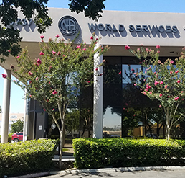
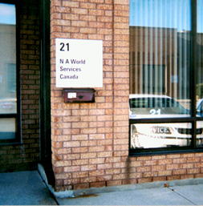
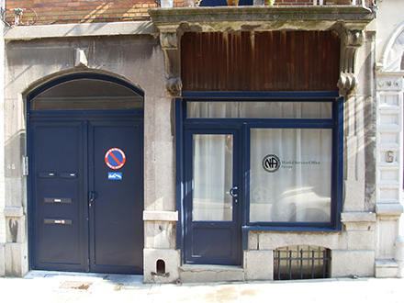
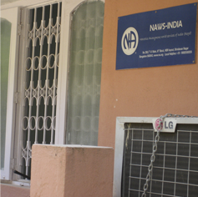
Narcotics Anonymous
World Service Office
Chatsworth, California, USA
NAWS has one branch office
In Brussels, Belgium
Two distribution centers
One in Mississauga, Ontario, Canada, and the other in Bangalore, India
Notes:
These are pictures of the 4 World Service locations
WSO-E, in Brussels, Belgium closed temporarily, but has since resumed shipping from the European office. Orders are now processed at our Chatsworth locations and packed and shipped from Europe. They are looking for a larger Brussels location so that they can build up stock there. Questions about European orders can be directed to wsoeurope@na.org.

Slide 8


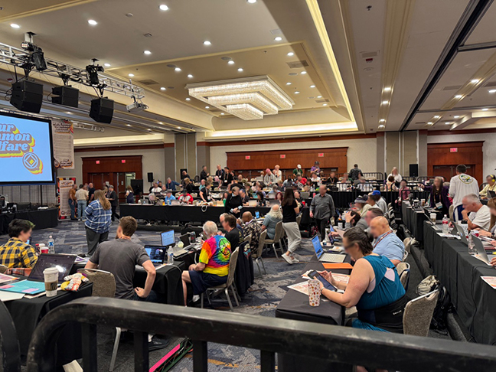
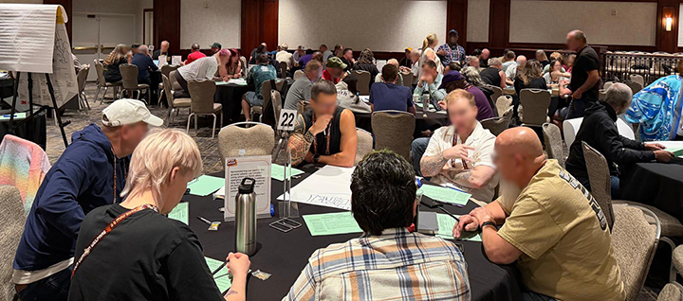
WSC
aka World Service Conference
Notes:
NA World Services also helps administer the World Service Conference and the projects it approves.
The 37th World Service Conference was held 3– 9 May 2026. It was the 50th anniversary of the WSC.

Slide 9
NAWS organizes and funds the World Service Conference—now hybrid, with a virtual interim meeting and bimonthly webinars.
More than 300 people, including Conference participants, World Board members, translators, and support staff come together in person and virtually tomake decisions, plan, and develop communication strategies to inform and involve members.
Highlights about
WSC 2026 can be found in the NAWS Update PPT.
It includes information about adopted motions, projects, and the Information Discussion Topics (IDTs) for this cycle.
Notes:
NAWS organizes and funds the World Service Conference—now hybrid, with a virtual interim meeting and bimonthly webinars.
More than 300 people, including Conference participants, World Board members, translators, and support staff come together in person and virtually tomake decisions, plan, and develop communication strategies to inform and involve members.
This is from the NAWS brochure that wa mentioned earlier.
Highlights about WSC 2026 can be found in the NAWS Update PPT.
It includes information about adopted motions, projects, and the Information Discussion Topics (IDTs) for this cycle.

Slide 10
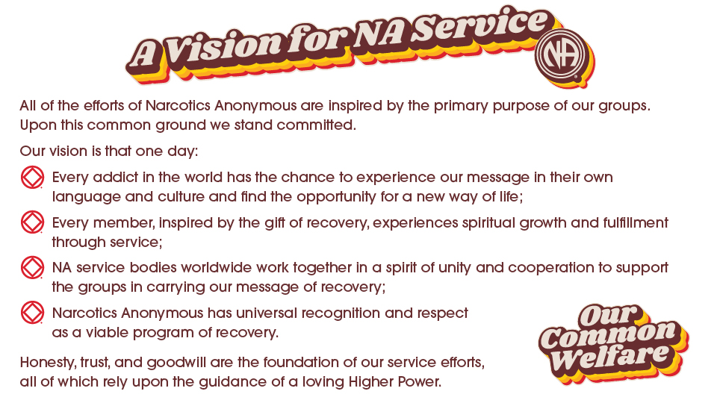
Notes:
Most of you have seen A Vision for NA Service before. This is the touchstone for all of the work of World Services.
WSC 2023 revised the Vision statement to change “his or her own” to “their own language and culture” as shown here.
This small change may be barely noticeable to some, but it is a big step in helping to achieve our Vision by using language inclusive of all members.

Slide 11
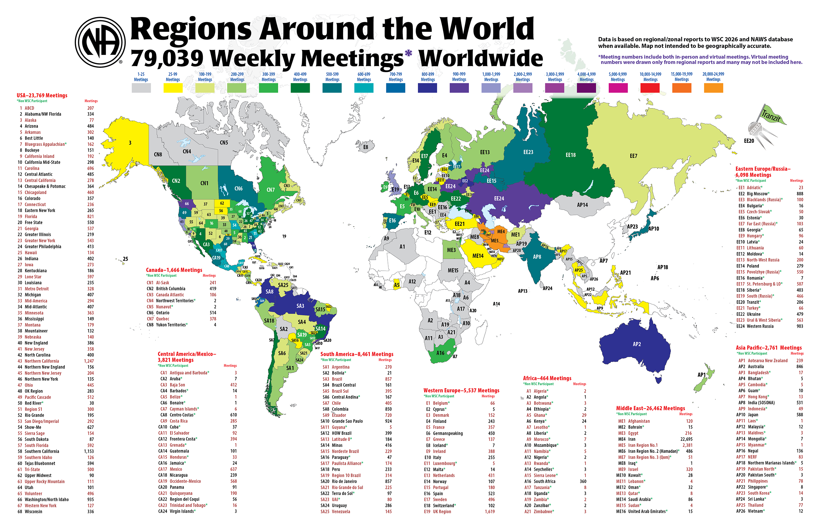
Notes:
We update this map every WSC, based on the numbers delegates report.
Meeting numbers have exceeded pre-pandemic levels but there may be many more virtual meeting than are being accounted for.

Slide 12
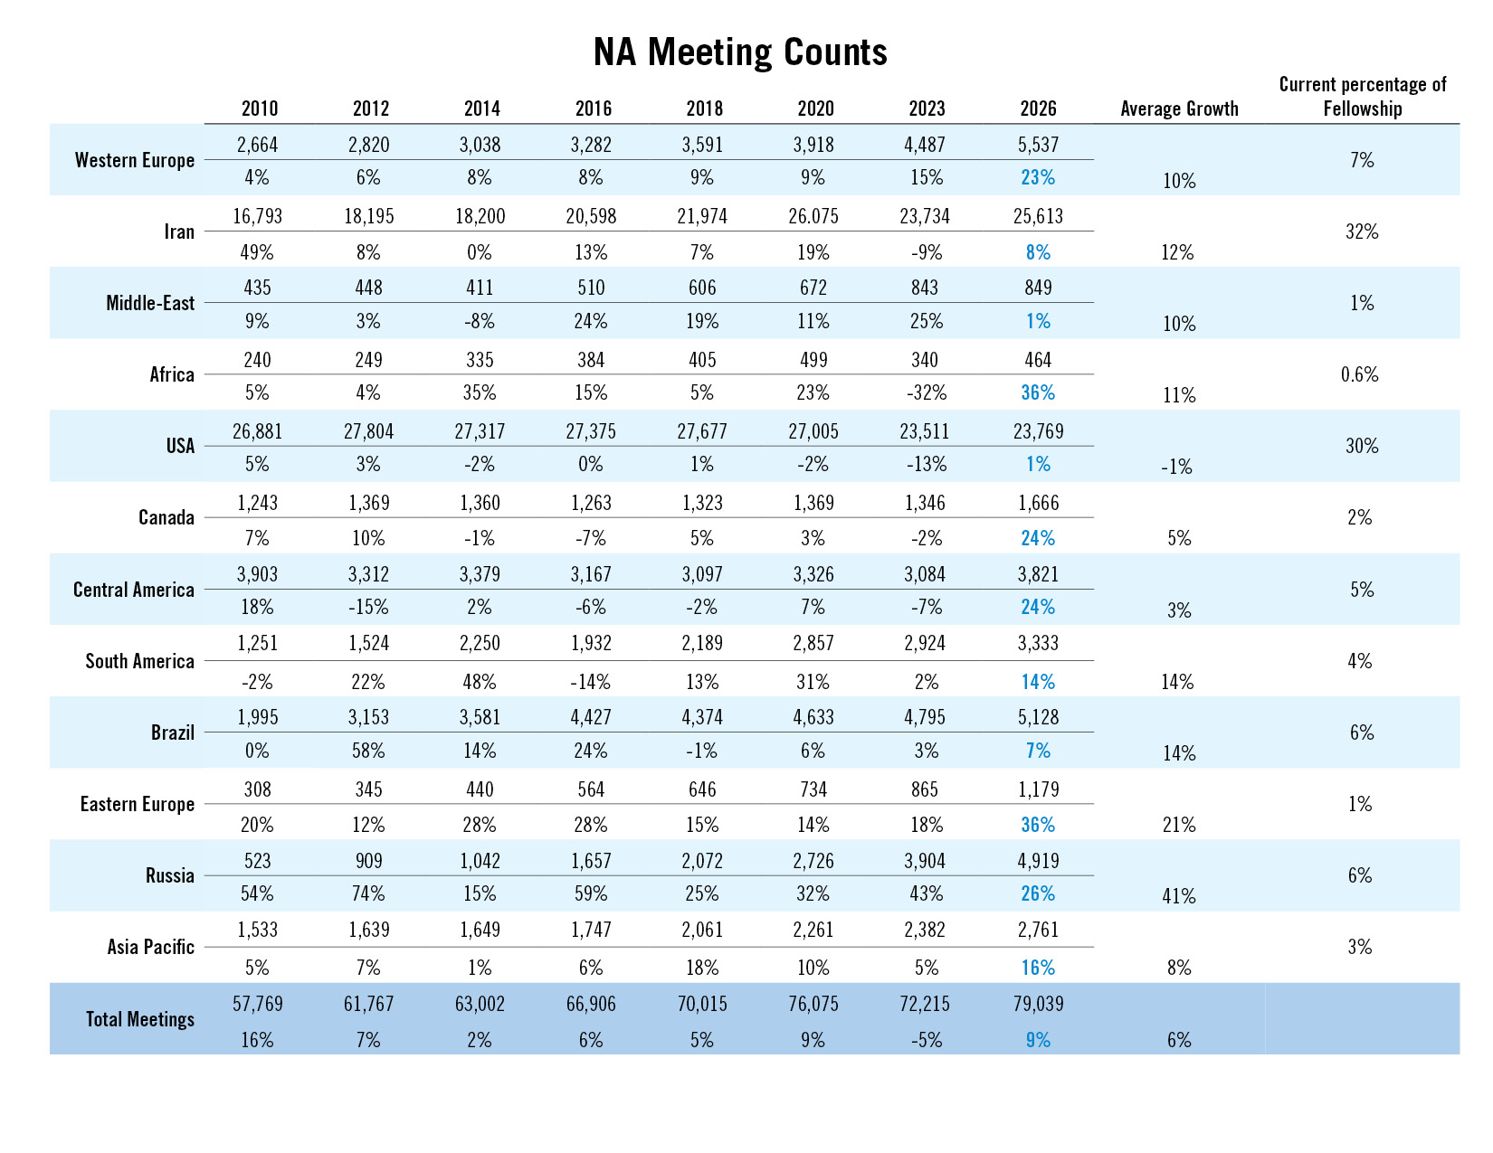
Notes:
This slide shows meeting counts in different parts of the world over the past 16 years. About one third of NA meetings are now in the US, about 1/3 in Iran, and 1/3 everywhere else.
Even before the pandemic, NA growth had flattened in some parts of the world, particularly within the US.
It can be easy to think of Fellowship development as something that happens “somewhere else,” but there is work to do locally no matter where we are.
We are eager to do what we can to support efforts to reverse that trend.
This chart is posted on na.org/maps, which is a page full of interesting maps, diagrams, and illustrations of NA’s growth.

Slide 13
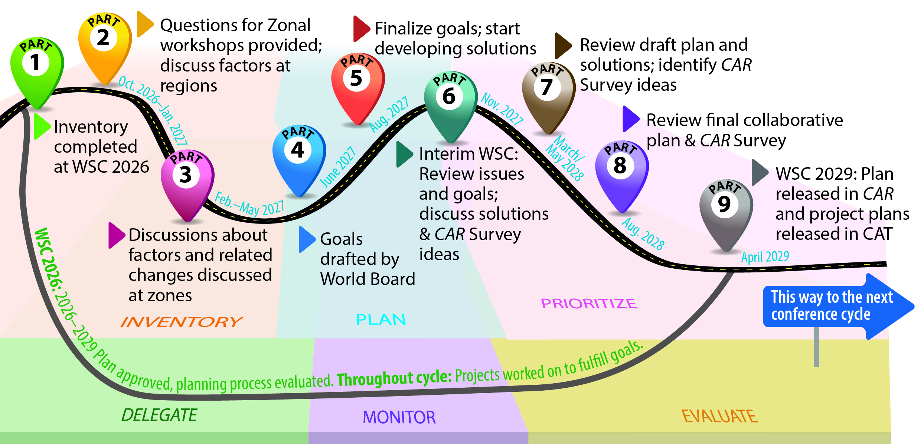
Collaborative Planning
Notes:
At WSC 2023, the strategic planning process was rebooted. The new planning process was a big focus last cycle and the result was a collaborative plan that conference participants have collectively created. It includes extensive communication with and guidance from delegates throughout the process.
WSC 2026 adopted the 2026-2029 plan and began the process of creating the 2029–2032 plan by conducting an inventory: identifying factors, inside and outside of NA, that could affect our ability to carry the message.
As was done last cycle, there will be zonal workshops that will discuss the challenges raised by the factors conference participants identified and prioritized.
For more information on the process, see the planning section of the conference page: na.org/planning.

Slide 14
Literature /
Carrying the Message
Production,
protection,
translation,
distribution…
Notes:
Making literature available is a huge part of what we do, and we could fill this whole presentation simply with the efforts to draft, translate, produce, distribute, and protect NA literature.
NAWS makes many choices that are purely about carrying the message that no ordinary corporation would make. Two examples are explained in the next two slides: giving away and subsidizing literature and providing literature for inmate tablets.

Slide 15
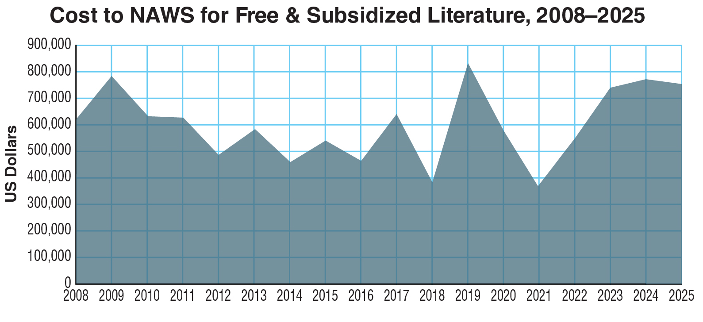
Notes:
This graph represents the cost of free and subsidized literature that NAWS distributes to communities around the world.
The total for FY 2020 was just under $580,000 and for FY 2021 was just over $368,000. The total for 2025 was $754,054. The need continues regardless of resources available. And so does our commitment to meet that need.
The support NA World Services has received from the Fellowship help make these efforts possible.
Note: We don’t report many of the details of where this literature goes partly not to embarrass or call attention to any communities. We never want to cause a community confusion or harm, even inadvertently.

Slide 16
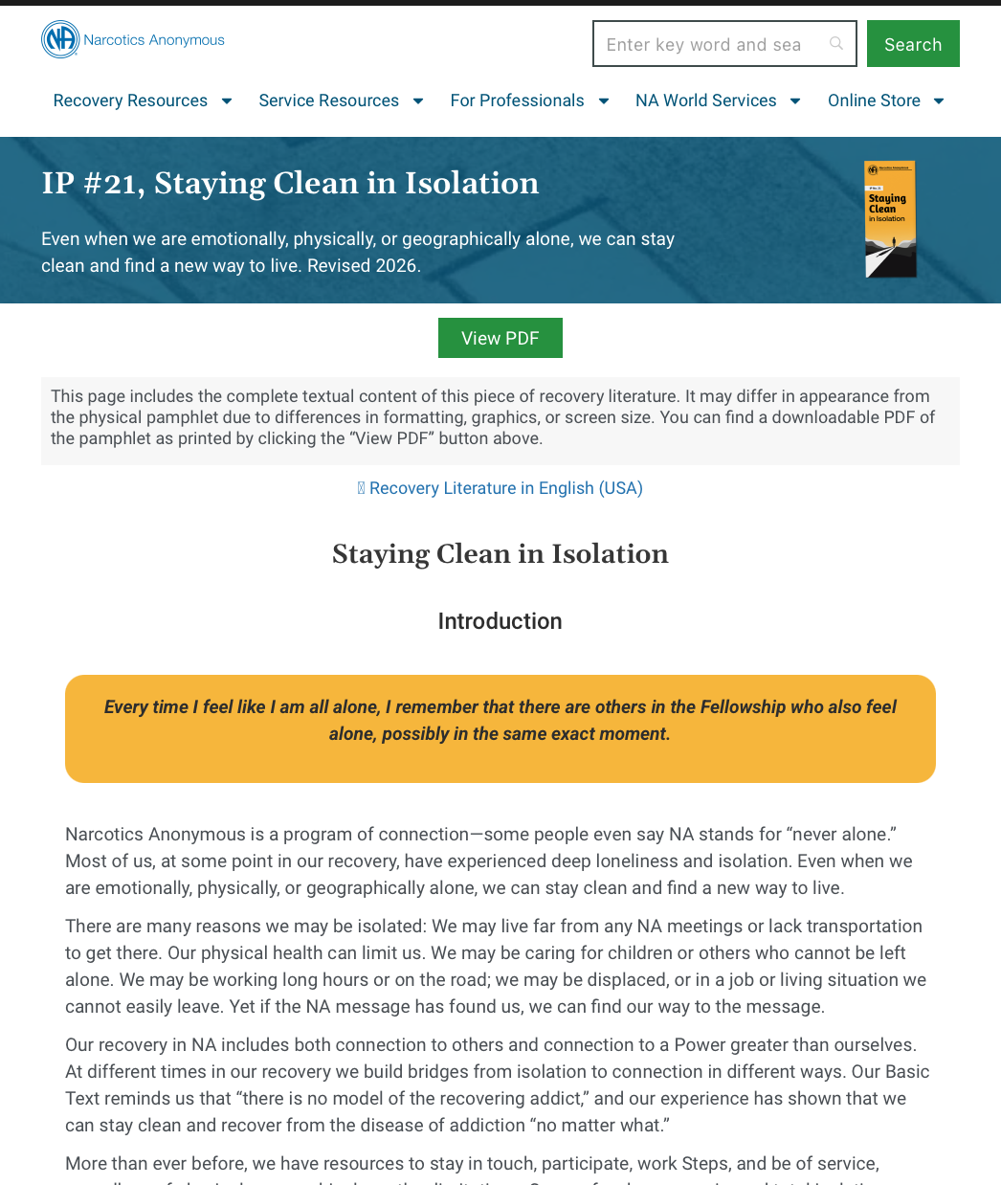
na.org/literature
Free Literature Online
Pamphlets and booklets are
posted in 61 languages.
NEW—web-formatted literature.
Easy to view on mobile devices!!
The Introductory Guide, which was developed specifically for the newcomer, is also online for free.
Notes:
Our message is available for free reading, listening (audio BTs), and watching (ASL) online.
IPs and booklets in 61 languages are posted at na.org/literature.
Last year, web-formatted literature was added to the website! This browser-friendly format is much easier to read on mobile devices.

Slide 17

A one-stop-shop to welcome newcomers
An Introductory Guide to NA is a booklet with a total of 142 pages that contains 10 Informational Pamphlets and a full chapter from the Basic Text.
Available in 23 languages
Notes:
It should also be brought to your attention that An Introductory Guide to NA is a one-stop-shop to welcome newcomers.
It is a booklet with a total of 142 pages that contains 10 Informational Pamphlets and a full chapter from the Basic Text.
It is available in 23 languages and costs a mere $2.45 US or 2.15 €.
Some groups cannot always afford to give the newcomer a Basic Text. A beget-friendly alternative is the Intro Guide.

Slide 18
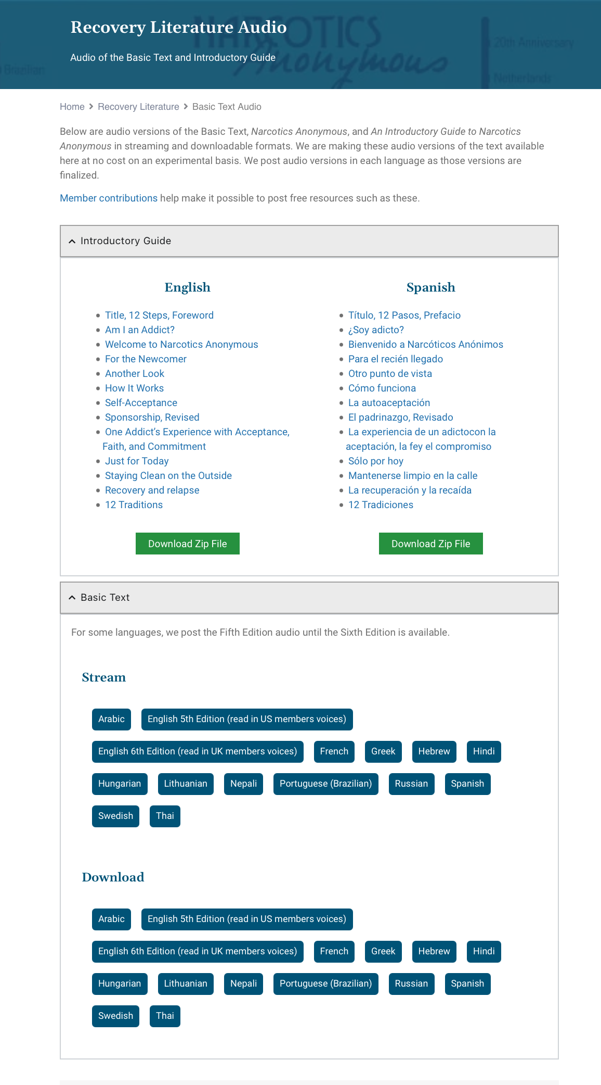

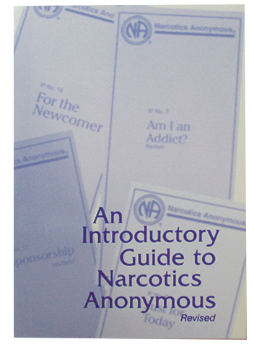

na.org/audio
Notes:
Free audio versions of the Basic Text have been posted as they become available. You can stream or download.
So far, there are 15 versions: Arabic, two English versions—one British and one American English, French Canadian, Greek, Hebrew, Hindi, Hungarian, Lithuanian, Nepali, Brazilian Portuguese, Russian, Spanish, Swedish, and Thai posted.
An Introductory Guide to NA with ten IPs and the Steps chapter from the Basic Text is also available in English and Spanish audio.
NAWS is also working on recording the Just for Today, with the help of NA zones.
You can find them at na.org/audio.

Slide 19
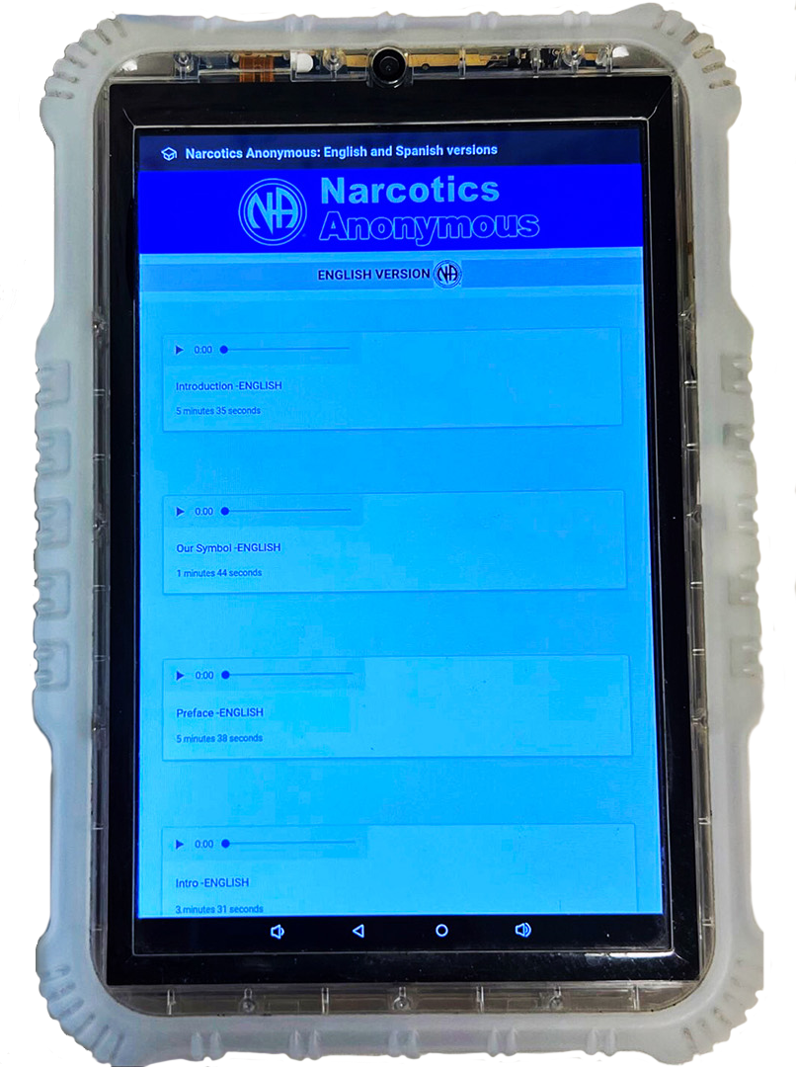
Inmate Tablets
Some facilities offer tablets to inmates
NAWS clears the way to share NA literature
  Audio BT
  Pamphlets
  Booklets
  Intro Guide
NAWS is working on an app for tablets that will make it easier to access materials.
Notes:
Some correctional facilities offer inmates tablets pre-loaded with a variety of material, including, in some cases, NA recovery literature, at no cost to the inmate.
One of the most important duties the Fellowship has assigned NA World Services is the protection of NA’s intellectual property and copyrights on behalf of the Fellowship. Inmate tablets are a new way to carry the message, and World Services must grant legal permission to load Narcotics Anonymous literature on tablets. Each of these agreements involves a lot of communication among corrections authorities, local NA members, and NA World Services.
The agreements made in these cases allow for the material that is currently posted on the NAWS website to be on tablets for inmates – audio Basic Texts, IPs, and booklets such as the White Booklet and the Intro Guide. NAWS continues to provide paper copies of the Basic Text to inmates upon request.
NAWS has about 40 agreements, ranging in size from one jail to a big provider or with the government in the case of Sweden.
WSC 2026 agreed to create a project plan relating to NA literature on inmate tablets.
NAWS is working on an app for tablets that will make it easier for incarcerated people to access materials and easier for provide the content for free in more facilities.

Slide 20
Fellowship Intellectual Property Trust
The purpose of the Trust is:
“to hold and administer all recovery literature and other intellectual properties of the Fellowship of Narcotics Anonymous in a manner that will help addicts find recovery from the disease of addiction and carry that message of recovery to the addict who still suffers, in keeping with the Twelve Steps and Twelve Traditions of NA.”
na.org/fipt
Notes:
One of World Services’ most important responsibilities is protecting the Fellowship’s property—its name, logos, and literature for the current and future Fellowship.
The Fellowship Intellectual Property Trust (FIPT for short) is a legal document that contains the collective decisions the NA Fellowship has made to preserve the integrity of our published message and the accountability of our publishing services. The Fellowship of Narcotics Anonymous, as given voice by its groups through their regional delegates at the World Service Conference, created and makes decisions about the trust. NA World Services, Inc. manages the trust on their behalf, and the Fellowship of Narcotics Anonymous as a whole is the beneficiary.
There is a lot of misinformation about the FIPT. Here is what the document itself says. The purpose of the trust is:
“to hold and administer all recovery literature and other intellectual properties of the Fellowship of Narcotics Anonymous in a manner that will help addicts find recovery from the disease of addiction and carry that message of recovery to the addict who still suffers, in keeping with the Twelve Steps and Twelve Traditions of NA.”
If you want more information about what the FIPT is and why it is important, see the video on the FIPT page: na.org/fipt.

Slide 21
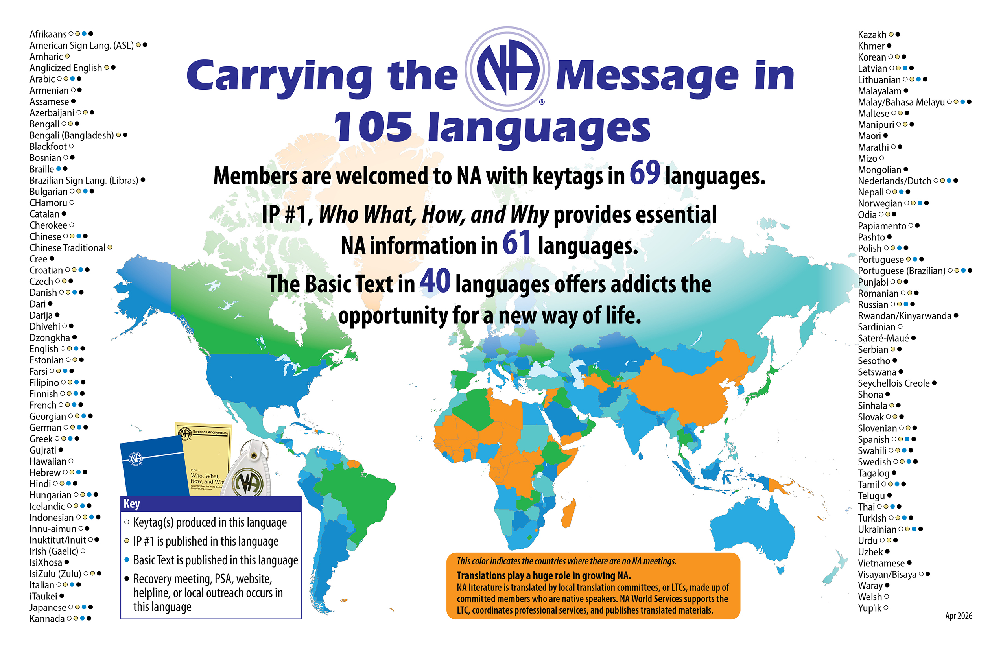
Notes:
This map shows the 105 languages NA members speak. Literature is translated into 61 of those languages.
This “Carrying the message map” is revised each fiscal year to include in the Annual Report. The latest version is posted at na.org/maps.
Not reflected in this graphic is the addition of 2 more Basic Text translations bringing the total to 42. The most recent translations are Azerbaijani, Slovenian, and Ukrainian.

Slide 22
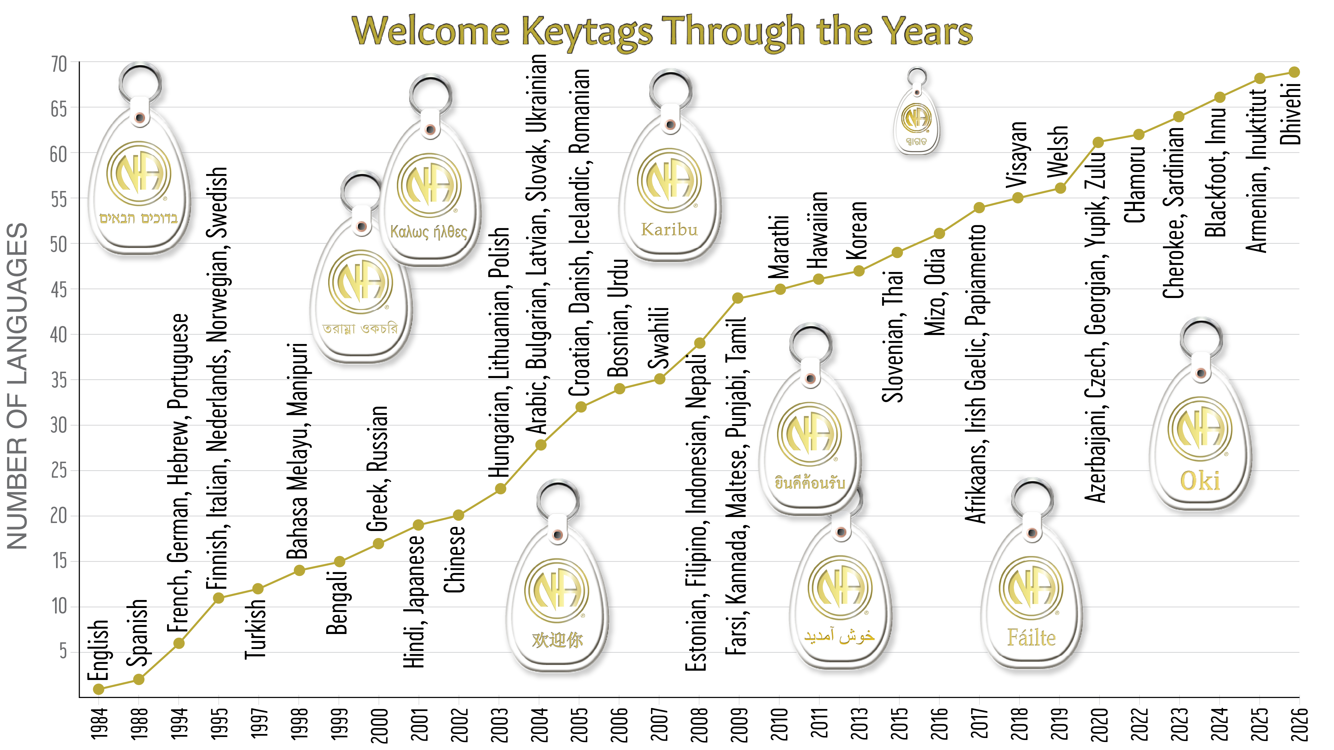
Notes:
Many of the languages in NA are reflected in our keytags. We produce welcome tags in 69 languages. Keytags are sometimes created in indigenous languages to better welcome members in their own language and culture, even if that language isn’t spoken in the meeting they are attending. Examples are Hawaiian, Welsh, Blackfoot, and others.

Slide 23
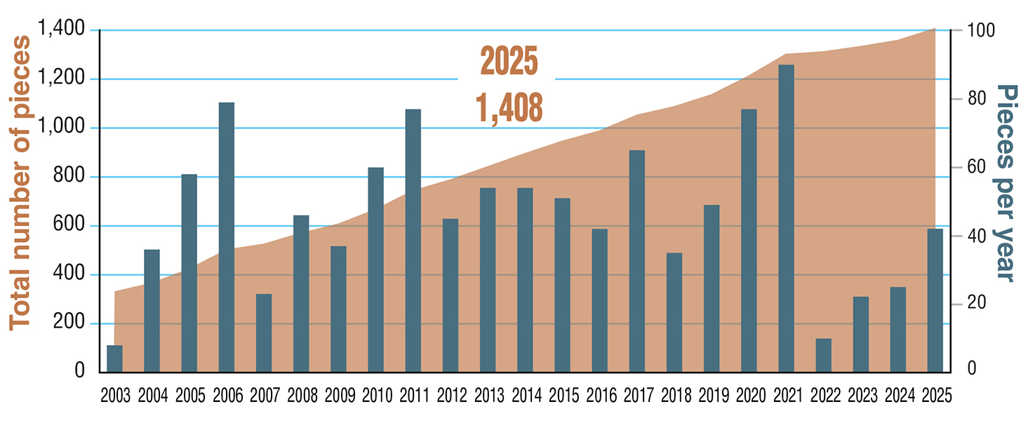
Total Published Translated Items & Pieces Per Year
for Fiscal Years 2003–2025
Notes:
This graph shows the number of translated items published at World Services as of the end of the 2025 fiscal year, which was June 2025. At that time, we had published 1,408 translated titles.
Local members do the heavy lifting in almost all translations. It takes dedicated members willing to devote countless hours to the work, even when a professional translator is used. NAWS oversees translations to make sure conceptual fidelity is maintained, and they organize proofing, copyrights, layout, and production. For almost a year during the pandemic, they had a translations staff of one and a production staff of one. They are slowly building back and now have a translations team of three and half.

Slide 24
By addicts, for addicts
our literature development process
Drafts developed
by workgroup/
focus group/
World
Board
Review
drafts circulated
to gather Fellowship input
Source material submitted by members
Approval
draft appears in the Conference Agenda
Report
Notes:
For the last 20 years, each literature project has had the same basic process.
NAWS surveys the Fellowship for input about the project itself. This allows input to be gathered from members all across the globe, speaking many different languages.
They collect source material from members.
They form a workgroup of members who review all of the source material and the resulting drafts. For the IP#21 revision, Staying Clean in Isolation, focus groups were used, inviting any member who expressed interest. The same model will be used for the 2026-2029 cycle.
Release drafts for Fellowship review
Revise based on input.
Publish an approval draft no later than with the CAR publication.
It’s a process that allows members all around the world, regardless of literacy level or language spoken, to contribute. Those contributions shape and give voice to the resulting draft.
NAWS used the volunteer form posted on na.org/projects to form web meetings with any interested member to work on projects like the revisions to IP #21 and H&I Basics, and the restructuring of our website.
You can use a new version of the form for the orijects for this cycle.

Slide 25
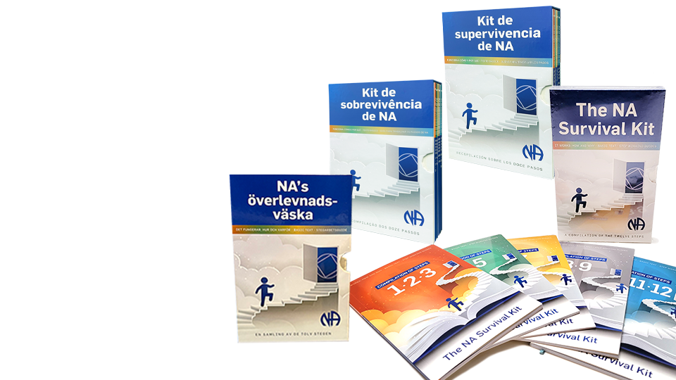
Spanish
Item #SP9425
NA Survival Kit
English
Item #9425
For each Step, there’s a section from the Basic Text chapter “How It Works,” the chapter from It Works: How and Why, and the chapter from The NA Step Working Guides.
Brazilian Portuguese
Item #PB9425
na.org/webstore
Swedish
Item #SW9425
Notes:
NA’s Basic Text explains the significance of the Steps in this way:
The steps are our solution. They are our survival kit. They are our defense against addiction which is a deadly disease. Our steps are the principles that make our recovery possible.
“How it Works,” Narcotics Anonymous
Information about the Twelve Steps is included in three different NA books. It’s common for NA sponsors to advise sponsees to read about the Step they are working in the Basic Text and It Works: How and Why before answering the questions in The Narcotics Anonymous Step Working Guides.
In that spirit, we have published this material into one boxed set titled The NA Survival Kit.
English, Spanish, Brazilian Portuguese, and Swedish are now available. We are working on Farsi and Russian.
For each Step, the Survival Kit includes the section from the Basic Text chapter “How It Works,” the chapter from It Works: How and Why, and the chapter from The NA Step Working Guides, with the questions numbered rather than bulleted.
The NA Survival Kit consists of five bound packets together in one slip case:
• Steps One, Two, and Three
• Steps Four and Five
• Steps Six and Seven
• Steps Eight and Nine
• Steps Ten, Eleven, and Twelve
They can be found at na.org/webstore

Slide 26
Services & Communication
na.org, eblasts,
social media, webinars,
email correspondence, NAWS News, etc.
So many ways to stay connected.
Notes:
NAWS connects with the Fellowship and members stay connected with the whole world.
There are so many ways to keep up with NAWS: the website, eblasts (that you can subscribe to at na.org/subscribe), social media, webinars, email correspondence, NAWS News, and more.

Slide 27

Need to find a meeting?
na.org/virtualmeetings
World Services keeps a list of virtual meetings around the world. Your meetings can be added here as well.
na.org/meetingsearch
From here you can find meetings on local websites and helpline numbers around the world.
Notes:
Need to find a meeting?
na.org/virtualmeetings
World Services keeps a list of virtual meetings around the world. Your meetings can be added here as well.
na.org/meetingsearch
From here you can find meetings on local websites and helpline numbers around the world.

Slide 28
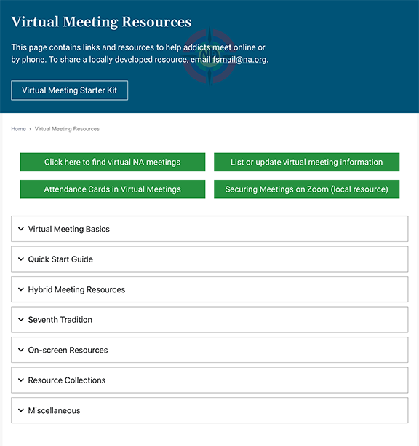
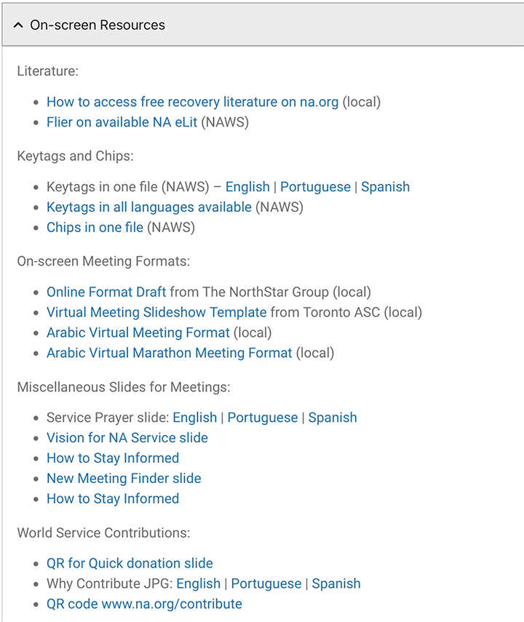
na.org/virtual
Notes:
Most of NA had to learn to do things differently during the pandemic. NAWS provided a lot of online service and support for virtual meetings and service efforts.
One of the first things they did when so much of the world closed down was to post a page of resources to help addicts find virtual meetings and to help members who were serving meetings and service bodies virtually: na.org/virtual. It is a treasure trove. New materials are posted whenever they are sent in.
The page includes: onscreen resources for virtual meetings, info on hybrid meetings, 7th tradition, and more. One of our most recent resources is Electronic Funds—Money Management under the Seventh Tradition section.
Let us know if there’s something you’d like to see on this page.

Slide 29
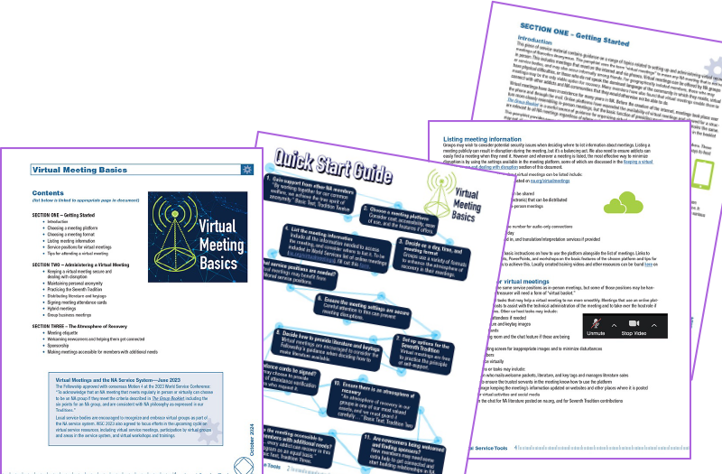
na.org/virtual
na.org/toolbox
Notes:
Virtual Meeting Basics is posted at the top of the drop-down menus on the Virtual NA Meeting Resources webpage. It is also posted at na.org/toolbox. It is currently translated in Farsi, French, Hungarian, Italian, Portuguese (Brazil), and Spanish.
This tool comes from the Local Service Toolbox project.
NAWS held many open webinars on the topic. They also collected a lot of resources from trusted servants around the world and posted several surveys to collect information. All of that information was used to put together a tool that compiles best practices for virtual meetings.
The tool covers a range of topics related to virtual NA recovery meetings, including
keeping meetings secure from disruption,
welcoming newcomers and sponsorship,
practicing the Seventh Tradition and signing attendance cards
making meetings accessible
hybrid meetings
and more.

Slide 30
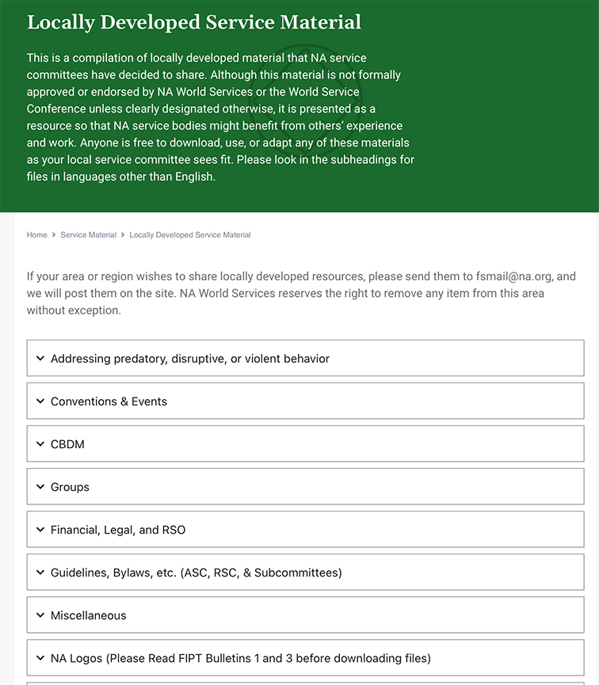
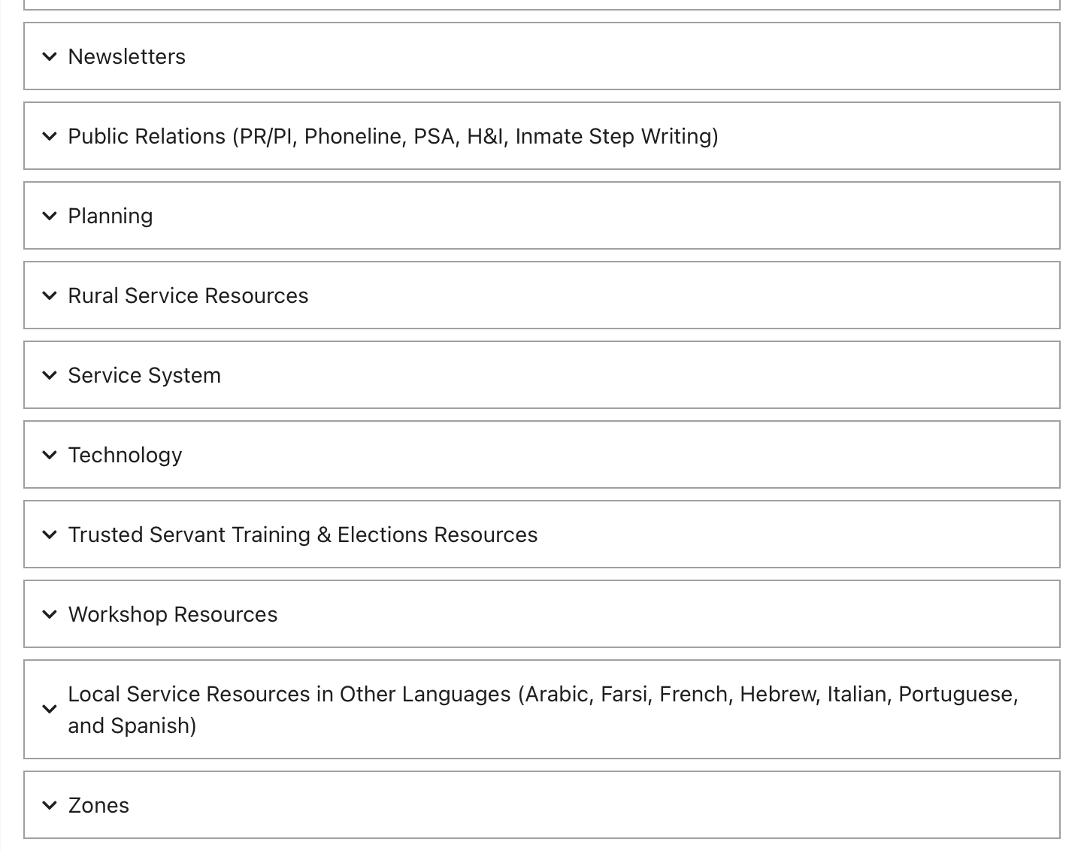
na.org/localresources
Notes:
Another place on the website that you can find lots and lots of resources for groups and service bodies is the Local Service Resources page: na.org/localresources
If you have a resource or tool that others might benefit from, please send it to worldboard@na.org.

Slide 31


Web Meetings
Hospitals & Institutions
handi@na.org
Public Relations
pr@na.org
Notes:
NAWS holds PR and H&I web meetings every few months. They are a great way to gather information and share experiences on service related topics.
These meetings are focused on members talking to each other and sharing successes and challenges. We’ve been holding them on a quarterly basis for years. You can find flyers for the most recent at na.org/webinar.
If you’re doing PR service work, and are interested, send an email to pr@na.org and we will keep you updated about dates and topics.
Likewise, if H&I is your jam, email handi@na.org.

Slide 32
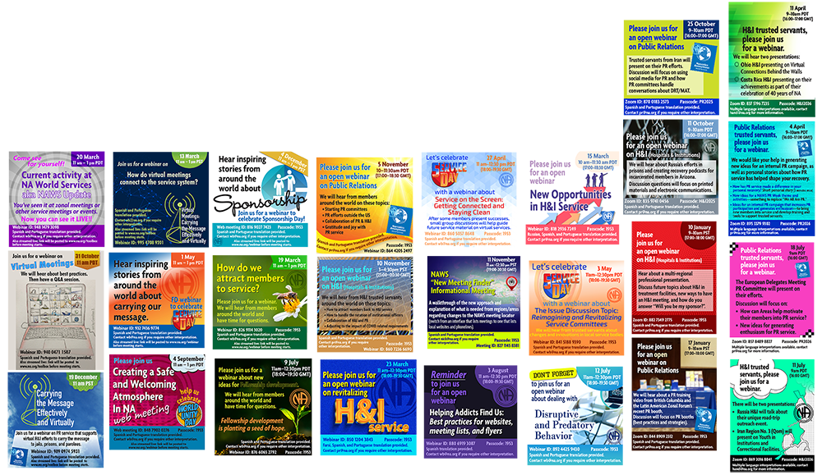
na.org/webinar
Notes:
We also hold quarterly webinars open to any interested member on topics of general Fellowship interest.
You can find the latest posted at na.org/webinar.

Slide 33
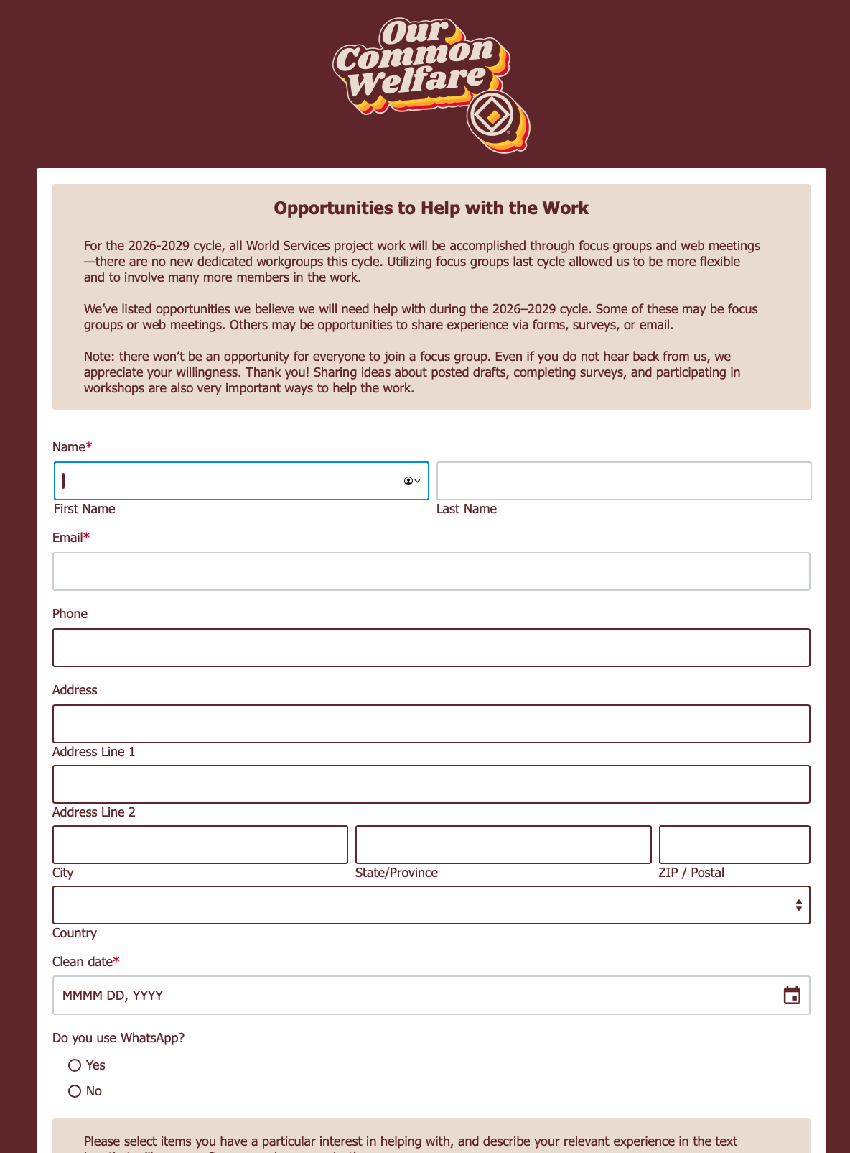
na.org/projects
Public Relations Service
New Recovery Literature—Disruptive and Predatory Behavior
Revising Existing Recovery Literature—Gender-Neutral and Inclusive Language
Generational and Cultural Diversity
New and Revised Service Tools—Group Service
New and Revised Service Tools—Area Service
DRT/MAT—Helping Members Take Root
WCNA 39 speaker evaluation
Translations
Technology
Proofing and/or Layout
More info on this cycle’s projects can be found in the NAWS Update PPT.
Notes:
Another way to get involved is to fill out the volunteer/focus group form on the project page: na.org/projects.
Any member with skills or interests relevant to current projects is encouraged to use the form to speak up! That list becomes the backbone of many efforts throughout the cycle. There are projects about local service this cycle, so you don’t need a ton of cleantime or service experience to participate. Every NA member deserves the gift of serving selflessly. Let’s create new tools for members and groups!
The list of available opportunities:
Public Relations Service
New Recovery Literature—Disruptive and Predatory Behavior
Revising Existing Recovery Literature—Gender-Neutral and Inclusive Language
Generational and Cultural Diversity
New and Revised Service Tools—Group Service
New and Revised Service Tools—Area Service
DRT/MAT—Helping Members Take Root
WCNA 39 speaker evaluation
Translations
Technology
Proofing and/or Layout

Slide 34
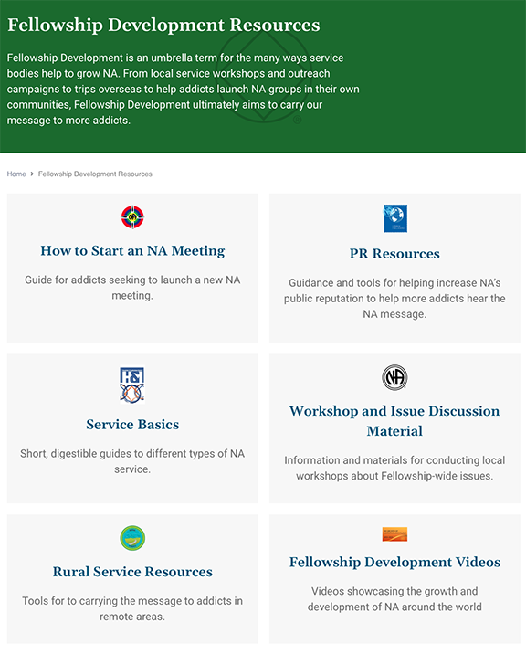
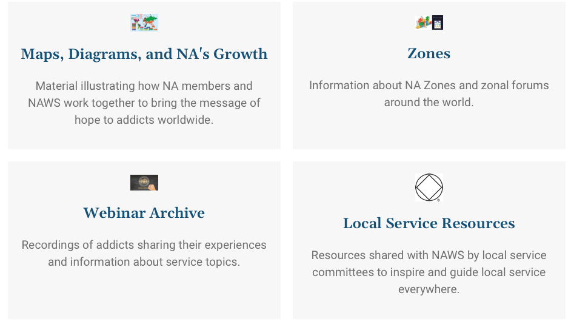
na.org/fdresources
na.org/videos
na.org/maps

Slide 35
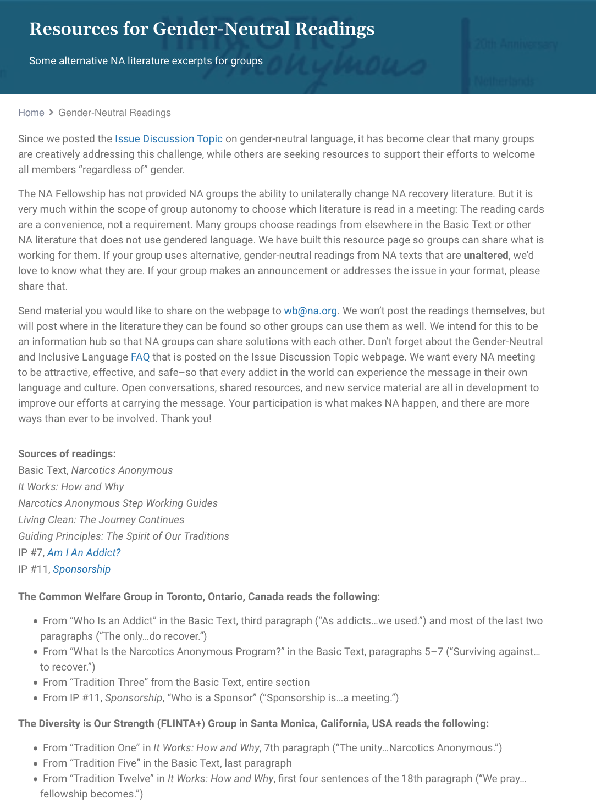
na.org/gender
More information on the new project on the topic of gender-neutral language can be found here:
na.org/genderproject
Notes:
The conversation about how to welcome all members regardless of gender has been ongoing for years now and it was clear that many groups are creatively addressing this challenge, while others are seeking resources to support their efforts to welcome all members “regardless of” gender.
The NA Fellowship has not provided NA groups the ability to unilaterally change NA recovery literature. But it is very much within the scope of group autonomy to choose which literature is read in a meeting: The reading cards are a convenience, not a requirement. Many groups choose readings from elsewhere in the Basic Text or other NA literature that does not use gendered language. World Services built this resource page so groups can share what is working for them. If your group uses alternative, gender-neutral readings from NA texts that are unaltered, send them to wb@na.org. If your group makes an announcement or addresses the issue in your format, please share that as well.
There is a current project on the topic of gender-neutral language. More information can be found at na.org/genderproject or in the NAWS Update PPT.

Slide 36
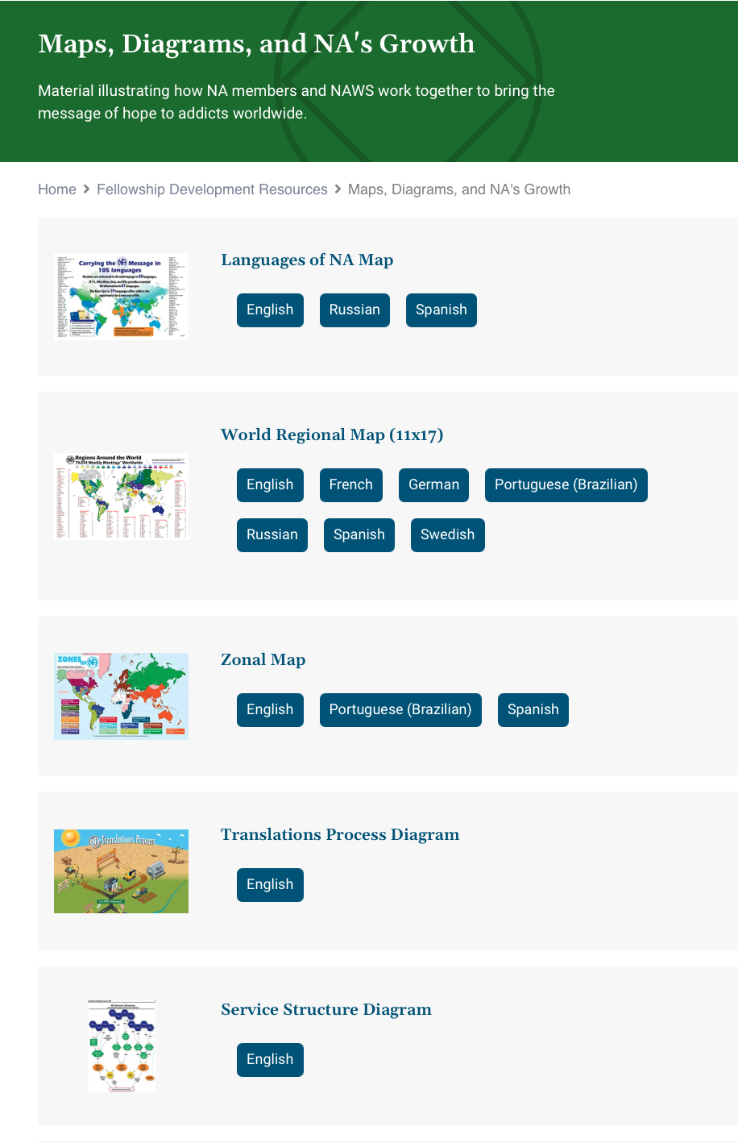
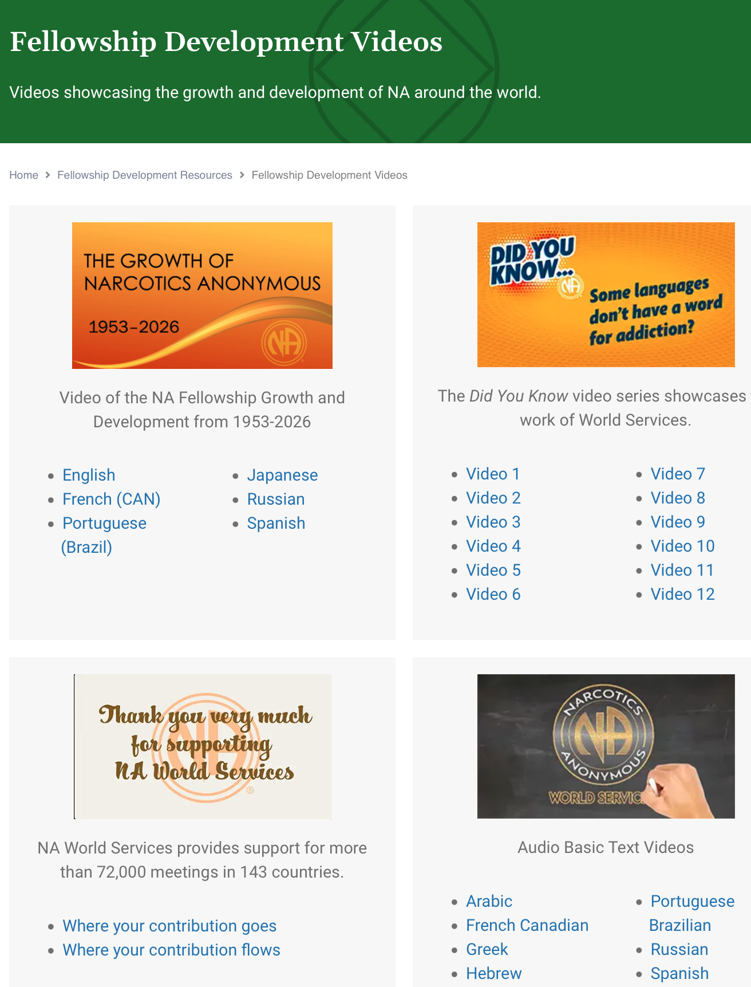
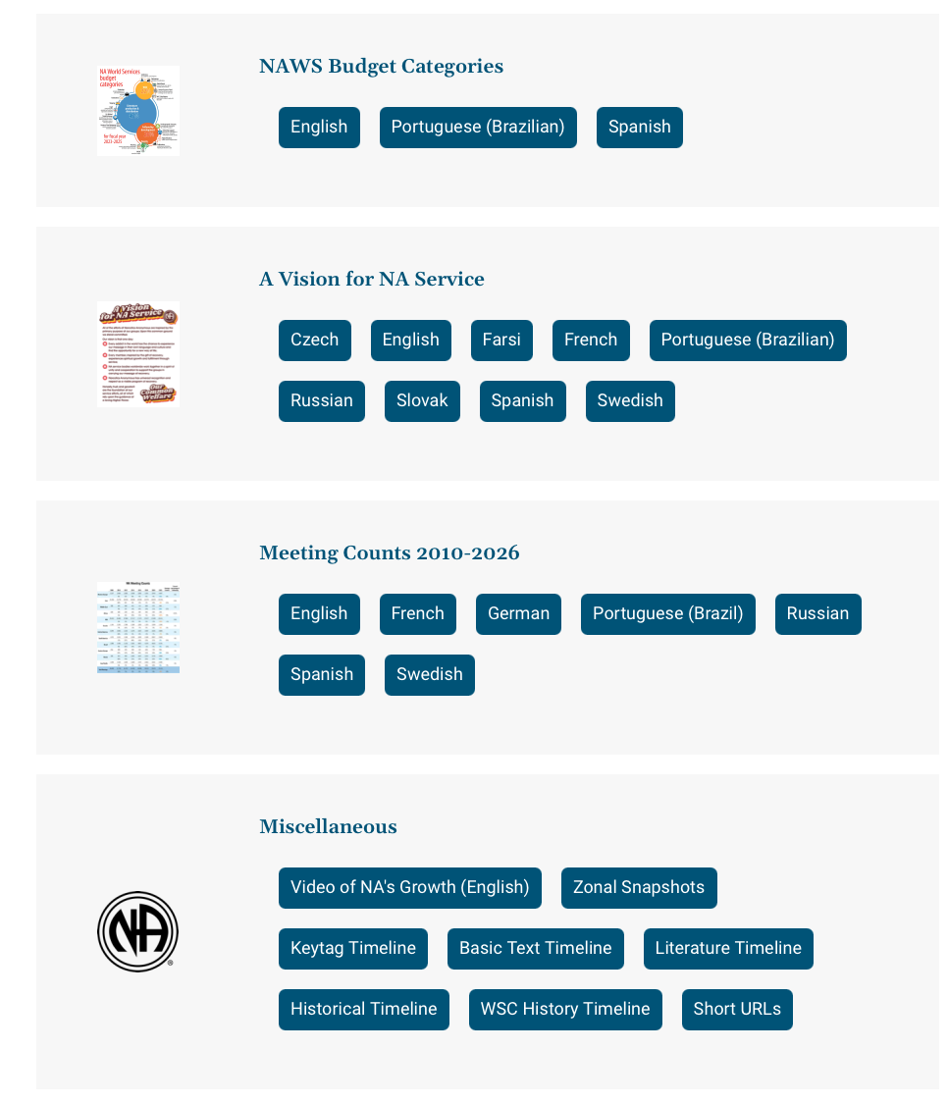
na.org/videos
na.org/maps

Slide 37
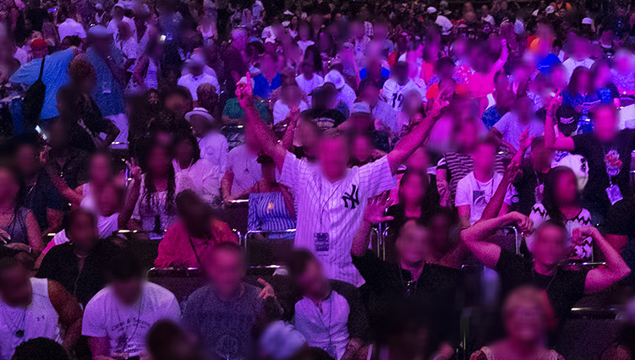
na.org/wcna
Go here to keep updated and listen to past recordings.
The World Convention of Narcotics Anonymous brings tens of thousands of members together. Thousands more, including many correctional facilities, connect for free through simultaneously translated audio streaming of main meetings.
We are delighted to announce that in 2028, WCNA 39 will celebrate NA’s 75th anniversary in Dublin, Ireland!
Notes:
The World Convention of Narcotics Anonymous brings tens of thousands of members together. Thousands more, including many correctional facilities, connect for free through simultaneously translated audio streaming of main meetings.
We are delighted to announce that in 2028, WCNA 39 will celebrate NA’s 75th anniversary in Dublin, Ireland!
Go to na.org/wcna to keep updated and listen to past recordings.
Or subscribe to NAWS Update emails (na.org/subscribe) or read the NAWS News (na.org/nawsnews) to stay informed.

Slide 38
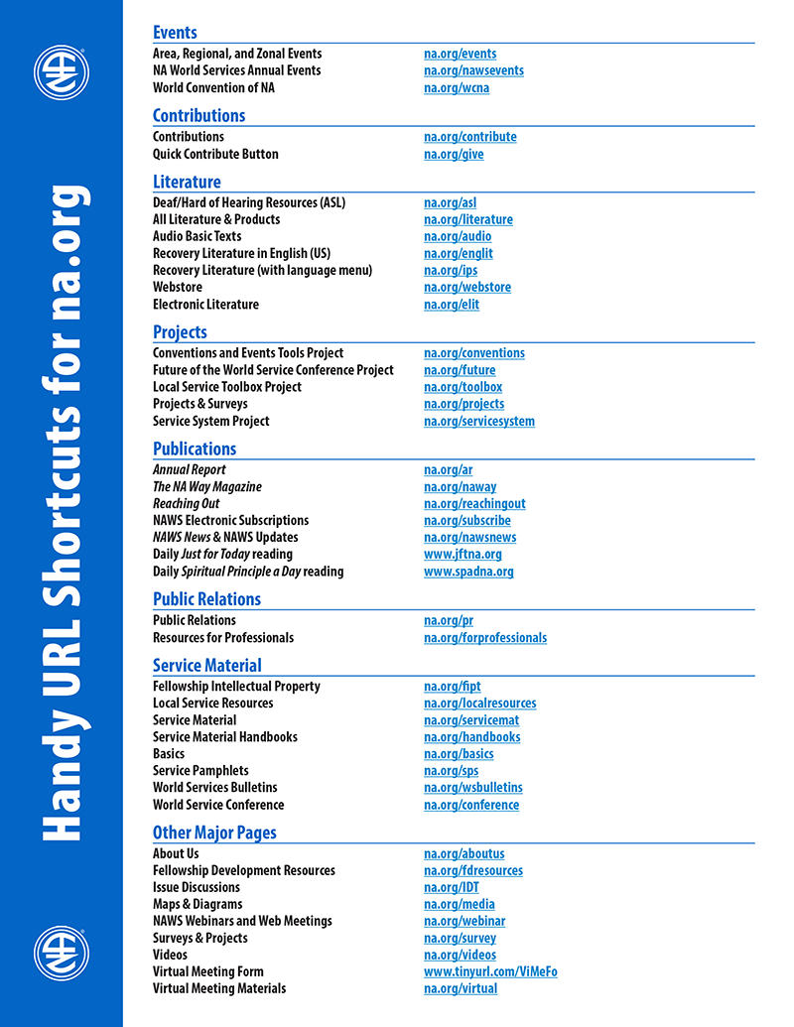
For more information
NAWS News: na.org/nawsnews
Annual Report: na.org/ar
About Us: na.org/aboutus
Projects & Surveys: na.org/projects
World Service Conference: na.org/conference
FD Resources: na.org/fdresources
A complete list of short URLs is posted in Miscellaneous on na.org/maps
Notes:
Most of our frequently accessed webpages have URL short cuts. Here are some of them. You can find a longer list of these shortcuts posted in Miscellaneous on na.org/maps
There is so very much more that we do at World Services, much more than we can cover in one presentation. For more information, see our FD resources page, NAWS News, and the Annual Report.

Slide 39


Join us on Social Media
Instagram: @narcoticsanonymous & @naglobalevents
Facebook: @naworldservices
Stay tuned for our new YouTube channel!
Send us your pictures, memes, event flyers, and ideas for posts:
If they are your creation or in the public domain
Don’t show members’ faces
Have wide interest to NA around the world
socialmedia@na.org
Notes:
Our Instagram handle is @narcoticsanonymous.
We also now have an official World Services’ Facebook page: @naworldservices
Check it out if you haven’t already
We also have an Instagram account just for events @naglobalevents where we post flyers for area, regional, and zonal celebrations and service events.
Stay tuned for our new YouTube channel!
If you have an event flyer you’d like posted or an idea for Instagram let us know: socialmedia@na.org.

Slide 40
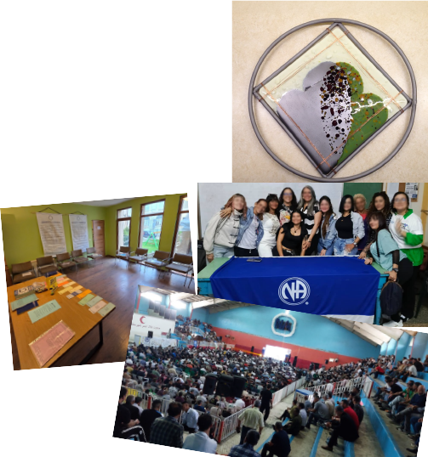
Keep sending us your Fellowship photos and videos
We use them in videos and presentations and even social media
events
workshops
meeting places
Fellowship development
member art using the NA logo or service symbol
na.org/wcna
“Share Your Photos”
Notes:
There is a photo upload form at na.org/wcna for you to send us photos of NA events, celebrations, cool logos, and member art.
World Services needs your images to make our PowerPoints, videos, and social media posts shine.

Slide 41
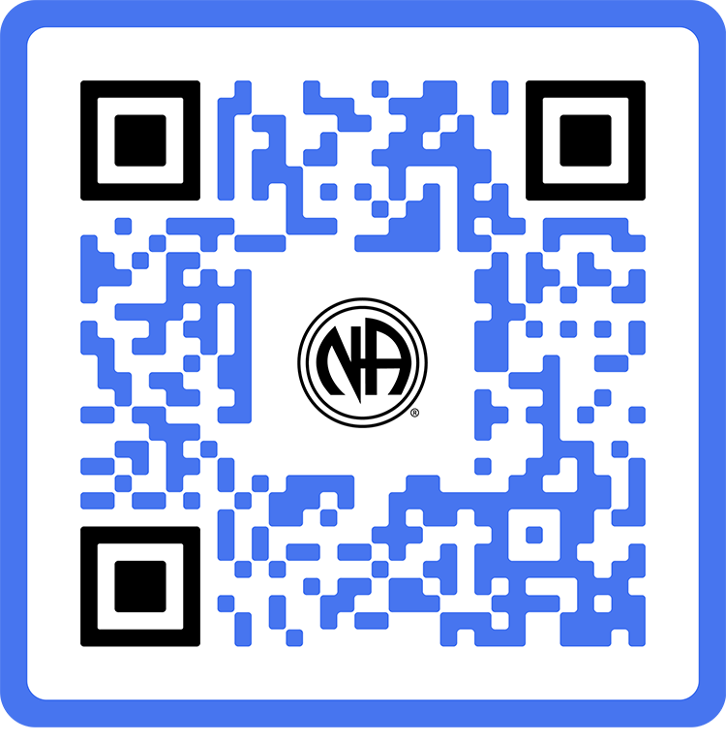
When We Share
na.org/contribute
Notes:
The biggest story for NAWS in the past six years is about how the changing world environment has affected resources, and how it has responded.
From the pandemic to wars to natural disasters, meetings have opened and closed, supply chains have been disrupted, and World Services has felt the effects.
Through it all, member dedication has been the steadying force in some very rough seas.

Slide 42

2025
Annual
Report
na.org/ar
Notes:
The Annual Report tells this story and more. The AR is the best picture of NAWS financials. It is published as a PDF and in a device friendly format.
It takes a long time to put together an AR. Inventories are conducted at the WSO, the branch offices and distribution centers. They do an on-site audit, conduct currency conversions, summarize all contributions, and have a World Board review.
Because it can take so long, WCNA 38 was reported in the 2024 AR, even though it took place in the 2025 fiscal year.
With locations operating in different currencies and operating under different legal systems, it isn’t really possible to produce a short, simple financial report. The closest to that is the financial position provided by our auditors in the AR.
Present and past Annual Reports are posted to na.org/ar.

Slide 43
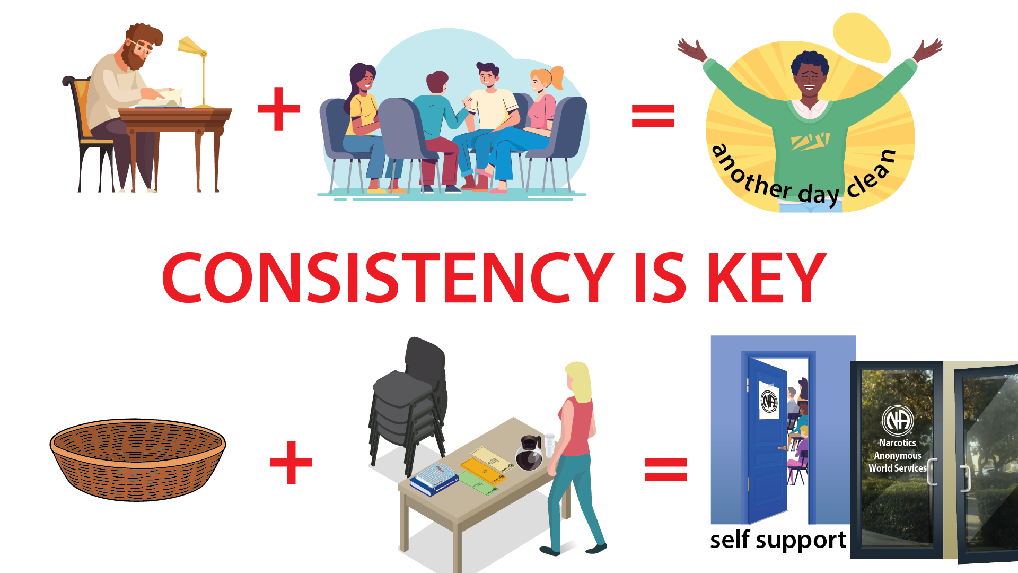
Notes:
For years, we have been saying that member contributions are the most sustainable source of income, and the most in line with our spiritual principle of self-support.
We have long known that relying on literature income primarily from the US to fund our global efforts is not sustainable. The pandemic forced a shift toward an income model that is more reliant on member contributions (including groups, service bodies and events). We don’t want to lose the lessons we learned so painfully in that time.
Consistency is key.
When members provide ongoing direct contributions we experience self-support in the purest way. When we share directly—in the basket at our homegroup and through Donorbox directly to World Services, we make sure that services continue uninterrupted, No Matter What.

Slide 44

Our commitment
to self-support doesn’t mean we go it alone—it means we do it together.
Guiding Principles, Tradition Seven
Notes:
One thing we know about NA is that if everyone does a little we can accomplish a lot.
Member contributions continue to support our services at every level, and direct member contributions to NAWS have allowed us to increase direct support of developing NA communities.
If you’re a member, you can set up a recurring or a one-time contribution at na.org/give.

Slide 45
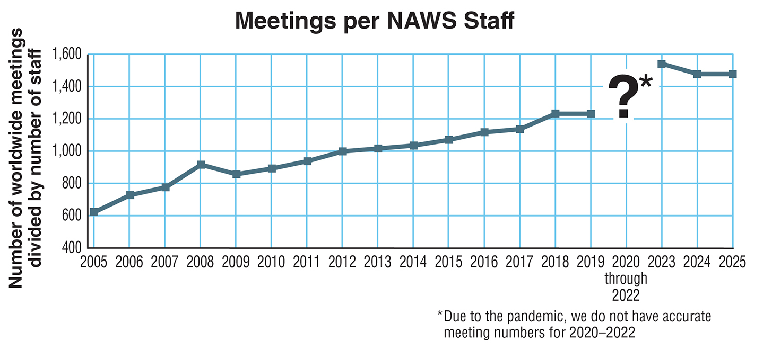
Notes:
This graph is from the 2025 Annual Report.
NA World Services does its best to maximize return on every Fellowship dollar. This chart, from the 2025 Annual Report, shows the number of NA meetings worldwide relative to the number of NAWS staff at all five locations. During the pandemic (where you see the question mark on the chart), many meetings closed or suspended operation and NAWS staff numbers were cut drastically. Even through that difficult time, our meetings-to-staff ratio has remained very high. This chart also cannot fully account for the rising number of virtual meetings. NAWS has been creating tools and providing support for virtual meetings since the shutdowns began, but because so many virtual meetings are not plugged into the service system, we have no way of counting them all.
While staffing has increased since the pandemic, World Services has not yet returned to pre-pandemic staffing levels which requires continued prioritization of projects and services.

Slide 46
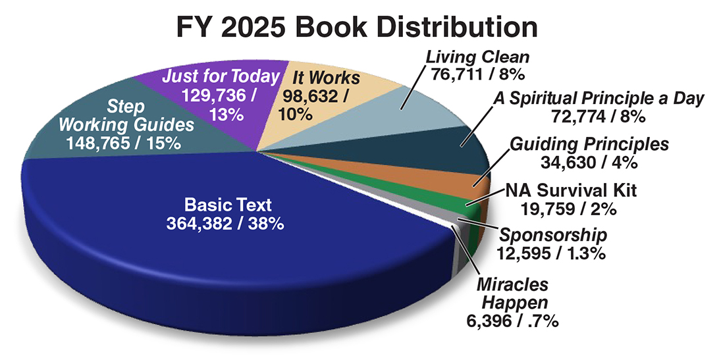
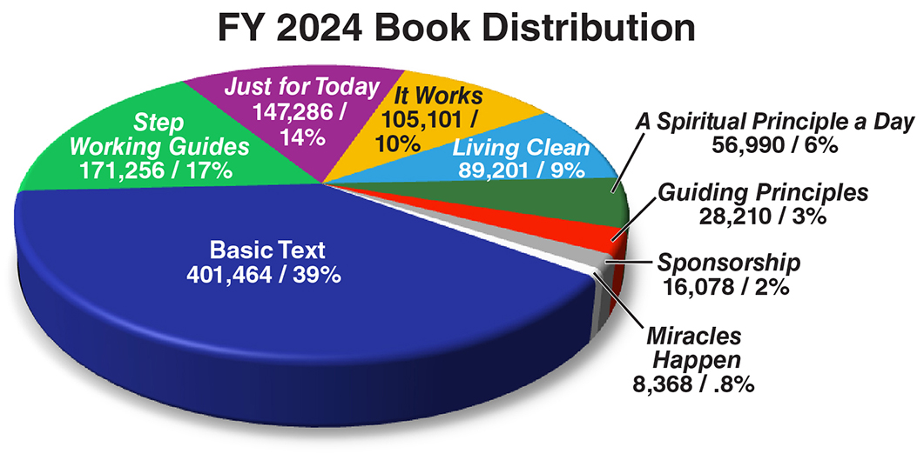
Sales for each
book are down
compared to
FY 2024.
Notes:
This graph is also from the 2025 Annual Report.
Sales for each book are down compared to fiscal year 2024.
There were also declines in the distribution of booklets, IPs, and welcome keytags.
It’s possible that free online availability decreases demand of IPs, but together with the decline in book sales and keytags, it is beginning to look like there are fewer newcomers finding their way to our doors.

Slide 47
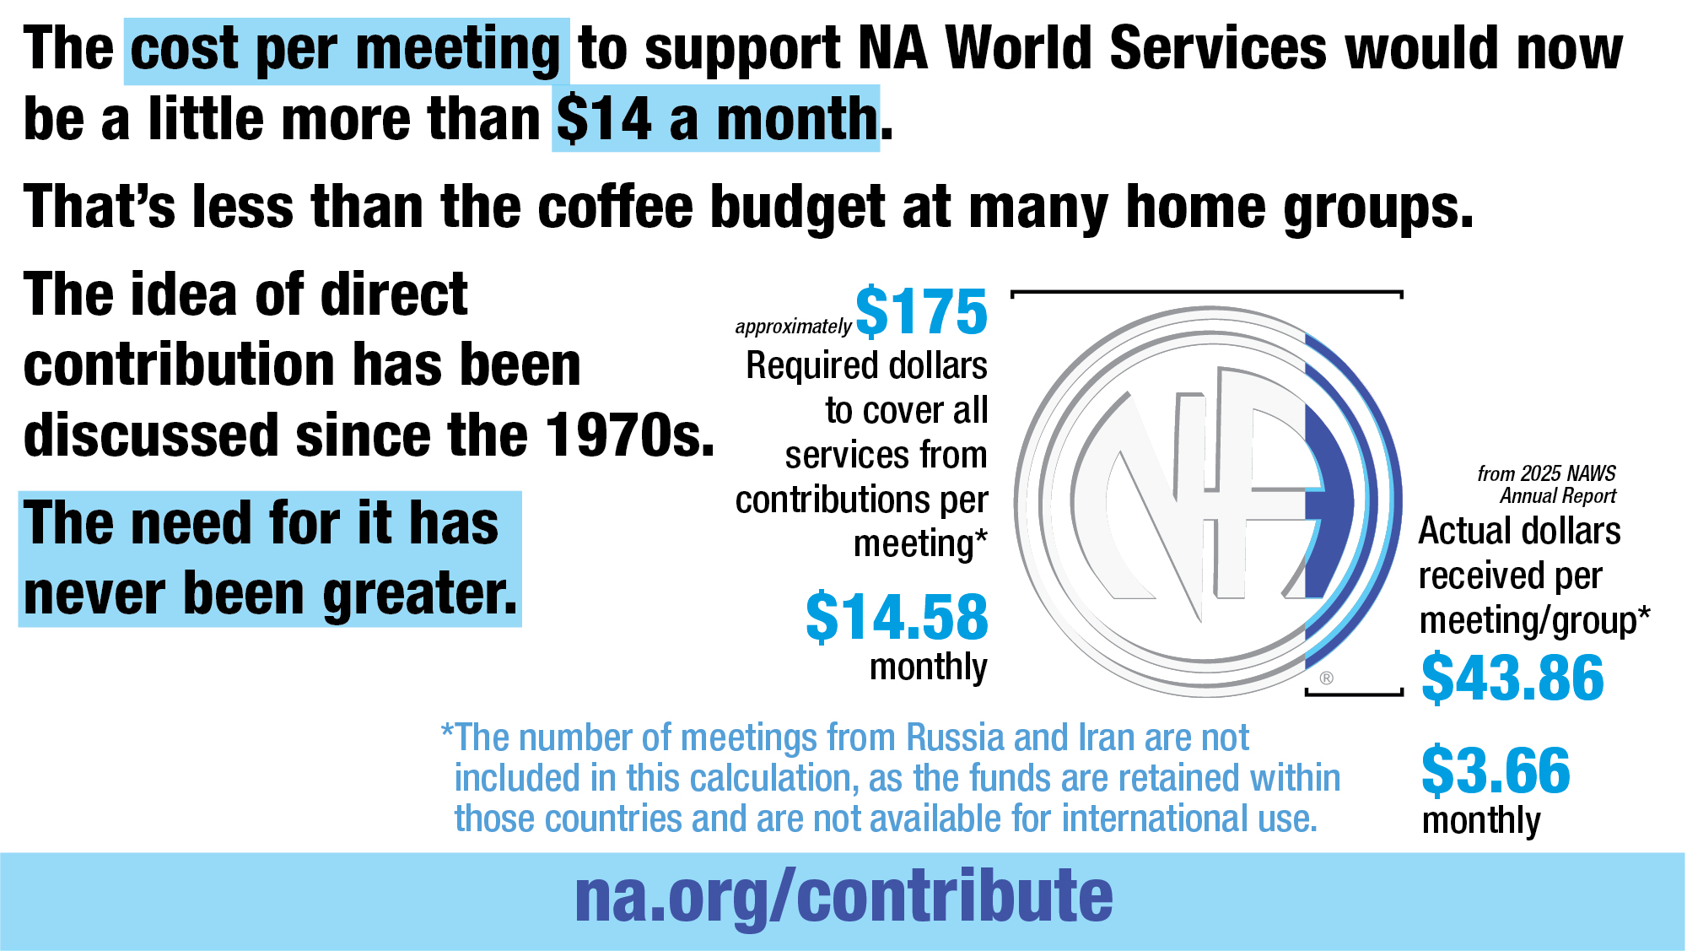
Notes:
The cost per meeting to support NA World Services would now be a little more than $14 a month.
That’s less than the coffee budget at many home groups.
The idea of direct contribution has been discussed since the 1970s.
The need for it has never been greater.

Slide 48
Questions and
Answers

Slide 49
WORLD SERVICES

