Slide 1




WORLD SERVICES
NAWS Update
The latest from NA World Services with updates on projects and much more!
October 2026

Slide 2





Contents
Collaborative Planning
Highlights from WSC 2026
Work for the Cycle
How to Stay Connected
When We Share
For More Information
Questions and Answers
Notes:
Overview of session. 40 minutes. We’ll try to save time for questions. You can always write to wb@na.org if you have a question you didn’t get a chance to ask today:
Collaborative Planning
Highlights from WSC 2026
Work for the Cycle
How to Stay Connected
When We Share
For More Information
Questions and Answers

Slide 3
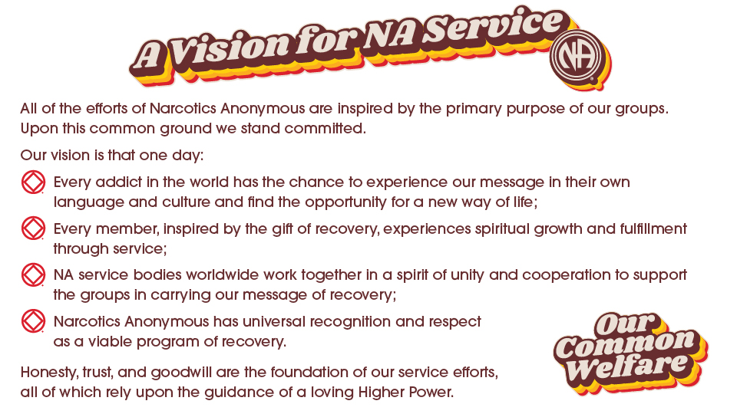
Notes:
Most of you have seen A Vision for NA Service before. This is the touchstone for all of the work of World Services.
WSC 2023 revised the Vision statement to change “his or her own” to “their own language and culture” as shown here.
This small change may be barely noticeable to some, but it is a big step in helping to achieve our Vision by using language inclusive of all members.

Slide 4
Collaborative Planning
NA World Services has operated with a strategic plan for over 20 years.
Every conference cycle, the plan is revised and renewed and included in the Conference Approval Track material.
The priorities in the plan help shape the work ahead.
The 2026-2029 Strategic Plan was included in the Conference Agenda Report for Fellowship approval, and it’s the first time the plan has been created by the conference as a whole. Making it a collaborative plan.
Notes:
NA World Services has operated with a strategic plan for over 20 years.
Every conference cycle, the plan is revised and renewed and included in the Conference Approval Track material.
The priorities in the plan help shape the work ahead.
The 2026-2029 Strategic Plan was included in the Conference Agenda Report for Fellowship approval, and it’s the first time the plan has been created by the conference as a whole. Making it a collaborative plan.

Slide 5
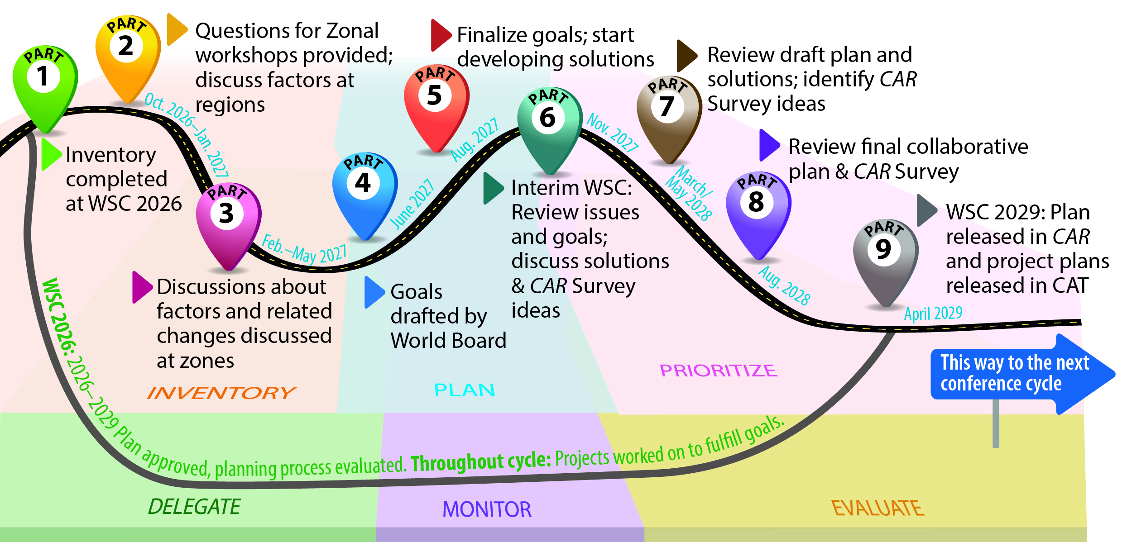
Collaborative Planning
Notes:
At WSC 2023, the conference decided to approve a three-year cycle on a trial basis. The longer cycle has allowed the time for a truly collaborative planning process.
WSC 2026 adopted the 2026-2029 plan and began the process of creating the 2029–2032 plan by conducting an inventory: identifying factors, inside and outside of NA, that could affect our ability to carry the message. This was Part 1 in the roadmap.
As was done last cycle, there will be zonal workshops (Part 3) that will discuss the challenges raised by the factors conference participants identified and prioritized.
For more information on the process, see the planning section of the conference page: na.org/planning.

Slide 6


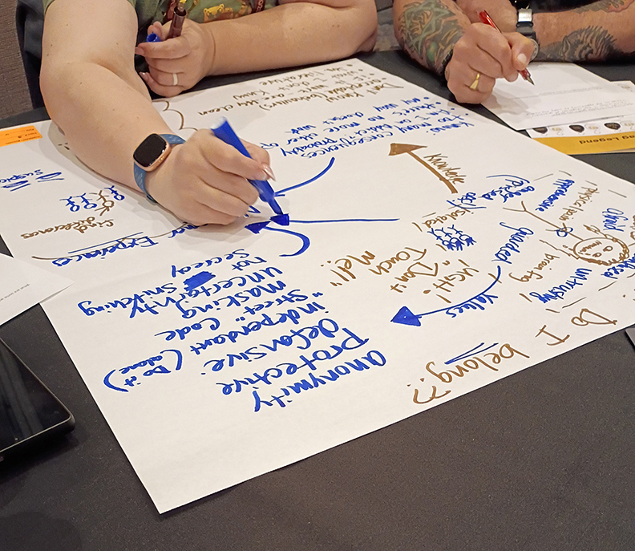
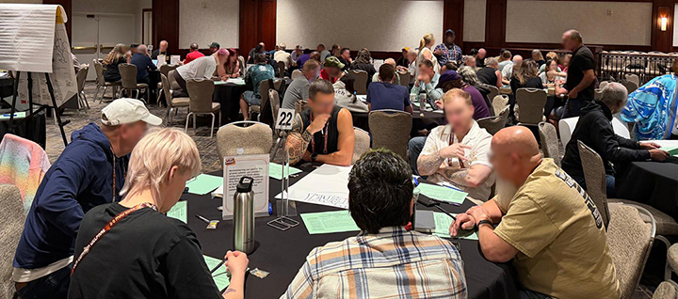
Highlights from WSC 2026
aka World Service Conference
Notes:
The 37th World Service Conference was held 3– 9 May 2026. It was the 50th anniversary of the WSC.

Slide 7

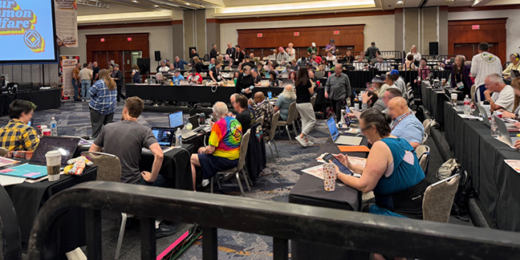
There were 148 voting members participating at WSC 2026:
133 delegates (127 RDs, 6 ZDs)
15 World Board members
43 participants joined remotely
- 14 delegates
- 28 alternates
- 1 WB member
Notes:
148 voting members present (online and in the room): 127 RDs (1 seated regions did not attend), 6 ZDs (all seated zones), and 15 World Board members.
43 participants joined remotely—15 voting participants and 28 alternates.
Also present: 113 alternate delegates, 3 HRP members, 2 cofacilitators, and 6 translators.
There were 180 men, 78 women, and 2 non-binary participants among the delegates, alternates, and WB.
Conference participants were from 48 countries, and spoke or signed 31 languages (based on Serenity Prayer languages at the close of the First Things First session).

Slide 8

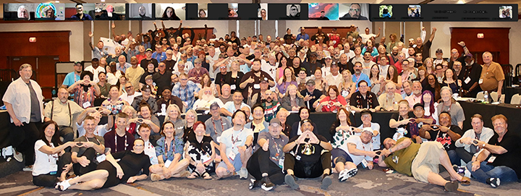
Of the 133 RDs and ZDs participating,
66 were from the USA and 67 were from outside the USA.
WSC 2026 made the decision to seat:
Afghanistan Region
10 Brasil Region
Notes:
Like WSC 2023, the majority of delegates were from outside the USA.
Of the 133 RDs and ZDs participating, 66 were from the US and 67 were from outside the US.
WSC 2026 made the decision to seat: Afghanistan Region and 10 Brasil Region.

Slide 9
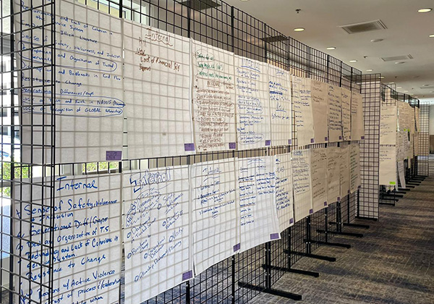
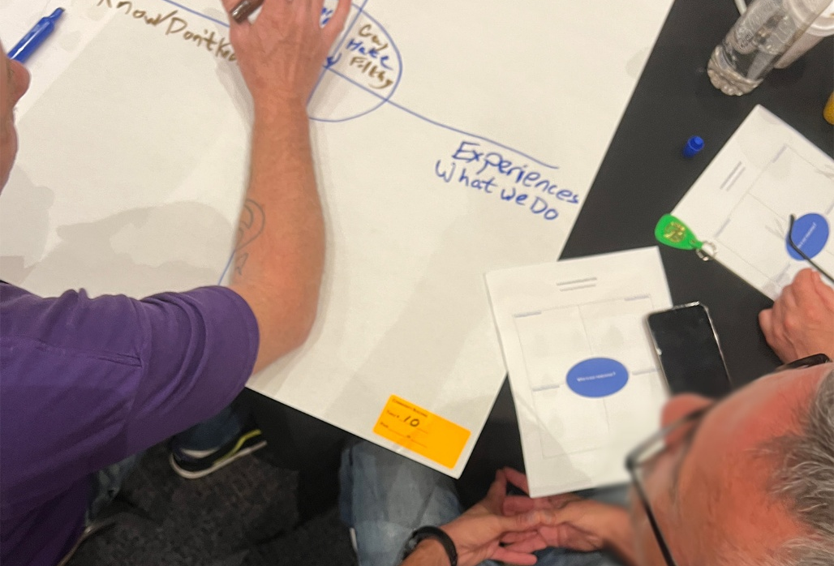
Discussion-Based Conference
Facilitated breakout sessions allowed conference participants to think together about some opportunities and challenges we face.
Focused conversations at round tables (or on screen) in six breakout sessions allowed all voices to be heard.
Notes:
Discussion-Based Conference
Facilitated breakout sessions allowed conference participants to think together about some opportunities and challenges we face.
Those discussions included six breakout sessions in which focused conversations at round tables (or on screen) allowed all voices to be heard.
Small groups reported back to larger groups, and the results were posted in the “gallery walk” for all to see and consider afterward.
In some cases, these discussions helped move the conversations and decisions during the week. In others, they created the groundwork for further conversations in the coming cycle.
The breakout sessions included:
Community Building on Our Common Welfare where participants looked at the needs of newcomers
Gender Neutral Language revisions to a piece of literature
Planning where participants looked at factors inside and outside NA that affect the ability to achieve our vision
Taking Root—DRT/MAT and NA. Discussion centered around how to keep members on DRT coming to meetings
2 New Idea discussions around 4 topics:
Revisions to Tradition Eleven
Service material for groups
Welcoming newcomers
Making NA service more welcoming and relevant

Slide 10
Work for the Cycle
Work for the cycle is decided through motions, surveys, discussions, workshops, and most importantly, the co-created collaborative plan.
Notes:
Work for the cycle is decided through motions, surveys, discussions, workshops, and most importantly, the co-created collaborative plan.

Slide 11
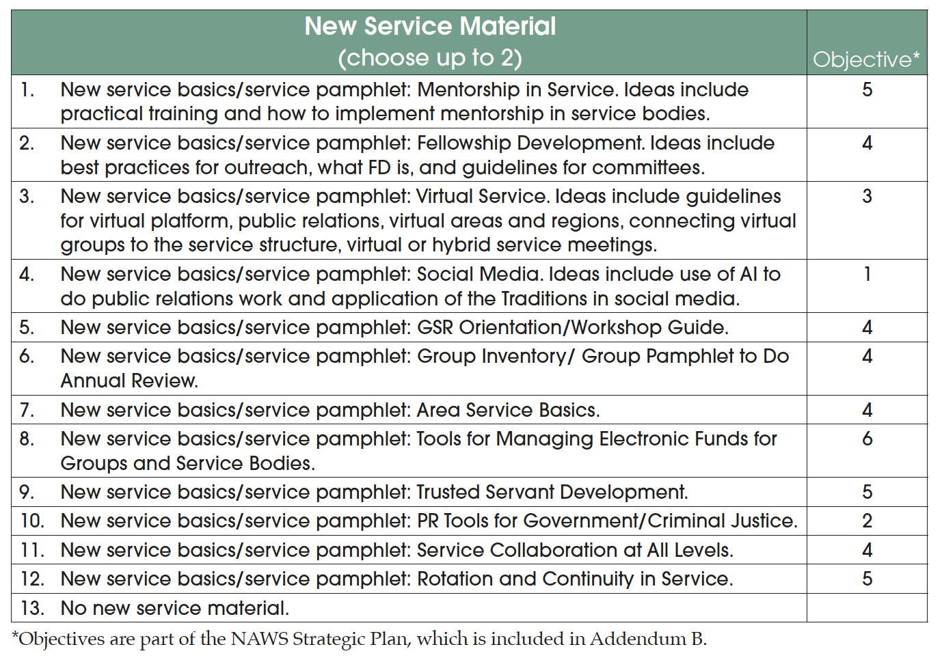
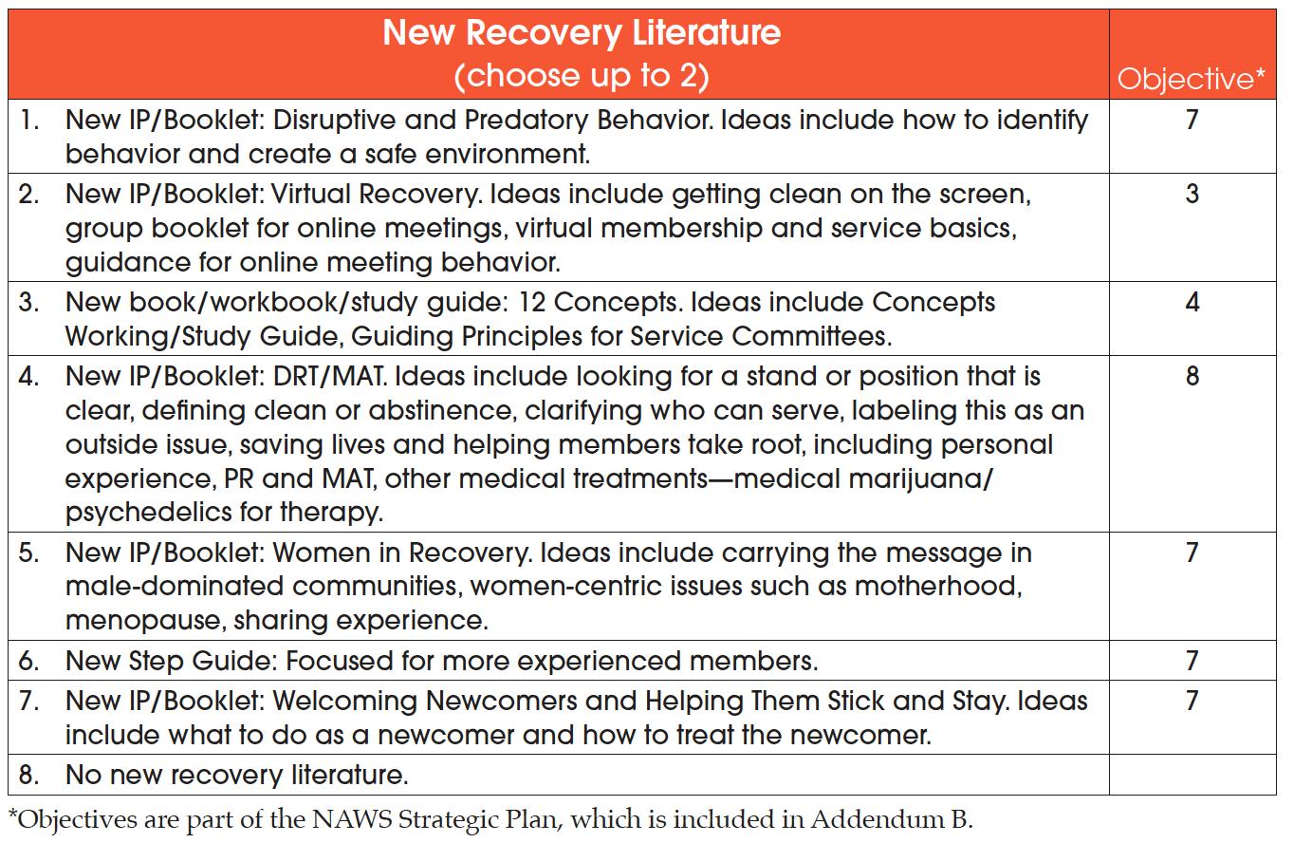
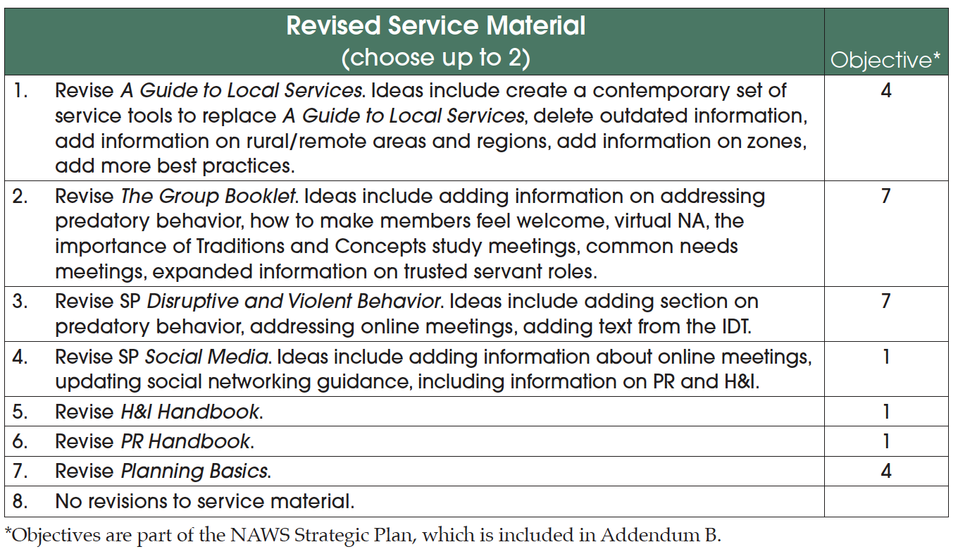
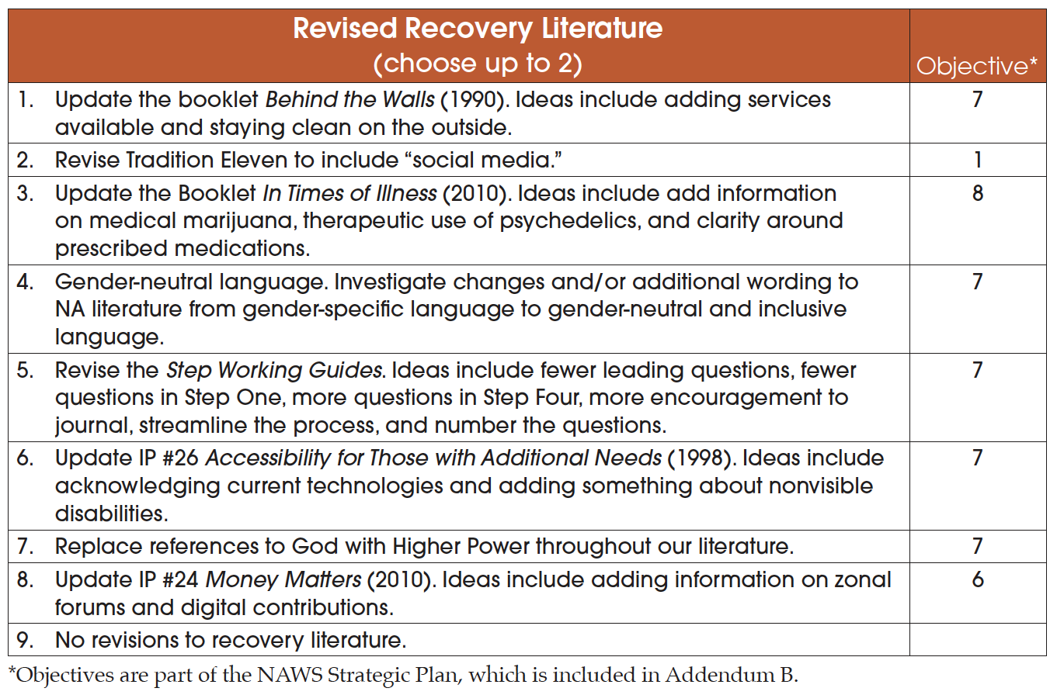
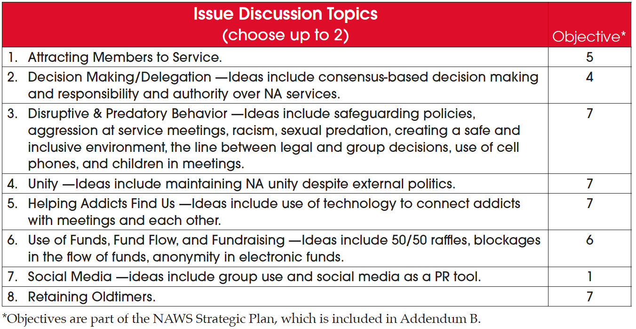
2026 CAR Survey
Members and regions fill out the survey ahead of the World Service Conference.
Notes:
A tool used to prioritize possible recovery literature and service material projects is a survey that appears in the Conference Agenda Report or CAR. Issue Discussion Topics (IDTs) are also listed here.
Members can submit ideas to be included in the survey and their elected delegates work with the World Board to consolidate those lists.
The end result is the CAR Survey. Members and regions fill out the survey ahead of the World Service Conference.

Slide 12



Completed projects from WSC 2023
IP #21, Staying Clean in Isolation was approved.
na.org/lit na.org/webstore
Revisions to H&I Basics
and the service pamphlet
Group Business Meeting
were completed.
na.org/basics na.org/sps na.org/webstore
Notes:
First, it’s worth mentioning a few completed projects from WSC 2023
IP #21, Staying Clean in Isolation was approved at WSC 2026.
It is available at na.org/let and in the webstore.
Revisions to H&I Basics and the service pamphlet Group Business Meeting were completed.
H&I Basics is available at na.org/basics and Group Business Meetings is available at na.org/sps. Both are in the webstore.

Slide 13
Project plan for Three-Year Conference Cycle
Refine and describe meetings, planning, policies, and deadlines so we can decide whether to adopt it long term. Also GWSNA revision.
Project plan for Fellowship Awareness and Engagement with PR Service
Increase understanding of how effective Public Relations advances our message, Vision, and Fellowship growth.
Project plan for Raising Public Awareness of NA
Create PR tools for four target audiences, raising their awareness of NA as a viable program of recovery.
Motions adopted at WSC 2026 that were directly influenced by the collaborative plan
Notes:
Motions adopted at WSC 2026 that were directly influenced by the collaborative plan
Project plan for Three-Year Conference Cycle
Refine and describe meetings, planning, policies, and deadlines so we can decide whether to adopt it long term. Also GWSNA revision.
Project plan for Fellowship Awareness and Engagement with PR Service
Increase understanding of how effective Public Relations advances our message, Vision, and Fellowship growth.
Project plan for Raising Public Awareness of NA
Create PR tools for four target audiences, raising their awareness of NA as a viable program of recovery.

Slide 14
Project plan for Safety and Belonging/Gender-Neutral Language
Rolled in with Project Plan for Revising Existing Recovery Informational Pamphlets, which will start with IP #1 and make the language referring to members gender neutral.
Project plan for DRT/MAT—Helping Members Take Root
Develop resources for groups and workshops on how to make members and potential members feel welcomed.
Project plan for Generational and Cultural Diversity
Adapt communication methods and technology to meet our diverse membership's engagement preferences.
Hold the World Convention every 5 years, beginning in 2028
This was in part, a way to create a financially sustainable model for the World Convention (WCNA).
Notes:
More Motions adopted at WSC 2026 that were directly influenced by the collaborative plan
Project plan for Safety and Belonging/Gender-Neutral Language
Rolled in with Project Plan for Revising Existing Recovery Informational Pamphlets, which will start with IP #1 and make the language referring to members gender neutral.
Project plan for DRT/MAT—Helping Members Take Root
Develop resources for groups and workshops on how to make members and potential members feel welcomed.
Project plan for Generational and Cultural Diversity
Adapt communication methods and technology to meet our diverse membership's engagement preferences.
Hold the World Convention every 5 years, beginning in 2028
This was in part, a way to create a financially sustainable model for the World Convention (WCNA).

Slide 15
Motions adopted at WSC 2026 that were guided by the CAR Survey results
Project plan for New and Revised Service Tools
A Guide to Local Services, The Group Booklet / IP#2
Project plan for Revising Existing Recovery Informational Pamphlets
IP#1—make references to members gender neutral
Project plan for New Recovery IPs
Disruptive & Predatory Behavior
The collaboratively created 2026–2029 NA World Services Strategic Plan
posted here: na.org/planning
To create a project plan to look into providing booklength lit to the incarcerated on tablets.
Other motions adopted at WSC 2026
Notes:
Motions adopted at WSC 2026 that were guided by the CAR Survey results
Project plan for New and Revised Service Tools
A Guide to Local Services, The Group Booklet / IP#2
Project plan for Revising Existing Recovery Informational Pamphlets
IP#1—make references to members gender neutral
Project plan for New Recovery Informational Pamphlets
Disruptive & Predatory Behavior
Other motions adopted at WSC 2026
The collaboratively created 2026–2029 NA World Services Strategic Plan
posted here: na.org/planning
To create a project plan to look into providing booklength literature to the incarcerated on tablets.

Slide 16
Attracting members to service and mentoring them
Welcoming members
Something related to both group and area service to feed the revisions of A Guide to Local Services and
The Group Booklet
Issue Discussion Topics
for the
2026-2029 cycle
When workshop materials are available they will be posted at na.org/idt
Notes:
Issue Discussion Topics for the 2026-2029 cycle
Attracting members to service and mentoring them
Welcoming members
Something related to both group and area service to feed the revisions of A Guide to Local Services and The Group Booklet
When workshop materials are available they will be posted at na.org/idt

Slide 17

Safety and Belonging/Gender-Neutral Language project
At present the project is simply concerned with the language used to describe members, not God or the words of our Steps and Traditions.
IP #1 draft revisions are ready for review until the end of October 2026. Fellowship input will determine any next steps.
There is also a flyer for groups and service bodies to help explain the project.
There is also a flyer for groups and service bodies to help explain the project.
na.org/genderproject
Notes:
The current news on the Safety and Belonging/Gender-Neutral Language project is that at present the project is simply concerned with the language used to describe members, not God or the words of our Steps and Traditions.
IP #1, Who, What, How and Why draft revisions are ready for review until the end of October 2026.
Fellowship input will determine any next steps.
There is also a flyer for groups and service bodies to help explain the project.
na.org/genderproject

Slide 18
New and Revised Service Tools project
A workshop is being developed to provide input on the best practices for groups and group service.
Later this year a workshop will be available for area service.
na.org/IDT
Notes:
The current news on the New and Revised Service Tools project is that a workshop is being developed to provide input on the best practices for groups and group service.
The input provided through the input form will provide revisions for A Guide to Local Services, The Group Booklet / IP #2, The Group.
Later this year a workshop will be available for area service.
All workshop materials are posted at na.org/IDT.

Slide 19
PR projects:
Fellowship Awareness and Engagement with PR Service
Raising Public Awareness of NA
Focus groups are being organized to provide input on generating enthusiasm toward PR service and creating simple tools for PR trusted servants to use.
Members can use the focus group volunteer form express interest in the project.
na.org/projects
Notes:
Here is the current news on the two PR projects, Fellowship Awareness and Engagement with PR Service and Raising Public Awareness of NA
Focus groups are being organized to provide input on generating enthusiasm toward PR service and creating simple tools for PR trusted servants to use.
Members can use the focus group volunteer form express interest in the project.
As it is available, information will be posted at na.org/projects
There is a link for the volunteer form here as well.

Slide 20
How to Stay Connected
How to keep up-to-date
How to get involved
Notes:
There are many ways to get and stay connected and to get involved with the work.
The following slides will show you a few.

Slide 21
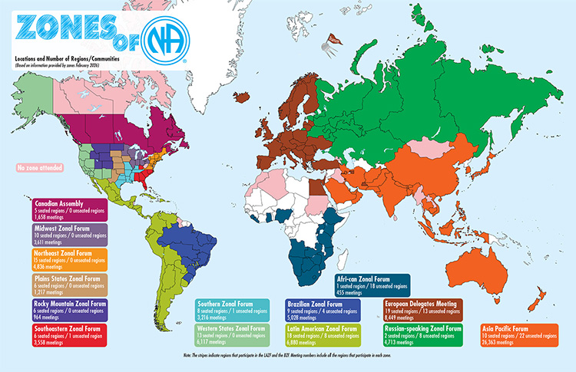
This cycle the WB is leaning heavily on its partnership with zones to accomplish projects and keep planning.
There will be zonal workshops to discuss the 2029-2032 collaborative plan in early 2027.
na.org/conference
Notes:
This cycle the WB is leaning heavily on its partnership with zones to accomplish projects and keep planning. Especially when it comes to collecting best practices for revisions to service materials.
There will be zonal workshops to discuss the 2029-2032 collaborative plan in early 2027.
When information is available it will be posted at na.org/conference

Slide 22
No standing workgroups this cycle.
The work will be accomplished with focus groups and compiled results from workshops.
Webinars will also provide information.
na.org/webinars
Notes:
There will be no standing workgroups this cycle.
The work will be accomplished with focus groups and compiled results from workshops, such as from the Issue Discussion Topics.
Webinars will also provide information.
na.org/webinars

Slide 23
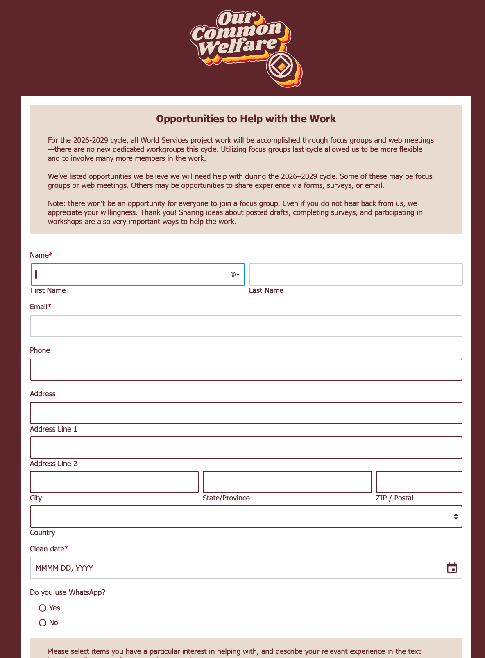
na.org/projects
Any member with skills or interests relevant to current projects is encouraged to use the form to speak up!
Public Relations Service
New Recovery Literature—Disruptive and Predatory Behavior
Revising Existing Recovery Literature—Gender-Neutral and Inclusive Language
Generational and Cultural Diversity
New and Revised Service Tools—Group Service
New and Revised Service Tools—Area Service
DRT/MAT—Helping Members Take Root
WCNA 39 speaker evaluation
Translations
Technology
Proofing and/or Layout
Notes:
A great way for members to get involved is to fill out the volunteer/focus group form on the project page: na.org/projects.
Any member with skills or interests relevant to current projects is encouraged to use the form to speak up! That list becomes the backbone of many efforts throughout the cycle. There are projects about local service this cycle, so you don’t need a ton of cleantime or service experience to participate. Not everyone will get chosen, but there are other ways to be involved—surveys, review drafts, holding workshops, etc.
Every NA member deserves the gift of serving selflessly. Let’s create new tools for members and groups!
The list of available opportunities:
Public Relations Service
New Recovery Literature—Disruptive and Predatory Behavior
Revising Existing Recovery Literature—Gender-Neutral and Inclusive Language
Generational and Cultural Diversity
New and Revised Service Tools—Group Service
New and Revised Service Tools—Area Service
DRT/MAT—Helping Members Take Root
WCNA 39 speaker evaluation
Translations
Technology
Proofing and/or Layout

Slide 24
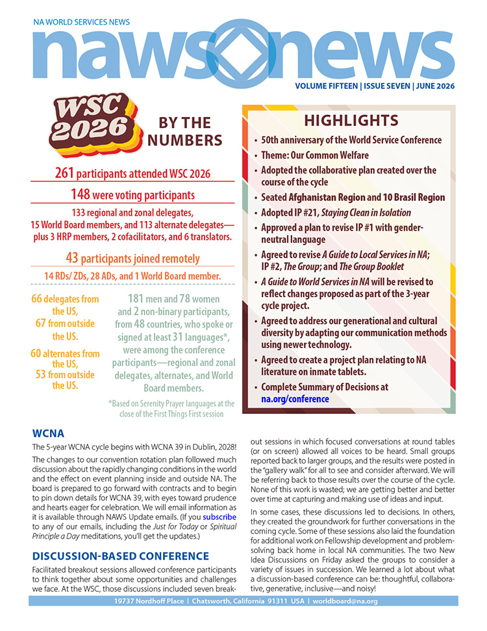
NAWS Updates eblasts
and
NAWS News
are the perfect resources to get the information you need to be involved.
na.org/subscribe

Slide 25


Webinars!!
The recording of this webinar is posted at na.org/webinars as well.
na.org/webinars
Notes:
Another great way to stay up-to-date and involved in the discussions, is to attend one of the upcoming webinars.
There are quarterly webinars for H&I and PR trusted servants with a variety of presentations and open discussions.
As well as webinars about timely topics that the Fellowship is discussing.
Or virtual events that celebrate our recovery, like the World Unity Day event that was at the beginning of September.
The audio recording of the Safety and Belonging: Gender-Neutral Language webinar can be found on the webinar page and the recording and PPT from World Unity Day can be found at na.org/wcna.

Slide 26
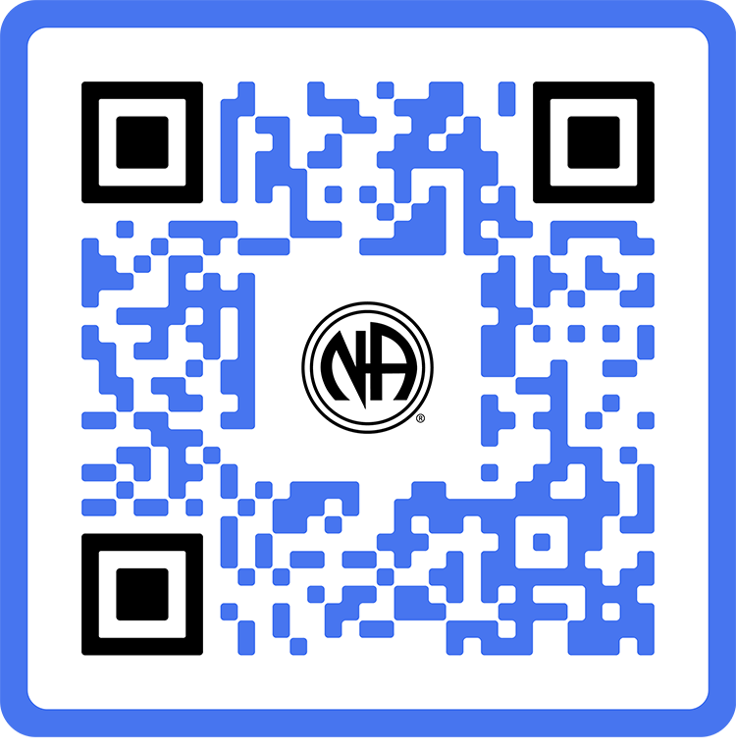
When We Share
na.org/contribute
Notes:
The biggest story for NAWS in the past six years is about how the changing world environment has affected resources, and how it has responded.
From the pandemic to wars to natural disasters, meetings have opened and closed, supply chains have been disrupted, and World Services has felt the effects.
Through it all, member dedication has been the steadying force in some very rough seas.

Slide 27
Contributing to Our Common Welfare session at WSC 2026
“In the face of so many other worrisome trends, remembering that we can take care of one another is so important. That’s our duty and our privilege.”
Notes:
This session reminded participants of the importance of everyone’ s involvement in service.
The conference discussion was guided by words from the CAR: “In the face of so many other worrisome trends, remembering that we can take care of one another is so important. That’s our duty and our privilege.”
With the important reminder that regions, areas, groups, and individuals must first take care of their responsibilities at home, conference participants worked together in pairs to consider first how to deepen the contribution conversation at home, and then what additional tools might support those efforts going forward. One of the first tools to be worked on is a resource to help groups to have this conversation.
As our relationship to self-support shifts from sales to contribution, participants were asked to consider that direct contribution doesn’t just support our spiritual mission; it’s an expression of it.

Slide 28
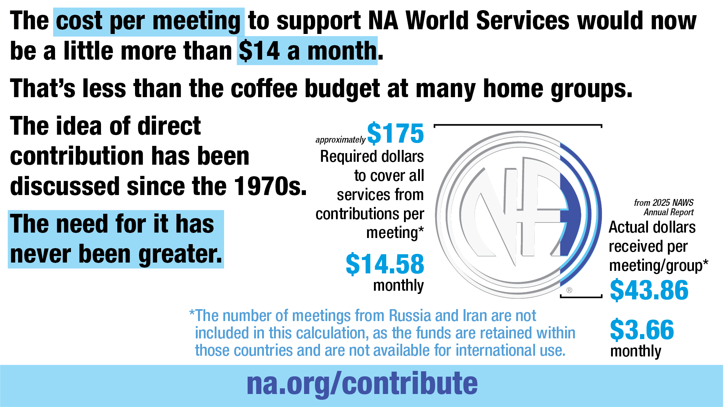
Notes:
The session went on to outline some of the difficulties with new restrictions on international currency transfers and those communities not being able to financially join the rest of NA.
Which calls attention to some of the ways our fund flow has never really worked the way we describe it in our service materials.
It’s a challenge, but it doesn’t have to be a problem. If every meeting that was able to do so contributed about $175 a year to NA World Services—a little more than $14 a month—we wouldn’t have to look to literature sales at all to fund the
services the Fellowship asks for.
That’s less than the coffee budget at many home groups.
The idea of direct contribution has been discussed since the 1970s.
The need for it has never been greater.

Slide 29

2025
Annual
Report
na.org/ar
Notes:
The Annual Report tells the story of member dedication in the face of turblulent financial and geopolitical times and much more. The AR is the best picture of NAWS financials. It is published as a PDF and in a device friendly format.
It takes a long time to put together an AR. Inventories are conducted at the WSO, the branch offices and distribution centers. They do an on-site audit, conduct currency conversions, summarize all contributions, and have a World Board review.
Because it can take so long, WCNA 38 was reported in the 2024 AR, even though it took place in the 2025 fiscal year.
With locations operating in different currencies and operating under different legal systems, it isn’t really possible to produce a short, simple financial report. The closest to that is the financial position provided by our auditors in the AR.
Present and past Annual Reports are posted to na.org/ar.

Slide 30

Our commitment
to self-support doesn’t mean we go it alone—it means we do it together.
Guiding Principles, Tradition Seven
Notes:
One thing we know about NA is that if everyone does a little we can accomplish a lot.
Member contributions continue to support our services at every level, and direct member contributions to NAWS have allowed us to increase direct support of developing NA communities.
If you’re a member, you can set up a recurring or a one-time contribution at na.org/give.

Slide 31
For More Information
The What Is NAWS PPT posted at na.org/what-is-na-world-services gives more detail on ongoing
World Services’ work. A few of those slides follow.
Plus some of our latest translations.
Notes:
The What Is NAWS PPT posted at na.org/what-is-na-world-services gives more detail on ongoing World Services’ work. A few of those slides follow.

Slide 32
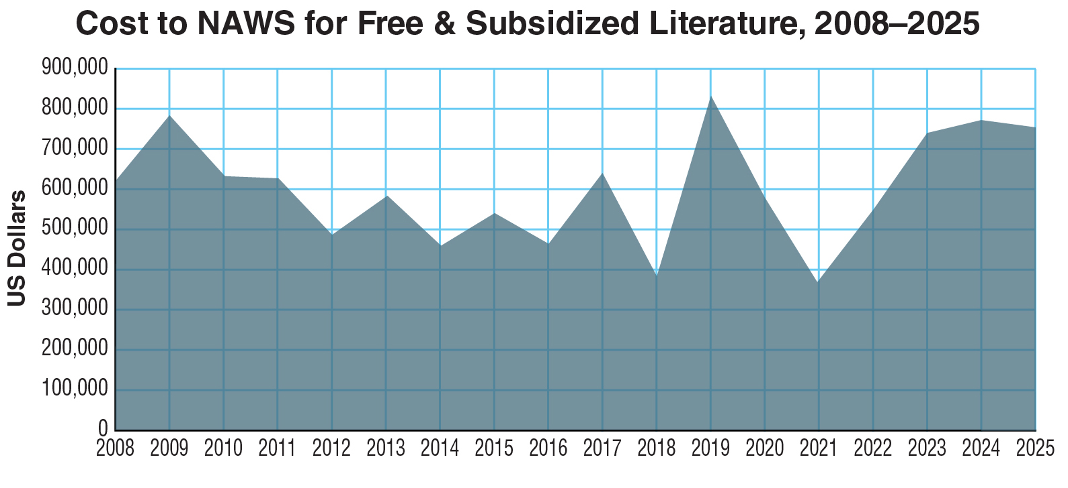
Notes:
This graph represents the cost of free and subsidized literature that NAWS distributes to communities around the world.
The total for FY 2020 was just under $580,000 and for FY 2021 was just over $368,000. The total for 2025 was $754,054. The need continues regardless of resources available. And so does our commitment to meet that need.
The support NA World Services has received from the Fellowship help make these efforts possible.
Note: We don’t report many of the details of where this literature goes partly not to embarrass or call attention to any communities. We never want to cause a community confusion or harm, even inadvertently.

Slide 33
Counterfeit literature limits the ability
to provide services and support NA communities who ask for help.
The manufacture, distribution, and purchase of counterfeit literature undermines the Fellowship’s group conscience.
Additional information can be found here:
Bulletin 34: Group Conscience and
NA Literature
Bulletin 35: Narcotics Anonymous Copyrights and Literature
na.org/fipt
Notes:
The counterfeit literature that disrupts our Fellowship in some locations, limits the ability to provide services and support NA communities who ask for help..
The manufacture, distribution, and purchase of counterfeit literature undermines the Fellowship’s group conscience.
Additional information can be found here:
Bulletin 34: Group Conscience and NA Literature
Bulletin 35: Narcotics Anonymous Copyrights and Literature
na.org/fipt

Slide 34
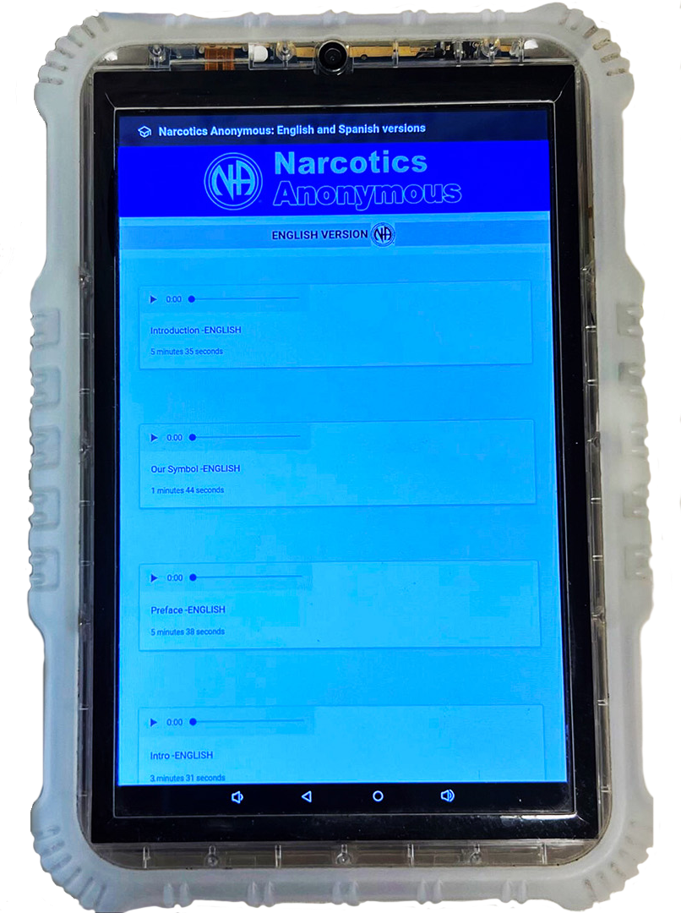
Inmate Tablets
Some facilities offer tablets to inmates
NAWS clears the way to share NA literature
  Audio BT
  Pamphlets
  Booklets
  Intro Guide
NAWS is working on an app for tablets that will make it easier to access materials.
Notes:
Some correctional facilities offer inmates tablets pre-loaded with a variety of material, including, in some cases, NA recovery literature, at no cost to the inmate.
One of the most important duties the Fellowship has assigned NA World Services is the protection of NA’s intellectual property and copyrights on behalf of the Fellowship. Inmate tablets are a new way to carry the message, and World Services must grant legal permission to load Narcotics Anonymous literature on tablets. Each of these agreements involves a lot of communication among corrections authorities, local NA members, and NA World Services.
The agreements made in these cases allow for the material that is currently posted on the NAWS website to be on tablets for inmates – audio Basic Texts, IPs, and booklets such as the White Booklet and the Intro Guide. NAWS continues to provide paper copies of the Basic Text to inmates upon request.
NAWS has about 40 agreements, ranging in size from one jail to a big provider or with the government in the case of Sweden.
WSC 2026 agreed to create a project plan relating to NA literature on inmate tablets.
NAWS is working on an app for tablets that will make it easier to access materials.

Slide 35

NAWS is also working on more audio literature because that is the most frequently accessed on tablets.
There are many requests from members for Just for Today audio.
With the help of zones,
that is getting recorded.
Notes:
NAWS is also working on more audio literature because that is the most frequently accessed on tablets.
There are many requests from members for Just for Today audio.
With the help of zones, that is getting recorded.

Slide 36
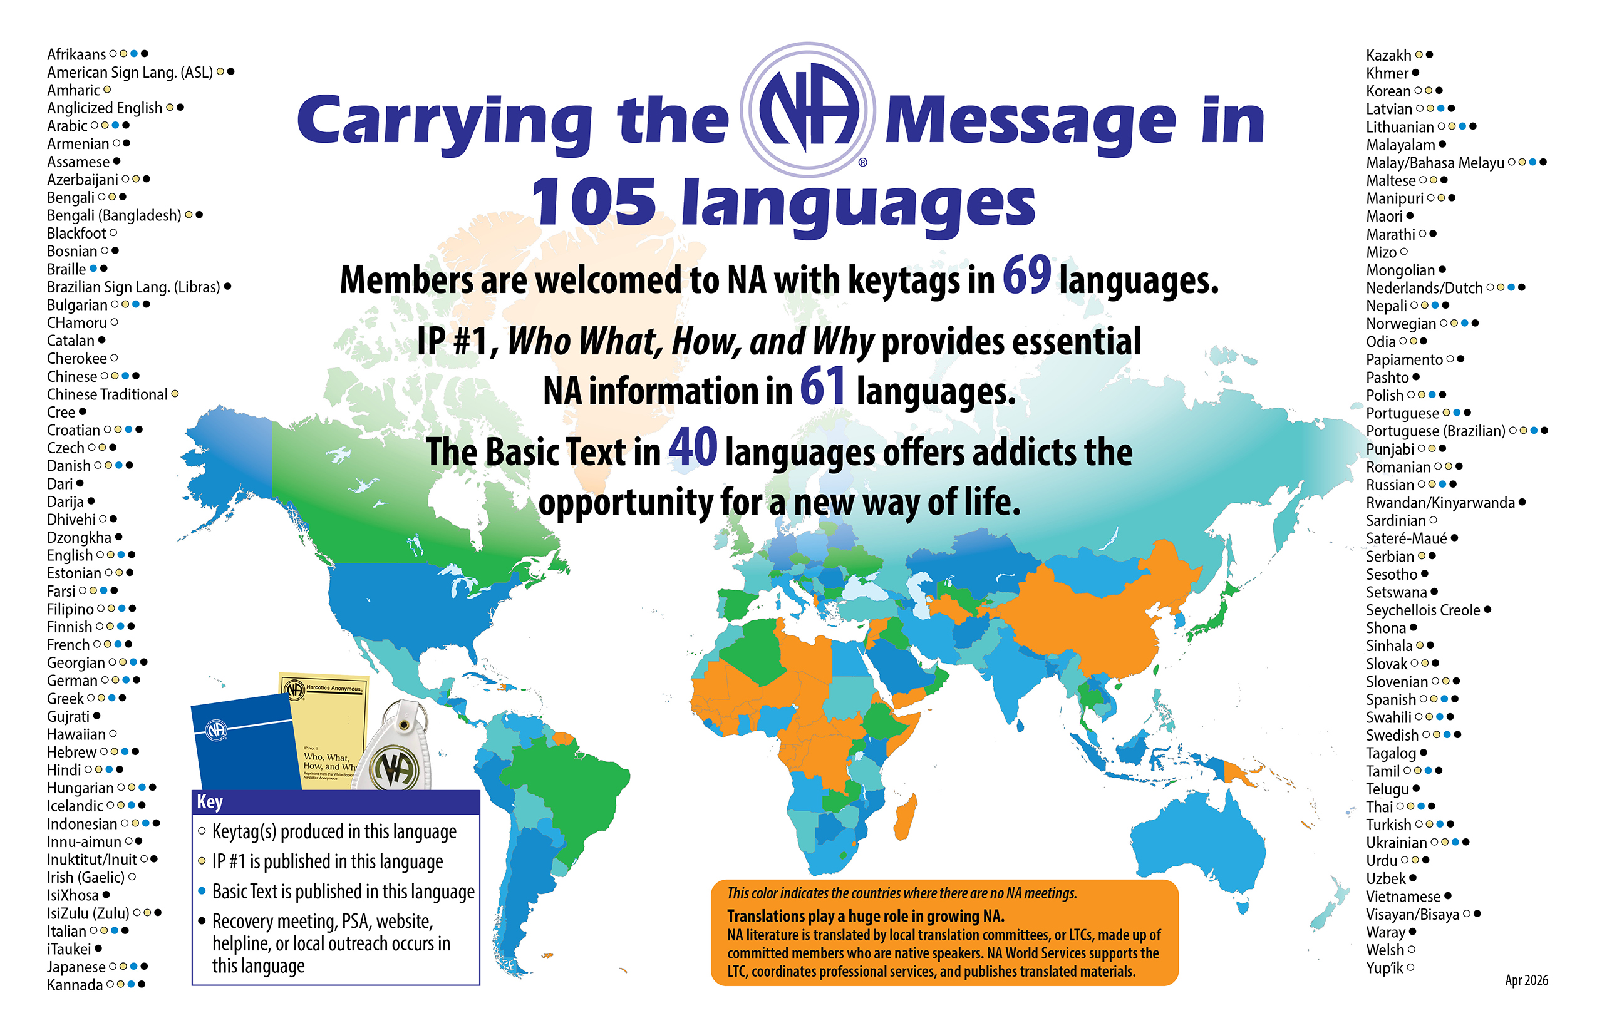
Notes:
This map shows the 105 languages NA members speak. Literature is translated into 61 of those languages.
This “Carrying the message map” is revised each fiscal year to include in the Annual Report. The latest version is posted at na.org/maps.
Not reflected in this graphic is the addition of 2 more Basic Text translations bringing the total to 42. The most recent translations are Azerbaijani, Slovenian, and Ukrainian.

Slide 37
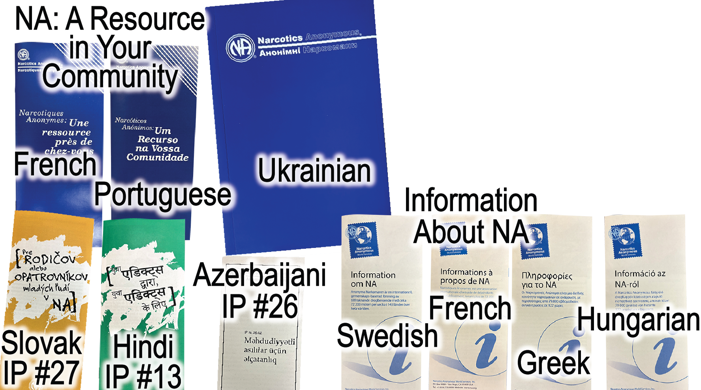
Some of
the latest translations
Notes:
Having literature in your own language saves lives. It helps addicts hear our message, understand the NA program, and connect with the shared experience of members around the world.
Translations play a huge role in carrying the message. Translations work is coordinated among a local translation committee, or LTC, made up of committed members who are native speakers, as well as contracted professionals and NAWS staff.
It takes a great deal of resources to produce translated literature. It’s not just about money. The scarcest resource is human. No machine can replace the need for LTCs, because NA language uses words differently than the communities – including treatment professionals – around us. If you want to learn more about translations, check out Translation Basics, which is posted at na.org.

Slide 38
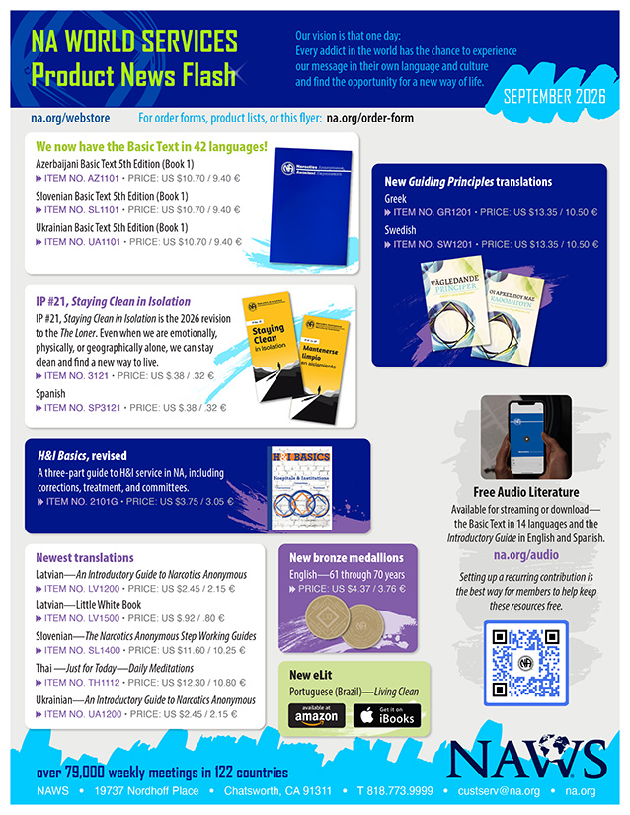
Product News Flash has been updated.
na.org/webstore
Notes:
The Product News Flash has been updated.
This flyer will be posted quarterly. Feel free to circulate.
It can be found at a link on na.org/webstore.

Slide 39

na.org/wcna
Go here to keep updated and listen to past recordings.
The World Convention of Narcotics Anonymous brings tens of thousands of members together. Thousands more, including many correctional facilities, connect for free through simultaneously translated audio streaming of main meetings.
We are delighted to announce that in 2028, WCNA 39 will celebrate NA’s 75th anniversary in Dublin, Ireland!
Notes:
The World Convention of Narcotics Anonymous brings tens of thousands of members together. Thousands more, including many correctional facilities, connect for free through simultaneously translated audio streaming of main meetings.
We are delighted to announce that in 2028, WCNA 39 will celebrate NA’s 75th anniversary in Dublin, Ireland!
Go to na.org/wcna to keep updated and listen to past recordings.
Or subscribe to NAWS Update emails (na.org/subscribe) or read the NAWS News (na.org/nawsnews) to stay informed.

Slide 40
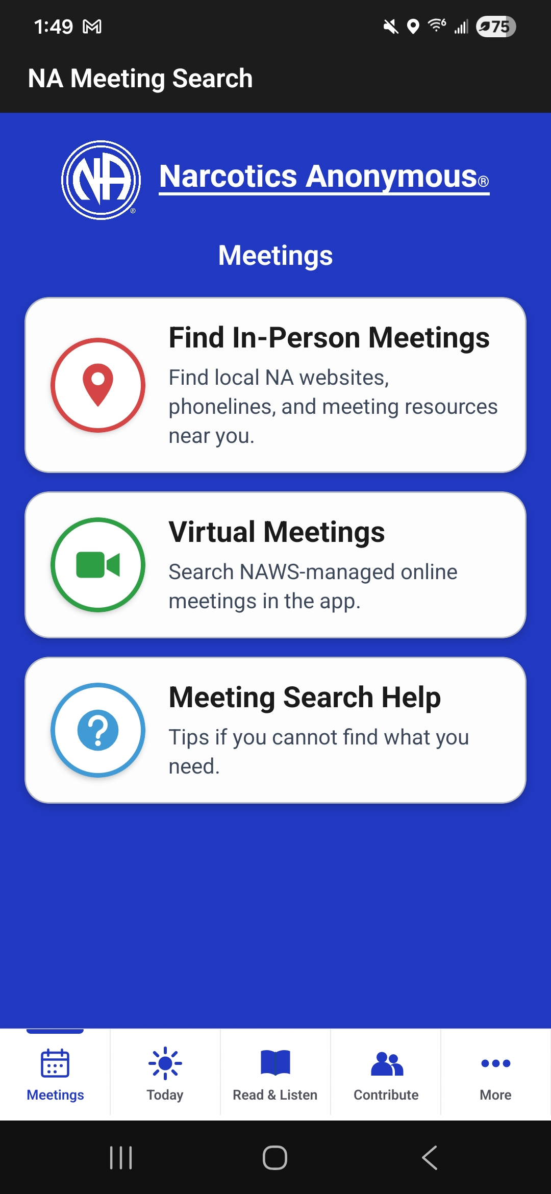
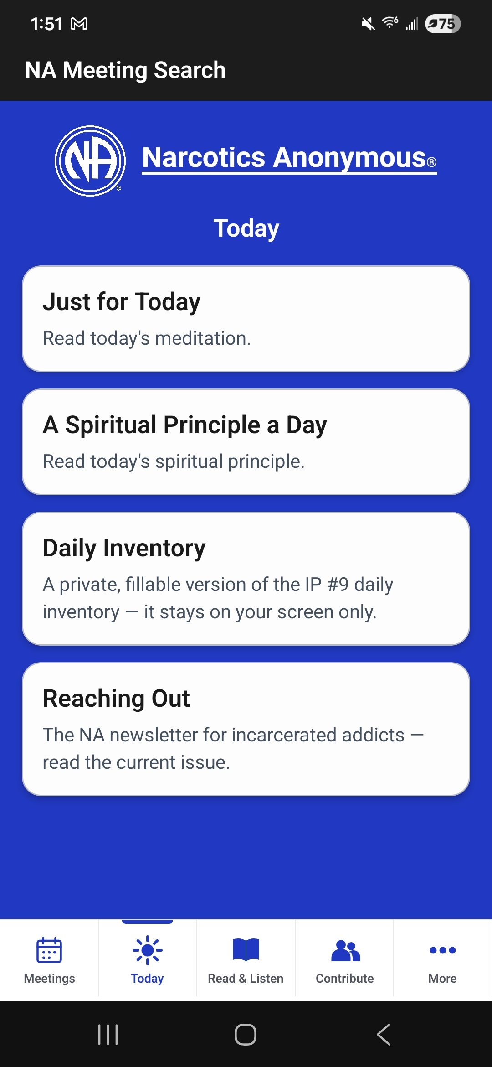
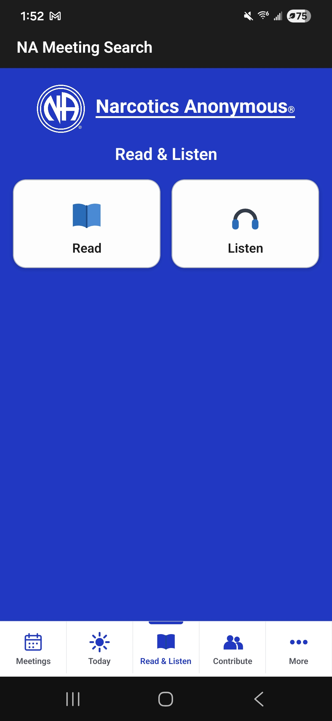
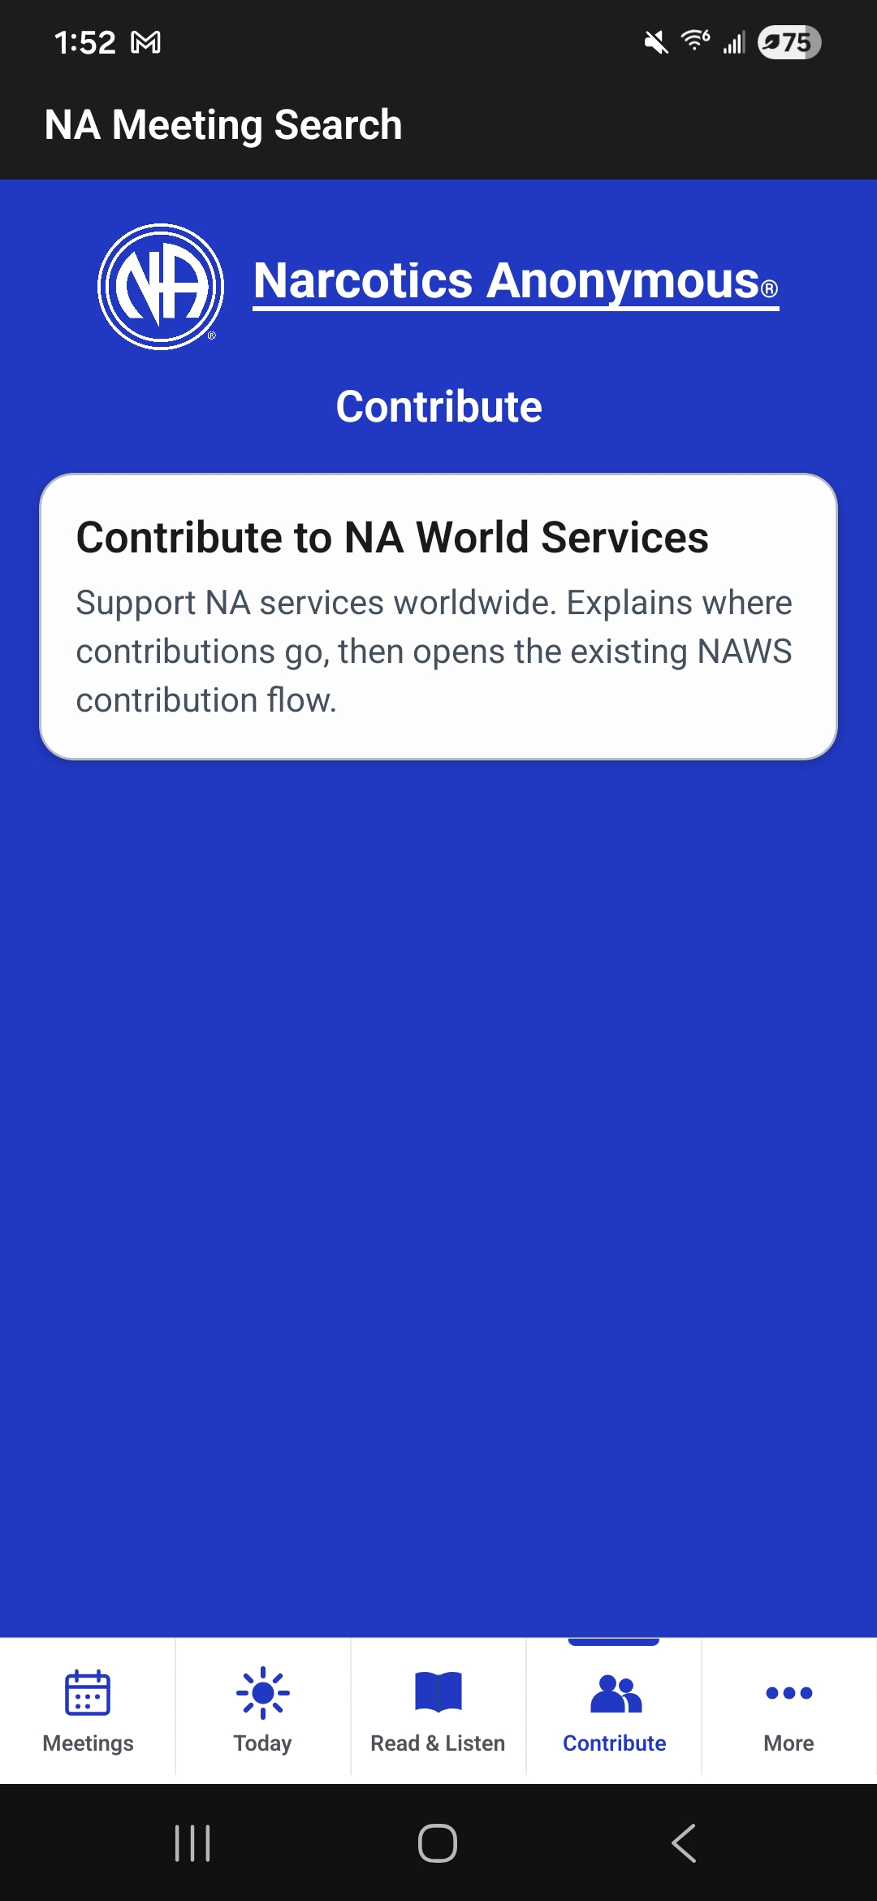
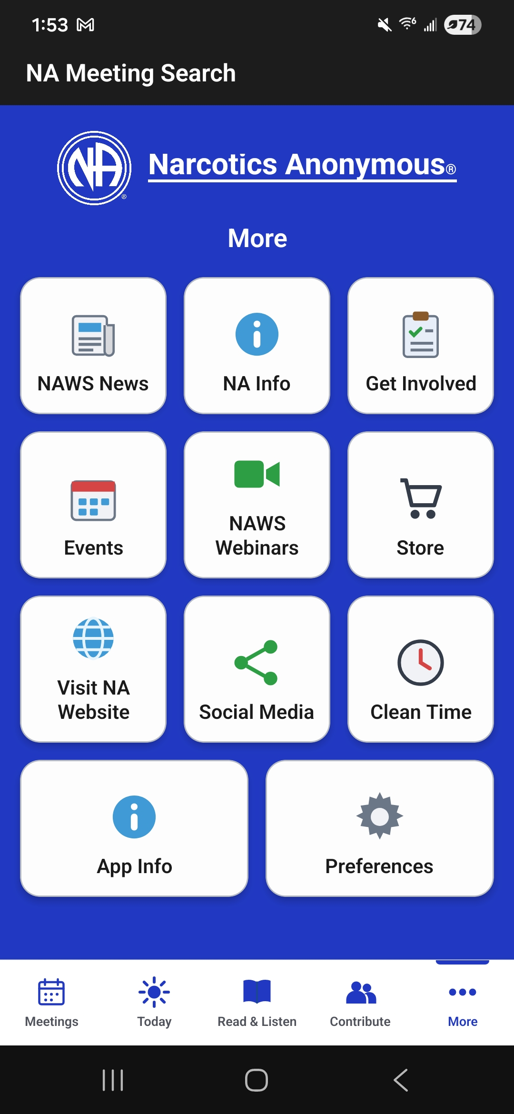
My NA app
(formerly known as
“NA Meeting Search” app)
Coming Soon…
a much needed update that will include a daily inventory from IP #9,
Living the
Program
Notes:
My NA app
formerly known as “NA Meeting Search” app
Coming Soon…
a much needed update that will include a daily inventory from IP #9, Living the Program

Slide 41
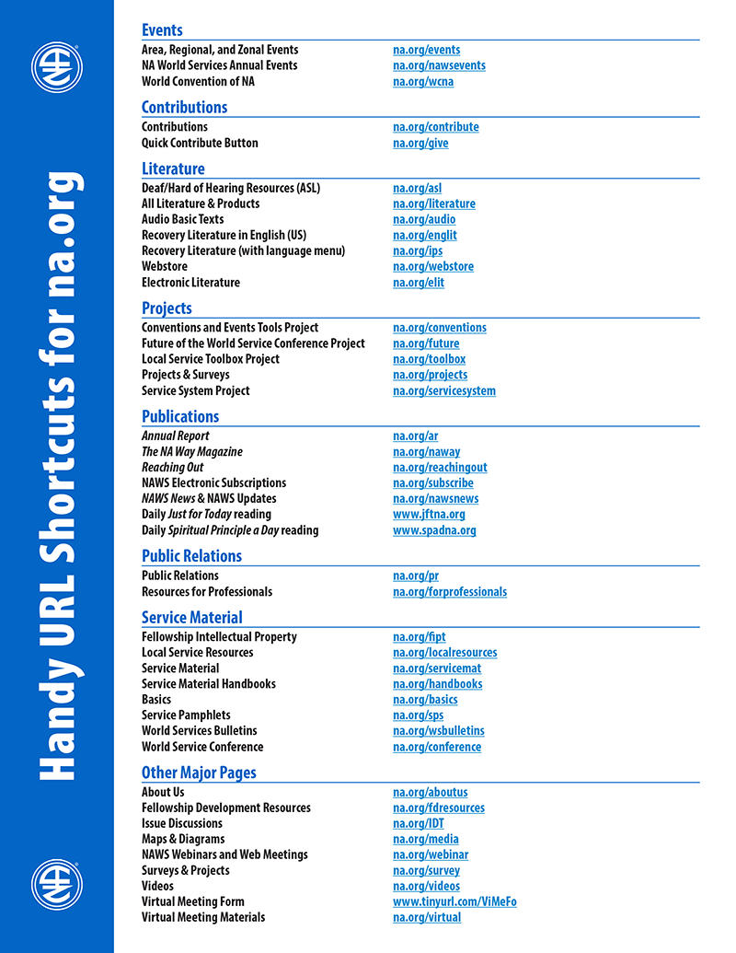
For more information
NAWS News: na.org/nawsnews
Annual Report: na.org/ar
About Us: na.org/aboutus
Projects & Surveys: na.org/projects
World Service Conference: na.org/conference
FD Resources: na.org/fdresources
A complete list of short URLs is posted in Miscellaneous on na.org/maps
Notes:
Most of our frequently accessed webpages have URL short cuts. Here are some of them. You can find a longer list of these shortcuts posted in Miscellaneous on na.org/maps
There is so very much more that we do at World Services, much more than we can cover in one presentation. For more information, see our FD resources page, NAWS News, and the Annual Report.

Slide 42
Questions and
Answers

