Slide 1


Safety and Belonging:
Gender-Neutral Language
This is a presentation on the current project, some history, and the proposed revisions to IP #1.

Slide 2
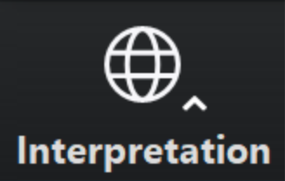
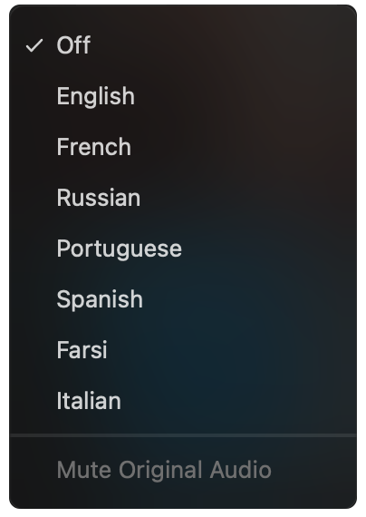
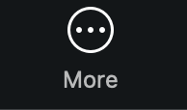
Select a language
Select English or one of the translation channels:
Farsi Hebrew Italian Portuguese Spanish
Click on this icon at the bottom of your screen.
It may be in the “More” panel.
Choose a language
✓ Off
English
Farsi
Hebrew
Italian
Portuguese
Spanish

Slide 3
Safety and Belonging:
Gender-Neutral Language
This is a presentation on the current project, some history, and the proposed revisions to IP #1.

Slide 4

God, grant us the serenity to
ACCEPT
the things we cannot change, the
COURAGE
to change the things we can, and the
WISDOM
to know the difference.

Slide 5


Submit questions using the Zoom Q&A feature at the bottom of your screen.
We will try to address questions at the end of the meeting if the presentation doesn’t answer them.
You can always send questions
to the World Board
at wb@na.org

Slide 6

What is the history of gender-neutral language and NA literature?

Slide 7
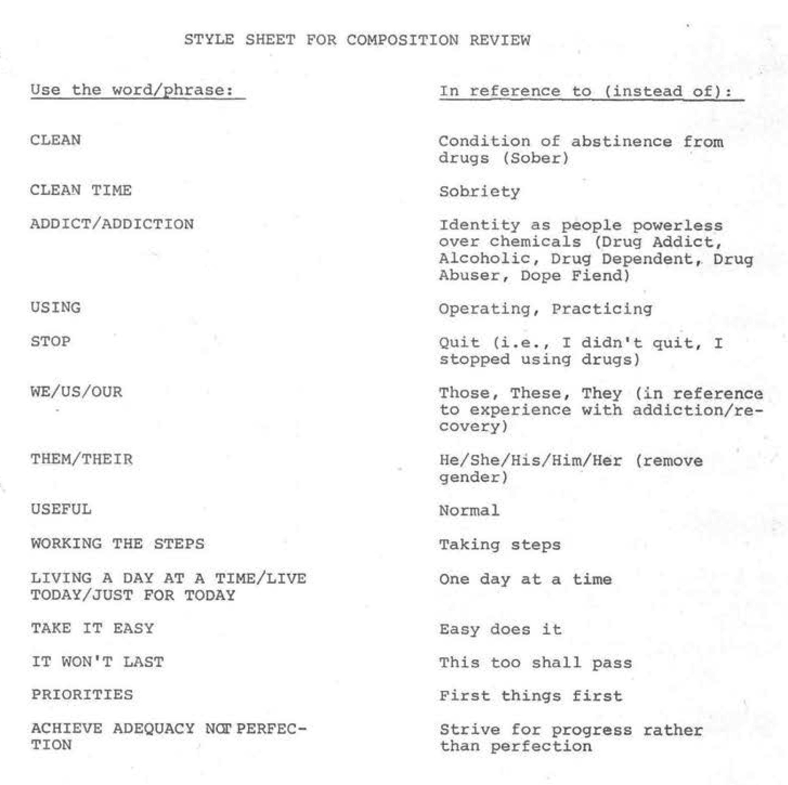
This is from when the Basic Text was being developed in 1981.

Slide 8
In 1988, the World Service Conference passed a motion:
To include the review of ‘gender specific terms’ in our literature among the goals and objectives of world literature, with the aim of bringing back a report to the WSC 1989.
1989 report from the World Literature Committee:
“As fellowship input indicates the need, our literature is constantly revised. Each successive revision of our literature reflects a reduction in gender specific terms, most generally the neuter male pronouns used with indefinite persons….
…Whatever we as a fellowship decide, the solution may not be entirely linguistic; perhaps we need to change some language and develop a tolerant, well-balanced attitude as well. Our desire to be as unprejudiced and unbiased as possible can be seen as we seek ever-increasing unity and strength in our common welfare.”

Slide 9
From the 2023 Motion 14:
…to investigate changes to NA literature from gender-specific language to language that is more gender neutral and inclusive.
Issue Discussion Topic: Gender-Neutral
and Inclusive Language
in NA Literature
Question in the CAR:
Are we willing to explore these types of changes in our literature in order to carry the message more effectively?
Over 5,500 members shared their thoughts
78% of more than 4,000 respondents said yes

Slide 10

Who Is An Addict?
What Is the NA Program?
Why Are We Here?
4 proposed changes
about the language we use to describe our members and potential members
NOT the words we use for
a Higher Power
NOT our Steps or Traditions

Slide 11
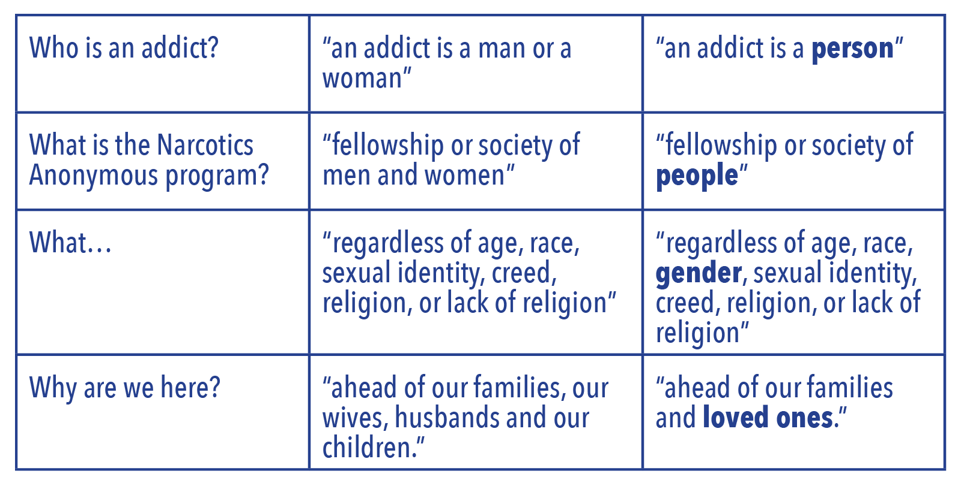
Here are the four proposed changes

Slide 12

“For newer members like me, the language we encounter can have a real effect on whether we experience NA as a place that includes us.”

Slide 13
Some members would like to see different language for the last suggested change.
Original text:
ahead of our families, our wives, husbands and our children
Suggested change:
ahead of our families and loved ones
“loved ones” was meant to be all inclusive.

Slide 14
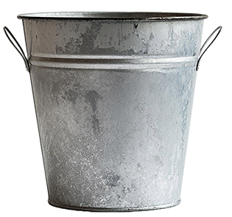

Gender-neutral language in NA literature
Steps/
Traditions
members
God
Only asking about the four changes in the posted draft of IP #1.
Posted through the end of October
All decisions made at the World Service Conference

Slide 15
What About Translations?
All NA literature is initially developed in English.
After World Service Conference approval, other language communities get involved.
Local translation committees, with NAWS oversight, are responsible for conceptual fidelity to the English text and will determine how the changes affect their translated literature.

Slide 16

This project was not motivated by money, but by the direction of the Fellowship.

Slide 17

Other revisions?
If the Fellowship is in favor of revising IP #1,
the World Board will talk about what might come next.
If other changes are
recommended,
conference participants will
discuss those as well.

Slide 18
The draft of IP #1 is posted through the end of October 2026.
Short online input form:
na.org/genderproject na.org/surveys
Do you object to any of these four changes, and why or why not?
Is there anything you think should be worded differently, or anything we missed?

Slide 19

Q&A
If you did not get a chance to ask your question, you can email it to wb@na.org.

Slide 20
Comments
Sharing is limited to 2 minutes.
na.org/genderproject na.org/surveys

Slide 21
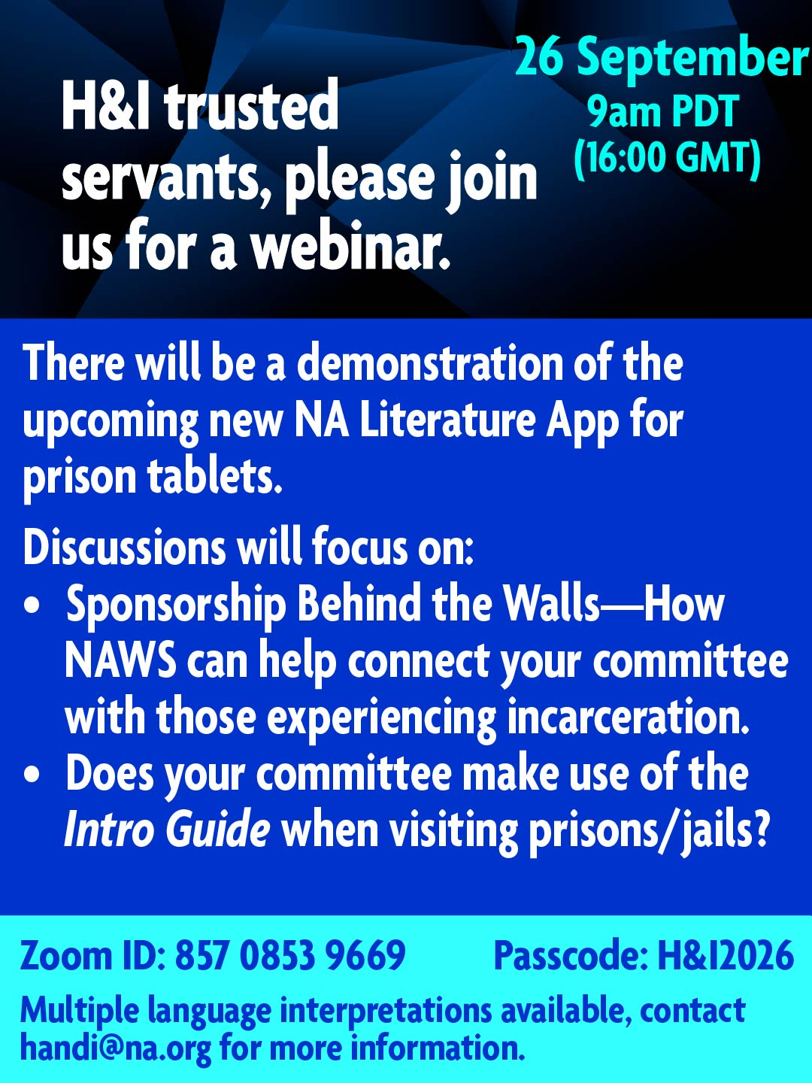

Webinars for
PR and H&I
trusted
servants.
na.org/webinar

Slide 22

Stay informed!
na.org/subscribe
NAWS News
Just for Today
Spiritual Principle a Day
NAWS Update emails

Slide 23
Thank you!!

