Slide 1

Public Relations & H&I in Rural Communities
How do we make sure an addict can find NA, no matter how far away they may live?
The distance changes how we organize the work. It does not change our primary purpose, our Traditions, or the message we carry.
PR helps the public and professionals understand what NA is and how to connect people with us.
H&I carries the NA message directly to addicts
Notes:
Central question: How do we make sure an addict can find NA, no matter how far away they live?
PR and H&I serve the same primary purpose. Rural geography changes how we organize the service, but it does not change the purpose or the message.

Slide 2
PR Can Start Inside NA
“We can do together what we cannot accomplish separately.”
— Twelve Concepts for NA Service
Bring every local meeting into area service.
Combine Resources
Strengthen communication and collaboration between Area Subcommittees — Especially PR, H&I, Phonelines, and Website
Doing Outreach to isolated or disconnected groups instead of waiting for them to come to area — including meetings that are not clearly identifying themselves as NA or AA
Help interested members start new meetings, then keep supporting them.
Notes:
Before asking how to reach the wider community, ask whether the local NA community is connected to itself. A rural group rarely has enough people or money to maintain PR, H&I, outreach, literature distribution, and meeting development alone.
The First Concept explains why groups join together: combined resources allow the service structure to provide work that a single group cannot maintain. Internal PR includes visiting disconnected meetings, inviting their participation, sharing information, finding interested volunteers, and supporting new meetings after they begin.
Sources: Twelve Concepts for NA Service, First Concept; Nomadic Addicts information packet.

Slide 3
What Is Public Relations?
Information and Relationships
PUBLIC INFORMATION
Gets accurate information out
Meeting lists, helplines, literature, PSAs, and presentations
PUBLIC RELATIONS
Builds trust and follows up
Relationships with the public, professionals, potential members, and our own Fellowship
What we call the committee matters less than what we understand its purpose to be: sharing information and building relationships.
Notes:
Public Information focused mainly on distributing accurate information. Public Relations includes that work and adds continuing relationships. The follow-up matters because people must know what NA is, trust the information, and know how to connect an addict with us.
Attraction means we describe NA clearly and let people decide whether it may help. We do not compare NA with other approaches or promise outcomes. Cooperation without affiliation allows us to work with hospitals, jails, treatment centers, schools, and public agencies while NA remains independent.
Sources: Public Relations Handbook; Tradition Eleven; Twelve Concepts for NA Service.

Slide 4
Applying Traditions
Tradition 11
Tradition 6
Attraction, not promotion
We don’t claim that NA is the best or only answer.
We don’t compare ourselves with treatment or other recovery approaches.
We do not promise anyone a result.
Cooperation, not affiliation
We work with community organizations while NA remains independent.
We are not endorsing an organization because we answer its questions or provide meeting information.
We are cooperating so that an addict has a better chance of finding us.
Notes:
Public Information focused mainly on distributing accurate information. Public Relations includes that work and adds continuing relationships. The follow-up matters because people must know what NA is, trust the information, and know how to connect an addict with us.
Attraction means we describe NA clearly and let people decide whether it may help. We do not compare NA with other approaches or promise outcomes. Cooperation without affiliation allows us to work with hospitals, jails, treatment centers, schools, and public agencies while NA remains independent.
Sources: Public Relations Handbook; Tradition Eleven; Twelve Concepts for NA Service.

Slide 5

Know the NA Message
Every PR and H&I member should be able to explain the same basics.
Four Basics
Who We Are
Who Can
Attend
What We
Offer
What We
Do Not Do
Notes:
The four basics are: who we are, who can attend, what we offer, and what we do not do. NA is a peer recovery fellowship for people with a drug problem. The only requirement for membership is a desire to stop using. We offer meetings, members sharing recovery experience, and NA literature. We do not provide treatment, counseling, medical care, residential care, or professional referrals.
Protect the NA message by using current NA literature and by separating personal opinion from an NA presentation. A facility program cannot become an NA meeting simply because it uses NA language. An independent NA group and an H&I panel have different purposes and accountability.
Sources: Information about NA; Public Relations Handbook; H&I Handbook; H&I Basics 2026.

Slide 6
Protect the NA Message
Use current NA literature.
Keep personal opinions out of NA’s position.
Distinguish an NA group from an H&I panel.
Correct facilities that call their own programming “NA.”
Notes:
The four basics are: who we are, who can attend, what we offer, and what we do not do. NA is a peer recovery fellowship for people with a drug problem. The only requirement for membership is a desire to stop using. We offer meetings, members sharing recovery experience, and NA literature. We do not provide treatment, counseling, medical care, residential care, or professional referrals.
Protect the NA message by using current NA literature and by separating personal opinion from an NA presentation. A facility program cannot become an NA meeting simply because it uses NA language. An independent NA group and an H&I panel have different purposes and accountability.
Sources: Information about NA; Public Relations Handbook; H&I Handbook; H&I Basics 2026.

Slide 7
How PR and H&I Work Together
PR opens the door. H&I carries the message.
PR works with the professionals.
H&I works directly with the addicts
who cannot fully reach community meetings.
Together they connect potential members
with community NA meetings.
Notes:
PR and H&I address different audiences. PR speaks with the administrators, volunteer coordinators, clinicians, corrections staff, and other professionals. It explains what NA can provide, clarifies expectations, maintains contact, and helps create access.
H&I speaks directly with addicts who cannot fully attend regular community meetings. It introduces the NA program and helps potential members understand how to connect with NA outside the facility.
A presentation to hospital staff is PR. A presentation to the patients is H&I. Both services need one another: PR builds and maintains the relationship, and H&I keeps the commitment that relationship made possible.
Source: H&I Handbook.

Slide 8
Rural Service: Pool the Resources
Inventory the area: Count willing members, cleared volunteers, vehicles, literature, money, facility contacts, and technology.
Share the load and Pool Resources: Rotate members, carpool, coordinate distant commitments, and ask neighboring service bodies for help.
Protect reliability: Choose a schedule the area can maintain. One dependable commitment builds more trust than repeated cancellations.
Notes:
Plan with the resources of the whole area rather than treating each rural meeting as a separate service community. Inventory actual capacity before accepting commitments: available trusted servants, volunteers with facility clearance, vehicles, travel time, literature funds, contacts, and technology.
Reliability matters more than quantity. A dependable monthly H&I panel serves NA better than a weekly promise the area repeatedly cancels. A few maintained professional relationships accomplish more than a large mailing with no follow-up.
The H&I material encourages isolated and developing communities to start small, adapt schedules to their resources, and seek help from neighboring areas, the region, the zone, and NAWS.
Sources: H&I Basics 2026; Twelve Concepts for NA Service.

Slide 9

Rural PR and H&I in Practice
Practical First Steps
PR: Choose one organization and one contact. Follow up.
Conference booth: Use current meeting information and collect contacts.
H&I: Choose one facility and a schedule you can keep.
Distance: Carpool, rotate volunteers, coordinate trips, and use virtual panels.
Meeting information: Keep websites, helplines, and local lists accurate.
Notes:
Choose work the area can begin and maintain. For PR, one good relationship means identifying the right contact, explaining NA clearly, leaving accurate local information, and following up. At a professional conference booth, prepare short answers, keep the table staffed, provide current meeting information, collect useful contacts, and follow up afterward.
For H&I, begin with one facility and a realistic schedule. Train more than one member, develop backups, follow facility rules, and keep staff informed. Carpooling, rotating volunteers, coordinating several distant commitments, and virtual panels can reduce the burden of geography.
Accurate meeting information is part of PR. A bad address in a rural community may send a newcomer on a long drive to a locked building.
Sources: Public Relations Handbook; H&I Basics 2026.

Slide 10
Build Something That Lasts
“Each of us shares responsibility for our Fellowship.” – Guiding Principles
Connect the groups.
Pool the resources.
Train and mentor members.
Build relationships you can maintain.
Keep the commitments.
Start with what you have. Do it well. Build from there.
Notes:
Effective rural service does not require a large committee. It requires connected groups, shared resources, prepared members, maintained relationships, and dependable commitments.
Invite one practical next step: reconnect one group, identify one community contact, train one new volunteer, repair one inaccurate meeting listing, or make one H&I commitment more dependable.
The goal is steady fellowship development. Newcomers become members. Members receive mentorship and become trusted servants. Stronger groups then support outreach, PR, and H&I across the wider geography.

Slide 11
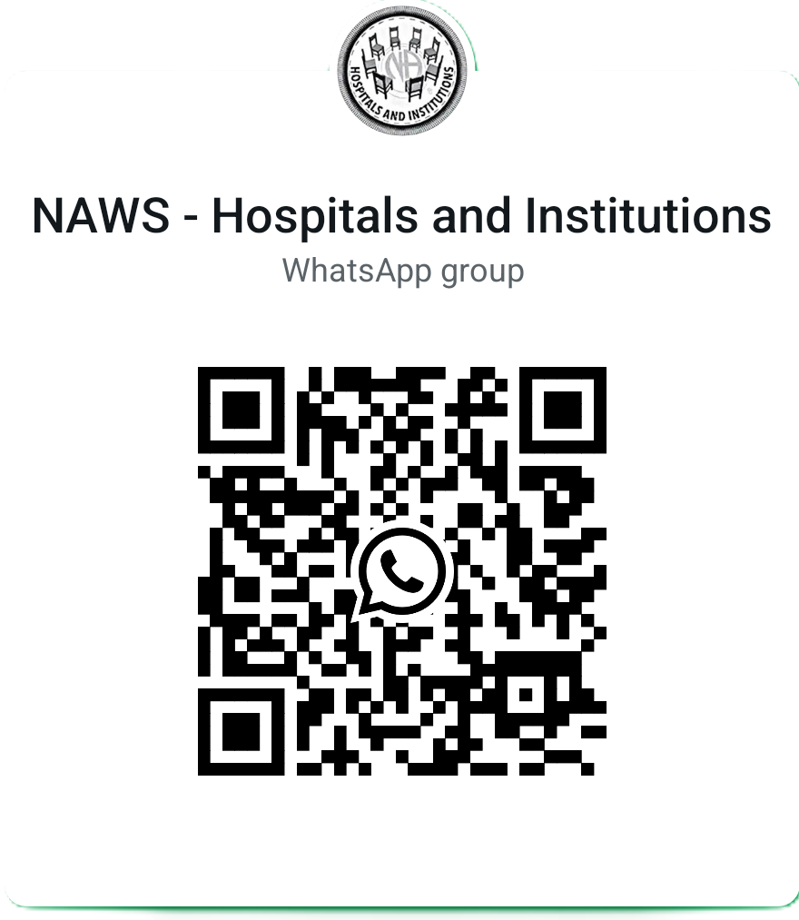
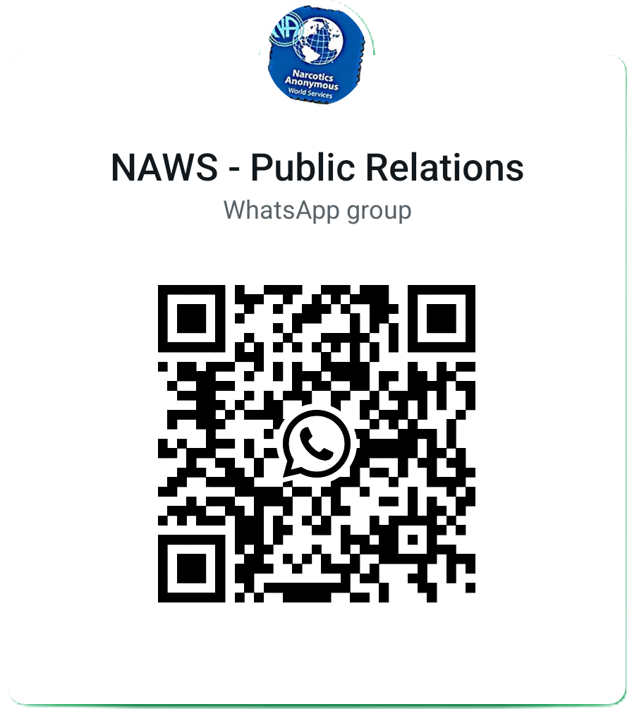
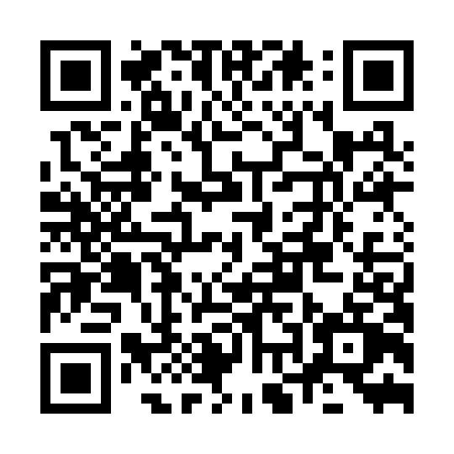
Additional Resources
Contact us!
PR@NA.ORG
NAWS Webinars
NAWS WhatsApp
Join to discuss PR and H&I with members throughout the Fellowship!
https://na.org/naws-events/webinar/
Notes:
Effective rural service does not require a large committee. It requires connected groups, shared resources, prepared members, maintained relationships, and dependable commitments.
Invite one practical next step: reconnect one group, identify one community contact, train one new volunteer, repair one inaccurate meeting listing, or make one H&I commitment more dependable.
The goal is steady fellowship development. Newcomers become members. Members receive mentorship and become trusted servants. Stronger groups then support outreach, PR, and H&I across the wider geography.

