Slide 1

Public Relations:
Why it’s important.

Slide 2
Why Should I Care?
“Public relations helps us reach addicts who may not otherwise find Narcotics Anonymous.”
— Public Relations Handbook
Public Relations is Fellowship Development.
“If PR grows, NA grows. If PR stalls, we stagnate.”

Slide 3
Why Should I Care? – The Numbers
Nearly 1 in 5 Regions do not have PR.
82% of Regions reported having a PR Committee.
Active PR more than doubles likelihood of membership growth.
61% of High PR Activity Regions reported growth vs. 27% for Low PR Activity.
Low PR activity more than doubles likelihood of membership decline.
9% of High PR activity regions reported shrinking vs. 20% of Low PR activity
Notes:
Regions were grouped based on signs of active PR work, such as clear descriptions of their efforts and participation in conferences or outreach.

Slide 4
PR - How We Get to Recovery
“We can only keep what we have by giving it away.”
-Basic Text
We are all products of PR.
PR members are the people who make sure
no addict misses the chance to find NA.
If no one did PR in your area… how would the next addict find NA?

Slide 5
PR Helps You
Personal Stories from a NAWS PR Webinar
I was hooked up to several drips in a hospital… a nurse walked in to me and said, “You know, your life doesn’t have to be like this.” And I said, “What is the alternative? I don’t know any other way.” And she told me about Narcotics Anonymous. That nurse was not a member of our Fellowship… but she knew that it was a place where people like me could go. – Simon
…you never know who’s going to get your message, when they’re going to get the message, and when they’ll actually receive it in their hearts. – Anne
I think, personally, PR has given me a reason to be visible in my life. – Patrick
People will say “when I found NA”… but seldom do we say, “How I was told about NA”… I think about that with our readings as well, where it says, “NA is available to us all”, but really, it’s only available if people know it’s here. - Paul
Notes:
Personal Stories from PR webinar

Slide 6
Fellowship Advantage
“Everything that occurs in the course of NA service must be motivated by the desire to more successfully carry the message.”
- Guiding Principles
We’ve already agreed on what our Primary Purpose is. Now it is time to use Public Relations to achieve that purpose.
PR carries the message of recovery around the world.
Notes:
We have an advantage as a fellowship because we already agreed on our primary purpose. It’s about how.
*4 out 5 regions have PR. That’s strong, but how do we fill in the gap?

Slide 7
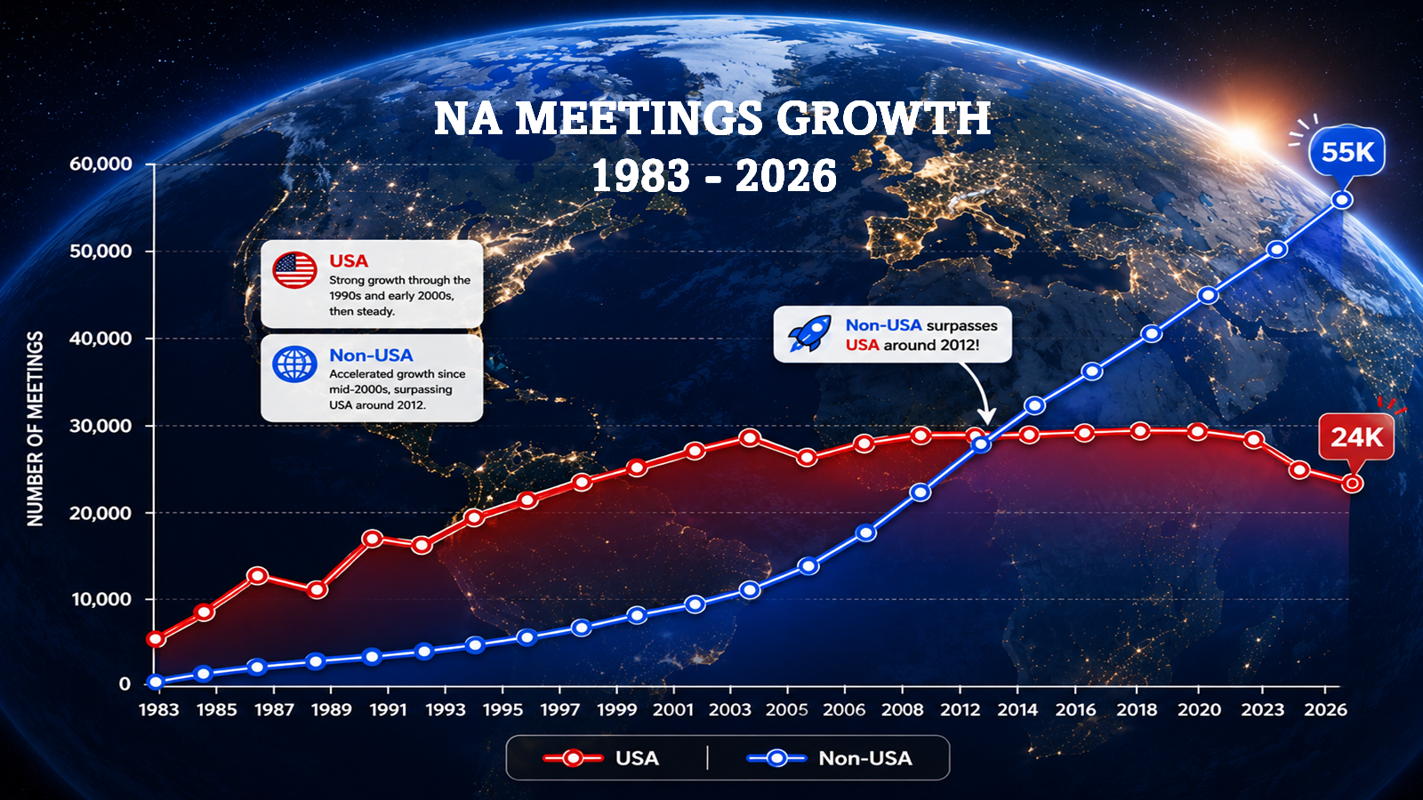

The Opportunity:
Strengthening Participation in the USA
USA
Higher service gaps (49%)
Lower mentorship (14%)
International
Lower Service Gaps (33%)
Higher Mentorship (24%)
Growth in the US has leveled off in recent years.
More emphasis on mentorship and fewer participation gaps outside the US.

Slide 8
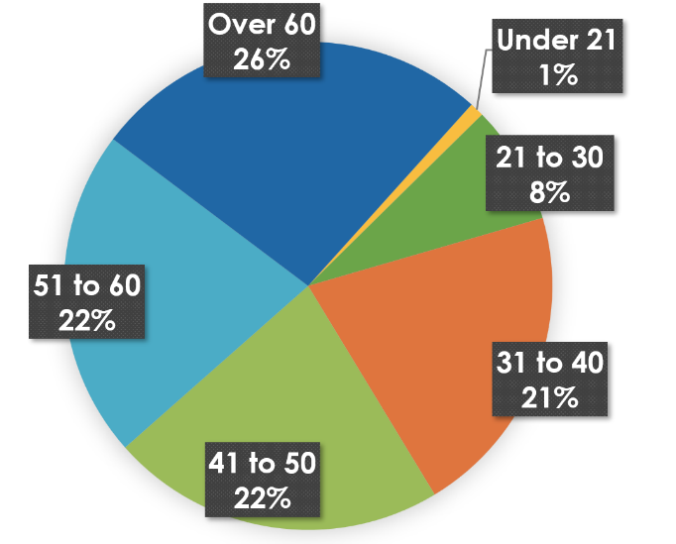
Opportunities: Outreach Gaps
2024 Membership Survey
Influences to Attend First NA Meeting
Age
Under 21 is just 1%, highlighting a huge gap in our reach.
TREATMENT FACILITY/
COUNSELING AGENCY
CRIMINAL JUSTICE SYSTEM
NA SERVICE EFFORT

Slide 9
What’s Working - Events
WCNA Workshops & Unity Day – Key Takeaways
Expanded global PR efforts at WCNA 38
Stronger focus on collaboration (policy, research, communities)
Emphasis on inclusion, language, and member experience
Growing use of social media & digital outreach
PR as a key driver of access to recovery worldwide
Notes:
WCNA Workshops & Unity Day – Key Highlights
WCNA 38 marked a major expansion of PR efforts, with the first comprehensive set of Public Relations workshops bringing together members and professionals to strengthen cooperation and broaden NA’s reach.
Workshops focused on themes such as cooperation with public policy and communities, inclusive practices, effective language, engagement in corrections, and navigating topics like medication and membership.
A central takeaway was the growing importance of collaboration—with government, researchers, and local partners—to increase understanding of NA and expand access to recovery.
Unity Day reinforced these efforts by highlighting global innovation in PR, including increased use of social media and shared learning across international communities.
Overall, the events emphasized that effective PR—grounded in data, relationships, and member experience—is essential to ensuring NA remains accessible and relevant for newcomers worldwide.

Slide 10
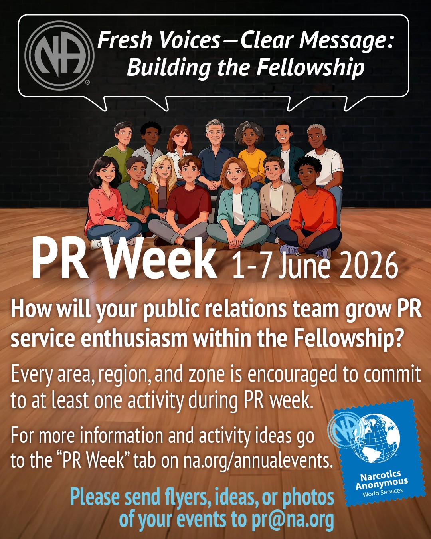
What’s Working - Events
PR Week – New Theme
June 1-7, 2026
Fresh Voices - Clear Message: Building the Fellowship
New suggested activities for PR week:
Hold learning days that feature PR mentorship.
Training events for new PR members.
Develop a video series of member stories on how PR service has had a positive impact on personal recovery.
Next PR Week June 7-12, 2027
Notes:
Not just about external PR, it’s about growing the Fellowship and increasing service.
Hold learning days that feature PR mentorship.
Training events for new PR members
Develop a series of member stories on how PR service has had a positive impact on personal recovery.

Slide 11
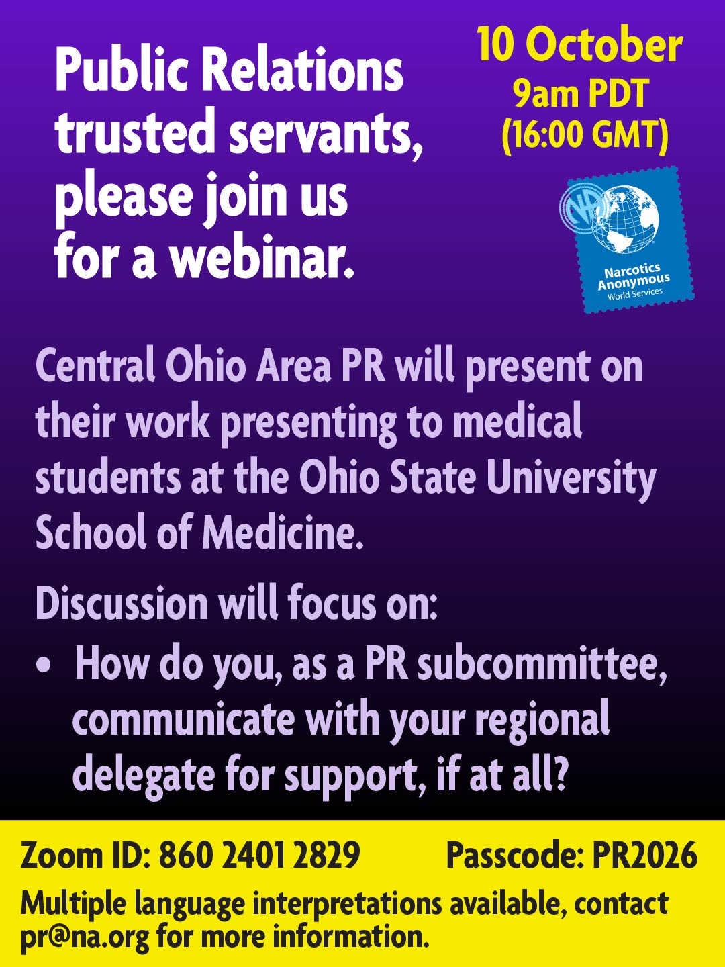

What’s Working – PR Outreach
Of those regions that reported emphasizing professional outreach, 62% reported growth.
Expanding PR in LAZF – going to Dominican Republic professional conference
Central Ohio PR – Presenting to the Ohio State University College of Medicine
Notes:
Examples from PR webinar presentations that show what is working for PR.

Slide 12
What’s Working – Digital Reach
Tremendous success with Social Media
Spain – With a Call-to-Action campaign across all social media, they reached over 350,000 professionals.
Russia – Dispelling myths and finding newcomers on YouTube with consistent posts and messaging.
Brazil – Over 60,000 followers on Instagram!

Slide 13
Awareness and Engagement
The Barriers
I’m not qualified to do PR.
Let’s create new tools to simplify it.
PR in a Box:
Simple to use tools and training materials.
PR is scary.
Get help and experience from other members.
PR Week, Webinars, Personal Stories, Mentorship
Notes:
Generate enthusiasm through personal stories, PR week, webinar engagement, to name a few.
PR in a box: Built from PR basics and handbook.

Slide 14

Raising Public Awareness
“PR helps to build ongoing relationships with the people and institutions that help NA to be recognized and welcomed…”
-Guiding Principles
Four Pillars
Addiction Treatment
Medical Community
General Public
Government
The Tools
Updated Professional Presentations (early cycle)
Multimedia Content (mid cycle)
Audience-specific Toolkits (mid cycle)
Notes:
Tailored Powerpoints for each audience
Social Media video series, like Mythbusters
Set of materials that local bodies may select from based on needs.

Slide 15
Take Action
NAWS Supports PR - We are committed to building these tools with the fellowship—not simply presenting them to the fellowship.
Grow PR Service - We can remove the barrier that says, "I'm not cut out for PR," by making PR more accessible, practical, and welcoming.
Strengthen PR at the Area Level - Strong fellowship development begins with strong area-level PR. Expanding PR service locally is one of our greatest opportunities.
Build the Leadership Pipeline - Mentorship and leadership development are essential to long-term success. Together, we can strengthen the path from Region → Area → Group and inspire the next generation of PR trusted servants.

Slide 16
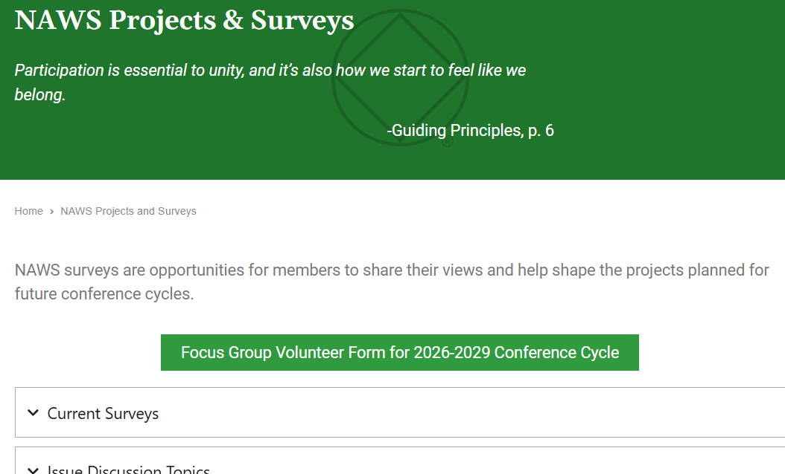
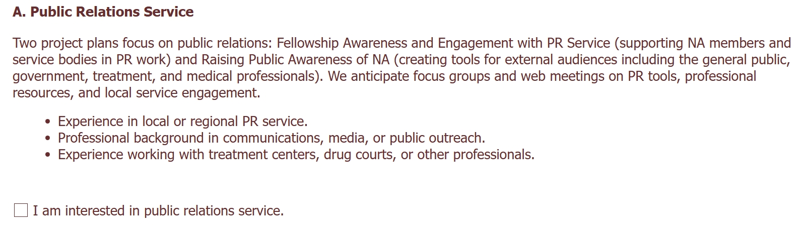
Volunteer Form
na.org/get-involved

Slide 17
Closing
“Each of us shares responsibility for our Fellowship.” – Guiding Principles
Take one thing back.
Start one conversation.
Build one PR effort.
That’s how we grow.

Slide 18
Contacting NAWS PR
PR@na.org
Notes:
May wish to add local contact information

