Slide 1

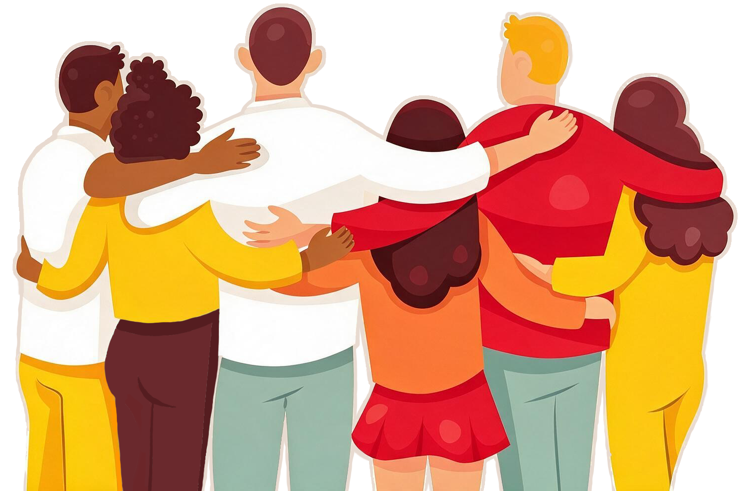
5 September 2026
Part 2

Slide 2
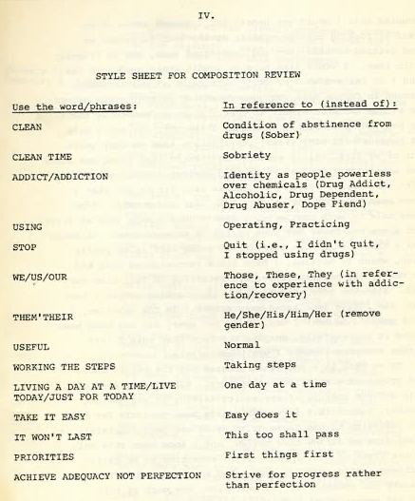
Gender-Neutral Language
This is simply motivated by the desire to more effectively carry the message—not outside issues and politics.
What is underlying here is a goal of welcoming, inclusiveness, and connection for both current and future members.

Slide 3

This is about the language we use to describe our members and potential members—not the words we use for a Higher Power, and not our Steps or Traditions.

Slide 4


Slide 5

Save the date!!
26 September
11:00am PDT

Slide 6
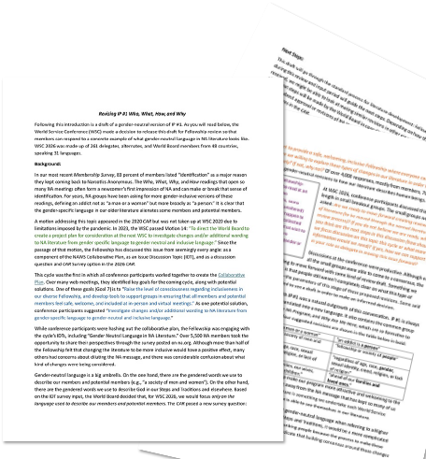
na.org/genderproject na.org/surveys
We want to know:
Do you object to any of these four changes, and why or why not?
Is there anything you think should be worded differently, or anything we missed?

Slide 7
A Spiritual Principle a Day, 5 September — Cooperation Despite Friction
Time and time again, in crises we have set aside our differences and worked for the common good.
Basic Text, Chapter 6, “Tradition One”
Cooperation is fundamental to what we do in NA, starting from the moment when the message is first carried to us. “I didn’t get clean because of my own Step One,” an addict shared. “I got clean because of someone else’s Step Twelve.” Whether we first heard the message from one member, a group, or a piece of literature, carrying the message to a using addict requires cooperation. We are clean because other members cooperated with each other—and we cooperated by listening and believing that recovery was possible for us, too.
Our cooperation in NA continues well beyond that first moment of willingness to listen and receive a message of hope. As we stay clean and get to know our fellow members better, we cooperate with each other and keep the doors open for the addicts yet to come. We’re sure to see or experience friction at some point, but addicts in recovery can be surprising in our ability to come together when it really matters.
“I got clean in a small town, and there were only two addicts at my first meeting,” a member wrote. “They carried a message to me that night. I thought they were best friends. Later, I learned that they couldn’t stand each other. I never would have known it from my first night clean.”
Some differences are more extensive than just a personality clash. “Our city was divided along racial/ethnic lines,” a group wrote. “We had two areas with big overlaps, and they didn’t get along. Some members finally had enough and created an annual unity event bringing both areas together. It was sort of controversial at first, but every year it gets bigger and better. Since it started, our areas have started collaborating on H&I and public relations service, too.”
Placing principles before personalities means cooperating whether or not I get along with someone.
I will do my best to set aside differences for NA unity.

Slide 8
Guiding Principles: The Spirit of Our Traditions, Introduction
Our Twelve Traditions are about relationships: with ourselves, our groups, our service bodies, and our Higher Power. While they address our practices in service, they also provide a foundation for us to learn how to live. They are practical and spiritual at the same time. Our Traditions help us to navigate: They remind us where we are going and where we are likely to run aground. They also remind us that we steer our own ship. Unity and autonomy guide us, not uniformity and governance. We surrender authority to a Higher Power and come together as equals. Our primary purpose is to carry the message to the addict who still suffers. If we are to accomplish that, we need recovery ourselves, and we need to come together in unity to build the groups and provide the services that make recovery available to us all. We need every principle, every resource, and every member.
…
Together, our Steps and Traditions allow us to grow and thrive, to interact with others, and to sustain ourselves through difficulty. These spiritual principles and practices can guide us in our decisions in service and throughout our lives. Although we each have different ways of connecting with and learning about the Traditions, we can all agree that these are the principles that keep us alive and free.

Slide 9


Take my will and my life,
guide me in my recovery,
show me how to live.

