Slide 1


5 September 2026
Part 1

Slide 2
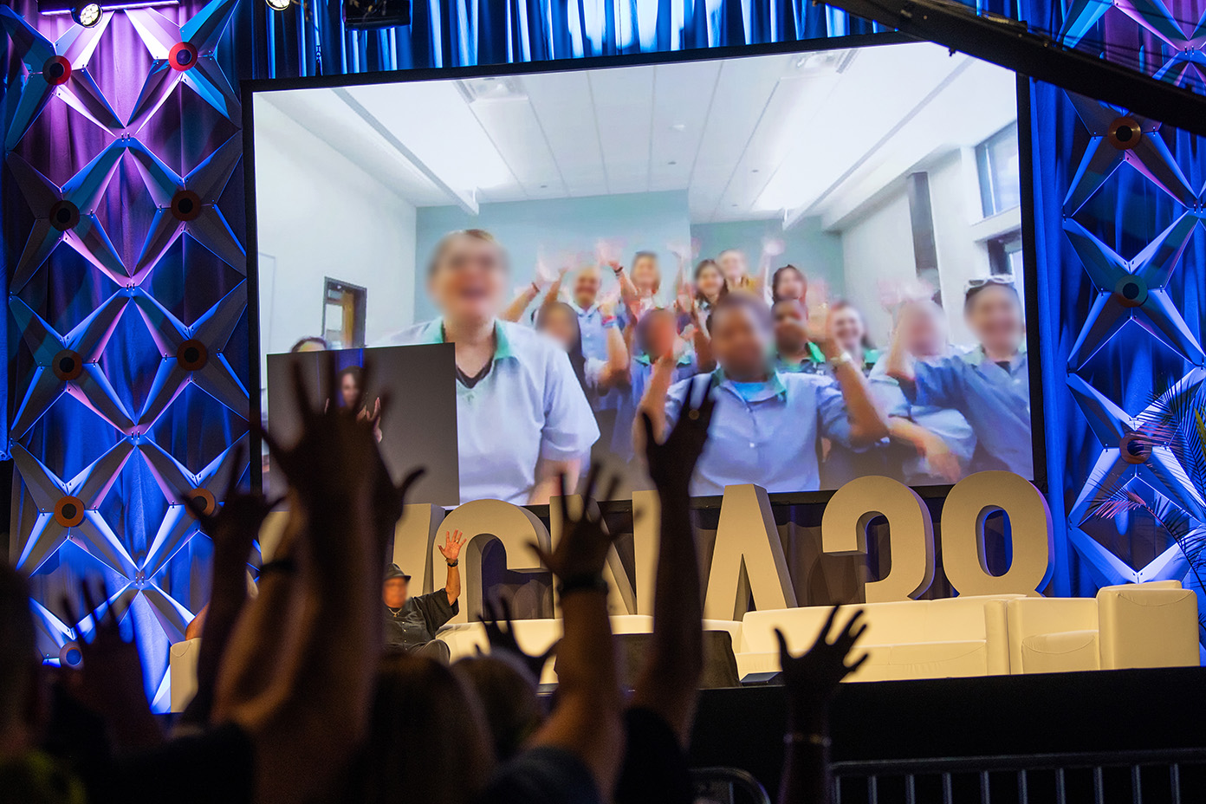

Slide 3

TODAY’S AGENDA
NA World Service happenings
Public Relations presentation
Moment of silence & Serenity Prayer
Videos
Update on safety and belonging project about gender-neutral language
Four recovery speakers

Slide 4
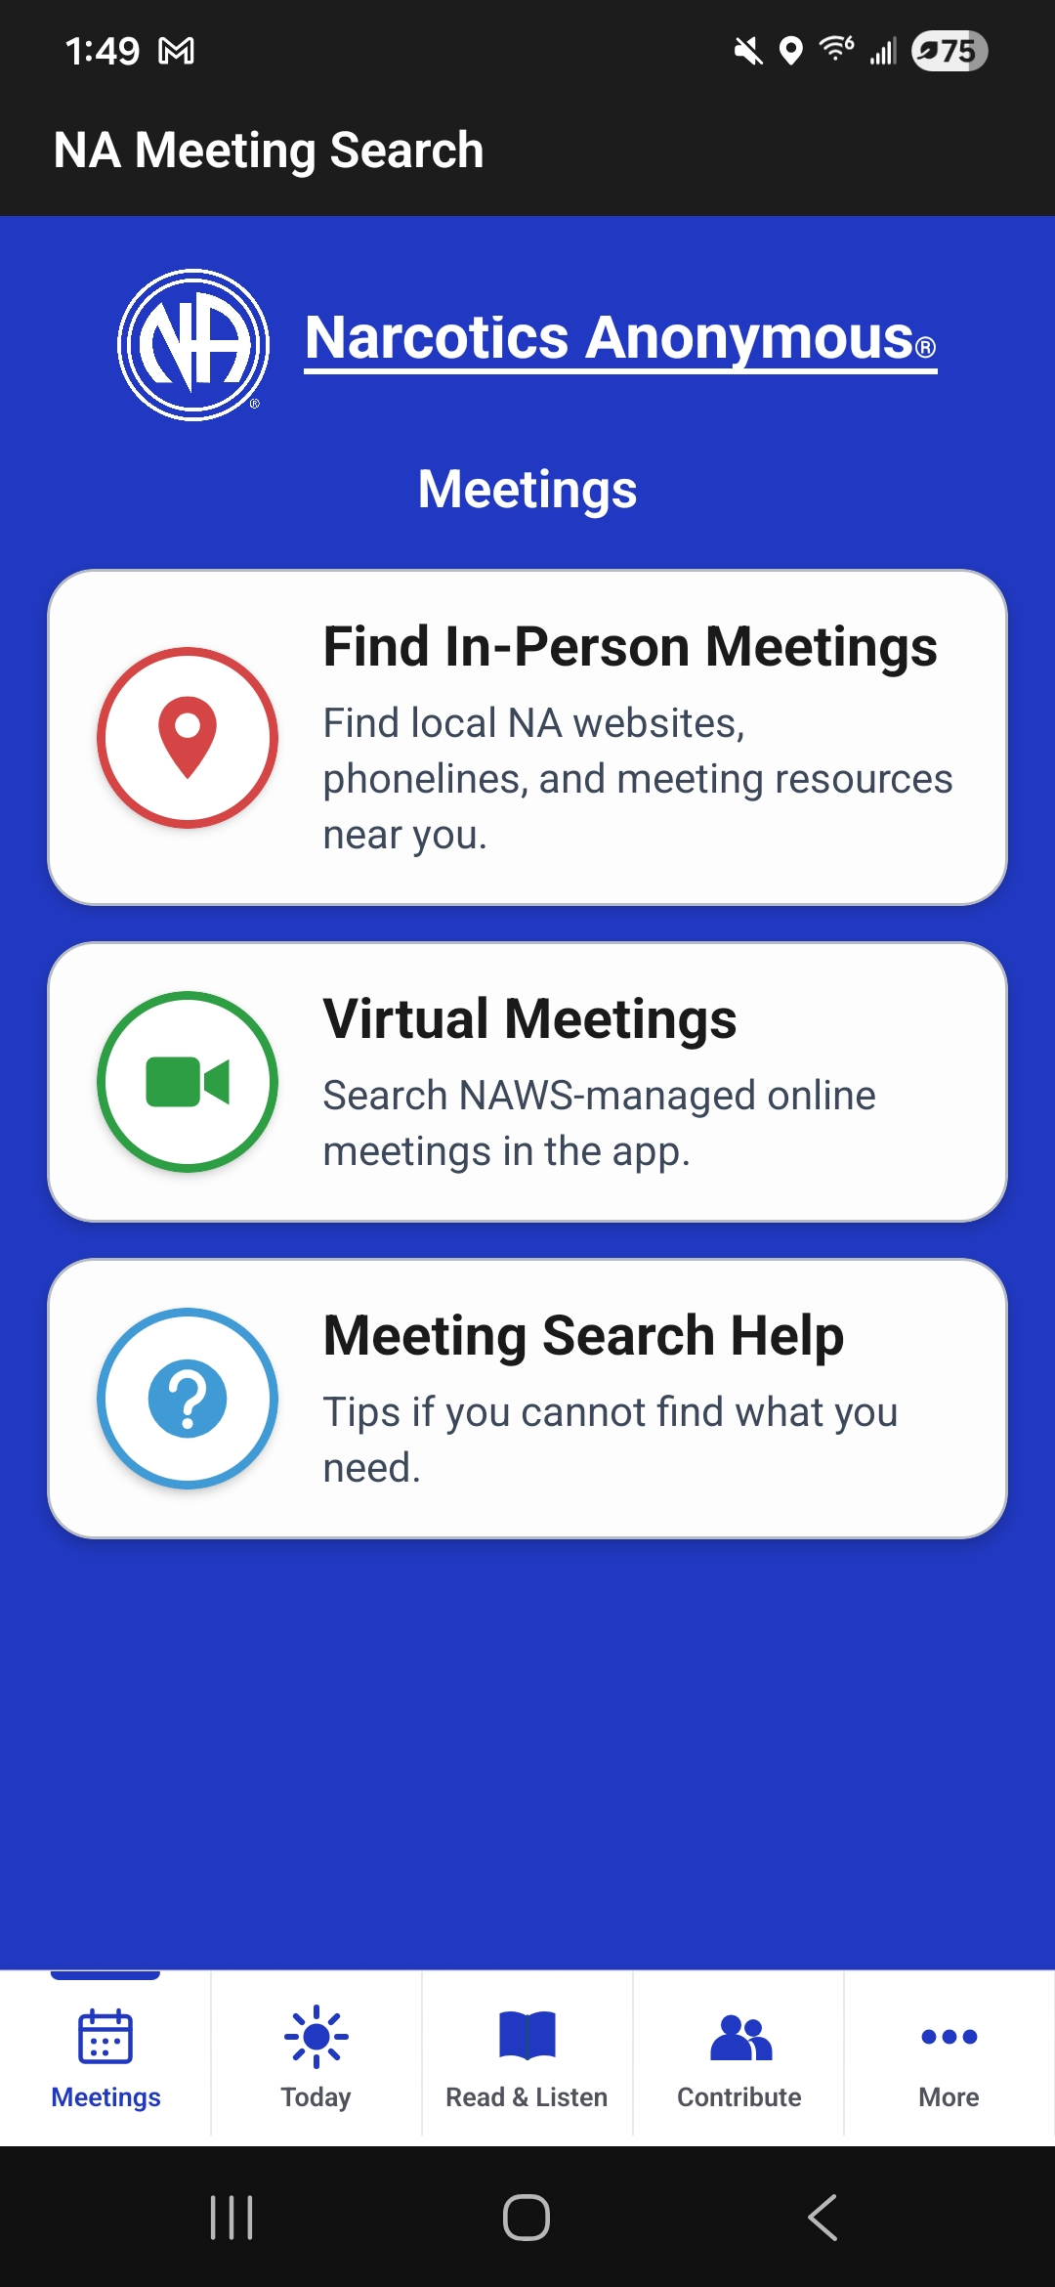
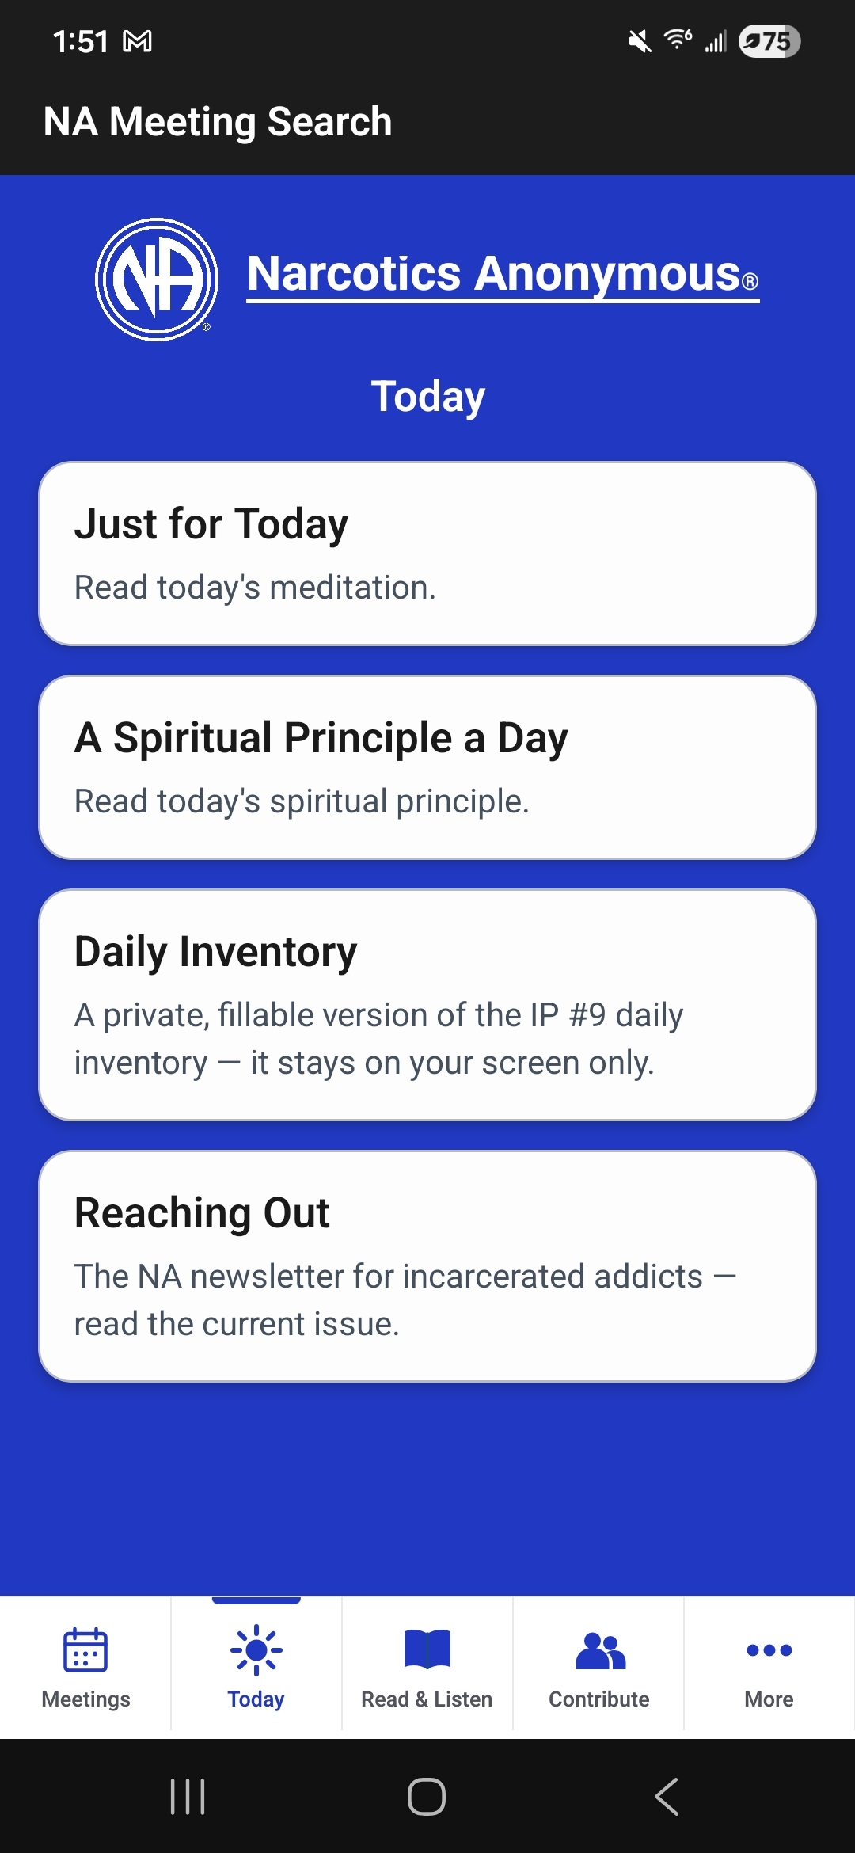
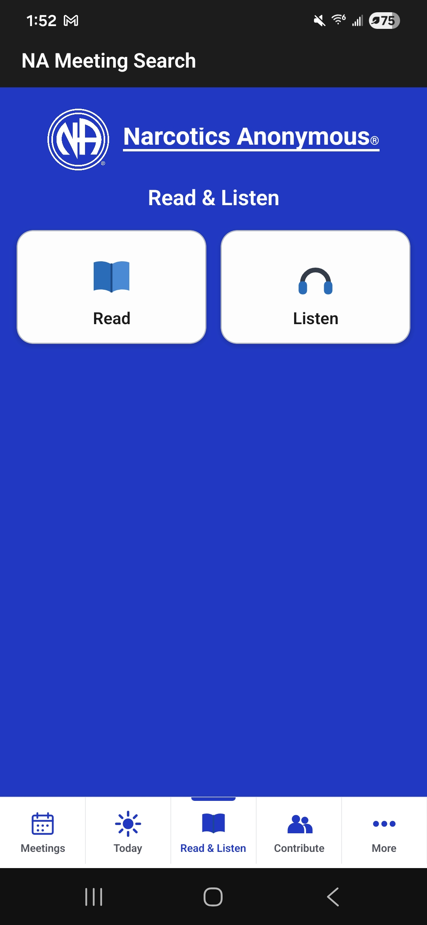
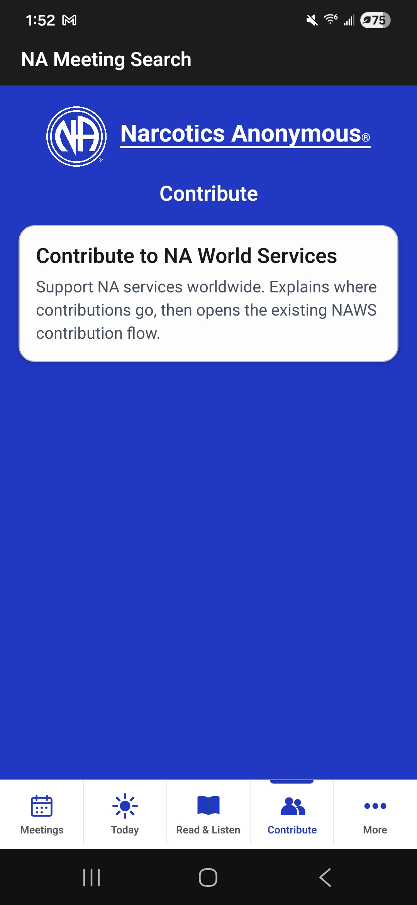
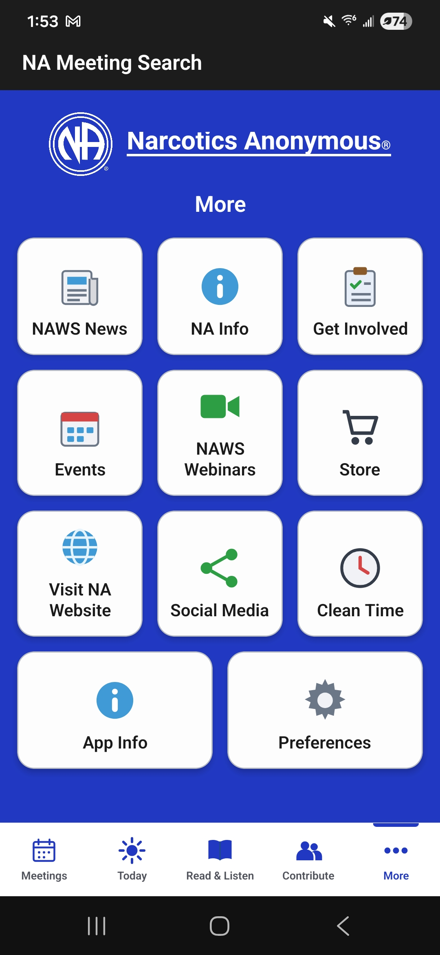
My NA app
Insta: @narcoticsanonymous FB: @naworldservices

Slide 5
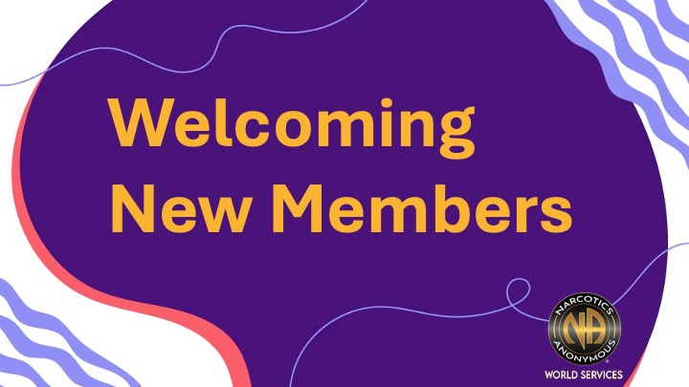

Issue Discussion Topics for 2026–2029
available soon at na.org/IDT
Attracting Members to Service and Mentoring Them
Area Service

Slide 6


Collaborative Plan
Revising A Guide to Local Services in NA and
The Group Booklet (including IP #2, The Group)
Safety and belonging/gender-neutral language
A three-year conference cycle
Collaborative plan can be found at na.org/planning

Slide 7
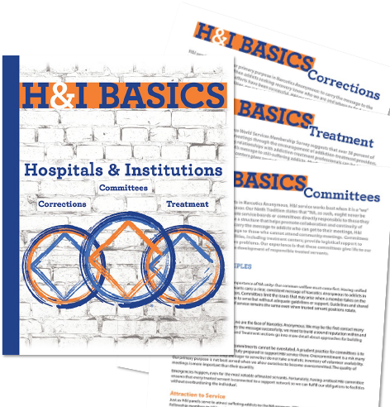


Find at na.org/basics
New NA literature
Read online at na.org/lit
#3121
#2101G

Slide 8
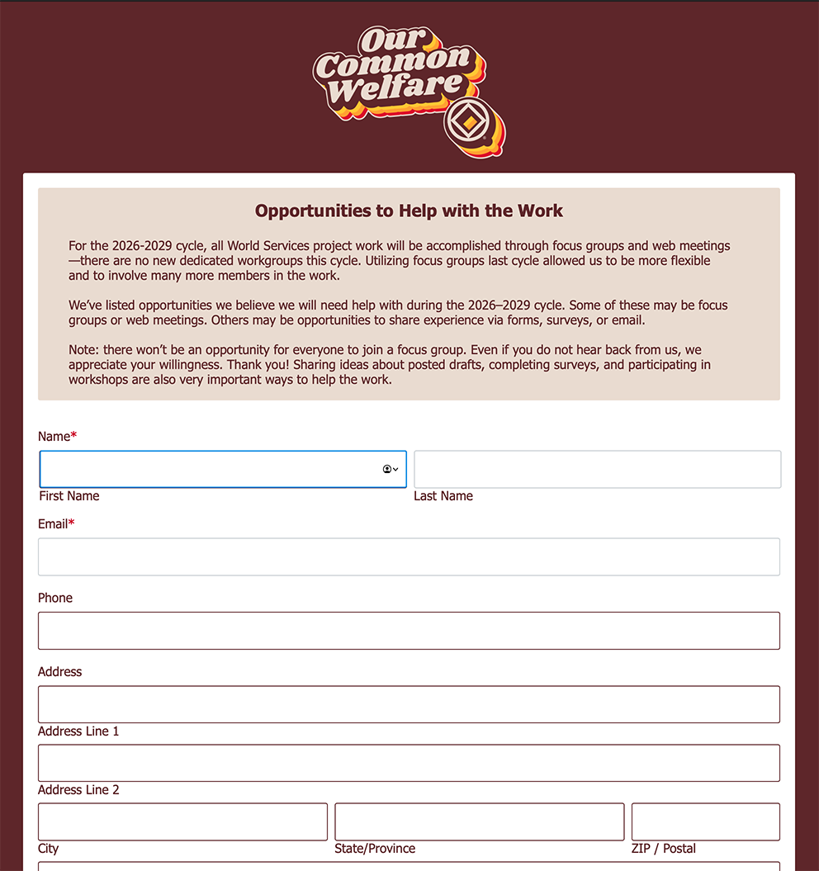

How does the work get done?
na.org/get-involved
na.org/projects
old workgroup method
Focus groups
Surveys
Questionnaires
Other tools

Slide 9
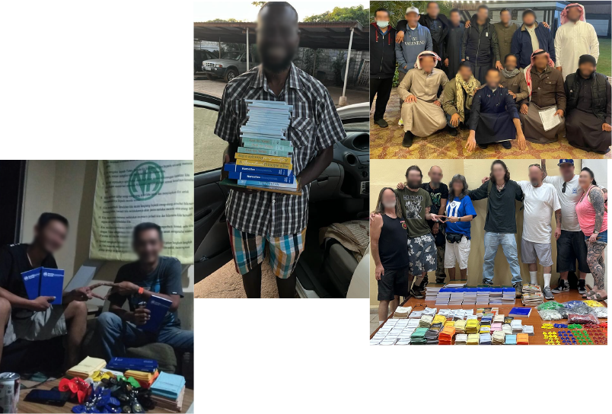
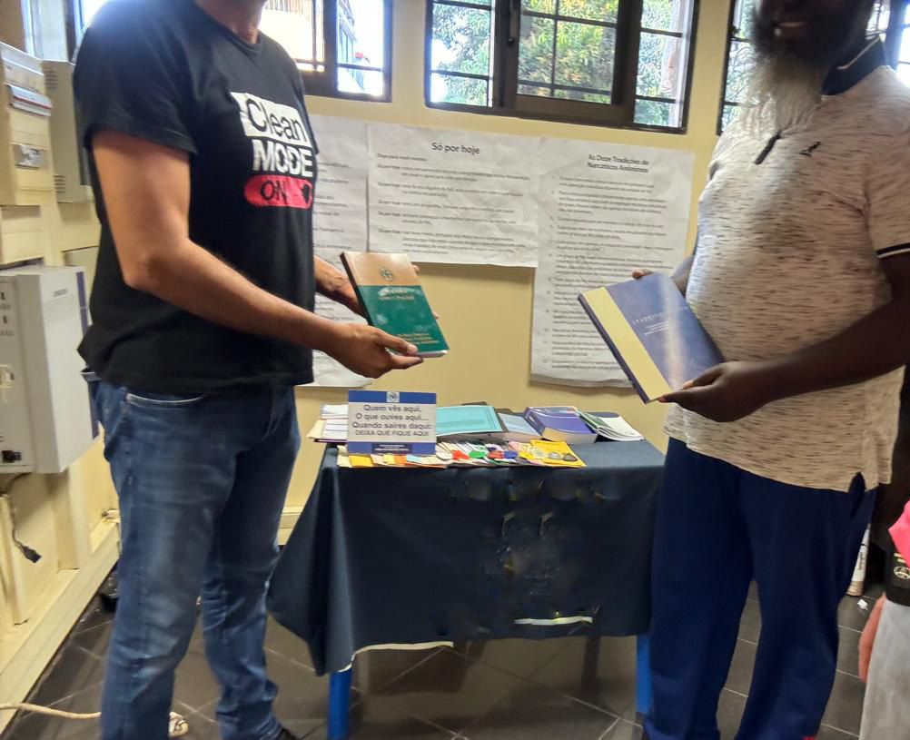
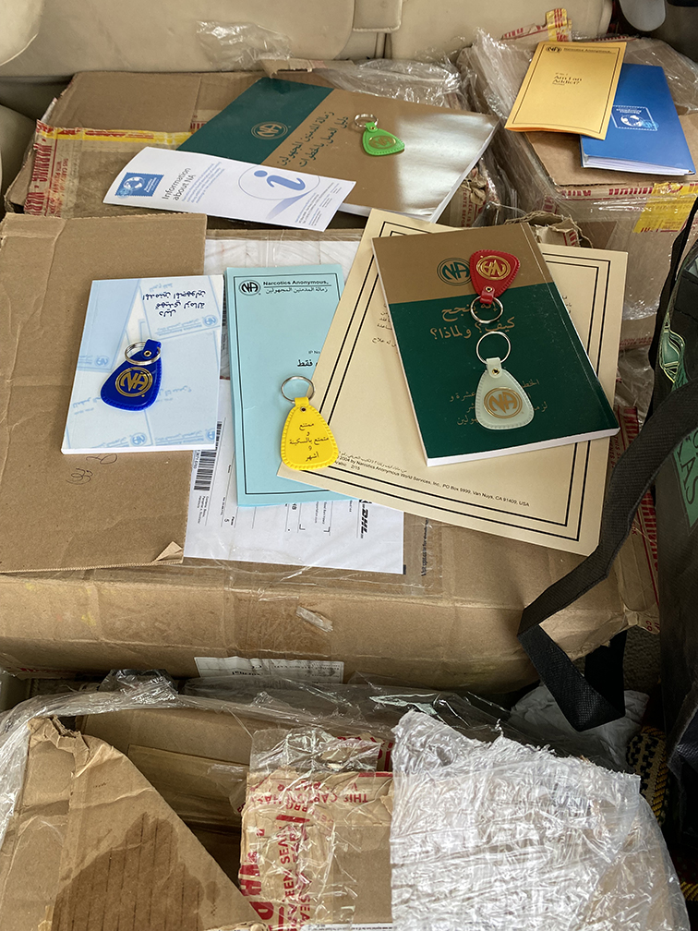
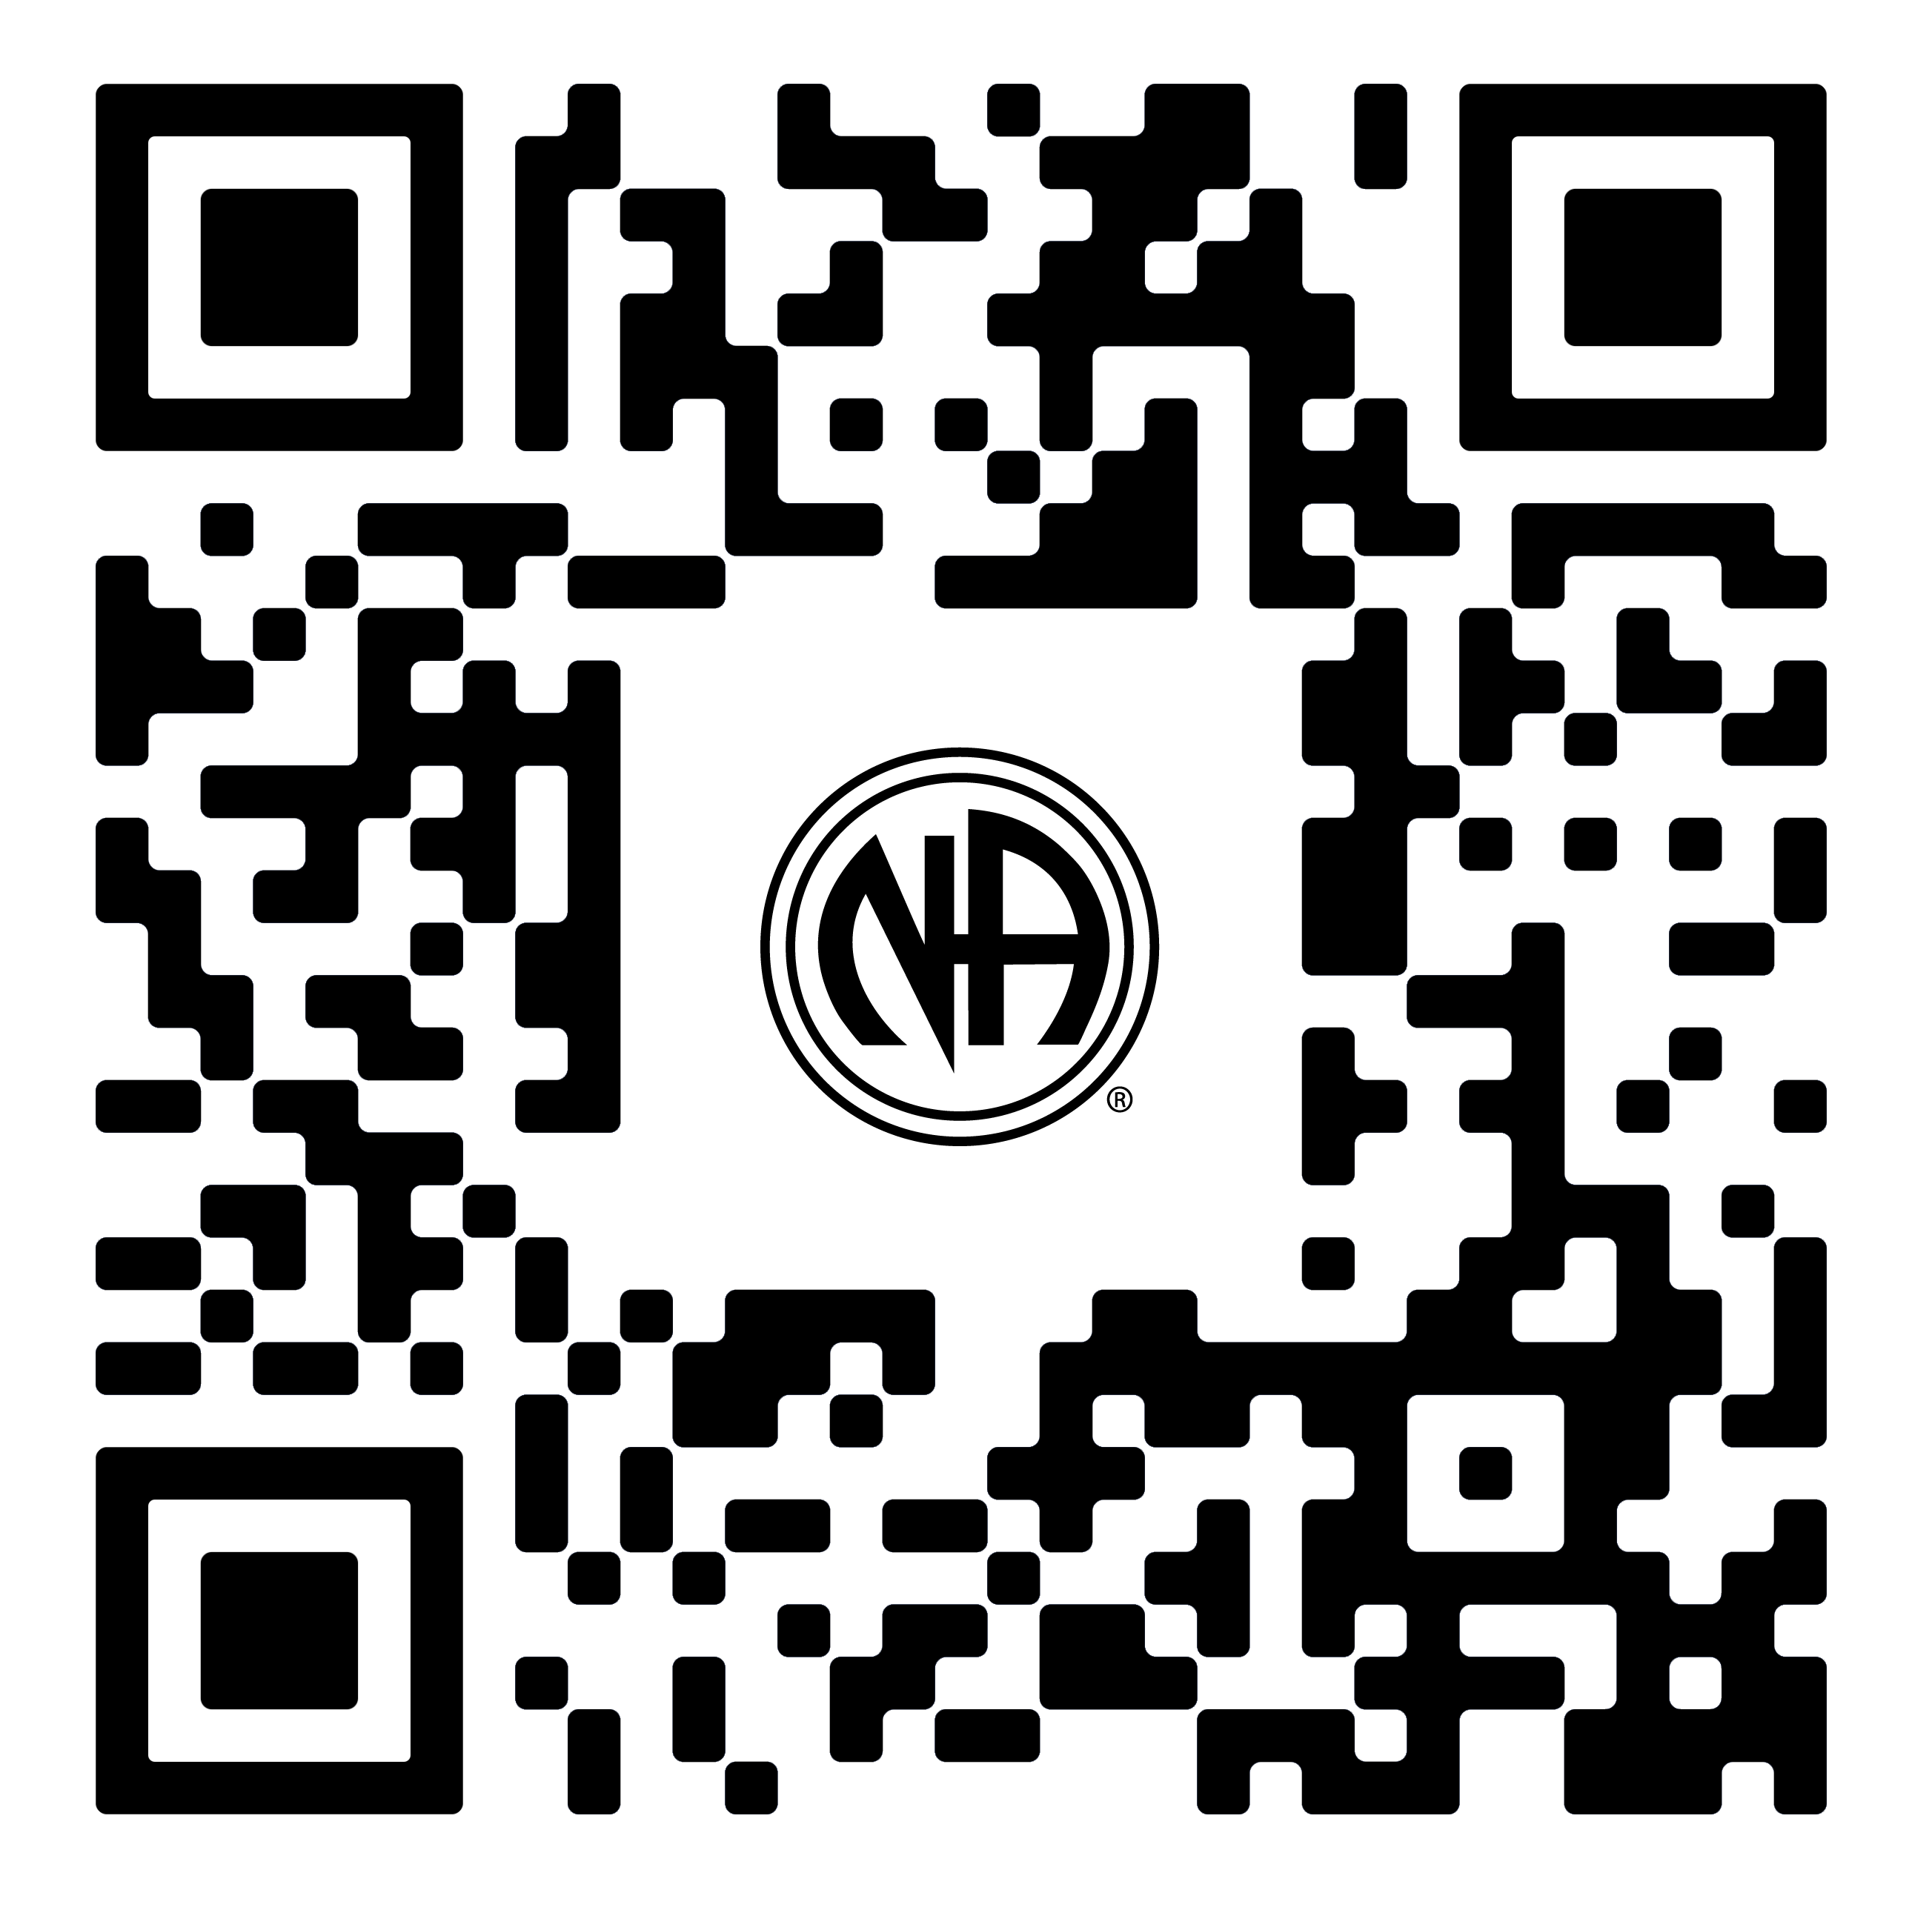
Angola group
Saudia Arabian lit drive
Cuba
Zambian member receiving lit from the Afri-can Zonal Forum lit drive
na.org/contribute
Indonesia

Slide 10




Upcoming Webinars
na.org/webinar

Slide 11

Public Relations:
Why it’s important.

Slide 12
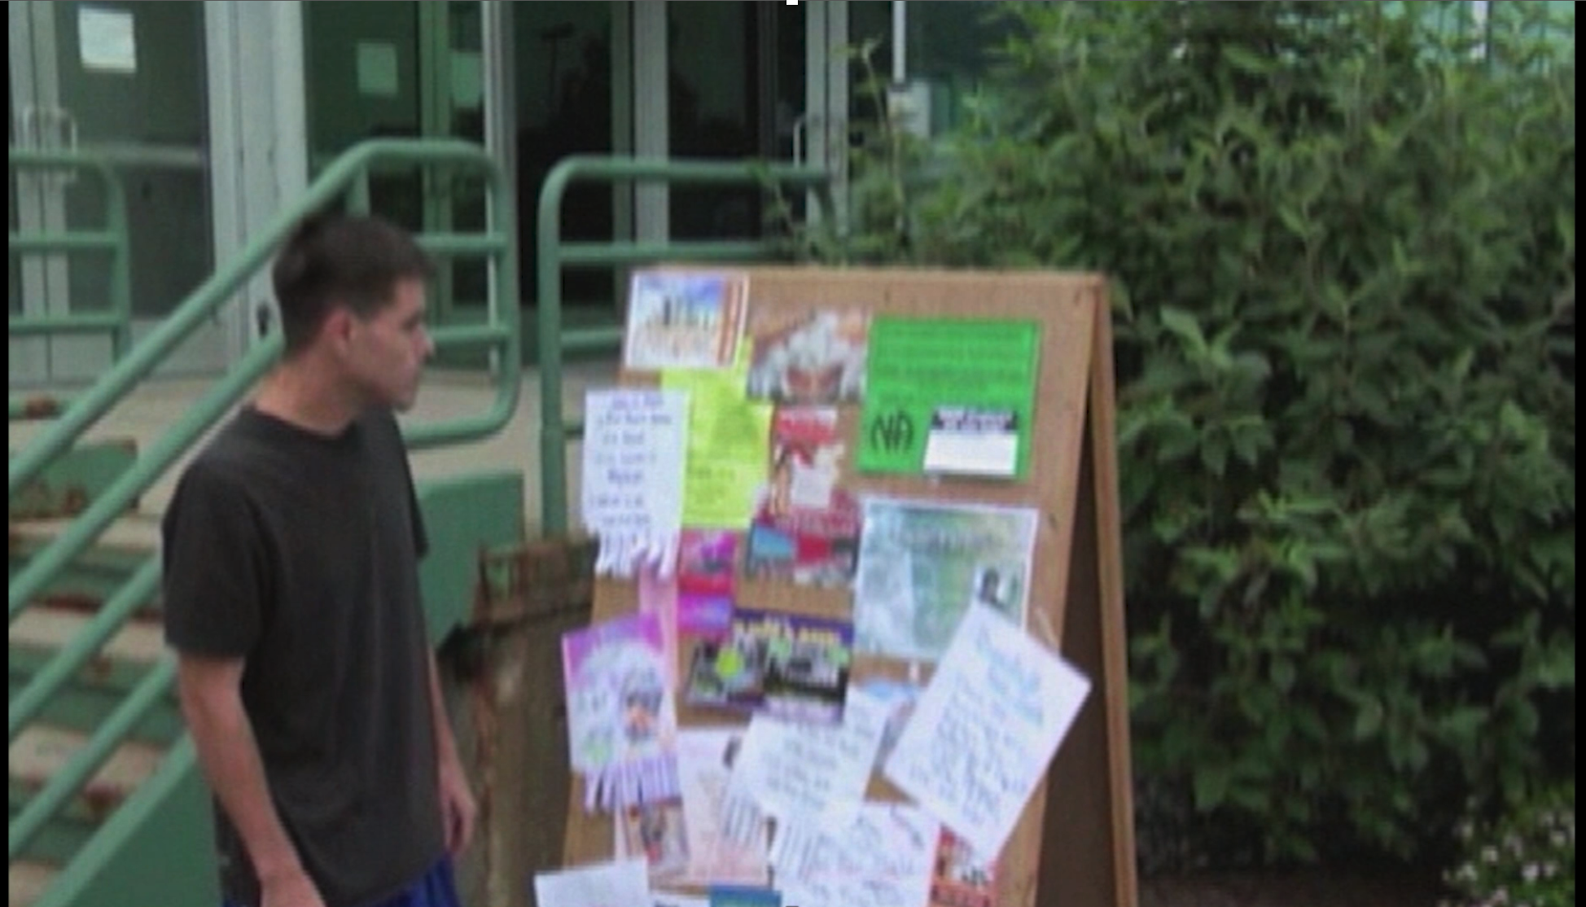
PSA – Ontario, Canada
Notes:
This PSA from the Ontario Region PR is a great example of PR in action at the local level.

Slide 13
Why Should I Care?
“Public relations helps us reach addicts who may not otherwise find Narcotics Anonymous.”
— Public Relations Handbook
Public Relations is Fellowship Development.
“If PR grows, NA grows. If PR stalls, we stagnate.”

Slide 14
Why Should I Care? – The Numbers
Nearly 1 in 5 Regions do not have PR.
82% of Regions reported having a PR Committee.
Active PR more than doubles likelihood of membership growth.
61% of High PR Activity Regions reported growth vs. 27% for Low PR Activity.
Low PR activity more than doubles likelihood of membership decline.
9% of High PR activity regions reported shrinking vs. 20% of Low PR activity
Notes:
Regions were grouped based on signs of active PR work, such as clear descriptions of their efforts and participation in conferences or outreach.

Slide 15
PR - How We Get to Recovery
“We can only keep what we have by giving it away.”
-Basic Text
We are all products of PR.
PR members are the people who make sure
no addict misses the chance to find NA.
If no one did PR in your area… how would the next addict find NA?
Notes:
Little intro before the personal story videos

Slide 16
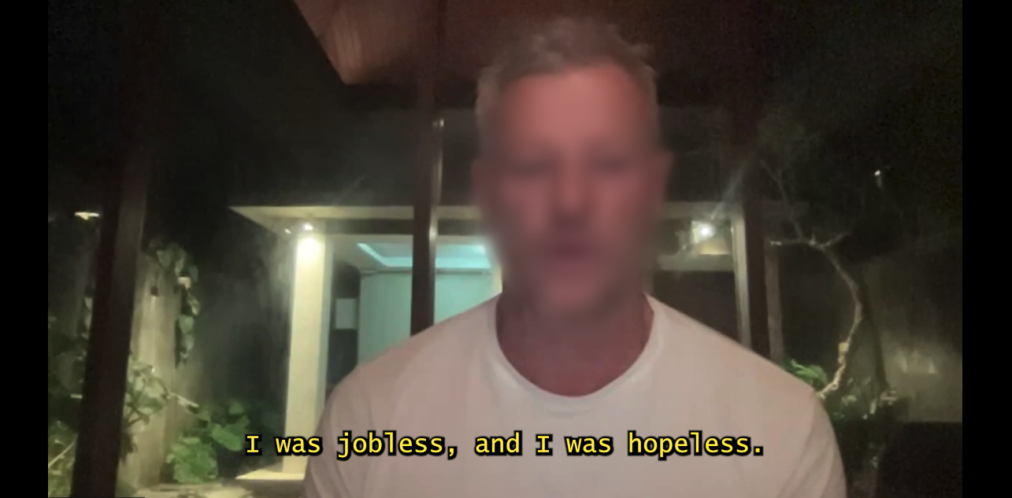
PR Helps You
Personal Stories from the PR Webinar
Notes:
Personal Stories from PR webinar

Slide 17
Fellowship Advantage
“Everything that occurs in the course of NA service must be motivated by the desire to more successfully carry the message.”
- Guiding Principles
We’ve already agreed on what our Primary Purpose is. Now it is time to use Public Relations to achieve that purpose.
PR carries the message of recovery around the world.
Notes:
We have an advantage as a fellowship because we already agreed on our primary purpose. It’s about how.
*4 out 5 regions have PR. That’s strong, but how do we fill in the gap?

Slide 18
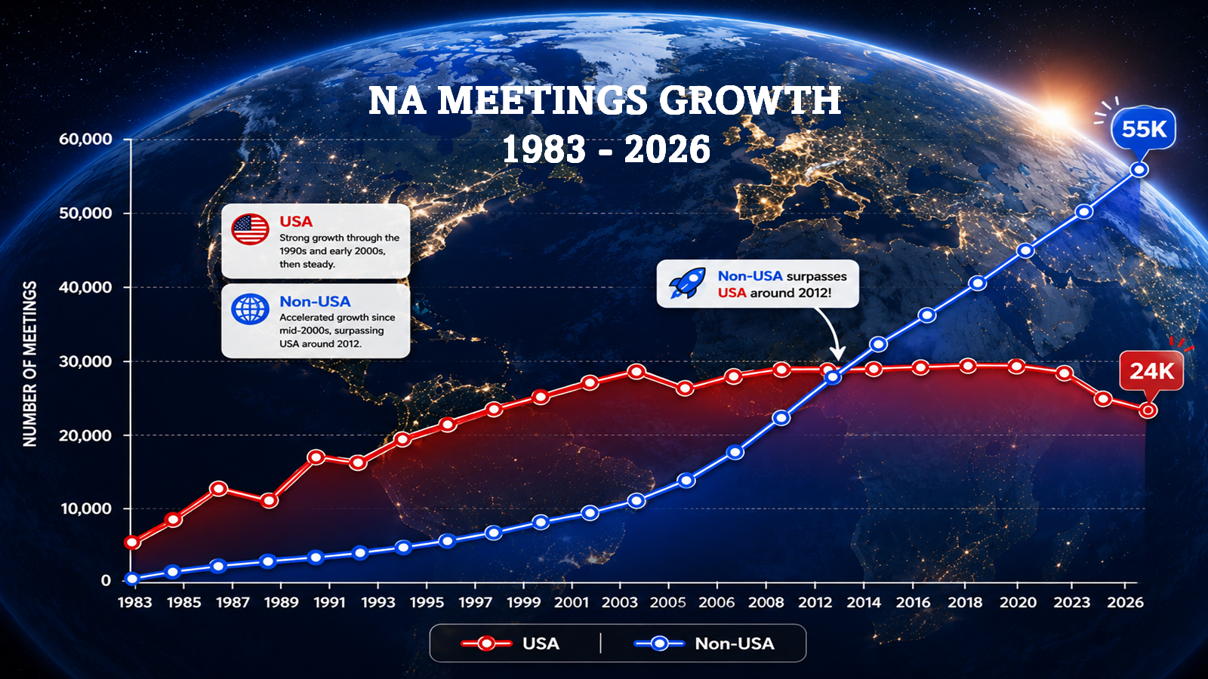

The Opportunity:
Strengthening Participation in the USA
USA
Higher service gaps (49%)
Lower mentorship (14%)
International
Lower Service Gaps (33%)
Higher Mentorship (24%)
Growth in the US has leveled off in recent years.
More emphasis on mentorship and fewer participation gaps outside the US.

Slide 19
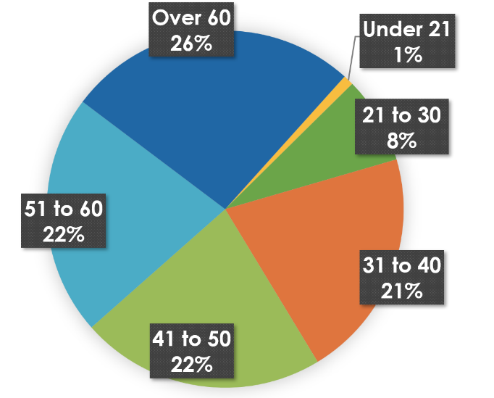
Opportunities: Outreach Gaps
2024 Membership Survey
Influences to Attend First NA Meeting
Age
Under 21 is just 1%, highlighting a huge gap in our reach.
TREATMENT FACILITY/
COUNSELING AGENCY
CRIMINAL JUSTICE SYSTEM
NA SERVICE EFFORT
Notes:
NA Service Effort is only 15%, showing the need for better PR.
Can use Under 21 at 1% as a serious outreach problem?

Slide 20
What’s Working - Events
WCNA Workshops & Unity Day – Key Takeaways
Expanded global PR efforts at WCNA 38
Stronger focus on collaboration (policy, research, communities)
Emphasis on inclusion, language, and member experience
Growing use of social media & digital outreach
PR as a key driver of access to recovery worldwide
Notes:
WCNA Workshops & Unity Day – Key Highlights
WCNA 38 marked a major expansion of PR efforts, with the first comprehensive set of Public Relations workshops bringing together members and professionals to strengthen cooperation and broaden NA’s reach.
Workshops focused on themes such as cooperation with public policy and communities, inclusive practices, effective language, engagement in corrections, and navigating topics like medication and membership.
A central takeaway was the growing importance of collaboration—with government, researchers, and local partners—to increase understanding of NA and expand access to recovery.
Unity Day reinforced these efforts by highlighting global innovation in PR, including increased use of social media and shared learning across international communities.
Overall, the events emphasized that effective PR—grounded in data, relationships, and member experience—is essential to ensuring NA remains accessible and relevant for newcomers worldwide.

Slide 21
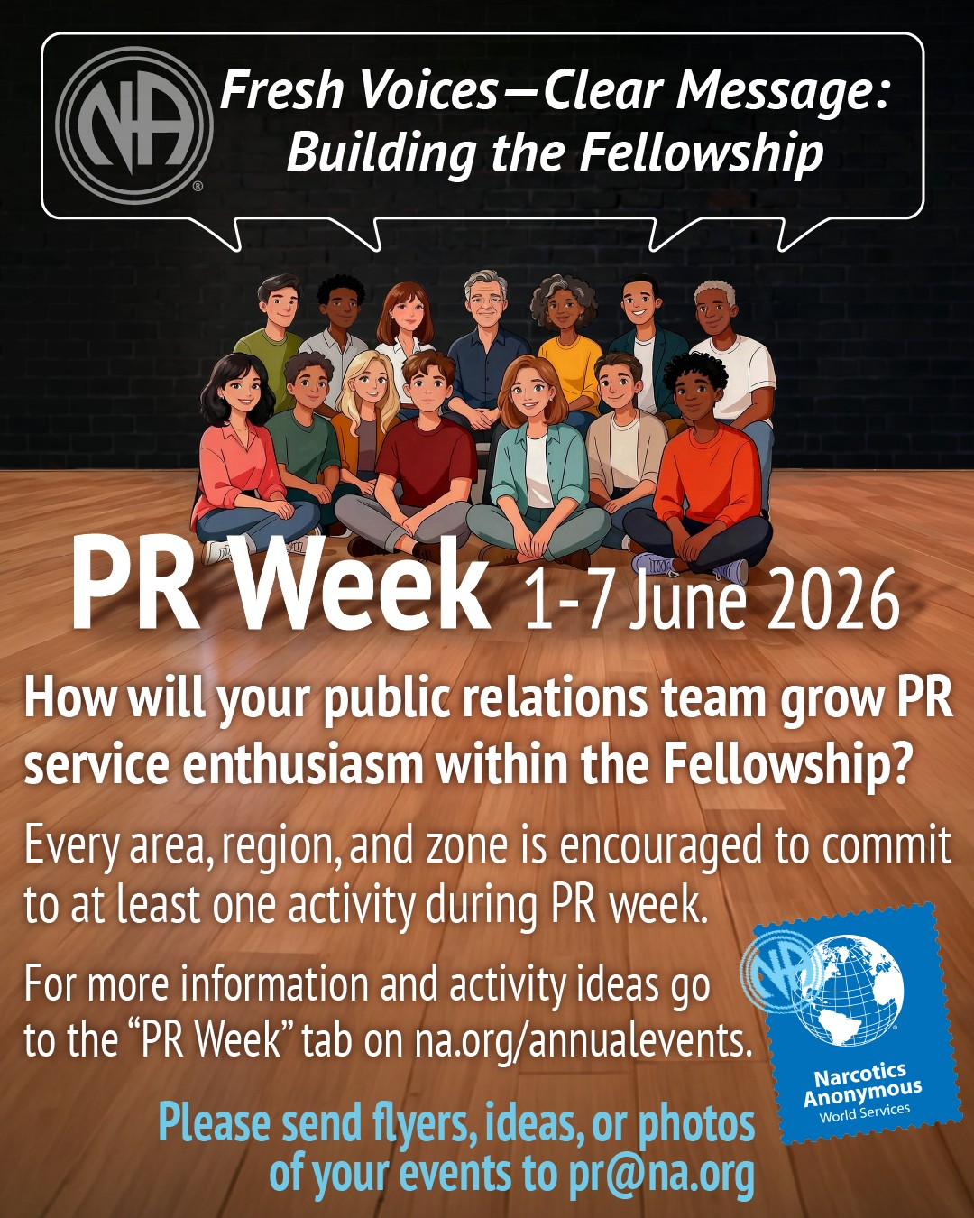
What’s Working - Events
PR Week – New Theme
June 1-7, 2026
Fresh Voices - Clear Message: Building the Fellowship
New suggested activities for PR week:
Hold learning days that feature PR mentorship.
Training events for new PR members.
Develop a video series of member stories on how PR service has had a positive impact on personal recovery.
Next PR Week June 6-12, 2027
Notes:
Not just about external PR, it’s about growing the Fellowship and increasing service.
Hold learning days that feature PR mentorship.
Training events for new PR members
Develop a series of member stories on how PR service has had a positive impact on personal recovery.

Slide 22
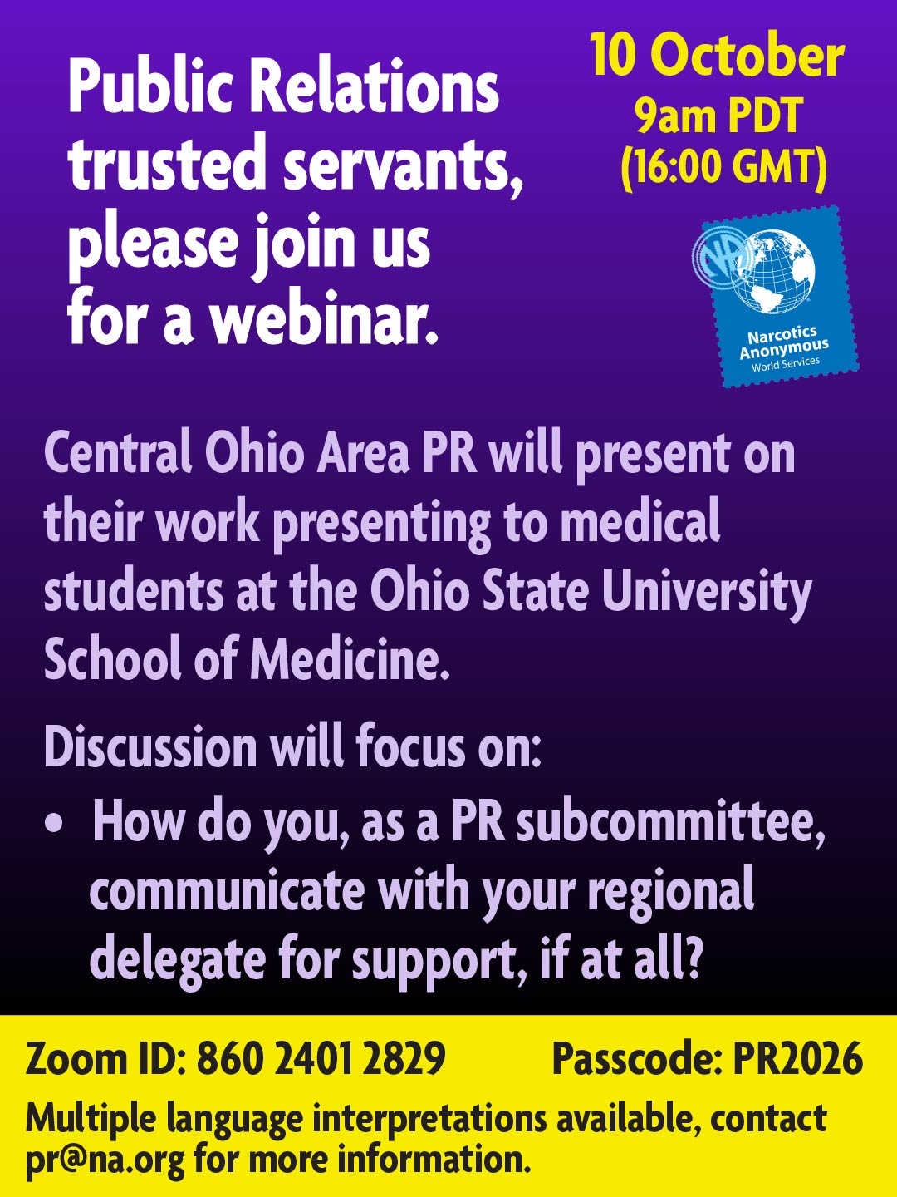

What’s Working – PR Outreach
Of those regions that reported emphasizing professional outreach, 62% reported growth.
Expanding PR in LAZF – going to Dominican Republic professional conference
Central Ohio PR – Presenting to the Ohio State University College of Medicine
Notes:
Examples from PR webinar presentations that show what is working for PR.

Slide 23
What’s Working – Digital Reach
Tremendous success with Social Media
Spain – Reaching more professionals
Russia – Dispelling myths and finding newcomers on YouTube
Brazil – Over 60,000 followers on Instagram

Slide 24

What’s Working – Digital Reach
Spain and Russia Region PR on their success.

Slide 25
Awareness and Engagement
The Barriers
I’m not qualified to do PR.
Let’s create new tools to simplify it.
PR in a Box:
Simple to use tools and training materials.
PR is scary.
Get help and experience from other members.
PR Week, Webinars, Personal Stories, Mentorship
Notes:
Area motivation: ownership mindset, can we reach H&I level of passion?
Generate enthusiasm through personal stories, PR week, webinar engagement, to name a few.
PR in a box: Built from PR basics and handbook.

Slide 26

Raising Public Awareness
“PR helps to build ongoing relationships with the people and institutions that help NA to be recognized and welcomed…”
-Guiding Principles
Four Pillars
Addiction Treatment
Medical Community
General Public
Government
The Tools
Updated Professional Presentations (early cycle)
Multimedia Content (mid cycle)
Audience-specific Toolkits (mid cycle)
Notes:
Tailored Powerpoints for each audience
Social Media video series, like Mythbusters
Set of materials that local bodies may select from based on needs.

Slide 27
Take Action
NAWS Supports PR - We are committed to building these tools with the fellowship—not simply presenting them to the fellowship.
Grow PR Service - We can remove the barrier that says, "I'm not cut out for PR," by making PR more accessible, practical, and welcoming.
Strengthen PR at the Area Level - Strong fellowship development begins with strong area-level PR. Expanding PR service locally is one of our greatest opportunities.
Build the Leadership Pipeline - Mentorship and leadership development are essential to long-term success. Together, we can strengthen the path from Region → Area → Group and inspire the next generation of PR trusted servants.
Notes:
#2 We know the stats for Regional PR, but what about the truly local level?

Slide 28
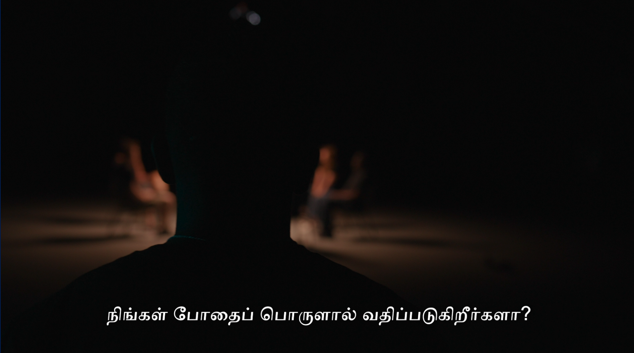
PSA – NA Malaysia
Notes:
Opening PSA to get their attention.

Slide 29
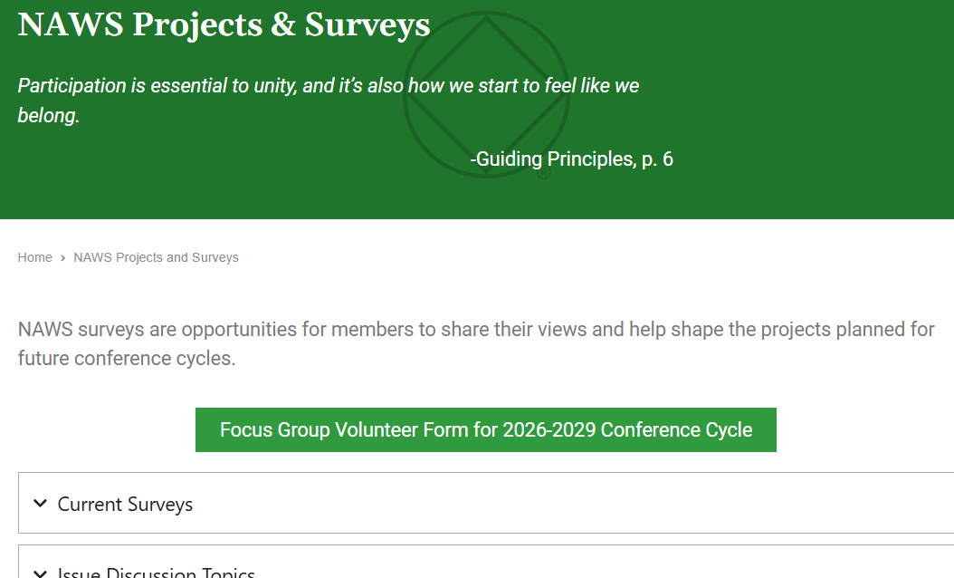
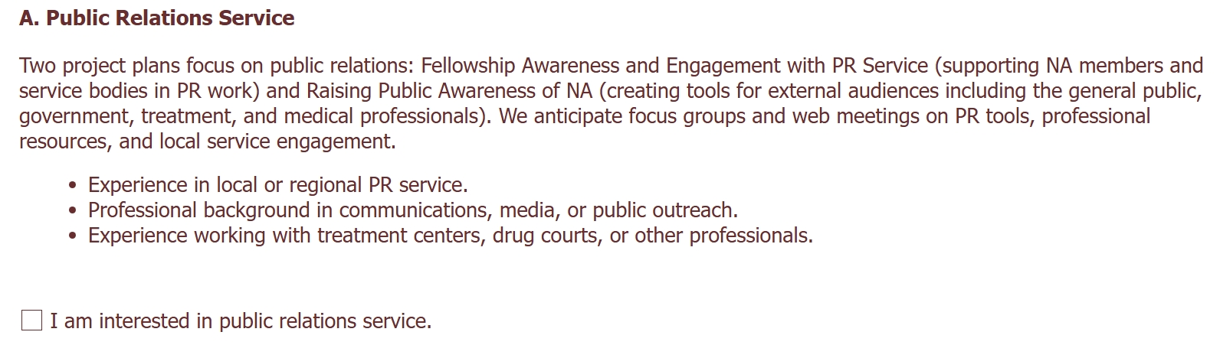
Volunteer Form
na.org/get-involved

Slide 30
Closing
“Each of us shares responsibility for our Fellowship.” – Guiding Principles
Take one thing back.
Start one conversation.
Build one PR effort.
That’s how we grow.
Notes:
Take one thing back to your region. Start one conversation. Build one PR effort. That’s how this grows.
Explain outward facing PR

Slide 31
Contacting NAWS PR
PR@na.org
Notes:
May wish to add local contact information

Slide 32

WCNA 39
Dublin, Ireland
Summer 2028
na.org/subscribe

Slide 33
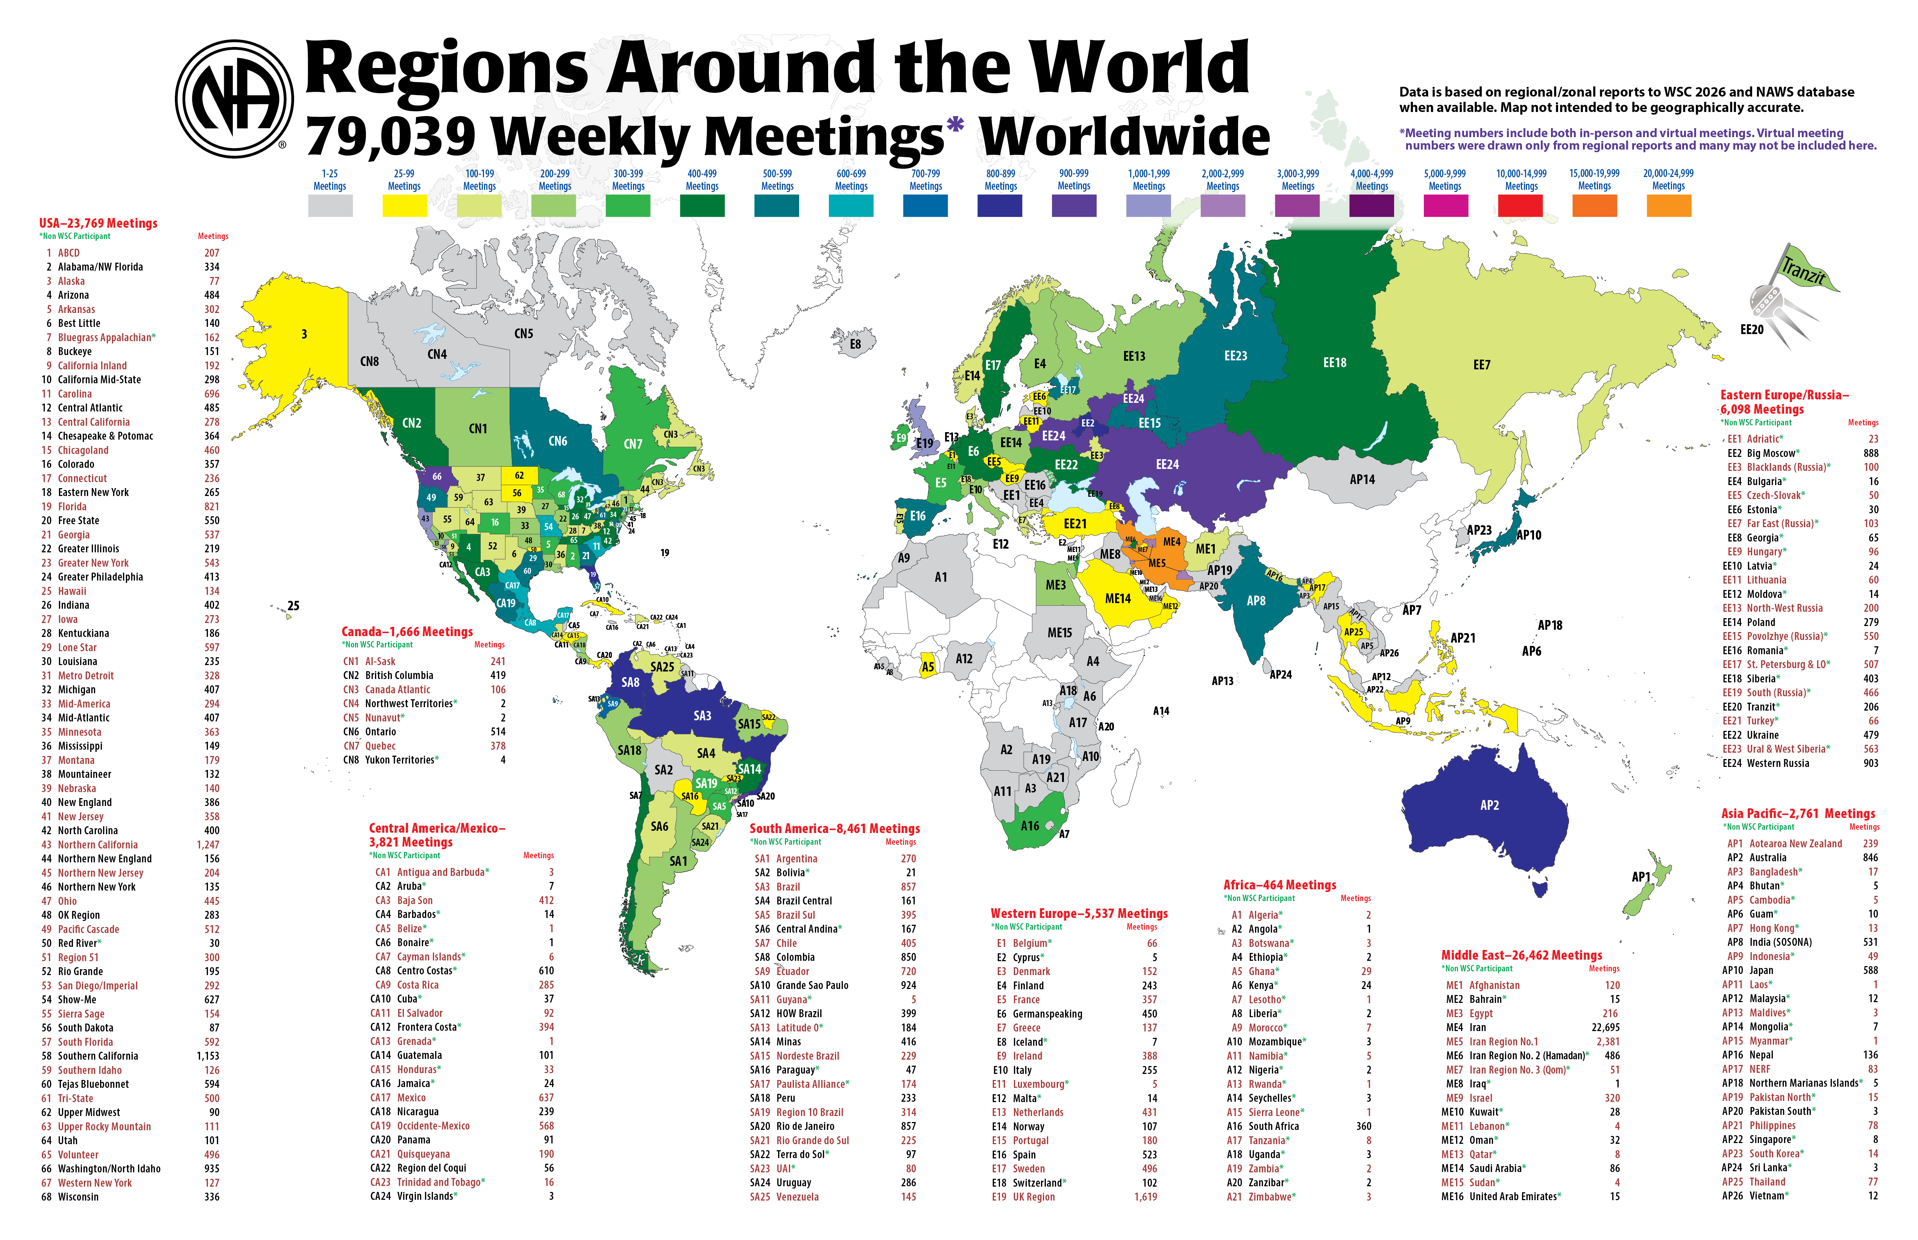

Slide 34
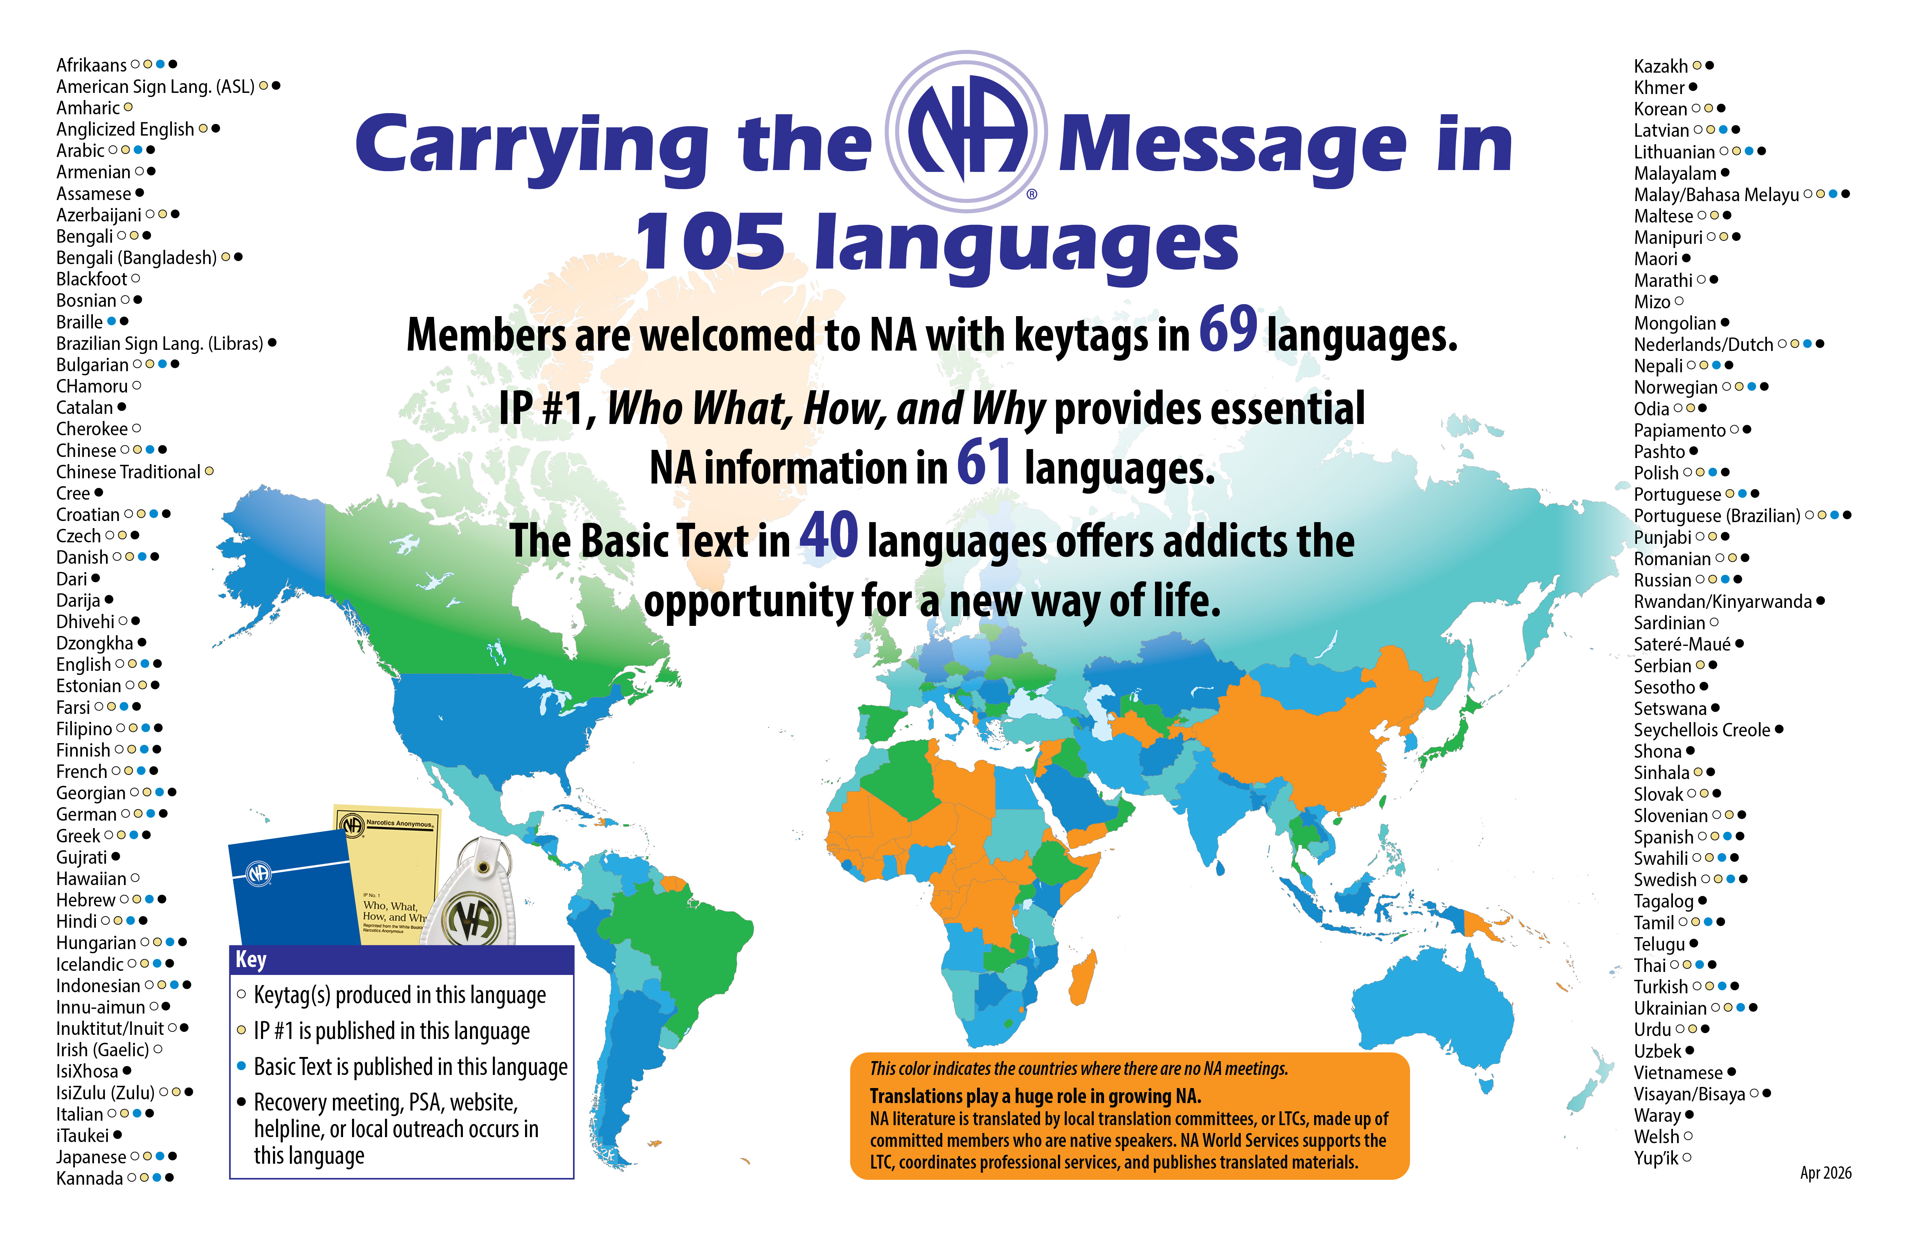
na.org/maps

Slide 35


We now publish our Basic Text
in 42 different languages!!
Azerbaijan
Slovenian
Ukrainian

Slide 36
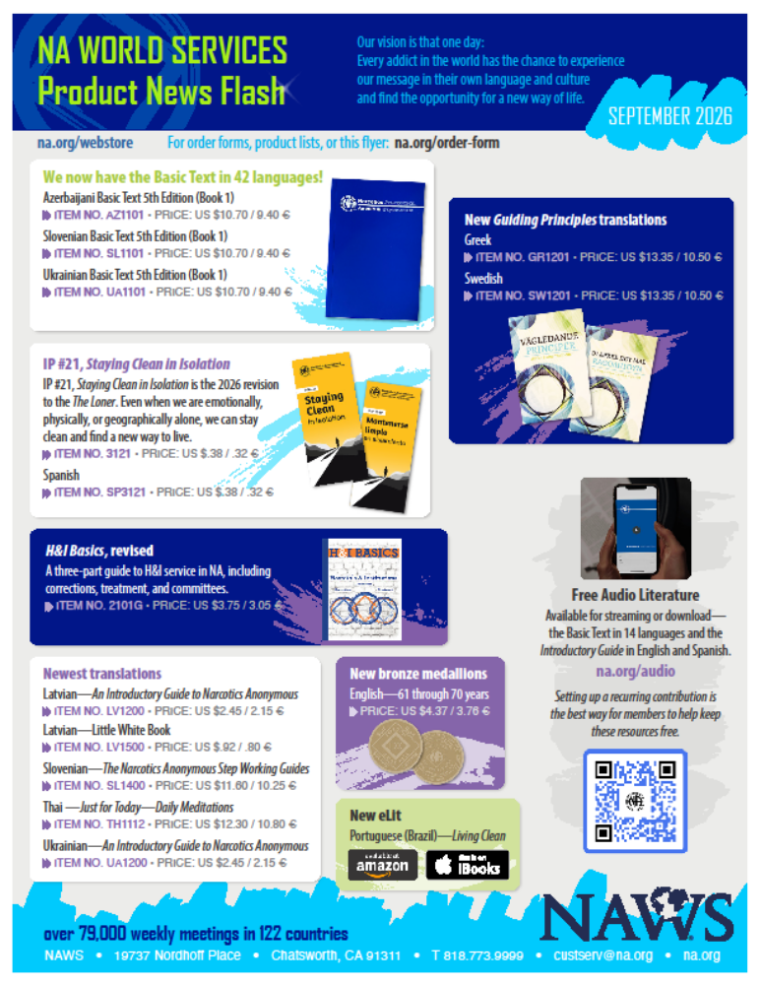
September 2026 NAWS Product News Flash
Available via the link on the Online Store webpage of na.org

Slide 37

Moment of Silence
To reflect on our global Fellowship and the primary purpose we all share.

Slide 38

God, grant us the serenity to
ACCEPT
the things we cannot change, the
COURAGE
to change the things we can, and the
WISDOM
to know the difference.

