Slide 1





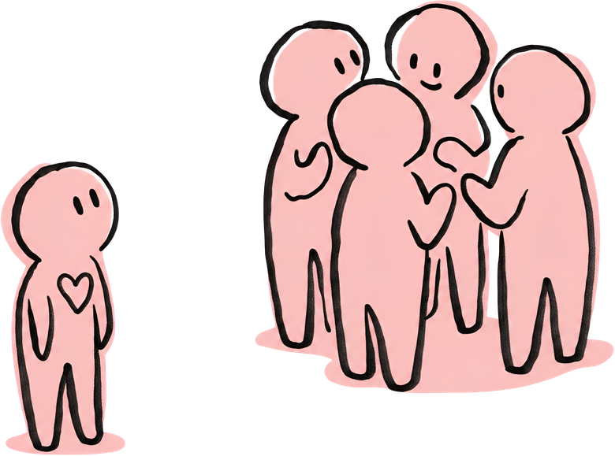


FROM THE DOORWAY
TO SERVICE:
CREATING BELONGING IN NA
Notes:
Many of the conversations at WSC 2026 went beyond the conference motions themselves. Conference participants spent significant time discussing new ideas that may shape future recovery literature, service tools, and Issue Discussion Topics (IDTs). These discussions reflect the challenges and opportunities across the fellowship and may influence the direction of NA over the coming conference cycles.
Today's workshop brings some of those discussions to the EDM. Our goal is not to make decisions or develop a single position, but to share our collective experience, learn from one another, and contribute ideas that may help shape future work.
This workshop explores how we create an atmosphere where members not only stay, but grow—from their first meeting to becoming trusted servants. Welcoming newcomers, supporting members who feel different or disconnected, mentoring future leaders, and making service meaningful are all parts of the same journey.
This approach moves beyond "How do we greet newcomers?" and into "How do we create a culture of belonging?"

Slide 2
Think about a time in NA when you truly felt that you belonged.
What made the difference?
Notes:
Think back to a moment in NA when you genuinely felt a sense of belonging.
What was it that made this experience stand out to you?
[let the audience reflect for a few moments.]
Now, I’d like you to turn to the person sitting next to you and share your thoughts about that experience.
[Tell the audience to talk to each other for a couple of minutes.]
Would anyone like to share what they discussed?
[Encourage audience participation by asking for a few volunteers to share their answers.]

Slide 3
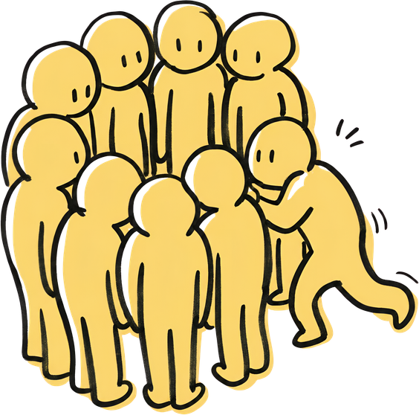
Belonging:
The Bridge Between Recovery and Service
When members experience belonging, they are more likely to:
  Keep coming back
  Find identification in the group
  Build relationships within their group
  Become trusted servants
  Help others feel welcome

Slide 4
Small Group Discussion
How can we create that culture intentionally?

Slide 5

Small group #1
1
2
3
What actions — not just words — help newcomers feel welcome?
How do we welcome members who may feel different because of age, gender, culture, language, disability, recovery pathway, or other experiences?
How can we make belonging visible in the way we hold meetings, do service, and treat each other before and after the meeting?

Slide 6
Small group #2
1
2
3
What makes service feel inviting and meaningful?
What makes service feel intimidating, exclusive, or difficult to access?
Have you ever been mentored in service, how was that? What made that experience effective?

Slide 7
Small group #3
1
2
3
What service opportunities are accessible to members with limited clean time, limited confidence, or limited experience?
How can we help members discover that service is part of recovery rather than something separate from it?
How can we create a culture where asking questions, making mistakes, and learning by doing are accepted parts of service?

Slide 8
Large group summary
Summarize the main points from your discussion. What is the most important takeaway?

Slide 9

Five Years From Now
Imagine that NA has become a place where more members feel welcomed, valued, and able to participate.
What changes would we see in our groups, areas, and regions?
Notes:
[let the audience reflect for a few moments.]
Now, I’d like you to turn to the person sitting next to you and share your thoughts about that experience.
[Tell the audience to talk to each other for a couple of minutes.]
Would anyone like to share what they discussed?
[Encourage audience participation by asking for a few volunteers to share their answers.]

Slide 10

Thank you!
Please feel free to send your input to zd@edmna.org
Zonal delegates & Fellowship Development

