Slide 1
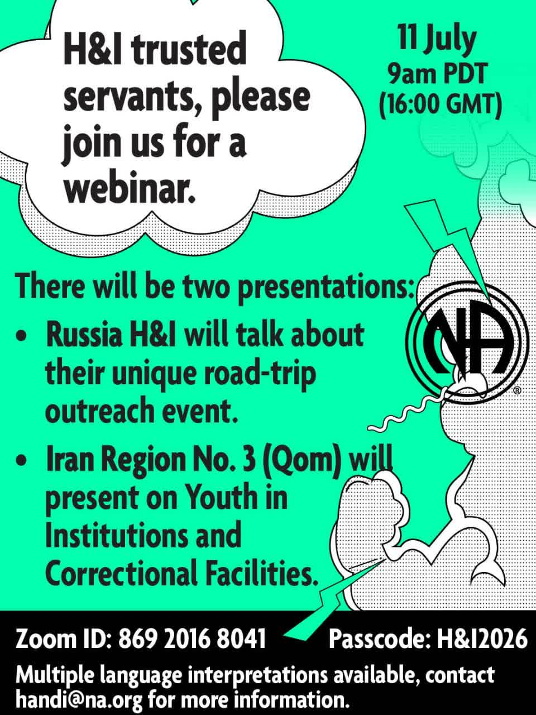

Youth Workshop in Correctional and Rehabilitation Institutions
Presented during the NA World Services H&I Webinar
Iran Region 3 – Qom
July 2026

Slide 2

Youth and Addiction Statistics
45% of newcomers in Iran Region 3 during 2024 were young people
60% of individuals admitted to treatment centers in Iran Region3 were young people.
According to the 2024 NA World Membership Survey, young people represent 29% of the Fellowship's membership.
The World Health Organization (WHO) has reported a 26% increase in the youth population compared with previous estimates.

Slide 3
What feelings do young people in treatment facilities commonly experience?
Every young person is unique, and each individual's circumstances are different. Feelings can be complex and may change over time. However, young people in treatment facilities may experience a wide range of emotions, including:
Fear and Anxiety: Concern about treatment, the early stages of recovery, or being judged by others
. Anger and Frustration: They may feel angry about their circumstances or frustrated with themselves or others.
Shame and Guilt: Feelings of shame about past behaviors or guilt over the harm they believe they have caused themselves or others.
Hopelessness and Depression: Feelings of helplessness or discouragement about the future.
Hope: Some may begin to feel hopeful that recovery can help them build a better life.
Loneliness: Feeling disconnected from family, friends, or the community.

Slide 4
How Can We Connect Effectively with Young People?
Recovery Is Equal for Everyone
Avoid a Parental or Lecturing Tone
Respect Their Ability to Think and Make Their Own Decisions
Avoid Stereotypes and Assumptions
Show Empathy for Their Challenges
Give Them the Opportunity to Share Their Experience
Focus on the Present and the Future
Avoid Moral Judgment
Keep the Message Simple and Clear
Use Practical, Relatable Examples
Respect Confidentiality
Never Pressure Anyone to Join NA
Cooperate with Facility Staff

Slide 5
Example of an Effective Conversation
with a Young Person
❌ Less Effective:
"You're young. You have your whole life ahead of you. Why did you let this happen to yourself? You just need to be stronger."
✅ More Effective:
"Hi, I'm [member's first name]. I know this may be a difficult time, and you may not believe it right now, but I've felt many of the same things you're feeling. I just want you to know that there is a way to recover and that things can get better. If you'd like, I'd be happy to share a little of my own experience. If not, that's perfectly okay."
Closing Thought:
When an H&I member approaches a young person with honesty, kindness, and no expectations or demands, that presence alone can plant a seed of hope—even if the young person says nothing.

Slide 6

Iran Region 3 H&I Committee – Qom
Thank you for your attention
na.qom.iran@gmail.com
989926504083+

