Slide 1

Financial matters
and Treasury guidance in NA

Slide 2
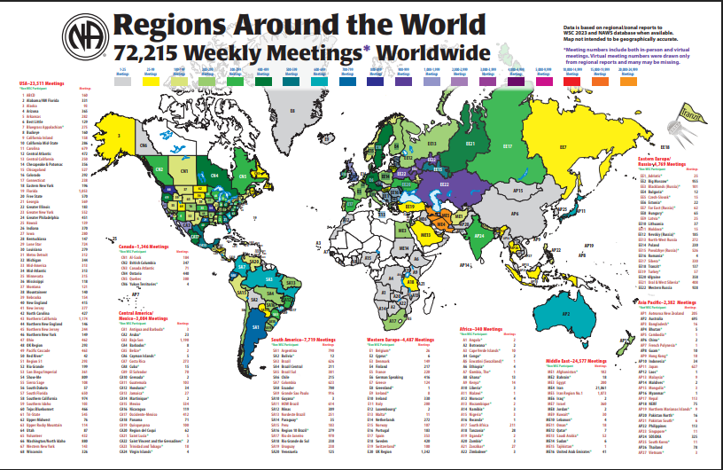
Excerpted from:
Fourteen World Service pamphlets and service publications, compiled and translated by Iran Region Three.

Slide 3

As a Fellowship, we value the many opportunities we have to practice the principle of self-support. Providing members with various ways to give back what they have received benefits not only the individual member, but also the addict who has not yet arrived. Obviously, one of the ways we give back is through the basket; however, by opening additional avenues for receiving contributions, we can increase members’ opportunities to give.

Slide 4
NA funds should be used to further our primary purpose in the following ways:
• Holding recovery meetings
• Providing public information
• Reaching addicts who are unable to come to NA
• Producing, translating, and distributing the written message
• Bringing our members together in a committed service community
• Maintaining websites and telephone helplines that connect newcomers with us
• Developing all NA activities, such as training and education efforts

Slide 5

Common methods of funding in NA include:
• Passing the basket at recovery meetings and forwarding any surplus contributions to service bodies;
• Establishing electronic bank accounts by service bodies to allow members to make direct contributions;
• Generating income through the production and sale of Fellowship publications and events.

Slide 6
Challenges Related to Money and Treasury
1
4
Legal issues (such as taxation and related matters)
Foresight and long‑term planning
2
Spiritual and legal safeguards
5
Accepting money from non‑addicts and outside institutions
Bank statements and receipts that are unclear or difficult for NA members to understand
Income derived from interest earned on bank accounts or from outside activities (such as online applications, YouTube, raffles, or other media platforms)
3
6

Slide 7

Guidelines for Treasurers
• Sustained clean time and stable recovery
• Opening a bank account specifically for NA funds, with two or three trusted servants as authorized co‑signers
• Having two people count the money and prepare daily financial reports
• Uploading and archiving treasury records and financial documents for transparency and member access
• Not borrowing from NA funds
• Not spending group funds without consultation or a group conscience decision
• Not accumulating excess group funds
• When paying obligations such as rent or contributions, promptly providing documentation or receipts to the recipient
• Preparing financial statements, balance sheets, and future budgets
• Responsible spending by trusted servants, with clear prioritization

Slide 8


thank you

