Slide 1

Narcotics
Anonymous
A Vital Community Resource

Slide 2
Origin of our name – Why “Narcotics?”
Commonly used for all illegal substances at the time of our inception in 1953
NA is not a drug-specific program but has universal appeal to all who share the disease of addiction

Slide 3
Historical Background
Adapted from AA; regular NA meetings started in Los Angeles, CA in 1953
Explosive growth coincided with publishing of the book Narcotics Anonymous, in 1983
As of April 2024, there are over 72,200 meetings in 143 countries

Slide 4

What is NA?
A Vital Resource
Therapeutic value of one addict helping another — support network
Process for change through the Twelve Steps
Adjunct to treatment professionals in continuing care

Slide 5
The NA Meeting
Primary vehicle for delivering the NA message of recovery
2 or more NA members gathering constitute a meeting
Meetings promote atmosphere of recovery from drug dependence
Members often share their personal experiences with addiction and recovery
Experienced older members support newer members
NA meetings are self supporting by those who choose to contribute (no fees)
Guidelines of how to conduct an NA meeting are available

Slide 6
The NA Meeting
Primary vehicle for delivering the NA message of recovery
NA meetings provide an environment within which people can help one another stop using drugs and
learn to live drug free

Slide 7
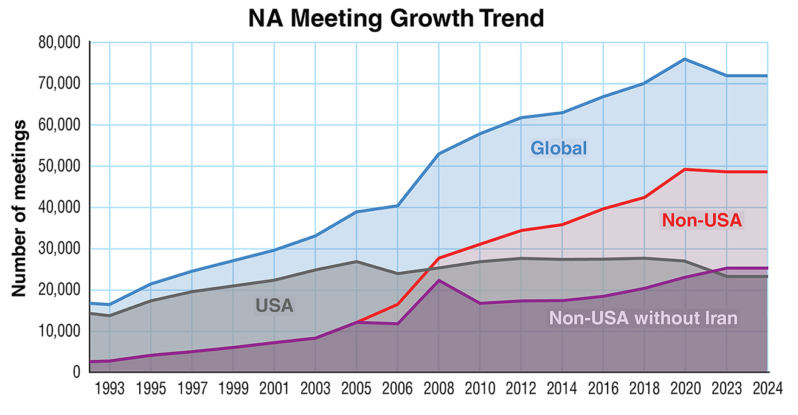
Notes:
NAWS serves the global NA Fellowship, as the meeting data represented on this graph demonstrates. The top line above the blue shows the trend for all of NA. The good news is that we are growing.

Slide 9
Cultural Adaptability of NA
Long Term NA Communities: Indian subcontinent, Japan, Western Europe, Latin America, Middle East
Recent Growth: Asia-Pacific, Eastern Europe and Africa
Publish NA literature in 61 languages and meetings held in 143 countries

Slide 10
2024 Membership Survey
Initiated in 1996
61% rated first NA meeting Important or
Very Important
Top three influences to attend first NA meeting:
  Another NA member
  Treatment / counseling agency
  Family
Members surveyed averaged 2.9 in person and 2.69 online meetings per week

Slide 11
Gender

Slide 12
Age
21–30 increased by 6%;
31–40 increased by 4%;
41–50 decreased by 2%;
51–60 increase by 3%;
Over 60 increased by 15%.
(Numbers reflect increases from 2018-2024)

Slide 13
Employment Status
From 2018-2024:
Homemaker increased by 2%; Unemployed increased by 2%; Part Time increased by 3%; Retired increased by 5%;
and Full Time decreased by 7% (with Iran; without Iran 6%).

Slide 14
Years Drug-Free
Average Years Drug-Free 2024: 13.8
Average Years Drug-Free 2018: 11.4

Slide 15
Areas of Improvement

Slide 16
Cooperating with Professionals
Welcoming your clients to meetings
Presentations to professionals and clients
Printed material, audio-visual, helplines, websites
Subscription to NA newsletters and literature useful for client introduction to NA
There is no charge or fee to attend NA recovery meetings or for NA presentations

Slide 17
Benefits to…
The Client:
  Assists with transition back into the community
  Can support clients while in treatment and correctional facilities
  Provides a peer-based support network
  Drug-free role model reinforcement
The Professional:
  Research indicates: improves retention
  Immediate access to aftercare support

Slide 18

NA Literature na.org/literature
Notes:
Literature – printed tool to reaffirm or transmit key core principles.

Slide 19


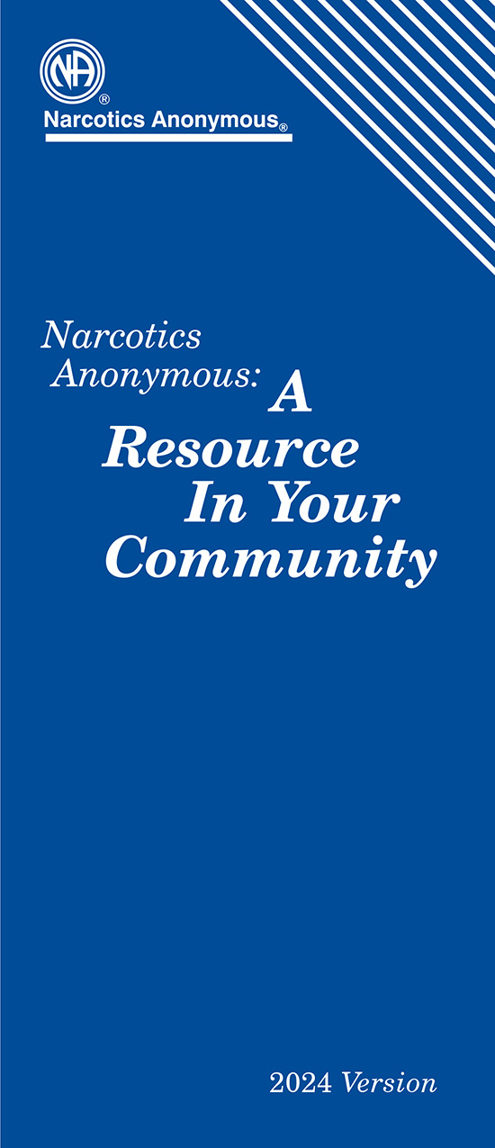

Additional Resources
na.org/resources-for-professionals
  Membership Survey
  Information about NA
  NA: A Resource in Your Community
  NA and Person’s Receiving MAT

Slide 20
Contacting NA
NA World Services
P.O. Box 9999
Van Nuys, CA 91409
Website: na.org
Phone: 818.773.9999
facebook.com/naworldservices
instagram.com/narcoticsanonymous
Notes:
May wish to add local contact information

