Slide 1

PowerPoint 2 of 6
2026 Conference Agenda Report
Motions
For a complete copy of the 2026 Conference Agenda Report, scan the QR Code or visit: www. na.org/conference
Notes:
This is the second of six PowerPoints covering material in the 2026 Conference Agenda Report (or CAR for short). This PowerPoint covers the five motions being offered in the CAR – three World Board motions and two Regional motions. This, and the other PowerPoints only cover the main points of the CAR. We encourage all members to read the CAR itself. For a complete copy of the 2026 Conference Agenda Report, scan the QR Code or visit www.na.org/conference.

Slide 2
World Board Motions
Motion 1 - approve the revision of IP #21, Staying Clean in Isolation;
See Essay on pages 17 - 18 in the 2026 CAR and Addendum A
Motion 2 - adopt the collaboratively created 2026–2029 NAWS Strategic Plan; and
See Essay on pages 19 – 24 in the 2026 CAR and Addendum B
Motion 3 - approve changes to the World Convention of NA guidelines.
See Essay on pages 25 – 29 in the 2026 CAR and Addendum C
Notes:
The three World Board Motions are:
Motion 1 – approve the revision of IP #21, Staying Clean in Isolation; (see the Essay on pages 17 – 18 in the 2026 CAR and Addendum A)
Motion 2 – adopt the collaboratively created 2026 – 2029 NAWS Strategic Plan (see the Essay on pages 19 – 24 in the 2026 CAR and Addendum B); and
Motion 3 – approve changes to the World Convention of NA guidelines (see the Essay on pages 25 – 29 in the 2026 CAR and Addendum C).
Let’s begin with Motion 1.

Slide 3
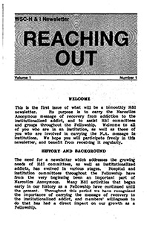
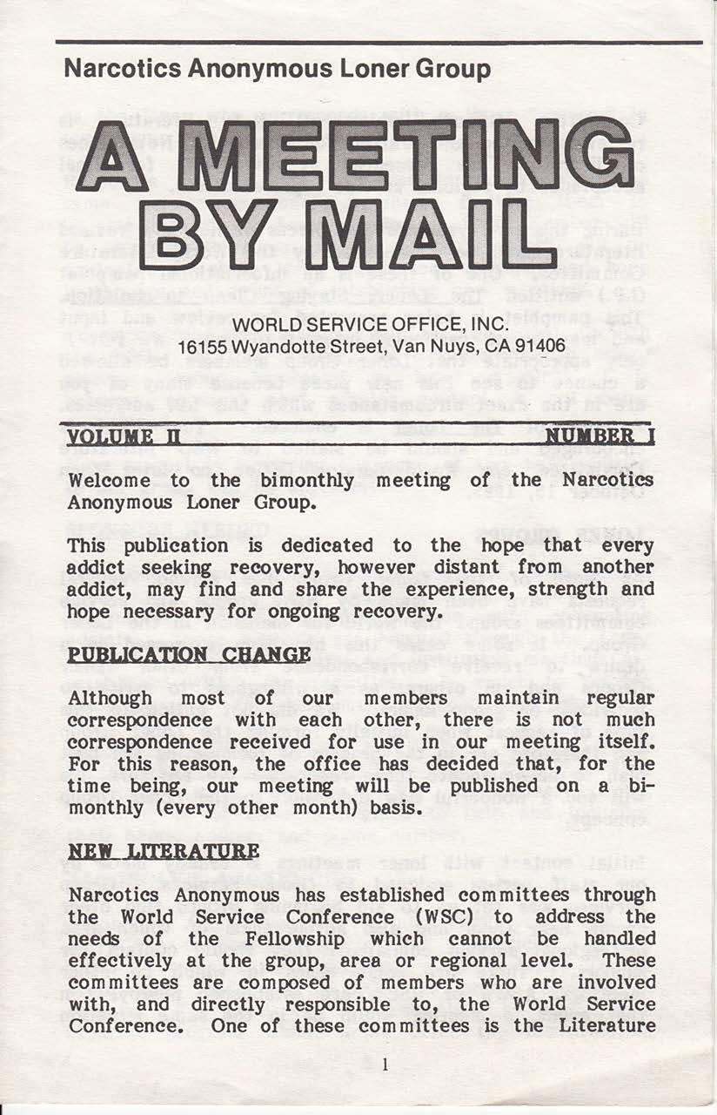
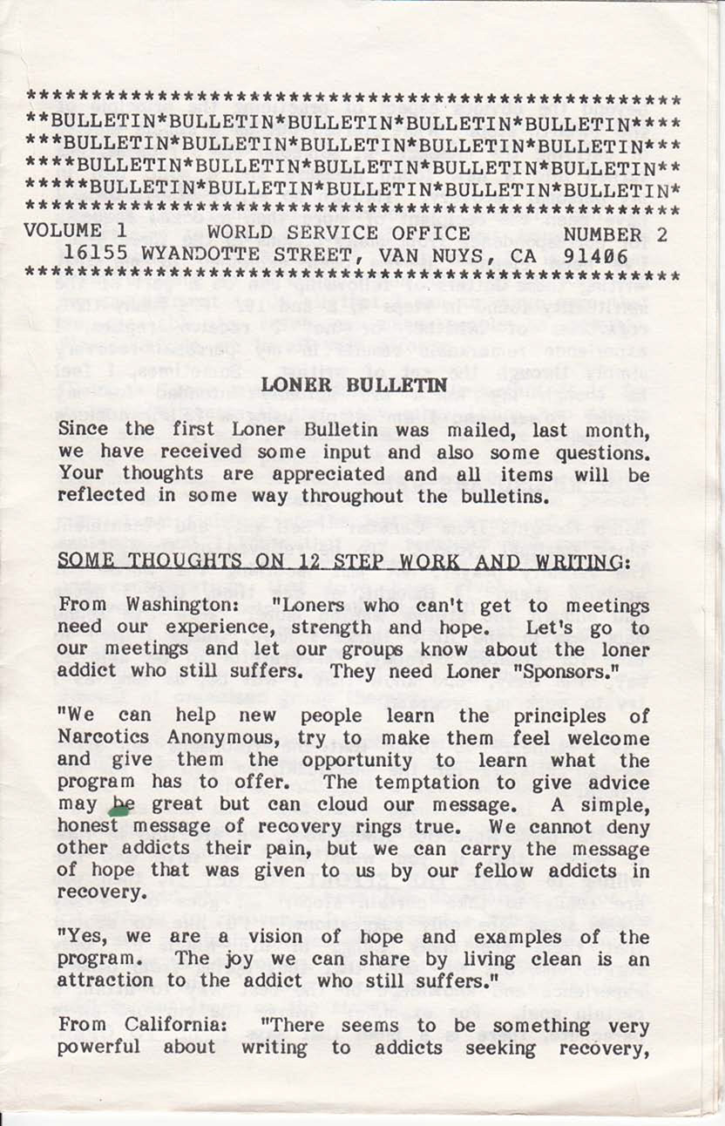

The Origin of Information Pamphlet (IP) #21 …
… the concept of the Loner Group was created to address the needs of addicts who, due to physical location (remote areas) … were unable to attend regular, in-person NA meetings.
The Loner Group put isolated members in touch with one another as pen pals.
1980s
Notes:
In response to a growing number of letters from addicts around the world pouring into the World Service Office in the early 1980’s, the concept of the Loner Group was created by World Services to address the needs of addicts who, due to physical location (remote areas) or other disabilities, were unable to attend regular, in-person NA meetings. The Loner Group put isolated members in touch with one another as pen pals. It was during this time that two publications were created:
Reaching Out, for those incarcerated; and
Meeting by Mail, for those isolated by distance, physical and mental health challenges, and other reasons, such as caregiving or military service, that kept people from being able to attend meetings in person.

Slide 4



The Origin of Information Pamphlet (IP) #21 (Continued)
1986
The need for the Loner Group led to the creation of IP #21 – The Loner: Staying Clean in Isolation …
… In 1986, the internet had not been invented, …
… IP #21 offered guidance and workable solutions for living a clean life while isolated.
IP #21 is a poignant reminder of those days. However, it ... does not include the numerous resources, or the experience developed … in the 3+ decades since it was first printed.
Notes:
The need for the Loner Group led to the creation of IP #21 - “The Loner: Staying Clean in Isolation”, first printed in 1986. Let’s put this date into context. In 1986, the internet had not been invented, and the mobile phone was still nearly 15 years away from being accessible to the average person. IP #21 offered guidance and workable solutions for living a clean life while isolated. During the creation of IP #21, the conference reached out to members of the Loner Group, and their experience was essential in creating that piece. IP #21 is a poignant reminder of those days. However, today it includes resources that no longer exist (Meeting by Mail went out of print in the late 90’s) and it does not include the numerous resources, or the experience developed from the many members who have found recovery away from physical meetings, in the 3+ decades since it was first printed.

Slide 5



Shaped By Fellowship Input …
2020 - 2022
… in March 2020, the pandemic caused a global shutdown. Later that year we held the first virtual World Service Conference. …
… members expressed interest in revising IP #21, and the 2020 World
Service Conference prioritized this work for the 2020 – 2023 Conference Cycle. …
Notes:
Fast forward, in March 2020, the pandemic caused a global shutdown. Later that year, we held the first virtual World Service Conference. Through the CAR survey, members expressed interest in revising IP #21, and the 2020 World Service Conference prioritized this work for the next conference cycle. The first survey on the subject went out and input was collected from members who were staying clean in isolation for the first time.

Slide 6
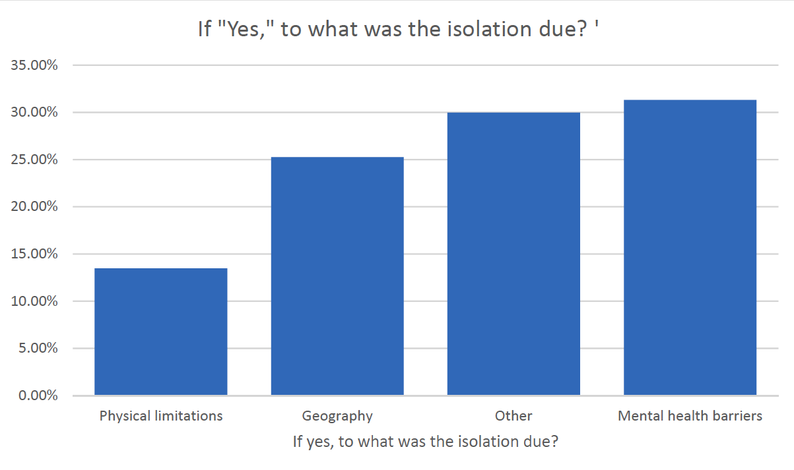
Shaped By Fellowship Input … (Continued)
… survey … showed some surprising results: Less than 25% … reported geographics (remote areas) as the cause of the isolation they experienced …
See page 83 of the 2023 Conference Report for the summary of survey data
… the delay … allowed us to draw on resources and experiences that simply had not existed, or had not been used, until just prior to our work on this project. …
Notes:
Between February and August 2022, a new survey was posted. More than 500 responses from 33 countries and 45 US states showed some surprising results: Less than 25% of those responding reported geographics (remote areas) as the cause of the isolation they experienced, and technology was rapidly shifting the landscape. See page 83 of the 2023 Conference Report for a summary of the survey data.
When this project was first prioritized, what we could not have known, or predicted at that time, were: (1) the many ways in which circumstances would later drive innovation in our Fellowship; (2) the expanding pool of experience in isolation; or (3) the increasing importance of this subject for so many of our members. Had we tried to make the revisions any earlier (including during the 2020 – 2023 conference cycle), it would have been outdated before it was printed. The delay caused by the disruption of the pandemic allowed us to draw upon resources and experiences that simply had not existed, or had not been used, until just prior to our work on this project.

Slide 7
Shaped By Fellowship Input … (Continued)
2023 - 2025
… participants were asked to share their experience on:
what had led to their isolation;
what made the experience of isolation difficult;
what about the experience was transformative; and
what tools or resources had helped them
Their input was beautiful, brilliant, and highly emotional.
… there are many reasons beyond geographic location that can result in someone finding themselves in isolation … whatever the reason, most did not appreciate being called “loners”. …
Notes:
The project was reprioritized at the 2023 Conference and, when we came back to it, our experience as a Fellowship had transformed. Two separate focus groups were formed. One message that was heard resoundingly in both the survey and focus groups was that there are many reasons beyond geographic location that can result in someone finding themselves in isolation. However, whatever the reason, most did not appreciate being called “loners.” Hence the reason that word was dropped from the title. In the focus groups, participants were asked to share their experience on:
what had led to their isolation;
what made the experience of isolation difficult;
what about the experience was transformative; and
what tools or resources had helped them.
Their input was beautiful, brilliant, and highly emotional. Between 2020 and today, virtual meetings have become commonplace in our Fellowship, and our lives together have in some ways become more interconnected than ever. There are resources available for isolated members today that could not have been imagined when IP #21 was first drafted in the early 1980s. Those resources are included in the revisions made to IP #21 in Addendum A that is being submitted for Fellowship’s approval.

Slide 8
Motion 1: Approve the revised IP #21, Staying Clean in Isolation, contained in Addendum A, as Fellowship-approved recovery literature to replace the current IP #21 The Loner - Staying Clean in Isolation.
Maker: World Board
Intent: To update this IP originally approved in 1986 with current Fellowship experience.
Financial Impact: None at this time.
Policy Affected: None
Pause for QUESTIONS
Notes:
Motion 1: Approve the revised IP #21, Staying Clean in Isolation, contained in Addendum A, as Fellowship-approved recovery literature to replace the current IP #21 The Loner—Staying Clean in Isolation.
Maker: World Board
Intent: To update this IP originally approved in 1986 with current Fellowship experience.
Financial Impact: None at this time.
Policy affected: None
Pause for Questions

Slide 9


The NA World Services Strategic Plan
NA World Services has operated with a
strategic plan for over 20 years. … What is new is:
All Conference Participants have been directly involved in co-creating this iteration of the … Plan;
This is the first time the Plan has been included in the CAR; and
The Fellowship is being asked to adopt the Plan.
from 2016 Conference Approval Track
... As this type of planning is new to the Conference, evaluating and improving the planning process will be discussed during the 2026 World Service Conference.
Notes:
NA World Services has operated with a strategic plan for over 20 years. For every conference, the plan is revised and renewed, and the priorities in the plan help shape the work for the cycle ahead. In the past, the NAWS Strategic Plan was formulated by the World Board, in combination with NAWS Staff, while trying to integrate things heard from Fellowship discussions. Once revised and renewed, the Plan would then be included in the Conference Approval Track material. What is new this cycle is that:
All Conference Participants have been directly involved in co-creating this iteration of the NAWS Strategic Plan for the Conference cycle ahead;
This is the first time the Plan has been included in the Conference Agenda Report; and
The Fellowship is being asked to adopt the Plan.
As this type of planning is new to the Conference, evaluating and improving the planning process will be discussed during the 2026 World Service Conference.

Slide 10
What is a Strategic Plan?
We understand that “ought never be organized” doesn’t mean that we do what we do without any planning or predictability. …
Guiding Principles, Tradition Nine
Strategic Planning allows us to:
Live in the present while we prepare for what is to come.
Proceed step by step, and check our direction and our progress
Guides change that can improve NA World Services’ efforts to better address factors within and outside NA that may affect our ability to carry the message.
The magic of NA comes from our spiritual connection … the “as such” that ought never
be organized. Planning … supports our groups and frees them to set the stage for that magic.
Notes:
Guiding Principles, Tradition Nine talks about … “We understand that “ought never be organized” doesn’t mean that we do what we do without any planning or predictability.” Strategic Planning allows us to :
Live in the present while we prepare for what is to come.
It allows us to proceed step by step, and to check our direction and our progress.
And, it allows us to guide change that can improve NA World Services’ efforts to better address factors within and outside NA that may affect our ability to carry the message.
The magic of NA comes from our spiritual connection to one another – the “as such” that ought never be organized. Planning our services supports our groups and frees them to set the stage for that magic.

Slide 11
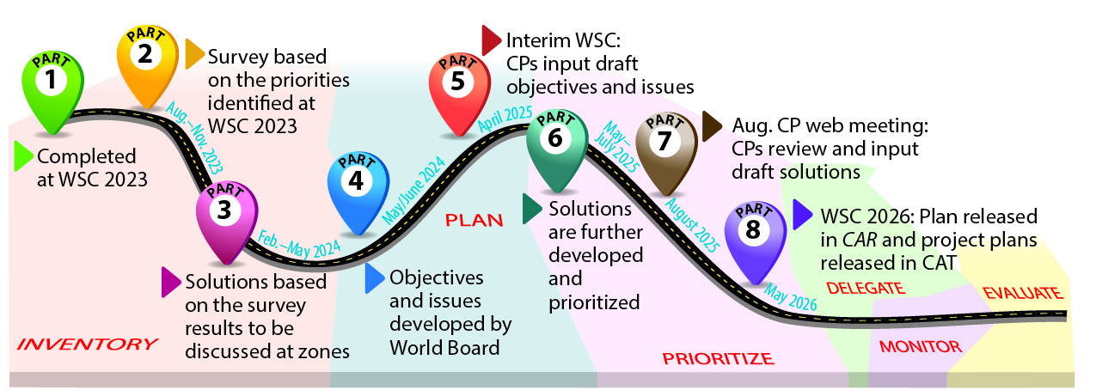
What are the Steps in the Strategic Planning Process?
For complete details on the above, see the planning progress reports generated throughout the cycle at www.na.org/planning.
Notes:
This image is a summary of the steps taken during the planning process. The process started during the 2023 World Service Conference when Conference Participants (CPs) began an inventory, identifying factors, inside and outside of NA, that could affect our ability to carry the message. The process continued throughout the cycle with identifying the issues and drafting objectives and solutions, resulting in the current iteration of the NAWS Strategic Plan attached as Addendum B to the Conference Agenda Report that is being presented to the Fellowship for adoption.

Slide 12
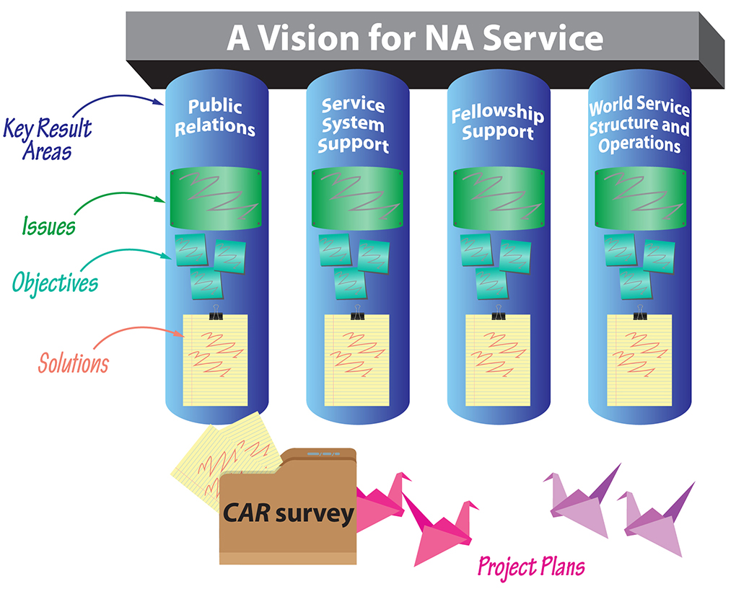
What is in the NAWS Strategic Plan?
Key Result Areas are the major areas in which the service efforts are focused in order to realize A Vision for NA Service. …
Issues are the factors … most important to address this cycle.
Objectives are … what we want to achieve by the end of the planning cycle …
Solutions are paths to achieving our objectives. They are the work we want World Services to undertake on behalf of NA as a whole. …
Notes:
Becoming familiar with the terms used in the NAWS Strategic Plan will greatly assist with you understanding it and how it works. The components of the Plan are: Key Result Areas; Issues; Objectives; and Solutions.
The Key Result Areas in the Plan are: Public Relations; Service System Support; Fellowship Support; and World Service Structure and Operations. These are the four pillars of the Plan, and they change very little, if at all, from cycle to cycle. They are the major areas where service efforts are focused to bring to life A Vision for NA Service.
Issues are the factors that conference participants collectively decided are most important to address in a given cycle.
Objectives are goals to aim for. They express what we want to achieve by the end of the planning cycle, as opposed to how we want to achieve it.
And Solutions are the paths to achieving our Objectives. They are the work we want World Services to undertake on behalf of NA as a whole. Solutions don’t have to include everything that might make progress on an Objective, just the steps we want to take in the immediate cycle in front of us.

Slide 13
What is in the NAWS Strategic Plan? (Continued)
The Objectives and Solutions in the Plan are new initiatives and ideas …
There is much in the Plan relating to:
online and hybrid environment (carrying the message; collecting funds; doing service);
using technology to improve communication and connections;
making sure addicts find a safe space to recover in NA; and
continuing to explore how to make our language inclusive so that every addict can find a home in NA
The Solutions represent the incremental progress that can be made before the 2029 World Service Conference.
Notes:
In addition to the ongoing work World Services is already doing, the Objectives and Solutions of the Plan are new initiatives and ideas for World Services to carry out in the next 3 years. The Solutions represent the incremental progress that can be made before the 2029 World Service Conference. Sometimes parts of the Plan are carried forward from cycle to cycle, perhaps with slight revisions. Reading through the NAWS Strategic Plan gives a window into some of the ways NA is evolving. There’s much in the Plan relating to:
carrying the message, collecting funds, and doing service all in an online and hybrid environment;
using technology to improve communication and connections;
making sure addicts find a safe space to recover in NA regardless of treatment modalities that may be mandated or prescribed for them outside NA; and
continuing to explore how to make our language inclusive so that every addict can find a home in NA.

Slide 14
What is in the NAWS Strategic Plan? (Continued)
Key Result Areas; Issues; Objectives; Solutions
Let’s take a closer look at a part of the Plan’s Fellowship Support Key Result Area …
… Fellowship Support … is about doing the work to ensure that any addict who finds NA feels safe, respected, and valued …
One of the Issues identified as important to address … is Safety and Belonging.
To address the Issue of Safety and Belonging ... Objective #7 in the Plan seeks to: Raise the level of consciousness regarding inclusiveness in our diverse Fellowship and develop tools to support groups in ensuring that all members and potential members feel safe, welcomed, and included at in-person and virtual meetings.
Notes:
Let’s take a closer look at a part of the Plan’s Fellowship Support Key Result Area. Fellowship Support is about doing the work to ensure that any addict who finds NA feels safe, respected, and valued enough to stay and welcome those who come in after them. One of the Fellowship Support Issues identified as important to address during this cycle is Safety and Belonging.
To address the Issue of Safety and Belonging, Objective #7 in the Plan seeks to: Raise the level of consciousness regarding inclusiveness in our diverse Fellowship and develop tools to support groups in ensuring that all members and potential members feel safe, welcomed, and included at in-person and virtual meetings.

Slide 15
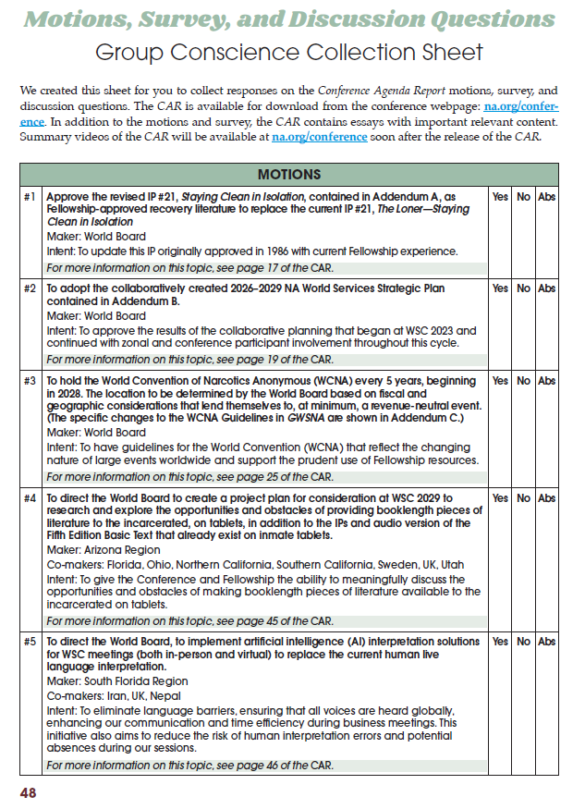
What is in the NAWS Strategic Plan? (Continued)
CAR Survey Interaction with the Strategic Plan …
… items listed in the CAR Survey correspond with the Objectives in the … Plan. As you will see:
4 of the 8 options under New Recovery Literature;
5 of the 9 options under Revised Recovery Literature;
2 of the 8 options under Revised Service Materials; and
4 of the 8 options under Issue Discussion Topics
… all correspond with Objective #7 under the Key Result Area of Fellowship Support.
… the Objectives are the goals we are aiming for, and the Solutions are the paths to reach our Objectives.
Notes:
The Objectives of the Strategic Plan is where the CAR Survey intersects with the Plan. Pages 48 to 51 in the Conference Agenda Report is the Motion, Survey, and Discussion Questions - Group Conscience Collection Sheet. Beginning on page 49 is the CAR Survey. The items listed in the CAR Survey correspond with the Objectives in the Strategic Plan. As you will see:
4 of the 8 items under New Recovery Literature;
5 of the 9 items under Revised Recovery Literature;
2 of the 8 items under Revised Service Materials; and
4 of the 8 items under Issue Discussion Topics
… all correspond with Objective #7 under Fellowship Support. As previously mentioned, the Objectives are goals we are aiming for, and the Solutions are the paths to reach our Objectives.

Slide 16
What is in the NAWS Strategic Plan? (Continued)
The identified Solutions we want World Services to undertake to work toward Objective #7 are:
Investigate changes and/or additional wording to NA literature from gender-specific language to gender-neutral and inclusive language.
Update the service pamphlet or develop a new pamphlet on safety in NA and dealing with predatory behavior.
Update the Group Booklet to add guidance about safety and inclusion.
Create a tool to deal with disruptive or inappropriate behavior in virtual meetings.
Looking at the items in the CAR Survey that correspond with Objective #7, you will see that, some almost mirror the identified Solutions …
Notes:
The identified Solutions we want World Services to undertake to work toward Objective #7 are:
Investigate changes and/or additional wording to NA literature from gender-specific language to gender-neutral and inclusive language.
Update the service pamphlet or develop a new pamphlet on safety in NA and dealing with predatory behavior.
Update the Group Booklet to add guidance about safety and inclusion.
Create a tool to deal with disruptive or inappropriate behavior in virtual meetings.
Looking at the items in the CAR Survey that correspond with Objective #7, you will see that, some almost mirror the identified Solutions to work toward Objective #7.

Slide 17
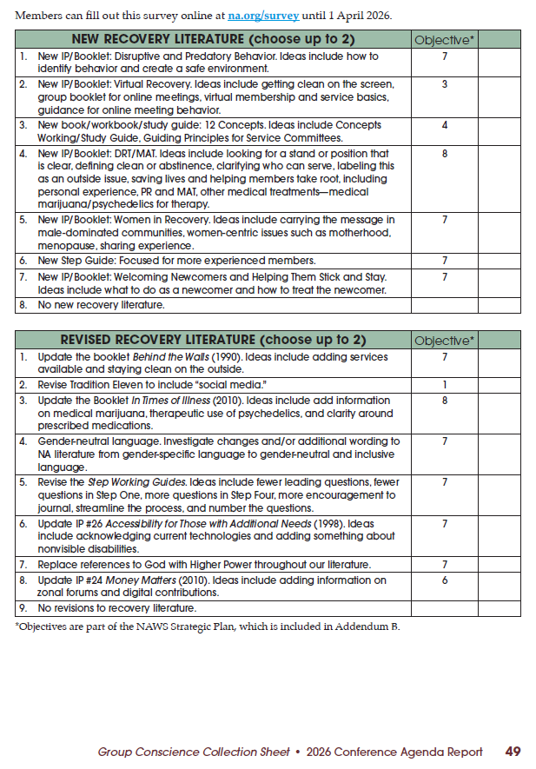
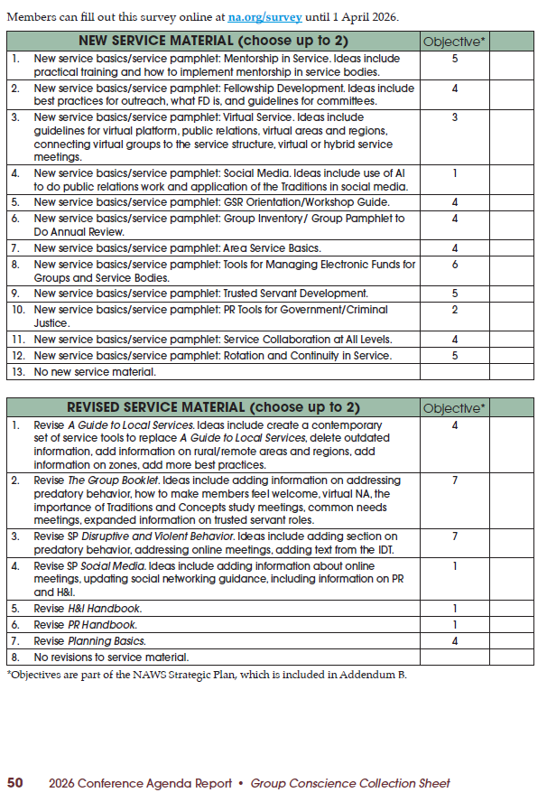
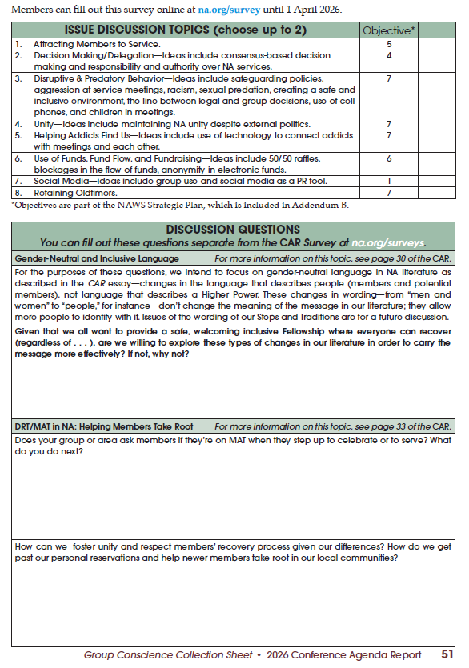
What is in the NAWS Strategic Plan? (Continued)
Everyone … is encouraged to complete the CAR Survey …
… The Fellowship’s participation in the CAR Survey is direct involvement in prioritizing some of the work World Services will be directed to undertake …
Go to: www.na.org/survey to submit your CAR Survey responses before April 1, 2026
Notes:
Everyone in the Fellowship is encourage to complete the CAR Survey and choose up to two items in each category. The CAR Survey items that get the most votes will have an influence on the focus and priority of project plans relating to recovery literature, service materials, and issues discussion topics. In addition to the options for new or revised recovery literature and service materials, there is also the option of not creating any new, or revising any existing, recovery literature or service materials. The Fellowship’s participation in the CAR Survey is direct involvement in prioritizing some of the work World Services will be directed to undertake on behalf of NA as a whole.

Slide 18


Implementing the Plan …
… The Conference Approval Track (CAT) material will contain the project plans for the work set out in the NAWS Strategic Plan.
The CAT … will also include “blank” project plans that will be used for the projects determined by the CAR Survey results.
Notes:
The specifics on how Solutions are carried out are spelled out in project plans. The Conference Approval Track – or CAT - material will contain the project plans for the work set out in the NAWS Strategic Plan. The CAT material will also include “blank” project plans that will be used for the projects determined by the CAR Survey results.
NA Regions and Zones will also be asked to work on the projects for the cycle ahead by holding workshops, collecting best practices, and reviewing drafts. Making progress on most of the solutions in the plan depends upon collaboration from zones and regions. It is the hope that the NAWS Strategic Plan inspires local projects. There may be solutions that fit inside these objectives that can be addressed at local levels, and perhaps the plan will encourage more local service bodies to engage in their own planning.

Slide 19

Adopting the Plan …
The Motion uses the word “adopt” rather than approve … the Fellowship is being asked to take ownership of (to adopt) something that your Delegates have participated in creating on your behalf for our common welfare.
… Delegates have worked together to ensure the Plan outlines the work World Services most needs to undertake in the three years in front of us.
… work on the next strategic plan will begin at the same time as when this Plan will be considered for adoption – during the 2026 World Service Conference. …
Notes:
The Motion uses the word “adopt” rather than approve and the Fellowship is being asked to take ownership of (to adopt) something that the Delegates have participated in creating on your behalf for our common welfare. The Plan is large, contains many details and reflects our collective needs and priorities. The Delegates have worked together to ensure the Plan outlines the work World Services most needs to undertake in the three years in front of us.
Because planning is an ongoing process, work on the next strategic plan will begin at the same time as when this Plan will be considered for adoption - during the 2026 World Service Conference. With only five Motions in the CAR, there will be more time during the 2026 Conference for discussion. Some of those discussions will center around the factors in NA and the world around us that may most affect NA in the years ahead - after 2029. Delegates will be asked to begin this work and the question they will discuss may be something like this:
What issues, challenges, and needs do we need to address to be ready to serve the addict here today and who will be here in the future?
If that question sparks ideas for you, share them with your Delegate or at your area or regional CAR workshop.

Slide 20
Motion 2: To adopt the collaboratively created 2026–2029 NA World Services Strategic Plan contained in Addendum B.
Maker: World Board
Intent: To approve the results of the collaborative planning that began at WSC 2023 and continued with zonal and conference participant involvement throughout this cycle.
Financial Impact: No direct financial impact. Any future expenses will be called out in project plans or budgets.
Policy Affected: None
Pause for QUESTIONS
Notes:
Motion 2: To adopt the collaboratively created 2026–2029 NA World Services Strategic Plan contained in Addendum B.
Maker: World Board
Intent: To approve the results of the collaborative planning that began at WSC 2023 and continued with zonal and conference participant involvement throughout this cycle.
Financial Impact: No direct financial impact. Any future expenses will be called out in project plans or budgets.
Policy Affected: None
Pause for Questions

Slide 21

The History of NA’s World Convention
For over five decades, the World Convention has been a celebration of unity and recovery …
1971 – 1996 – Annual Event
Mid–90’s – Two-year schedule; held outside of North America every other convention
1998 to 2009 - Added two extra non-North American locations in the rotation; and
2012 - every three years, alternate between US and non-US locations beginning in 2015
Notes:
For over five decades, the World Convention has been a celebration of unity and recovery for the Fellowship. From 1971 to 1996, it was an annual event. In the mid-90s, the then World Convention Corporation presented motions, which were adopted by the Conference, to create a new “zonal” rotation plan and change to a two-year schedule. The goal of this rotation plan was to increase worldwide participation by moving the convention outside of North America every other convention. The rotation plan was then slightly altered, from nine zones to six, adding in two extra North American locations during the 1998 to 2009 timeframe.
Faced with ongoing challenges related to attendance, effective planning, and the financial bottom line, the World Board proposed a new rotation plan that was adopted at the 2012 Conference. This revised plan would alternate between US and non-US locations, with the convention being held every three years beginning in 2015.

Slide 22
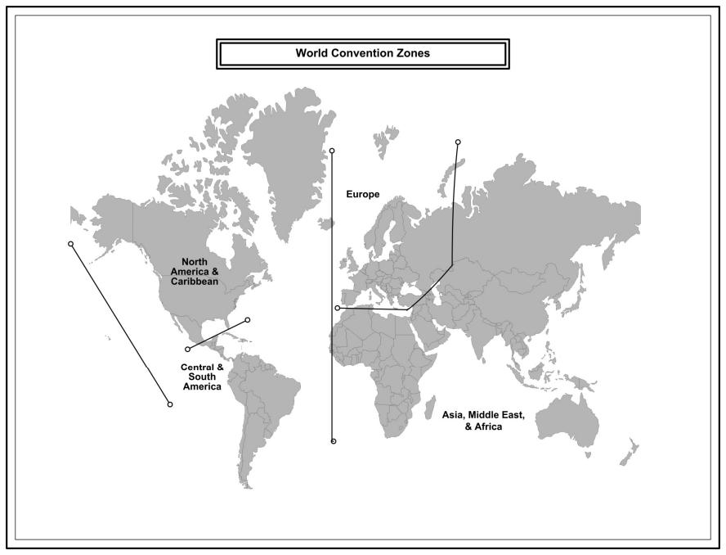
Year | North American Locations | Net | Registrations
1993 | 23 - Chicago, Illinois | $186,181
1994 | 24 - Baltimore, Maryland | $271,474
1996 | 26 - St. Louis, Missouri | $98,489
1998 | 27 - San Jose, California | $11,040 | Over 15,000
2002 | 29 - Atlanta, Georgia | $420,372 | Over 13,000
2003 | 30 - San Diego, CA – 50 Yrs. | $33,831 | 22,000
2005 | 31 - Honolulu, Hawaii | $172,476 | Over 8,600
2007 | 32 - San Antonio, Texas | -$596,000 | Less - 10,000
2011 | 34 - San Diego, California | $282,577 | 13,900
2013 | 35 - Philadelphia, PA – 60 Yrs. | $209,434 | 19,100
2018 | 37 - Orlando, Florida | $1,177,456 | 21,000
2024 | 38 - Washington, DC | -$956,129 | 18,320
Year | Europe Locations | Net | Registrations
1995 | 25 - Paris, France | $14,422
2009 | 33 - Barcelona, Spain | -$212,895 | 5,500
2028 | 39 – Europe (TBD) – 75 Yrs.
Year | Central | S. American Locations | Net | Registrations
2000 | 28 - Cartegena de Indias, Columbia | -$41,095 | Over 1,400
2015 | 36 - Rio de Janeiro, Brazil | -$384,710 | Less – 3,000
Notes:
This slide shows the years, locations, net incomes, and number of registrations for the World Convention dating back to 1993. As you will see, with the exception of the conventions held in San Antonio, Texas (2007) and the one held in Washington, DC (2024), the convention trends in North America were net-financial successes. After the loss in 2007, the next three North America conventions – 2011, 2013, and 2018 - all generated net income, along with a continual increase in registrations. The 2018 Convention in Orlando, Florida saw the largest increase, both in attendance of 21,000+, and in net income of over one million. A significant contributor to the success in Orlando, Florida was the beneficial contract for meeting space and the level of attendance.

Slide 23
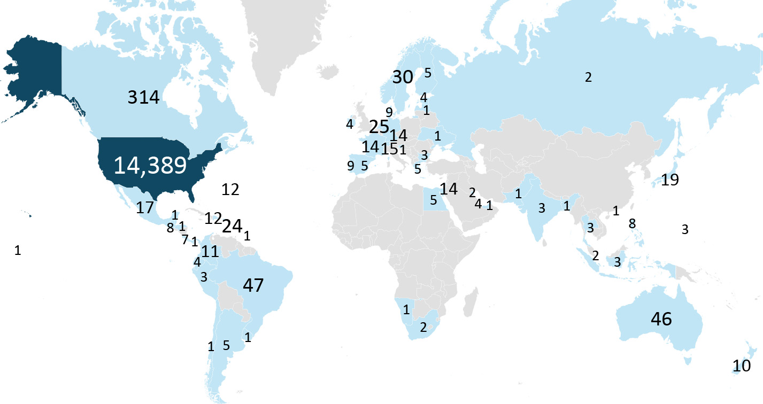
… travel and health concerns … entwined with the strain on financial and human resources of NA made cancelling the Australia convention the most responsible action.
World Convention of NA 38 - Pre-registrations by Countries
The majority of the 3,616 responding ranked costs of travel and other financial factors, as well as location, as the highest influencers on their decision on whether to attend.
Notes:
Prior to the global pandemic in 2020, the 38th World Convention was planned to be held in Melbourne, Australia. After the global shutdown, travel and health concerns from COVID, entwined with the strain on financial and human resources of NA World Services, made canceling the Australia convention the most responsible action. At the 2023 World Service Conference, a motion passed to suspend the current World Convention rotation policy to give the World Board time to research and evaluate what would be practical moving forward. It took most of the past 18 months to gather the information needed for the discussions and to reach consensus on what changes in policy made the most sense.
A survey was conducted to see if there was a common theme of why NA members attend (or don’t attend) the World Convention. As expected, the majority of the 3,616 responding ranked costs of travel and other financial factors, as well as location, as the highest influencers on their decision on whether to attend. Nearly half of the responses received (48%) were from members who have never attended an NA World Convention. There will be more on the results from this survey reported in the Conference Report prior to 2026 World Service Conference.

Slide 24
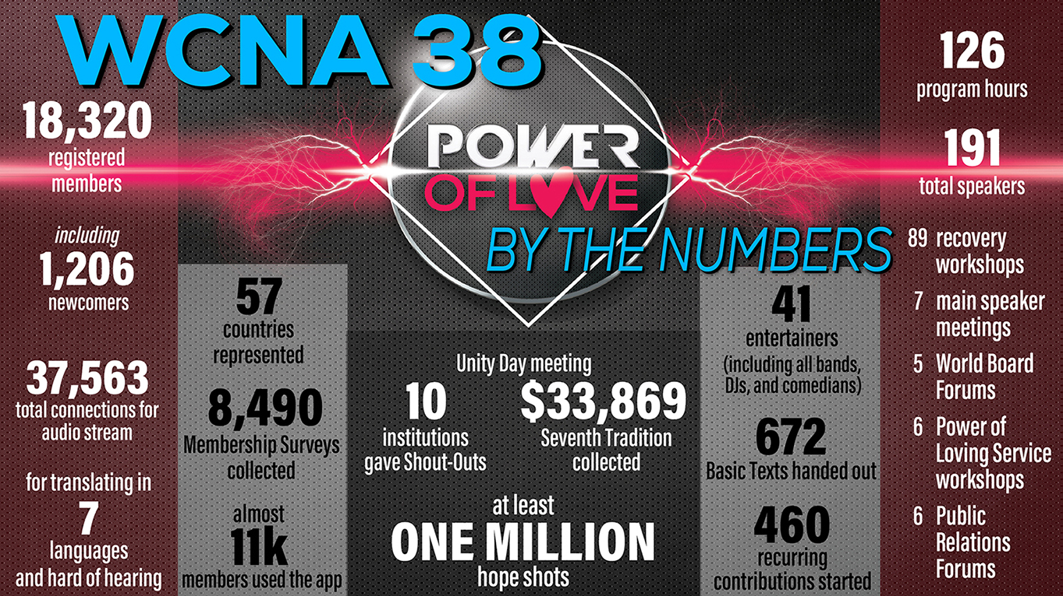
Notes:
As you know, the 2024 World Convention was held in Washington, DC. One of the main things this Convention taught us was just how much the landscape had changed and how uncertain convention attendance could be. Based on the trends from the past two conventions in North America, the fact that there had not been a Convention in six years, and that Washington, DC, is located within an easy drive of many of the most densely populated NA regions, it was reasonable to think that attendance had the potential to be even higher than it was at the 2018 Convention in Orlando, Florida, and it made logical sense to plan accordingly. In most cases, past performance can be an indicator of what future outcomes can be, but that was not the case here, as we now know.
In addition to financial strain in the current economy, other factors, such as lingering health and safety concerns, especially among our aging members, may have also contributed to the overall level of attendance in DC. WCNA 38 was planned for a projected attendance of 24,000, and just over 18,000 members registered. As was reported in the 2024 Annual Report, the bottom line for the 38 World Convention shows that the expenses exceeded the income by $956,129. Thankfully, World Services’ efforts to increase reserves helped us to be prepared for an unfavorable outcome.
For more information on the history of the NA World Convention, go to na.org/wcna.

Slide 25

Some of the Factors Considered …
Many factors brought the World Board to their decision to offer Motion #3:
Overall event expenses, especially audio | video production expenses;
The rising costs and increasing complexities of international travel; and
Global political and economic climates, etc.
The World Board was able to reach consensus on the idea of … a revenue-neutral event … … keeping in mind prior comfort … if Conventions provide Public Relations or Fellowship Development opportunities that are impactful to the community.
For more details, read the Essay on pages 25 to 29 in the Conference Agenda Report.
Notes:
Many factors brought the World Board to their decision to offer Motion 3. Some of the factors considered were: overall event expenses, especially expenses related to audio and video production - something we rely heav­ily upon - continue to climb. The rising costs and increasing complexities of international travel, especially for Conventions outside North America, given that most Convention attendees, regardless of where the convention is held, typically are US members. Many of the global political and economic issues that exist today greatly impact the feasibility of planning future events.
The World Board was able reach consensus on the idea of the Convention being a revenue-neutral event – meant not to lose money. However, keeping in mind prior comfort with expenses exceeding income if the Convention provides for Public Relations or Fellowship Development opportunities that are impactful on the community.
For more details, read the Essay on pages 25 to 29 in the Conference Agenda Report.

Slide 26
Future …
The proposed new guidelines … seek to: (1) change … from an every 3-year event to an every 5-year event; and (2) permit the World Board to determine the location. … A 5-year Cycle:
Is less frequent; making the Convention a more special occurrence;
Allows our membership more time to plan to attend; and
Puts the convention on track to celebrate NA milestone anniversaries beginning with our 75th anniversary in 2028.
Delegating more of the rotation and location decision-making … is prudent simply because so much is unknown … The current rotation plan … is no longer practical … The world has become far too unpredictable, especially looking out over long periods of time.
Notes:
The proposed new guidelines in Addendum C seek to: (1) change the World Convention from being an every 3-year event to an every 5-year event; and (2) permit the World Board to determine the location based on fiscal and geographic considerations that lend themselves to, at minimum, a revenue-neutral event.
Changing to a 5-year cycle:
Is less frequent; making the Convention a more special occurrence;
Allows our membership more time to plan to attend; and
Puts the convention on track to celebrate NA milestone anniversaries beginning with our 75th anniversary in 2028.
Delegating more of the rotation and location decision-making responsibility to the World Board is prudent simply because so much is unknown - inside and outside of NA. The current rotation plan that aspires to hold every other Convention outside of North America is no longer practical for planning. The conference industry as a whole is changing; our members’ behavior is changing; and there is no way to predict what the landscape will look like years in the future. The world has become far too unpredictable, especially looking out over long periods of time.

Slide 27
Motion 3: To hold the World Convention of Narcotics Anonymous (WCNA) every 5 years, beginning in 2028. The location to be determined by the World Board based on fiscal and geographic considerations that lend themselves to, at minimum, a revenue neutral event. (The specific changes to the WCNA Guidelines in GWSNA are shown in Addendum C.)
Maker: World Board
Intent: To have guidelines for the World Convention (WCNA) that reflect the changing nature of large events worldwide and support the prudent use of Fellowship resources.
Financial Impact: No direct financial impact. Any future expenses will be called out in project plans or budgets.
Policy Affected: The policy offered in Addendum C will replace the current
WCNA guidelines in GWSNA (pages 46–48) shown in Addendum D.
Pause for QUESTIONS
Notes:
Motion 3: To hold the World Convention of Narcotics Anonymous (WCNA) every 5 years, beginning in 2028. The location to be determined by the World Board based on fiscal and geographic considerations that lend themselves to, at minimum, a revenue neutral event. (The specific changes to the WCNA Guidelines in GWSNA are shown in Addendum C.)
Maker: World Board
Intent: To have guidelines for the World Convention (WCNA) that reflect the changing nature of large events worldwide and support the prudent use of Fellowship resources.
Financial Impact: No direct financial impact. Any future expenses will be called out in project plans or budgets.
Policy Affected: The policy offered in Addendum C will replace the current WCNA guidelines in GWSNA (pages 46–48) shown in Addendum D.
Pause for Questions

Slide 28
Regional Motions
Motion 4 - To direct the World Board to create a project plan for consideration at WSC 2029 to research and explore the opportunities and obstacles of providing book-length pieces of literature to the incarcerated, on tablets, in addition to the IPs and audio version of the Fifth Edition Basic Text that already exist on inmate tablets; and
Motion 5 - To direct the World Board, to implement artificial intelligence (AI) interpretation solutions for WSC meetings (both in-person and virtual) to replace the current human live language interpretation.
See pages 44 - 47 in the 2026 CAR
Notes:
Having a Conference Agenda Report with only two regional motions is not the norm. However, perhaps it’s a sign of a shift toward a more collaborative and discussion-based conference. With fewer motions for discussion and decision there will be more time for conference participants to talk about issues that affect NA as a whole; and time to work on honing and shaping the next steps in the collaborative planning efforts.
The two Motions are:
Motion 4 - To direct the World Board to create a project plan for consideration at WSC 2029 to research and explore the opportunities and obstacles of providing booklength pieces of literature to the incarcerated, on tablets, in addition to the IPs and audio version of the Fifth Edition Basic Text that already exist on inmate tablets; and
Motion 5 - To direct the World Board, to implement artificial intelligence (AI) interpretation solutions for WSC meetings (both in-person and virtual) to replace the current human live language interpretation.
Let’s begin with Motion 4.

Slide 29
Motion 4: To direct the World Board to create a project plan for consideration at WSC 2029 to research and explore the opportunities and obstacles of providing booklength pieces of literature to the incarcerated, on tablets, in addition to the IPs and audio version of the Fifth Edition Basic Text that already exist on inmate tablets.
Maker: Arizona Region
Co-makers: Florida, Ohio, Northern California, Southern California, Sweden, UK, Utah
Intent: To give the Conference and Fellowship the ability to meaningfully discuss the opportunities and obstacles of making book-length pieces of literature available to the incarcerated on tablets.
Financial Impact: There is minimal cost in creating a project plan. The cost to NAWS would be in the project itself if the WSC were to adopt and prioritize the plan.
Policy Affected: None
Notes:
Motion 4: To direct the World Board to create a project plan for consideration at WSC 2029 to research and explore the opportunities and obstacles of providing booklength pieces of literature to the incarcerated, on tablets, in addition to the IPs and audio version of the Fifth Edition Basic Text that already exist on inmate tablets.
Maker: Arizona Region
Co-makers: Florida, Ohio, Northern California, Southern California, Sweden, UK, Utah
Intent: To give the Conference and Fellowship the ability to meaningfully discuss the opportunities and obstacles of making booklength pieces of literature available to the incarcerated on tablets.
Financial Impact: There is minimal cost in creating a project plan. The cost to NAWS would be in the project itself if the WSC were to adopt and prioritize the plan.
Policy Affected: None

Slide 30
Motion #4 Rationale
Rational by Region: Narcotics Anonymous exists to carry a message of hope and freedom to every addict seeking recovery, including our members behind the walls. As correctional systems increasingly transition from physical books to secure digital tablets, many incarcerated addicts are being cut off from book-length NA literature such as Just for Today, It Works: How and Why, and Living Clean. Without action, this shift threatens to limit access to the foundation of our message for some of our most isolated members. …
Approving this motion would allow the World Board to develop a project plan exploring practical, principled ways to make our Fellowship’s booklength literature available through prison tablet systems. This plan would examine logistical, legal, financial, and Fellowship-related issues, ensuring that any approach upholds the principles of self-support and preserves the integrity of NA’s intellectual property, as outlined in the Fellowship Intellectual Property Trust (FIPT).
Notes:
Rational by Region: Narcotics Anonymous exists to carry a message of hope and freedom to every addict seeking recovery, including our members behind the walls. As correctional systems increasingly transition from physical books to secure digital tablets, many incarcerated addicts are being cut off from book-length NA literature such as Just for Today, It Works: How and Why, and Living Clean. Without action, this shift threatens to limit access to the foundation of our message for some of our most isolated members. …
Approving this motion would allow the World Board to develop a project plan exploring practical, principled ways to make our Fellowship’s booklength literature available through prison tablet systems. This plan would examine logistical, legal, financial, and Fellowship-related issues, ensuring that any approach upholds the principles of self-support and preserves the integrity of NA’s intellectual property, as outlined in the Fellowship Intellectual Property Trust (FIPT).

Slide 31
Motion #4 Rationale (Continued)
Many incarcerated members already face disparities in literature access, depending on facility policies and geography. …
Exploring digital options would help the Fellowship respond to these inequities while adapting to a changing environment. It also presents an opportunity to strengthen our trusted servant relationships with correctional institutions, ensuring that NA literature remains accessible to those with limited financial resources.
By supporting this motion, the World Service Conference would affirm our commitment to carrying the message to all addicts, regardless of circumstance, and empower the World Board to be proactive, bringing back informed options for Fellowship review and approval.
Notes:
Many incarcerated members already face disparities in literature access, depending on facility policies and geography. …
Exploring digital options would help the Fellowship respond to these inequities while adapting to a changing environment. It also presents an opportunity to strengthen our trusted servant relationships with correctional institutions, ensuring that NA literature remains accessible to those with limited financial resources.
By supporting this motion, the World Service Conference would affirm our commitment to carrying the message to all addicts, regardless of circumstance, and empower the World Board to be proactive, bringing back informed options for Fellowship review and approval.

Slide 32
Motion #4 – World Board Response
The World Board shares the maker’s commitment to ensuring that all addicts—including those who are incarcerated—have access to NA literature and the message of recovery. We recognize the shift from printed books to digital tablets in correctional systems offers both opportunities and challenges.
We believe this motion is unnecessary, as NA World Services is already engaged in ongoing efforts to make literature accessible in correctional facilities while upholding self-support and the integrity of the Fellowship Intellectual Property Trust (FIPT). We currently work with vendors and departments to provide, at no cost, materials already available on na.org. …
The Basic Text is available in twelve languages in audio, and IPs, booklets, and translated materials are accessible in 61 languages. An Introductory Guide to NA — with ten IPs and the Steps chapter from the Basic Text — is soon to be available in English and Spanish audio.
Notes:
The World Board shares the maker’s commitment to ensuring that all addicts—including those who are incarcerated—have access to NA literature and the message of recovery. We recognize the shift from printed books to digital tablets in correctional systems offers both opportunities and challenges.
We believe this motion is unnecessary, as NA World Services is already engaged in ongoing efforts to make literature accessible in correctional facilities while upholding self-support and the integrity of the Fellowship Intellectual Property Trust (FIPT). We currently work with vendors and departments to provide, at no cost, materials already available on na.org. …
The Basic Text is available in twelve languages in audio, and IPs, booklets, and translated materials are accessible in 61 languages. An Introductory Guide to NA — with ten IPs and the Steps chapter from the Basic Text — is soon to be available in English and Spanish audio.

Slide 33
Motion #4 – World Board Response (Continued)
Providing full-length books on tablets is not a simple solution. Correctional environments vary widely; many still require physical books. We do not contract with for-profit tablet companies that would charge for materials we provide for free. Our focus remains on accessibility, not commercialization. …
It is important to recognize that NA World Services remains largely funded through literature sales, a considerable amount of which comes from initiatives to help incarcerated addicts. We make many resources freely available because we believe deeply in our mission; we must also ensure the sustainability of the services that allow us to carry that message worldwide.
We once offered PDFs of major titles online, but massive unauthorized distribution forced their removal. Audio materials, especially in Spanish, are now the most frequently accessed resources on inmate tablets. This has guided our recent recording projects. …
Notes:
Providing full-length books on tablets is not a simple solution. Correctional environments vary widely; many still require physical books. We do not contract with for-profit tablet companies that would charge for materials we provide for free. Our focus remains on accessibility, not commercialization. …
It is important to recognize that NA World Services remains largely funded through literature sales, a considerable amount of which comes from initiatives to help incarcerated addicts. We make many resources freely available because we believe deeply in our mission; we must also ensure the sustainability of the services that allow us to carry that message worldwide.
We once offered PDFs of major titles online, but massive unauthorized distribution forced their removal. Audio materials, especially in Spanish, are now the most frequently accessed resources on inmate tablets. This has guided our recent recording projects. …

Slide 34
Motion #4 – World Board Response (Continued)
As has been our practice for more than two decades, NAWS continues to provide free literature to incarcerated members upon request and offers a Basic Text after continued contact. We also recognize the importance of H&I efforts to carry meetings into facilities as well as reentry support, including helping members who receive addiction medication to feel welcome in NA.
While digital tools will continue to evolve, our balanced approach—combining technology, human connection, and financial responsibility—remains the most effective way to carry our message. The motion’s intent aligns with work already in progress at NA World Services.
Pause for QUESTIONS
Notes:
As has been our practice for more than two decades, NAWS continues to provide free literature to incarcerated members upon request and offers a Basic Text after continued contact. We also recognize the importance of H&I efforts to carry meetings into facilities as well as reentry support, including helping members who receive addiction medication to feel welcome in NA.
While digital tools will continue to evolve, our balanced approach—combining technology, human connection, and financial responsibility—remains the most effective way to carry our message. The motion’s intent aligns with work already in progress at NA World Services.

Slide 35
Motion 5: To direct the World Board, to implement artificial intelligence (AI) interpretation solutions for WSC meetings (both in-person and virtual) to replace the current human live language interpretation.
Maker: South Florida Region
Co-makers: Iran, UK, Nepal
Intent: To eliminate language barriers, ensuring that all voices are heard globally, enhancing our communication and time efficiency during business meetings. This initiative also aims to reduce the risk of human interpretation errors and potential absences during our sessions.
Financial Impact: The financial impact of implementing this technology is expected to be significant but has not yet been determined pending further analysis.
Policy Affected: None
Notes:
Motion 5: To direct the World Board, to implement artificial intelligence (AI) interpretation solutions for WSC meetings (both in-person and virtual) to replace the current human live language interpretation.
Maker: South Florida Region
Co-makers: Iran, UK, Nepal
Intent: To eliminate language barriers, ensuring that all voices are heard globally, enhancing our communication and time efficiency during business meetings. This initiative also aims to reduce the risk of human interpretation errors and potential absences during our sessions.
Financial Impact: The financial impact of implementing this technology is expected to be significant but has not yet been determined pending further analysis.
Policy Affected: None

Slide 36
Motion #5 – Rationale by Region
We would like to provide further clarification regarding the intent of this initiative. Our objective is to empower RDs and ADs whose primary language is not English, enabling them to articulate their perspectives more effectively in their native language during direct discussions. This will reduce the reliance on interpreters. Additionally, this approach aligns with our second concept: the service structure will seek guidance and resources from the groups, including spiritual guidance, which we regard as a matter of conscience in this context.
Notes:
We would like to provide further clarification regarding the intent of this initiative. Our objective is to empower RDs and ADs whose primary language is not English, enabling them to articulate their perspectives more effectively in their native language during direct discussions. This will reduce the reliance on interpreters. Additionally, this approach aligns with our second concept: the service structure will seek guidance and resources from the groups, including spiritual guidance, which we regard as a matter of conscience in this context.

Slide 37
Motion #5 – World Board Response
World Services shares the goal of improving communication and participation at the World Service Conference (WSC), especially for members whose first language is not English. Removing barriers to participation is something we deeply value.
However, this motion would limit the conference’s ability to adapt and make timely operational decisions. We support experimenting with new technologies to enhance accessibility and efficiency, but this motion mandates a specific tool—AI interpretation—to replace human interpreters. That replacement is the concern. …
Human interpreters, nearly always NA members, bring accuracy, cultural understanding, and a spiritual connection that technology cannot replicate. Replacing them would undermine effective communication at the WSC.
Notes:
World Services shares the goal of improving communication and participation at the World Service Conference (WSC), especially for members whose first language is not English. Removing barriers to participation is something we deeply value.
However, this motion would limit the conference’s ability to adapt and make timely operational decisions. We support experimenting with new technologies to enhance accessibility and efficiency, but this motion mandates a specific tool—AI interpretation—to replace human interpreters. That replacement is the concern. …
Human interpreters, nearly always NA members, bring accuracy, cultural understanding, and a spiritual connection that technology cannot replicate. Replacing them would undermine effective communication at the WSC.

Slide 38
Motion #5 – World Board Response (Continued)
We’ve long held that WSC participants themselves are best positioned to test and decide on process changes, as noted in our 2023 CAR response: “Allowing participants to make decisions about the processes that affect the WSC meeting is significantly more nimble than making these types of changes through the CAR.” Given how quickly technology evolves, flexibility is more practical than a rigid policy. …
AI tools could be explored as supplements — not replacements — in smaller settings or between conferences, but mandating them now, without trials or research, is premature. WSC interpreters do far more than translate — they convey recovery concepts, emotional tones, and cultural nuances vital to understanding. They also help participants between sessions, ensuring two-way communication that AI cannot yet provide.
Notes:
We’ve long held that WSC participants themselves are best positioned to test and decide on process changes, as noted in our 2023 CAR response: “Allowing participants to make decisions about the processes that affect the WSC meeting is significantly more nimble than making these types of changes through the CAR.” Given how quickly technology evolves, flexibility is more practical than a rigid policy. …
AI tools could be explored as supplements — not replacements — in smaller settings or between conferences, but mandating them now, without trials or research, is premature. WSC interpreters do far more than translate — they convey recovery concepts, emotional tones, and cultural nuances vital to understanding. They also help participants between sessions, ensuring two-way communication that AI cannot yet provide.

Slide 39
Motion #5 – World Board Response (Continued)
Conference discussions sometimes include sensitive matters. AI-based systems pose potential privacy risks and lack the understanding of NA’s Traditions that human interpreters bring. …
Current technology also struggles with accuracy, speed, and context—especially with our specialized recovery language.
The World Board supports continued exploration of new tools to aid communication, but not as mandated substitutes for human interpreters. The WSC’s success depends on flexibility, inclusivity, and spiritual connection—not automation. We encourage ongoing experimentation and dialogue at the conference level as technology continues to evolve.
Pause for QUESTIONS
Notes:
Conference discussions sometimes include sensitive matters. AI-based systems pose potential privacy risks and lack the understanding of NA’s Traditions that human interpreters bring. …
Current technology also struggles with accuracy, speed, and context—especially with our specialized recovery language.
The World Board supports continued exploration of new tools to aid communication, but not as mandated substitutes for human interpreters. The WSC’s success depends on flexibility, inclusivity, and spiritual connection—not automation. We encourage ongoing experimentation and dialogue at the conference level as technology continues to evolve.

Slide 40
Five other PowerPoints available online
CAR survey available online
CAR available for download
      worldboard@na.org
      na.org/conference
Notes:
We hope this PowerPoint has helped in your discussion of this material. Please note that there are five other PowerPoints that focus on the rest of the CAR. These resources, the CAR itself, and the online CAR survey are available online at na.org/conference.
We welcome your questions and your feedback on the CAR, and all other issues, at worldboard@na.org.

