Slide 1
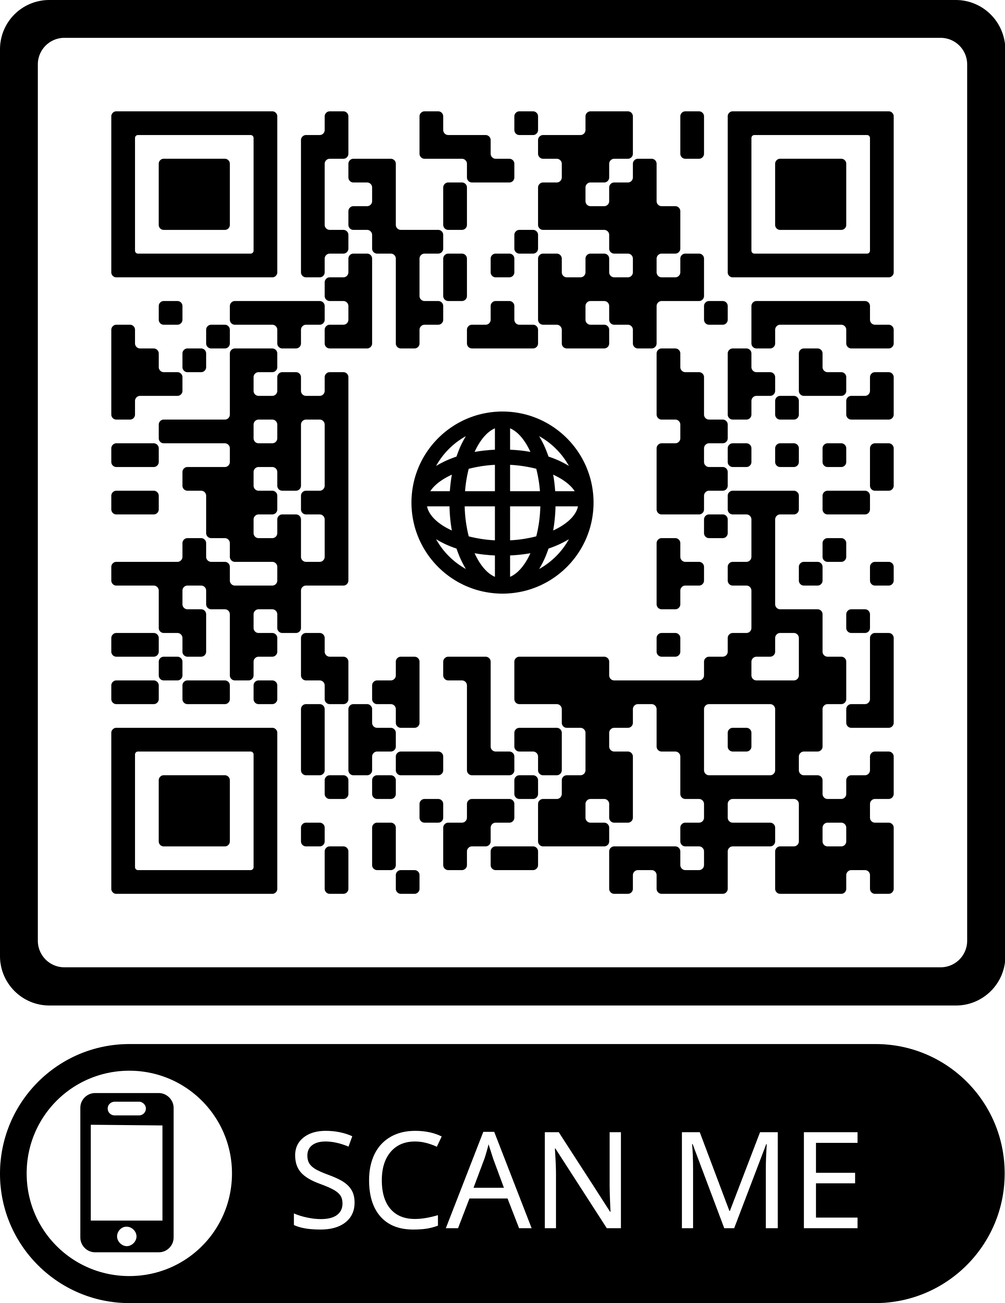
PowerPoint 3 of 6
2026 Conference Agenda Report
Gender-Neutral and Inclusive Language
For a complete copy of the 2026 Conference Agenda Report, scan the QR Code or visit: www. na.org/conference
Notes:
This is the third of six PowerPoints covering material in the 2026 Conference Agenda Report (or CAR for short). This PowerPoint covers the topic Gender-Neutral and Inclusive Language and an essay on this topic can be found on pages 30 – 32 in the 2026 Conference Agenda Report. This, and the other PowerPoints only cover the main points of the 2026 CAR. We encourage all members to read the CAR itself. For a complete copy of the 2026 Conference Agenda Report, scan the QR Code or visit www.na.org/conference.

Slide 2

Gender-Neutral Language in NA Literature is one of two topics with discussion questions ...
These topics are for discussion only – no decisions are being made; and
The discussions are an opportunity to hear each other and gather and submit our thoughts on the topics.
Share your feedback by April 1st at www.na.org/surveys or scan the QR Code!
Notes:
Gender-Neutral Language in NA Literature is one of two topics with discussion questions included in the 2026 CAR. If you are discussing these questions in workshops, please note that the topics are for discussion only, no decisions are being made. The discussions are an opportunity to hear each other and gather and submit our thoughts on the topics. You can submit input on the discussion by going to: www.na.org/survey or by scanning the QR Code on this slide. The deadline to submit input is April 1, 2026.

Slide 3
The Term: “Gender-Neutral Language”
Gender-neutral language can include three separate things:
the words we use to describe our members and potential members;
the words | pronouns we use to describe a Higher Power (God of our understanding); and
the words of our Steps and Traditions.
These are three separate and distinct discussions, and they impact NA’s literature differently.
Notes:
In the Fellowship, when we talk about gender-neutral language, we are discussing at least three separate things:
the words we use to describe our members and potential members;
the words | pronouns we use to describe a Higher Power (God of our understanding); and
the words of our Steps and Traditions.
These are three separate and distinct discussions, and they impact NA’s literature differently. This workshop, and the discussions that will take place at the 2026 World Service Conference on this topic, will focus solely on gender-neutral language as it relates to the words we use to describe our members and potential members.

Slide 4
The Term: “Gender-Neutral Language” (Continued)
An example of Gender-Neutral language … when talking about our members and potential members is …
IP #7, Am I An Addict? which reads: “Very simply, an addict is a person whose life is controlled by drugs.”
An example of Gender-Specific language … when talking about our members and potential members is …
Little White Book | Basic Text, “Who Is an Addict?” which read: “Very simply, an addict is a man or woman whose life is controlled by drugs.”
Notes:
An example of what is meant by gender-neutral wording when “… talking about our members and potential members” is the first paragraph of IP #7, Am I An Addict? which reads: “Very simply, an addict is a person whose life is controlled by drugs.” This differs from the gender-specific wording found in “Who Is An Addict” – and often read at the beginning of meetings - which reads, “Very simply, an addict is a man or woman whose life is controlled by drugs.”

Slide 5

The Term: “Gender-Neutral Language” (Continued)
… “a man or woman” or “a person” may seem insignificant to many of us.
Yet for some addicts, it can make all the difference in feeling a part of.
Newer NA literature - beginning with
Living Clean in 2012 - has aimed for gender-neutrality
Notes:
The difference between using the words “a man or woman” or “a person” may seem insignificant to many of us. Yet for some addicts, it can make all the difference in feeling a part of. Gender-neutral language smooths the path for identification in ways most members may not even notice. In fact, many are unaware that, with the publication of Living Clean in 2012, new NA literature has been written to be more gender neutral.

Slide 6

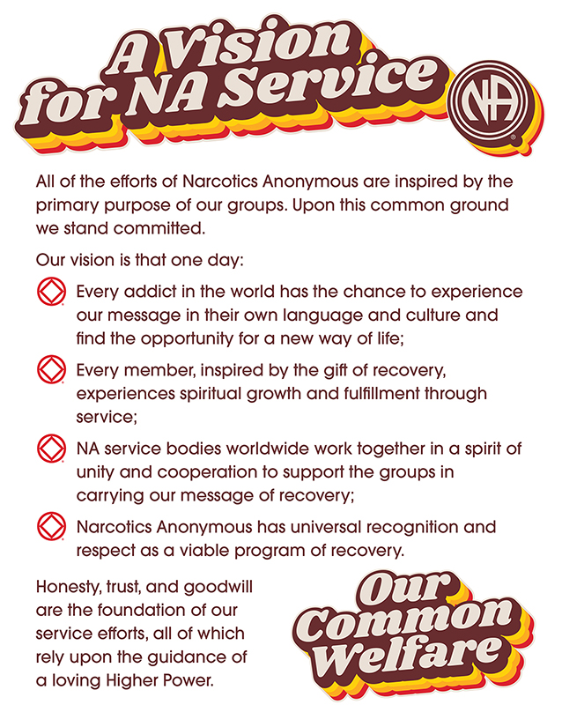
The Term: “Gender-Neutral Language” (Continued)
… Every addict in the world has a chance to experience our message ...
In keeping with gender-neutrality, … “A Vision for NA Service” was revised by changing the phrase “… in his or her own language and culture” to read “… in their own language and culture.”
Notes:
A Vision for NA Service gets to the very heart of what this discussion is about. “Our vision is that one day: Every addict in the world has a chance to experience our message …” In keeping with gender-neutrality, the 2023 World Service Conference voted to revise “A Vision for NA Service” by changing the phrase “… in his or her own language and culture” to read “… in their own language and culture.”

Slide 7

Looking At Our History …
The Chapter on “How It Works” in the Basic Text once read …
“The only way to keep from getting or continuing a habit is not to take that first fix, pill, or drink.”
The 1986 World Service Conference voted to revise this statement to read …
“The only way to keep from returning to active addiction is not to take that first drug.”
Notes:
Looking at our history, the Basic Text had been revised for the exact reason of expanding the circle of addicts who feel welcome as members. The original chapter on “How It Works” once read: “The only way to keep from getting or continuing a habit is not to take that first fix, pill, or drink.” As our Fellowship evolved, some addicts spoke up. They didn’t relate to “that first fix, pill, or drink” because their using took some other form. It was clear that more inclusive language was needed to welcome more addicts into our Fellowship. The 1986 World Service Conference passed a motion to revise the Basic Text to read, “The only way to keep from returning to active addiction is not to take that first drug.”

Slide 8
Looking At Our History (Continued)
… the change in 1986 from: “… that first fix, pill, or drink” to “… that first drug” lost nothing and … carried as much weight as it ever did.
… other possible, simple revisions … like changing “… a nonprofit fellowship or society of men and women …” to “ … a nonprofit fellowship or society of people …” could be just as effective.
Notes:
Making the 1986 change from “… that first fix, pill, or drink” to “… that first drug” lost nothing and the sentence carried as much weight as it ever did. Those who could not identify with the specific words “fix, pill, or drink,” were able to gain a sense of acceptance and belonging with the change to “… that first drug.”
In a recent survey, a majority of respondents believe that other simple revisions like changing “a nonprofit fellowship or society of men and women” to “a nonprofit fellowship or society of people” could have the same effect.

Slide 9
Gender-Neutral Language in NA Literature
… gender-specific language is excluding, causing … members and potential members not to feel fully accepted or included …
In 2023, the World Service Conference passed Motion 14 directing the World Board to:
“… create a project plan for consideration at the next WSC to investigate changes and/or additional wording to NA literature from gender specific language to gender neutral and inclusive language.”
Notes:
The topic of gender-neutral and inclusive language stems from the fact that gender-specific language is excluding, causing significant populations of members or potential members not to feel fully accepted or included in Narcotics Anonymous meetings.
In 2023, the World Service Conference passed Motion 14 directing the World Board to: “ … create a project plan for consideration at the next WSC to investigate changes and/or additional wording to NA literature from gender specific language to gender neutral and inclusive language.”

Slide 10

Gender-Neutral Language in NA Literature (Continued)
Gender-neutral language has … been on the Fellowship’s radar for the last two … cycles.
… the World Board intends to engage Conference Participants in discussions … just on language used to describe our members and potential members …
Also, the Project Plan called for by Motion 14 from the 2023 CAR will be included in the Conference Approval Track material ...
Notes:
For the last two conference cycles the topic - Gender-neutral language - has been on the Fellowship’s radar, and the question on how to make meetings more welcoming is not a new one. During the 2026 World Service Conference, the World Board intends to engage Conference Participants in discussions that focus just on language used to describe our members and potential members. Also, the Project Plan called for by Motion 14 from the 2023 CAR will be included in the Conference Approval Track material for review and approval.

Slide 11
Gender-Neutral Language in NA Literature (Continued)
… “Investigating changes and|or additional wording … from gender specific language to gen­der-neutral and inclusive language” is identified as 1 of 4 Solutions to address the Issue of Safety and Belonging … to fulfill Objective #7 which is to …
“Raise the level of consciousness regarding inclusiveness in our diverse fellowship and develop tools to support groups in ensuring that all members and potential members feel safe, welcomed, and included at in-person and virtual meetings.”
See Addendum #B (NAWS Strategic Plan, page #68 – Objective #7) attached to the 2026 CAR
Notes:
The topic of Gender-neutral language is also featured in the 2026 – 2029 NAWS Strategic Plan … “Investigating changes and|or additional wording to NA literature from gender-specific language to gender-neutral and inclusive language is identified as 1 of 4 Solutions to address the Issue of Safety and Belonging, in an effort to fulfill Objective #7 of the Strategic Plan which is to:
“Raise the level of consciousness regarding inclusiveness in our diverse Fellowship and develop tools to support groups in ensuring that all members and potential members feel safe, welcomed, and included at in-person and virtual meetings.”

Slide 12

Concerns About Changing …
… that altering our foundational text may cause NA to lose some of its time-honored strength.
… about setting a precedent of revising literature any time someone dislikes how it is phrased.
“If it ain’t broke, don’t fix it.”
Notes:
For some members, the idea of altering our Basic Text may raise concerns that NA might lose some of its time-honored strength. These members worry about setting a precedent of revising literature any time someone dislikes how it is phrased. One of the prevailing views of members who gave input opposed to changing the language was essentially “If it ain’t broke, don’t fix it.”

Slide 13
Concerns About Changing … (Continued)
Although not “broken” … the current language of NA is not working for everyone. … members … feel excluded … particularly by … gendered language in group readings …
… data … shows that members perceived their first NA meeting as very important and 83% … reported identification as a key component of what influenced them to stay in NA.
… We discount those potential members who are missing from the conversation when we conclude that the literature worked for us as written when we were new, so it should work for everyone the same way.
Notes:
Although the language of NA may not be “broken,” the simple truth is that it isn’t working for everyone. World Services hears more and more from members who feel excluded by the gendered language in our literature – particularly the gendered language in the group readings, which can be many addicts’ first exposure to the program.
The data from the 2024 Membership Survey shows that members perceived their first NA meeting as very important and 83% of survey respondents reported identification as a key component of what influenced them to stay in NA. What this data could not capture was the voice of the most vital population – the suffering addicts who went to their first NA meeting, felt they didn’t belong, and never came back. We discount those potential members who are missing from the conversation when we conclude that the literature worked for us as written when we were new, so it should work for everyone else the same way.

Slide 14

In recovery, we learn to focus on our similarities, not our differences. However, new­er members often viewing themselves as “ter­minally unique.” It is the spiritual principle of unity that guides us as we discuss how to make addicts everywhere feel welcome in Narcotics Anonymous. Our common welfare should come first.
Notes:
As we mature in our recovery, we learn to focus on our similarities, not our differences. But newcomers can have a tendency to focus on the differences, often viewing themselves as “terminally unique.” It is the spiritual principle of unity that guides us as we discuss the implications of altering our older literature to be more inclusive. Inclusive language doesn’t divide; rather the opposite: We are a society of people. Our primary purpose is to carry the message to the addict who still suffers. Regardless of our personal beliefs, we all wish to make addicts everywhere feel welcome. Our common welfare should come first. The question of exactly what that looks like in action has sparked impassioned and thought-provoking discussions in workshops around the world.

Slide 15
Discussion Icebreaker …
Because so many of the discussions we are having this cycle are asking us to consider the experience of those coming into Narcotics Anonymous and trying to decide whether this is home, before we discuss the topic, we want to take a few minutes to consider some of the ways in which we each may have felt “terminally unique” when we came in.
Think back to when you were new: What were some of the ways you felt different or unique or like an outsider? What helped you recognize that NA was where you belonged?
Pause for discussion
Notes:
Discussion Icebreaker
Because so many of the discussions we are having this cycle are asking us to consider the experience of those coming into Narcotics Anonymous and trying to decide whether this is home, before we discuss the topic, we want to take a few minutes to consider some of the ways in which we each may have felt “terminally unique” when we came in. Think back to when you were new: What were some of the ways you felt different or unique or like an outsider? What helped you recognize that NA was where you belonged?
I’ll start: [Facilitator, share your experience]
Who else wants to share?

Slide 16
Discussion Questions …
Again, for the purposes of these questions, our focus is on language that describes members and potential members (people) only. Changes in wording like - from “men and women” to “people,” for instance - don’t change the meaning of the message in our literature.
Given that we all want to provide a safe, welcoming inclusive Fellowship where every­one can recover (regardless of …), are we willing to explore these types of changes in our literature in order to carry the message more effectively?
If not, why not?
Pause for discussion
Share your feedback by April 1st at www.na.org/surveys!
Notes:
Discussion Questions
At the 2026 Conference, we will spend time discussing this issue. To help inform the discussion, please spend some time at your CAR workshop discussing this question, and provide us with your feedback by April 1, 2026 - at na.org/surveys.
For the purposes of these questions, we intend to focus on gender neutral language in NA literature as described in the CAR essay - changes in the language that describes people (members and potential members) only. These changes in wording - from “men and women” to “people,” for instance - don’t change the meaning of the message in our literature; they allow more people to identify with it. So, here’s the question we want to discuss and offer feedback on:
Given that we all want to provide a safe, welcoming inclusive Fellowship where everyone can recover (regardless of . . . ), are we willing to explore these types of changes in our literature in order to carry the message more effectively? If not, why not?
Remember, this is a discussion, not a decision. It’s an opportunity to hear each other and to gather your thoughts for the input form.

Slide 17
Five other PowerPoints available online
CAR survey available online
2026 CAR available for download
worldboard@na.org | na.org/conference
Scan the QR Code and give your feedback by April 1, 2026!
Notes:
We hope this PowerPoint has helped in your discussion of this material. Please share your thoughts on this discussion at na.org/survey. Your input will be considered by conference participants at the World Service Conference in May.
You can find some groups’ ideas for alternative gender-neutral readings at na.org/gender.
Please note that there are five other PowerPoints that focus on the rest of the CAR. These resources and the CAR itself, and the CAR survey are available online at www.na.org/conference.
We welcome your questions and your feedback on the CAR, and all other issues, at worldboard@na.org.

