Slide 1
PowerPoint 5 of 6
2026 Conference Agenda Report
Literature, Service Material, and Issue Discussion Topics survey
Notes:
This is the fifth of six PowerPoints covering material in the 2026 Conference Agenda Report (or CAR for short).

Slide 2

2026 CAR PowerPoints
Introduction to CAR
Motions
3. Gender-Neutral and Inclusive Language
4. DRT/MAT in NA: Helping Members Take Root
5. Literature, Service Material, and Issue Discussion Topics survey
6. Pricing Our Literature
Notes:
This PowerPoint covers the Literature, Service Material, and Issue Discussion Topic survey. Here are the titles of the other five PowerPoints.

Slide 3
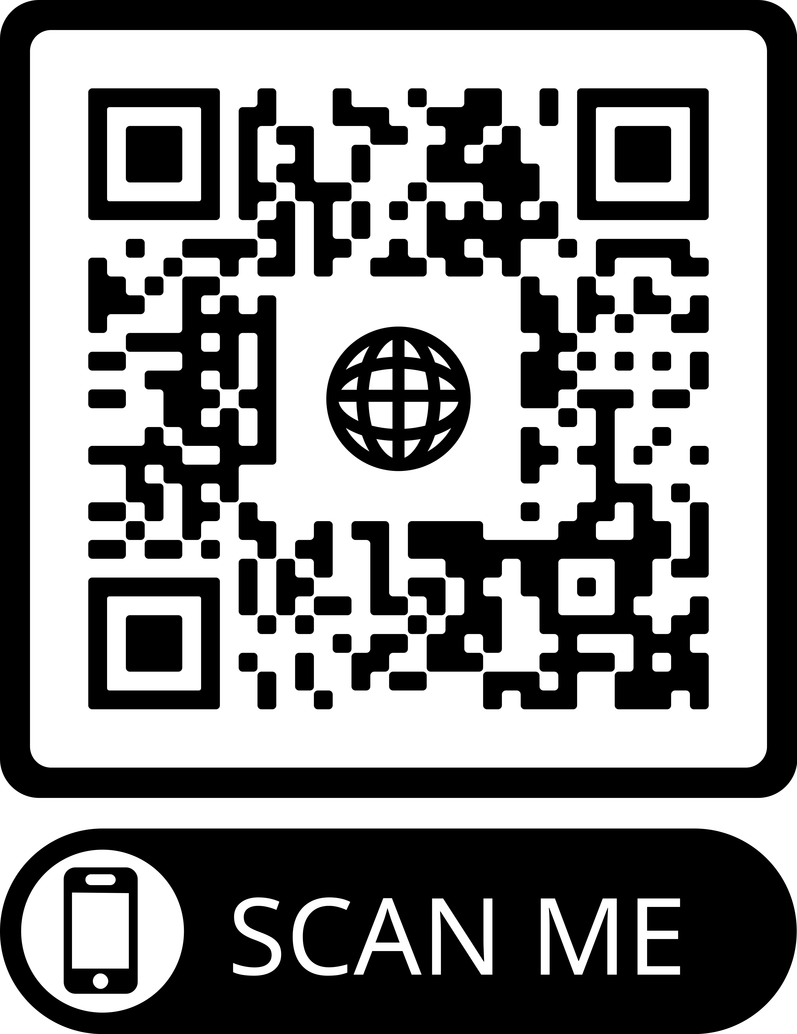
2026 CAR PowerPoints
These PowerPoints only cover the main points of the CAR. We encourage all members to read the CAR itself. Please visit na.org/conference for the complete 2026 CAR.
Notes:
Please keep in mind, these PowerPoints only cover the main points of the CAR. We encourage all members to read the CAR itself. Please visit na.org/conference for the complete 2026 CAR, the other PowerPoints, and other conference materials.

Slide 4
Literature, Service Material, and Issue Discussion Topics survey
Since 2016, the conference has used a CAR survey to help participants set priorities for recovery literature, service material, and Issue Discussion Topics (IDTs) for the cycle
2025 Interim WSC passed Motion 5: Instead of submitting motions for project plans to create specific pieces of service material, recovery literature, or IDTs for the 2026 Conference Agenda Report, conference participants will submit those ideas for possible inclusion in the 2026 CAR Survey.
Notes:
Since 2016, the World Service Conference has used a survey in the CAR to help guide participants in setting priorities for new and revised recovery literature and service material, and deciding what the Issue Discussion Topics (IDTs) for the upcoming conference cycle will be. The advantage of prioritizing in this way is that it allows the Fellowship and conference to think about all the ideas collectively next to each other.
This is the fifth time the survey has been included in the CAR, but it’s a new approach this time. The 2025 Interim WSC passed Motion 5 which included this text: “Instead of submitting motions for project plans to create specific pieces of service material, recovery literature, or IDTs for the 2026 Conference Agenda Report, conference participants will submit those ideas for possible inclusion in the 2026 CAR Survey.” The motion outlined a new, more collaborative process to create the CAR Survey. This is a trial for this conference cycle only.

Slide 5
Any member was able to submit ideas for inclusion in the survey via an online form rather than by email
FIRST TIME!
more than 500 ideas submitted
similar ideas were combined
conference participants went through 2 rounds of prioritization
Notes:
For the first time, any member was able to submit ideas for inclusion in the survey via an online form rather than by email. The conference decided to start with a clean slate as many members considered the lists in previous surveys too long.
The board reviewed the more than 500 ideas submitted and combined similar ideas to create a shorter list of broader topics. For instance, there were six different pieces of input related to service material on Fellowship development. All of those ideas are captured in the survey entry “New service basics/service pamphlet: Fellowship Development. Ideas include best practices for outreach, what FD is, and guidelines for committees”
This approach is in the spirit of consensus building, where you start with the broad ideas everyone can agree to and then develop specifics. Once the lists were compiled, conference participants went through two rounds of prioritization to create the shorter lists contained in the survey.

Slide 6
What Happens to the CAR Survey Results?
NAWS ongoing work: production, reporting, translations, shipping, sending literature to members and communities in need, PR web meetings, and much more
WSC approved projects
3 February 2026: CAT contains general project plans without a specific focus
The CAR Survey guides the conference’s decision about the focus.
Notes:
Most of the work of NA World Services is reasonably consistent from cycle to cycle—production, reporting, translations, shipping, sending literature to members and communities in need, PR web meetings, and so much more.
World Services also takes on projects that vary from cycle to cycle that are about accomplishing objectives described in the NAWS Strategic Plan (see Addendum B in the CAR). Project plans are included in the Conference Approval Track material that is posted 90 days before the WSC on the 3rd of February, 2026, and they are approved by the World Service Conference.
Since 2016, the board has offered general project plans for recovery literature, service material, and Issue Discussion Topics without a specific focus. The CAR Survey results help guide the conference’s decisions about the focus for these projects.

Slide 7

How can we do this better?
I don’t know. But we will figure it out.
NAWS Strategic Plan
CAR Survey
Notes:
The Planning essay in this CAR (see pages 19-24), explains the new collaborative planning process the conference initiated this cycle. The CAR Survey is not yet as well integrated into the process as we would hope. The CAR Survey and the NAWS Strategic Plan are, in essence, two different ways to show what work needs to be done in the upcoming cycle, and the conference needs to find a more seamless connection between the plan and the CAR Survey in future cycles.

Slide 8
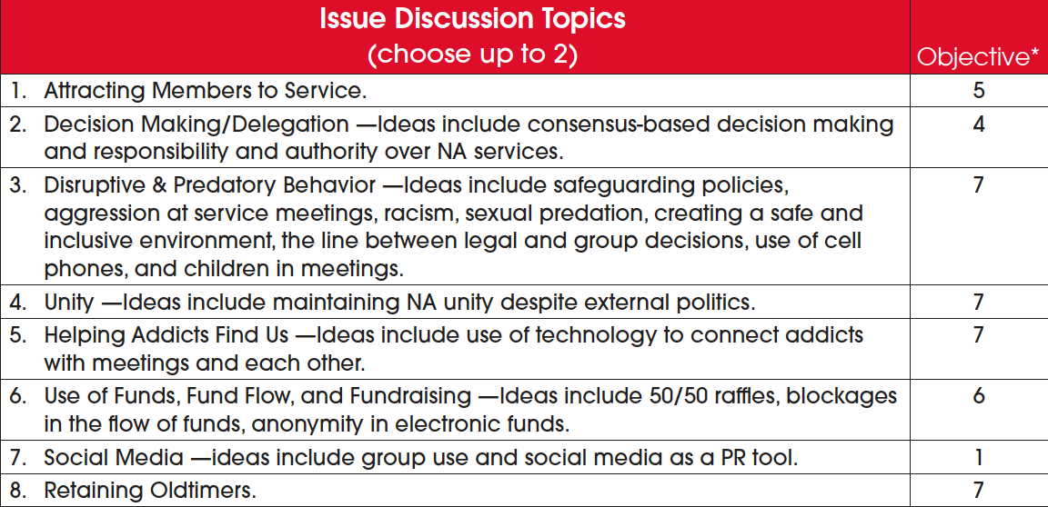

*Objectives are part of the NAWS Strategic Plan, which is included in Addendum B.
Notes:
In the meantime, the righthand column in the CAR Survey lists Strategic Plan objective numbers to show the connection between each item and the Strategic Plan objectives. In the online version of the survey, these objective numbers show up in brackets next to each item. Sometimes the connection between survey items and plan objectives is obvious, and in other cases it’s not such a smooth fit. The objective numbers are offered just to help you in your consideration as you prioritize items.

Slide 9
Please, fill the survey out at na.org/survey
Choose up to two (2) items in each category
Be aware online entries are randomized
For that reason the list is numbered
Also please consider what would benefit the wide world of NA.
Sometimes that means thinking about underserved or underrepresented populations.
Notes:
Every interested member is encouraged to fill out the survey, which is included in the CAR and posted on na.org/survey. Delegates should also fill out the survey with the conscience of their regions and zones. Choose up to two (2) items in each category. Please be aware that the online entries are randomized so the order will not be the same for you when you fill out the online survey as the order listed here. For that reason, the lists are numbered. The numbers don’t indicate importance—they are simply a way to quickly identify each item.
When we each select priorities, ideally, we’re considering not just personal preferences or the preferences of our group or area, but what would benefit the wide world of NA. Sometimes that means thinking about underserved or underrepresented populations. If everyone simply prioritized their own interests, IPs for “young addicts” or those with “additional needs” might never have been published. Also, keep in mind that there may not be enough time to do everything that’s prioritized! There are always more needs than resources.

Slide 10
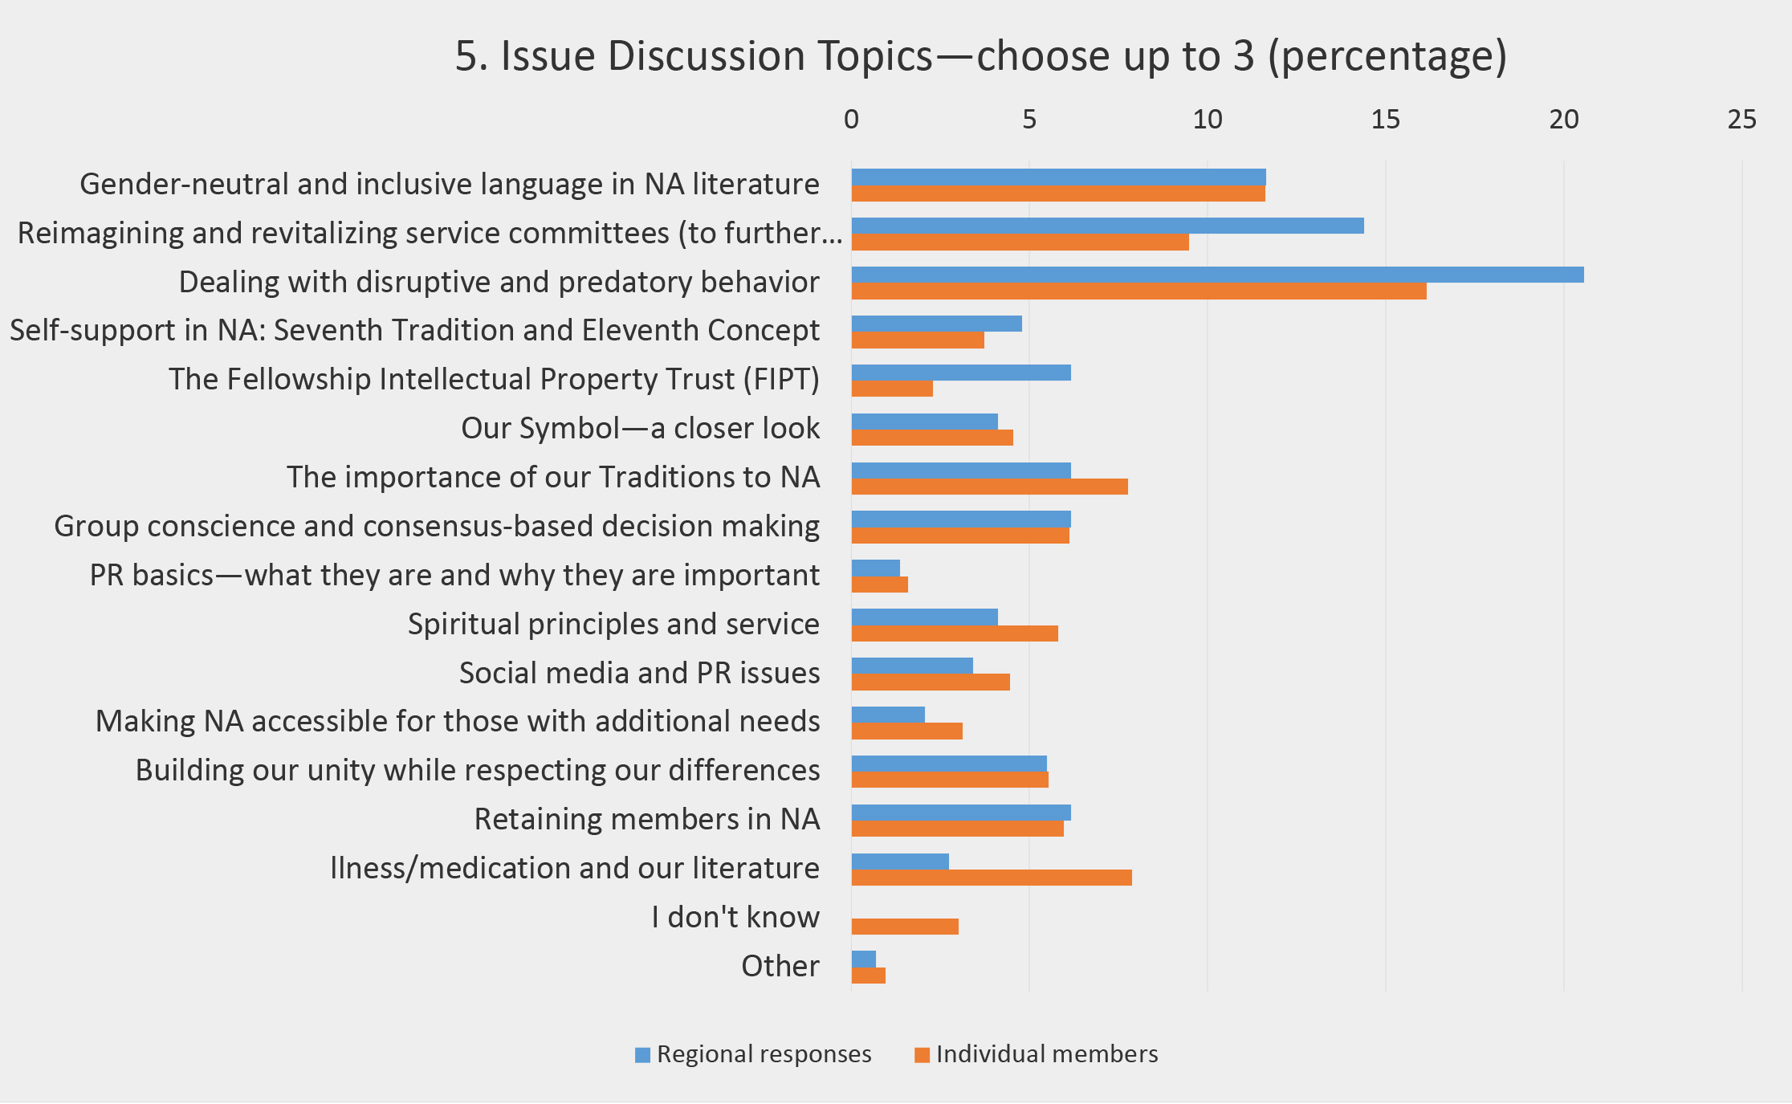
Results from survey for IDTs for 2023 WSC
Please fill out the survey by 1 April 2026
Notes:
Two sets of results—those from members and those from delegates—are distributed at the World Service Conference and included as an appendix in the conference minutes.
Please fill out the survey by 1 April 2026, so that there is enough time to compile your responses for the conference to consider.

Slide 11

Recovery Literature
Disruptive and Predatory Behavior was an IDT this past cycle and input clearly indicates desire for new or revised material on the topic.
Notes:
Several items in the Recovery Literature section of the survey have been the subject of ongoing discussions and/or conference action.
Dealing with Disruptive and Predatory Behavior was an Issue Discussion Topic this past cycle, and Fellowship input clearly indicated a desire for new or revised material on the topic.

Slide 12


Discussions for 2026 WSC
DRT/MAT as It Relates to NA: Helping Members Take Root
&
Gender-Neutral and Inclusive Language in NA Literature
were also IDTs and have essays and discussion questions in the CAR.
na.org/survey has forms to offer input which will be included in the discussions for WSC
There are also PowerPoints dedicated to their discussion.
Notes:
Another Issue Discussion Topic the cycle was DRT/MAT as It Relates to NA: Helping Members Take Root. As the essay on the topic in this CAR indicates, our Fellowship seems to be divided on this issue. It is the intention to have a discussion at WSC 2026 on the topic, and there is a form to gather input on discussion questions at na.org/survey.
Gender-Neutral and Inclusive Language in NA Literature was also an Issue Discussion Topic this past cycle, and again, the Fellowship does not seem to have consensus on this topic. As with DRT/MAT as It Relates to NA, there is an essay and discussion questions in this CAR, and again, an input form is posted on na.org/survey to help inform conference discussions on the topic. One of the project plans in the Conference Approval Track material will be on this topic, as directed by Motion #14 in 2023: “To direct the World Board to create a project plan for consideration at the next WSC to investigate changes and/or additional wording to NA literature from gender specific language to gender neutral and inclusive language.”

Slide 13
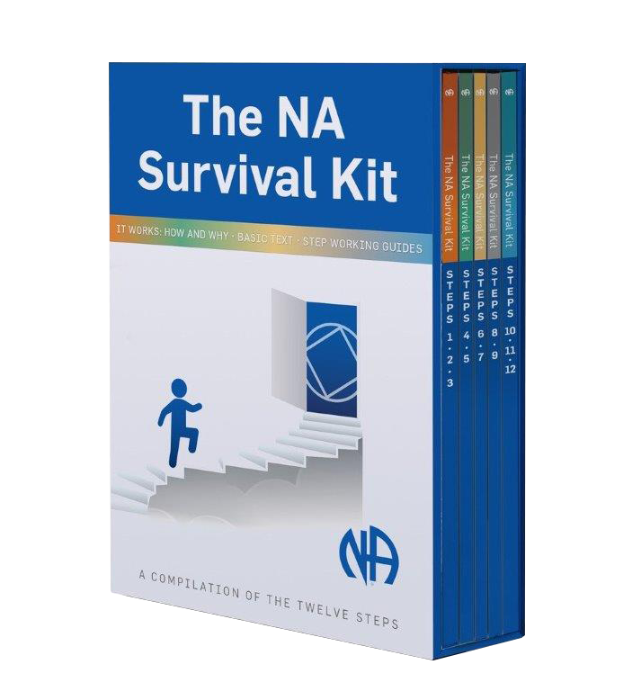
New or Revised Step Material
Newcomers?
Longtimers?
Incarcerated members?
Does the NA Survival Kit satisfy some of the needs?
There are two Step-related pieces in the CAR Survey: one each in “new” and “revised” recovery literature.
Notes:
One more explanatory note: You may recall that the CAR Survey in 2023 contained a number of items related to new or revised Step material. One of the focuses the conference approved for the New and Revised Recovery Literature project plan was to survey the Fellowship to help determine what new or revised Step-related material members want to see. The Fellowship was surveyed, and there seems to be no clear direction. Some members would like material for newcomers, some for longtimers, some for incarcerated members. Some members would like to see revisions to existing material. There is not a consensus. What’s more, the survey was conducted before the NA Survival Kit was published, and that publication may satisfy some of the needs that members have expressed.
There are two Step-related pieces in the CAR Survey: one each in “new” and “revised” recovery literature.
The results of the survey on Step working materials will be reported in the Conference Report as will summaries for the Issue Discussion Topics.

Slide 14
New Recovery Literature (choose up to 2)
 |  | Objective*
1. | New IP/Booklet: Disruptive and Predatory Behavior. Ideas include how to identify behavior and create a safe environment. | 7
2. | New IP/Booklet: Virtual Recovery. Ideas include getting clean on the screen, group booklet for online meetings, virtual membership and service basics, guidance for online meeting behavior. | 3
3. | New book/workbook/study guide: 12 Concepts. Ideas include Concepts Working/Study Guide, Guiding Principles for Service Committees. | 4
4. | New IP/Booklet: DRT/MAT. Ideas include looking for a stand or position that is clear, defining clean or abstinence, clarifying who can serve, labeling this as an outside issue, saving lives and helping members take root, including personal experience, PR and MAT, other medical treatments—medical marijuana/psychedelics for therapy. | 8
5. | New IP/Booklet: Women in Recovery. Ideas include carrying the message in male-dominated communities, women-centric issues such as motherhood, menopause, sharing experience. | 7
6. | New Step Guide: Focused for more experienced members. | 7
7. | New IP/Booklet: Welcoming Newcomers and Helping Them Stick and Stay. Ideas include what to do as a newcomer and how to treat the newcomer. | 7
8. | No new recovery literature.
Pause for discussion
Notes:
This is the full list of items in the New Recovery Literature section of the survey. Please select up to two items from this list.
pause for discussion

Slide 15
Revised Recovery Literature (choose up to 2)
 |  | Objective*
1. | Update the booklet Behind the Walls (1990). Ideas include adding services available and staying clean on the outside. | 7
2. | Revise Tradition Eleven to include “social media.” | 1
3. | Update the Booklet In Times of Illness (2010). Ideas include add information on medical marijuana, therapeutic use of psychedelics, and clarity around prescribed medications. | 8
4. | Gender-neutral language. Investigate changes and/or additional wording to NA literature from gender-cspecific language to gender-neutral and inclusive language. | 7
5. | Revise the Step Working Guides. Ideas include fewer leading questions, fewer questions in Step One, more questions in Step Four, more encouragement to journal, streamline the process, and number the questions. | 7
6. | Update IP #26 Accessibility for Those with Additional Needs (1998). Ideas include acknowledging current technologies and adding something about nonvisible disabilities. | 7
7. | Replace references to God with Higher Power throughout our literature. | 7
8. | Update IP #24 Money Matters (2010). Ideas include adding information on zonal forums and digital contributions. | 6
9. | No revisions to recovery literature.
Pause for discussion
Notes:
This is the full list of items in the Revised Recovery Literature section. Please choose no more than two from this list.
pause for discussion

Slide 16
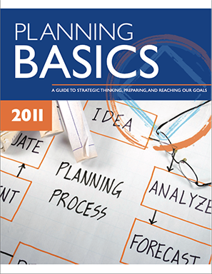


Service Material
Reimagining and Revitalizing Service Committees—Fellowship input on the topic seems to point to updating Planning Basics, a suggestion that came up repeatedly
Revising The Group Booklet and A Guide to Local Services would make progress toward a number of objectives in our the strategic plan. If these items are prioritized, the board would work together with zones
Notes:
The fourth Issue Discussion Topic from last cycle was Reimagining and Revitalizing Service Committees. Fellowship input on the topic seems to point to updating Planning Basics, a suggestion that came up repeatedly.
As we just mentioned, Dealing with Disruptive and Predatory Behavior was also an Issue Discussion Topic this past cycle, and Fellowship input clearly indicated a desire for new or revised material on the topic.
While ideas for new service tools are valuable and the board wants to hear them, there are also a lot of very old service materials that need to be updated to reflect current experience and reality.
In the course of our collaborative planning this cycle, it was heard repeatedly that revising The Group Booklet and A Guide to Local Services would make progress toward a number of objectives in the strategic plan. If these items are prioritized, the board would work together with zones and regions to collect best practices from throughout the Fellowship so that the revised drafts would reflect what’s working in NA. This would take up much of our attention in the cycle ahead, but it is work that would meet many needs.
The service material section is divided into ideas for new pieces and ideas for revisions, as was done for recovery literature. Please select up to two of the options in each category from the list.

Slide 17
New Service Material (choose up to 2)
 |  | Objective*
1. | New service basics/service pamphlet: Mentorship in Service. Ideas include practical training and how to implement mentorship in service bodies. | 5
2. | New service basics/service pamphlet: Fellowship Development. Ideas include best practices for outreach, what FD is, and guidelines for committees. | 4
3. | New service basics/service pamphlet: Virtual Service. Ideas include guidelines for virtual platform, public relations, virtual areas and regions, connecting virtual groups to the service structure, virtual or hybrid service meetings. | 3
4. | New service basics/service pamphlet: Social Media. Ideas include use of AI to do public relations work and application of the Traditions in social media. | 1
5. | New service basics/service pamphlet: GSR Orientation/Workshop Guide. | 4
6. | New service basics/service pamphlet: Group Inventory/ Group Pamphlet to Do Annual Review. | 4
7. | New service basics/service pamphlet: Area Service Basics. | 4
8. | New service basics/service pamphlet: Tools for Managing Electronic Funds for Groups and Service Bodies. | 6
9. | New service basics/servi6e pamphlet: Trusted Servant Development. | 5
10. | New service basics/service pamphlet: PR Tools for Government/Criminal Justice. | 2
11. | New service basics/service pamphlet: Service Collaboration at All Levels. | 4
12. | New service basics/service pamphlet: Rotation and Continuity in Service. | 5
13. | No new service material.
Pause for discussion
Notes:
This is the full list of items in the New Service Material section of the survey. Please select up to two options.
pause for discussion

Slide 18
Revisions to Existing Service Material (choose up to 2)
 |  | Objective*
1. | Revise A Guide to Local Services. Ideas include create a contemporary set of service tools to replace A Guide to Local Services, delete outdated information, add information on rural/remote areas and regions, add information on zones, add more best practices. | 4
2. | Revise The Group Booklet. Ideas include adding information on addressing predatory behavior, how to make members feel welcome, virtual NA, the importance of Traditions and Concepts study meetings, common needs meetings, expanded information on trusted servant roles. | 7
3. | Revise SP Disruptive and Violent Behavior. Ideas include adding section on predatory behavior, addressing online meetings, adding text from the IDT. | 7
4. | Revise SP Social Media. Ideas include adding information about online meetings, updating social networking guidance, including information on PR and H&I. | 1
5. | Revise H&I Handbook. | 1
6. | Revise PR Handbook. | 1
7. | Revise Planning Basics. | 4
8. | No revisions to service material.
Pause for discussion
Notes:
This is the full list of items in the Revisions to Existing Service Material section of the survey. Please select up to two options.
pause for discussion

Slide 19

Issue Discussion Topics
Are just that—issues that are discussed throughout the Fellowship in the time between Conferences.
The results of those discussions can contain some of NA’s best practices and have created the foundation for several service pamphlets and other tools and literature.
Notes:
Issue Discussion Topics are just that—issues that are discussed throughout the Fellowship in the time between conferences. The results of those discussions can contain some of NA’s best practices and have created the foundation for several service pamphlets and other tools and literature.

Slide 20
Issue Discussion Topics (choose up to 2)
 |  | Objective*
1. | Attracting Members to Service. | 5
2. | Decision Making/Delegation —Ideas include consensus-based decision making and responsibility and authority over NA services. | 4
3. | Disruptive & Predatory Behavior —Ideas include safeguarding policies, aggression at service meetings, racism, sexual predation, creating a safe and inclusive environment, the line between legal and group decisions, use of cell phones, and children in meetings. | 7
4. | Unity —Ideas include maintaining NA unity despite external politics. | 7
5. | Helping Addicts Find Us —Ideas include use of technology to connect addicts with meetings and each other. | 7
6. | Use of Funds, Fund Flow, and Fundraising —Ideas include 50/50 raffles, blockages in the flow of funds, anonymity in electronic funds. | 6
7. | Social Media —ideas include group use and social media as a PR tool. | 1
8. | Retaining Oldtimers. | 7
Pause for discussion
Notes:
This is the full list of items in the Issue Discussion Topics section of the survey. Please select no more than two options.
pause for discussion

Slide 21

As a reminder, responses from members, and regions and zones will be collected until 1 April 2026. You can access the survey at na.org/survey or on the NA Meeting Search app.
Notes:
As a reminder, responses from members, and from regions and zones will be collected until the first of April, 2026. You can access the survey at na.org/survey or on the NA Meeting Search app.

Slide 22
Five other PowerPoints available online
CAR survey available online
CAR available for download
worldboard@na.org
na.org/conference
Notes:
We hope this PowerPoint has helped in your discussion of this material. Please note that there are five other PowerPoints that focus on the rest of the CAR. These resources, the CAR itself, and the online CAR survey are available online at na.org/conference.
We welcome your questions and your feedback on the CAR, and all other issues, at worldboard@na.org.

