Slide 1
PowerPoint 4 of 6
2026 Conference Agenda Report
DRT/MAT and NA:
Helping Members Take Root
Notes:
This is the fourth of six PowerPoints covering material in the 2026 Conference Agenda Report (or CAR for short).

Slide 2

2026 CAR PowerPoints
Introduction to CAR
Motions
3. Gender-Neutral and Inclusive Language
4. DRT/MAT in NA: Helping Members Take Root
5. Literature, Service Material, and Issue Discussion Topics survey
6. Pricing Our Literature
Notes:
This PowerPoint covers the essay DRT/MAT in NA–Helping Members Take Root.

Slide 3
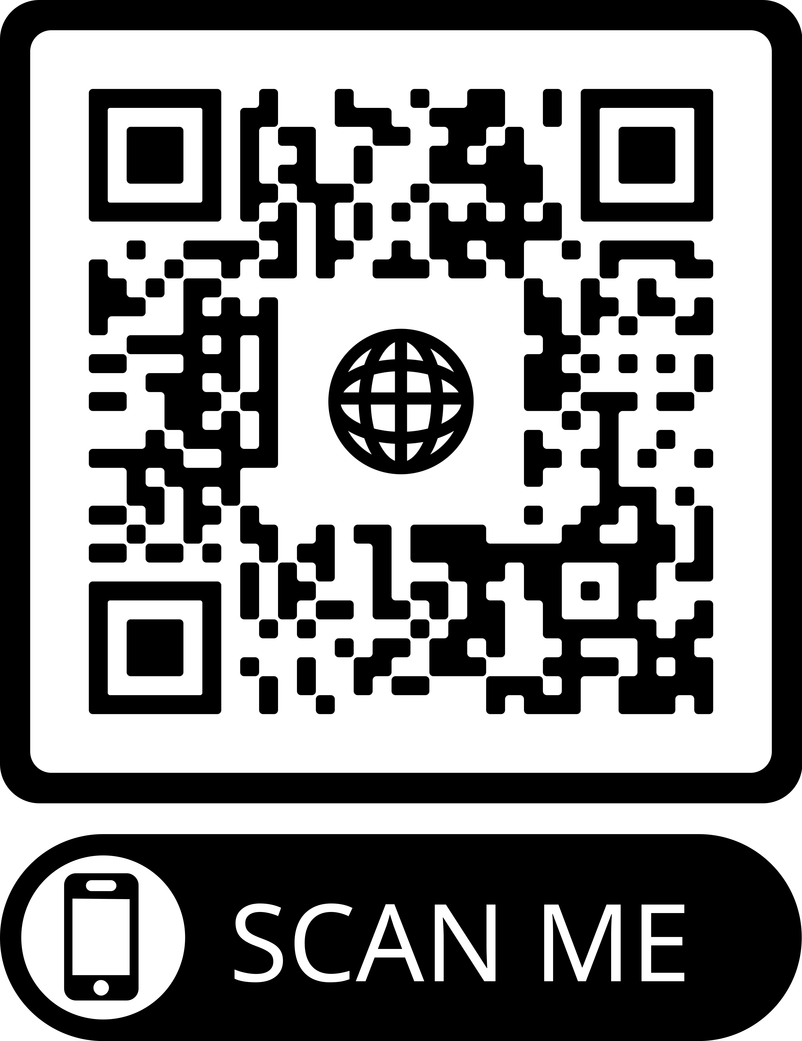
2026 CAR PowerPoints
These PowerPoints only cover the main points of the CAR. We encourage all members to read the CAR itself. Please visit na.org/conference for the complete 2026 CAR.
Notes:
These PPTs only cover the main points of the CAR. We encourage all members to read the CAR itself. Please visit na.org/conference for the complete 2026 CAR, the other PowerPoints, the CAR Survey, input forms for discussion questions, and other conference materials.

Slide 4

This one of two topics with discussion questions included in this CAR.
If you’re discussing these questions in your workshop, please note that this is a discussion, not a decision—you don’t need to come to an agreement.
It’s an opportunity to hear each other and gather your thoughts for the unput form, which you’ll find at na.org/survey.
Notes:
This is one of two topics with discussion questions included in this CAR. If you are discussing these questions in your workshop, please note that this is a discussion, not a decision - you don’t need to come to an agreement. It’s an opportunity to hear each other and gather your thoughts for the input form, which you can find at na.org/survey.

Slide 5
DRT/MAT in NA: Helping Members Take Root
Our future depends on making sure our message is clear and that the doors to Narcotics Anonymous are open to all addicts.
The Issue Discussion Topic (IDT) “Helping Members Take Root” asked how we can help people “stick and stay”—make the decision to become members of Narcotics Anonymous.
Notes:
As we consider Our Common Welfare, we realize our future depends on making sure our message is clear and the doors to Narcotics Anonymous are open to all addicts. Who comes to NA, how they find us, and whether they stay is important to all of us. The Issue Discussion Topic (IDT) “Helping Members Take Root” asked about what happens after addicts come through our doors, and how we can help people “stick and stay”— make the decision to become members of Narcotics Anonymous.

Slide 6
Medications used to treat addiction have been a wedge issue in NA for a long time.
More than 850 IDT responses covering a spectrum of perspectives
Often feels like an issue of survival, both for the addict suffering and the Fellowship itself.
What we seem to need most is to create an atmosphere of recovery around the issue.
There’s enough common ground to build a new foundation for this conversation beginning from our spiritual principles.
Can we agree for now to listen to one another with love, compassion, and a willingness to respect our opposing viewpoints?
Notes:
There was a lot of input on this IDT. Medications used to treat addiction have been a wedge issue in NA for a long time. Among the more than 850 responses one thing that stood out was the shared sense of hurt and urgency. To many of us, it feels like an issue of survival, both for the addict suffering and for the Fellowship itself.
At this point, it seems like what we need most is to create an atmosphere of recovery around the issue. There is common ground, and on that ground we can build a new foundation for this conversation, beginning from our spiritual principles in this polarized world, on this highly charged issue, can we agree for now to listen to one another with love, compassion, and a willingness to respect our opposing viewpoints?

Slide 7
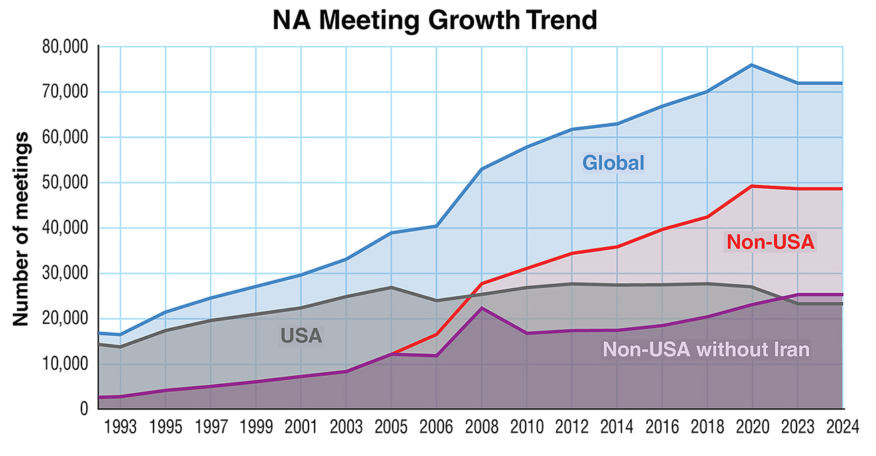
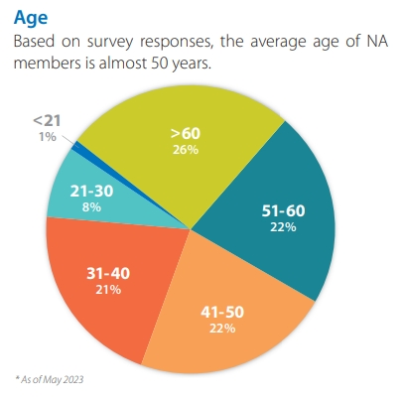
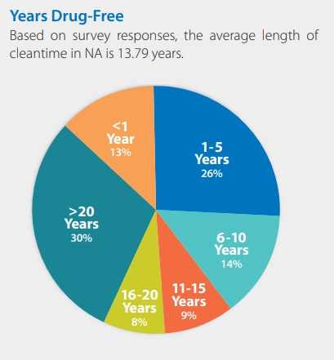
2024 Membership Survey Data
NA growth is flat in the US
About half of our members worldwide are over age 50
47% have more than ten years clean.
82% say they stay because they felt welcome as newcomers.
Notes:
In the years that we have been discussing this, the growth of NA particularly in the US has flattened or even declined. We see our members getting older: About half of our members are over 50, and 47% have more than ten years clean. Our recent Membership Survey showed that the US has fewer members under 30, and fewer members who came to NA on medication for addiction, than in other parts of the world.
NA’s future depends on those just getting started and those yet to come. Identification with members and the welcome they felt is why people stay. We need to make sure that newcomers have the opportunity to become longtime members.

Slide 8
At WCNA 38 PR sessions, professionals expressed reservations in referring addicts to NA.
They are hesitant because addicts treated with medication for addiction had experienced an unwelcoming atmosphere at NA meetings.
Numerous members (responding to the IDT) said that they were advised not to share about medications they were prescribed (and in some cases, legally mandated) to take.
Too often, we are not providing that vital welcome or a consistent message of hope.
And we may be creating an atmosphere where addicts are afraid to tell the truth.
Notes:
At WCNA 38, the professionals at our PR sessions were frank about their reservations referring addicts to NA because addicts being treated with medication for addiction had experienced a hostile or unwelcoming atmosphere at NA meetings. And numerous members said that in our program of total honesty, they were advised not to share about the medications they were prescribed (and in some cases, legally mandated) to take. In too many places, we are not providing that vital welcome or a consistent message of hope. And we may be creating an atmosphere where addicts are afraid to tell the truth.

Slide 9

How can we help addicts coming in the door stay in NA long enough to want what we have?
How can we help addicts seeking recovery—who may be hearing a different message from professionals—to choose our way of life?
Can we make NA a welcoming environment without compromising our integrity or our message?
Notes:
How can we help addicts coming in the door to stay long enough to want what we have? How can we help addicts seeking recovery—who may be hearing a very different message from professionals than they hear in NA—to choose our way of life? And can we make NA a welcoming environment for those addicts without compromising our integrity or our message?

Slide 10
A conversation over decades…
1990s Board of Trustees bulletin
2006 IDT, Who is missing from our meetings?
2012 IDT The Third Tradition (The only requirement for membership is the desire to stop using.)
2014 IDT, Welcoming All Members
2018 IDT, DRT/MAT as It Relates to Narcotics Anonymous
2023 IDT, DRT/MAT as It Relates to Narcotics Anonymous: Helping Members Take Root
Notes:
We have been talking about one or another form of drug replacement therapy for many years.
• In the 1990s, the Board of Trustees issued a bulletin
• 2006 IDT: Who is missing from our meetings?
• 2012 IDT: The Third Tradition (The only requirement for membership is a desire to stop using.)
• 2014 IDT: Welcoming All Members
• 2018 IDT: DRT/MAT as It Relates to Narcotics Anonymous
• 2023 IDT: DRT/MAT as It Relates to Narcotics Anonymous: Helping Members Take Root

Slide 11
“The question of the newcomer attending NA for the first time—or even regularly attending meetings on MAT—is not the dilemma we face as a Fellowship. Our Third Tradition is settled: We welcome everyone. The dilemma is not ‘are they members,’ or ‘do they have the desire.’ Someone is a ‘member’ when they say they are, and desire is unmeasurable. The question is, ‘Are our members who are on MAT considered clean and completely abstinent in accordance with the principles of NA?’”
~a member responding to the IDT
This is not a casual disagreement.
It’s a matter of life and death.
If we were to pick any side, addicts would leave and die.
Notes:
After so much conversation, we are no closer to consensus on our response to a number of questions related to addiction medication. But we have made some progress. We do have consensus on basic principles like:
•unity
• welcome
• and our message.
We want to welcome everyone to Narcotics Anonymous, help them decide if they belong and want to “take root” here--become members. But once those addicts are here, difficult questions arise, mostly around service and celebration. A member said it best in their response to the IDT:
The question of the newcomer attending NA for the first time—or even regularly attending meetings on MAT—is not the issue. Our Third Tradition is a settled question: We welcome everyone. This isn’t the exact dilemma we face as a Fellowship. The dilemma is not “are they members,” or “do they have the desire.” Someone is a “member” when they say they are, and that desire is an unmeasurable commodity. The question is, “Are our members who are on MAT considered clean and completely abstinent in accordance with the principles of NA?”
This is not a casual disagreement. For many of us, it goes to the heart of our understanding of what Narcotics Anonymous is and what our recovery means. To say we are not in a position to solve it is to acknowledge the gravity of this issue. This is actually a matter of life and death: If we were to pick any side, addicts would leave and die. And to many of those whose positions are fixed, the answer seems clear and obvious.

Slide 12
The Spiritual Principle of Surrender
We once thought our Fellowship could eventually come to a single position.
However, we find that we simply do not have consensus on whether a person taking medication to treat their addiction is “clean.”
But we have the tools to recover with one another in unity and grace, despite differences in how we understand the program we all love.
Notes:
When this conversation started so many cycles ago, many of us thought the Fellowship would come to a single position on its definition of abstinence and its position on medication-based approaches to the disease of addiction.
We simply do not have consensus on whether a person taking medication to treat their addiction is “clean.” The answers offered in service pamphlets and bulletins have not resolved this in the minds and hearts of NA members. But we have the tools to live and recover with one another in unity and grace, despite differences in how we understand the program we all love.

Slide 13
The Spiritual Principle of Surrender
We have consensus that abstinence is central to the NA program and to our message. But there is not consensus among members on what exactly constitutes abstinence.
We have addressed medication issues in In Times of Illness and IP #30, Mental Health in Recovery. Many of us consider medication to treat the disease of addiction a separate category, but as these medications change, it gets harder to find a line between one kind of medication and another.
Like any surrender, admitting that we’re not getting closer to consensus frees us to approach this conversation differently. We all know the process works, and we can trust the process to bring us to the truth, even if it takes a long time.
Notes:
Thinking about how we survive such a significant difference drives us to our spiritual principles. And that begins with admission and surrender.
We do have consensus that abstinence is central to the NA program and to our message.
But there is not consensus among members on what exactly constitutes abstinence. Many of us have experience with needing medication in recovery for various reasons: These issues are addressed in the booklet In Times of Illness, and in IP #30, Mental Health in Recovery. Although many of us consider medication to treat the disease of addiction an entirely separate category, as these medications change—no longer simply opioids or opiate blockers—it is increasingly difficult to find a line between one kind of medication and another.
It continues to be the case that we believe in abstinence, but members define and experience it differently, and what constitutes abstinence ultimately rests with the recovering addict, in communication with a sponsor and their Higher Power.
While this may be surprising to many of us, the surrender to this current reality brings freedom. Admitting that we’re not getting closer to consensus frees us to approach this conversation differently. The diversity of perspectives on the topic of abstinence speaks to the diversity of approaches to recovery within our program. What we all know is that the process works, and that we can trust the process to bring us to the truth, even if it takes a long time. But trusting the process is not a small task when we feel that the integrity of our group or our message is in question.

Slide 14
Tradition Three
Each of us has a part to play in making NA groups welcoming to everyone. Doing so requires checking our reservations about the recovery of others. A newcomer may seem too young or too old, or too beaten down or not having lost enough; they may have done the wrong drug, or not used like we did; they may still be on parole, or take medication we have opinions about. . . . There is no model of the recovering addict, no profile of the addict who suffers, and no condition on membership besides desire— which is between the addict and their Higher Power.
Guiding Principles: The Spirit of Our Traditions, Tradition Three
Notes:
The challenge of medication-driven treatment often gets framed through Traditions Three and Five, as we’ve seen in those previous IDTs. Tradition Three tells us that the only requirement for membership is a desire to stop using; It Works reminds us that “our task is to fan the flame of desire, not dampen it. Any addict who walks into a meeting, even a using addict, displays a level of willingness that cannot be discounted.” In the Issue Discussions we have confronted our opinions about different forms of treatment, and what Guiding Principles points out may be our reservations about each other.
Each of us has a part to play in making NA groups welcoming to everyone. Doing so requires checking our reservations about the recovery of others. A newcomer may seem too young or too old, or too beaten down or not having lost enough; they may have done the wrong drug, or not used like we did; they may still be on parole, or take medication we have opinions about. . . . There is no model of the recovering addict, no profile of the addict who suffers, and no condition on membership besides desire— which is between the addict and their Higher Power.
Guiding Principles: The Spirit of Our Traditions, Tradition Three

Slide 15
Tradition Five
Our primary purpose is simply to carry the message that an addict, any addict, can stop using drugs, lose the desire to use, and find a new way to live.
When we focus on carrying our message, we can surrender some of our desire to control those who hear it and allow people to come to an understanding in their own time.
The biggest challenge seems to be in Tradition Two: We are afraid that this issue might “break” NA. Trusting that our Fellowship is resilient asks us to step out in faith.
Notes:
In Tradition Five, we consider our primary purpose, which is simply to carry the message that an addict, any addict, can stop using drugs, lose the desire to use, and find a new way to live. Our conversations about DRT/MAT remind us that when we are focused on carrying our message, we can surrender, to some degree, our desire to control those who hear it and allow people to come to an understanding in their own time. And while these have been important conversations, it seems the challenge is actually in Tradition Two: We are afraid this question might “break” NA. Trusting that our Fellowship is resilient asks us to step out in faith.

Slide 16
Where we have consensus…
Our message is hope and the promise of freedom. For many of us, total abstinence is not a first goal when we come in the door.
Membership requires only a desire to stop using, and we don’t have classes of members. It is not our job to determine what someone takes or what their relationship to it is. It is our job to help the member answer that themselves, with guidance from their sponsor and Higher Power.
We are forever nonprofessional.
We respect professionals in the field and acknowledge that their approaches change over time and across disciplines.
Our approach does not change. We are addicts seeking recovery together, and what we offer is a spiritual path in fellowship with others.
Notes:
In the description of our symbol in the Basic Text, we are told, “The outer circle denotes a universal and total program that has room within it for all manifestations of the recovering person.” Today, our vital and diverse program bears that out. Our differences of opinion and practice are great, yet we continue to recover together in unity.
• Our message is hope and the promise of freedom. We understand that, for many of us, total abstinence is not our first goal when we come in the door.
• In the words of one member, “Some of us circle the airport a long time before we come in for a landing.” Membership requires only a desire to stop using, and we don’t have classes of members. It is not our job to determine what someone takes or what their relationship to it is. It is our job to help the member answer that themselves, with guidance from their sponsor and Higher Power.
• We are forever nonprofessional, and as an organization, we opt out of the conversation happening in the field of addiction treatment. We understand that treatment is almost always about the transition from active addiction to some form of recovery. NA’s approach doesn’t end with stability, but in so many ways begins here. Our approach does not change. We are addicts seeking recovery together, and what we offer is a spiritual path in fellowship with others.

Slide 17
Where we have consensus…
Narcotics Anonymous is a spiritual program, a Fellowship of people, not a science, although we are grateful for those researchers who reflect us back to ourselves through their lens.
Our message is attractive enough that many ultimately want to be clean.
Chasing them away before they get the message is deadly.
One elder member shared, “We’re treating [people on addiction medication] like [some early members of] AA treated us!”
Stigmatizing members doesn’t get people clean, and it doesn’t change the thinking of treatment professionals. It just makes it harder for the message to get through.
Notes:
• Narcotics Anonymous is a spiritual program, a Fellowship of people, a program of action. It is not science, although we are grateful for those researchers who reflect us back to ourselves through their lens.
• Our message is attractive enough that many ultimately want to be clean. Chasing them away before they get the message or after they have a tentative sense of membership is deadly. One elder member shared, “We’re treating [people on addiction medication] like [some early members of] AA treated us!” Stigmatizing members doesn’t get people clean, and it doesn’t change the thinking of treatment professionals. It just makes it harder for the message to get through.

Slide 18
If we dig into the spiritual work of the program, we will want to be clean. Our task is to trust that the work will get members where they need to be. Perhaps the answers ultimately rest in the Steps.
Beyond a question of right or wrong, we instead ask, how can we invite people to experience membership in NA?
We want to hold space for addicts to stay long enough to understand what abstinence is for them, and to be courageous enough to choose it—whether it takes a day or a decade. Can we be so loving and embracing that people come to believe abstinence is possible for them?
Notes:
The spiritual work of the program is its own progression. If we dig into the work, we will want
to be clean. Our task is to trust that the work will get members where they need to be. We can see where these conversations bring us to the Traditions, but perhaps the answers ultimately rest in the Steps. We can widen this conversation beyond a question of right or wrong and instead ask how we can invite people to experience membership in NA?
We want to hold space for that addict: to stay long enough to understand what abstinence is for them, and to be courageous enough to choose that for themselves—whether it takes them a day or a decade to get there. We know this when addicts are relapsing. We have a harder time being patient, it seems, when addicts are undergoing a medication-based treatment. Can we be so loving and embracing that people come to believe abstinence is possible for them?

Slide 19
Changing the narrative
Our Basic Text tells us that we come to an understanding of the program for ourselves.
Though there are many things we don’t agree on, we share a message, a purpose, a program, and a set of principles.
It’s time for us to change the conversation with the understanding that our members do not all agree about MAT. Focusing on what we agree on allows us to move forward.
Notes:
Our Basic Text tells us that we come to an understanding of the program for ourselves, and with our diverse understandings we peacefully coexist in the spirit of our First Tradition. Though there are many things we don’t agree on, we share a message, a purpose, a program, and a set of principles that guide us through deep waters. Learning to live together in unity—without unanimity—asks us to practice equanimity.
It’s time for us to change the conversation with the understanding that our members do not agree with one another about MAT. Focusing on what we agree on allows us to move forward.

Slide 20

Changing the narrative
We may find that NA communities address issues of service and celebration differently from one another, just as we may find that some sponsors regard medication differently from one another. And maybe that’s okay.
Meanwhile, we can reconfirm our consensus and focus our energy on welcoming addicts, supporting them, and retaining them to the point where they can come to an understanding for themselves.
Notes:
We may find that NA communities address issues of service and celebration differently from one another, just as some sponsors regard medication differently from one another. And maybe that’s okay. Meanwhile, we can reconfirm our consensus and focus our energy on welcoming addicts and supporting them to the point where they can come to an understanding for themselves.

Slide 21
When “all manifestations of the recovering person” come together in unity, our symbol tells us, “The greater the base, (as we grow in unity in numbers and in fellowship) the broader the sides of the pyramid, and the higher the point of freedom.”
We are grateful, when there is so much polarization around us, to stand together with all our differences. We look forward to continuing this conversation to create a wider door, a broader base, and a greater understanding of how we grow from here. We begin by seeking actual experience from local communities.
Notes:
In the process of asking how we help members take root in NA, this IDT confirmed something vital: Our roots are already deep and intertwined. When “all manifestations of the recovering person” come together in unity, our symbol tells us, “The greater the base, (as we grow in unity in numbers and in fellowship) the broader the sides of the pyramid, and the higher the point of freedom.” We are grateful, when there is so much polarization around us, to stand together with all our differences.
We look forward to continuing this conversation to create a wider door, a broader base, and a greater understanding of how we grow from here. We begin with some questions seeking experience from local communities.

Slide 22
Discussion Icebreaker
Because so many of the discussions we are having this cycle are asking us to consider the experience of those coming into Narcotics Anonymous and trying to decide whether this is home, before we discuss the questions in the CAR we want to take a few minutes to consider some of the ways in which we each may have felt “terminally unique” when we came in.
Think back to when you were new: What were some of the ways you felt different or unique or like an outsider? What helped you recognize that NA was where you belonged?
Pause for discussion
Notes:
[Facilitator, if you already did this icebreaker before the other set of discussion questions, you could choose to take time here to call on some people who didn’t get a chance to share before or skip the ice breaker for this session.]
Because so many of the discussions we are having this cycle are asking us to consider the experience of those coming into Narcotics Anonymous and trying to decide whether this is home, before we discuss the questions in the CAR we want to take a few minutes to consider some of the ways in which we each may have felt “terminally unique” when we came in. Think back to when you were new: What were some of the ways you felt different or unique or like an outsider? What helped you recognize that NA was where you belonged?
I’ll start: [Facilitator, share your experience]
Who else wants to share?

Slide 23
Discussion Questions
To help inform the discussion at WSC 2026, please spend some time at your CAR workshop discussing these question, and give us your feedback by 1 April 2026 at na.org/surveys. Remember, this is a discussion, not a decision—you don’t need to come to agreement.
Does your group or area ask members whether they’re on MAT when they step up to celebrate or to serve? What do you do next?
Given our differences, how can we foster unity and respect each member’s recovery process? How do we get past our personal reservations and help newer members take root in our local communities if their process differs from our own?
Pause for discussion
Pause for discussion
Notes:
Discussion Questions
At WSC 2026, conference participants will spend time discussing this issue. To help inform the discussion, please spend some time at your CAR workshop discussing these questions, and provide us with your feedback by April 1st 2026 at na.org/surveys.
Remember, this is a discussion, not a decision—you don’t need to come to agreement. It’s an opportunity to hear each other and to gather your thoughts for the input form.
Does your group or area ask members whether they’re on MAT when they step up to celebrate or to serve? What do you do next?
PAUSE FOR DISCUSSION
Given our differences, how can we foster unity and respect each member’s recovery process? How do we get past our personal reservations and help newer members take root in our local communities if their process differs from our own?
PAUSE FOR DISCUSSION

Slide 24
Five other PowerPoints available online
CAR survey available online
CAR available for download
worldboard@na.org
na.org/conference
Notes:
We hope this PowerPoint has helped in your discussion of this material. Please share your thoughts on these questions at na.org/survey. Your input will be considered by conference participants at the World Service Conference in May.
Please note that there are five other PowerPoints that focus on the rest of the CAR. These resources, the CAR itself, and the online CAR survey are available online at na.org/conference.
We welcome your questions and your feedback on the CAR, and all other issues, at worldboard@na.org.

