Slide 1
PowerPoint 3 of 6
2026 Conference Agenda Report
Gender-Neutral and
Inclusive Language
Notes:
This is the third of six PowerPoints covering material in the 2026 Conference Agenda Report (or CAR for short).

Slide 2

2026 CAR PowerPoints
Introduction to CAR
Motions
3. Gender-Neutral and Inclusive Language
4. DRT/MAT in NA: Helping Members Take Root
5. Literature, Service Material, and Issue Discussion Topics survey
6. Pricing Our Literature
Notes:
This PowerPoint covers the topic Gender-Neutral and Inclusive Language.

Slide 3
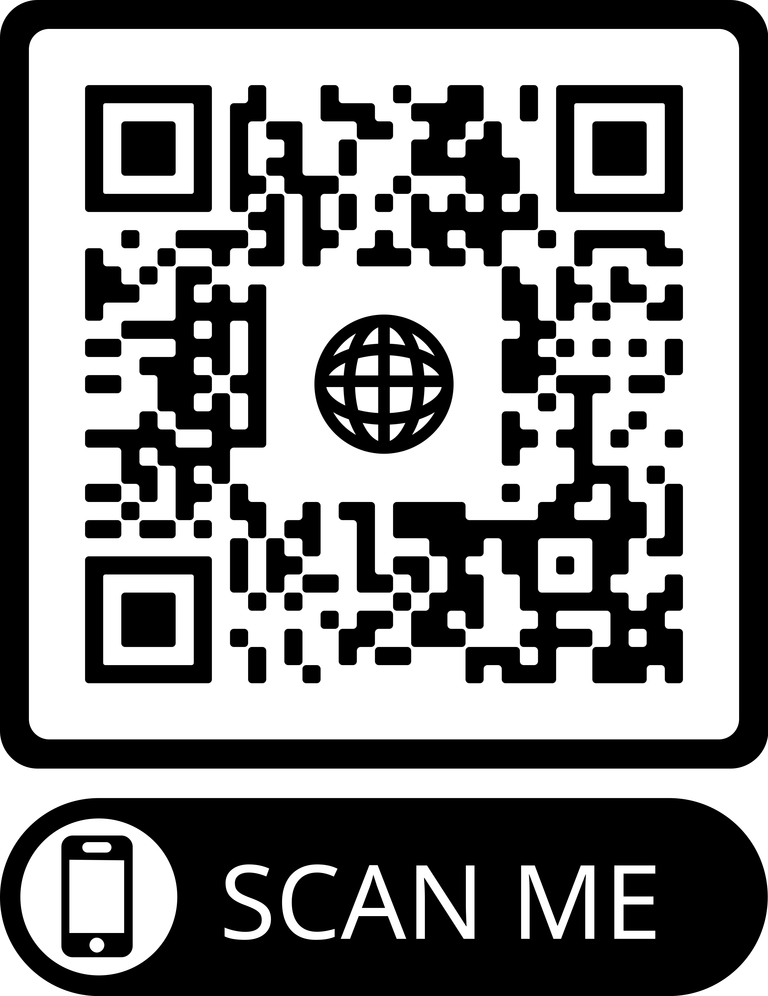
2026 CAR PowerPoints
These PowerPoints only cover the main points of the CAR. We encourage all members to read the CAR itself. Please visit na.org/conference for the complete 2026 CAR.
Notes:
These PPTs only cover the main points of the CAR. We encourage all members to read the CAR itself. Please visit na.org/conference for the complete 2026 CAR, the other PowerPoints, and other conference materials.

Slide 4

This one of two topics with discussion questions included in this CAR.
If you’re discussing these questions in your workshop, please note that this is a discussion, not a decision—you don’t need to come to an agreement.
It’s an opportunity to hear each other and gather your thoughts for the unput form, which you’ll find at na.org/survey.
Notes:
Gender-Neutral Language in NA Literature is one of two topics with discussion questions included in this CAR. If you are discussing these questions in your workshop, please note that this is a discussion, not a decision - you don’t need to come to an agreement. It’s an opportunity to hear each other and gather your thoughts for the input form, which you can find at na.org/survey.

Slide 5
Gender-Neutral Language in NA Literature
Some significant populations of still-suffering addicts do not feel fully accepted or included in NA meetings.
“One of the many beautiful aspects of NA is that our program works for any addict, regardless of age, ethnicity, economic status, belief system, and so on. We are the ‘big tent’ fellowship. Our challenge is to communicate that to others. How can we better demon­strate to all of the people in our communities that we are an open and diverse fellowship? And what can we do to help all addicts feel equally comfortable in our rooms?”
2008 CAR, Who Is Missing From Our Meetings?
Notes:
The topic of gender-neutral and inclusive language stems from the fact that some significant populations of still-suffering addicts do not feel fully accepted or included in Narcotics Anonymous meetings.
The question of how to make meetings more welcoming is not a new one. This passage from the 2008 CAR could have been written just as easily today:
One of the many beautiful aspects of NA is that our program works for any addict, regardless of age, ethnicity, economic status, belief system, and so on. We are the ‘big tent’ fellowship. Our challenge is to communicate that to others. How can we better demon¬strate to all of the people in our communities that we are an open and diverse fellowship? And what can we do to help all addicts feel equally comfortable in our rooms?”

Slide 6

Gender-neutral language has been on the Fellowship’s radar the past two WSC cycles.
A motion addressing this topic appeared in the 2020 CAR but was not taken up at WSC 2020 due to limitations imposed by the pandemic.
In 2023, the WSC passed Motion 14: “To direct the World Board to create a project plan for consideration at the next WSC to investigate changes and/or additional wording to NA literature from gender specific language to gender neutral and inclusive language.”
Notes:
Gender-neutral language has most recently been on the Fellowship’s radar for two conference cycles. A motion addressing this topic appeared in the 2020 CAR but was not taken up at WSC 2020 due to limitations imposed by the pandemic. In 2023, the WSC passed Motion 14: “To direct the World Board to create a project plan for consideration at the next WSC to investigate changes and/or additional wording to NA literature from gender specific language to gender neutral and inclusive language.”

Slide 7
2026-2029 NAWS Strategic Plan
Objective 7 of the plan is to “Raise the level of consciousness regarding inclusiveness in our diverse Fellowship, and develop tools to support groups in ensuring that all members and poten­tial members feel safe, welcomed, and included at in-person and virtual meetings.”
One of the corresponding suggested solutions is “Investi­gate changes and/or additional wording to NA literature from gender specific language to gen­der neutral and inclusive language.”
Notes:
Since then, conference participants have been working together to identify goals and solu¬tions for inclusion in the NAWS Strategic Plan. Objective 7 of the plan is to “Raise the level of consciousness regarding inclusiveness in our diverse Fellowship, and develop tools to support groups in ensuring that all members and potential members feel safe, welcomed, and included at in-person and virtual meetings.” One of the corresponding suggested solutions is “Investigate changes and/or additional wording to NA literature from gender-specific language to gender-neutral and inclusive language.”

Slide 8
Over 5,500 NA members shared their perspectives.
50% said they believed that changing the word­ing of NA literature to be gender inclusive would have a positive effect.
About 45% did not support changing the literature.
2023-2026 IDT Survey
Notes:
Gender-neutral language in NA literature was also selected as an Issue Discussion Topic by the 2023 WSC, and we have had a survey posted throughout the cycle. Over 5,500 responded, and it is clear that many have strong feelings about this issue. 50 percent said they believed that changing the wording of NA literature to be gender inclusive would have a positive effect. About 45 percent did not support changing the literature.

Slide 9
Many responses were from Rus­sia, where current laws and political pressures have made issues related to gender and identity especially fraught.
To some extent, Russian responses may be related a dif­ferent set of issues than the type of changes we are discussing for NA literature.
Setting aside Russian responses, the balance shifts to 62% in support of gender-neutral changes to NA literature and 32% not in support.
2023-2026 IDT Survey
Notes:
It’s worth noting that there was a lot of input from Russia, where current laws and political pressures have made issues related to gender and identity particularly fraught. In some respects, the responses from Russia may be related to or influenced by a different set of issues than the type of changes we are dealing with related to NA literature. Setting aside Russian responses, the balance shifts to 62% in support of gender-neutral changes to NA literature and 32% against. In a Fellowship as diverse and international as NA, making collective decisions can be challenging. The World Board hopes that clarifying the exact nature of the changes being considered and continuing the conversation about the issues will help us build consensus as a Fellowship. The 2026 Conference Report will include a compilation of the survey data on this Issue Discussion Topic.

Slide 10
What is meant by gender-neutral language?
Gender-neutral language can include three separate things:
the words we use to describe our members and potential members,
the words we use to describe God,
and the words of our Steps and Traditions.
For WSC 2026 as a starting point, the board intends to focus just on the language used to describe our members and potential members.
The board will offer a project plan on this topic, as directed by Motion 14.
Notes:
When we talk about gender-neutral language, we are really discussing three separate things: the words we use to describe our members and potential members, the words we use to describe God, and the words of our Steps and Traditions. These three things should not be treated as a single question but addressed individually, as they impact NA’s literature differently and, in the case of the Steps and Traditions, require a different revision process. For WSC 2026 as a starting point, the board intends to focus just on the language used to describe our members and potential members. The board will offer a project plan on this topic, as directed by Motion 14. While the 2025 Interim WSC decided that initiatives for new or revised recovery literature, service material, or IDTs were to be submitted via the CAR Survey rather than through motions, the project plan called for in Motion 14 asks for a project to investigate changes, not to do any immediate revisions; therefore it does not fit into one of those categories and will have its own project plan.

Slide 11
What is meant by gender-neutral language?
When talking about our members and potential members:
Gender-neutral:
IP #7, Am I An Addict?:
“Very simply, an addict is a person whose life is controlled by drugs.”
IP #7 is already gender-neutral!
Gender-specific:
Little White Book/Basic Text, “Who Is an Addict?”: “Very simply, an addict is a man or woman whose life is controlled by drugs.”
Notes:
Some of the input not in support of making NA literature gender-neutral seemed to reflect some misunderstanding of what gender-neutral language actually means for our literature. A clear example can be seen in the first paragraph of IP #7, Am I An Addict?, which states “Very simply, an addict is a person whose life is controlled by drugs.” This differs from the wording in “Who Is An Addict” in the Little White Book, commonly read at meetings, which reads, “Very simply, an addict is a man or woman whose life is controlled by drugs.”

Slide 12

The difference between “a man or woman” and “a person” may seem insignificant to many of us.
Yet for some addicts, it makes all the difference in feeling a part of.
Newer NA literature has aimed for gender-neutrality starting with Living Clean in 2012.
Notes:
The difference between “a man or woman” and “a person” may seem insignificant to many of us. Yet for some addicts, it makes all the difference. Gender-neutral language smooths the path for identification in ways most members may not even notice. In fact, many are unaware that new NA literature has been written to be more gender neutral since 2012, with the publication of Living Clean.

Slide 13

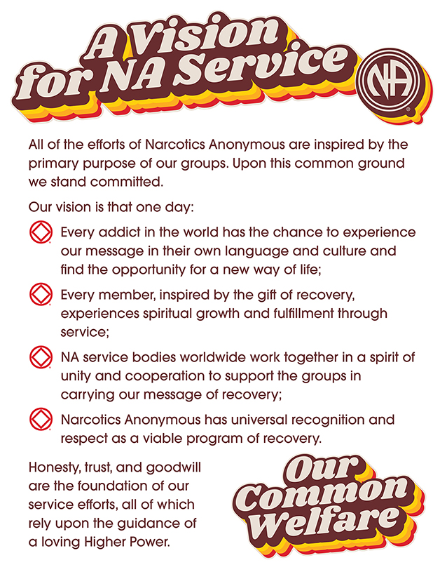
At the 2023 WSC, the conference made a consensus decision to revise “A Vision for NA Service,” changing the phrase “his or her own language and culture” to read “their own language and culture.”
The Vision statement gets to the heart of what this discussion is all about: Every addict in the world has the chance to experience our message.
Notes:
At the 2023 WSC, the conference made a consensus decision to revise “A Vision for NA Service,” changing the phrase “his or her own language and culture” to read “their own language and culture.” The Vision statement gets to the heart of what this discussion is all about: Every addict in the world has the chance to experience our message.

Slide 14

Why not change the wording?
Concerns that altering our foundational text may cause NA to lose some of its time-honored strength.
Concerns about setting a precedent of revising literature any time someone dislikes how it is phrased.
“If it ain’t broke, don’t fix it.”
Notes:
For some members, the idea of altering our Basic Text may raise concerns that NA might lose some of its time-honored strength. These members worry about setting a precedent of revising literature any time someone dislikes how it is phrased. The prevailing view of the members who gave input opposed to changing the language was essentially “If it ain’t broke, don’t fix it.”

Slide 15
However…
…the current language isn’t working for everyone.
Increasingly we hear from members who feel excluded by the gendered language—especially in the group readings, which are many addicts’ first exposure to the program.
And those are just the ones who stayed.
The 2024 Membership Survey indicates that members perceive their first NA meeting as very important. When asked what influenced them to stay in NA, 83% of Membership Survey respondents reported identification as a key component.
Notes:
However, while the language of NA may not be “broken,” the simple truth is that it isn’t working for everyone. World Services hears more and more from members who feel excluded by the gendered language in our literature—especially the group readings, which are many addicts’ first exposure to what NA is all about. What’s more, a survey of members cannot capture the voice of the most vital population: suffering addicts who went to their first NA meeting, felt they didn’t belong, and never came back. The 2024 Membership Survey indicates that members perceive their first NA meeting as very important. When asked what influenced them to stay in NA, 83 percent of reported identification as a key component. We cannot discount those potential members who are missing from the conversation.

Slide 16
Looking at our history…
The Basic Text has been revised before to expand the circle of addicts who feel welcome.
The chapter “How It Works” once read, “The only way to keep from getting or continuing a habit is not to take that first fix, pill, or drink.”
Some addicts didn’t relate to that language because their drug use took a different form. More inclusive language was needed to welcome more addicts into our Fellowship.
The 1986 World Service Conference passed a motion to revise the Basic Text language to read, “The only way to keep from returning to active addiction is not to take that first drug.”
Notes:
Looking at our history, we find that the Basic Text has been revised before for this exact reason: to expand the circle of addicts who feel welcome as members. The original chapter “How It Works” stated that “The only way to keep from getting or continuing a habit is not to take that first fix, pill, or drink.” As our Fellowship evolved and grew, some addicts spoke up. They didn’t relate to “that first fix, pill, or drink” because their using took some other form. It was clear that more inclusive language was needed to welcome more addicts into our Fellowship. The 1986 World Service Conference passed a motion to revise the Basic Text language to read, “The only way to keep from returning to active addiction is not to take that first drug.”

Slide 17

Looking at our history…
Changed in 1986:
…that first fix, pill, or drink…
In discussion for WSC 2026 as a possible change:
…a nonprofit fellowship or society of men and women…
to
…that first drug…
to
…a nonprofit fellowship or society of people…
Notes:
With this simple change, the sentence carries as much weight as it ever did. Nothing was lost, while for those who could not identify with the specific words “fix, pill, or drink,” a sense of acceptance and belonging was gained. A majority of survey respondents seem to believe that changing “a society of men and women” to “a society of people” and so forth could have the same effect.

Slide 18

In recovery, we learn to focus on our similarities, not our differences.
But new­comers often viewing themselves as “ter­minally unique.”
It is the spiritual principle of unity that guides us as we discuss how to make addicts everywhere feel welcome in Narcotics Anonymous.
Our common welfare should come first.
Notes:
As we mature in our recovery, we learn to focus on our similarities, not our differences. But newcomers can have a tendency to home in on the differences, often viewing themselves as “terminally unique.” It is the spiritual principle of unity that guides us as we discuss the implications of altering our older literature to be more inclusive. Inclusive language doesn’t divide; rather the opposite: We are a society of people. Our primary purpose is to carry the message to the addict who still suffers. Regardless of our personal beliefs, we all wish to make addicts everywhere feel welcome. Our common welfare should come first. The question of exactly what that looks like in action has sparked impassioned and thought-provoking discussions in workshops around the world.

Slide 19
Discussion Icebreaker
Because so many of the discussions we are having this cycle are asking us to consider the experience of those coming into Narcotics Anonymous and trying to decide whether this is home, before we discuss the questions in the CAR we want to take a few minutes to consider some of the ways in which we each may have felt “terminally unique” when we came in.
Think back to when you were new: What were some of the ways you felt different or unique or like an outsider? What helped you recognize that NA was where you belonged?
Pause for discussion
Notes:
Discussion Icebreaker
[Facilitator, if you already did this ice breaker before the other set of discussion questions, you could choose to take time here to call on some people who didn’t get a chance to share before or skip the ice breaker for this session.]
Because so many of the discussions we are having this cycle are asking us to consider the experience of those coming into Narcotics Anonymous and trying to decide whether this is home, before we discuss the questions in the CAR we want to take a few minutes to consider some of the ways in which we each may have felt “terminally unique” when we came in. Think back to when you were new: What were some of the ways you felt different or unique or like an outsider? What helped you recognize that NA was where you belonged?
I’ll start: [Facilitator, share your experience]
Who else wants to share?

Slide 20
Discussion Questions
For the purposes of these questions, we intend to focus on the language that describes peo­ple (members and potential members) not language that describes a Higher Power. These changes in wording—from “men and women” to “people,” for instance—don’t change the meaning of the message in our literature; they allow more people to identify with it. Issues of the wording of our Steps and Traditions are for a future discussion.
Given that we all want to provide a safe, welcoming inclusive Fellowship where every­one can recover (regardless of . . . ), are we willing to explore these types of changes in our literature in order to carry the message more effectively?
If not, why not?
Pause for discussion
Share your feedback by April 1st at na.org/surveys!
Notes:
Discussion Questions
At WSC 2026, conference participants will spend time discussing this issue. To help inform the discussion, please spend some time at your CAR workshop discussing this question, and provide us with your feedback by April 1st 2026 at na.org/surveys.
For the purposes of these questions, we intend to focus on gender neutral language in NA literature as described in the CAR essay—changes in the language that describes people (members and potential members) not language that describes a Higher Power. These changes in wording—from “men and women” to “people,” for instance—don’t change the meaning of the message in our literature; they allow more people to identify with it. Issues of the wording of our Steps and Traditions are for a future discussion.
Given that we all want to provide a safe, welcoming inclusive Fellowship where every¬one can recover (regardless of . . . ), are we willing to explore these types of changes in our literature in order to carry the message more effectively? If not, why not?
Remember, this is a discussion, not a decision—you don’t need to come to agreement. It’s an opportunity to hear each other and to gather your thoughts for the input form.

Slide 21
Five other PowerPoints available online
CAR survey available online
CAR available for download
worldboard@na.org
na.org/conference
Notes:
We hope this PowerPoint has helped in your discussion of this material. Please share your thoughts on this IDT at na.org/survey. Your input will be considered by conference participants at the World Service Conference in May.
You can find some groups’ ideas for alternative gender-neutral readings at na.org/gender.
Please note that there are five other PowerPoints that focus on the rest of the CAR. These resources and the CAR itself, and the CAR survey are available online at www.na.org/conference.
We welcome your questions and your feedback on the CAR, and all other issues, at worldboard@na.org.

