Slide 1
PowerPoint 2 of 6
2026 Conference Agenda Report
Motions
Notes:
This is the second of six PowerPoints covering material in the 2026 Conference Agenda Report (or CAR for short).

Slide 2

2026 CAR PowerPoints
Introduction to CAR
Motions
3. Gender-Neutral and Inclusive Language
4. DRT/MAT in NA: Helping Members Take Root
5. Literature, Service Material, and Issue Discussion Topics survey
6. Pricing Our Literature
Notes:
This PowerPoint covers the five motions being offered in the CAR—3 World Board motions and 2 regional motions

Slide 3

2026 CAR PowerPoints
These PowerPoints only cover the main points of the CAR. We encourage all members to read the CAR itself. Please visit na.org/conference for the complete 2026 CAR.
Notes:
Please keep in mind, these PowerPoints only cover the main points of the CAR. We encourage all members to read the CAR itself. Please visit na.org/conference for the complete 2026 CAR, the other PowerPoints, and other conference materials.

Slide 4
World Board Motions
Motion 1—approve the revision of IP #21, Staying Clean in Isolation
Motion 2—adopt the collaboratively created 2026–2029 NAWS Strategic Plan
Motion 3—approve changes to the World Convention of NA guidelines.
Notes:
First we will cover the World Board Motions, which are:
Motion 1—approve the revision of IP #21, Staying Clean in Isolation
Motion 2—adopt the collaboratively created 2026–2029 NAWS Strategic Plan
Motion 3—approve changes to the World Convention of NA guidelines.

Slide 5

IP #21 Revision Background
November 2019—literature survey went out in the CAR
March 2020—global shutdown
WSC 2020 — first all virtual World Service Conference
The conference agreed with prioritizing this work for the 2020–2023 cycle.
The first survey went out and input was collected from members who were staying clean in isolation for the first time.
However, the nature of the emergency led to the project being shelved.
It was reprioritized in 2023 and when we came back to it, our experience as a Fellowship had transformed.
Notes:
In November 2019, the literature survey went out in the CAR.
In March 2020, the global shutdown began.
WSC 2020 was the first all virtual World Service Conference. Through the CAR survey members expressed interest in revising IP #21, The Loner: Staying Clean in Isolation. The conference agreed with prioritizing this work for the 2020–2023 cycle. The first survey on the subject went out and input was collected from members who were staying clean in isolation for the first time. However, the nature of the emergency led to the project being shelved.
It was reprioritized in 2023 and when we came back to it, our experience as a Fellowship had transformed.

Slide 6

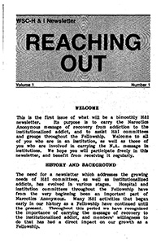
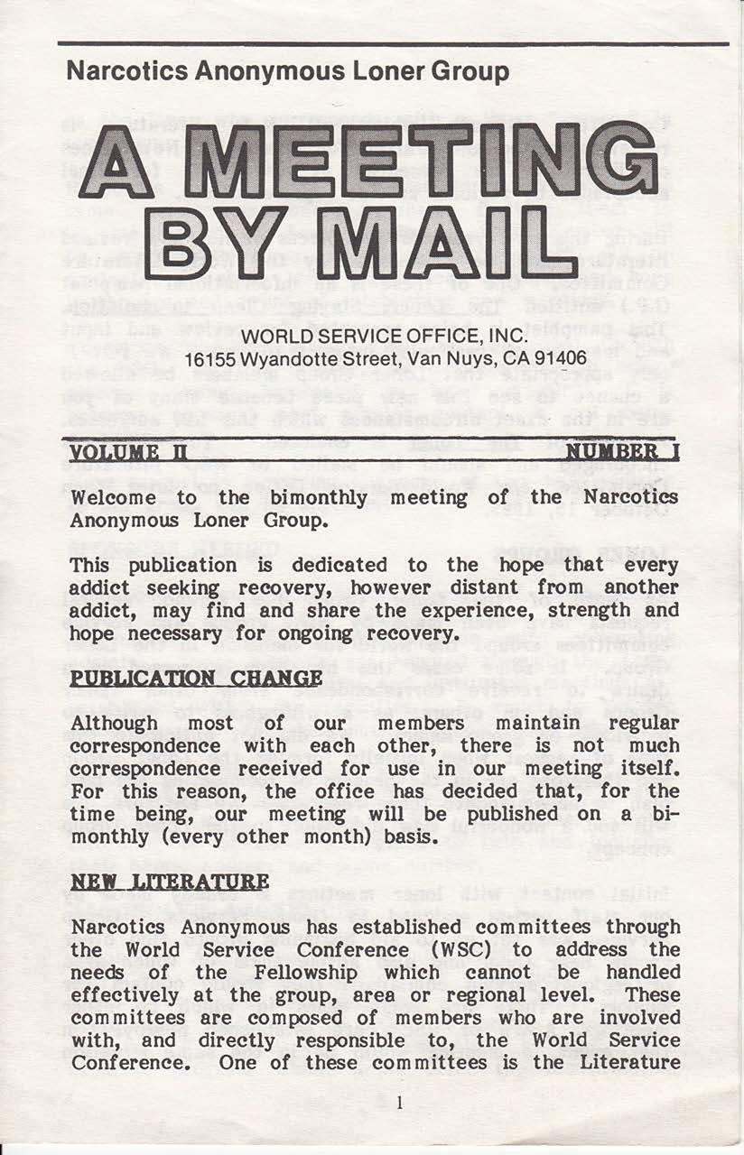
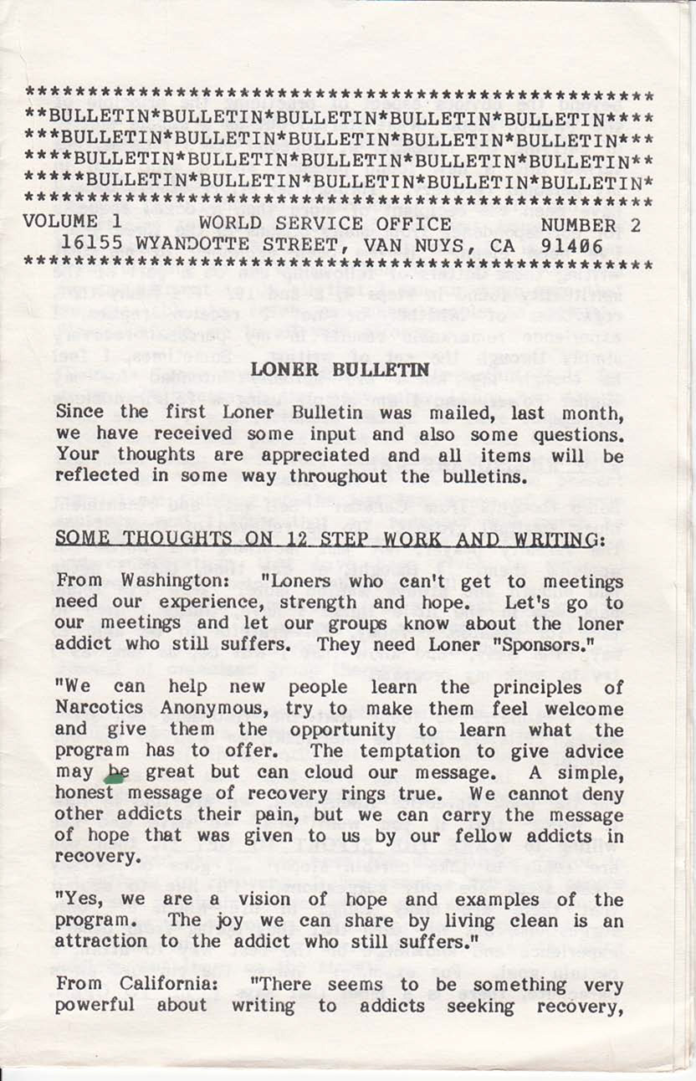

present day
1980s
Notes:
Had we tried to work on the revision any earlier it would have been outdated before it was printed. The delay meant we could draw on resources and experiences that simply had not existed prior. Between 2020 and today, virtual meetings have become commonplace in our Fellowship and our lives together have in some ways become more interconnected than ever. There are resources available for isolated members today that could not have been imagined when this IP was first drafted in the early 1980s.
At that time, in response to the growing number of letters that were pouring into the World Service Office from addicts around the world, the World Service Office created the Loner Group to put isolated members in touch with one another as pen pals. It was during this time that two publications were created: Reaching Out, for those incarcerated, and Meeting by Mail, for those isolated by distance, physical and mental health challenges, and other reasons, such as caregiving or military service, that kept people from being able to attend meetings in person.

Slide 7
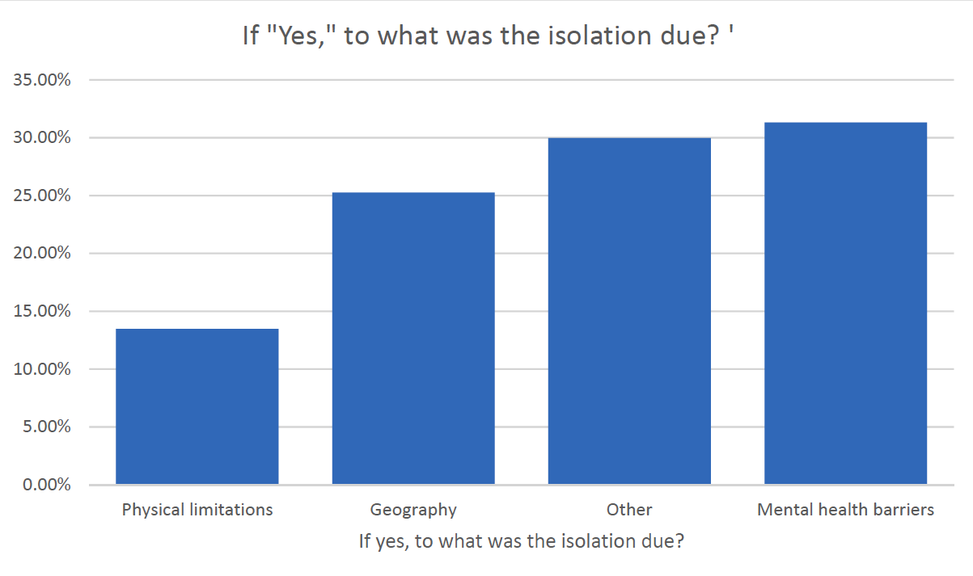
Shaped by Fellowship Input
from 2023 Conference Report
February to August 2022—survey was posted
2023–2026 cycle—posted a volunteer form for members interested in project work and focus groups
Two focus groups were formed, participants were asked to share their experience:
what had led to their isolation
what made the experience of isolation difficult
what about the experience was transformative
what tools or resources had helped them
Notes:
We could not have known the many ways in which circumstances would drive innovation in our Fellowship, the expanding pool of experience in isolation or the increasing importance of this subject for so many of our members. From February to August 2022, a survey was posted. More than 500 responses from 33 countries and 45 US states showed some surprising results: Less than 25% of those reporting isolation in recovery were experiencing it as a result of geographic isolation, and technology was rapidly shifting the landscape. (The 2023 Conference Report includes a summary of the survey data.)
The project was reprioritized at the 2023 WSC, and in the 2023–2026 cycle, World Services posted a volunteer form for members interested in project work and focus groups. From the members who had expressed interest and had experience with isolation two focus groups were formed. In these virtual conversations, participants were asked to share their experience: what had led to their isolation, what made the experience of isolation difficult, what about the experience was transformative, and what tools or resources had helped them. Their input was beautiful, brilliant, and highly emotional.
One message that was heard resoundingly in both the survey and focus groups was that there are many reasons beyond geographic location that someone might find themselves in isolation, and whatever the reason, they don’t much appreciate being called “loners.” Hence dropping that from the title.

Slide 8
Motion 1: Approve the revised IP #21, Staying Clean in Isolation, contained in Addendum A, as Fellowship-approved recovery literature to replace the current IP #21 The Loner—Staying Clean in Isolation.
Maker: World Board
Intent: To update this IP originally approved in 1986 with current Fellowship experience.
Financial Impact: None at this time.
Policy Affected: None
Pause for discussion
Notes:
Motion 1: Approve the revised IP #21, Staying Clean in Isolation, contained in Addendum A, as Fellowship-approved recovery literature to replace the current IP #21 The Loner—Staying Clean in Isolation.
Maker: World Board
Intent: To update this IP originally approved in 1986 with current Fellowship experience.
Financial Impact: None at this time.
Policy affected: None
pause for discussion

Slide 9

The NAWS Strategic Plan isn’t new.
from 2016 Conference Approval Track
NA World Services has operated with a strategic plan for over 20 years.
What is new is that you are being asked to adopt the plan.
The plan is revised and renewed and in the past included in the Conference Approval Track material.
This is the first time it has been included in the CAR
Also the first time it has been created by the conference as a whole.
current plan is in Addendum B in the CAR
Notes:
The NAWS Strategic Plan isn’t new. NA World Services has operated with a strategic plan for over 20 years. What is new is that you are being asked to adopt the plan.
For every conference, the plan is revised and renewed, and the priorities in the plan help shape the work for the cycle ahead. In the past, the NAWS Strategic Plan was included in the Conference Approval Track material. This is the first time it has been included in the CAR and it’s the first time it has been created by the conference as a whole. All conference participants have been involved in every stage of co-creating the plan which is Addendum B in the CAR.
Creating and adopting the strategic plan collectively and collaboratively is part of a larger shift from a motion-driven service culture to one characterized by discussion and consensus-building.

Slide 10
What is a Strategic Plan?
Live in the present while we prepare for what is to come
Proceed step by step, and check our direction and our progress
Guides change related to factors within and outside NA that World Services needs to do a better job addressing
These objectives and solutions are about new initiatives and ideas that would be implemented in addition to the ongoing work at World Services.
The plan is for the cycle ahead which is 2026-2029, and it only represents the pieces that can be focused on right now, not all the possibilities.
Notes:
Planning allows us to live in the present while we prepare for what is to come. Planning allows us to proceed step by step, and to check our direction and our progress. The strategic plan guides change related to factors within and outside NA that may affect our ability to carry the message. The plan’s objectives and solutions are about new initiatives and ideas that would be implemented in addition to the ongoing work at World Services.
The plan is for the cycle ahead which is 2026-2029, and it only represents the pieces that can be focused on right now, not all the possibilities. Some goals are large; the solutions in the plan simply represent the incremental progress that can be made before the next WSC, based on what is prioritized. Sometimes pieces are carried forward from cycle to cycle, perhaps with slight revisions.

Slide 11

What’s in the Plan?
The 2026–2029 plan gives a window into some of the ways NA is evolving.
online and hybrid environment
carrying the message
collecting funds
doing service
using technology to improve communication and connections
making sure addicts find a safe space to recover in NA
continuing to explore how to make our language inclusive so that every addict can find a home in NA
Notes:
Reading through the 2026–2029 plan gives a window into some of the ways NA is evolving. There’s much in the plan about carrying the message, collecting funds, and doing service in an online and hybrid environment; using technology to improve communication and connections; making sure addicts find a safe space to recover in NA regardless of treatment modalities that may be mandated or prescribed for them outside NA; and continuing to explore how to make our language inclusive so that every addict can find a home in NA.
There is always more included in the plan than can be done in a given cycle. The work starts with what has been prioritized first, and it is communicated with conference participants throughout the cycle.

Slide 12
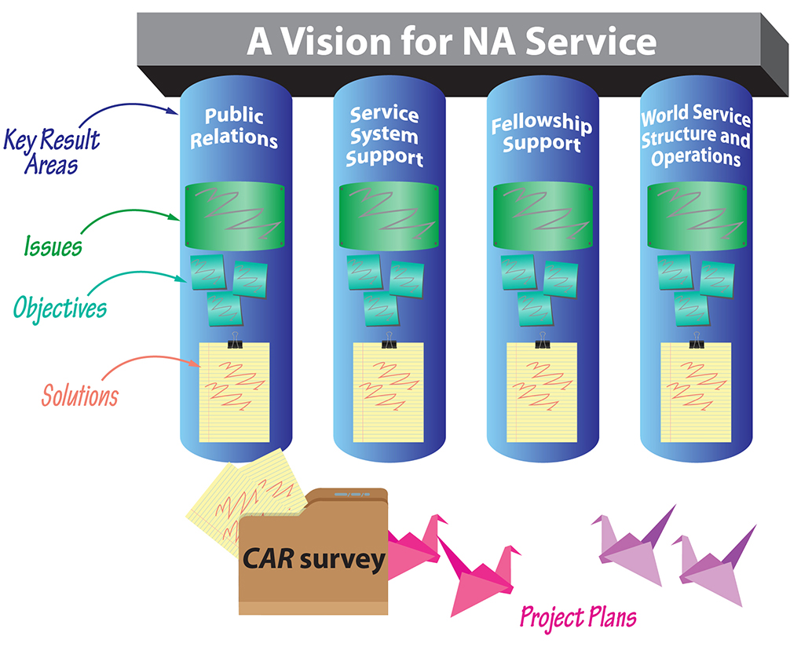
Notes:
Understanding the strategic plan means becoming familiar with the vocabulary. These are the components of the plan:
Key Results Areas are the major areas in which the service efforts are focused in order to realize A Vision for NA Service. These are the four pillars of the plan that are built together. They will change very little, if at all, from cycle to cycle.
Issues are the factors that conference participants collectively decided are most important to address this cycle.
Objectives are goals to aim for. They express what we want to achieve by the end of the planning cycle, as opposed to how we want to achieve it.
Solutions are paths to achieving our objectives. They are the work we want World Services to undertake on behalf of NA as a whole. Solutions don’t have to include everything that might make progress on an objective, just the steps we want to take in the cycle ahead, if the project is prioritized.

Slide 13
na.org/planning
The Planning Process
WSC 2023 Conference participants (CPs) began an inventory
After WSC 2023 CPs prioritized those factors via survey
February through May 2024 Every zone in the world met and discussed the challenges raised by the factors and possible solutions
June 2024 WB drafted objectives based on all those discussion notes
Interim WSC CPs discussed issues and objectives
July 2025 WB revised objectives and drafted solutions
August CP web meeting CPs discussed solutions
September 2025 WB revised solutions and finalized draft of plan
Notes:
The extra time in the experimental three-year cycle allowed the conference to create this plan together. The planning section of the conference webpage contains reports on the progress from throughout the cycle: na.org/planning.
WSC 2023 Conference participants (CPs) began an inventory, identifying factors, inside and outside of NA, that could affect our ability to carry the message.
After WSC 2023 CPs prioritized those factors via survey.
February through May 2024 Every zone in the world met and discussed the challenges raised by the factors and possible solutions.
June 2024 World Board drafted objectives based on all those discussion notes and also drafted World Services Structure and Operations objectives.
Interim WSC Conference participants discussed issues and objectives.
July 2025 World Board revised objectives based on CP discussions at the Interim WSC. World Board drafted solutions.
August CP web meeting Conference participants discussed solutions.
September 2025 World Board revised solutions and finalized draft of plan based on CP discussions.

Slide 14

Implementing the Plan
The Conference Approval Track material contains the project plans that grow out of the NAWS Strategic Plan.
Since 2016, the results from the CAR Survey have guided conference participants to help select focuses for some projects.
Evaluating and improving the planning process is one of the many things that will be discussed at WSC 2026.
Most projects begin with a Fellowship survey. Focus groups help get the work done. Zones and regions will be crucial in the cycle ahead. It is the hope that the NAWS Strategic Plan inspires local projects.
Notes:
The specifics of how to implement solutions are spelled out in project plans. The Conference Approval Track material contains the project plans that grow out of the NAWS Strategic Plan. Within the project plans in the Conference Approval Track material are “blank” plans for recovery literature, service material, and Issue Discussion Topics. Since 2016, the results from the CAR Survey have guided conference participants to help select focuses for these projects.
The conference is new to collaborative planning, and it will continue to refine the process. Evaluating and improving the planning process is one of the many things that will be discussed at WSC 2026.
Most projects for service material or recovery literature begin with some sort of Fellowship-wide survey to determine what members would like to see included or considered in the project. Then virtual focus groups are used to get the work done. Focus groups as opposed to standing workgroups are cheaper, more flexible and allow greater diversity. However, with the projects suggested in the cycle ahead, NAWS will also be asking zonal and regional bodies to work on the projects by holding workshops, collecting best practices, and reviewing drafts. Making progress on most of the solutions in the plan depends upon collaboration from zones and regions.
In fact, it is the hope that the NAWS Strategic Plan inspires local projects. There may be solutions that fit inside these objectives that can be addressed at local levels, and perhaps the plan will encourage more local service bodies to engage in their own planning.

Slide 15
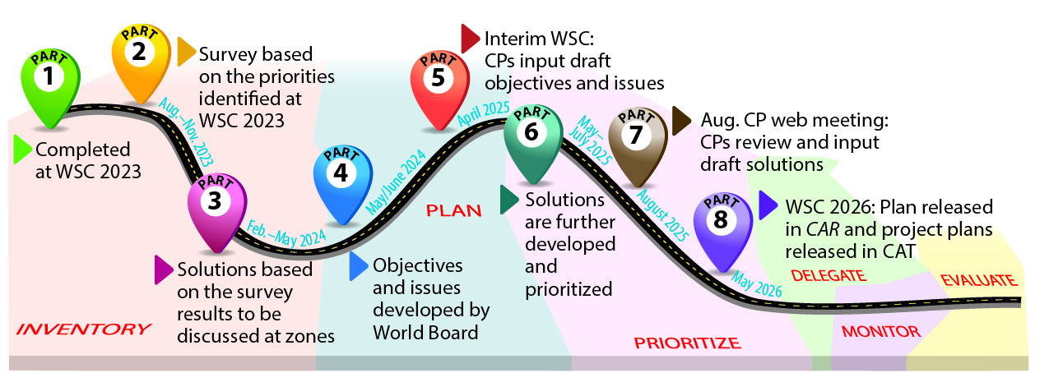
At the 2026 World Service Conference, delegates will be asked to start that work on the next strategic plan.
What issues, challenges, and needs do we need to address to be ready to serve the addict here today and who will be here in the future?
Notes:
Throughout this cycle, the planning journey has been illustrated as a road trip we have been taking together, but in reality, the planning process is cyclical. Because planning is cyclical, the next strategic plan will be created as this one is approved. At the 2026 World Service Conference, delegates will be asked to start that work, just as they started the planning process in 2023 to get here today. Having fewer motions in the CAR means more time at WSC 2026 for discussions, and some of those discussions will center around the factors in NA and the world around us that may most affect NA in the years ahead (after 2029).
The question participants will discuss at the WSC may be something like this:
What issues, challenges, and needs do we need to address to be ready to serve the addict here today and who will be here in the future?
If that question sparks ideas for you, share them with your delegate or at your area or regional CAR workshop.
[Facilitator: If there is time, you may want to pause for discussion here.]

Slide 16
Adopting the plan
The delegates worked together for years (literally) to make sure the plan outlines the work World Services most needs to undertake in the three years in front of us.
Every bit of the plan has been discussed by conference participants—delegates, alternates, and the board.
There have been many, many discussions to create this plan. This has truly been a consensus-based process.
We are asking the Fellowship to take ownership of something that your delegates have co-created on your behalf for our common welfare.
Notes:
The NAWS Strategic Plan is large and contains many details, but you’re being asked to adopt it as a whole, rather than piece by piece. The delegates worked together for years (literally) to make sure the plan outlines the work World Services most needs to undertake in the three years in front of us.
The plan absolutely reflects our collective needs and priorities. Every bit of the plan has been discussed by conference participants—delegates, alternates, and the board. There have been many, many discussions to create this plan. This has truly been a consensus-based process.
We are using the word adopt in the motion rather than approve because, while most members are seeing this for the first time, the plan has been created collectively over the course of years. We are asking the Fellowship to take ownership of something that your delegates have co-created on your behalf for our common welfare.

Slide 17
Motion 2: To adopt the collaboratively created 2026–2029 NA World Services Strategic Plan contained in Addendum B.
Maker: World Board
Intent: To approve the results of the collaborative planning that began at WSC 2023 and continued with zonal and conference participant involvement throughout this cycle.
Financial Impact: No direct financial impact.
Any future expenses will be called out in
project plans or budgets.
Policy Affected: None
Pause for discussion
Notes:
Motion 2: To adopt the collaboratively created 2026–2029 NA World Services Strategic Plan contained in Addendum B.
Maker: World Board
Intent: To approve the results of the collaborative planning that began at WSC 2023 and continued with zonal and conference participant involvement throughout this cycle.
Financial Impact: No direct financial impact. Any future expenses will be called out in project plans or budgets.
Policy Affected: None
pause for discussion

Slide 18
WCNA History
1971–1996: annual event
Mid-90s: two-year schedule and held outside of North America every other convention
1998 to 2009: Added two extra non-North American locations in the rotation
2012: every three years, alternate between US and non-US locations beginning in 2015
Notes:
For over five decades, the World Convention has been a celebration of unity and recovery for the Fellowship. From 1971 to 1996, it was an annual event. In the mid-90s, the then World Convention Corporation presented motions, which were adopted by the WSC, to create a new “zonal” rotation plan and change to a two-year schedule. The goal of this rotation plan was to increase worldwide participation by moving the convention outside of North America every other convention. The rotation plan was then slightly altered, from nine zones to six, adding in two extra North American locations during the 1998 to 2009 timeframe.
Faced with ongoing challenges related to attendance, effective planning, and the financial bottom line, the World Board proposed a new rotation plan that was adopted at WSC 2012. This revised plan would alternate between US and non-US locations, with the convention being held every three years beginning in 2015.

Slide 19
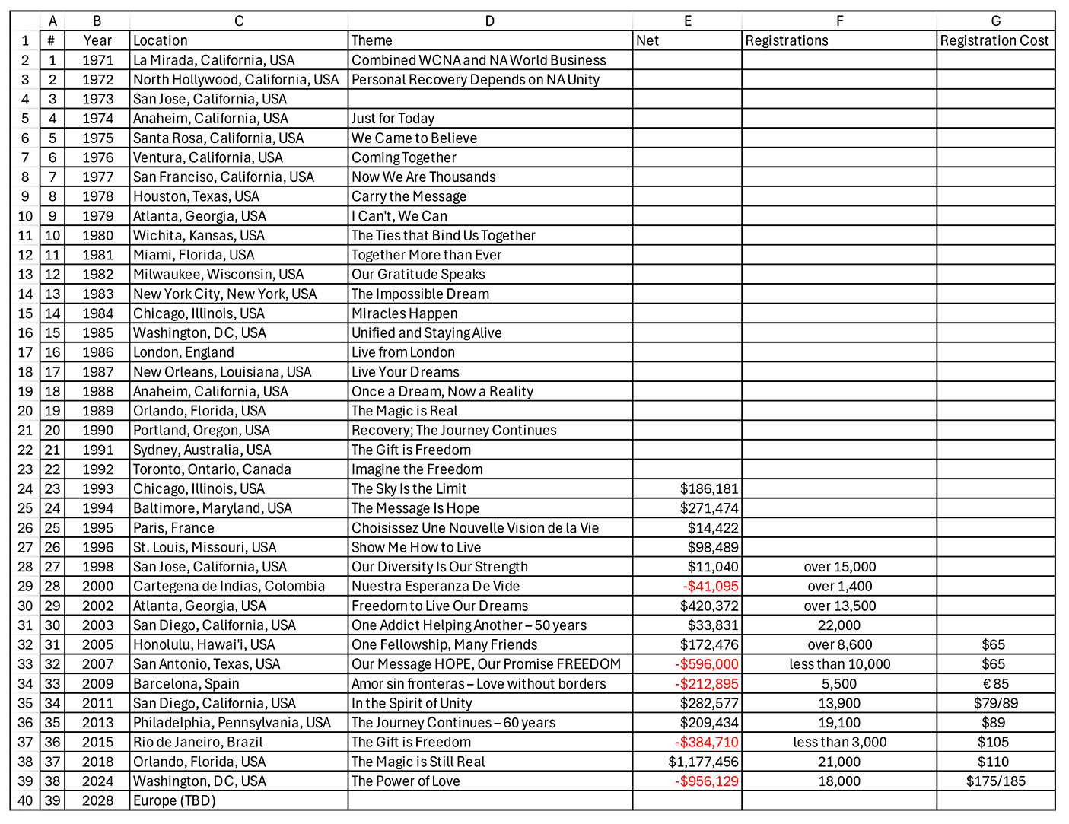
na.org/wcna
WCNA History
2023: suspended the WCNA rotation policy after 2024, to allow time to research and determine what is possible and practical moving forward
Notes:
With the exception of WCNA 32 in San Antonio, the trend for conventions held in North America was positive. Both WCNA 34 and 35 had good attendance and modest profits. The magic of WCNA 37 (Orlando), in 2018, was outstanding. That convention saw more than 21,000 in attendance and a substantial income of over a million dollars. This was largely due to the beneficial contract for meeting space and the level of attendance.
Prior to the global pandemic in 2020, WCNA 38 was planned to be held in Melbourne, Australia. After the global shutdown, travel and health concerns from COVID, entwined with the strain on financial and human resources of NA World Services, made canceling the convention the most responsible action.
In response to unstable circumstances, the 2023 WSC approved a motion offered by the World Board to suspend the WCNA rotation policy after 2024, to allow time to research and determine what is possible and practical moving forward with the World Convention.
For more information on the history of WCNA please go to na.org/wcna.

Slide 20
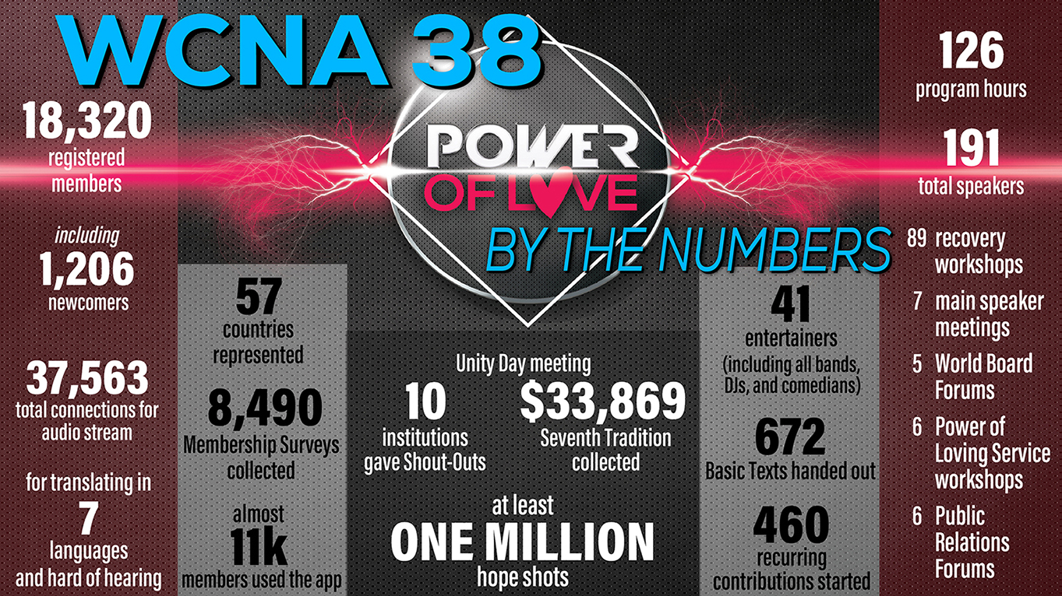
Notes:
WCNA 38 was held in 2024 in Washington, DC. One of the main things WCNA 38 taught us was just how much the landscape had changed and how uncertain convention attendance could be. Based on the trends from the past two conventions in North America, the fact that there had not been a WCNA in six years, and that Washington, DC, is located within an easy drive of many of the most densely populated NA regions, it was reasonable to think that attendance had the potential to be even higher than in Orlando, and it made logical sense to plan accordingly. In most cases, past performance can be indicative of future outcomes, but that was not the case here, as we now know.
In addition to financial strain in the current economy, other factors, such as lingering health and safety concerns, especially among our aging members, may have also contributed to the overall level of attendance in DC. WCNA 38 was planned for a projected attendance of 24,000, and just over 18,000 members registered.

Slide 21
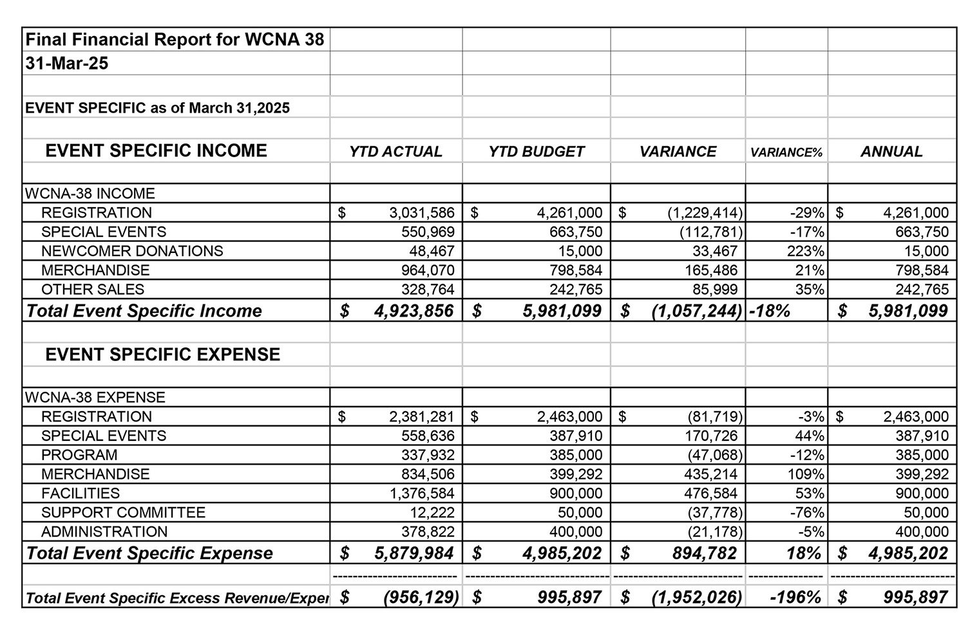
WCNA Financial Report
from 2024 Annual Report na.org/ar
Notes:
As was reported in the 2024 Annual Report, the bottom line for WCNA 38 reflects expenses over income of $956,129. Thankfully, World Services’ efforts to increase reserves helped us to be prepared for an unfavorable outcome.

Slide 22
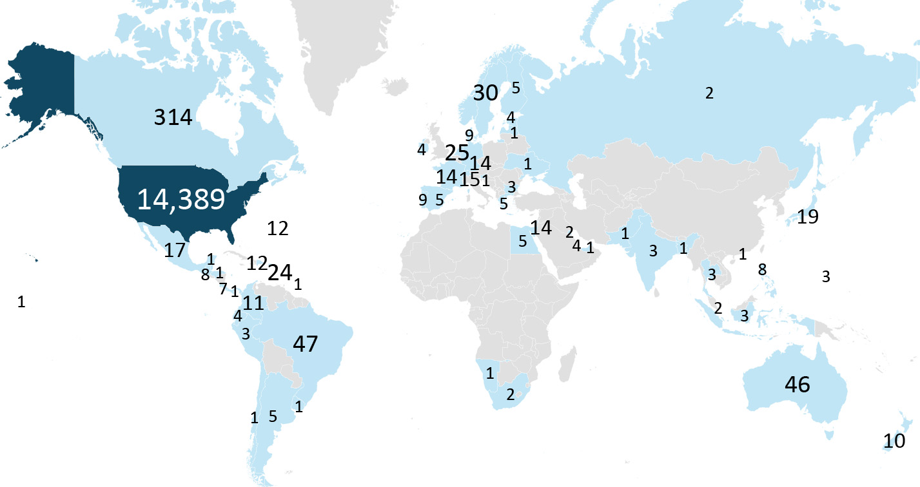
The majority of the 3,616 responding ranked costs of travel and other financial factors, as well as location, as the highest influencers on their decision of whether to attend.
WCNA 38 pre-registrations by country
Notes:
The 2023 motion to suspend the current rotation policy of WCNA gave World Services time to research and evaluate what would be practical moving forward. It took most of the past 18 months to gather the information needed for the discussions and to reach consensus on what changes in policy made the most sense.
A survey was conducted to see if there was a common theme of why NA members attend (or don’t attend) WCNA. As expected, the majority of the 3,616 responding ranked costs of travel and other financial factors, as well as location, as the highest influencers on their decision of whether to attend. Nearly half of the responses received were from members who have never attended a WCNA. There will be more on the results from this survey reported in the Conference Report prior to WSC 2026.

Slide 23

Future
Many factors brought the World Board to their decision to offer Motion 3: Overall expenses, market trends, costs and complexities of international travel, global political and economic climates, etc.
The proposed guidelines delegate more of the rotation and location decision-making responsibility to the World Board simply because so much is unknown.
Please read the essay in the CAR for more insights.
Notes:
Many factors brought the World Board to their decision to offer Motion 3: Overall expenses, market trends, costs and complexities of international travel, global political and economic climates, etc.
The proposed guidelines delegate more of the rotation and location decision-making responsibility to the World Board simply because so much is unknown—inside and outside of NA. The conference industry as a whole is changing; our members’ behavior is changing; and there is no way to predict what the landscape will look like years in the future.
Please read the essay in the CAR for more insights.

Slide 24
Motion 3: To hold the World Convention of Narcotics Anonymous (WCNA) every 5 years, beginning in 2028. The location to be determined by the World Board based on fiscal and geographic considerations that lend themselves to, at minimum, a revenue neutral event. (The specific changes to the WCNA Guidelines in GWSNA are shown in Addendum C.)
Maker: World Board
Notes:
Motion 3: To hold the World Convention of Narcotics Anonymous (WCNA) every 5 years, beginning in 2028. The location to be determined by the World Board based on fiscal and geographic considerations that lend themselves to, at minimum, a revenue neutral event. (The specific changes to the WCNA Guidelines in GWSNA are shown in Addendum C.)
Maker: World Board

Slide 25
Motion 3:
Intent: To have guidelines for the World Convention (WCNA) that reflect the changing nature of large events worldwide and support the prudent use of Fellowship resources.
Financial Impact: No direct financial impact. Any future expenses will be called out in project plans or budgets.
Policy Affected: The policy offered in Addendum C will replace the current WCNA guidelines in
GWSNA (pages 46–48) shown in Addendum D.
Pause for discussion
Notes:
Intent: To have guidelines for the World Convention (WCNA) that reflect the changing nature of large events worldwide and support the prudent use of Fellowship resources.
Financial Impact: No direct financial impact. Any future expenses will be called out in project plans or budgets.
Policy Affected: The policy offered in Addendum C will replace the current WCNA guidelines in GWSNA (pages 46–48) shown in Addendum D.
pause for discussion

Slide 26
Regional Motions
With fewer motions for discussion and decision there will be more time during the WSC for conference participants to talk about issues that affect NA as a whole; and time to work on honing and shaping the next steps in the collaborative planning efforts.
Notes:
Regional Motions
Having two motions from regions in this CAR is definitely not the norm for the WSC, but perhaps it’s a sign of the shift toward a more collaborative and discussion-based conference. With fewer motions for discussion and decision there will be more time during the WSC for conference participants to talk about issues that affect NA as a whole; and time to work on honing and shaping the next steps in the collaborative planning efforts.

Slide 27
The Regional/Zonal Motion Process
1 July 2025: draft CAR motion deadline
3 August 2025: final draft deadline
9 draft motions submitted
Several agreements reached not requiring conference action. These are described on page 44 of the CAR.
2 ideas in draft motions were already covered by CAR Survey items.
End result is two regional motions in this CAR.
Notes:
The deadline to submit a draft motion to the CAR was July 1st 2025, with the final draft by August 3rd 2025. As of July 1st, there were nine draft motions submitted. Over the course of the month, the board worked with the motion makers to help them get the motions “CAR-ready.” A Guide to World Services explains what makes a motion “CAR-ready” on pages 19–20.
The World Board often reaches solutions with motion makers that do not require conference action. Several such agreements were reached. These are described on page 44 of the CAR. These agreements are great examples of ways to collaborate with the World Board. Often ideas or concerns can be resolved without the need for a CAR motion. The World Board always encourages concerned members to reach out, via email to wb@na.org, to start a conver¬sation.
In two other cases, the ideas contained in draft motions were already covered by items contained within the CAR Survey, The Interim WSC had passed a motion to include all ideas for new and revised recovery literature and service material in the CAR Survey rather than as CAR motions for the 2026 conference as an experiment, so the ideas could be considered and prioritized next to each other.
The end result is the two regional motions currently in this CAR.

Slide 28
Motion 4: To direct the World Board to create a project plan for consideration at WSC 2029 to research and explore the opportunities and obstacles of providing booklength pieces of literature to the incarcerated, on tablets, in addition to the IPs and audio version of the Fifth Edition Basic Text that already exist on inmate tablets.
Maker: Arizona Region
Co-makers: Florida, Ohio, Northern California, Southern California, Sweden, UK, Utah
Notes:
Motion 4: To direct the World Board to create a project plan for consideration at WSC 2029 to research and explore the opportunities and obstacles of providing booklength pieces of literature to the incarcerated, on tablets, in addition to the IPs and audio version of the Fifth Edition Basic Text that already exist on inmate tablets.
Maker: Arizona Region
Co-makers: Florida, Ohio, Northern California, Southern California, Sweden, UK, Utah

Slide 29
Motion 4:
Intent: To give the Conference and Fellowship the ability to meaningfully discuss the opportunities and obstacles of making booklength pieces of literature available to the incarcerated on tablets.
Financial Impact: There is minimal cost in creating a project plan. The cost to NAWS would be in the project itself if the WSC were to adopt and prioritize the plan.
Policy Affected: None
Notes:
Intent: To give the Conference and Fellowship the ability to meaningfully discuss the opportunities and obstacles of making booklength pieces of literature available to the incarcerated on tablets.
Financial Impact: There is minimal cost in creating a project plan. The cost to NAWS would be in the project itself if the WSC were to adopt and prioritize the plan.
Policy Affected: None

Slide 30
Motion 4—Rationale by Region
Narcotics Anonymous exists to carry a message of hope and freedom to every addict seeking recovery, including our members behind the walls. As correctional systems increasingly transition from physical books to secure digital tablets, many incarcerated addicts are being cut off from booklength NA literature such as Just for Today, It Works: How and Why, and Living Clean. Without action, this shift threatens to limit access to the foundation of our message for some of our most isolated members. . . .
Notes:
Rationale by Region: Narcotics Anonymous exists to carry a message of hope and freedom to every addict seeking recovery, including our members behind the walls. As correctional systems increasingly transition from physical books to secure digital tablets, many incarcerated addicts are being cut off from booklength NA literature such as Just for Today, It Works: How and Why, and Living Clean. Without action, this shift threatens to limit access to the foundation of our message for some of our most isolated members. ...

Slide 31
Motion 4—Rationale by Region
Approving this motion would allow the World Board to develop a project plan exploring practical, principled ways to make our Fellowship’s booklength literature available through prison tablet systems. This plan would examine logistical, legal, financial, and Fellowship-related issues, ensuring that any approach upholds the principles of self-support and preserves the integrity of NA’s intellectual property, as outlined in the Fellowship Intellectual Property Trust (FIPT).
Many incarcerated members already face disparities in literature access, depending on facility policies and geography. . . .
Notes:
Approving this motion would allow the World Board to develop a project plan exploring practical, principled ways to make our Fellowship’s booklength literature available through prison tablet sys-tems. This plan would examine logistical, legal, financial, and Fellowship-related issues, ensuring that any approach upholds the principles of self-support and preserves the integrity of NA’s intellectual property, as outlined in the Fellowship Intellectual Property Trust (FIPT).
Many incarcerated members already face disparities in literature access, depending on facility pol¬icies and geography. ...

Slide 32
Motion 4—Rationale by Region
Exploring digital options would help the Fellowship respond to these inequities while adapting to a changing environment. It also presents an opportunity to strengthen our trusted servant relationships with correctional institutions, ensuring that NA literature remains accessible to those with limited financial resources.
By supporting this motion, the World Service Conference would affirm our commitment to carrying the message to all addicts, regardless of circumstance, and empower the World Board to be proactive, bringing back informed options for Fellowship review and approval.
Notes:
Exploring digital options would help the Fellowship respond to these inequities while adapting to a changing environment. It also presents an opportunity to strengthen our trusted servant relationships with correctional institutions, ensuring that NA literature remains accessible to those with limited financial resources.
By supporting this motion, the World Service Conference would affirm our commitment to carrying the message to all addicts, regardless of circumstance, and empower the World Board to be proactive, bringing back informed options for Fellowship review and approval.

Slide 33
Motion 4—World Board Response
The World Board shares the maker’s commitment to ensuring that all addicts—including those who are incarcerated—have access to NA literature and the message of recovery. We recognize the shift from printed books to digital tablets in correctional systems offers both opportunities and challenges.
We believe this motion is unnecessary, as NA World Services is already engaged in ongoing efforts to make literature accessible in correctional facilities while upholding self-support and the integrity of the Fellowship Intellectual Property Trust (FIPT). We currently work with vendors and departments to provide, at no cost, materials already available on na.org. . . .
Notes:
World Board Response: The World Board shares the maker’s commitment to ensuring that all addicts—including those who are incarcerated—have access to NA literature and the message of recovery. We recognize the shift from printed books to digital tablets in correctional systems offers both opportunities and challenges.
We believe this motion is unnecessary, as NA World Services is already engaged in ongoing efforts to make literature accessible in correctional facilities while upholding self-sup¬port and the integrity of the Fellowship Intellectual Property Trust (FIPT). We currently work with vendors and departments to provide, at no cost, materials already available on na.org. ...

Slide 34
Motion 4—World Board Response
The Basic Text is available in twelve languages in audio, and IPs, booklets, and translated materials are accessible in 61 languages. An Introductory Guide to NA—with ten IPs and the Steps chapter from the Basic Text—is soon to be available in English and Spanish audio.
Providing full-length books on tablets is not a simple solution. Correctional environments vary widely; many still require physical books. We do not contract with for-profit tablet companies that would charge for materials we provide for free. Our focus remains on accessibility, not commercialization. . .
Notes:
The Basic Text is available in twelve languages in audio, and IPs, booklets, and translated materials are accessible in 61 languages. An Introductory Guide to NA—with ten IPs and the Steps chapter from the Basic Text—is soon to be avail¬able in English and Spanish audio.
Providing full-length books on tablets is not a simple solution. Correctional environments vary widely; many still require physical books. We do not contract with for-profit tablet companies that would charge for materials we provide for free. Our focus remains on accessibility, not commercialization. ...

Slide 35
Motion 4—World Board Response
It is important to recognize that NA World Services remains largely funded through literature sales, a considerable amount of which comes from initiatives to help incarcerated addicts. We make many resources freely available because we believe deeply in our mission; we must also ensure the sustainability of the services that allow us to carry that message worldwide.
We once offered PDFs of major titles online, but massive unauthorized distribution forced their removal. Audio materials, especially in Spanish, are now the most frequently accessed resources on inmate tablets. This has guided our recent recording projects. . .
Notes:
It is important to recognize that NA World Services remains largely funded through literature sales, a considerable amount of which comes from initiatives to help incarcerated addicts. We make many resources freely available because we believe deeply in our mission; we must also ensure the sustainability of the services that allow us to carry that message worldwide.
We once offered PDFs of major titles online, but massive unauthorized distribution forced their removal. Audio materials, especially in Spanish, are now the most frequently accessed resources on inmate tablets. This has guided our recent recording projects. ...

Slide 36
Motion 4—World Board Response
As has been our practice for more than two decades, NAWS continues to provide free literature to incarcerated members upon request and offers a Basic Text after continued contact. We also recognize the importance of H&I efforts to carry meetings into facilities as well as reentry support, including helping members who receive addiction medication to feel welcome in NA.
While digital tools will continue to evolve, our balanced approach—combining technology, human connection, and financial responsibility—remains the most effective way to carry our message. The motion’s intent aligns with work already in progress at NA World Services.
Pause for discussion
Notes:
As has been our practice for more than two decades, NAWS continues to provide free literature to incarcerated members upon request and offers a Basic Text after continued contact. We also recognize the importance of H&I efforts to carry meetings into facilities as well as reentry support, including helping members who receive addiction medication to feel welcome in NA.
While digital tools will continue to evolve, our balanced approach—combining technology, human connection, and financial responsibility—remains the most effective way to carry our message. The motion’s intent aligns with work already in progress at NA World Services.
pause for discussion

Slide 37
Motion 5: To direct the World Board, to implement artificial intelligence (AI) interpretation solutions for WSC meetings (both in-person and virtual) to replace the current human live language interpretation.
Maker: South Florida Region
Co-makers: Iran, UK, Nepal
Notes:
Motion 5: To direct the World Board, to implement artificial intelligence (AI) interpretation solutions for WSC meetings (both in-person and virtual) to replace the current human live language interpretation.
Maker: South Florida Region
Co-makers: Iran, UK, Nepal

Slide 38
Motion 5:
Intent: To eliminate language barriers, ensuring that all voices are heard globally, enhancing our communication and time efficiency during business meetings. This initiative also aims to reduce the risk of human interpretation errors and potential absences during our sessions.
Financial Impact: The financial impact of implementing this technology is expected to be significant but has not yet been determined pending further analysis.
Policy Affected: None
Notes:
Intent: To eliminate language barriers, ensuring that all voices are heard globally, enhancing our communication and time efficiency during business meetings. This initiative also aims to reduce the risk of human interpretation errors and potential absences during our sessions.
Financial Impact: The financial impact of implementing this technology is expected to be significant but has not yet been determined pending further analysis.
Policy Affected: None

Slide 39
Motion 5—Rationale by Region
We would like to provide further clarification regarding the intent of this initiative. Our objective is to empower RDs and ADs whose primary language is not English, enabling them to articulate their perspectives more effectively in their native language during direct discussions. This will reduce the reliance on interpreters. Additionally, this approach aligns with our second concept: the service structure will seek guidance and resources from the groups, including spiritual guidance, which we regard as a matter of conscience in this context.
Notes:
Rationale by Region: We would like to provide further clarification regarding the intent of this initiative. Our objective is to empower RDs and ADs whose primary language is not English, enabling them to articulate their perspectives more effectively in their native language during direct discussions. This will reduce the reliance on interpreters. Additionally, this approach aligns with our second concept: the service structure will seek guidance and resources from the groups, including spiritual guidance, which we regard as a matter of conscience in this context.

Slide 40
Motion 5—World Board Response
World Services shares the goal of improving communication and participation at the World Service Conference (WSC), especially for members whose first language is not English. Removing barriers to participation is something we deeply value.
However, this motion would limit the conference’s ability to adapt and make timely operational decisions. We support experimenting with new technologies to enhance accessibility and efficiency, but this motion mandates a specific tool—AI interpretation—to replace human interpreters. That replacement is the concern. . . .
Notes:
World Board Response: World Services shares the goal of improving communication and participation at the World Service Conference (WSC), especially for members whose first language is not English. Removing barriers to participation is something we deeply value.
However, this motion would limit the conference’s ability to adapt and make timely operational decisions. We support experimenting with new technologies to enhance accessibility and efficiency, but this motion mandates a specific tool—AI interpretation—to replace human interpreters. That replacement is the concern. ...

Slide 41
Motion 5—World Board Response
Human interpreters, nearly always NA members, bring accuracy, cultural understanding, and a spiritual connection that technology cannot replicate. Replacing them would undermine effective communication at the WSC.
We’ve long held that WSC participants themselves are best positioned to test and decide on process changes, as noted in our 2023 CAR response: “Allowing participants to make decisions about the processes that affect the WSC meeting is significantly more nimble than making these types of changes through the CAR.” Given how quickly technology evolves, flexibility is more practical than a rigid policy. . . .
Notes:
Human interpreters, nearly always NA members, bring accuracy, cultural understanding, and a spiritual connection that technology cannot replicate. Replacing them would undermine effective communication at the WSC.
We’ve long held that WSC participants themselves are best positioned to test and decide on process changes, as noted in our 2023 CAR response: “Allowing participants to make decisions about the processes that affect the WSC meeting is significantly more nimble than making these types of changes through the CAR.” Given how quickly technology evolves, flexibility is more practical than a rigid policy. ...

Slide 42
Motion 5—World Board Response
AI tools could be explored as supplements—not replacements—in smaller settings or between conferences, but mandating them now, without trials or research, is premature. WSC interpreters do far more than translate—they convey recovery concepts, emotional tones, and cultural nuances vital to understanding. They also help participants between sessions, ensuring two-way communication that AI cannot yet provide.
Conference discussions sometimes include sensitive matters. AI-based systems pose potential privacy risks and lack the understanding of NA’s Traditions that human interpreters bring. . . .
Notes:
AI tools could be explored as supplements—not replacements—in smaller settings or between con-ferences, but mandating them now, without trials or research, is premature. WSC interpreters do far more than translate—they convey recovery concepts, emotional tones, and cultural nuances vital to understanding. They also help participants between sessions, ensuring two-way communication that AI cannot yet provide.
Conference discussions sometimes include sensitive matters. AI-based systems pose potential pri¬vacy risks and lack the understanding of NA’s Traditions that human interpreters bring. ...

Slide 43
Motion 5—World Board Response
Current technology also struggles with accuracy, speed, and context—especially with our specialized recovery language.
The World Board supports continued exploration of new tools to aid communication, but not as mandated substitutes for human interpreters. The WSC’s success depends on flexibility, inclusivity, and spiritual connection—not automation. We encourage ongoing experimentation and dialogue at the conference level as technology continues to evolve.
Pause for discussion
Notes:
Current tech¬nology also struggles with accuracy, speed, and context—especially with our specialized recovery language.
The World Board supports continued exploration of new tools to aid communication, but not as mandated substitutes for human interpreters. The WSC’s success depends on flexibility, inclusivity, and spiritual connection—not automation. We encourage ongoing experimentation and dialogue at the conference level as technology continues to evolve.
pause for discussion

Slide 44
Five other PowerPoints available online
CAR survey available online
CAR available for download
worldboard@na.org
na.org/conference
Notes:
We hope this PowerPoint has helped in your discussion of this material. Please note that there are five other PowerPoints that focus on the rest of the CAR. These resources, the CAR itself, and the online CAR survey are available online at na.org/conference.
We welcome your questions and your feedback on the CAR, and all other issues, at worldboard@na.org.

