Slide 1

Where does the money goes?!
Workshop on:
The Flow of funds and Service Structure Sustainability in NA

Slide 2

Agenda
Introduction
Spiritual Principles in Self-Support
The Flow of Funds in NA
The Concept 2 and Group Responsibility
General Discussion
Withholding of funds : Risks and Consequences
How can we avoid unnecessary withholding of funds?
Small Group Discussion
Conclusions
Surprise Game
Closing
Duração: 01:30H

Slide 3
1. Introduction
Why this topic?
In NA, our purpose is simple: to carry the message to the addict who still suffers. But for this to happen, it is essential that our services function effectively, efficiently, transparently, and within the principles of fellowship.
Workshop Objectives:
✅ Raise awareness among members about the importance of self-sustainability;
✅ Understanding how money circulates within the NA structure;
✅ Explore how we can better apply the principles of Tradition 7 in our services.;
✅ Reflect on how to balance financial prudence with the need to support the fellowship.

Slide 4
2. Spiritual Principles in Self-Support
- Let us recall the 7th Tradition :
“Every NA group should be fully self-supporting, declining outside contributions”.
The self-sustainability of our 7th tradition incorporates, like all other traditions, a variety of fundamental spiritual principles - The list of principles and values below can be useful whenever we apply this tradition:
Gratitude
Anonymity
Dignity
Sacrifice
Responsability
Freedom
Generosity
Unity
Faith
Prudence
Humility
Autonomy
Integrity
Simplicity
Comitment
From “Guiding Principles”, 7th Tradition spiritual principles, page. 121

Slide 5
2. Spiritual Principles in Self-Support
Gratitude and Humility – Contributing financially and with service to NA is a way of expressing gratitude for the gift of recovery;
Prudence and Responsibility – It is up to each member and group to ensure that NA services can continue to function;
Faith and Unity – Trusting that, by giving what we can, the fellowship will always have what it needs;
Integrity and Anonymity – Avoid external funding to ensure NA remains true to its purpose;
Autonomy and Freedom – Maintaining the autonomy of the fellowship by avoiding any dependence on external funds ensures freedom from any kind of influence;
Generosity and Commitment – These principles remind us that in NA, we freely give back what we have been given. When we contribute—whether through service, meeting attendance, or financial contributions—we are turning gratitude into action.

Slide 6
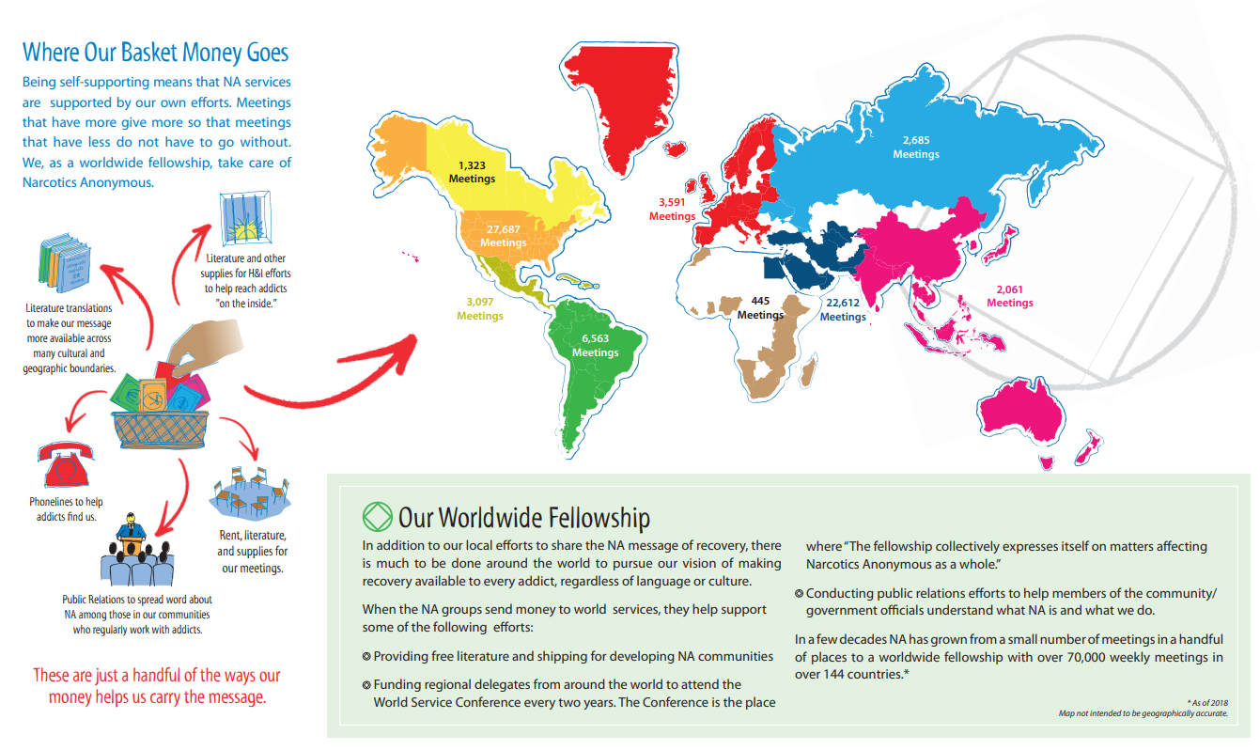
3. The Flow of Funds in NA
According to IP 28 – funding NA services:
" Groups pay their expenses first and then send contributions to each service level to help cover the costs of the work done on their behalf.“
IP 24, on the other hand, addresses ‘the issue of money and self-financing in NA” reinforces the importance of individual contributions from members
" The money we put in the bag allows our groups to keep the door open and create a good atmosphere of recovery for that newcomer who, shivering and trembling, is still on the street, unsure whether to enter the meeting or not.“
Sources of funding in NA - The main sources of revenue include:
Direct contributions from members;
Selling official literature;
Occasionally, events and conventions organised by the fellowship;
Where does the money from contributions go?
The funds collected in the groups flow into different levels of service to keep NA operational:
Legal Entity
Groups
Area
WORLD
(EDM–NAWS-WSC)
Region
Helpline
PR/HI
Accountant
Literature
Traslations
Learning Day´s
Conventions

Slide 7
4. The Concept 2 and Group Responsibility
"The responsibility and ultimate authority for NA services rests with NA groups (...). Conversely, the service structure must always look to the groups for support and guidance.
“… When our groups provide the resources—awareness and ideas, people, money—necessary to ensure NA services, they are also providing guidance for the service structure...”
“… Money is necessary to carry out NA services. Without it, our helplines would be disconnected, there would be no NA literature to distribute, our H&I panels would have no pamphlets, and our PI volunteers would be unable to provide the community with printed material about NA.”
IP 24 reinforces this idea by stating that:
" The NA members who came before us assured us that we would find our place here (...). Now we have the opportunity and responsibility to give other addicts the chance to hear the message.“

Slide 8
General Discussion
What experiences or challenges have you had with applying Tradition 7 in your group/service committee, and what solutions have you found?

Slide 9

5. Withholding of funds : Risks and Consequences
Why withholding money can be a problem?
It undermines the purpose of self-financing: NA's money belongs to the fellowship and should be used to fulfil our primary purpose;
Creates tension and conflict: It can generate mistrust and internal debates about how the money should be used;
Hinders fellowship growth: Idle funds could be used to print more literature, improve NA outreach, or support areas facing financial difficulties;
Distracts attention from the service: Instead of focusing on caring the message, committees may end up spending time discussing how to manage the money they have raised..
What does literature tell us about this?
IP 24 highlights:
“…as members, we have a duty to ensure that the money we contribute is used responsibly: prioritizing our needs, (…) and encouraging our groups and committees not to hold large amounts of money.“

Slide 10

6. How can we avoid unnecessary withholding of funds?
✔ Set aside a prudent reserve
Keep only what is necessary to cover foreseeable expenses;
✔ Ensure that funds flow between different service levels
If a committee has accumulated funds, it should consider sending them to support other areas of the fellowship;
✔ Transparency in financial management
Regular financial reports prevent speculation and ensure that everyone understands where the money is going;
✔ Strengthening the practice of Group Consciousness
Before withholding funds, committees should consult their area, region, or groups on how best to use the money.

Slide 11
7. Small Group Discussion
What is the flow that our contributions and literature purchases should follow?
What can our Region/Area/Group/Service Committee do to prevent the withholding of funds?
What can our Region/Area/Group/Service Committee do to prevent the withholding of funds?
What can we do to raise awareness among more members about this issue?

Slide 12
7. Small Group Discussion guide
Part 1
Forming small groups
Appoint a pointperson to present the group's ideas (preferably taking notes and jotting down ideas). Appoint a moderator (to manage the time for discussion among everyone).
Answers/ideas:
Each group should answer each of the questions with ideas they believe could improve the topic of discussion. (00:20 minuts)
Part 2
Conclusion:
Presentation of each group's ideas and conslusions (00:20 minuts)

Slide 13
8. Conclusão
Let's hear your discussions.
Tell us what example(s) you discussed and some of the solutions you came up with in your group…

Slide 14
🔹 Final Message
"In NA, we pay our own way to maintain our freedom. By contributing freely, we ensure that we have meetings to attend and support the services that keep NA alive and growing worldwide. Since the groups created the service structure, they also have the responsibility to provide the funds necessary for it to function. By fulfilling this responsibility, they exercise their authority over the structure and ensure that it continues to fulfil its primary purpose: to carry the message to the addict who still suffers..“
(Based on IP 24, IP 28 and the 2nd Concept for Service)

Slide 15
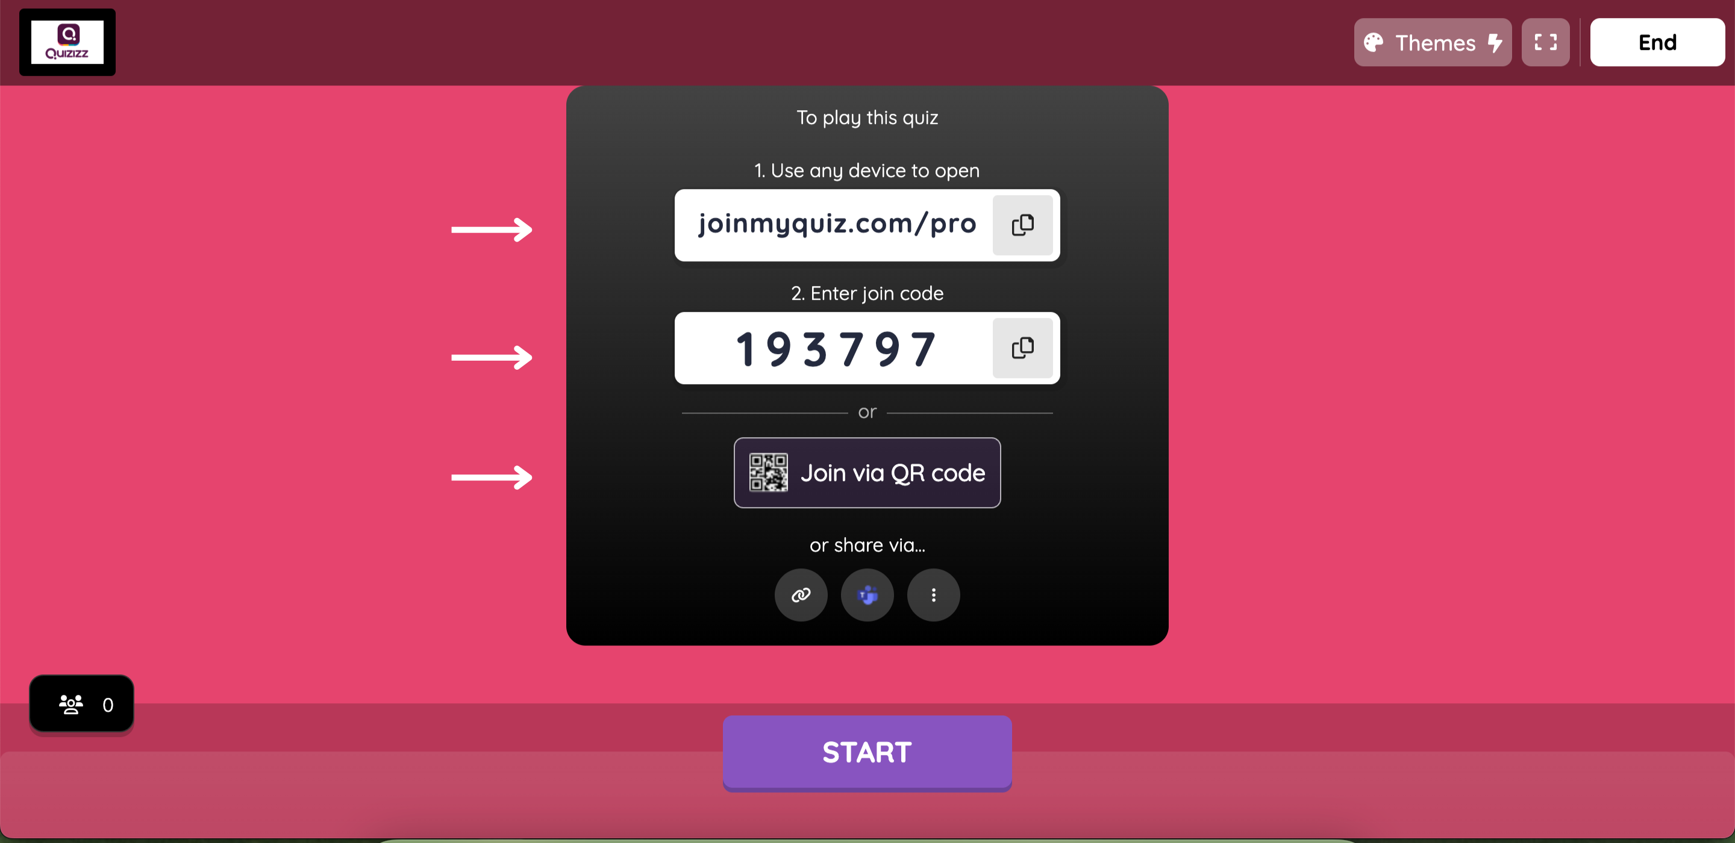
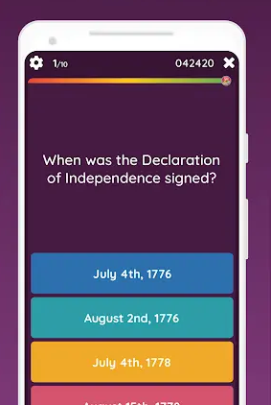
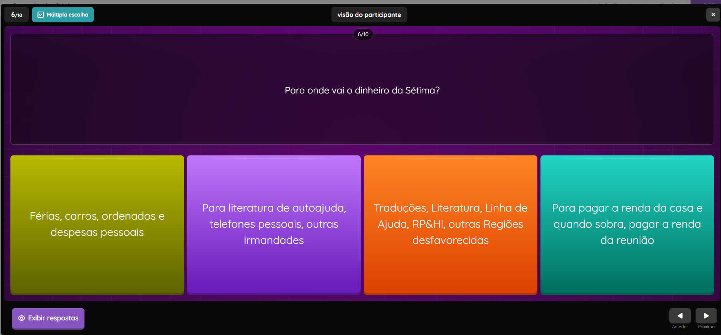

Slide 16



Thank You!

