Slide 1

Strategic Planning / Future of the WSC

Slide 2
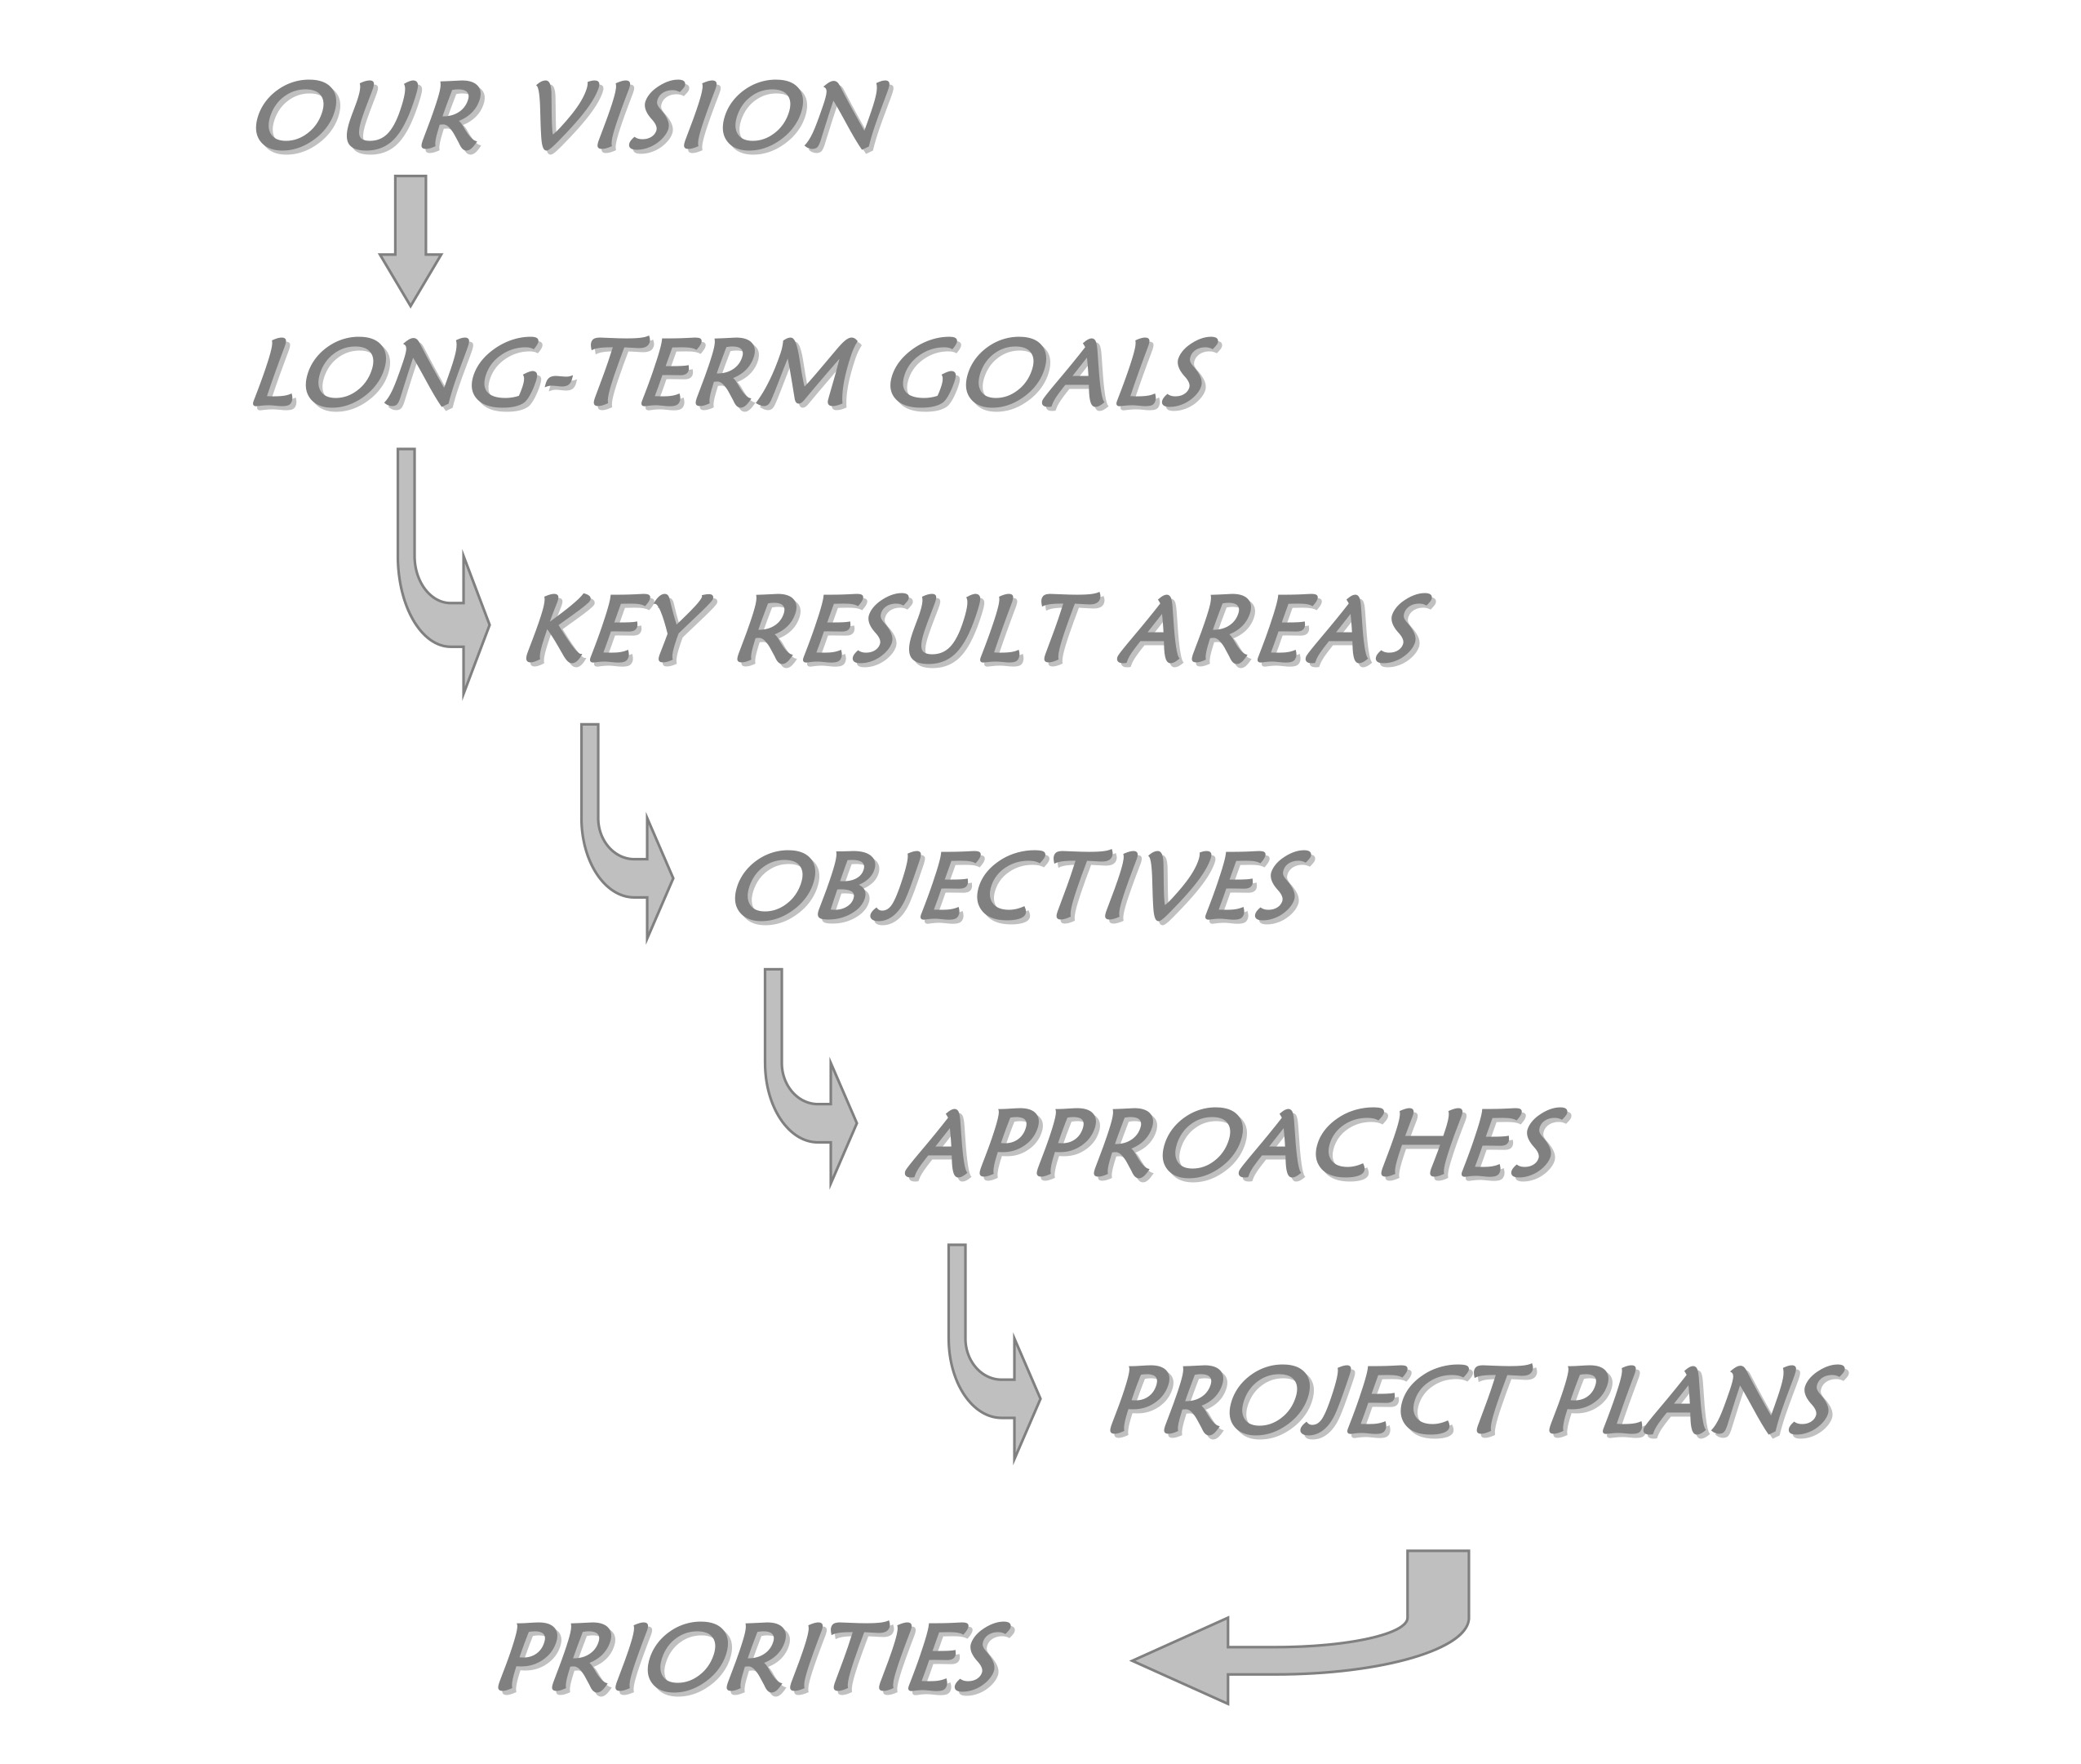
from 2004 Strategic Plan
in the CAT

Slide 3
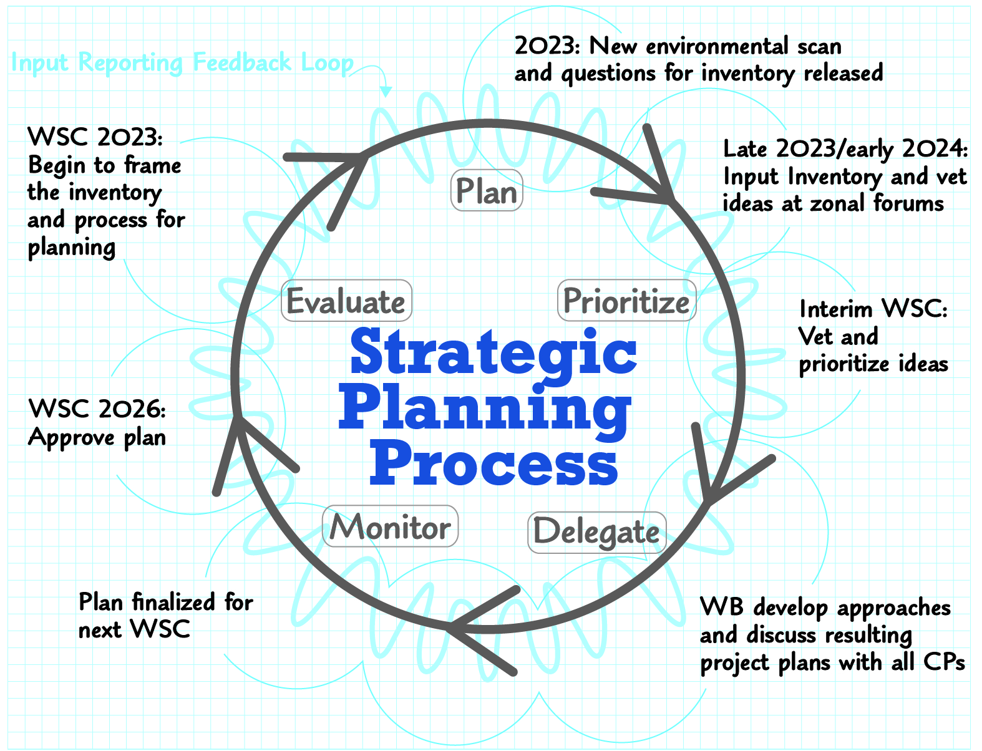
Why
plan?

Slide 4
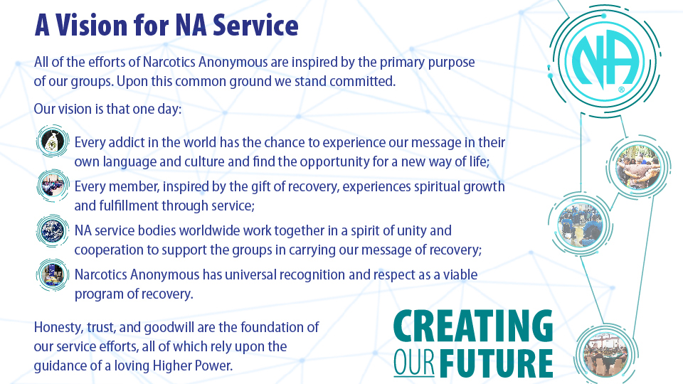

Slide 5
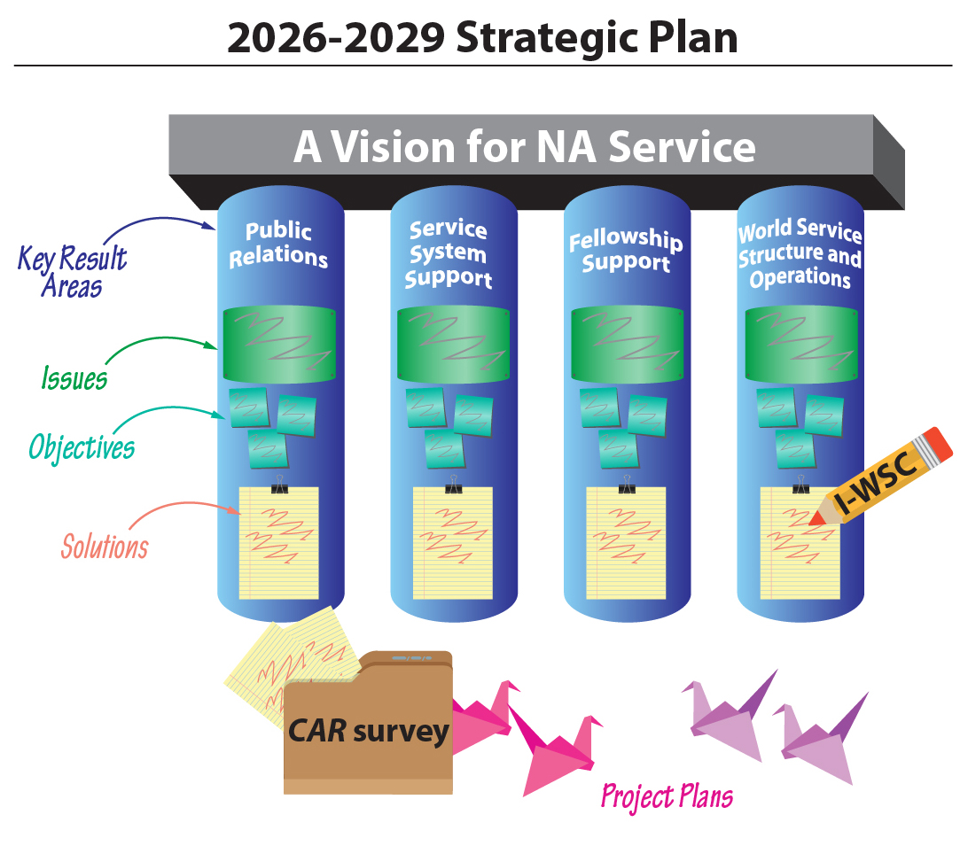

Slide 6
2026–2029 Strategic Plan
Key Result Areas | Issues
Public Relations | Credibility of NA
Service System Support | Safety and Belonging
 | Impact of the Rise of Virtual NA
 | Lack of Cohesion in the Service System
 | Development and Organization of Trusted Servants
 | Disruption in the Flow of Funds
Fellowship Support | Harm Reduction
 | Generational and Cultural Differences
World Service Structure and Operations | Three-year Conference Cycle
 | Future of the World Convention
 | NAWS Sustainability

Slide 7
Public Relations
Issue: Credibility of NA
Objectives
Raise Fellowship awareness of the importance of effective Public Relations in carrying our message, achieving our Vision and furthering Fellowship development.
Create PR tools for four target audiences:
    a. General public (including families)
    b. Government (including criminal justice, policy)
    c. Addiction treatment
    d. Medical profession

Slide 8
Service System Support
Issue: Safety and Belonging
Objectives
Raise the level of consciousness regarding inclusiveness in our diverse Fellowship, and develop tools to support groups in ensuring that all members and potential members feel safe, welcomed, and included at in-person and virtual meetings.
Issue: Impact of the Rise of Virtual NA
Objectives
Improve the ability of virtual groups and service bodies to fully participate in the service system and for their voices to be heard as part of the NA Fellowship’s conscience.
Issue: Lack of Cohesion in the Service System
Objectives
Further the concept of coordination and collaboration within the service system and the understanding and appreciation of complementary roles and contributions to A Vision for NA Service.
Issue: Development and Organization of Trusted Servants
Objectives
Through mentorship, training, and tools, increase continuity of service delivery and inspire members of all ages and stages of recovery to be of service.
Issue: Disruption in the Flow of Funds
Objectives
Create tools for groups and service bodies to offer convenient ways for members to contribute, and to facilitate and encourage the flow of funds through all components of the service system.

Slide 9
Fellowship Support
Issue: Medication-Assisted Treatment
Objectives
In the spirit of our Third Tradition, achieve a common understanding across the Fellowship of what it means to be an NA member and how to create the space for addicts to choose membership, regardless of how they found NA.
Issue: Generational and Cultural Diversity
Objectives
Continue to adapt communication methods and technology to meet a diverse membership’s preferences for engagement.

Slide 10
World Service Structure and Operations
Issue: Three-year Conference Cycle
Objectives
Further refine and describe the three-year conference cycle, including major meetings, policies, planning process, deadlines and guidelines.
Issue: Future of the World Convention
Objectives
Create a financially sustainable model for the World Convention (WCNA), in harmony with our Eleventh Concept, that meets the needs and expectations of the Fellowship in a changing world.
Issue: NAWS Sustainability
Objectives
Building on Objective 7, raise understanding of the need for and importance of adequate financial resources in carrying the NA message of recovery.
Continue to evaluate and adjust activities at NA World Services to best support its roles and functions in a changing world.

Slide 11
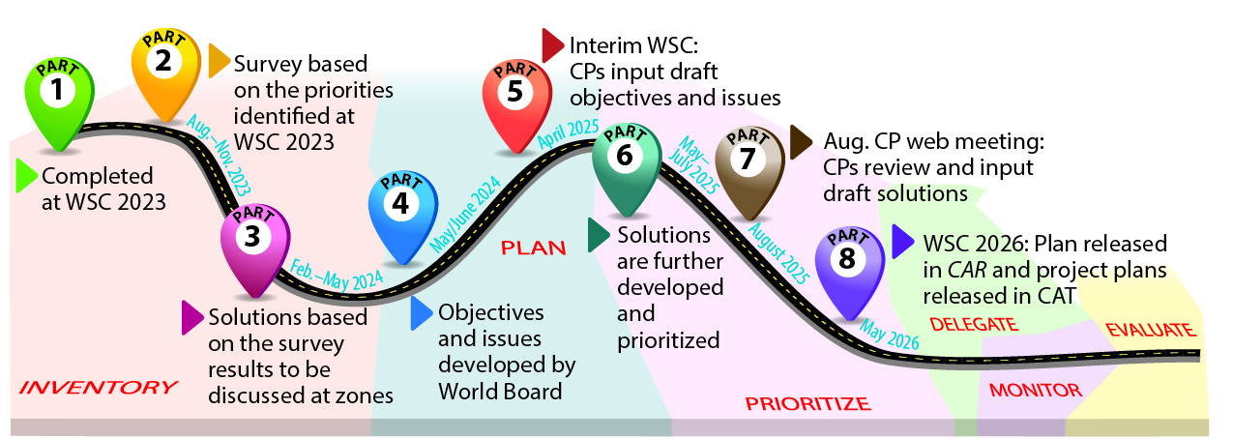

Slide 12


Slide 13
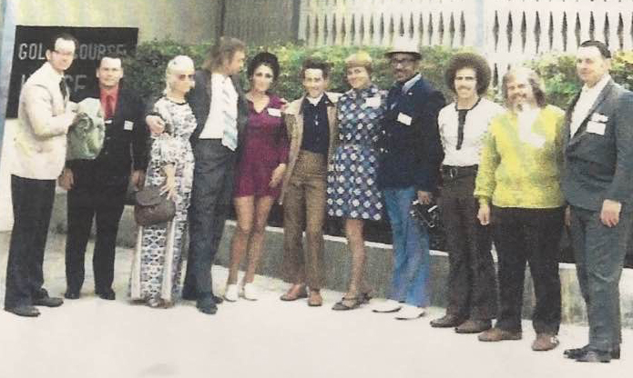


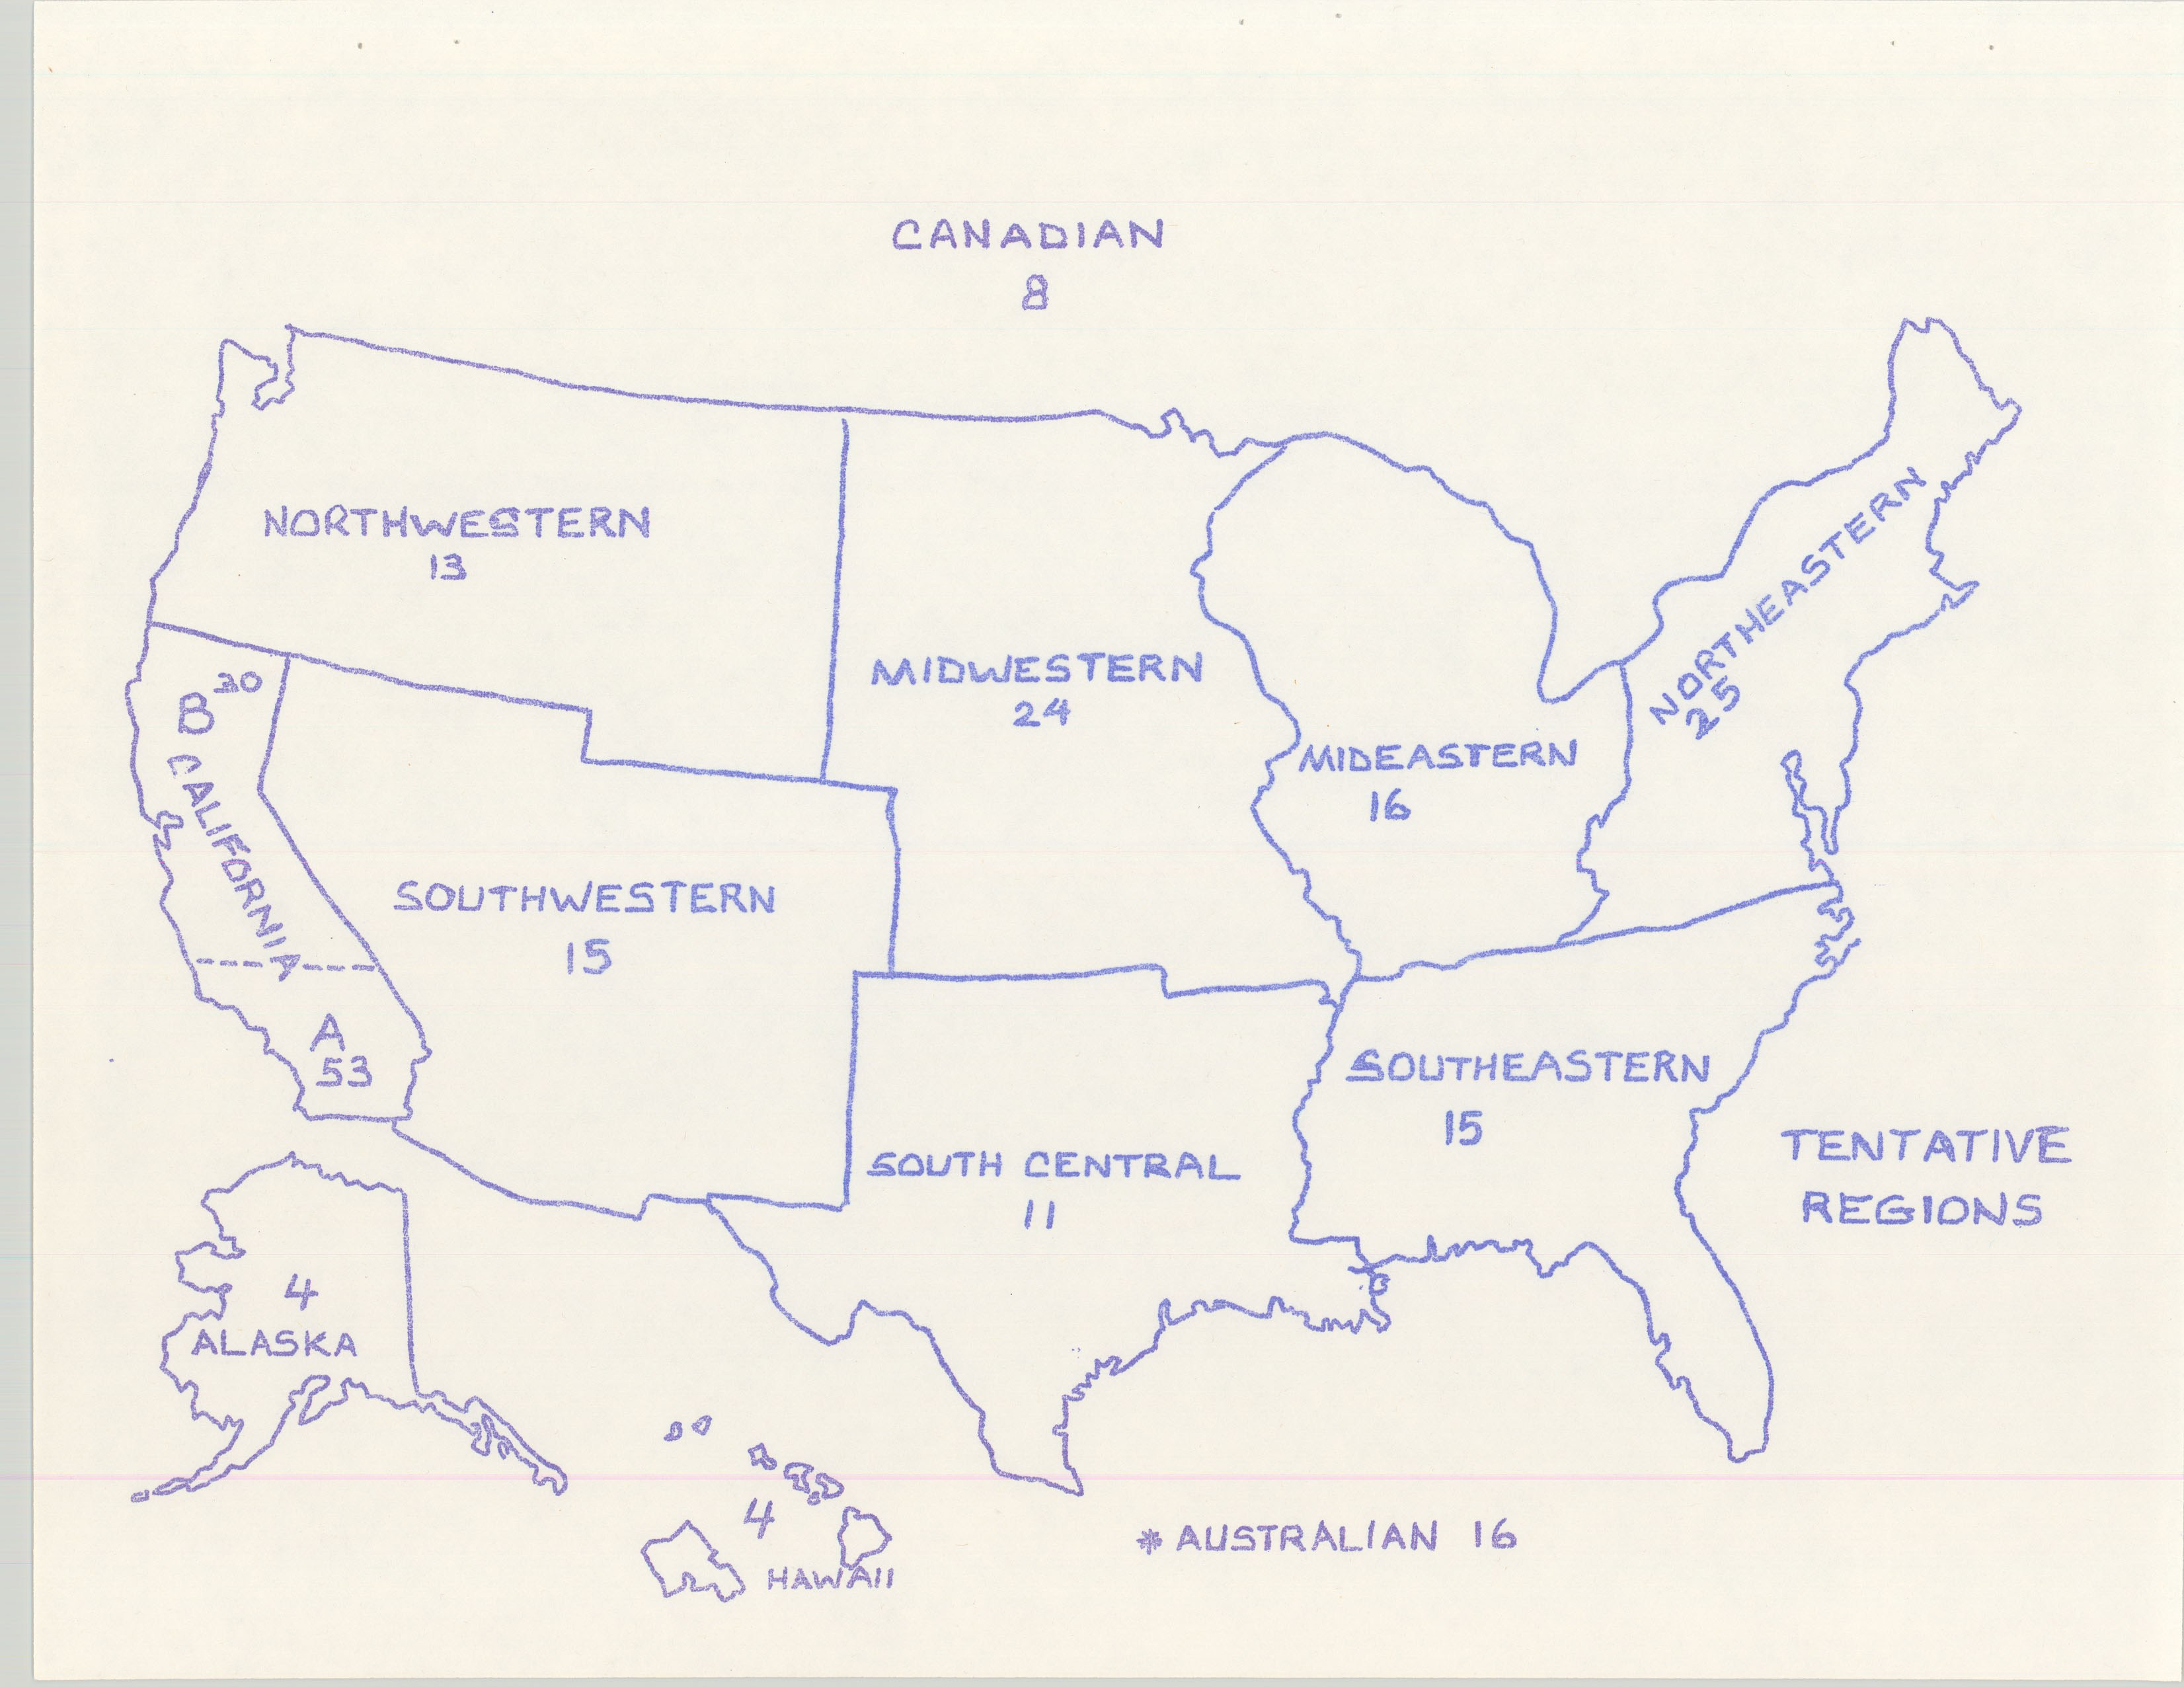
WCNA 1
1976 WSC (number is active groups)

Slide 14
What experience do you have at the WSC that is different than how we do things today?

Slide 15
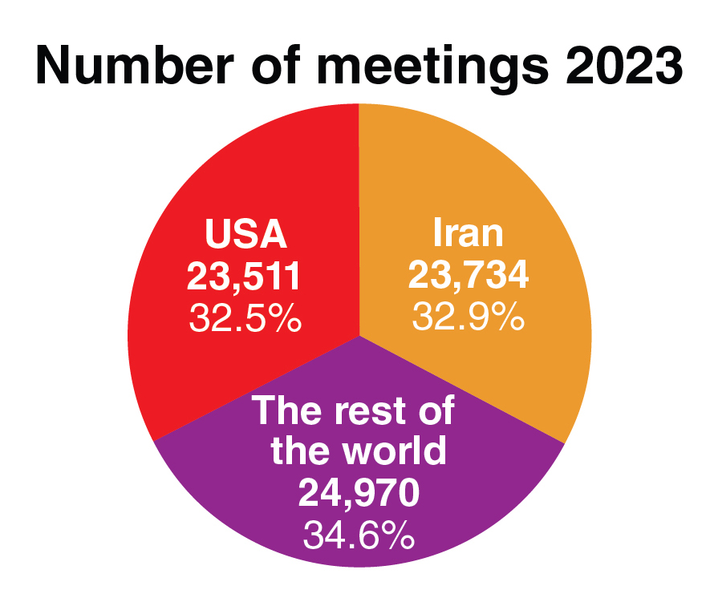
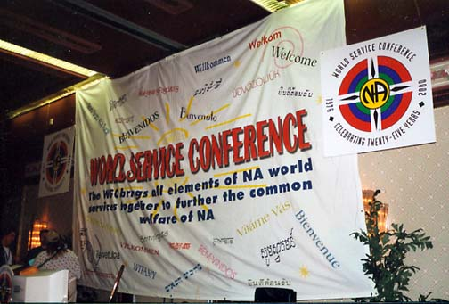
1990s = ~60 seated regions
2008 = just over 100
Today = 128 seated regions

Slide 17
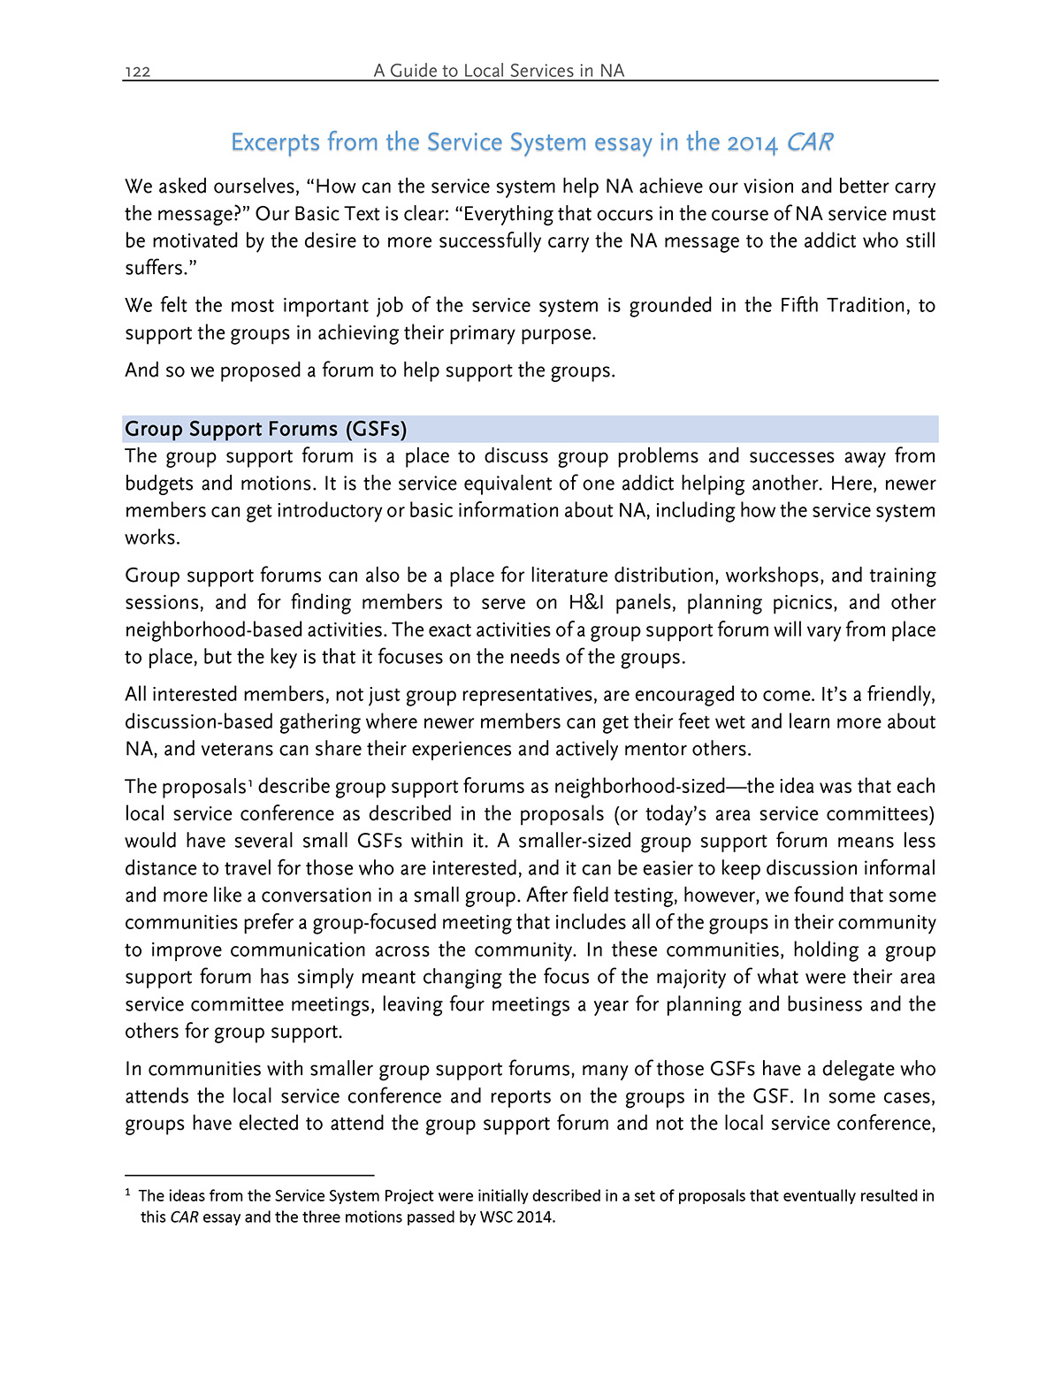
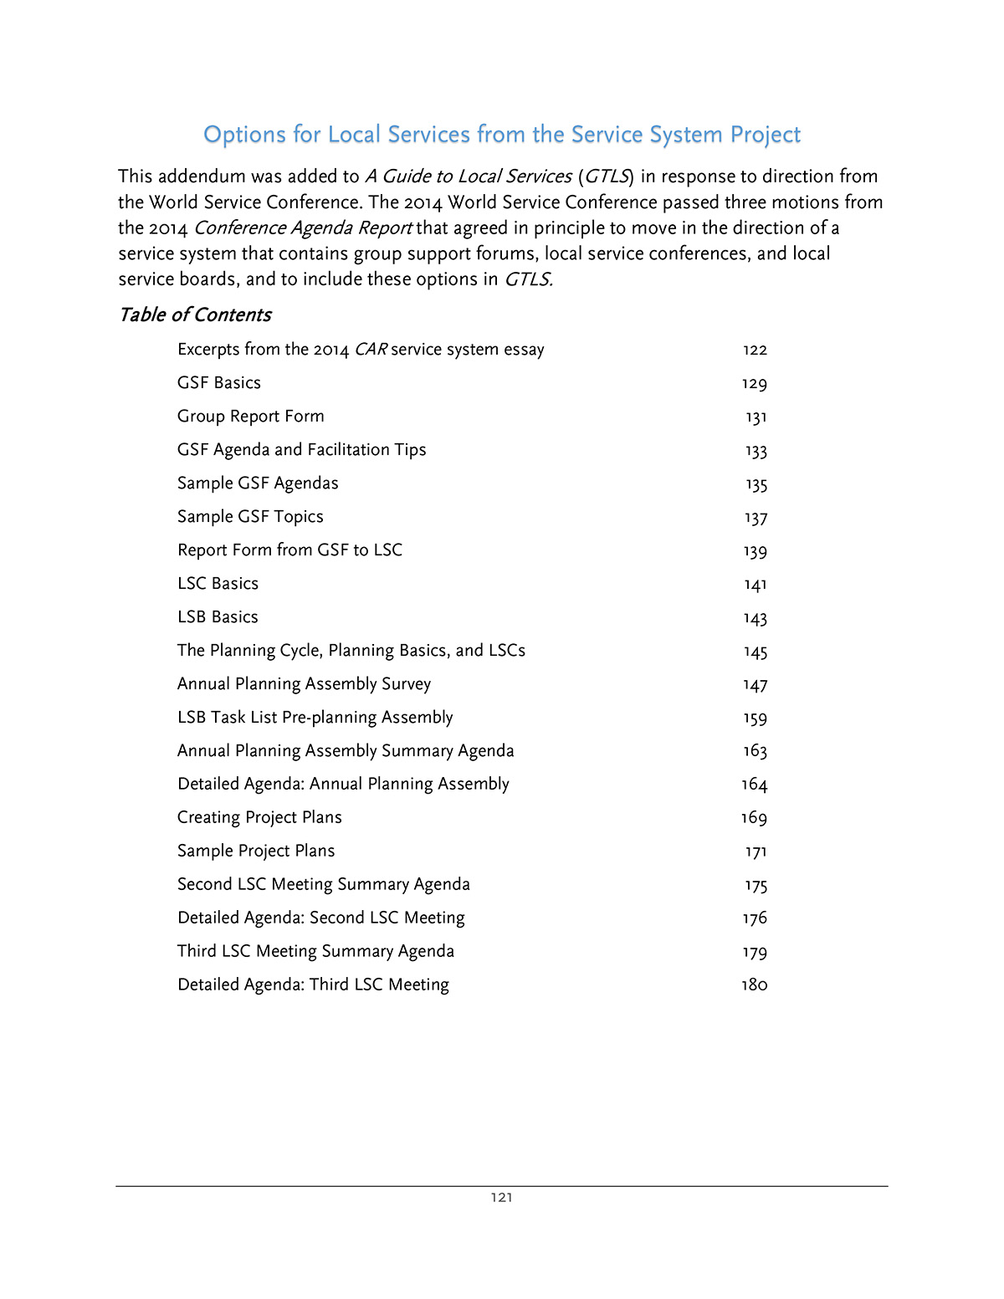
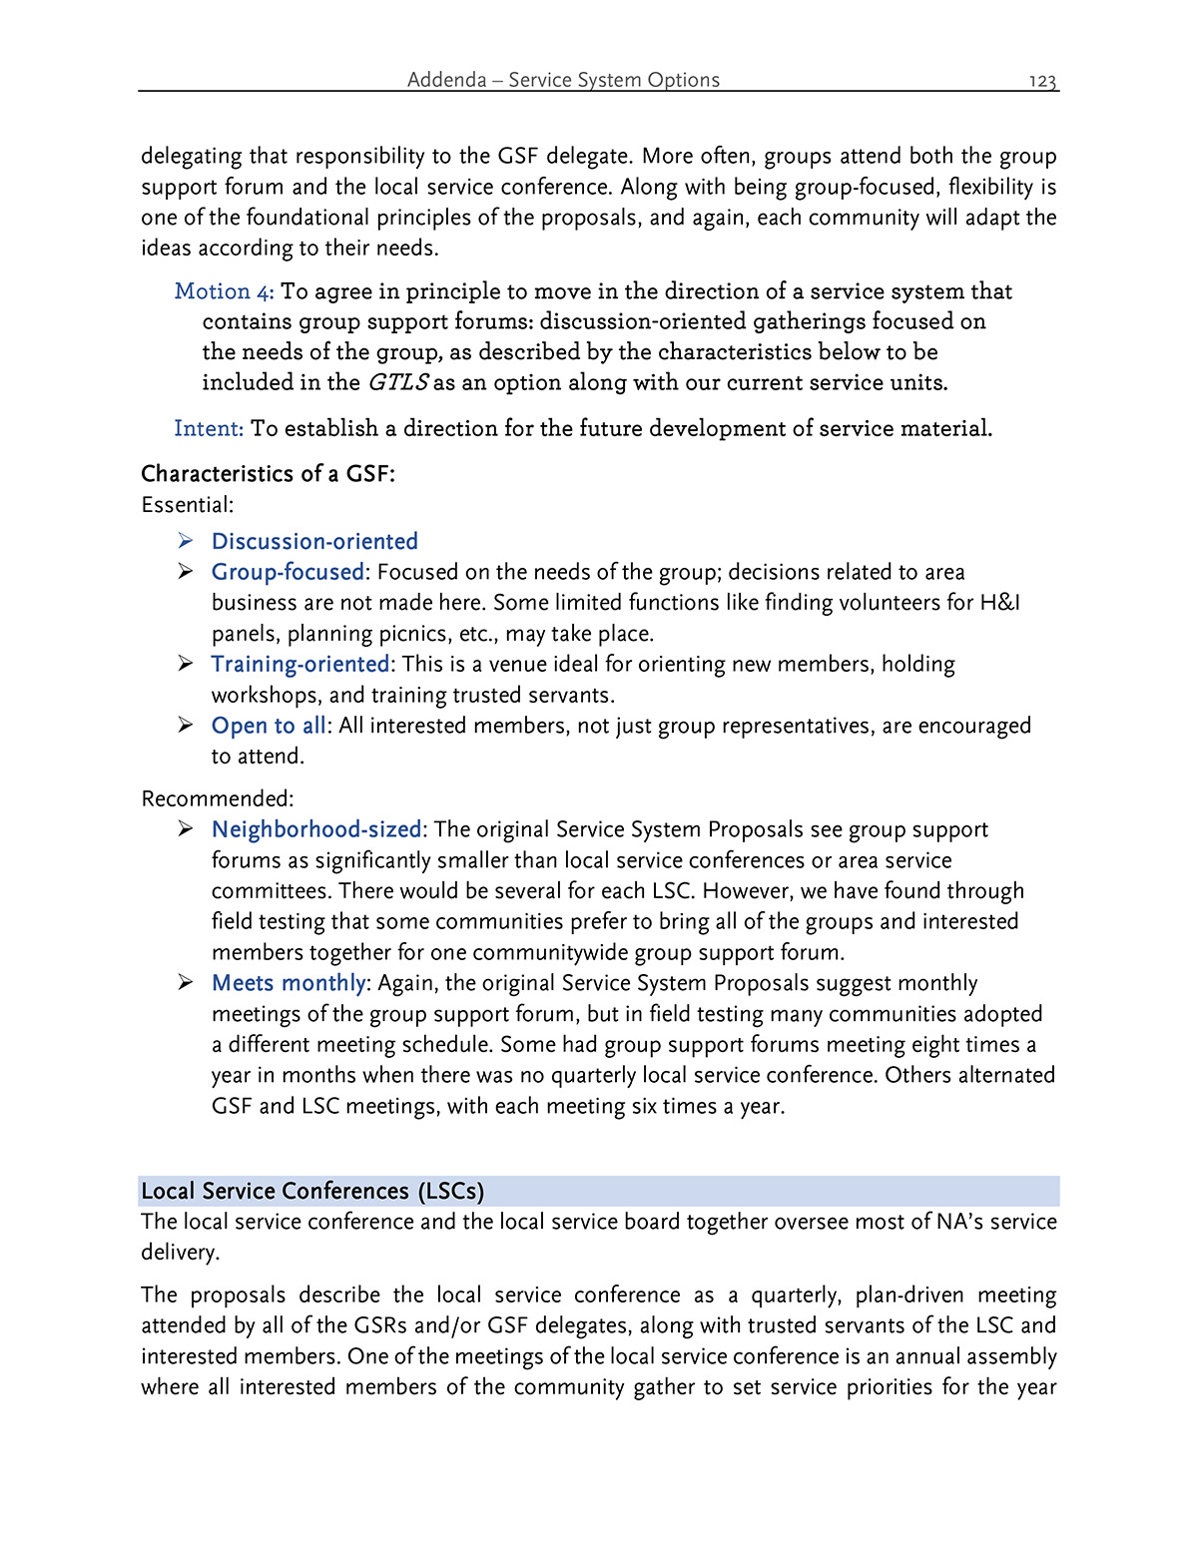
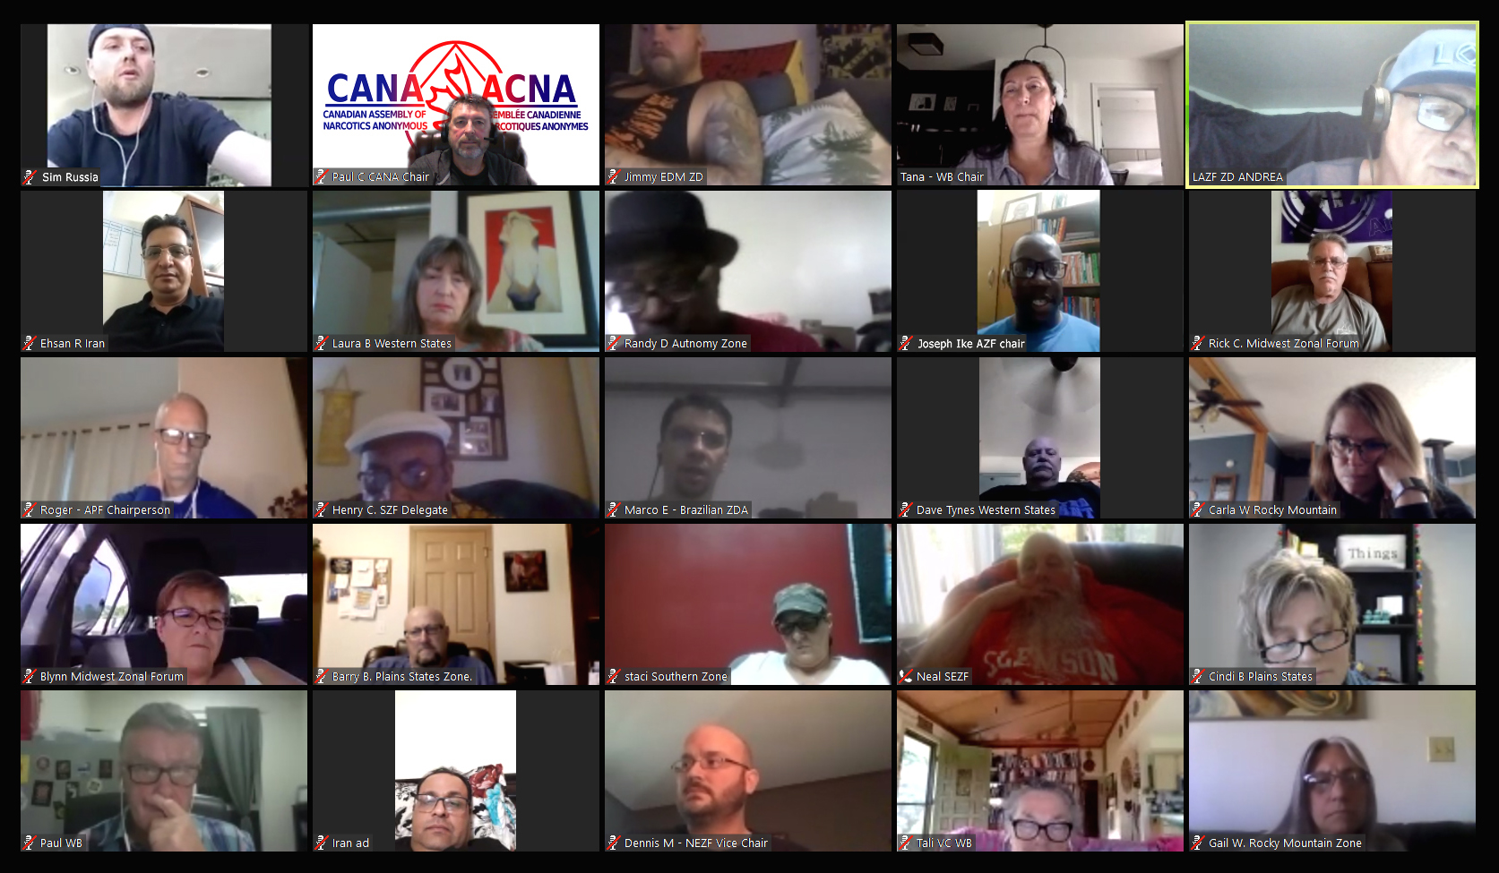
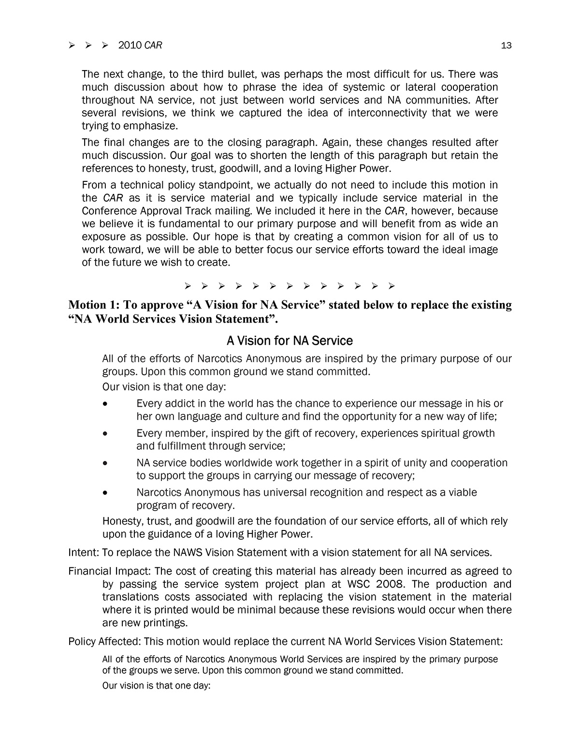
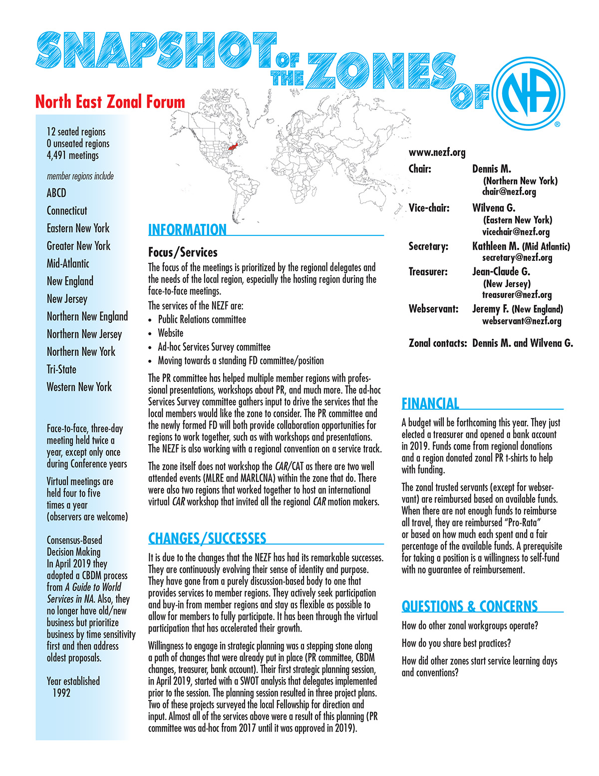
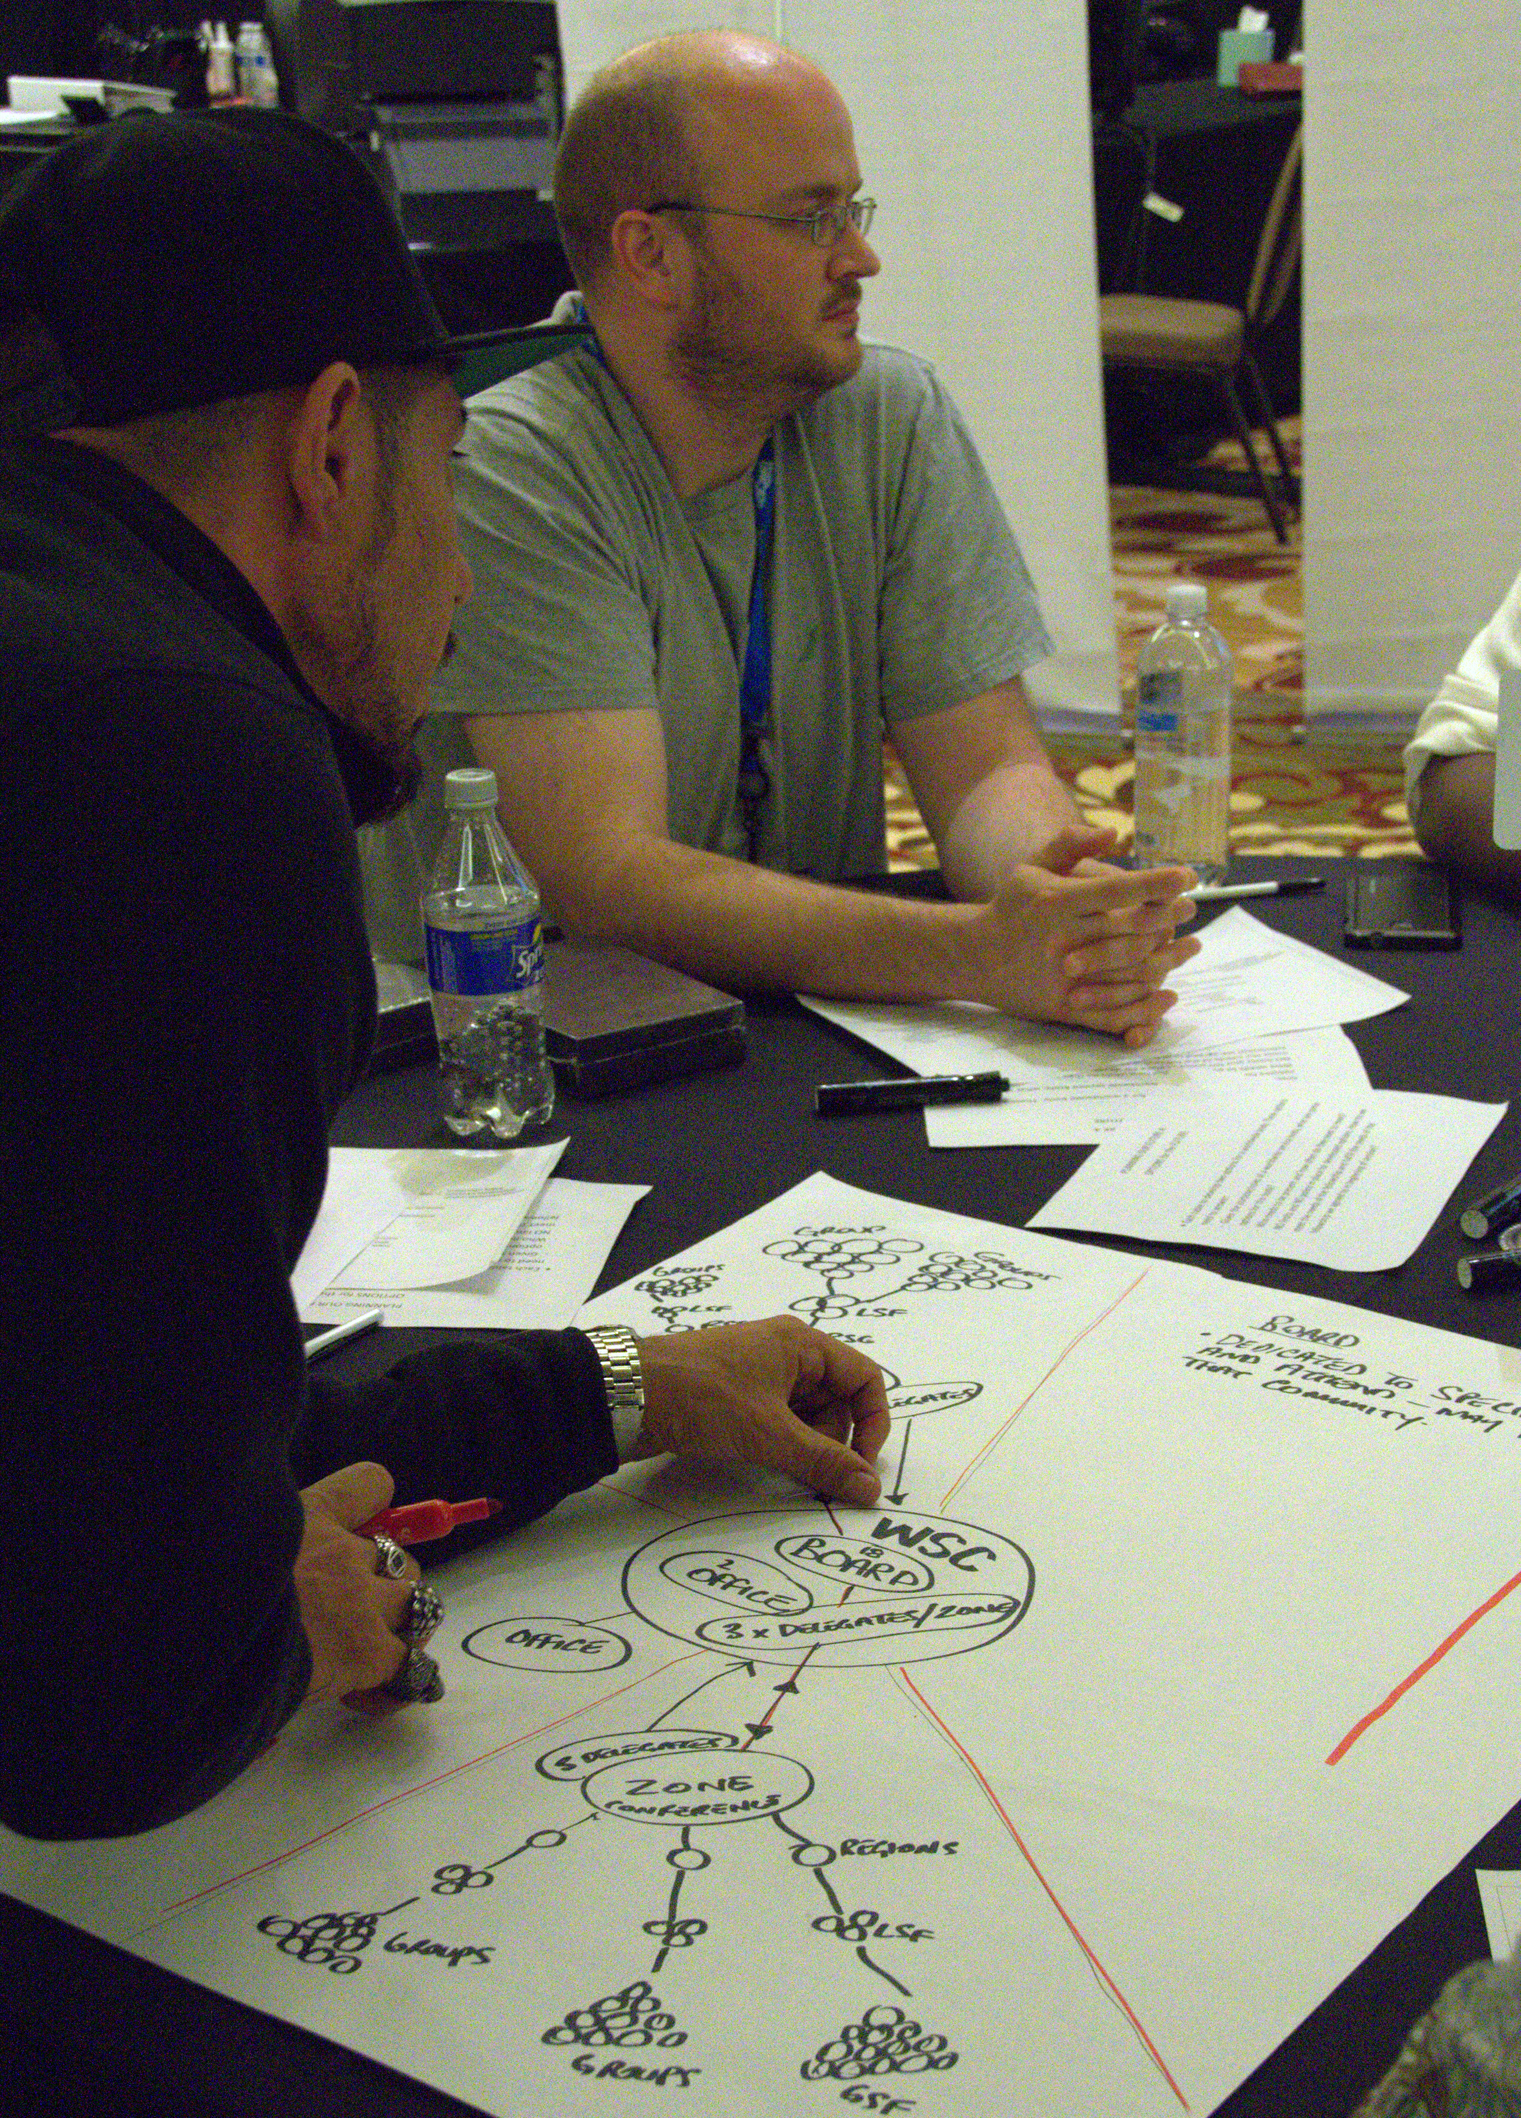
Virtual Meeting of Zones
WSC 2014—Planning Our Future

Slide 18


Slide 19

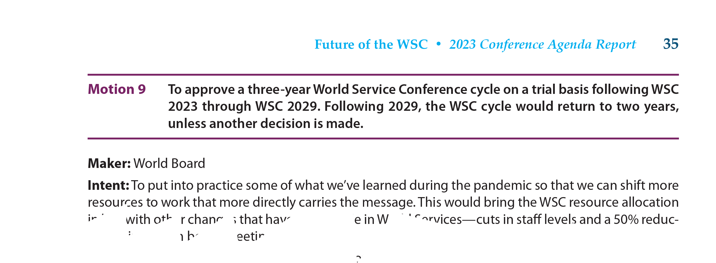

Slide 20
Adopted process and decision-making motions
Motion 1 approved how discussion was handled on items that had consensus in an initial straw poll.
Motion 5 adopted a new process to create the CAR survey and consider project ideas.
Motions 6 & 7 changed the timeframe for amendments to have earlier deadlines.
Motion 8 refined the language defining amendments in GWSNA.
Motion 9 clarified who can offer amendments in discussion.
Motions 10 & 11 were from the Human Resource Panel and focused on accepting candidates only through the RBZ process and repurposing the world pool.
Motion 12 allowed for there to not be a seating workgroup this cycle.

Slide 21
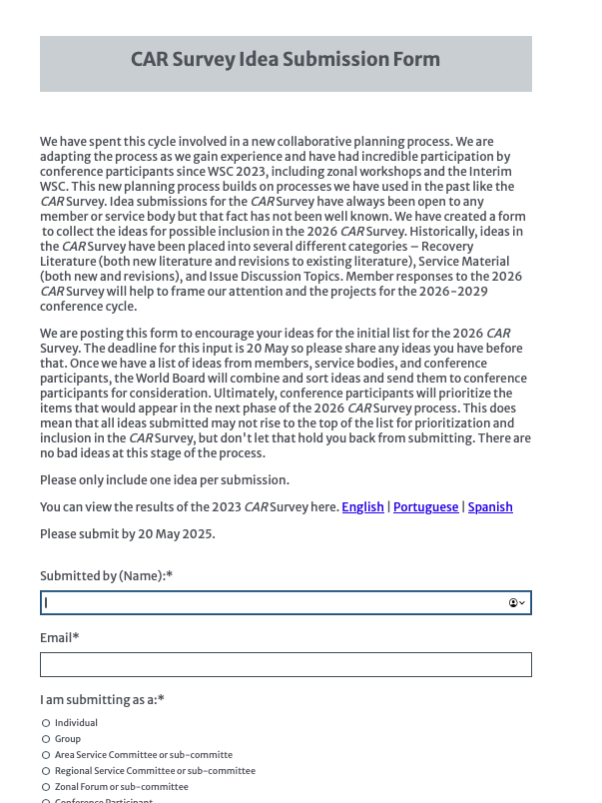
CAR Survey
Submit ideas on the form posted on na.org/conference
Deadline 20 May 2025
Then CPs will review and prioritize
Survey published in the CAR

Slide 22
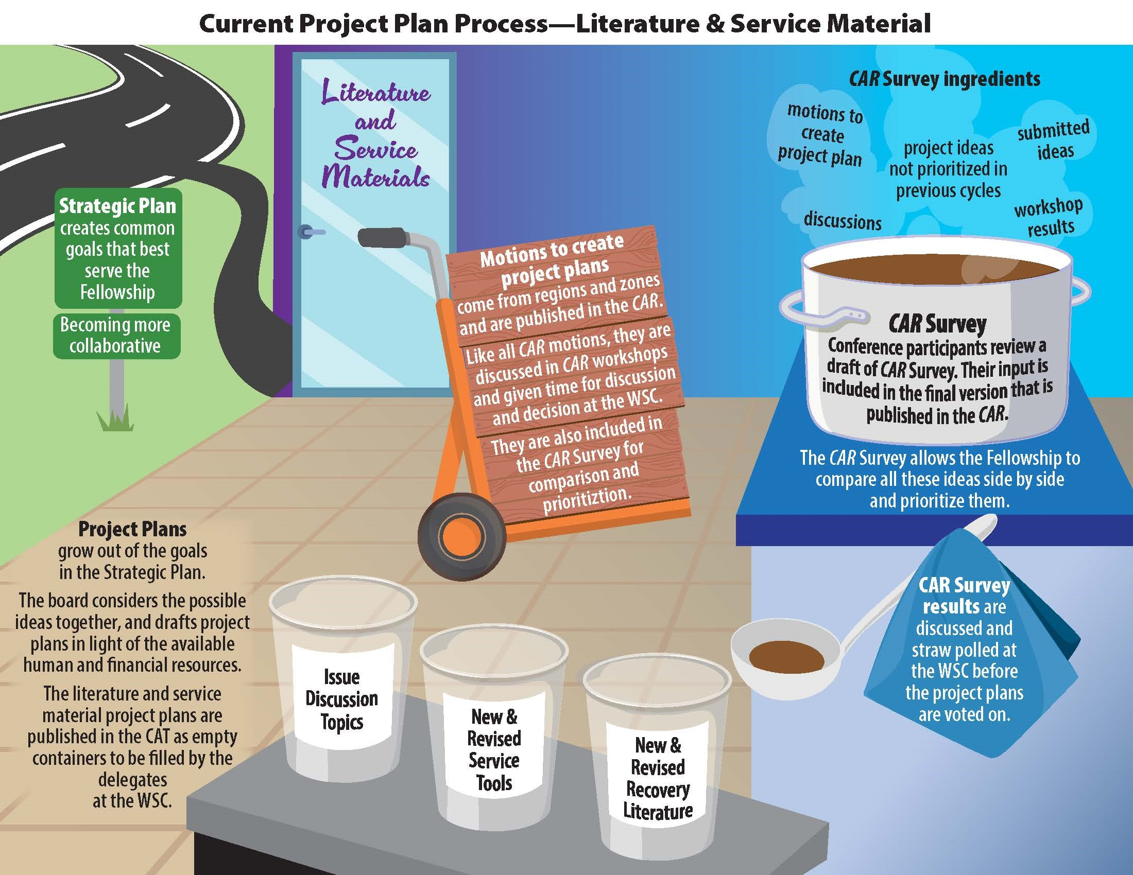

Slide 23
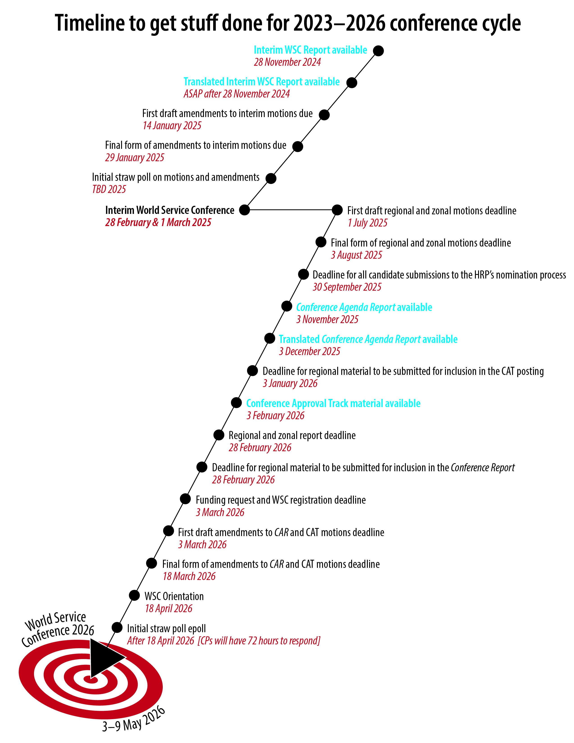
reports to read
deadlines to track
webinars to attend
when to be ready for all the items coming their way leading into the 2026 World Service Conference

Slide 25


