Slide 1

NAWS UPDATE
The latest from NA World Services with updates on projects and WCNA 38 and much more!
Notes:
This session gives an introduction to NA World Services—who we are and what we do—and covers highlights of latest activity.

Slide 2



Introduction
WSC 2023
Resources / Invest in Our Vision
Literature / Carrying the Message
Services & Communication
Questions and Answers
Outline
Notes:
Overview of session. 90 minutes. We’ll try to save time for questions. You can always write to wb@na.org if you have a question you didn’t get a chance to ask today:
Intro
WSC 2023
Resources / Invest in Our Vision
Carrying the Message / Literature
Serving and Communicating Online
Questions and Answers
There is PR work, legal work, work responding to emails and calls, and much more that is not covered in detail here.

Slide 3

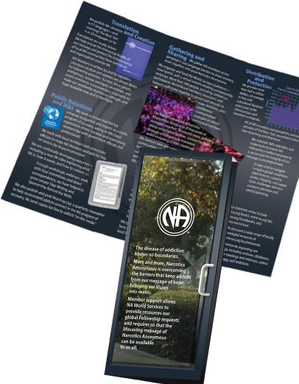

Introduction
What is NAWS?
AKA Narcotics Anonymous
World Services
Notes:
NAWS stands for Narcotics Anonymous World Services.
Some of our activity is covered in this “NAWS brochure” posted at na.org/what-is-na-world-services”

Slide 4
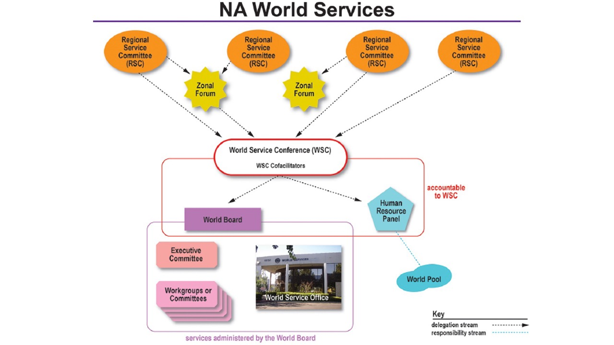
Notes:
“World services” = the World Service Conference and the World Board (WB), Human Resource Panel (HRP), and WSC Cofacilitators who are elected by the conference, plus the World Service Office, whose activities are overseen by the World Board.
This diagram illustrates that the office and workgroups are accountable to the WB
And the WB and HRP are accountable to the WSC.
The WB, the HRP, and the WSC Cofacilitators are all elected by the conference.
You can find more information about World Services from A Guide to World Services in NA. That’s where this diagram comes from.

Slide 5
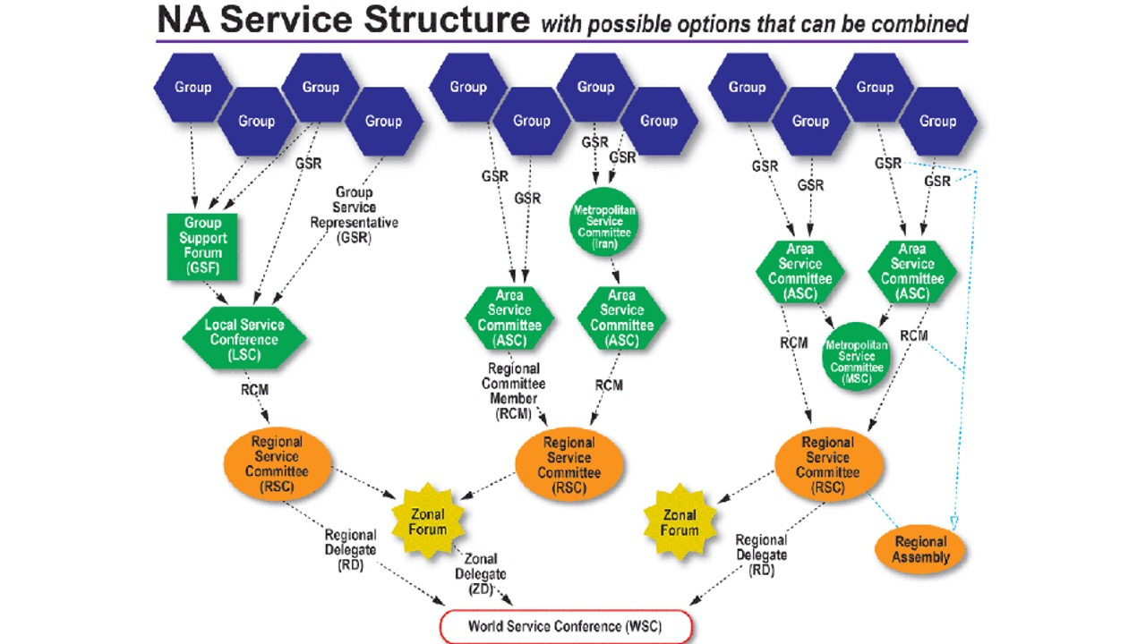
Notes:
The conference is, in turn, accountable to groups. All of the entities in NA World Services are directly accountable to the Fellowship that created them.
This diagram is also from GWSNA. It shows the connection of the groups to the World Service Conference, including some of the diversity that NA communities use to organize their services. This is a great diagram to use as a handout or slide if you need an overview of the structure from group to WSC.

Slide 6

The basic purposes of our World Services are…
communication, coordination,
information,
and guidance.
We provide these services so that our groups and members can more successfully carry the message of recovery and so that our program of recovery can be made more available to addicts everywhere.
            A Guide to World Services in NA
Notes:
A Guide to World Services describes the basic purpose of NAWS as “communication, coordination, information, and guidance.” CCIG, for short.
If NAWS had a mission statement, this would pretty much be it. Like the Vision Statement, this informs all of our work--the projects that we work on that are approved by the WSC, as well as the work that continues week in and week out.
The five locations of NA World Services around the world spend the vast majority of their time and resources on what we call essential services. That is primarily literature production and distribution; protecting the Fellowship’s intellectual property; and providing communication, coordination, information, and guidance to members and service bodies around the world.

Slide 7
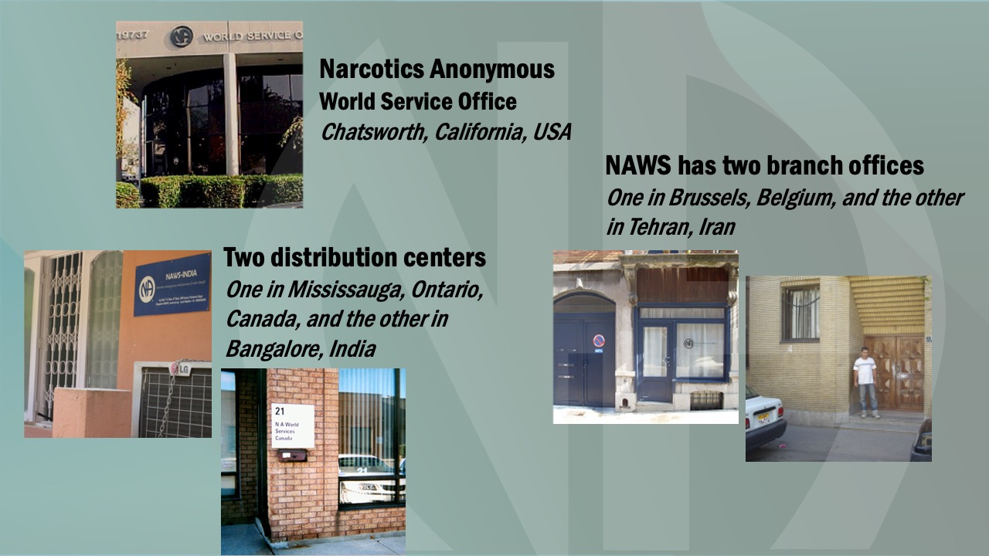
Notes:
These are pictures of the 5 World Service locations
We had to close WSO-E, in Brussels, Belgium temporarily, but we have resumed shipping from the European office. Orders are now processed at our Chatsworth locations and packed and shipped from Europe. We are looking for a larger Brussels location so that we can build up stock there. Questions about European orders can be directed to wsoeurope@na.org.

Slide 8

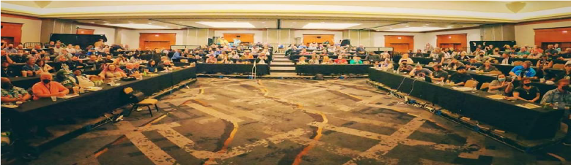
WSC 2023
Here are a few of the highlights.
Notes:
NA World Services also helps administer the World Service Conference and the projects it approves.
The 36th World Service Conference was held 30 April – 6 May 2023.
It’s a big service meeting! But not just like a large RSC.

Slide 9
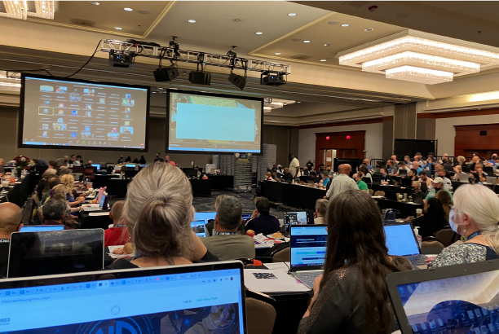
There were 139 voting members participating at WSC 2023:
126 delegates
(120 RDs, 6 ZDs)
13 World Board members
First truly hybrid WSC!
The virtual participants who joined the conference were:
11 RDs
2 ZDs
1 World Board member
25 alternates
Notes:
NA World Services also helps administer the World Service Conference and the projects it approves.
WSC 2023 was the first truly hybrid WSC. We are still learning how to hold a hybrid WSC. It’s new to us and involves more technology, preplanning, flexibility, and staff.
39 Virtual participants: 11 RDs, 2 ZDs, 1 World Board member, and 25 alternates. (At WSC 2018, only a few participants joined remotely—one delegate and two alternates.)
139 voting members present (online and in the room): 120 RDs (3 seated regions did not attend). 6 ZDs (all seated zones), and 13 World Board members.
Also present: 103 alternate delegates, 4 HRP members, 2 cofacilitators, 5 in-person translators and additional virtual translators.
There were 179 men and 63 women among delegates, alternates, and WB.
Conference participants were from 45 countries, and we spoke 28 languages (based on Serenity Prayer languages at the close of the First Things First session).

Slide 10

For the first time in NA history, the majority of delegates to the World Service Conference are from outside the USA!
134 regions and zones are now seated at the WSC.
66 of them are from the US, and
68 of them are from other places around the world.
WSC 2023 made the decision to seat five regions:
Brazil Central
Iran Region #1
Nordeste Brazil
Rio Grande do Sul
Thailand
Notes:
For the first time in NA history, the majority of delegates to the World Service Conference are from outside the USA!
WSC 2023 made the decision to seat five regions: Brazil Central, Iran Region #1, Nordeste Brazil, Rio Grande do Sul, and Thailand.
134 regions and zones are now seated at the WSC.
66 of them are from the US, and 68 of them are from other places around the world.

Slide 11

Interim WSC meeting
was held 28 February & 1 March 2025
for two 2-hour sessions each day
There were 144 voting members:
129 delegates (123 RDs, 6 ZDs)
15 World Board members
There were also:
89 alternate delegates
4 HRP members
2 cofacilitators
8 translators
15 enlisted volunteers, mostly former world level trusted servants (to facilitate and take notes for the breakout rooms)
100s of members listened to the livestream in English, Portuguese, Spanish, and
Russian.
Notes:
The 2025 Interim WSC was held 28 February and 1 March 2025, for two 2-hour sessions each day. This was the first intentional all virtual Interim WSC meeting.
There were 144 voting members participating—129 delegates and 15 World Board members. In addition, there were 89 alternate delegates, 4 HRP members, 2 cofacilitators, 8 translators, and 15 former world level trusted servants who helped facilitate and take notes for the planning dicussion sessions. Of the 129 delegtates attending, 123 were regional delegates and 6 were zonal delegates.
128 seated regions that could have participated. However, 5 seated regions did not attend.
This year’s conference participants were from 44 countries.

Slide 12
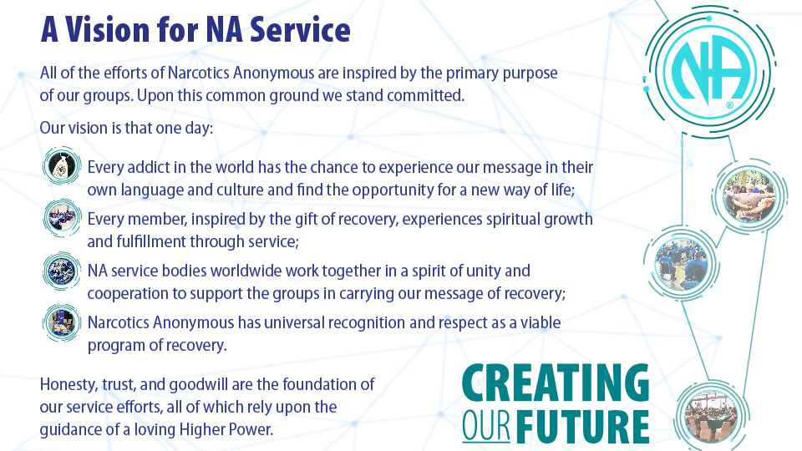
Notes:
Most of you have seen A Vision for NA Service before. This is the touchstone for all of the work of World Services.
WSC 2023 revised the Vision statement to change “his or her own” to “their own language and culture” as shown here.
This small change may be barely noticeable to some, but it is a big step in helping to achieve our Vision by using language inclusive of all members.

Slide 13
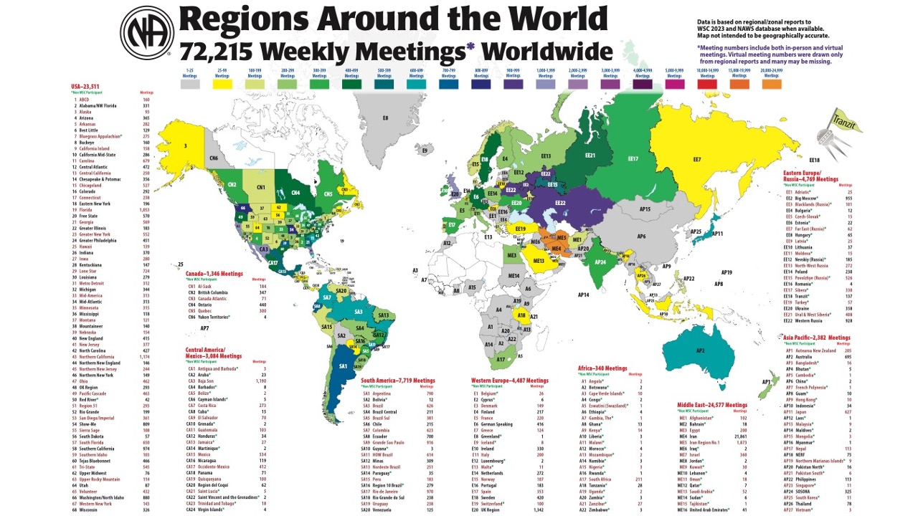
Notes:
We update this map every WSC, based on the numbers delegates report. We expected the numbers to decrease after the pandemic, and they did. (The 2020 version of this map had more than 76,000 meetings.)
72,215 is likely an undercount because we don’t yet have an accurate way to count virtual meetings that are not connected to the service system.

Slide 14
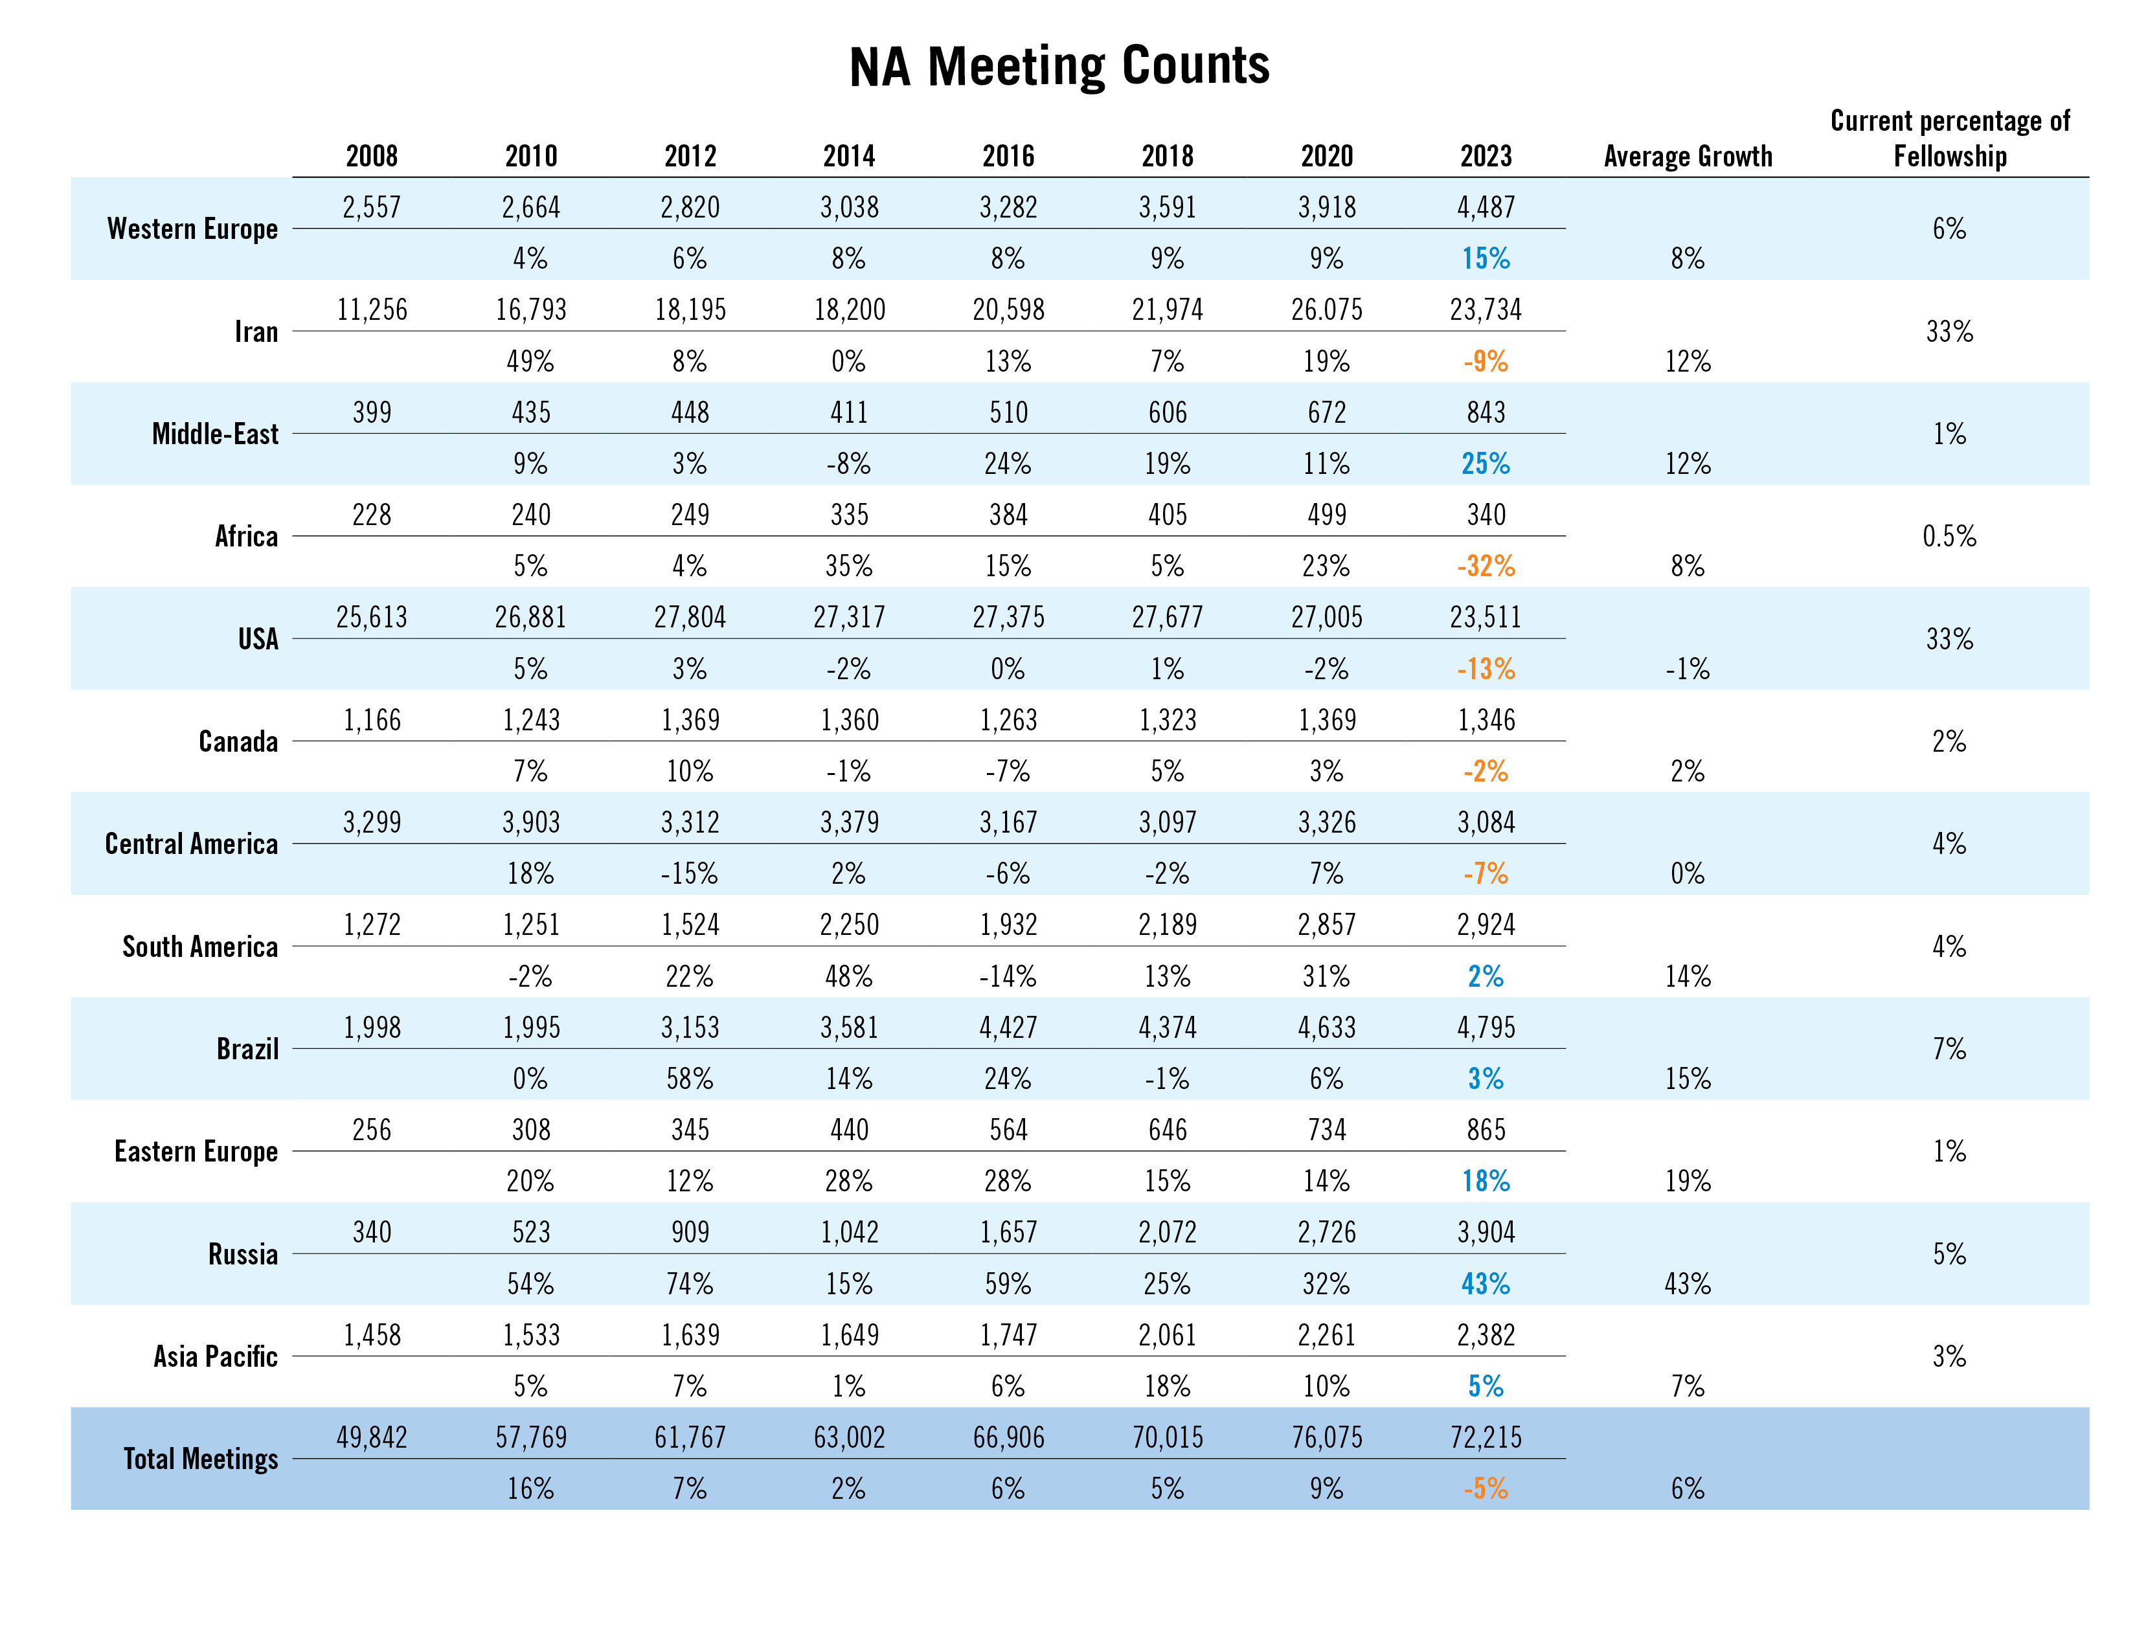
Notes:
This slide shows meeting counts in different parts of the world over the past 17 years. About one third of NA meetings are now in the US, about 1/3 in Iran, and 1/3 everywhere else.
Even before the pandemic, NA growth had flattened in some parts of the world. It can be easy to think of Fellowship development as something that happens “somewhere else,” but there is work to do locally no matter where we are.
We are eager to do what we can to support efforts to reverse that trend.
This chart is posted on na.org/maps, which is a page full of interesting maps, diagrams, and illustrations of NA’s growth.

Slide 15
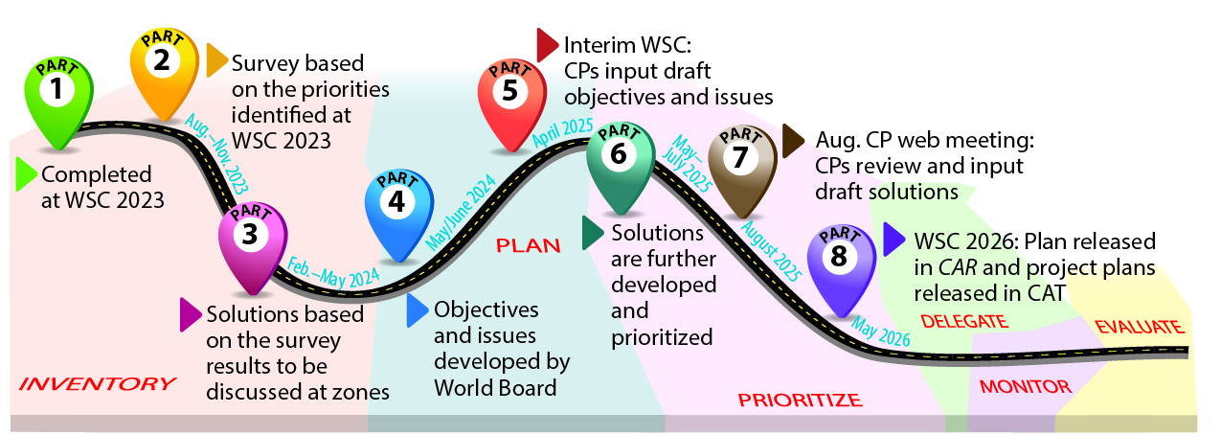
Strategic Planning
Participants will review and provide input on the draft solutions
Notes:
At WSC 2023 we rebooted the strategic planning process. The new process is collaborative and includes extensive communication with and guidance from delegates throughout the process. The new planning process has been a big focus for us this cycle and the result should be a strategic plan that conference participants have collectively created.
WSC 2023 agreed on a list of factors affecting NA. After the conference, participants prioritized the factors through a survey, and then every zone workshopped the challenges and solutions related to each factor. The board discussed the workshop results and drafted the strategic plan objectives for review at the interim WSC. Some changes were made based on conference participants’’ discussions, and the revised objectives were posted at na.org/planning. The solutions will be the next piece to discuss.
For more information on the process, see the planning section of the conference page: na.org/planning.

Slide 16
Some of the motions adopted at WSC 2023
Changed the FIPT to recognize seated zonal delegates and clarify the definition of recovery literature
Recognized virtual meetings as groups
Added the ability for local stories to be
added to translated Basic Texts with
certain conditions
Approved a 3-year
conference cycle as a trial
for two cycles
And much more. . .
for a
full report
read the
NAWS News
June 2023
na.org/nawsnews
Notes:
WSC 2023 accomplished a lot! This slide lists just some of the significant decisions. The June 2023 NAWS News gives a full report. You can find that at na.org/nawsnews
The FIPT was changed to reflect conference decisions to create a zonal delegate position as a full voting conference participant. The definition of recovery literature was also clarified. And there were changes to the Operational Guidelines and the Use Policy. The 2023 CAR explains these changes in detail.
Virtual meetings were recognized as groups if they meet the 6 criteria described in The Group Booklet.
If a language community has local stories published in their Little White Book, up to six of those stories can be published in their translation of the Basic Text if they choose.
The conference decided to try a 3-year cycle for two cycles (6 years). There will be a virtual interim meeting mid-way through the cycle.

Slide 17
Some of the motions adopted at Interim WSC 2025
Streamline the way decisions are made at the conference
Open and expand the CAR Survey creation process
Update the World Services nomination process
Addressed legally necessary issues
for a
full report
read the
NAWS News
March 2025
na.org/nawsnews
Two sessions were devoted to planning—a new endeavor for the conference that the three-year cycle made possible.
Notes:
The 2025 Interim WSC made decisions related to the operation of the World Service Conference, procedures that shape the election process, the construction of the CAR survey, and how decisions are made at the WSC, and took care of some legally necessary business – such as passing a one-year budget.
More than the decisions that were made, the iWSC was an opportunity for conference participants to review the draft strategic plan objectives and issues and provide input.
This collaborative process gave conference participants more of a chance to think together, rather than just debate, and provide a true group conscience of the Fellowship.

Slide 18

Work for the 2023-2026 Conference Cycle
Dealing with disruptive and predatory behavior
Gender-neutral and inclusive language in NA literature
Reimagining and revitalizing service committees
Welcoming members on DRT/MAT
Issue
Discussion Topics
na.org/idt
Notes:
Participants at WSC 2023 selected Issue Discussion Topics for the cycle. CAR survey results helped inform those decisions.
The 2023-2026 IDTs are:
Dealing with disruptive and predatory behavior
Gender-neutral and inclusive language in NA literature
Reimagining and revitalizing service committees
Welcoming members on DRT/MAT
All workshop materials can be found at na.org/idt
We will be devoting time at open web meetings throughout 2025 to these topics. See na.org/webinar for more information.

Slide 19
Virtual Service Basics
(including virtual service meetings, virtual meetings and areas participating in the service system, virtual workshops and trainings, etc.)
PR video
(explaining what NA is, how it works, and how to contact us)
Revise and update H&I Basics
Revise and update the service pamphlet Group Business Meetings
(with a section on using a CBDM process and the concept of delegation)
Service Material
Notes:
Participants selected a number of focuses for the Service Material project for the upcoming cycle, also informed by the CAR survey results. These resources will be worked on as we are able:
Virtual Service Basics
A PR video explaining what NA is, how it works, and how to contact us
Revise and update H&I Basics
Revise and update the service pamphlet Group Business Meetings (with a section on using a CBDM process and the concept of delegation)

Slide 20
Virtual Service Basics
Developing a tool on best practices
Outline was posted and members provided input
A draft of the tool will be
available soon
na.org/toolbox
1
Revision to H&I Basics
Draft of the first component—Corrections—was posted for review and input. A revision is coming soon.
Plan on 2 more pieces—Treatment and Committees
na.org/revising-HI-basics
Group Business Meetings service pamphlet
A draft of the revision and update will be available soon
na.org/projects
Notes:
The development of Virtual Service Basics and the revision of H&I Basics are underway.
The pandemic changed NA culture rapidly. Online groups are now common throughout NA, but as a Fellowship, we are new at connecting virtual groups to the service system, and serving online and in hybrid environments. This resource will collect best practices on a range of related topics.
An outline for Virtual Service Basics was posted for input. A draft will be available soon.
A review draft of the Corrections component of the H&I Basics revision was posted to na.org/revising-HI-basics. A revision will be coming soon, as well as an initial draft of the Treatment section. The third part will be about H&I committee work.
We are also working on a draft revision of the Group Business Meetings service pamphlet to post for a 90-day7 review. When that is ready, a link will be posted at na.org/projects.

Slide 21
Revise IP #21, The Loner
Survey the Fellowship about
the Step Working Guide to
address the following from
the CAR survey:
Step working guide aimed at members not new to working the Steps
Step working booklet focused mainly on Steps 1–3, aimed primarily at new members and those in treatment and drug courts
Revise and simplify the Step Working Guides
Recovery Literature
Notes:
CAR survey results also helped shape participants’ decisions about the focus of the literature projects this cycle.
The conference decided to continue work on revising IP #21, The Loner: Staying Clean in Isolation.
The survey on Step Working materials was completed and the World Board is discussing next steps. The results will be published before WSC 2026.

Slide 22
2
Revision to IP #21,
Staying Clean in Isolation
Input was provided on the posted draft
Background information can be found on the webpage
na.org/revisingIP21
Approval draft to be included in the 2026 CAR
Notes:
The review draft of a revised IP#21 was posted at na.org/revisingIP21 along with an input form. One of the big pieces of input we got in last cycle’s survey on the project was that we may want to rethink the term “loner.” We’ve re-titled the review draft simply Staying Clean in Isolation as a result of the survey input and focus group discussions which echoed that idea.
The approval draft will be in the 2026 CAR which will be posted in October 2025.

Slide 23
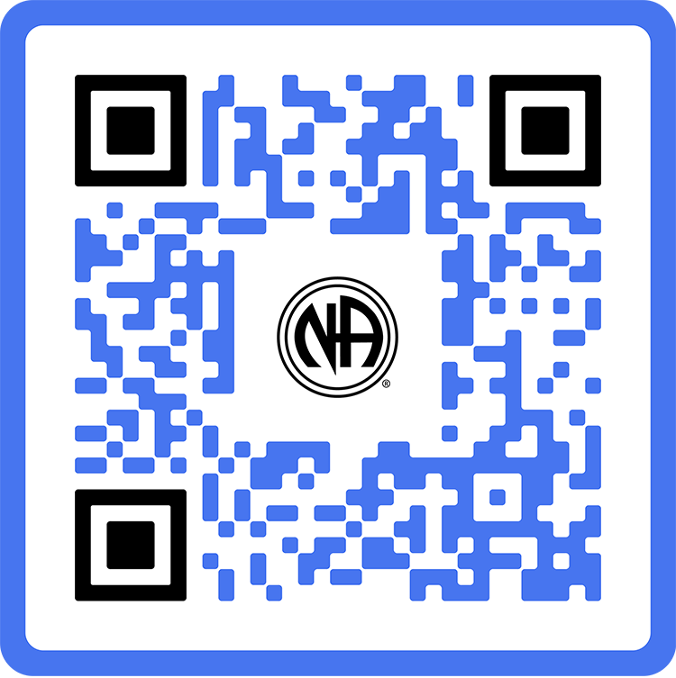
Resources /
Invest in Our Vision
na.org/contribute
Notes:
The biggest story for us in the past five years is about how the changing world environment has affected our resources, and how we have responded. From the pandemic to wars to natural disasters, meetings have opened and closed, supply chains have been disrupted, and World Services has felt the effects. Through it all, member dedication has been the steadying force in some very rough seas.

Slide 24

2024
Annual
Report
na.org/ar
Notes:
The Annual Report tells this story and more. The AR is the best picture of our financials. We publish a PDF version and for the first time, a browser-friendly version.
It takes a long time to put together an AR. We inventory the WSO, the branch offices and distribution centers, do an on-site audit, conduct currency conversions, summarize all contributions, and have a World Board review.
Because it can take so long, we included the reporting from WCNA 38 in this AR, even though it took place in the next fiscal year.
With locations operating in different currencies and operating under different legal systems, it isn’t really possible to produce a short, simple financial report. The closest we can get is the financial position provided by our auditors in the AR.
Present and past Annual Reports are posted to na.org/ar.

Slide 25

Financial Impact of the Pandemic
NAWS income 90% from literature sales pre-pandemic
March 2020—literature income decreased approx. 85%
Expenses cut: staff, periodicals, travel….
Shutdowns were five years ago and we are still building back
Notes:
Crisis = Danger + Opportunity
2020 began a financial crisis. Chinese word for crisis is sometimes understood to be composed of the characters for danger + opportunity.
Though the global shut downs were five years ago, we are still building back.
Pre-pandemic 90% of World Services’ income came from literature sales. In the March 2020 global shutdown, literature income decreased about 86%.
Our reserve funds helped keep us going. But we had to cut what we could. Cutting staff was the quickest way to cut costs.
We discontinued paper mailings and the NA Way. NAWS stopped travelling to events and holding in-person board meetings or workgroup meetings.
And our members stepped up. Direct donations kept us afloat through the worst of it.

Slide 26
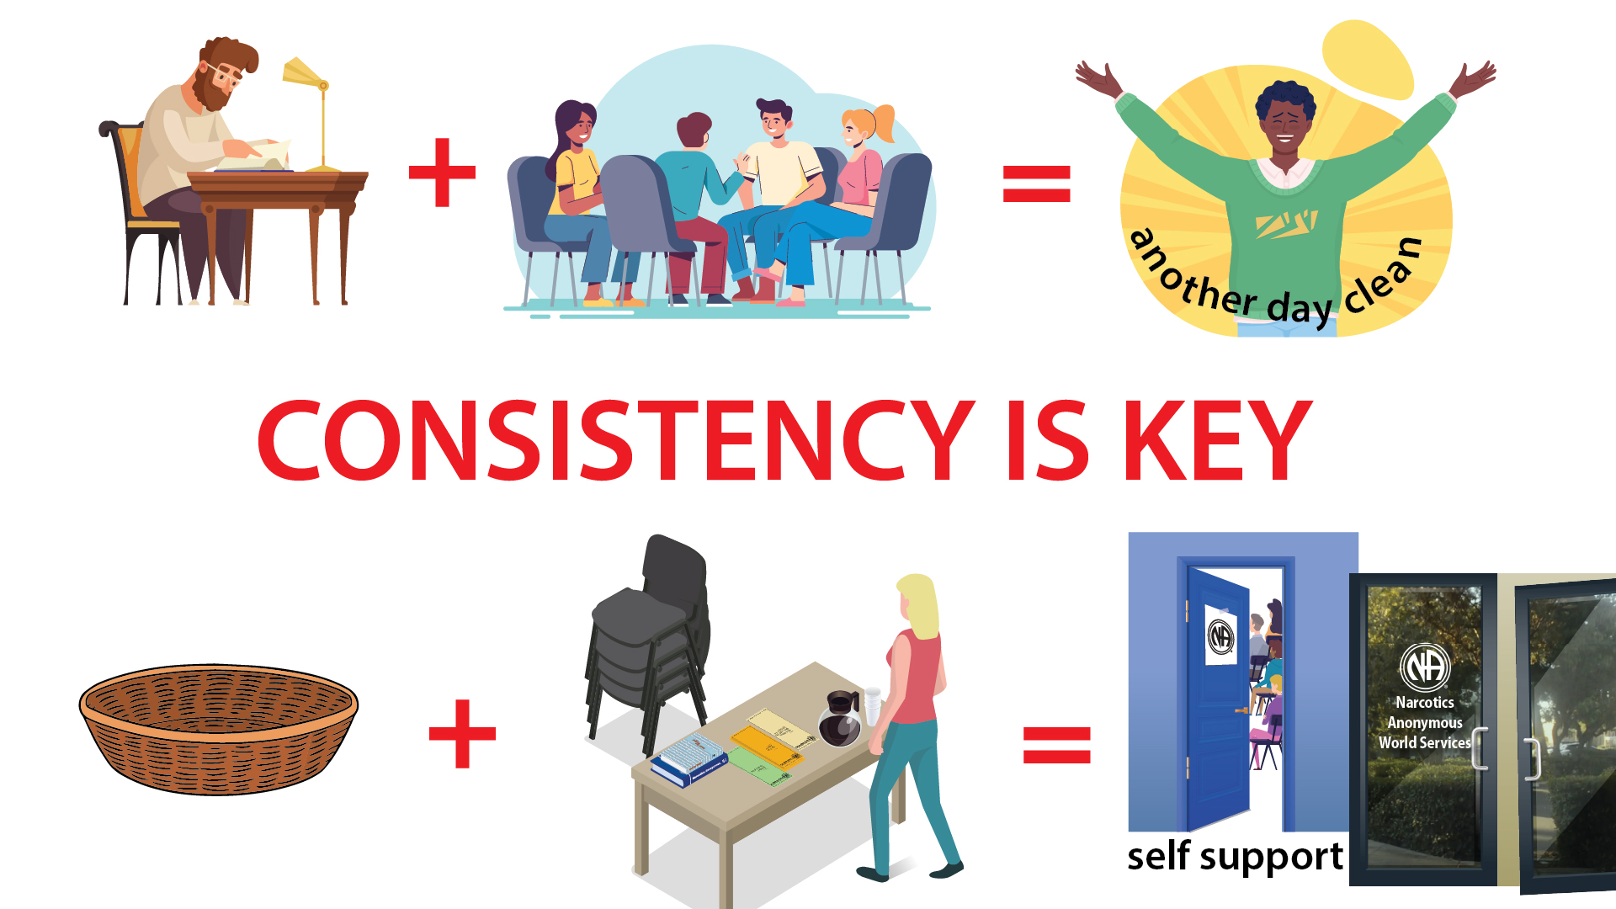
The future
looks bright.
Notes:
We resumed publishing Reaching Out in January 2023. In July 2022 the Board met in-person for the first time in over two years. They met virtually during the shutdown and continue to do so. There has been some travel, but it’s still much reduced. Staff numbers remain well below pre-pandemic levels. We are doing more with less.
As meetings reopened and local services got going again, member contributions did dip, but the Fellowship continues to be amazing by showing their generous support.
For years, we have been saying that member contributions are the most sustainable source of income, and the most in line with our spiritual principle of self-support.
We have long known that relying on literature income primarily from the US to fund our global efforts is not sustainable. The pandemic forced a shift toward an income model that is more reliant on member contributions (including groups, service bodies and events). We don’t want to lose the lessons we learned so painfully in that time.
Consistency is key.
When members provide ongoing direct contributions we experience self-support in the purest way. When we share directly—in the basket at our homegroup and through Donorbox directly to World Services, we make sure that services continue uninterrupted, No Matter What.

Slide 27
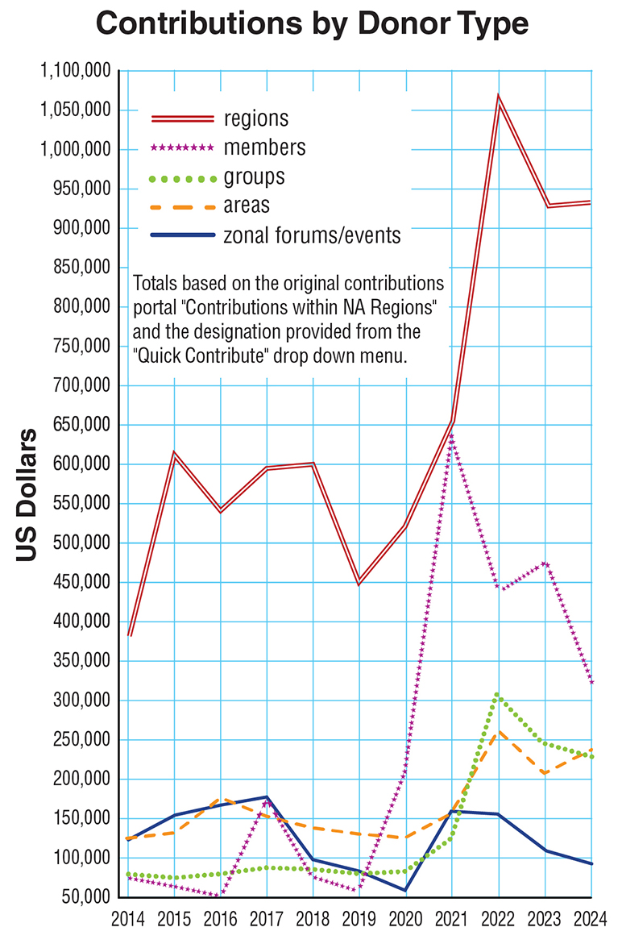
The reopening of meetings and the increased involvement of service bodies marks the growth for 2021-2022.
2023 saw resources going toward local service delivery and group expenses as in-person groups reopened and local service bodies ramped up activities.
Member contributions continue to support our services at every level, and direct member contributions to NAWS have allowed us to increase direct support of developing NA communities.
Profound
increase in member contributions
for 2020-2021.
Notes:
We are increasing our stockpile of inventory to protect NA members from the unpredictability of the supply chain these days, and building those reserves costs money as well.
The reopening of meetings and the increased involvement of service bodies accounts for the growth for 2021-2022.
For 2023, as in-person groups reopened and areas, regions, and zones have ramped up activities, more resources went toward local service delivery and group expenses. So we expected a downturn in contributions this year. And yet, member contributions increased.
2024 saw contributions slightly below fiscal year 2023, however contributions from regions and areas have increased.
Member contributions continue to support our services at every level, and direct member contributions to NAWS have allowed us to increase direct support of developing NA communities.
This chart is one of the many included in the 2024 Annual Report.

Slide 28

Our commitment
to self-support doesn’t mean we go it alone—it means we do it together.
Guiding Principles, Tradition Seven
Notes:
One thing we know about NA is that if everyone does a little we can accomplish a lot.
If you’re a member, you can set up a recurring or a one-time contribution at na.org/give.

Slide 29
Literature /
Carrying the Message
Production, translation, distribution…
Notes:
Making literature available is a huge part of what we do, and we could fill this whole presentation simply with the efforts to draft, translate, produce, distribute, and protect NA literature.
NAWS makes many choices that are purely about carrying the message that no ordinary corporation would make. Two examples are explained in the next two slides: giving away and subsidizing literature and providing literature for inmate tablets.

Slide 30
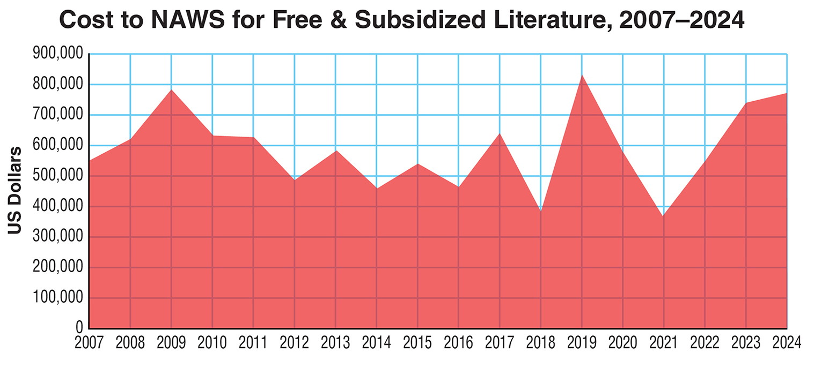
Notes:
This graph represents the cost of free and subsidized literature that NAWS distributes to communities around the world.
In the 2019 fiscal year, we distributed more than we ever have before—more than $832,000 dollars’ worth. In 2020, we continued to ship literature to places that couldn’t afford to purchase it even as we were cutting expenses in as many areas as we could. Despite the financial challenges of the 2021 fiscal year, sending literature to those in need continued to be a priority.
The total for FY 2020 was just under $580,000 and for FY 2021 was just over $368,000. The total for 2023 was $738,826 and for 2024 it was $769,958. The need continues regardless of the pandemic or resources available. And so does our commitment to meet that need.
The support NA World Services has received from the Fellowship help make these efforts possible.
Note: We don’t report many of the details of where this literature goes partly not to embarrass or call attention to any communities. We never want to cause a community confusion or harm, even inadvertently.

Slide 31
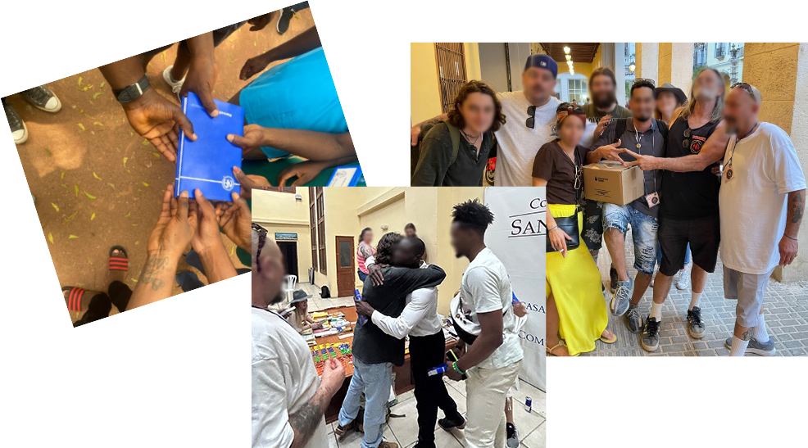
Notes:
Communities receiving free/subsidized literature.

Slide 32

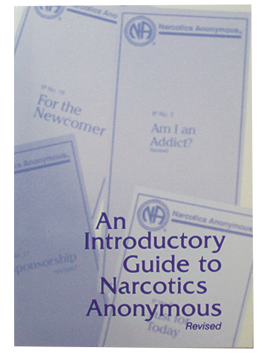
Free Literature
Online
Pamphlets and booklets are posted in 58 languages.
NEW—web-formatted literature.
Easy to view on mobile devices!!
The Introductory Guide, which was developed specifically for the newcomer, is also online for free: na.org/literature
Notes:
We also make our message available for free reading, listening (audio BTs), and watching (ASL) online.
IPs and booklets in 58 languages (soon to be 61) are posted at na.org/literature.
New for 2025, web-formatted literature! We started with English (USA) and will be adding other languages a little at a time. This browser-friendly format is much easier to read on mobile devices.

Slide 33
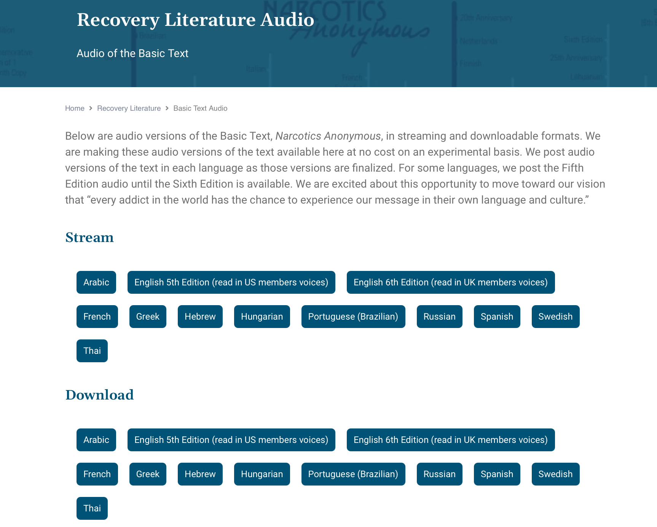


na.org/audio
Notes:
We have been posting free audio versions of the Basic Text as they become available. You can stream or download.
So far, we have 12 versions: Arabic, two English versions—one fifth edition, French Canadian, Greek, Hebrew, Hungarian, Brazilian Portuguese, Russian, Spanish, Swedish, and Thai posted.
You can find them at na.org/audio.

Slide 34
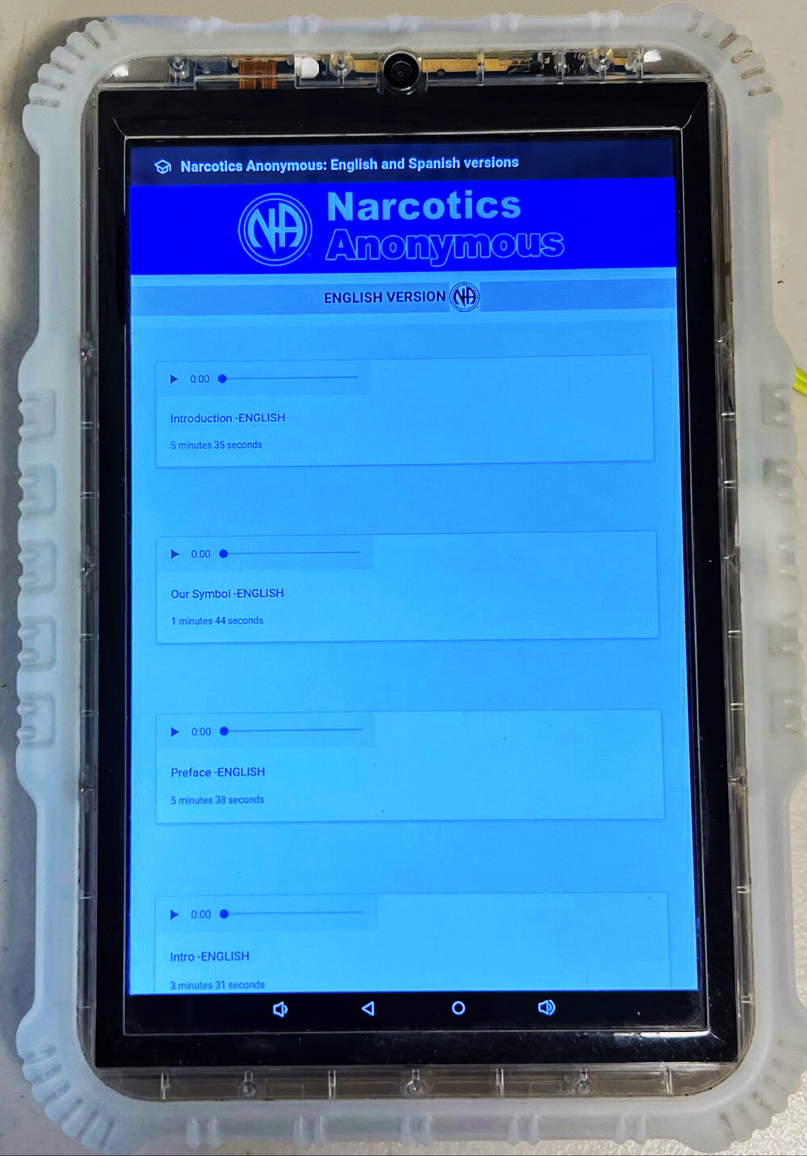
Inmate Tablets
Some facilities offer tablets to inmates
NAWS clears the way to share NA literature
  Audio BT
  Pamphlets
  Booklets
  Intro Guide
Notes:
Some correctional facilities offer inmates tablets pre-loaded with a variety of material, including, in some cases, NA recovery literature, at no cost to the inmate.
One of the most important duties the Fellowship has assigned NA World Services is the protection of NA’s intellectual property and copyrights on behalf of the Fellowship. Inmate tablets are a new way to carry the message, and World Services must grant legal permission to load Narcotics Anonymous literature on tablets. Each of these agreements involves a lot of communication among corrections authorities, local NA members, and NA World Services.
The agreements we have made in these cases allow for the material that is currently posted on our website to be on tablets for inmates – audio Basic Texts, IPs, and booklets such as the White Booklet and the Intro Guide. We continue to provide paper copies of the Basic Text to inmates upon request.
1.2 million incarcerated persons in the US now have access to free NA literature on tablets.
The number of inmate tablets with NA literature in Arizona rose to almost 50,000 in 2022.
In Ohio, after seeing the success of inmate tablets, corrections officials have decided to purchase NA literature to give to inmates upon release.
There are over 3,000 counties in the US, and each agreement requires time and attention.
We have also been working on agreements with some communities outside the US. In 2024, we finalized our first such agreement with Sweden.

Slide 35
Fellowship Intellectual Property Trust
The purpose of the Trust is:
“to hold and administer all recovery literature and other intellectual properties of the Fellowship of Narcotics Anonymous in a manner that will help addicts find recovery from the disease of addiction and carry that message of recovery to the addict who still suffers, in keeping with the Twelve Steps and Twelve Traditions of NA.”
Notes:
One of World Services’ most important responsibilities is protecting the Fellowship’s property—its name, logos, and literature for the current and future Fellowship.
The Fellowship Intellectual Property Trust (FIPT for short) is a legal document that contains the collective decisions the NA Fellowship has made to preserve the integrity of our published message and the accountability of our publishing services. The Fellowship of Narcotics Anonymous, as given voice by its groups through their regional delegates at the World Service Conference, created and makes decisions about the trust. NA World Services, Inc. manages the trust on their behalf, and the Fellowship of Narcotics Anonymous as a whole is the beneficiary.
There is a lot of misinformation about the FIPT. Here is what the document itself says. The purpose of the trust is:
“to hold and administer all recovery literature and other intellectual properties of the Fellowship of Narcotics Anonymous in a manner that will help addicts find recovery from the disease of addiction and carry that message of recovery to the addict who still suffers, in keeping with the Twelve Steps and Twelve Traditions of NA.”
If you want more information about what the FIPT is and why it is important, see the video on the FIPT page: na.org/fipt.
As we mentioned earlier, WSC 2023 made a decision to revise the Trust document as well as to revise the Operational Rules and the Use Policy.

Slide 36
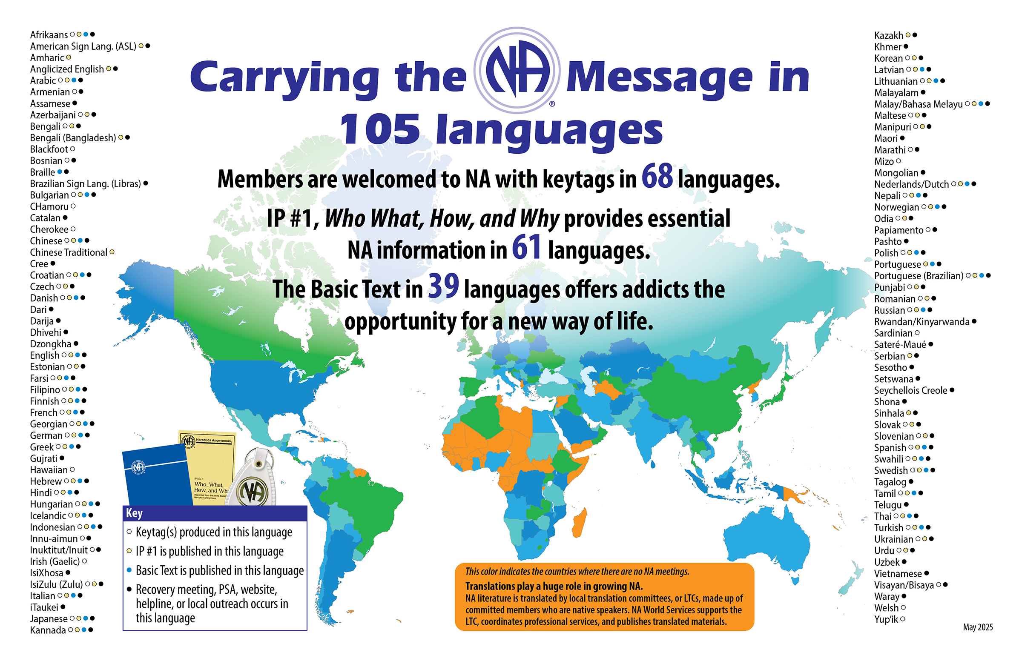
Notes:
This map shows the 105 languages NA members speak. We translate literature into 61 of those languages.
This “Carrying the message map” is revised each fiscal year to include in the Annual Report. The latest version is posted at na.org/maps.
Most recently, we have started producing IP#1 in Sinhala, and Azerbaijani, Kazakh, and Romanian will follow shortly.
Besides the Armenian and Blackfoot keytags we started producing last year, we also have Sinhala, Inuktitut, and Innu-aimun keytags.

Slide 37
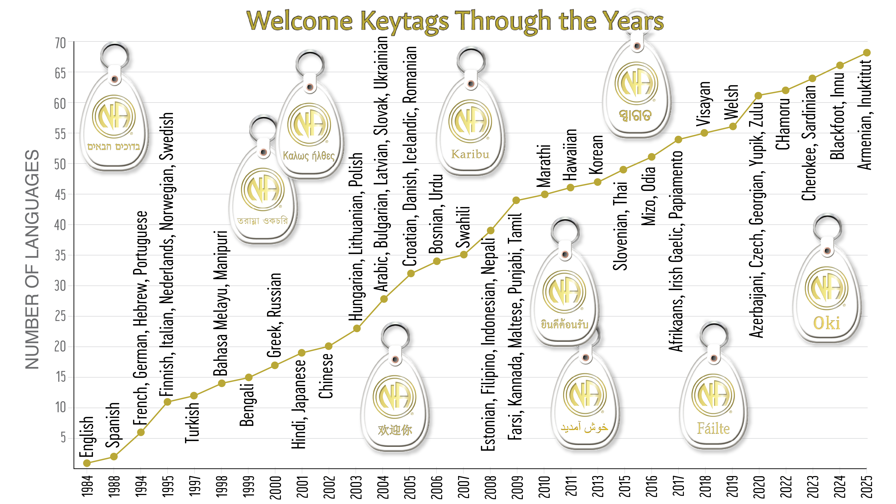
Notes:
Many of the languages in NA are reflected in our keytags. We produce welcome tags in 68 languages. Keytags are sometimes created in indigenous languages to better welcome members in their own language and culture, even if that language isn’t spoken in the meeting they are attending. Examples are Hawaiian, Welsh, Blackfoot, and others.

Slide 38
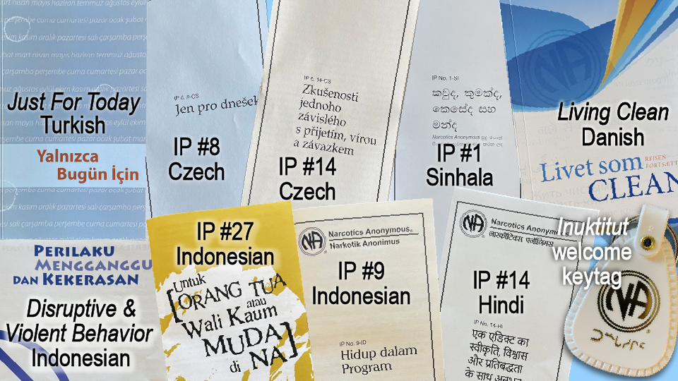
Some of our latest translations
Notes:
Having literature in your own language saves lives. It helps addicts hear our message, understand the NA program, and connect with the shared experience of members around the world.
Translations play a huge role in carrying the message. Translations work is coordinated among a local translation committee, or LTC, made up of committed members who are native speakers, as well as contracted professionals and NAWS staff.
It takes a great deal of resources to produce translated literature. It’s not just about money. The scarcest resource is human. No machine can replace the need for LTCs, because NA language uses words differently than the communities – including treatment professionals – around us. If you want to learn more about translations, check out Translation Basics, which is posted at na.org.

Slide 39
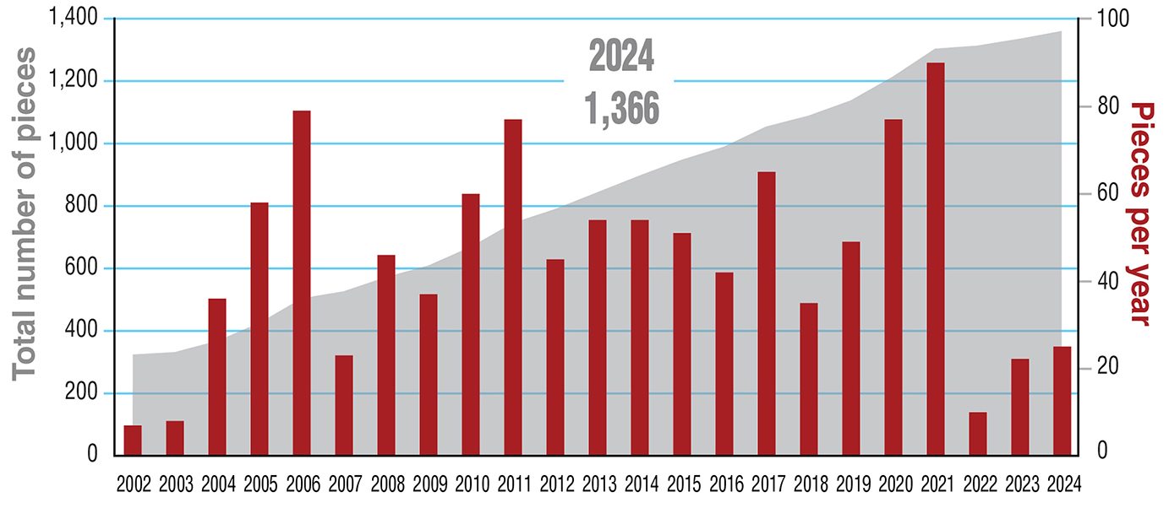
Total Published Translated Items & Pieces Per Year
for Fiscal Years 1997–2024
Notes:
This graph shows the number of translated items published at World Services as of the end of the 2024 fiscal year, which was June 2024. At that time, we had published 1,366 translated titles.
Local members do the heavy lifting in almost all translations. It takes dedicated members willing to devote countless hours to the work, even when a professional translator is used. We oversee translations to make sure conceptual fidelity is maintained, and we organize proofing, copyrights, layout, and production. For almost a year during the pandemic, we had a translations staff of one and a production staff of one. We are slowly building back and now have a translations team of three and half.

Slide 40
By addicts, for addicts
(our literature development process)
Source material
submitted by members
Drafts developed
by the workgroup
Review drafts circulated
to gather Fellowship input
Approval draft appears in the Conference Agenda Report
Notes:
For the last 20 years, each literature project has had the same basic process.
We survey the Fellowship for input about the project itself. This allows input to be gathered from members all across the globe, speaking many different languages.
We collect source material from members.
We form a workgroup of members who review all of the source material and the resulting drafts. For the IP#21 revision, Staying Clean in Isolation, we used focus groups, inviting any member who expressed interest.
Release drafts for Fellowship review
Revise based on input.
Publish an approval draft no later than with the CAR publication.
It’s a process that allows members all around the world, regardless of literacy level or language spoken, to contribute. Those contributions shape and give voice to the resulting draft.
Recently, we’ve been able to use the volunteer form posted on na.org/projects to form web meetings with any interested member to work on projects like the revisions to IP #21 and H&I Basics, the creation of Virtual Service Basics, and the restructuring of our website.

Slide 41
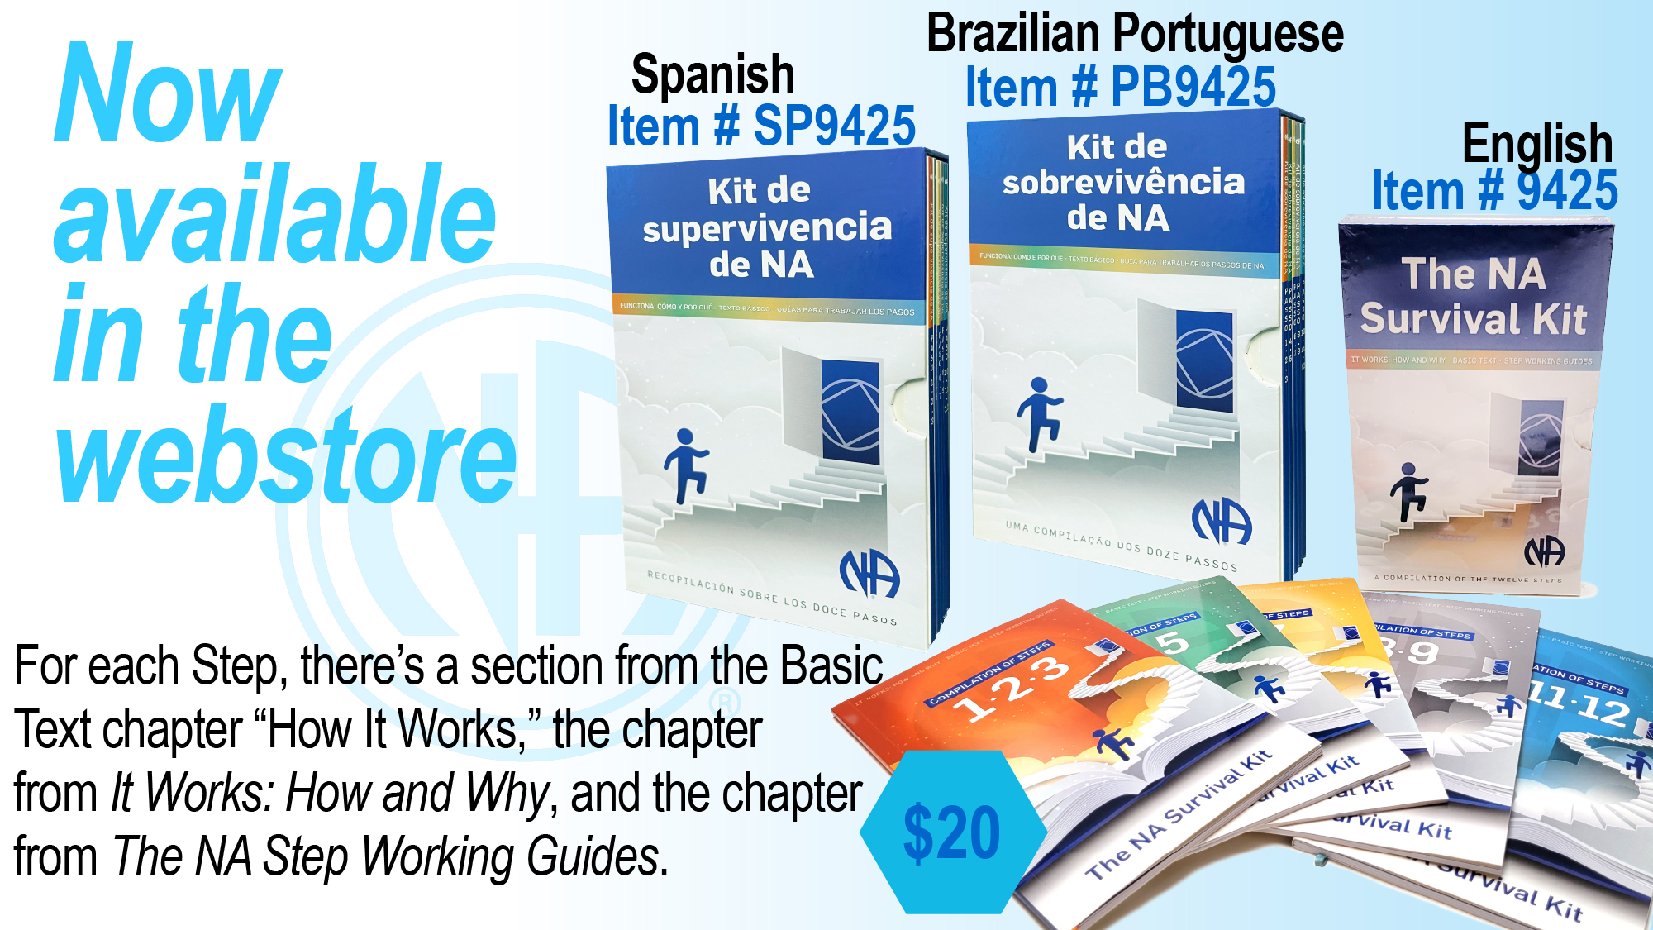
Notes:
NA’s Basic Text explains the significance of the Steps in this way:
The steps are our solution. They are our survival kit. They are our defense against addiction which is a deadly disease. Our steps are the principles that make our recovery possible.
“How it Works,” Narcotics Anonymous
Information about the Twelve Steps is included in three different NA books. It’s common for NA sponsors to advise sponsees to read about the Step they are working in the Basic Text and It Works: How and Why before answering the questions in The Narcotics Anonymous Step Working Guides.
In that spirit, we have published this material into one boxed set titled The NA Survival Kit.
English, Spanish, and Brazilian Portuguese are now available. We are working on Farsi, Russian, and Swedish.
For each Step, the Survival Kit includes the section from the Basic Text chapter “How It Works,” the chapter from It Works: How and Why, and the chapter from The NA Step Working Guides, with the questions numbered rather than bulleted.
The NA Survival Kit consists of five bound packets together in one slip case:
• Steps One, Two, and Three
• Steps Four and Five
• Steps Six and Seven
• Steps Eight and Nine
• Steps Ten, Eleven, and Twelve
It can be found at na.org/webstore

Slide 42
Services & Communication
Notes:
2024 has ushered in some changes for NAWS.

Slide 43
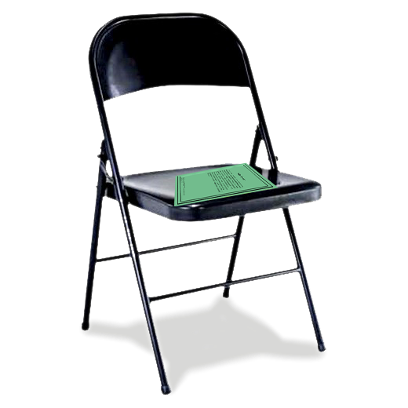
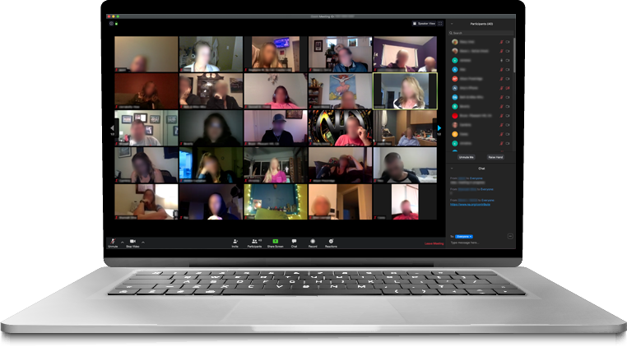
na.org/meetingsearch
in-person
&
virtual meetings
points to local websites and phonelines
more accurate and current
listed by day and time
first search by language
new virtual meetings can submit their information
na.org/virtualmeetings
Notes:
Check out NAWS meeting search at na.org/meetingsearch.
Find in-person meetings through local websites and phonelines.
Virtual meetings are listed by day and time. Search by selecting a language first. If you have a virtual meeting you would like to add please use the link.
The 2023 World Service Conference passed a motion acknowledging that an NA meeting that meets regularly in person or virtually can choose to be an NA group if they meet the criteria described in The Group Booklet.

Slide 44
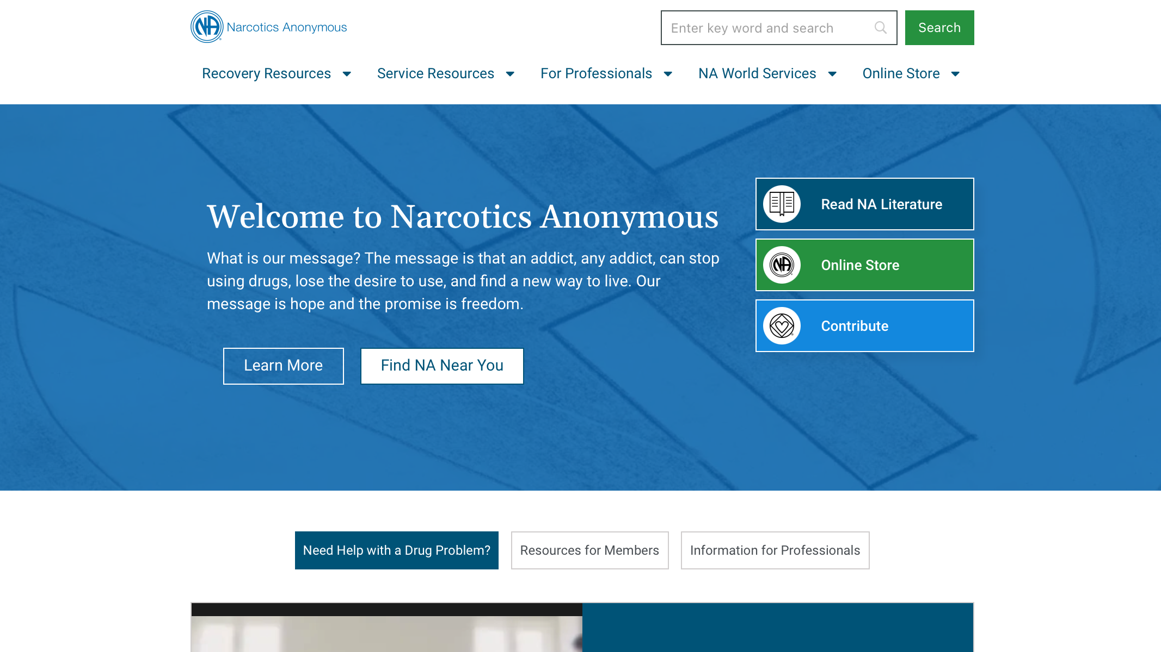
Notes:
We are delighted to announce that the new, mobile-friendly na.org website is up! Our IT team accomplished a minor miracle in getting this together. We had known for some time that the days our old website could stand would be numbered. When the website failed, our IT team went into overdrive.
What you see now at na.org looks different from the website you may be used to accessing, but nearly all the same information is still there. We believe it will be easier to navigate, less confusing, more readable, more secure, and less likely to leave us in the lurch again.
With the new website comes new links. If your service body website has links to readings and IPs, those will have to be updated. If you have other links to pages at na.org, please check to make sure your links are functional as soon as you (or your webservant) can.
We are continuing to add features, correct errors, and build out the site. We recently were able to add the search function back.
There are a few large files that are still unlinked, but fear not! New links and browser-friendly versions are being created. Nothing has been lost.

Slide 45
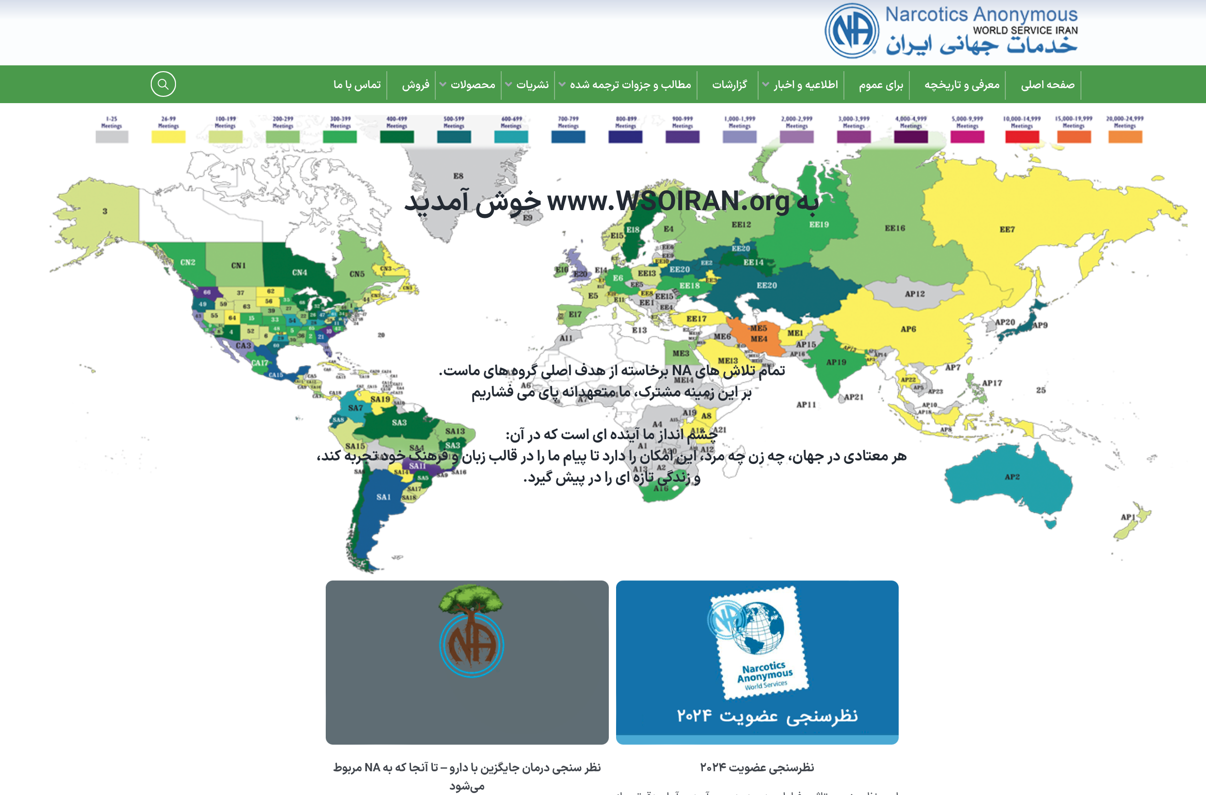
www.wsoiran.org
Notes:
WSO Iran continues to be steadfast in providing communications and translations for members who speak Farsi.

Slide 46
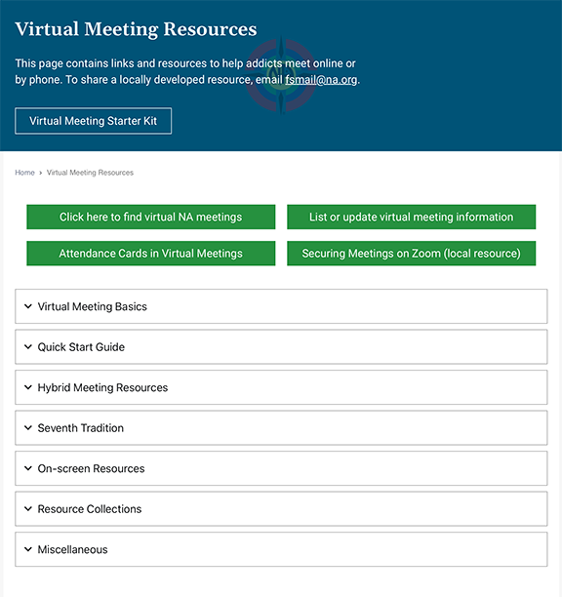
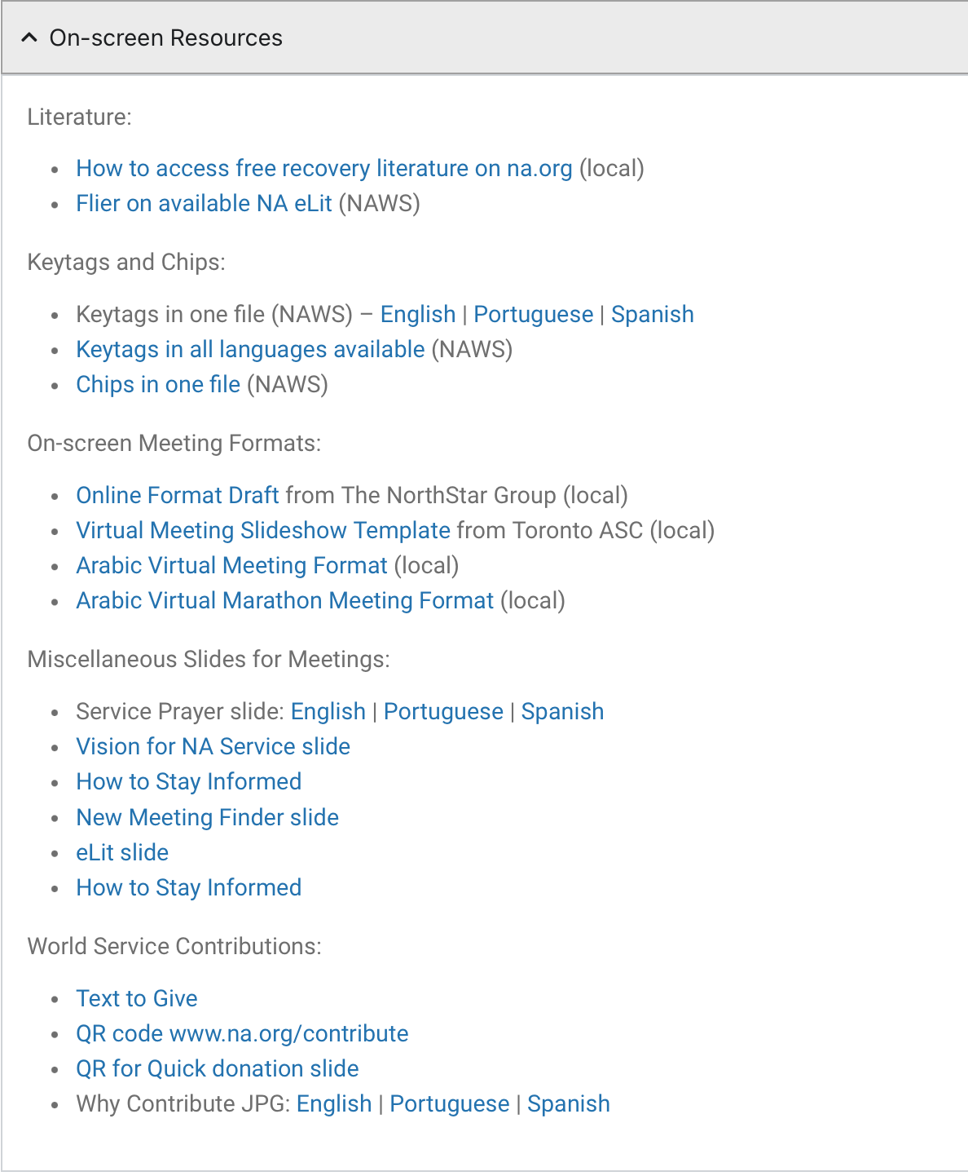
na.org/virtual
Notes:
Most of NA had to learn to do things differently during the pandemic. We provided a lot of online service and support for virtual meetings and service efforts.
One of the first things we did when so much of the world closed down was to post a page of resources to help addicts find virtual meetings and to help members who were serving meetings and service bodies virtually: na.org/virtual. It is a treasure trove. We post new materials here regularly.
The page includes: onscreen resources for virtual meetings, info on hybrid meetings, 7th tradition, and more. One of our most recent resources is Electronic Funds—Money Management under the Seventh Tradition section.
Let us know if there’s something you’d like to see on this page.

Slide 47
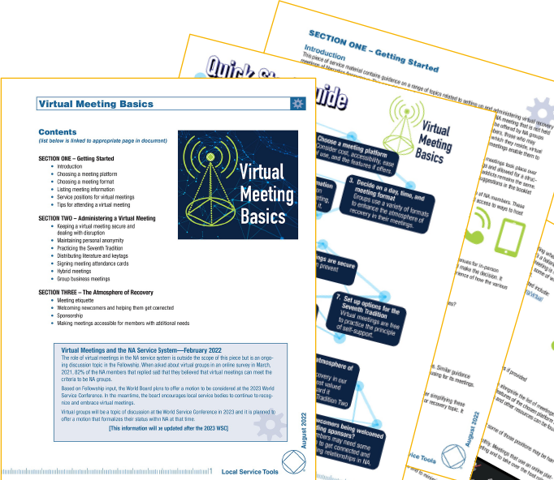
VISIT
na.org/virtual
or
na.org/toolbox
to download!
Notes:
Virtual Meeting Basics is posted at the top of the drop-down menus on the Virtual NA Meeting Resources webpage. It is also posted at na.org/toolbox. It is currently translated in Farsi, French, Italian, Hungarian, and Spanish.
This tool comes from the Local Service Toolbox project.
We held many open webinars on the topic. We also collected a lot of resources from trusted servants around the world. We posted several surveys to collect information. We used all of that information to put together a tool that compiles best practices for virtual meetings.
The tool covers a range of topics related to virtual NA recovery meetings, including
keeping meetings secure from disruption,
welcoming newcomers and sponsorship,
practicing the Seventh Tradition and signing attendance cards
making meetings accessible
hybrid meetings
and more.
We are taking a similar approach with Virtual Service Basics.

Slide 48
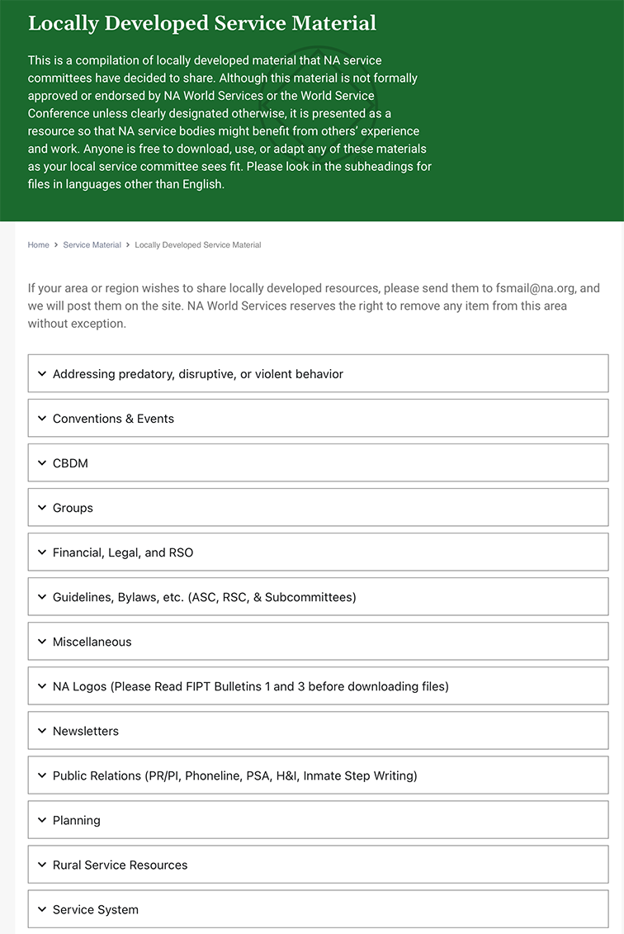
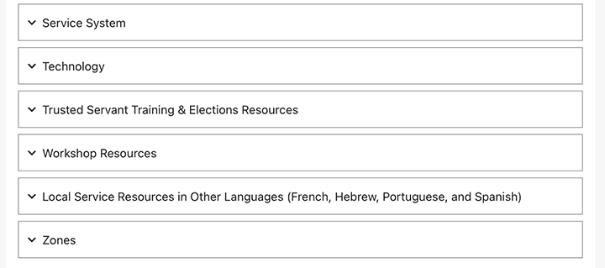
na.org/localresources
Notes:
Another place on our website that you can find lots and lots of resources for groups and service bodies is the Local Service Resources page: na.org/localresources
If you have a resource or tool that others might benefit from, please send it to worldboard@na.org.

Slide 49


Web Meetings
Public Relations
Hospitals & Institutions
Email pr@na.org for more info!
Notes:
We hold PR and H&I web meetings that are a great way to gather information and share experiences on service related topics.
These meetings are focused on members talking to each other and sharing successes and challenges. We’ve been holding them on a quarterly basis for years. You can find a complete list at na.org/webinar.
If you’re doing PR service work, and are interested, send an email to pr@na.org and we will keep you updated about dates and topics.

Slide 50

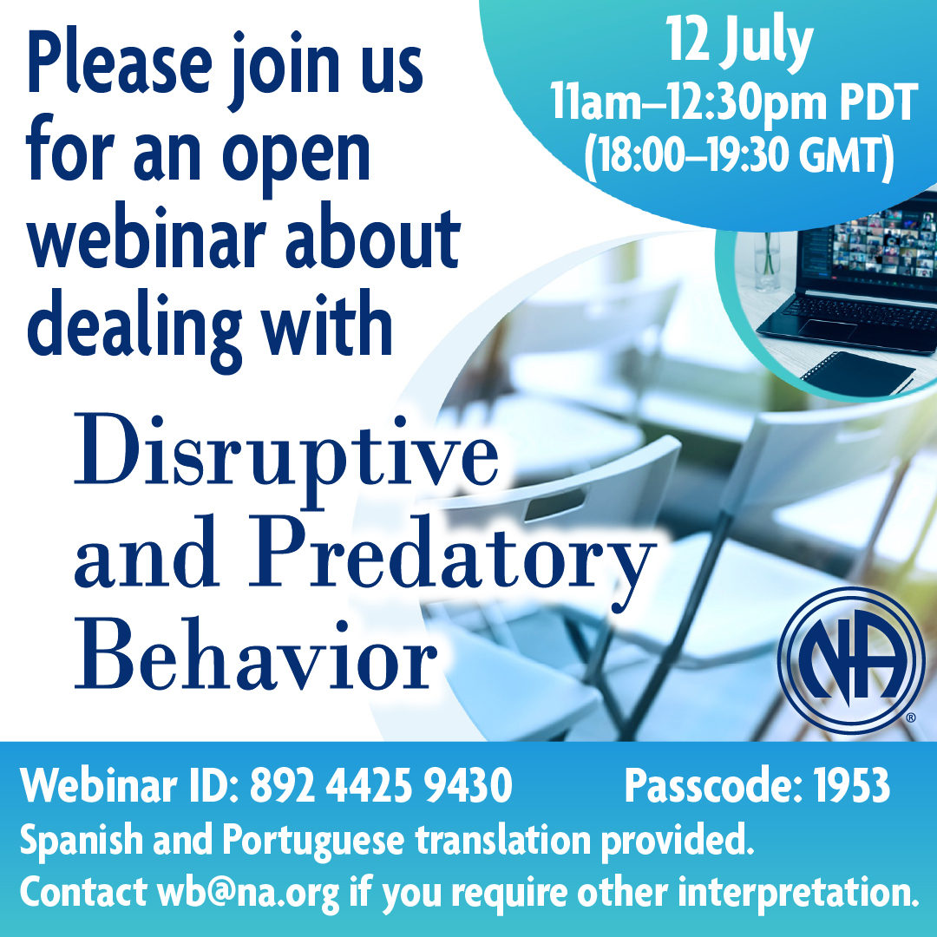
Upcoming
Webinars
na.org/webinar
Notes:
We also hold quarterly webinars open to any interested member on topics of general Fellowship interest. You can find the latest posted at na.org/webinar.
The next open webinar will be 12 July and will feature information about a current Issue Discussion Topic: Disruptive and Predatory Behavior.
From 9pm PDT, on 5 September to 9pm PDT on 6 September there will be a Unity Day extravaganza.
Unity Day happens every year, on the first weekend in September. This year, we’re planning a round the clock celebration. Every zone and Iran will have an hour to share, present, celebrate however they want.
We’re looking forward to a celebration of service, recovery, and all things NA!
Tune in anytime for speakers, videos, workshops and much more! You can also join the Serenity Prayer at 9am, 6 September. More information can be found at na.org/annualevents.

Slide 51
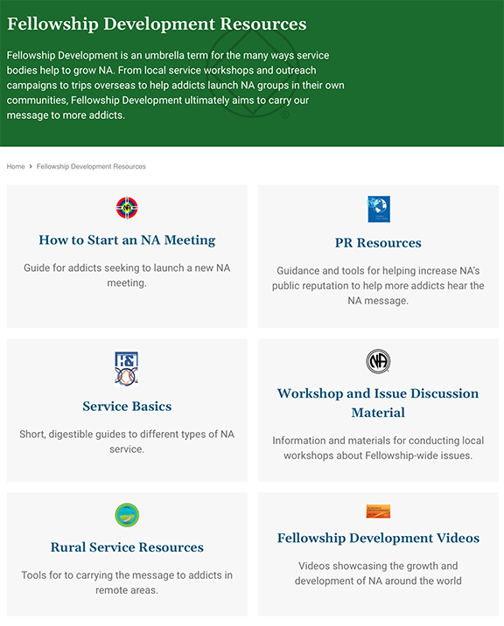
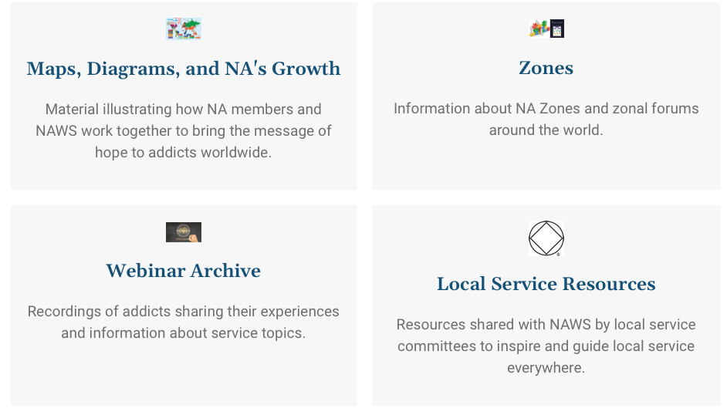
na.org/fdresources
na.org/videos
na.org/maps
Notes:
The old media page has been spread out to other locations on the new website.
You can start at na.org/fdresources where you can find the bulk of material for local service workshops and outreach campaigns.
From there you can access the videos page (shortcut is na.org/videos) or the page “Maps, Diagrams, and NA's Growth” (short cut is na.org/maps)

Slide 52
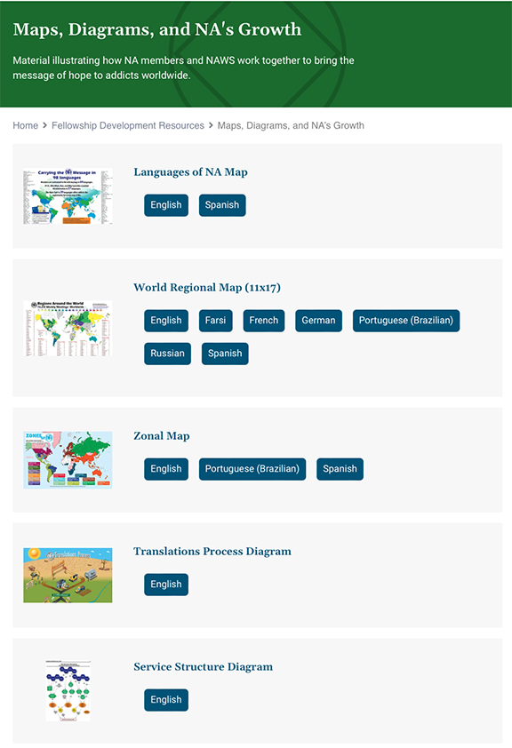
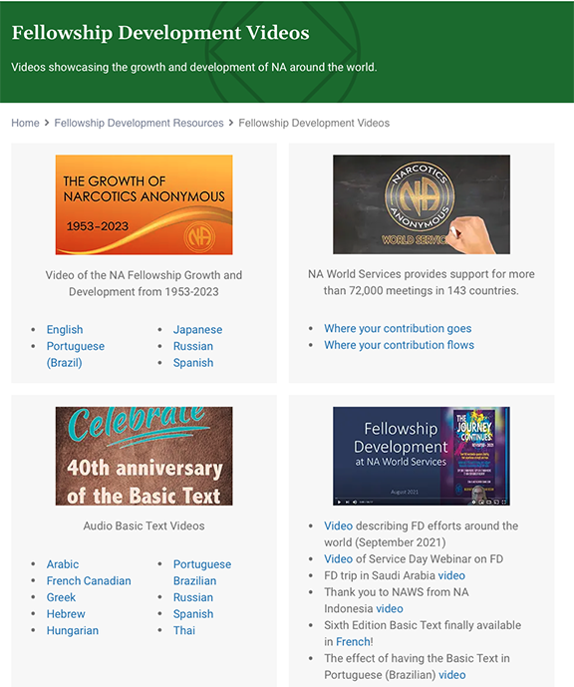
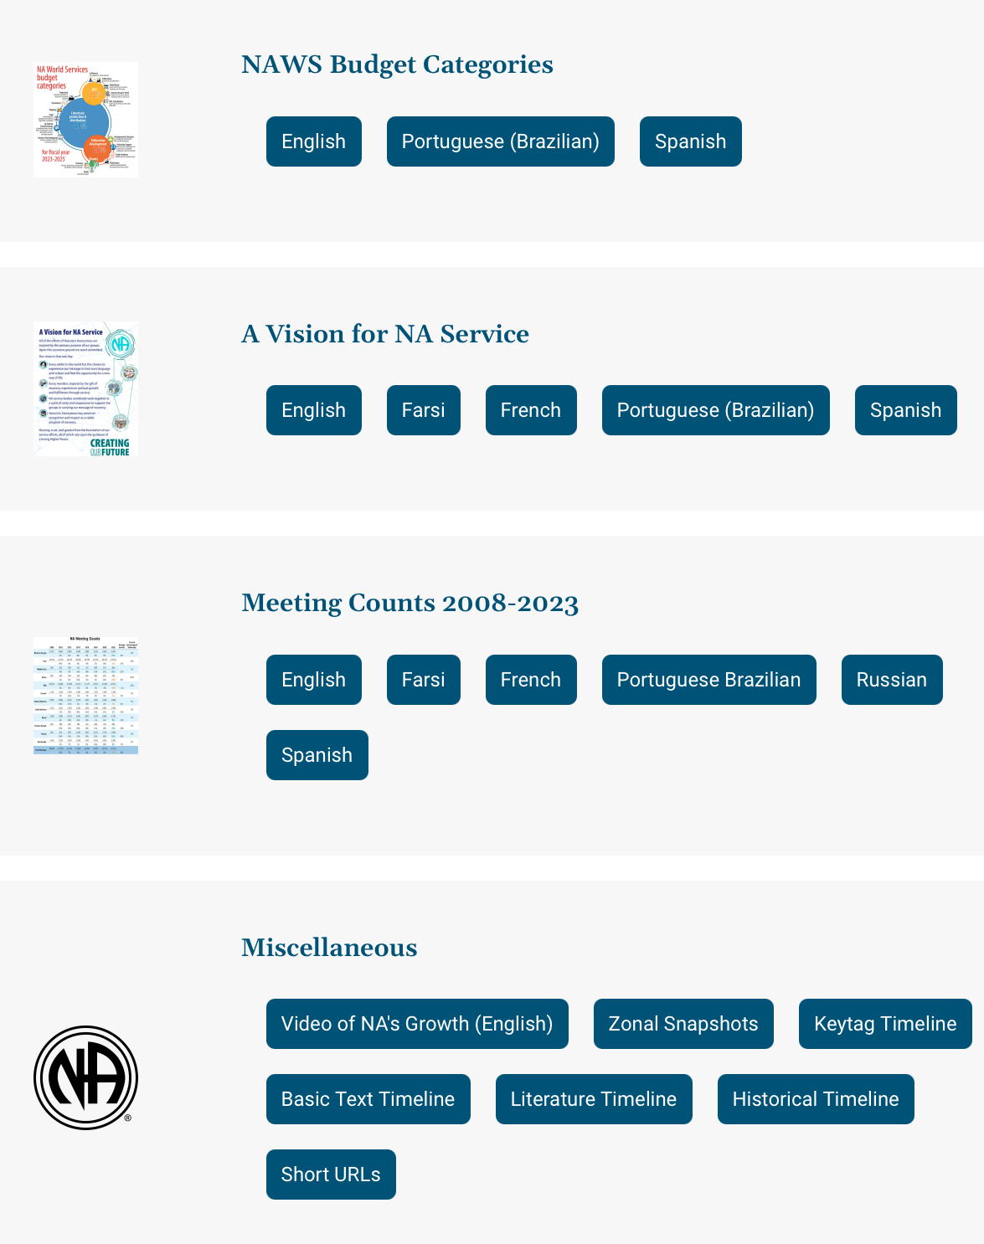
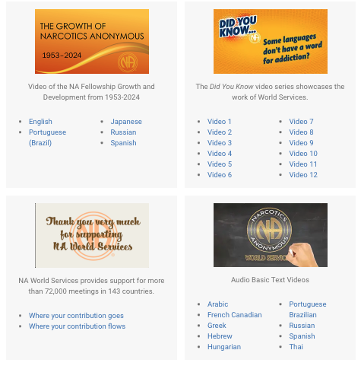
na.org/maps
na.org/videos
Notes:
On the na.org/videos page there are a few videos posted that would be great to play at workshops or events.
On the “Maps, Diagrams, and NA's Growth” page you will find all sorts of posters and documents that could be used in service meetings and some that illustrate how NA members and NAWS work together to bring the message of hope to addicts worldwide.

Slide 53
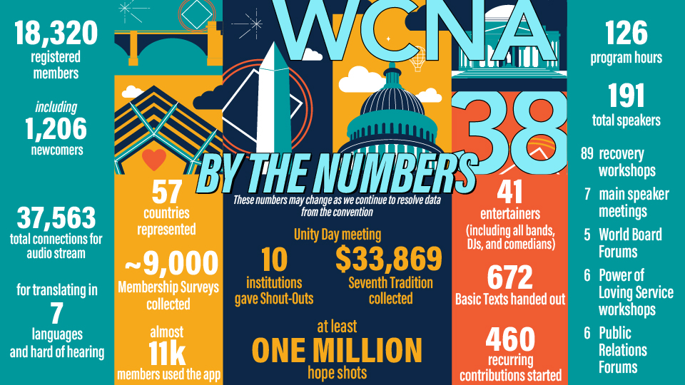
Notes:
A huge thank you to everyone who made WCNA 38 so powerful. We hope that all of us who were touched by the WCNA experience bring that Power of Love home to our communities, and use that energy to reach out just a little bit more than we did before. Addicts all over the world are dying to hear our message, and we each have work to do!
As you may have heard, registration was well below our projected break-even point. From the 2024 Annual Report: “The bottom line for the convention reflects expense over income of $956,129.”
For the financial breakdown please read the Annual Report at na.org/ar.

Slide 54
As a result of the COVID pandemic, to suspend the World Convention of NA (WCNA) rotation policy after 2024, to allow the World Board to determine what is possible and practical moving forward and then seek approval from conference participants.
Notes:
We’re not sure where and when the next world convention will be held. The 2023 World Service Conference passed the motion on your screen with consensus:
As a result of the COVID pandemic, to suspend the World Convention of NA (WCNA) rotation policy after 2024, to allow the World Board to determine what is possible and practical moving forward and then seek approval from conference participants.
Intent: Given the disruption in the rotation of WSC and WCNA that has already occurred, the increases in event costs, and the other changes brought about by the pandemic, to allow an evaluation by the World Board and approval by conference participants for what is possible and practical in the future.
The board has been in discussion about this and will report any recommendations about the next World Convention to conference participants and seek their approval. We intend to have recommendations about the future of WCNA in the 2026 CAR.
Please subscribe to NAWS Update emails (na.org/subscribe) or read the NAWS News (na.org/nawsnews) to stay informed.

Slide 55
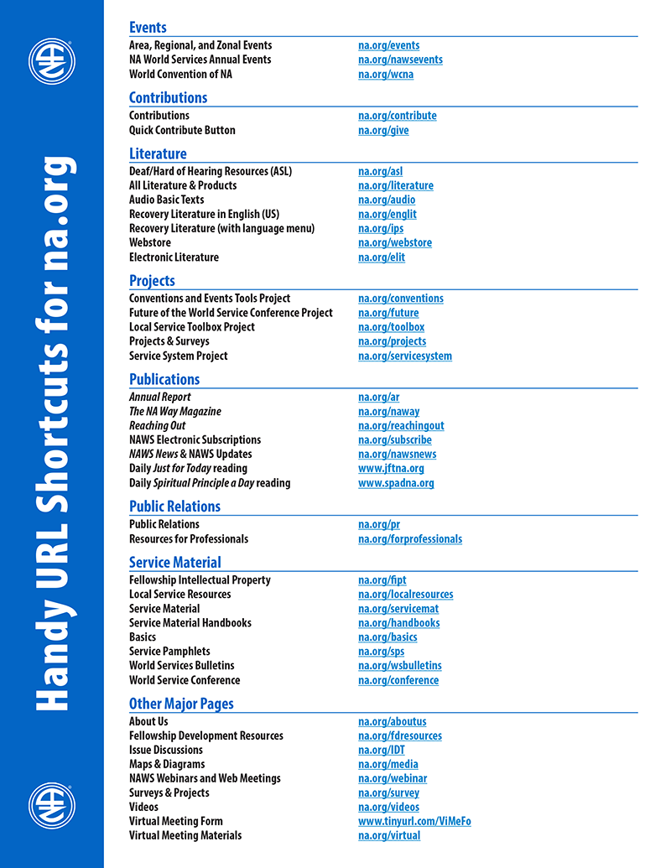
For more information
NAWS News: na.org/nawsnews
Annual Report: na.org/ar
About Us: na.org/aboutus
Projects & Surveys: na.org/projects
World Service Conference: na.org/conference
FD Resources: na.org/fdresources
A complete list of short URLs is posted in Miscellaneous on na.org/maps
Notes:
Most of our frequently accessed webpages have URL short cuts. Here are some of them. You can find a longer list of these shortcuts posted in Miscellaneous on na.org/maps
There is so very much more that we do at World Services, much more than we can cover in one presentation. For more information, see our FD resources page, NAWS News, and the Annual Report.

Slide 56

Join us on Social Media
Instagram: @narcoticsanonymous & @naglobalevents
FacebooK: @naworldservices
Send us your pictures, memes, event flyers, and ideas for posts:
If they are your creation or
in the public domain
Don’t show members’ faces
Have wide interest to NA around
the world
Share your joy
socialmedia@na.org
Notes:
Our Instagram handle is @narcoticsanonymous.
We also now have an official World Services’ Facebook page: @naworldservices
Check it out if you haven’t already
We also have an Instagram account just for events @naglobalevents where we post flyers for area, regional, and zonal celebrations and service events. If you have an event flyer you’d like posted or an idea for Instagram let us know: socialmedia@na.org.

Slide 57
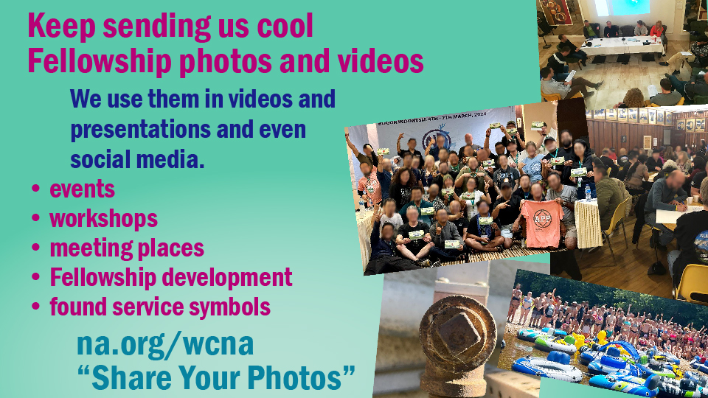
Notes:
There is a photo upload form at na.org/wcna for you to send us photos of NA events, celebrations, cool logos, found service symbols (see Instagram @narcoticsanonymous for examples)..
We need your images to make our PowerPoints, videos, and social media posts shine. And we would love to share your images and videos on Unity Day!

Slide 58
Questions and Answers

