Slide 1

Disruptive and Predatory Behavior

Slide 2
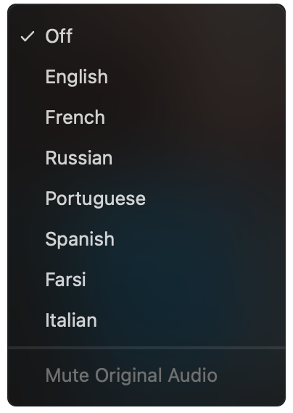
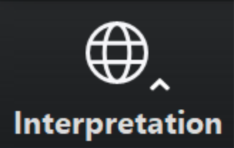
Select a language
Select English or one of the translation channels: Arabic Farsi French Hebrew Italian Portuguese Russian Spanish
English
Arabic
Farsi
French
Hebrew
Italian
Portuguese
Russian
Spanish
1. Find at bottom of screen
2. Choose a language

Slide 3


Slide 4
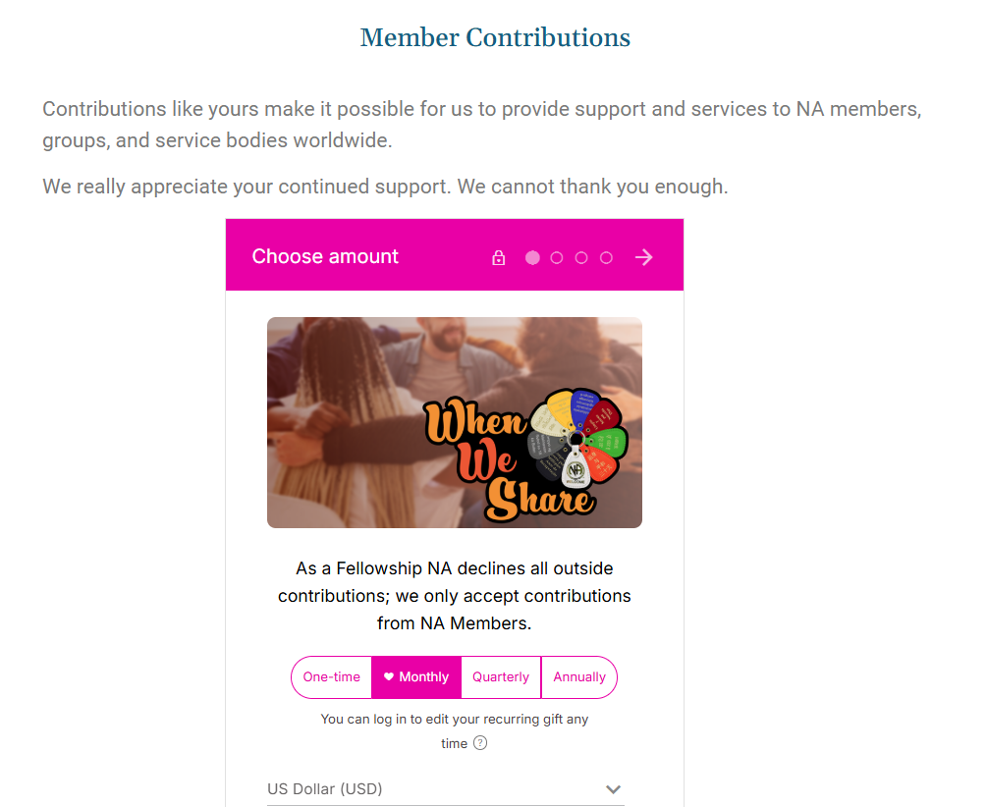

Slide 5
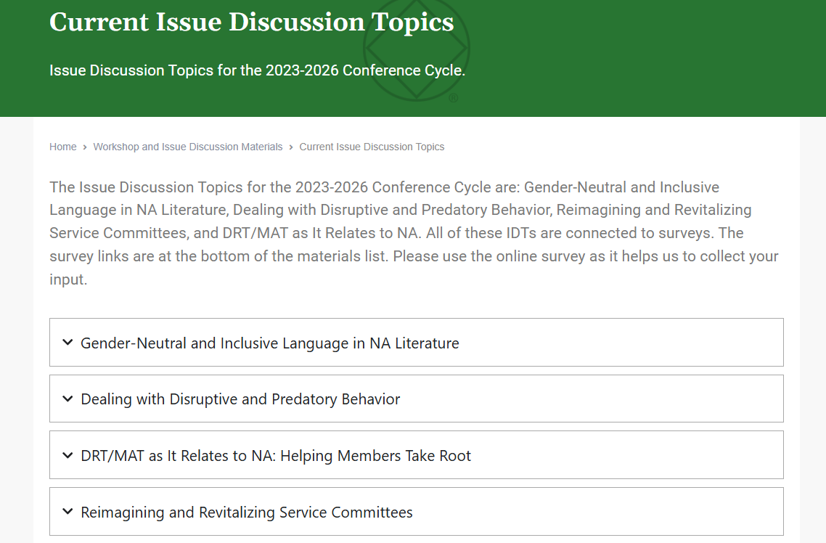

Slide 6
na.org/localresources
resources from local service bodies
na.org/sps
Disruptive & Violent Behavior Service Pamphlet written
in 2007

Slide 7
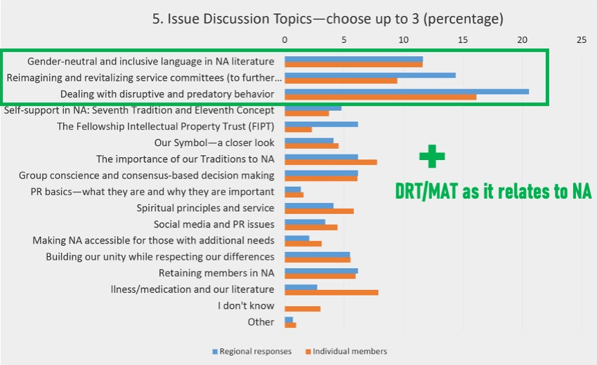

Guided by Fellowship input and response to the CAR survey, the 2023 World Service Conference selected this as an Issue
Discussion
Topic,
or IDT.

Slide 8
This topic, at its heart, is about our ability as a Fellowship to carry the message —
if professionals hear negative things about NA, they will stop referring clients to us
if new members do not feel safe, they won’t stay
and addicts who need us may never find us.

Slide 9
From Living Clean …
“All our lives we had looked for the peace and safety we experience in recovery.”
Addressing predatory and disruptive behavior is part of how we give it away.

Slide 10

Atmosphere of Recovery
An atmosphere of recovery is about making sure everyone who needs NA feels safe and welcome.
  Anonymity, sharing, listening, respect,
  no judgment, and safety.
      What else characterizes an
      atmosphere of recovery?

Slide 11
Negative Behaviors
We need to come to a common understanding of the problem before we can seek a solution.
  One way to think about disruptive behavior generally is behavior that interferes with the
  peace, security, and integrity of a meeting
  and its members

Slide 12
Negative Behaviors
Predatory behavior happens when a member knowingly or unknowingly takes advantage of another member's vulnerability.
Sometimes blatant, sometimes subtle
Characterized by manipulation
Sexual connotation or targets sexuality

Slide 13
Here are some examples of disruptive and predatory behaviors:
Bullying/picking on/
harassing
Threatening physical violence
Racist words or actions
Homophobic words or actions
Theft
Asking members for money
Private messaging members (virtual)
Distribution of non-approved literature
Stalking
Violating restraining orders
Use phone to record during meeting
Loud family members/pets (virtual)
Disruptive children (in-person)
Interrupting when member sharing
Making unwanted sexual advances

Slide 14
Positive Solutions
We should be clear to all addicts:
You are welcome.
  Behavior that harms others or disrupts the atmosphere of recovery is not welcome.

Slide 15
Positive Solutions
The worst thing we can do for a newcomer is
make NA feel like where they came from.
  We need to do our best to protect our members, while respecting their right to make their own decisions.
  It can be a fine line between being
  protective and overbearing
  Am I the right person to offer help?

Slide 16
Disruptions in Virtual Meetings
Sometimes an attendee’s bad behavior might
be a sign that they really need a meeting!
  There are steps we can take to protect the meeting:
  mute or turn off a camera
  restrict screen sharing
  close down the chat feature
        There are tools and suggestions
        in Virtual Meeting Basics: na.org/basics

Slide 17
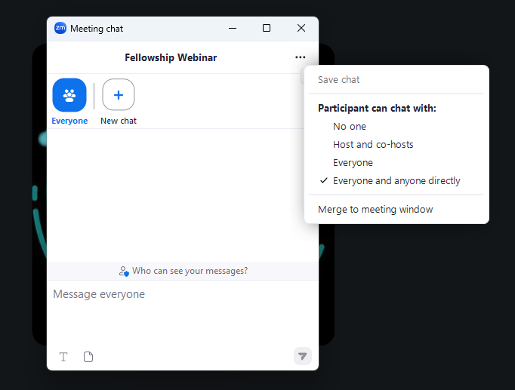

Slide 18
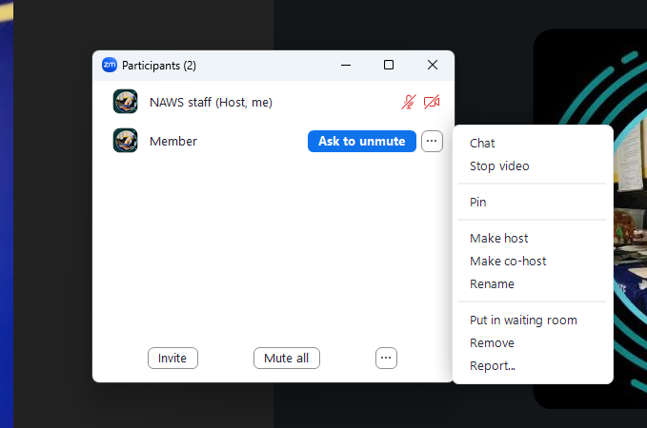

Slide 19
Below is a list of possible solutions:
Add a paragraph to the group format
Approach new members and make sure they feel welcome
Join another member(s) and pull aside the member exhibiting the behavior and try to talk to them
If someone is violating a protective order, have a couple of people offer to go to another meeting with them
Turn off camera/put a member in the waiting room (virtual)
Discuss behavior in a group business meeting
Chairperson/leader/group secretary can request a short break or ask group to join in a prayer or moment of silence
Hold a recovery meeting focused on a discussion about atmosphere of recovery
Discuss with other groups at a local service body meeting
Approach member in a loving and caring way
Temporarily suspend meeting
Call law enforcement

Slide 20
The Asia Pacific Forum

Slide 21

Solutions for
Predatory Behavior

Slide 22
What is Predatory Behavior?
Many recovering addicts around the world have been thinking about the best way to address predatory behavior in the fellowship. In meetings, one of the most common ways this occurs is unwelcome sexual and romantic advances towards members, especially newcomers.
While the vast majority of NA members do not engage in this kind of behavior, the unfortunate reality is that too many of us, Especially our most vulnerable, have experienced it in various forms.

Slide 23
What is Predatory Behavior?
Some may perceive the discussion of this topic as controversial and divisive, but the future of our fellowship depends upon our collective willingness to engage in honest dialogue about difficult topics that affect our most vulnerable members. This pamphlet addresses predatory behavior in the fellowship from multiple perspectives, drawing directly from the experience of our members. What follows is a solution-oriented discussion, reflection, and list of suggestions for moving forward in a spirit of unity.
“We want our place of recovery to be a safe place...”
Basic Text, “What is the Narcotics Anonymous Program?”

Slide 24
Historical Context
The problem at hand is a real part of our history. Though predatory behavior is not exclusive to our fellowship, it may be exacerbated in the recovery community. Most of us have heard the term “13th Step” used to describe a situation in which a member with more clean time takes advantage of a member in early recovery. This is a form of exploitation that deprives the newcomer of an opportunity to recover. It is predatory by nature because one person has more power than the other.

Slide 25
What is Predatory Behavior?
Requires looking beyond individual acts of misconduct towards the institutional nature of sexism and male dominance in history
Vast majority of cases involve women
Issue has always been prevalent in NA; partly because problems in NA are often a reflection of problems in society
“Mostly we know when we are doing something wrong, taking advantage of someone who is vulnerable, being controlling, deceptive, or abusive—and we have a responsibility to ourselves as well as to the other person to stop it.”
Living Clean: The Journey Continues, Relationships

Slide 26
Moving Forward - The “Safety Statement”
Small, but important step forward
Accountability and responsibility begins with the group
Shedding light on predatory behavior = difficult discussions ahead
Uncharted territory full we must navigate together and grow
How do we handle reports of harassment, abuse, or threatening behavior?
May be times when we should suggest that a member seeks outside help from a mental health professional or, in extreme cases, law enforcement

Slide 27
NA doesn’t enforce rules or regulate behavior, but a safe atmosphere is integral to our primary purpose. Harassment, threats, or abuse jeopardize our primary purpose. If someone feels physically or emotionally unsafe due to the behavior of another NA member, they may be unable or unwilling to stay in the meeting or to return, preventing them from hearing the message, participating in their recovery, and benefiting from the program and fellowship. Predatory behavior threatens the livelihood of the individual addict and the fellowship as a whole.
“In Narcotics Anonymous, we are concerned with protecting ourselves from ourselves.” Basic Text, Tradition Two

Slide 28
A “Safety Statement” can be integrated into the opening reports of trusted servants or included as a separate reading. The statement below is adapted from IP #29 “An Introduction to NA Meetings.”
“We strongly discourage any harassment, threats, or disturbing behavior before, during, and after our meetings. This includes unwelcome sexual and romantic advances towards members, especially newcomers. Our meetings are for sharing NA recovery. It is the responsibility of all group members to help maintain an atmosphere in which every addict is safe to recover. If you feel harassed or threatened, share your concerns with the meeting leader or a trusted servant.”

Slide 29
The statement above is not fellowship-approved literature but a group can decide to include it in their format. The “Safety Statement” has been adapted from IP #29 to be more suitable for the group setting. If groups are considering the inclusion of the “Safety Statement” in their meeting format, they can assure members it is closely derived from IP #29, which is fellowship-approved literature. Most importantly, the “Safety Statement” embodies the spiritual principles that are needed to cultivate an atmosphere of recovery for all our members.
“An atmosphere of recovery in our groups is one of our most valued assets, and we must guard it carefully...”
Basic Text, Tradition Two

Slide 30
"In active addiction, we worked hard to reach goals that left us feeling empty, lost, and dead inside. We got what we needed, no matter the cost to ourselves or those around us. As obsession and compulsion drove us to bitter ends, we surprised ourselves at what we would do, or what we would sacrifice. The more we pursued our goals, the less we felt any sense of purpose at all.”
Guiding Principles: The Spirit of Our Traditions, Tradition Five
“11.​ What is an atmosphere of recovery? As a member of an NA group, what am I doing to create and sustain an atmosphere of recovery?”
“12.​ What do I recognize as exploitative behavior? What is my part in our shared responsibility to keep NA a safe place for all?”
Guiding Principles: The Spirit of Our Traditions, Tradition Five, Questions For Members

Slide 31
Preliminary questions that may serve as a starting point for discussions at business meetings or annual group inventories.
● What should a meeting leader or trusted servant do when a member reports an incident involving predatory behavior?
● Are we equipped to handle such reports? If not, how can we train trusted servants to deal with these issues?
● When should members intervene in predatory behavior?
● What is the best way to approach or confront a member who is engaging in predatory behavior?
● What kinds of incidents fall under the realm of “outside issues”?
● When should we suggest that members seek outside help?
● What protections are in place for minors and young addicts who attend our meetings?
● How can we assure parents of young addicts that their children are safe in our meetings?
● How do our home groups take an inventory of these issues on a regular basis?

Slide 32
These questions represent the beginning of a necessary and fundamental healing process that should take place among reflective NA members around the world. Rather than problems, these questions present us with opportunities for spiritual growth. When we come together in a spirit of unity, nothing is too great a challenge. Our resourcefulness, experience, strength, and hope always prevail when our minds and hearts are open to God’s will for us and the power to carry it out.

Slide 33
Spirituality in Action
There is a growing number of us, men and women, who want to make a difference and become part of the solution. It’s especially important, now more than ever, for us to organize by holding learning days, workshops, speaker jams, conventions, conferences, and other forums that feature speakers and topics that address predatory behavior in the fellowship. We should make an effort to seek out those individuals, groups, areas, and regions who have already been working diligently to make progress. Discussing this topic openly doesn’t cast Narcotics Anonymous in a negative light, but instead demonstrates our honesty, courage, and willingness to apply spiritual principles to a problem that has been affecting NA members for too long. As we look toward the future, we should always be concerned with the safety, protection, and recovery of all our members, especially newcomers, young people, and other vulnerable addicts. We are not defined by how we treat our most experienced members, but by the actions we take to ensure the recovery of the addicts who need us most. Breaking the silence on this topic is a spiritual act of love, faith, and courage that has the power to help our fellowship right now and in the future.

Slide 34


Don’t forget to fill out the form at na.org/survey
This is one of four IDTs this cycle.
The other three are:
Gender Neutral and Inclusive Language in NA Literature
Reimagining and revitalizing service committees (to further
the reach of the NA message, improve communication,
provide mentorship and training, and make service
more attractive and accessible, learning from
our experience the past few years)
DRT/MAT as it relates to NA
As workshop material is available,
it will be posted to na.org/idt

