Slide 1
Narcotics Anonymous (NA) Literature and Inmate Tablets

Slide 2
Why Inmate tablets?
More and more institutions are providing tablets for incarcerated addicts to use for things such as video calls and non-NA literature.
Thanks to this, incarcerated addicts are using them at a high rate since:
Tablets make literature more accessible to a broader audience, as they do not require the mailing process.
It is becoming increasingly difficult to send hardcopy literature to incarcerated addicts as rules and regulations in facilities get stricter.

Slide 3
What’s available?
The literature that is approved for use in inmate tablets by the World Board is:
An Introductory Guide to Narcotics Anonymous
Narcotics Anonymous Little White Book
All informational pamphlets and booklets.
The 5th edition of the book: Narcotics Anonymous (Basic Text) in audio.
To date, no book-length recovery books have been approved for inclusion by the World Board.

Slide 4
The need is growing…
Currently, NA literature is on inmate tablets in California, Ohio, Kansas, Arizona, Virginia, Indiana, Florida, Sweden, and more are coming soon!
This creates an opportunity for thousands more addicts to have access to NA literature.

Slide 5
First step: It’s on you!
Establish a relationship with the institution’s warden or other appropriate person.
Try working with your local H&I subcommittee for help.

Slide 6
Content Providers
Many prisons use content providers, or Learning Management Systems, to provide the content found on tablets.
A contract will be needed between NAWS and the content provider.
NAWS already has contracts with some providers, including Edovo and Cypherworks.
NAWS will not enter into a contract with any content provider who intends to charge incarcerated addicts for access to our message!
Ask the warden if they use a content provider, and which one it is.

Slide 7
If there is already a contract in place for the content provider:
Make it known to the warden that the literature may already be available.
Have them speak with the provider about providing access.

Slide 8
If it’s a new provider:
The warden will need to make a request to the provider to work with NAWS on a contract.
They can then connect with NAWS through HANDI@na.org

Slide 9
If there is no provider:
The facility will upload the literature directly to the tablets on their own.
A contract will be needed between the institution(s) and NAWS.

Slide 10
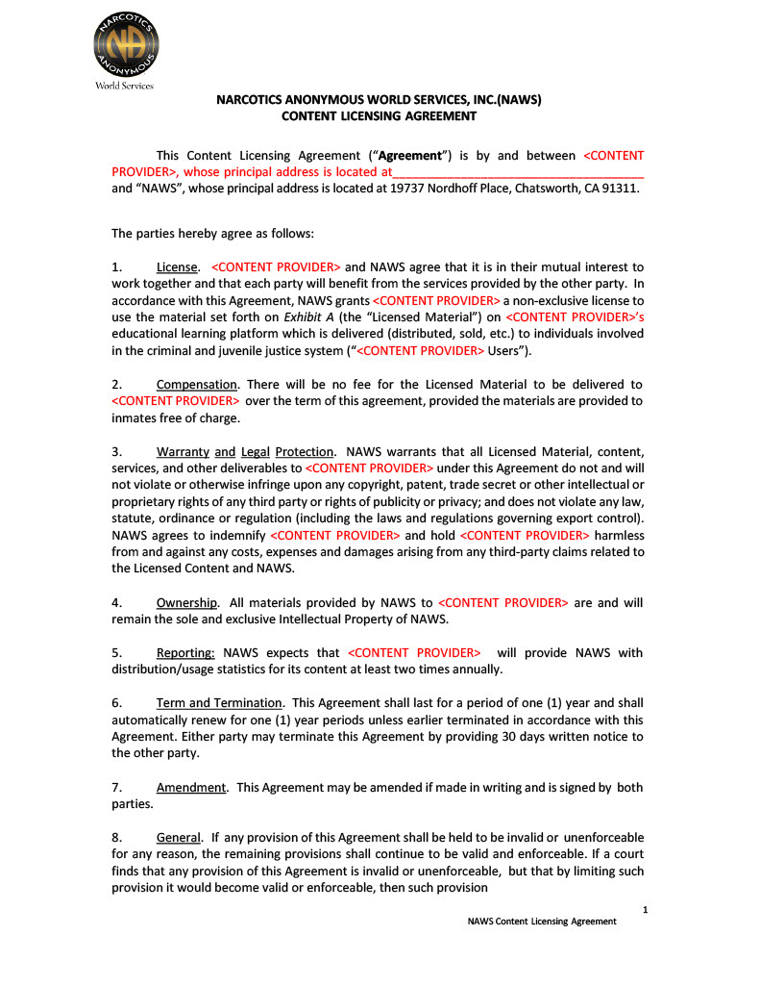
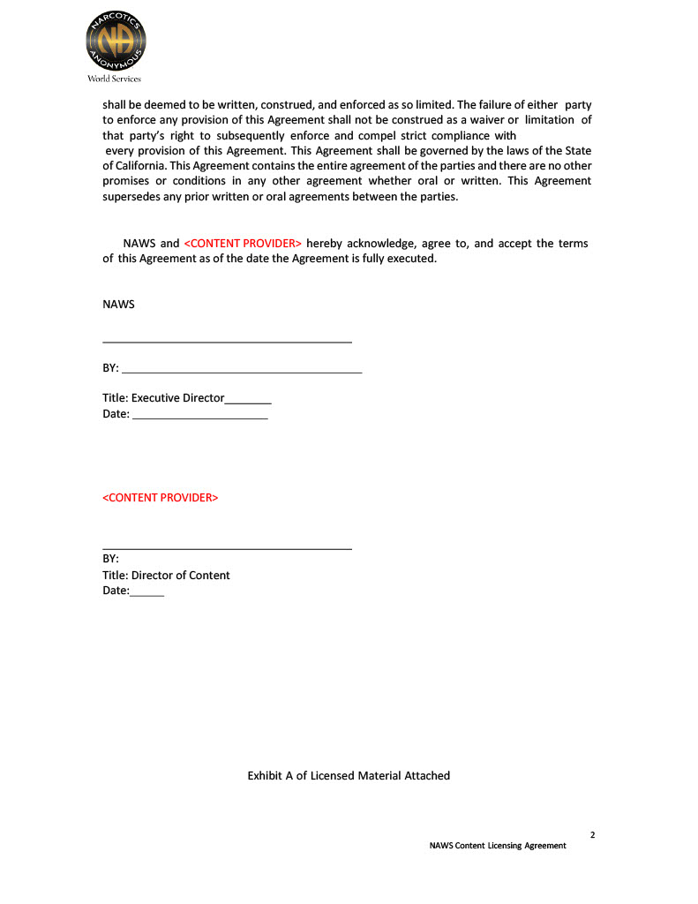
Example Contract: Content Provider and NAWS

Slide 11
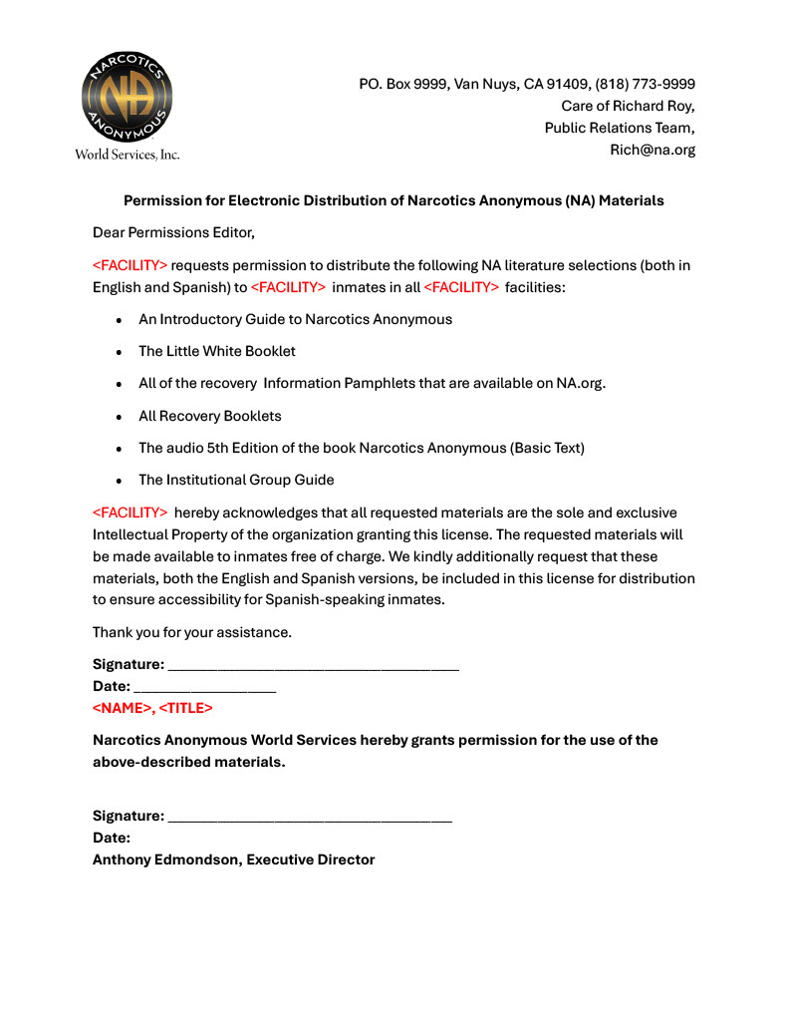
Example Contract: Government Entity and NAWS

Slide 12
Once contracts are signed:
A connection will be made between the provider or institution and NAWS, who will work to get the literature uploaded.
The literature should then be online and available for the incarcerated addicts to use!

Slide 13
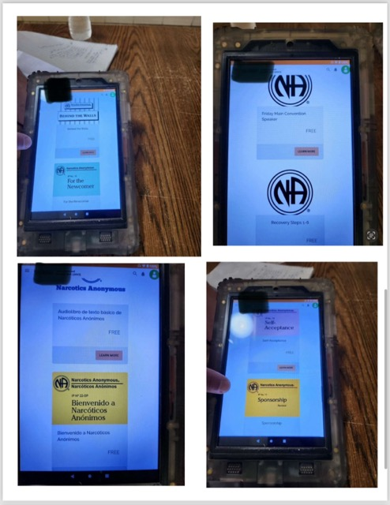
It can be hard to know if all the work was successful. It can help to turn to the H&I Committee to communicate with incarcerated addicts to confirm its benefits. Asking the warden or social director to get a picture of the tablets in action and any data that may be available about utilization as it relates to incarcerated addicts accessing our message is another way to confirm the effectiveness of addicts accessing tablets.
Follow Through

Slide 14
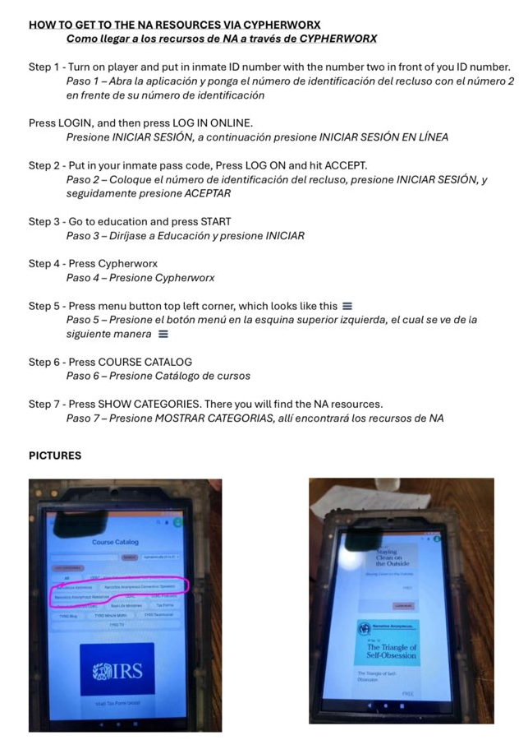
Example Instructions for Incarcerated Addicts Using a Cyperworks Tablet.
This can be a useful tool to write up and give to the warden to print for incarcerated addicts.

Slide 15
Thank you!
NA World Services Rich Roy
818-435-1553
rich@na.org
handi@na.org

