Slide 1
Our Vision at Work!

Slide 2
A Vision for NA Service
All of the efforts of Narcotics Anonymous are inspired by the primary purpose of our groups. Upon this common ground we stand committed.
Our vision is that one day:
Every addict in the world has the chance to experience our message in their own language and culture and find the opportunity for a new way of life;
Every member, inspired by the gift of recovery, experiences spiritual growth and fulfillment through service;
NA service bodies worldwide work together in a spirit of unity and cooperation to support the groups in carrying our message of recovery;
Narcotics Anonymous has universal recognition and respect as a viable program of recovery.
Honesty, trust, and goodwill are the foundation of our service efforts, all of which rely upon the guidance of a loving Higher Power.

Slide 3
A Vision for NA Service
All of the efforts of Narcotics Anonymous are inspired by the primary purpose of our groups. Upon this common ground we stand committed.
Our vision is that one day:
Every addict in the world has the chance to experience our message in his or her own language and culture and find the opportunity for a new way of life;
Every member, inspired by the gift of recovery, experiences spiritual growth and fulfillment through service;
NA service bodies worldwide work together in a spirit of unity and cooperation to support the groups in carrying our message of recovery;
Narcotics Anonymous has universal recognition and respect as a viable program of recovery.
Honesty, trust, and goodwill are the foundation of our service efforts, all of which rely upon the guidance of a loving Higher Power.
We’ll discuss:
What each bullet means for us
How we—as members and trusted servants—can contribute to each piece of this Vision
How NA World Services supports these efforts

Slide 4
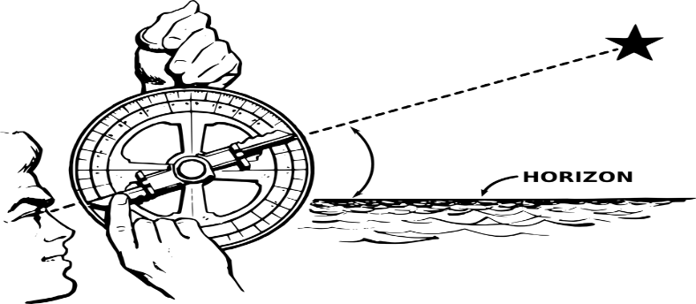
A Vision for NA Service
All of the efforts of Narcotics Anonymous are inspired by the primary purpose of our groups. Upon this common ground we stand committed.

Slide 5
Our vision is that one day:
Every addict in the world has the chance to experience our message in their own language and culture and find the opportunity for a new way of life
NAWS is a hub of experience, strength, and hope
NAWS is positioned to hear about service efforts in different parts of the world and can help make connections
NAWS plays an essential role in translations

Slide 6
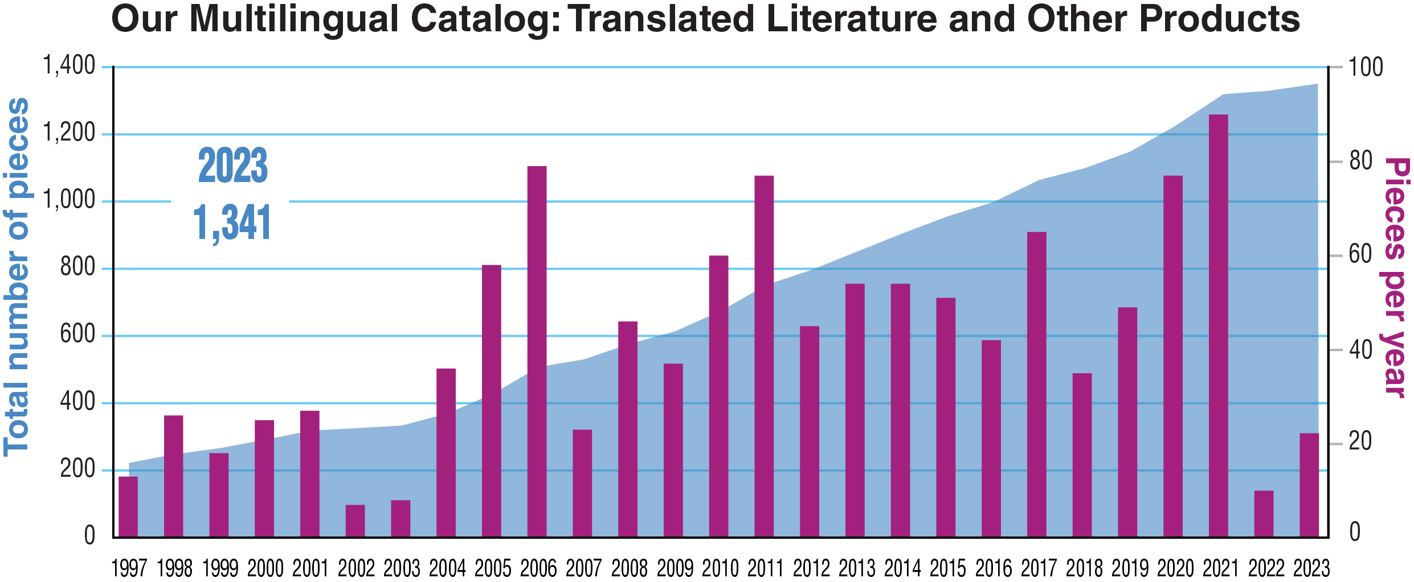

Slide 7
Some of our most recent translations.

Slide 8
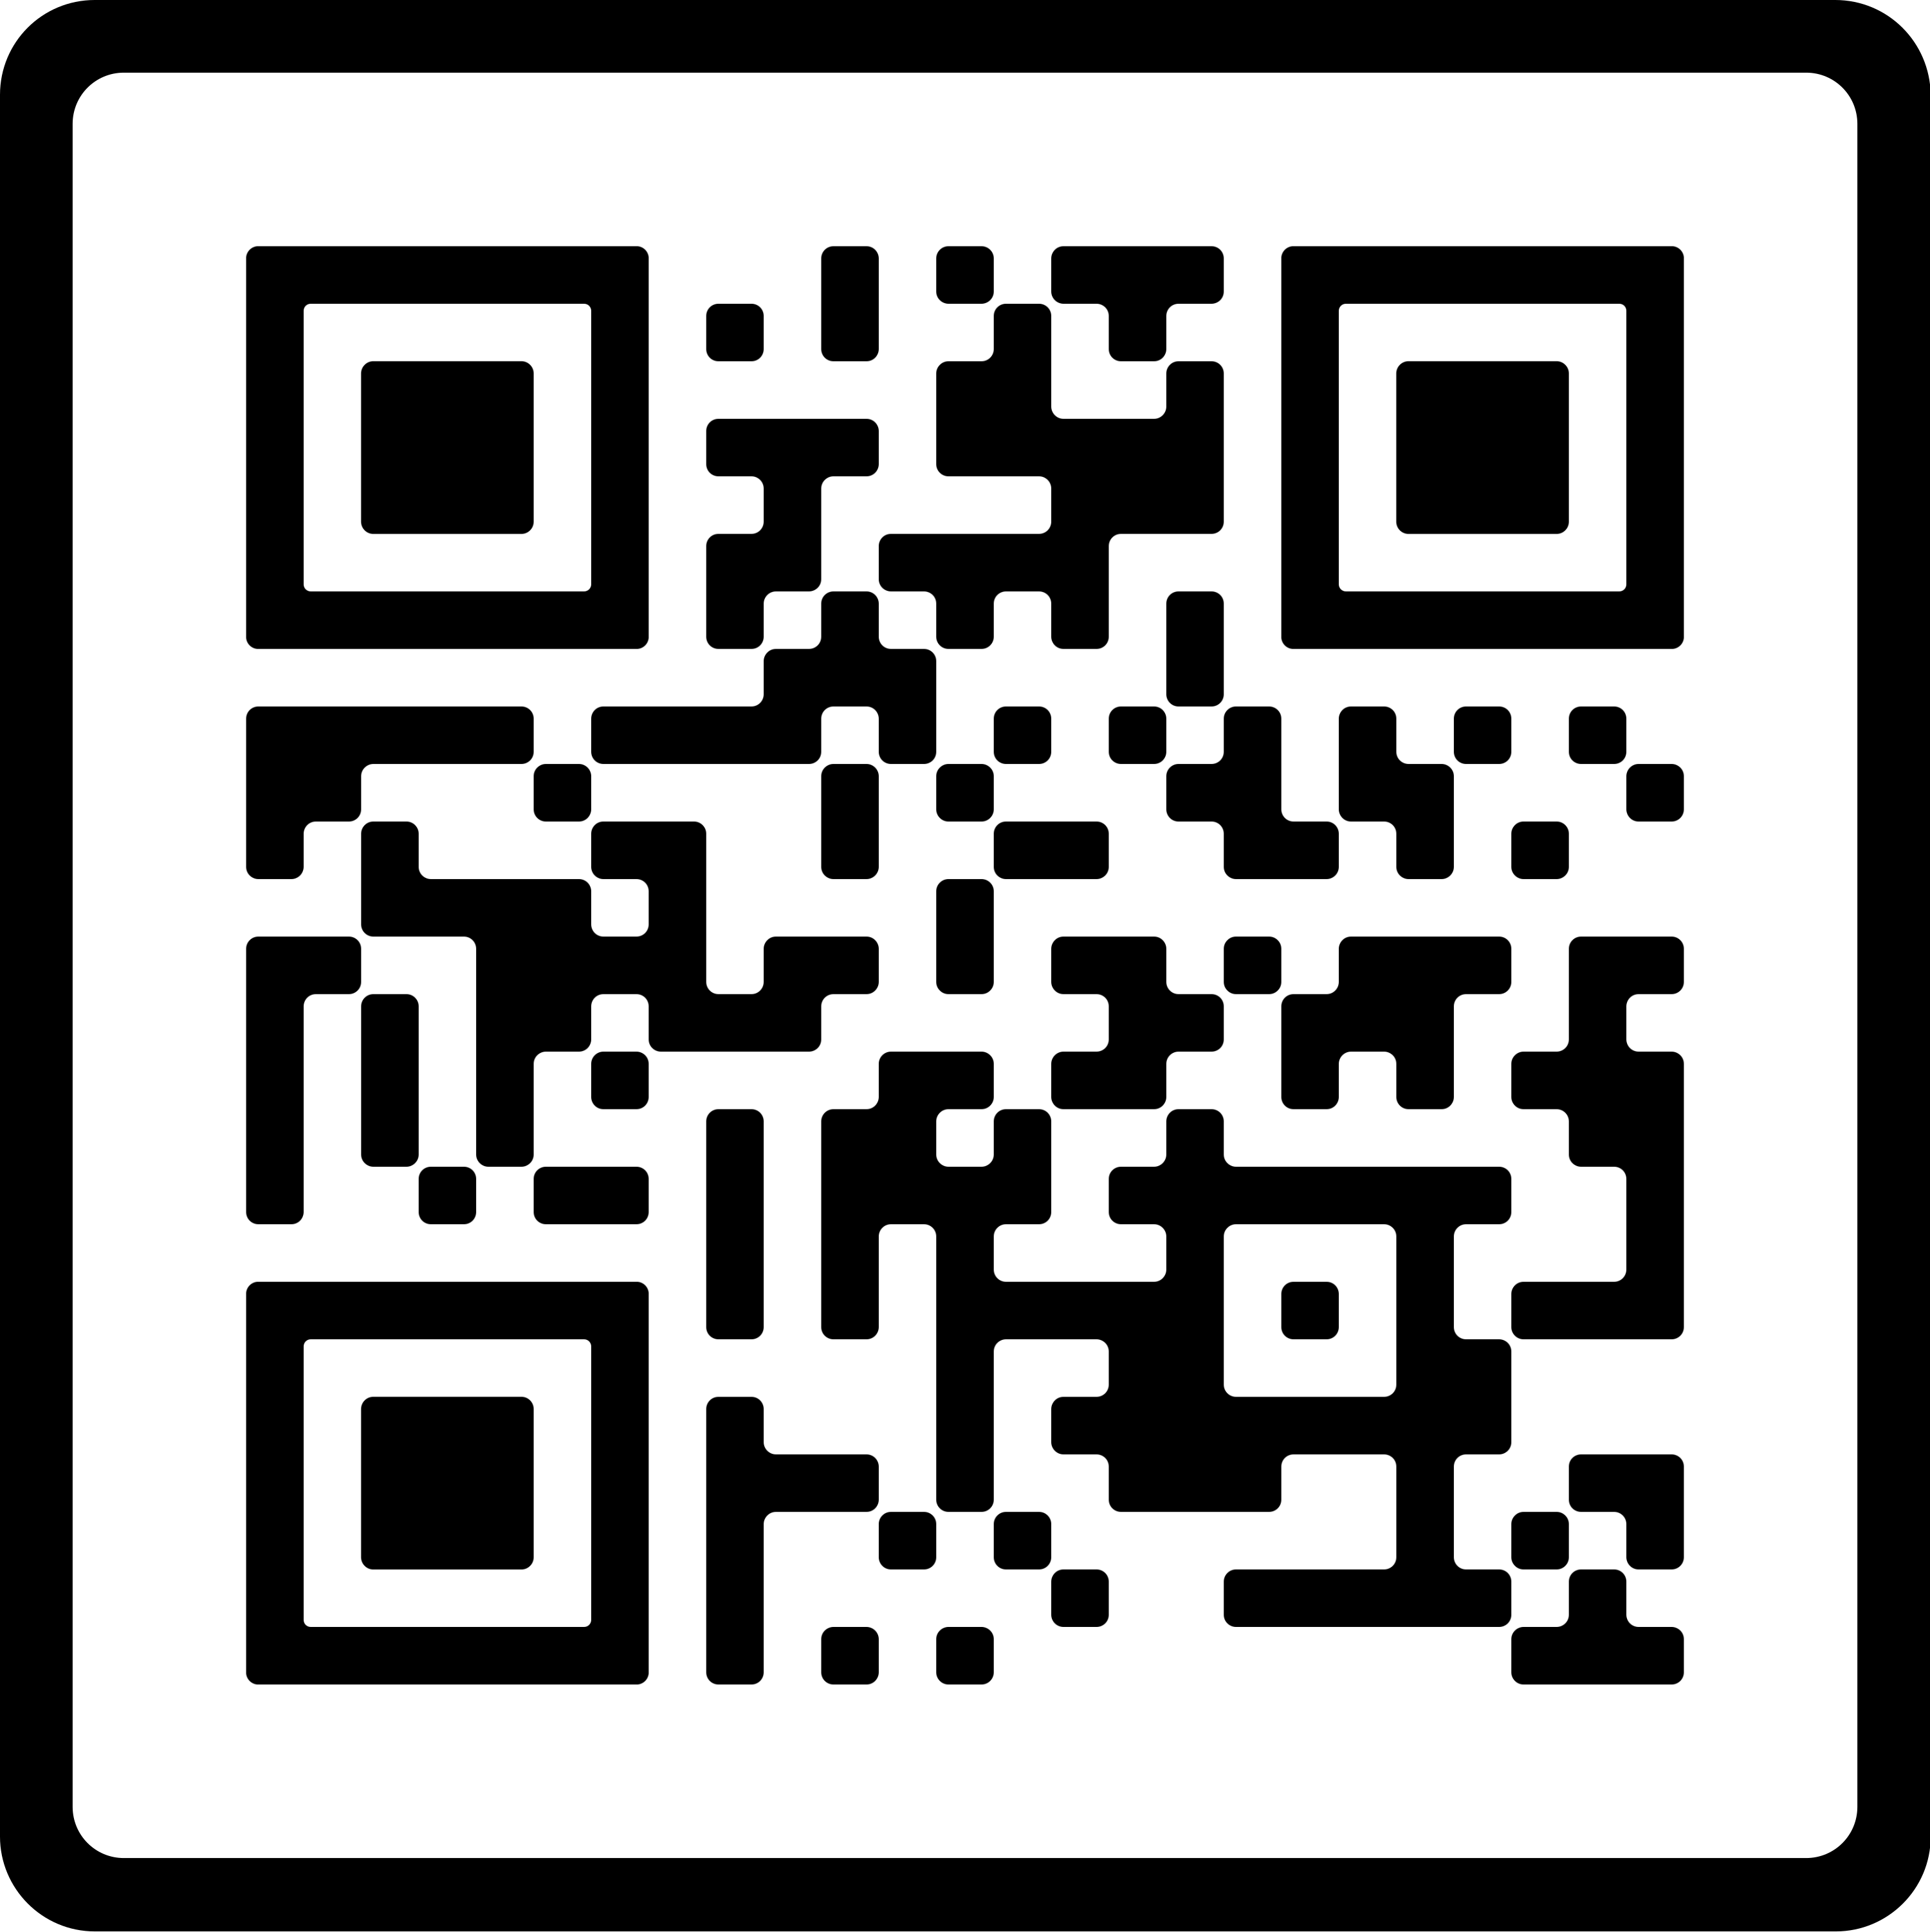
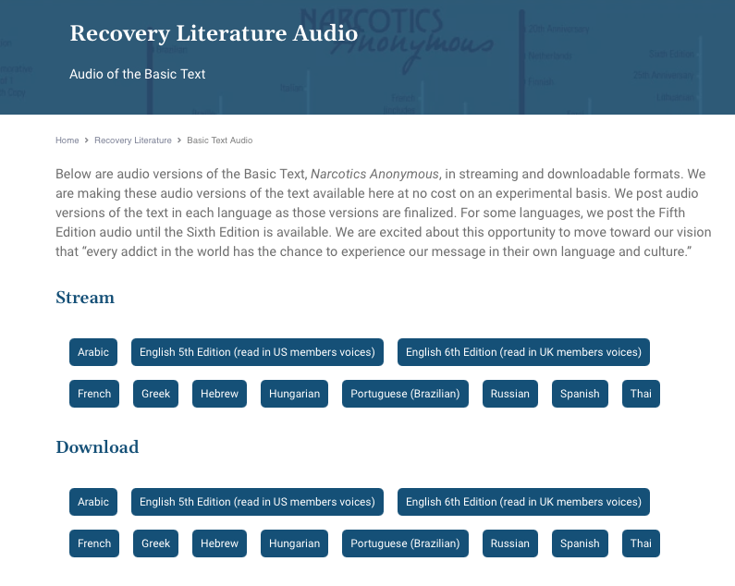
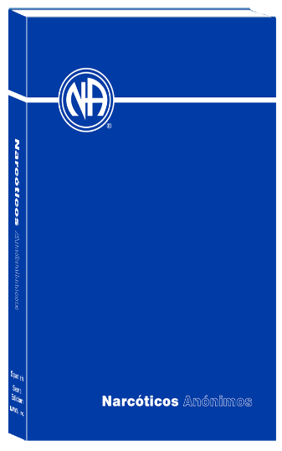
na.org/audio
How can we contribute to this piece of our Vision?

Slide 9
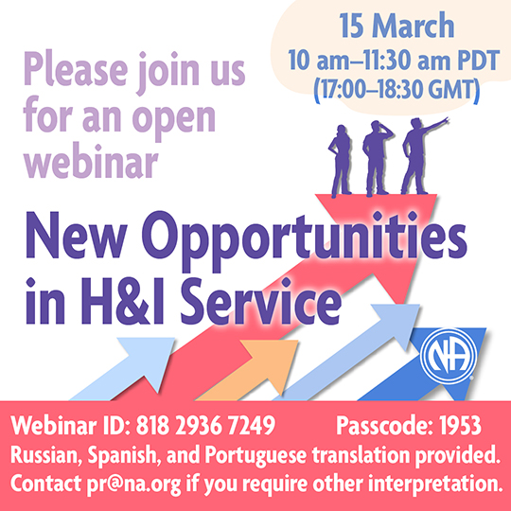
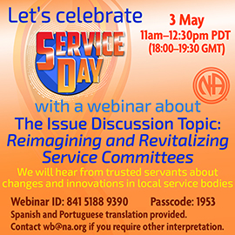
Every member, inspired by the gift of recovery, experiences spiritual growth and fulfillment through service
NA World Services plays an important supporting role
NAWS coordinates literature projects like Guiding Principles that help our recovery and service efforts
NAWS hosts web meetings

Slide 10
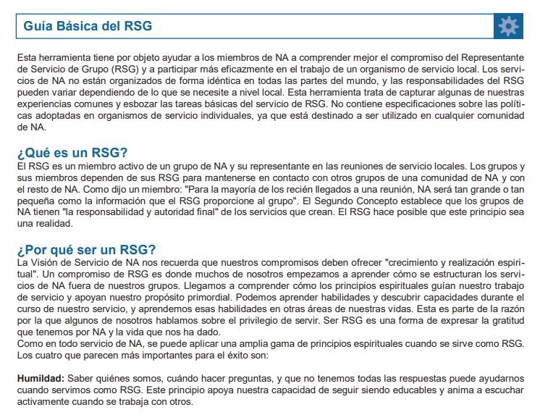
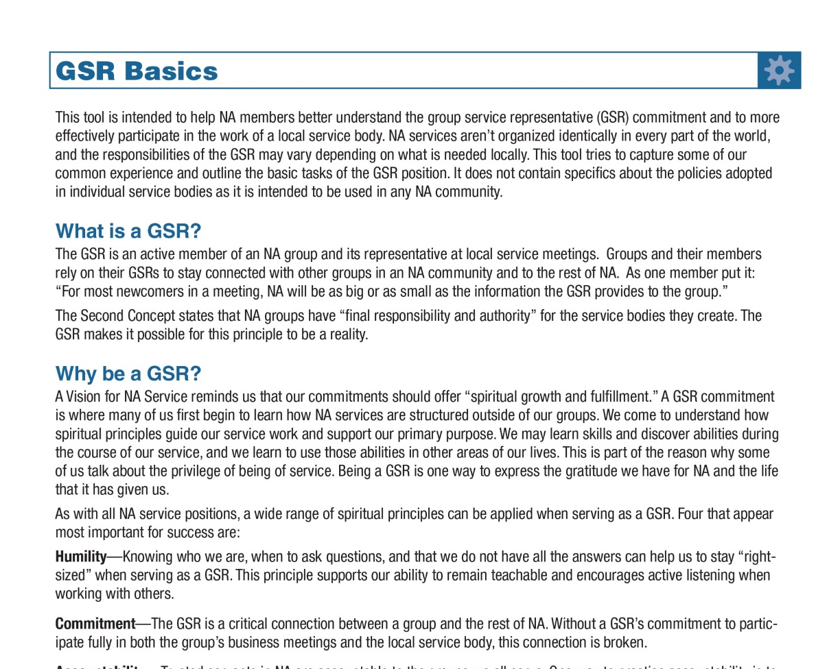
NAWS publishes service materials that reflect our collective wisdom and contribute to healthy service experiences for us all
How can we contribute to this piece of our Vision?

Slide 11
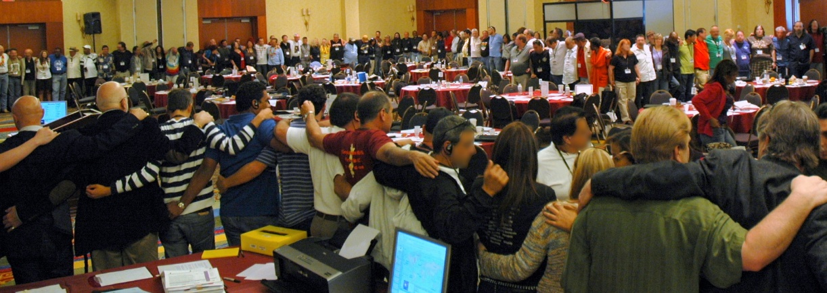
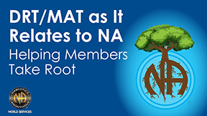
NA service bodies worldwide work together in a spirit of unity and cooperation to support the groups in carrying our message of recovery
NAWS is responsible to hold the World Service Conference
Opportunities for dialogue and discussion across the Fellowship and around the world also include: Webinars, Issue Discussion Topics, and World Board attendance

Slide 12
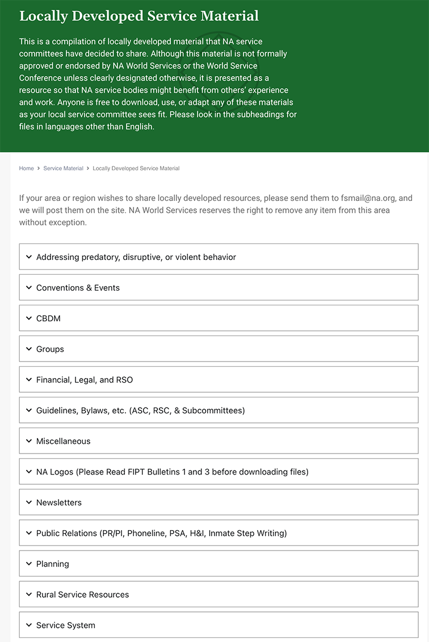
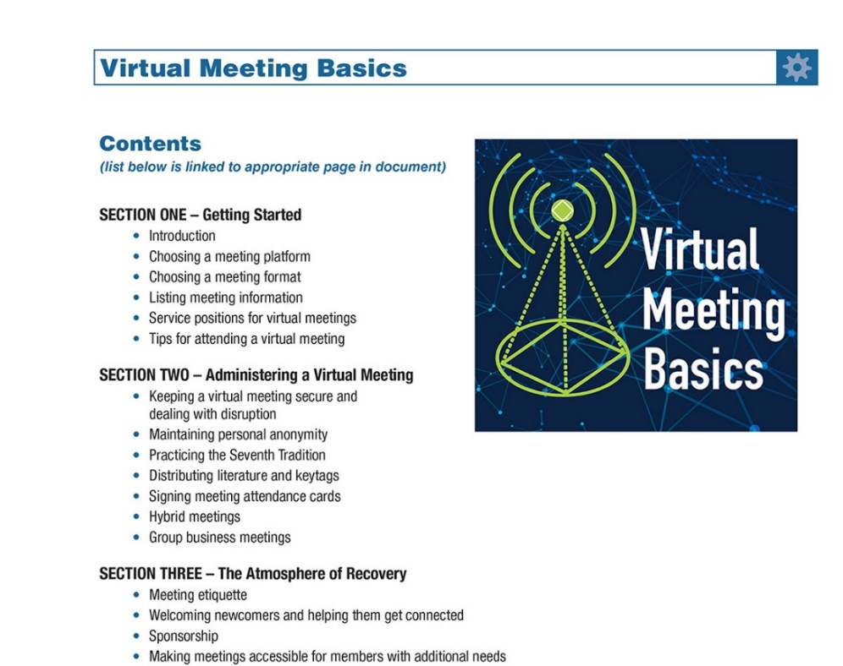
Information and resources gathered are made available at na.org/localresources
Information and tools are made available in a variety of formats
How can we contribute to this piece of our Vision?

Slide 13
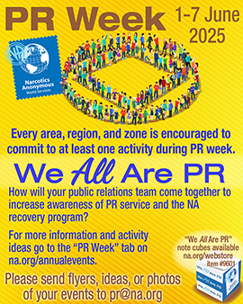
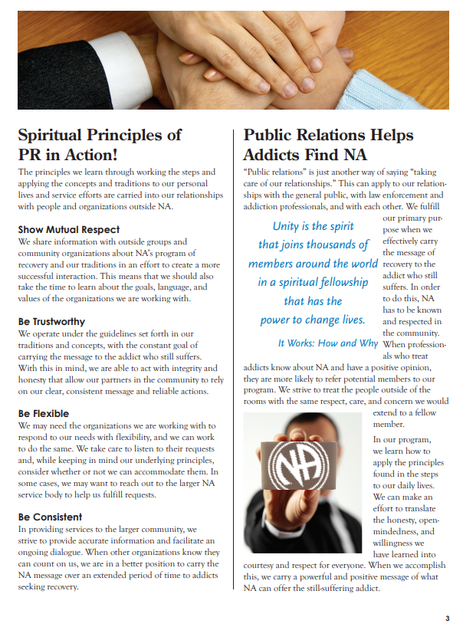
Narcotics Anonymous has universal recognition and respect as a viable program of recovery
World Services has the benefit of a global view of Public Relations

Slide 14
The results of the membership survey are published periodically in the form of a helpful pamphlet
na.org/pr
How can we contribute to recognition and respect for Narcotics Anonymous personally and in our local services?

Slide 15
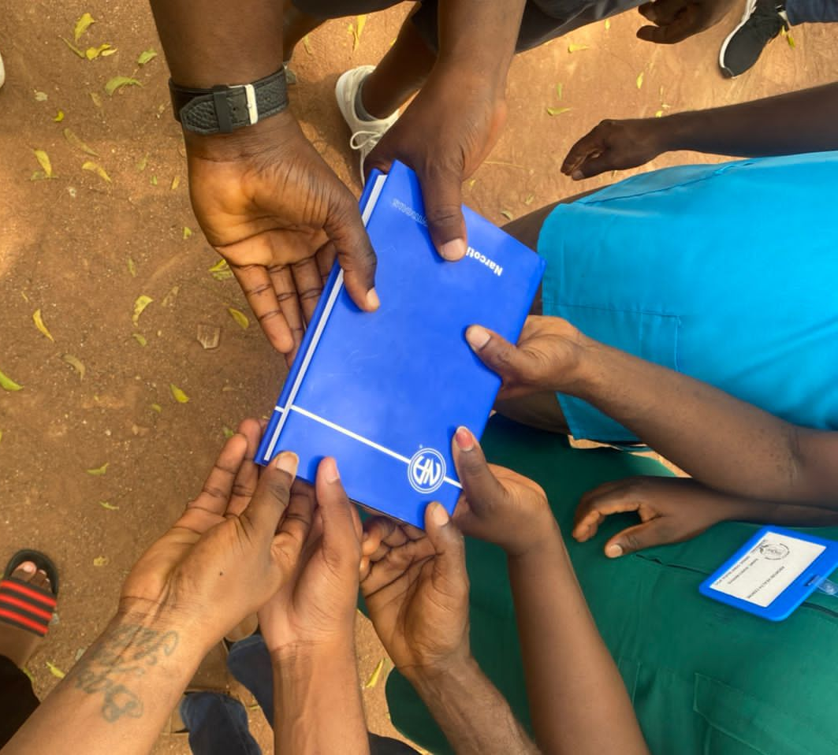
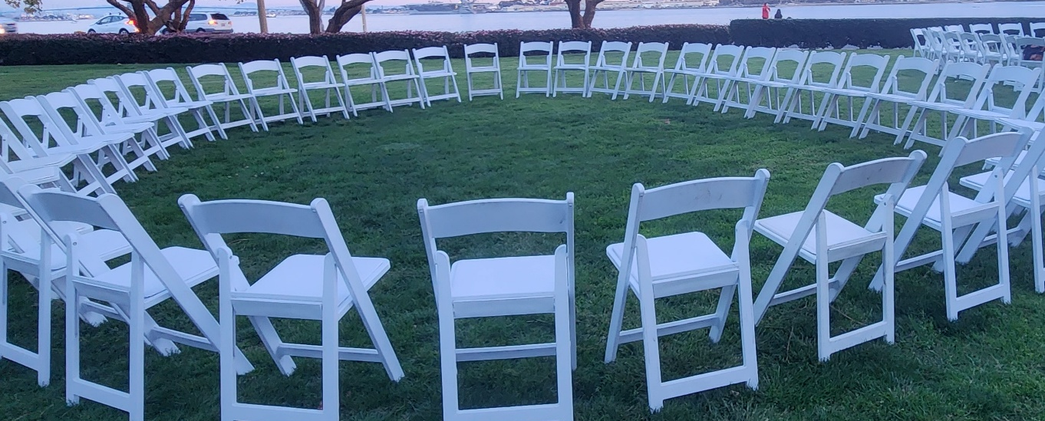
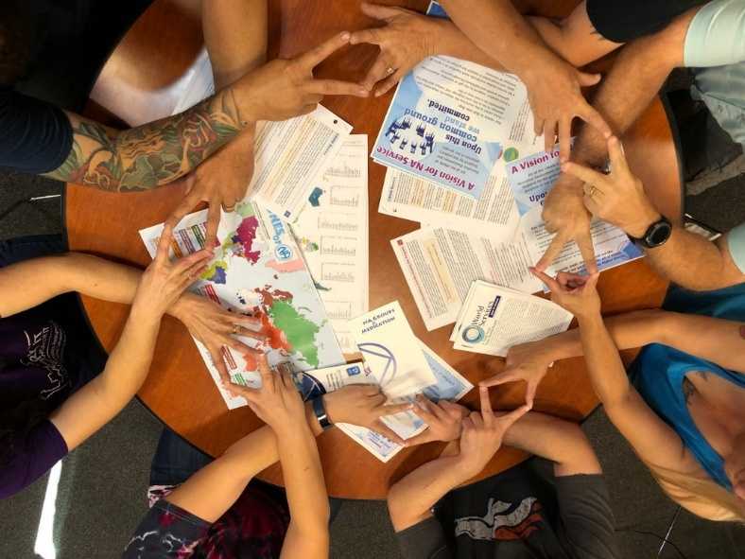
Honesty, trust, and goodwill are the foundation of our service efforts, all of which rely upon the guidance of a loving Higher Power.
How do we manifest honesty, trust and goodwill in our efforts, personally and in service?

Slide 16
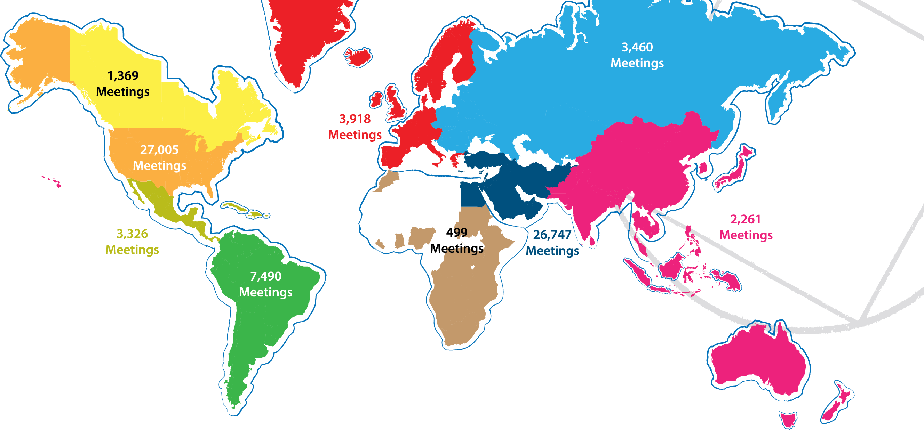
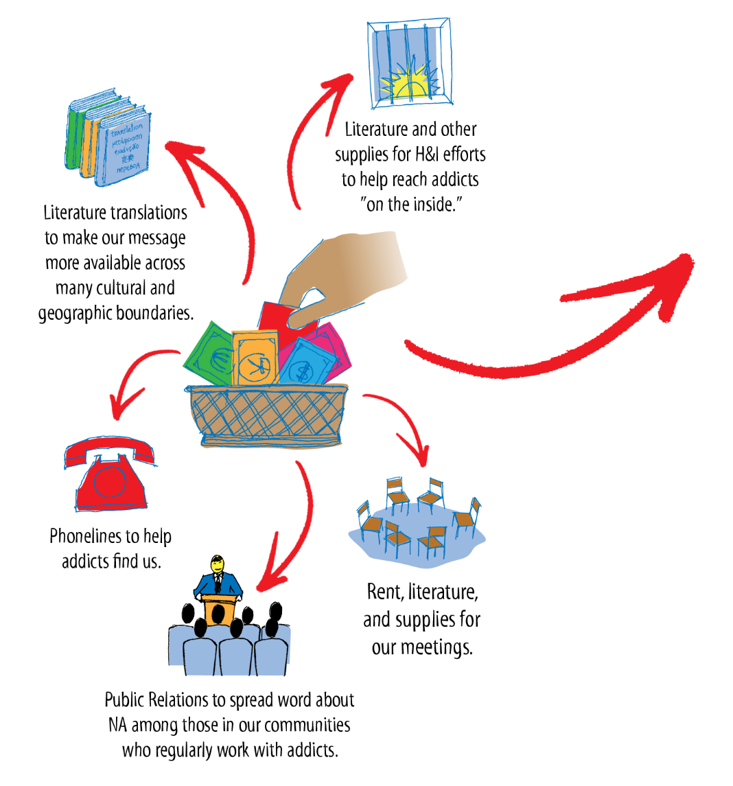
Notes:
Update meeting #s

Slide 17
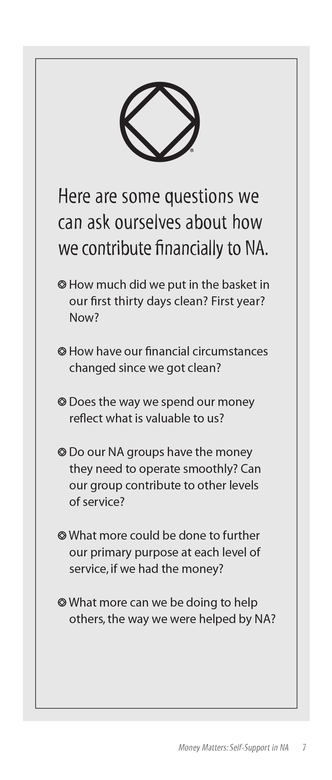

Slide 19
Our Vision at Work!

