Slide 1
Reimagining and Revitalizing Service Committees

Slide 2
Issue Discussion Topics for 2023–2026 cycle
Dealing with disruptive and predatory behavior
Gender-neutral and inclusive language in NA literature
Reimagining and revitalizing service committees
DRT/MAT as it relates to NA

Slide 3
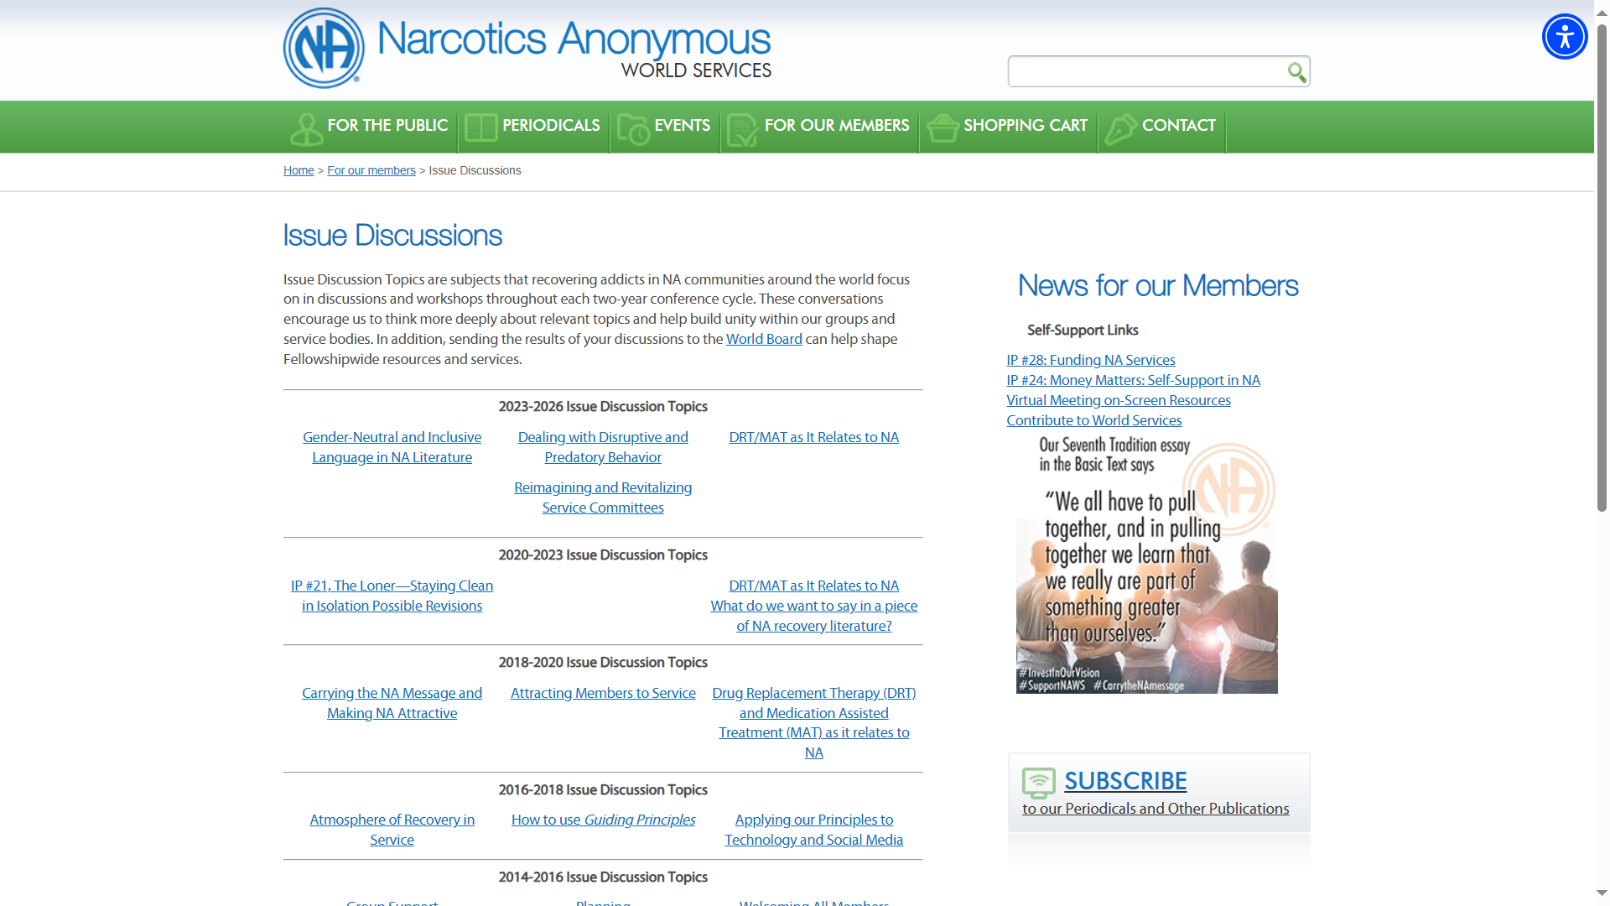
More IDTs from years past,, www.na.org/idt

Slide 4
With that said though…
This workshop isn’t the original IDT…
We rewrote it for today…

Slide 5
Imagination :
the faculty or action of forming new ideas, or images or concepts of external objects not present to the senses.
the ability of the mind to be creative or resourceful

Slide 6
Reimagine :
Reinterpret, rethink
Revitalize :
Imbue something with new life and vitality

Slide 7
What does that mean for us?
We reinterpret and rethink the way we do service, using new, resourceful, and creative ideas so that we can imbue our services with new life and vitality.
Let’s get started!

Slide 8
Large Group Discussion
What is working well in your service body?
What are your successes?

Slide 9
Large Group Discussion
What new idea have you tried out or are considering in your service body?
Did it work? Not work?

Slide 10
Large Group Discussion
What idea have you heard about from another service body that you want to try out?
What excites you about it?

Slide 11
Large Group Discussion
How have you incorporated virtual meetings and services in your service body?
How has this added value to recovery and service there?

Slide 12
Small Groups Set-up
You will need a facilitator and someone to take notes.
Review the groundrules, brainstorming guidelines, and facilitator’s instructions
Write clearly!

Slide 13
Small Groups Discussion
First, decide what service body you are – group, area, region, etc.
Next, come up with ideas for service delivery at your service body – pick the 3 that most excite you.
Last, think about changes that might need to happen to do these exciting new ideas..
Do you need to make structural changes?
Do you need to redefine some of your trusted servants' roles and responsibilities?
Do you need any additional resources to help reach this goal?

Slide 14
Large Group Discussion
Share your three ideas!
What’s exciting about them?
What needs to change to
accomplish them?

Slide 15
“Planning for NA services asks us to think ahead, take time to prepare,
and develop action plans to reach identified goals.” Planning Basics

Slide 16
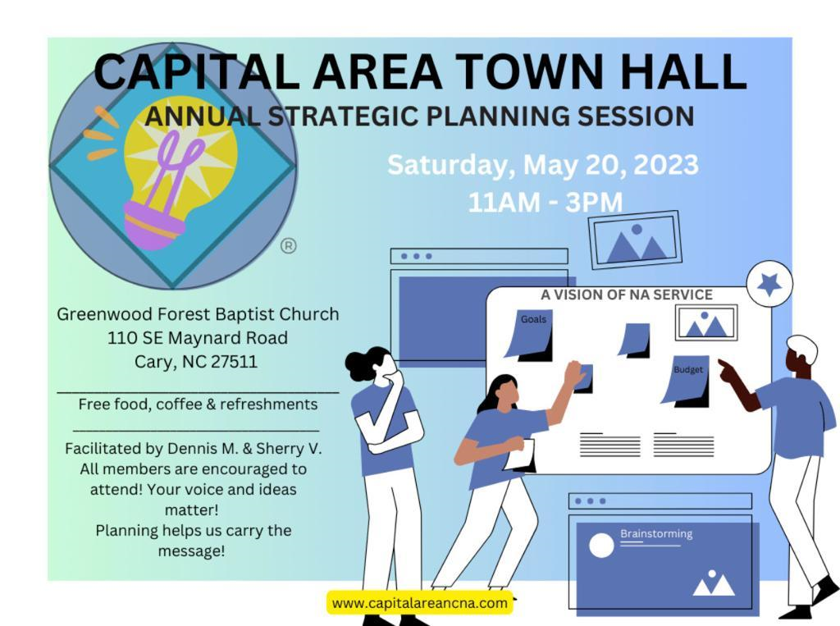
Real life example
May 2023 Capital Area Annual Service Planning Day
Issue: Area structure is rigid / unable to bend; “this is how we’ve always done it”
Goal: An area service structure that provides flexible service delivery and focuses on outcomes rather than process
Approaches:
Establish an annual planning process that includes prioritization and evaluation of services and development of an annual budget
Streamline subcommittees and incorporate task teams
Establish Consensus Based Decision Making
Streamline the CASC policy to match actual practices and move to an annual policy
Service Delivery Ad Hoc Subcommittee
Service Delivery Ad Hoc Subcommittee formed August 2023 as a result of the May 2023 Service Planning Day
Subcommittee meets once a month – all are welcome
Research into how other NA service bodies operate, discussion on how Capital Area NA can benefit from those examples

Slide 17
Example: Flexible Service Model Structure
Town Hall
Town Hall: Planning Day
Town Hall
Town Hall
GSR Orientation, policy updates, financials, ASC facilitation
Admin
Chair, Secretary, Treasurer, RCM and alternates
Town Halls
CASC Services
Service Delivery Team
PR, group support , H&I, Website, phoneline
Convention Team
Convention event planning, facilitation
Activities Team
Unity events, service days monthly potlucks
Cross functional task teams, TT coordinators
Annual Cycle
Structure

Slide 18
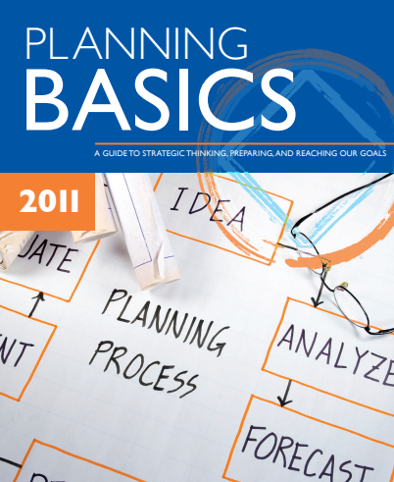
Resources Available
Service Basics (na.org)
https://www.na.org/?ID=service-basics
Issue Discussion Topics (na.org)
https://www.na.org/?ID=IDT-IDT

Slide 19
What are you taking away from today to your service body?
What is the most exciting idea you look forward to trying?

