Slide 1

Lone Star Region
12 Concepts
This Photo by Unknown Author is licensed under CC BY-SA

Slide 2
Introduction
Narcotics Anonymous, as a fellowship, is defined by its principles. Our Twelve Steps detail our program for personal recovery. Our Twelve Traditions relate experience that can help NA groups maintain their unity, and our Twelve Concepts are guiding principles for our service structure. The concepts summarize the hard – won experience of our fellowship’s first forty years with such things as responsibility, authority, delegation, leadership, accountability, spiritual guidance, participation, communication, open-mindedness, fairness, and finances. The Twelve Concepts, together, help ensure that our fellowship's service structure remains forever devoted to service not government.
The Twelve Concepts for NA Service are a relatively recent addition to our fellowship’s body of guiding principle. Since NA’s inception in the early 1950s, we have used the Twelve Steps as guidance in our personal recovery and the Twelve Traditions to steer our groups. The traditions empower the groups to create a service structure, directly responsible to them. The traditions also offer fundamental ideals to guide all our collective efforts.

Slide 3
The 12 Concepts for NA service
The Twelve Traditions of NA have guided our groups well in the conduct of their individual affairs, and they are the foundation for NA services. They have steered us away from many pitfalls that could have meant our collapse. Our various service units serve, they do not govern; we stay out of public debate; we neither endorse nor oppose any of the many causes that our members may feel strongly about; our approach to addict is a non-professional one; we are fully self-supporting.
The Twelve Concepts for NA Service describe here are intended to be practically applied to our service structure at every level. The spiritual ideals of our steps and traditions provide the basis for these concepts, which are tailored to the specific needs of our fellowship’s service structure. The concepts encourage our groups to more readily achieve our traditions’ ideals, and our service structure to function effectively and responsibly.
These concepts have been crafted from our experience. They are not intended to be taken as “law” for NA service, but simply as guiding principles. We find that our services are stabilized when we conscientiously apply these concepts, much as our steps have stabilized our lives and our traditions have stabilized and unified our groups. The Twelve Concepts guide our services and help ensure that the message of Narcotics Anonymous is available to all addicts who have a desire ton stop using and begin practicing our way of life.

Slide 4

The primary responsibility of an na group is to conduct recovery meetings. The service structure ensures that other services are fulfilled effectively without distracting the groups from their primary purpose.
1ST CONCEPT
To fulfill our fellowship’s primary purpose, the NA groups have joined to create a structure which develops, coordinates, and maintains services on behalf of NA as a whole.
RESPONSIBILITY

Slide 5

1st concept
Our fellowship’s primary purpose is to carry the message “that an addict any addict, can stop using drugs, lose the desire to use, and find a new way to live.”
These recovery meetings, conducted thousands of times each day by NA groups around the world, are the most important service offered by our fellowship.
This Photo by Unknown Author is licensed under CC BY-NC-ND

Slide 6

1st concept
However, while recovery meetings are NA’s most important service, they are not the only means we have of fulling our fellowship’s primary purpose.
Other NA services attract the still suffering addict to our meetings.
No one of these service, by itself, comes close to matching the values of group recovery meetings in carrying our message.
Each committee, however, plays its own indispensable part of the overall program devised by the NA fellowship to fulfill its primary purpose.
We can do together what we cannot accomplish separately.

Slide 7
Brainstorming questions
What is the primary purpose of the groups?
What Tradition is involved with the primary purpose?
What Principles joins the Home Groups together to create services?
What are some other NA services that attract the still suffering addict to our meetings?
What could result when a group tries to perform their own services?
How, then, can NA groups ensure the fulfillment of these services?

Slide 8
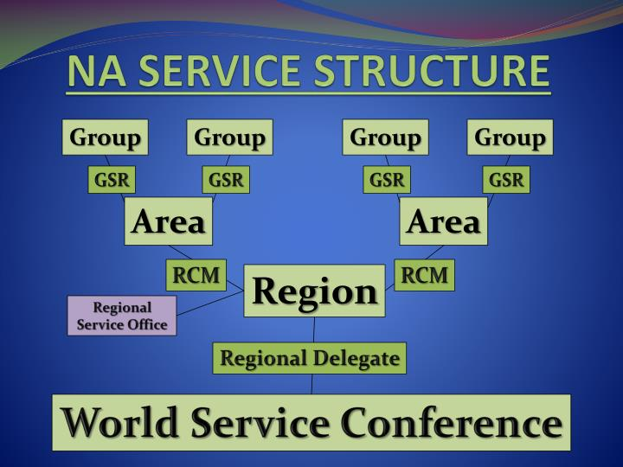
2nd concept
The final responsibility and authority for NA services rest with NA groups.
AUTHORITY
The service structure must always look to the groups for support and direction. The group have final responsibility for and authority over the service structure they have created.

Slide 9
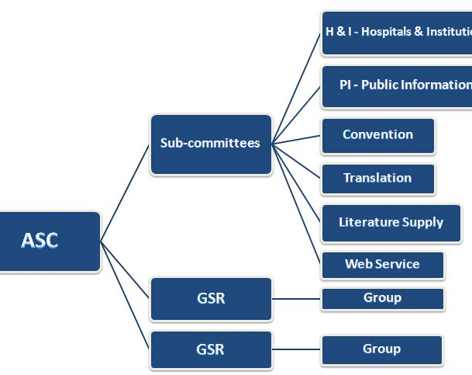
2nd concept
The NA service structure has been created by the groups to serve the common needs of the groups.
Our fellowship’s service boards and committees exist to help groups share their experience with one another.
Attracts new members to group recovery meetings and carry the NA message further than any single group could carry alone.
The groups have created the service structure, they have final authority over all its affairs.

Slide 10
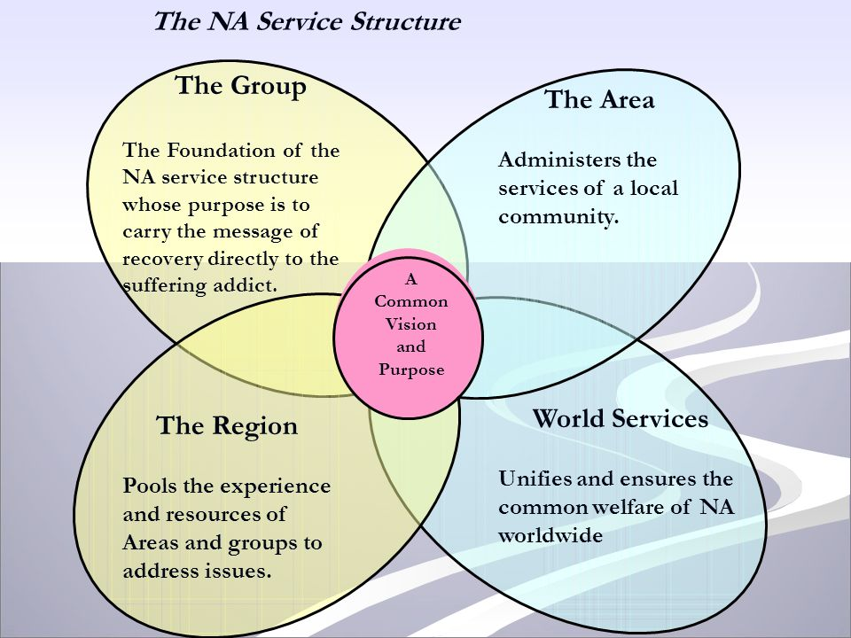
2nd concept
Ideally, responsibility and authority are flip sides of the same coin; the exercise of one is also an exercise of the other.
The most important resource contributed to the service structure by an NA group is almost exclusively spiritual: its ideas and its conscience.
Without the voice of the groups, the service structure may not know what kind of services are needed.
The NA groups bear the final authority in all our fellowship’s service affairs and should be routinely consulted in all matters directly affecting them.

Slide 11
Brainstorming Questions
Who creates the service structure and for what reason?
Who has final authority over all the service structures affairs?
Who has the final responsibility to support all the activities of the service structure?
How do spiritual principles of responsibility an authority work together?
What are the key points in selecting a qualified GSR, RCM, RD?
Who is responsible for the training of the GSR in relation to Traditions and Concepts?
What Tradition apply to this Concept?

Slide 12
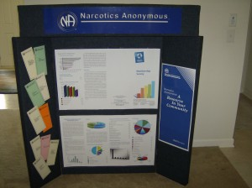
Concept 3
The na groups delegate to the service structure the authority necessary to fulfill the responsibility assigned to it.
DELEGATION
Delegation of authority can do much to free up both our groups and our services. Groups not required to ratify every decision made on their behalf at every level of service, are freed to devote their full attention to carrying the message. Our services must remain directly accountable t they must also be given a reasonable degree of discretion in o those they serve, yet they must also be given a reasonable degree of discretion in fulfilling their duties

Slide 13
3rd Concept
Delegation does not mean a loss of control over our services. Together, Concept One, Two, and Three have been designed to help maintain responsibility for our service structure without tying our trusted servants’ hands.
The Third Concept encourages our groups to focus their responsibilities, while assuring that the service structure is given authority it needs to fulfill other necessary NA services.
Our Twelve concepts do not ask our groups to abdicate their authority, , allowing the service structure to do whatever it pleases.
Groups after all have established the service structure to act on their behalf, at their direction.
When the groups need to exercise final authority in service matters, they are encouraged to do so.
In day-to-day matters, the groups have given our service boards and committees the practical authority necessary to do the jobs assigned them.

Slide 14
3rd Concept
Delegating can be risky business unless we do so responsibly.
To make Concept Three to work , other concepts must also be applied consistently.
If we select our leaders carefully, choosing those who can be trusted to responsibly exercise delegated authority in fulfilling the tasks we’ve given them, we can feel much more comfortable with the concept of delegation.
When we give our trusted servants a job, we must adequately describe to them the job we want done and must provide them with the support they need to complete their job.
With Third Concept squarely in place, our groups are free to conduct recovery meetings and carry the NA message directly to the addict who still suffers, confident that the service structure they have created has the authority it needs to make the decisions involved in fulfilling its responsibilities.

Slide 15
BrainStorming
Questions
How do the groups balance their responsibility and authority regarding the service structure?
What is the significance of the group choosing trusted servants who are qualified?
How can some service decisions made by the service structure affect the primary purpose?
How important is the responsibility of the group to train their trusted servants in understanding and application of the literature important?
How are guidelines important to help us apply the Third Concept?
What do we sometimes fear about delegation?
What is required to make concept Three work?
How should we select our leaders? What will be the outcome?
What happens when the Third Concept is squarely in place?

Slide 16
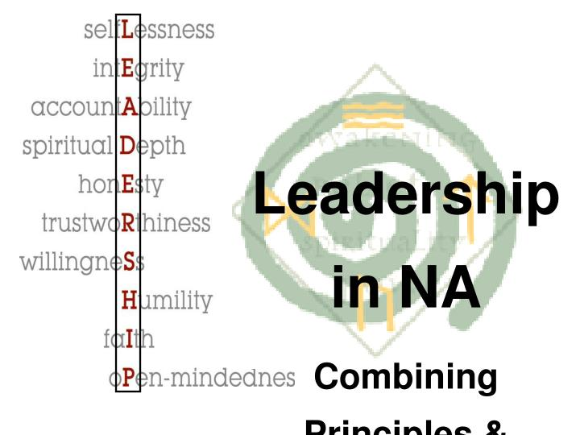
Concept 4 effective leadership is highly valued in Narcotics Anonymous. Leadership qualities should be carefully Considered when selecting trusted servants.
LEADERSHIP
Leaders help us organize, focus our energy and resources, and act in unity. Without good leaders it will be challenging, if not impossible, to achieve these goals. The more we consider these qualities when selecting NA leaders, the better our services will be.

Slide 17
4th Concept
Personal background and professional or educational qualifications, though helpful do not necessarily make for effective leadership.
One of the first things we look for when selecting trusted servants is humility. Being asked to lead, to serve , to accept responsibility is a humbling experience for a recovering addict.
Good leaders do not think they have to do everything themselves; they ask for help, advise, and direction on a regular basis.
We depend on those who serve us to report on their activities completely and truthfully.
Affective NA leadership knows not only how to serve, but when it will serve best to step aside and allow others to take over.
In some positions trusted servants will need specific skills in order to act as effective leaders.
The ability to communicate well can help our trusted servants share information and ideas, both in committee work and in reporting to those they serve.
Leaders capable of understanding where today’s action will take us and offering us the guidance we need to prepare for the demands of tomorrow, and to serve NA well.
Through continuing to work the Twelve Steps, our trusted servants have come to know not only their assets and defects and their limitations.

Slide 18
4th Concept
NA leaders are but trusted servants, not governors; yet we also expect our trusted servants to lead us.
If we select them carefully, we can confidently allow them to do so
Effective leadership is highly valued in NA and the Fourth Concept speaks of qualities we should consider when selecting leaders for ourselves.
We should remember that the fulfillment of many service responsibilities requires nothing more than willingness to serve.
While other responsibilities requiring certain specific skills, depend for their fulfillment far more heavily on the trusted servant’s spiritual maturity and personal integrity.
Willingness spiritual depth, and trustworthiness are strong demonstrations of the kind of leadership valued most highly.
NA members exercise personal leadership by helping clean up after meeting, taking extra care to welcome newcomers, and in countless other ways.
This modest spirit of service to others forms the foundation of our Fourth Concept, and the NA leadership itself.

Slide 19
BrainStorming
Questions
How do the qualities of our leaders affect our services?
Why is it important that an effective leader continues to work steps?
What invites us to respect our trusted servants the most?
How does the spiritual principle of integrity affect our leaders?
What are some other spiritual principles that affect effective leadership?
What inhibits and inspires our fellowship growth?
Who do we do a disservice to when we ask our members to perform tasks, they are incapable of fulfilling?
What do we expect of our trusted servants?
What other leaders does NA have that are not elected into office?
What forms the foundation of the Fourth Concept and of NA leadership itself?

Slide 20

CONCEPT 5
For each responsibility assigned to the service structure, a single point of decision and accountability should be clearly defined.
ACCOUNTABILITY
Each action we perform should have a clear point of accountability. For the committee as a whole, that point is the chair who reports to his or her respective Area Service Committee, Regional Service Committee, or World Services.

Slide 21
^{5th Concept}
When we decide a certain service task should be done, and clearly say which trusted servant, service board, or committee has the authority to accomplish the task, we avoid unnecessary confusion.
Project reports come straight from the single point of decision for the project, offering the best information available.
If problems in a project arise we know exactly where to go in order to correct them.
We do well when we clearly specify to whom authority is being given for each service responsibility.
AS we’ve already seen in the Fourth Concept, and shall see further in Concept Eight, accountability is a central feature of the NA way of service.

Slide 22
5th Concept
When we give our trusted servants responsibility for a particular service task, we hold them accountable for the authority we’ve delegated them. We remain accessible, consistently providing us with reports of their progress and consulting with us about their responsibilities.
Accountability does not mean that we delegate authority only to take it back. IT simply means that we want to be informed of decisions our trusted servants are considering as they go about the tasks we’ve assigned them.
We want to be kept up-to-date on each responsibility we’ve assigned to the service structure so that, if something goes wrong, we can take part in making it right.

Slide 23
BrainStorming
Questions
Does your group assign particular tasks to particular people?
Does this help ensure that important jobs actually get done?
Does anyone in your group know of a situation, either in the group or in a service board or committee , where more than one person or subcommittee were given responsibilities for the same task? What Happen?
If three different people are all given equal authority in a particular service matter and work is not done, who can be held accountable?

Slide 24

CONCEPT 6
Group conscience is the spiritual means by which we invite a loving God to influence our decision
ACCOUNTABILITY
Group Conscience is the means by which we bring the spiritual awakening of the Twelve Steps to bear in making service-related decisions. It is fundamental to our fellowship’s decision-making process. It is not , however, merely a euphemism for “voting” and is not itself the NA decision-making process.

Slide 25
6th concept
Conscience is an essentially spiritual faculty. It is our innate sense of right and wrong, an internal compass that each of us may consult in our personal reflections about the best course to take.
As we steadily apply spiritual principles in our lives, our decisions and actions increasingly become less motivated by self-interest, and more motivated by what our conscience tells us is good and right.
The development of a group conscience is an indispensable part of the decision-making process in Narcotics Anonymous however, group conscience is not itself a decision-making mechanism.
Developing a collective conscience provides us with the spiritual guidance we need for making service decisions.
We pray or meditate together, we share with one another, we consider our traditions, and we seek direction from a Higher Power.
The more care we take in our considerations, the more likely we are to arrive at unanimity, and no vote will be needed to help us translate our group conscience into a collective decision.
When making specific service decisions, voting or consensus may be the measure of our group conscience. However, group conscience can be seen in all our fellowship’s affairs, not merely in our decision-making process.

Slide 26
BrainStorming
Questions
What do we mean when we say that NA is a spiritual society? Does a spiritual society approach the decision-making process differently than other organization?
Is “group conscience” just NA’s way of saying “voting”? (As in, “Let’s take a group conscience on that.”) In what way is group conscience distinct from our decision-making process? In what way is group conscience a fundamental part of that process?
Does the 6th Concept conflict with the Second Tradition, or help clarify it?
How does the practice of the 6th Concept help us focus on “principles, not personalities” when we make service decisions?
Besides decision making, in what other areas of our fellowship’s life can we see group conscience at work?

Slide 27

CONCEPT 7
All members of a service body bear substantial responsibility for that body’s decisions and should be allowed to fully participate in it’s decision – making process.
Participation
The Seventh Concept is one way of putting the principle of group conscience to work in the service environment. This concept suggest that each service body should encourage all it’s members to participate in its decision – making process.

Slide 28
^{7 th} concept
Bringing their different perspectives together, we give our service bodies the opportunity to develop a fully informed, balanced group conscience leading to sound, sensitive service decisions.
Our service boards and committees represent a cross – section of NA perspective and experience.
NA service is a team effort. Our service representatives are responsible to the NA Fellowship a whole rather than any special constituency; so are all the other trusted servants on the team.
There is no firm rule about how to apply the concept of participation to every situation. In an atmosphere of love, mutual respect, and frank open discussion, each service body decides these things for itself.
In the vast majority of cases, however, the service body will exercise its delegated authority in fulfilling the responsibilities to the groups have assigned to it, disposing of the matters in the normal normal course of its service meetings.

Slide 29
BrainStorming
Questions
How does the Seventh Concept apply to the service environment?
What determines the participation as a group member?
How does Tradition Two apply to group conscience?
How does Tradition One applky to a service team? What is of great value when we seek to express the collective conscience of the whole?
What is the rule for applying the concept of participation to every situation?
In most cases how will the service body exercise its delegated authority?
What is the foundation for the Seventh Concept?
Who has the right to participate in the decision – making process?

Slide 30

CONCEPT 8
Our Service structure depends on the integrity and effectiveness of our communications.
Communication
Our fellowship’s service structure is founded on the unity of our groups; to maintain that union we must have regular communications throughout Narcotics Anonymous.

Slide 31
^{8 th} concept
The effectiveness of the service structure depends on the continued unity of the NA groups, and on their continued support and direction. These things can only be maintained in an atmosphere of honesty, open, and straightforward communication among all parties concern.
Regular communication plays a large part in the fulfillment of our groups’ final responsibility and authority for NA services.
When the groups are regularly given full and accurate information from all elements of the service structure, they become familiar with the structure’s normal pattern of activity.
Clear, frequent two – way communication is an important prerequisite for delegation.
Open frank communication is a critical ingredient of effective leadership. To better know the ideas, wishes, needs, and conscience of those they serve, trusted servants must listen carefully to their fellowship.

Slide 32
^{8 th} concept
Finally, full and frequent communication is essential in the development of group conscience, the spiritual means by which we invite the influence of a loving God in making our collective decision.
To develop group conscience, communications must be honest and direct.
WE listen closely to one another, frankly speaking our minds and hearts on the matter at hand.
A conscience fed od ignorance is an ineffective conscience incapable of providing reliable guidance.
An effective conscience can develop only in an atmosphere of regular, open communication among all parties concerned.
Honesty, open, straightforward communication is essential to both the integrity and the effectiveness of the NA service structure.
With regular two – way communication, our groups and our services are well positioned communication, our groups and our services are well positioned to uphold the ideals and fulfill the responsibilities described in our Twelve Concepts.

Slide 33
BrainStorming
Questions
What is our service structure founded on?
What does the service structure depend on?
What plays a large part in the fulfillment of our groups’ authority for NA services?
How do group’s receive their information about the service structure?
What will more likely cause the groups to supply adequate support to the service structure?
What is a critical ingredient of effective leadership?
What must trusted servants do to better know the conscience of those they serve?
What cause an ineffective conscience?
What is the purpose of our services?

Slide 34

CONCEPT 9
All elements of our service structure have the responsibility to carefully consider all viewpoints in their decision-making processes
Open-mindedness
It’s easy to discuss things with those who agree with us. But in recovery we learned that our own best thinking may not necessarily offer us the best possible guidance. We have been taught that, before making significant decisions, we should check our judgement against the ideas of others.

Slide 35
Ninth concept
The Ninth Concept is one tool we use to ensure that our group conscience is as well-informed as it can possibly be.
In any discussion, it is tempting to ignore dissenting members, especially if the vast majority of members think alike.
Yet it is often the lone voice, offering new information of a unique perspective on things that save us from hasty or misinformed decisions.
Concept Nine also encourages us, to frankly speak our minds in discussions of service issues, even when most other members think differently.
No, this concept is not telling us to be nay-sayers, objecting to anything agreed to by the majority.
It does say, however, that we are responsible to share our thoughts and our conscience with our fellow members, carefully explaining our position and listening with equal care to the positions of others.
By insisting on thorough discussion of important issues, the worst we can do is take a little of each other’s time; at best, we protect the fellowship from the consequences of a hasty or misinformed decision.

Slide 36
^{Ninth concept}
Concept Nine encourages us to continue to consult group conscience, even after a decision has already been made.
The expression of the individual conscience to the group is the foundation of group conscience. Without it, we block the guidance of a loving God, our ultimate authority.
For the sake of our fellowship and for the sake of our members yet to come, our groups, service boards, and committees must always carefully consider all viewpoints in their decision – making processes.

Slide 37
BrainStorming
Questions
What should we do before making significant decisions?
What has our experience shown us?
Should we ignore the dissenting members?
What is NA encouraged to do with the lone voice?
What does Concept Nine encourage us individually to do?
What is our responsibility as members in Concept Nine?
How should we apply patience in making our decisions?
What is the foundation of group conscience?
Who is affected when groups, service boards, and committees consider all viewpoints in our decision-making process?

Slide 38

CONCEPT 10
Any member of a service body can petition that body for the redress of a personal grievance, without fear of reprisal
Fairness
The Tenth Concept is our fellowships’ guarantee of respect for the individual trusted servant. This concept may seem self-evident, but our belief in the principle involved is so strong that we want to say it loudly and clearly.

Slide 39
^{tenth concept}
Narcotics Anonymous is a spiritual society, with high ideals for how we treat each other. Our members, however, are only human, and we sometimes mistreat one another.
The Tenth Concept is our spiritual society’s promise that one us is wronged in the service environment, the aggrieved trusted servant may ask that wrong be made right.
Together, the Ninth and Tenth Concepts support an atmosphere in which our members feel free to express themselves frankly on matters at hand.
After having demonstrated the courage of their convictions, individuals become the subject of reprisals initiated by those who have disagreed with them.
The Tenth Concept allows them to petition the appropriate service body for redress of their grievance.
In the fellowship such as ours, whose success is based upon mutual support and cooperation, that kind of respect for the individual is indispensable.

Slide 40
BrainStorming
Questions
What is the purpose of the Tenth Concept?
What is the promise of our spiritual society?
Why is the Tenth Concept’s guarantee of the right to appeal for redress of a personal grievance designed?
How do the Ninth and Tenth concepts work together?
What are the rights of the individual NA member?

Slide 41


Eleventh concept
This Photo by Unknown Author is licensed under CC BY-SA

Slide 42
FISCAL RESPONSIBILITY & FISCAL ACCOUNTABILITY
NA funds are to be used to further our primary purpose, and must be managed responsibly.
The Eleventh Concept establishes the sole absolute priority for the use of NA funds: to carry the message. The importance of that priority calls for total fiscal accountability. Direct contributions to each level of service help us focus on our primary purpose, and enhance accountability.

Slide 43
Eleventh concept
Narcotics Anonymous funds should always be used to further our primary purpose.
Our funds are used to pay expenses for running our meetings, informing the public where to find us, reaching the addict who can’t get to meetings,
It is used to develop, produce, translate and distribute our message in written form.
To bring our members together in a service community committed to the vision of spreading our message around the world to those in need. All of this is done in support of our spiritual aim to carry the message to addict who still suffers.
One way we apply the Concept Eleven is by establishing clear spending priorities.

Slide 44
Eleventh concept
The Eleventh Concept applies directly to the management of our funds, but it also has implications of the management of our resources.
While Groups are responsible to fund our services, they are also responsible to carefully manage those funds contributed.
The groups have created the service structure to not only provide the services on their behalf but to also manage those services.
Direct group contributions to our service structure encourage responsible management of service fund sand help our services maintain their focus.
Accountability is an essential part of the responsibility of financial management.

Slide 45
Brainstorming
Questions
What is the purpose of the Eleventh Concept?
Where do our contributions come from and how does the flow of funds work in NA?
What does it mean by prioritizing our services?
What are some of our resources and why must they also be managed?
Why should groups manage their contributions?
What are some of the ways we delegate our service resources?
What are some of the group’s financial priorities?
What must we have to hold our service structure accountable?

Slide 46
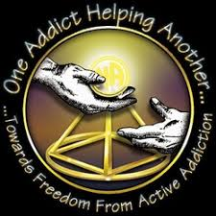
CONCEPT TWELVE
In keeping with the spiritual nature of Narcotics Anonymous, our structure should always be one of service, never of government.
Selfless Service
Within the context of the Twelve Concepts, as a body, this concept serves much the same function as Tradition Twelve in the context of the traditions. It brings our consideration concepts for NA service back to the spiritual root of selfless service. “A structure based on that foundation could only be one of service, never of government.”

Slide 47
Selfless service is an essentially spiritual endeavor. Our Twelfth Step says, in part, that “having had a spiritual awakening,” we individually “tried to carry this message to addicts.”
Our collective service efforts arise from that same spiritual foundation. Having experienced results of this program in our own lives, we join together to carry the recovery message further than we could individually.
NA service is the cooperative effort of trusted servants receiving guidance from the groups, not a rule enforced by a governing body.
TWELFTH CONCEPT

Slide 48
In order to serve well, each element of our service structure must make an earnest effort at effective communication.
In NA service, we share with one another so that we may combine our strength, to better fulfill the fellowship’s primary purpose.
To maintain our accountability to those we serve, we are bound to inform them in a complete, accurate, and concise fashion of our activities.
Open, honest, and straightforward communication nurtures the spirit of service in our fellowship.
Together, we recover, and together, we serve-----this is the spiritual core of our program, the foundation of our fellowship. A a structure based on that foundation could only be one of service, never government.
TWELFTH CONCEPT

Slide 49
What is the difference between service and government?
What is it about NA’s ,primary purpose and it’s spiritual identity that says “our structure should always be one of service , never of government?
How does gratitude, humility, communication, and selflessness help our structure remain “one of service, never of government?”
How does the Twelfth Concept apply to each of the other Eleven Concepts?
Brainstorming Questions

Slide 50

Thank you

