Slide 1
Attracting Members to Service

Slide 2
Where would you be if you never had the opportunity to hear the NA message?

Slide 3
A Vision for NA Service
All of the efforts of Narcotics Anonymous are inspired by the primary purpose of our groups.
Upon this common ground we stand committed.
Our vision is that one day:
Every addict in the world has the chance to experience our message in their own language and culture and find the opportunity for a new way of life;
Every member, inspired by the gift of recovery, experiences spiritual growth and fulfillment through service;
NA service bodies worldwide work together in a spirit of unity and cooperation to support the groups carrying our message of recovery.
Narcotics Anonymous has universal recognition and respect as a viable program of recovery
Honesty, trust, and goodwill are the foundation of our service efforts, all of which rely upon the guidance of a loving Higher Power.

Slide 5
Large-group Discussion
What would NA look like without service?
Why is service such a significant part of the NA program?
Notes:
Facilitator: Notes can be taken on a post it wall note or typed directly on a slide at the end of this presentation. Please keep all notes and submit to be included in this presentation.

Slide 6
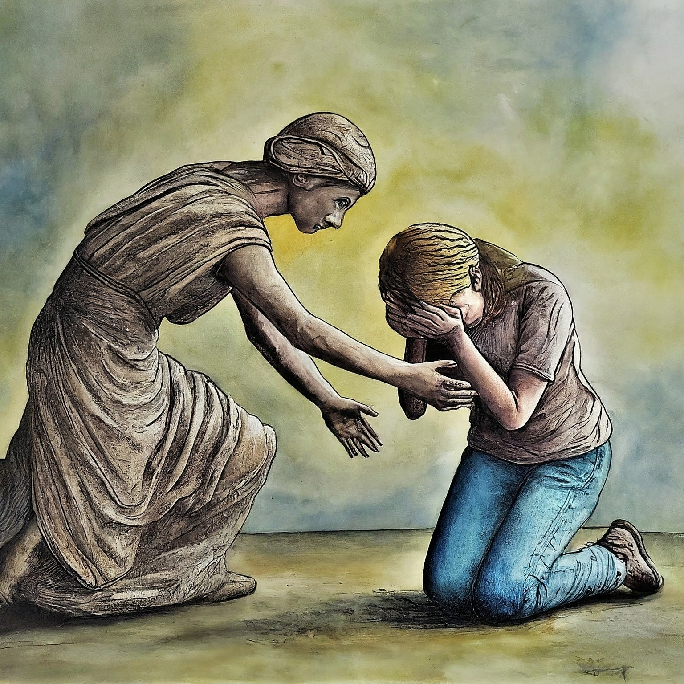
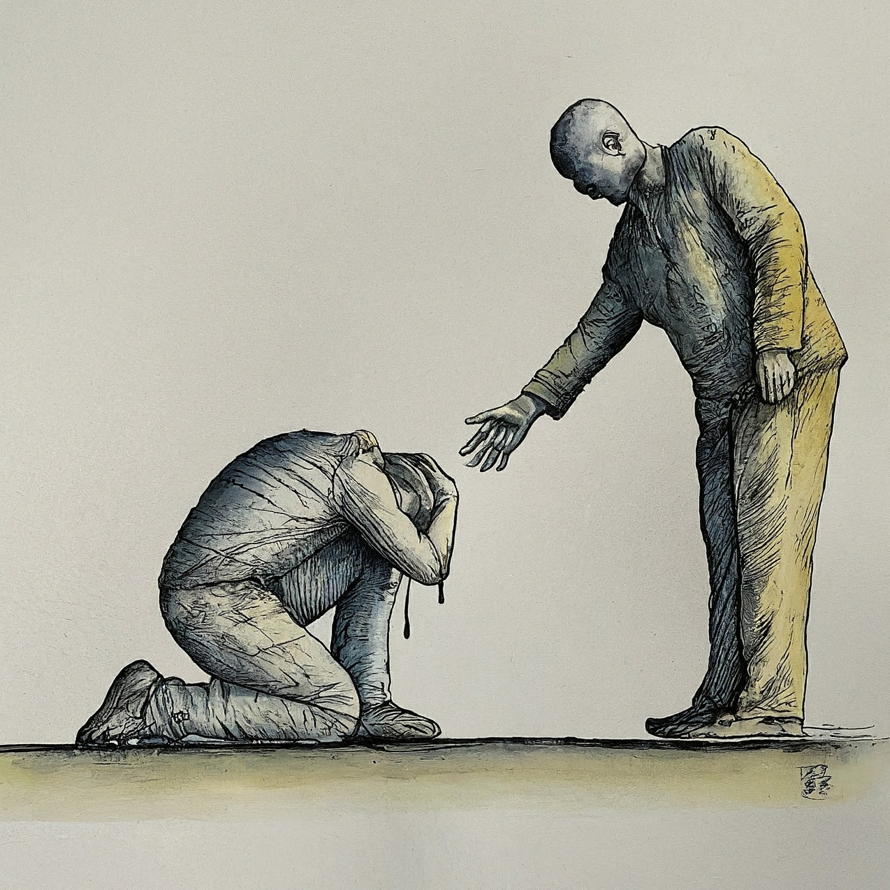
Basic Text quote
Everything that occurs in the course of NA service must be motivated by the desire to more successfully carry the message of recovery to the addict who still suffers.

Slide 7
Small-Group Discussion
How have I personally benefited from NA service? How has it helped me stay clean and enhanced my recovery?
Imagine it’s five years from now. NA is growing in your area and members are excited about doing service. There are plenty of volunteers for each position and elections have multiple nominees. What has changed to make this possible? What about your NA community has made service so attractive?
Notes:
Break the group in to small groups of 5 or less. Give out the handouts for groups to gather notes. They will report back a few responses for each question. Allow for 15 minutes of discussion.

Slide 8
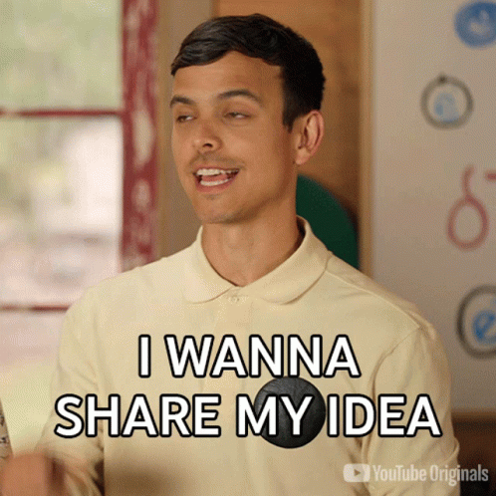
Report Back
Sharing ideas!
What will YOU do with what you’ve learned?
How can you attract members to service?

Slide 9
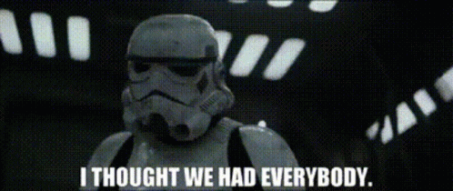
Large-group Discussion
What changes can we make to our attitudes and practices to attract populations that are missing to service?
Who is missing?
Notes:
Facilitator: Notes can be taken on a post it wall note or typed directly on a slide at the end of this presentation. Please keep all notes and submit to be included in this presentation.

Slide 10
Next Steps
Thank you for participating.
Take photos or notes about what you learned.
Add them to the following slides to continue the brainstorming!

Slide 11
Notes collected at presentations
Date of workshop:
Location:
Facilitators:
Add notes or photos here

Slide 12
Notes collected at presentations
Date of workshop:
Location:
Facilitators:
Add notes or photos here

Slide 13
Notes collected at presentations
Date of workshop:
Location:
Facilitators:
Add notes or photos here

Slide 14
Notes collected at presentations
Date of workshop:
Location:
Facilitators:
Add notes or photos here

