Slide 1

NAWS UPDATE
The latest from NA World Services with updates on projects and WCNA 38 and much more!
Notes:
This session gives an introduction to NA World Services—who we are and what we do—and covers highlights of latest activity.

Slide 2



Introduction
WSC 2023
Resources / Invest in Our Vision
Literature / Carrying the Message
Services & Communication
Questions and Answers
Outline
Notes:
Overview of session. 90 minutes. We’ll try to save time for questions. You can always write to wb@na.org if you have a question you didn’t get a chance to ask today:
Intro
WSC 2023
Resources / Invest in Our Vision
Carrying the Message / Literature
Serving and Communicating Online
Questions and Answers
We are focused here on the past year. There is PR work, legal work, work responding to emails and calls, and more that are not covered in detail here.

Slide 3


Introduction
What is NAWS?
AKA Narcotics Anonymous
World Services
Notes:
NAWS stands for Narcotics Anonymous World Services.

Slide 4
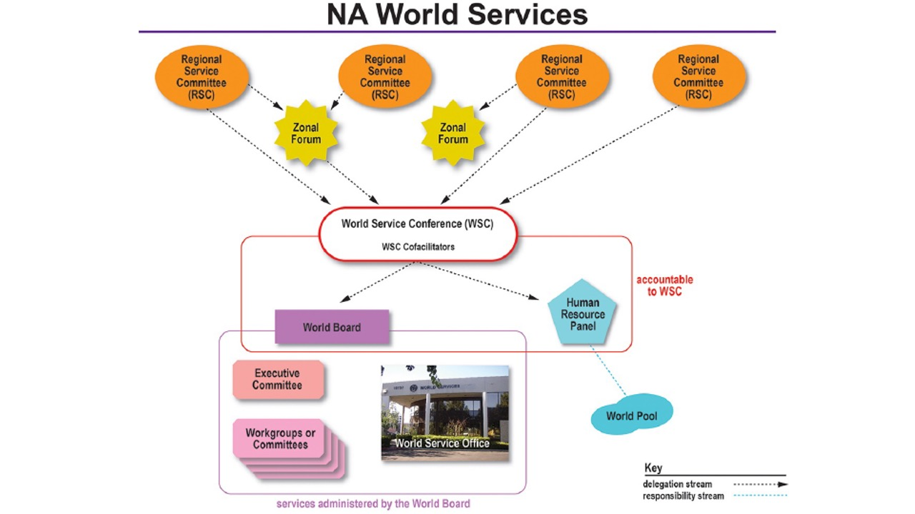
Notes:
“World services” = the World Service Conference and the World Board (WB), Human Resource Panel (HRP), and WSC Cofacilitators who are elected by the conference, plus the World Service Office, whose activities are overseen by the World Board.
This diagram illustrates that the office and workgroups are accountable to the WB
And the WB and HRP are accountable to the WSC.
The WB, the HRP, and the WSC Cofacilitators are all elected by the conference.
You can find more information about World Services from A Guide to World Services in NA. That’s where this diagram comes from.

Slide 5
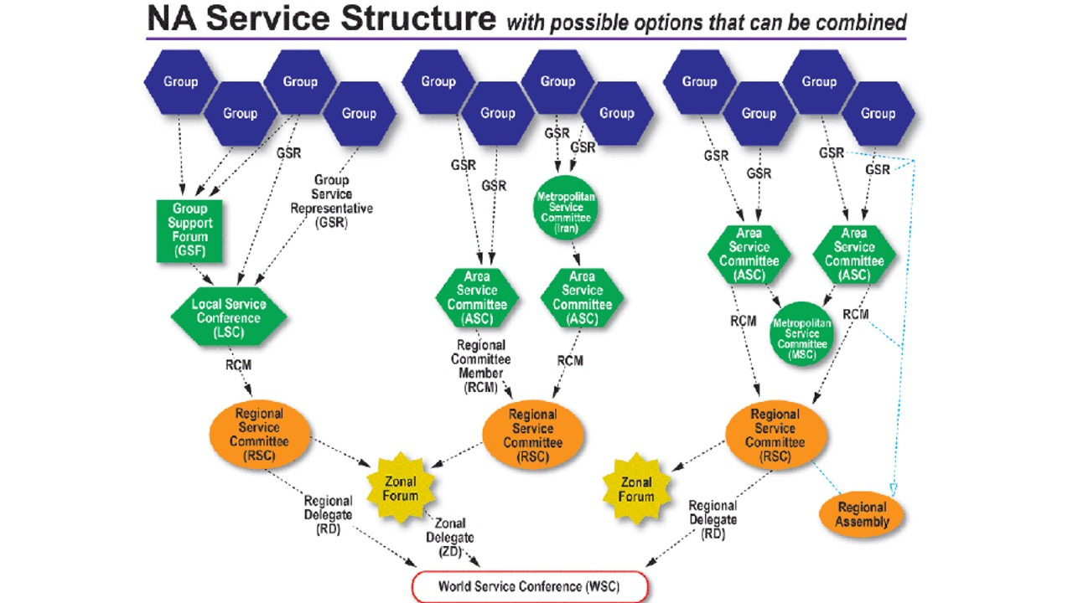
Notes:
The conference is, in turn, accountable to groups. All of the entities in NA World Services are directly accountable to the Fellowship that created them.
This diagram is also from GWSNA. It shows the connection of the groups to the World Service Conference, including some of the diversity that NA communities use to organize their services. This is a great diagram to use as a handout or slide if you need an overview of the structure from group to WSC.

Slide 6

The basic purposes of our World Services are…
communication, coordination,
information,
and guidance.
We provide these services so that our groups and members can more successfully carry the message of recovery and so that our program of recovery can be made more available to addicts everywhere.
            A Guide to World Services in NA
Notes:
A Guide to World Services describes the basic purpose of NAWS as “communication, coordination, information, and guidance.” CCIG, for short.
If NAWS had a mission statement, this would pretty much be it. Like the Vision Statement, this informs all of our work--the projects that we work on that are approved by the WSC, as well as the work that continues week in and week out.
The five locations of NA World Services around the world spend the vast majority of their time and resources on what we call essential services. That is primarily literature production and distribution; protecting the Fellowship’s intellectual property; and providing communication, coordination, information, and guidance to members and service bodies around the world.

Slide 7
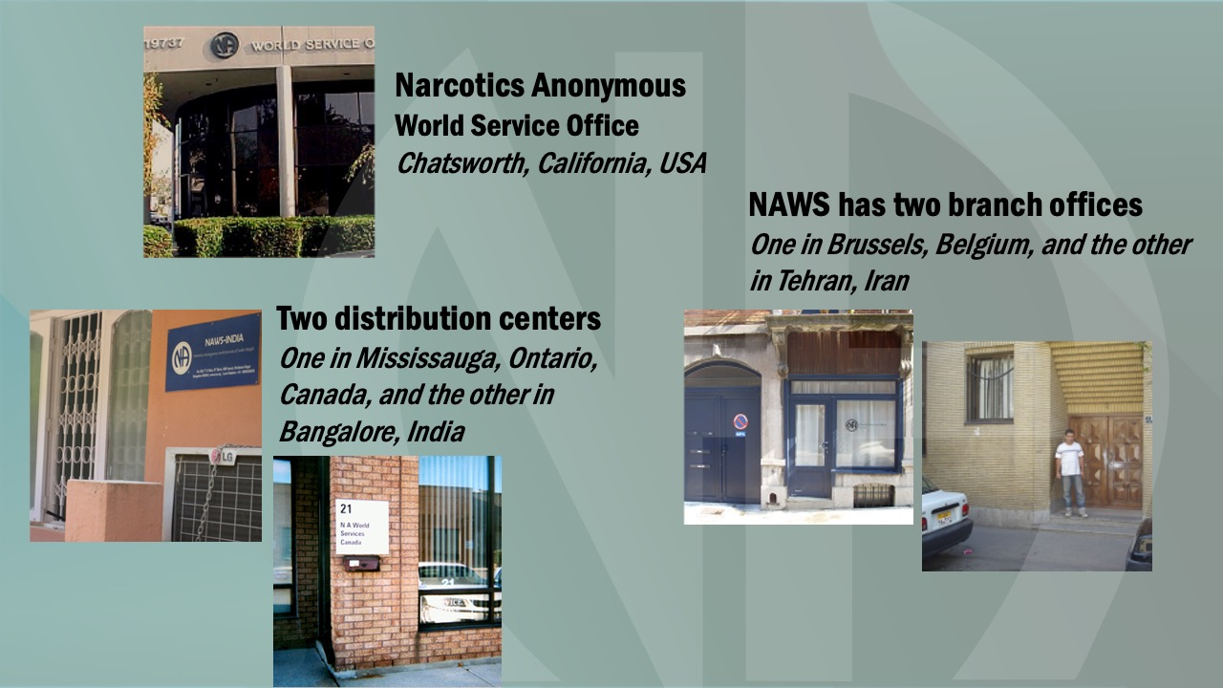
Notes:
These are pictures of the 5 World Service locations
As a result of our need to make some changes at WSO-E, in Brussels, Belgium we closed the European office temporarily. We have resumed shipping from the European office. Orders are now processed at our Chatsworth locations and packed and shipped from Europe. We are looking for a larger Brussels location so that we can build up stock there. Questions about European orders can be directed to wsoeurope@na.org.

Slide 8

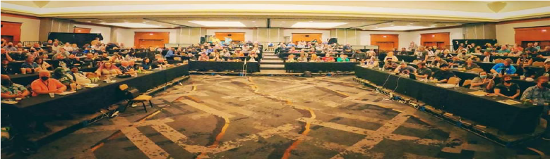
WSC 2023
Here are a few of the highlights.
Notes:
NA World Services also helps administer the World Service Conference and the projects it approves.
The 36th World Service Conference was held 30 April – 6 May 2023.
It’s a big service meeting! But not just like a large RSC.

Slide 9
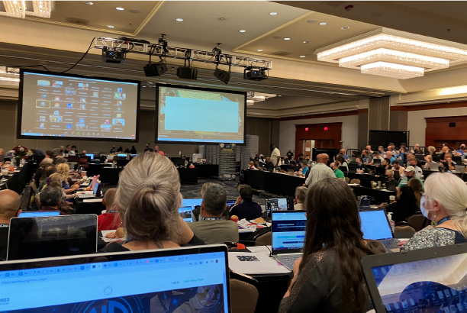
There were 139 voting members participating at WSC 2023:
126 delegates
(120 RDs, 6 ZDs)
13 World Board members
There were also:
103 alternate delegates
4 HRP members
2 cofacilitators
5 in-person translators
additional virtual
translations
There were 179 men and 63 women among delegates, alternates, and WB.
Notes:
There were 139 voting members participating at WSC 2023—126 delegates and 13 World Board members. In addition, there were 103 alternate delegates, 4 HRP members, 2 cofacilitators, 5 in-person translators and additional virtual translations.
There are a total of 123 seated regions that could have participated at WSC 2023. There were 120 RDs participating (3 seated regions did not attend this WSC). Of 6 seated zones, 6 ZDs were participating.
Of the 126 delegates from seated regions and zones participating, 66 were from the US, 5 from Canada, and 55 from outside the US and Canada.
There were 179 men and 63 women among delegates, alternates, and WB.

Slide 10
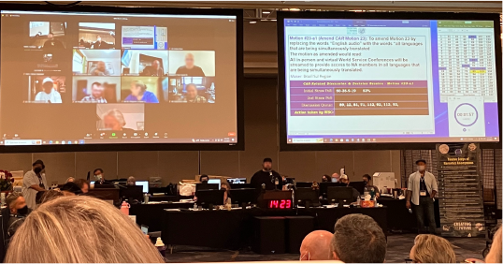
First truly hybrid WSC!
The virtual participants who joined the conference were:
11 RDs
2 ZDs
1 World Board member
25 alternates
Notes:
First truly hybrid WSC! The virtual participants that joined the conference were: 11 RDs, 2 ZDs, 1 World Board member, and 25 alternates.
At WSC 2018, a few participants joined remotely—one delegate and two alternates.
We are still learning how to hold a hybrid WSC. It’s new to us and involves more technology, preplanning, flexibility, and staff.

Slide 11
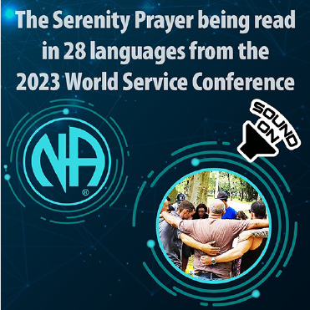
Conference participants were
from 45 countries, and spoke
28 languages.
This is based on Serenity Prayer languages at the close of the
First Things First session.
The 2023 WSC Serenity Prayer can be heard on the NAWS Instagram page @narcoticsanonymous, posted on 12 May 2023.
Notes:
Conference participants were from 45 countries, and we spoke 28 languages (based on Serenity Prayer languages at the close of the First Things First session).

Slide 12

WSC 2023 made the decision to seat five regions:
Brazil Central
Iran Region #1
Nordeste Brazil
Rio Grande do Sul
Thailand
For the first time in NA history, the majority of delegates to the World Service Conference are from outside the USA!
134 regions and zones are now seated at the WSC.
66 of them are from the US, and
68 of them are from other places around the world.
Notes:
This conference made the decision to seat five regions: Brazil Central, Iran Region #1, Nordeste Brazil, Rio Grande do Sul, and Thailand.
For the first time in NA history, the majority of delegates to the World Service Conference are from outside the USA!
134 regions and zones are now seated at the WSC.
66 of them are from the US, and 68 of them are from other places around the world.

Slide 13
Interim WSC meeting
28 February & 1 March 2025
11am-1pm & 2pm-4pm, Pacific Time
There are currently
149 voting members:
128 regions, 6 zones, 15 WB
(Besides the 5 new regions,
2 new board members
were elected at WSC 2023)
There will be a Mixlr link for anyone who would like to listen.
na.org/conference
(link will be posted shortly
after a given session begins)
Languages available: English, Spanish, and Portuguese Brazilian
Notes:
WSC 2023 also elected two new board members, bringing the number of conference participants to 149. When you add in the number of possible alternates, that makes 283 conference participants possible at the upcoming interim WSC meeting (and WSC 2026).
A Mixlr link to listen in the to the interim meeting in English, Brazilian Portuguese, or Spanish will be posted on na.org/conference. If a delegate wants to request another language, they must email wb@na.org as soon as possible. Note: the small group discussions will not be streamed due to technical limitations.

Slide 14
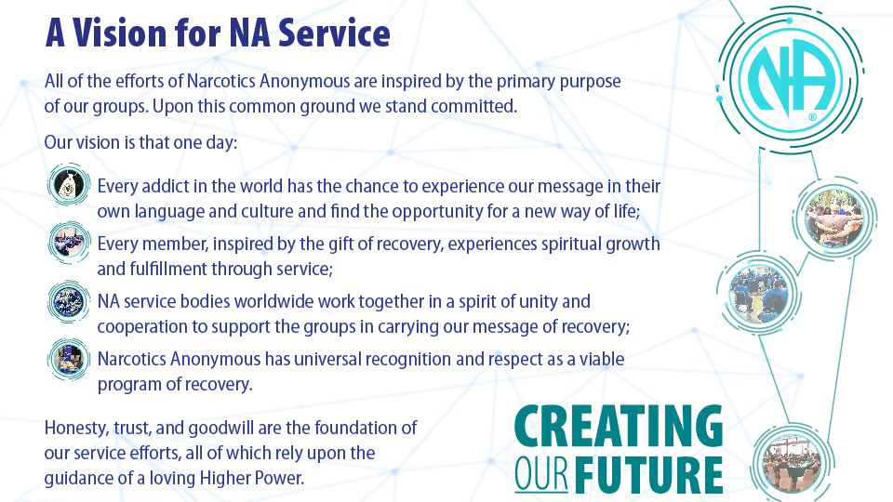
Notes:
Most of you have seen A Vision for NA Service before. This is the touchstone for all of the work of World Services.
WSC 2023 revised the Vision statement to change “his or her own” to “their own language and culture” as shown here.
NAWS is a corporation with a spiritual mission. We make many choices that a “normal” corporation wouldn’t make. Everything we do is driven, not by a desire for profit, but by a desire to reach our vision. That said, it requires money to do most of what we do. More about that later in this presentation…

Slide 15
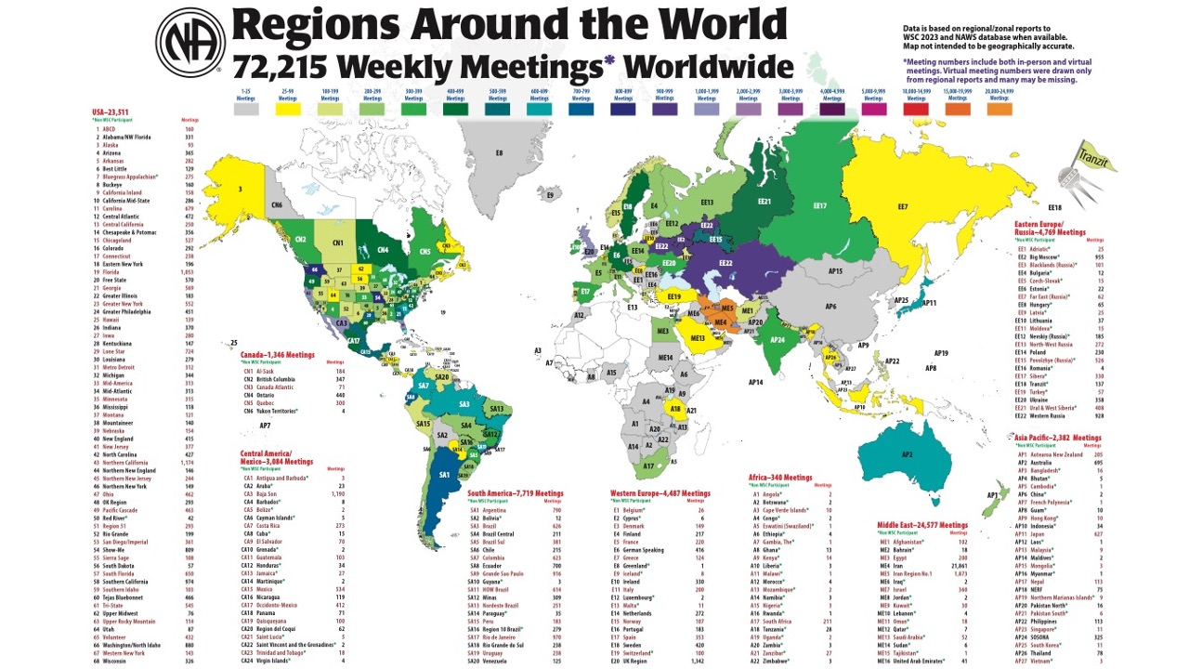
Notes:
We update this map every WSC, based on the numbers delegates report. We expected the numbers to decrease after the pandemic, and they did. (The 2020 version of this map had more than 76,000 meetings.)
72,215 is nonetheless likely an undercount because we don’t yet have an accurate way to count virtual meetings that are not connected to the service system.

Slide 16
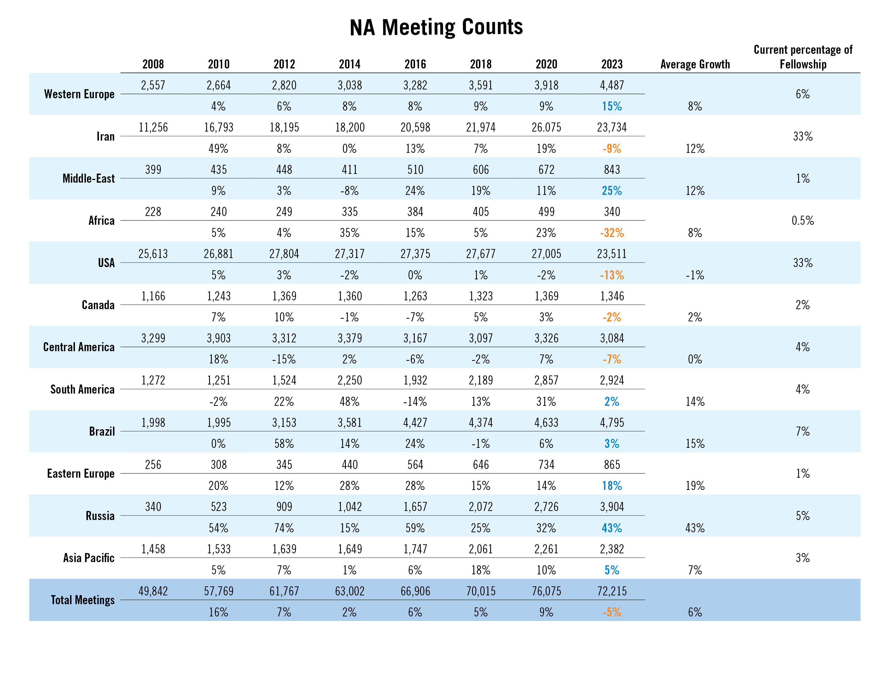
Notes:
This slide shows meeting counts in different parts of the world over the past 17 years.
Even before the pandemic, NA growth had flattened in some parts of the world. We are eager to do what we can to support efforts to reverse that trend.
This chart is posted on na.org/maps, which is a page full of interesting maps, diagrams, and illustrations of NA’s growth.

Slide 17
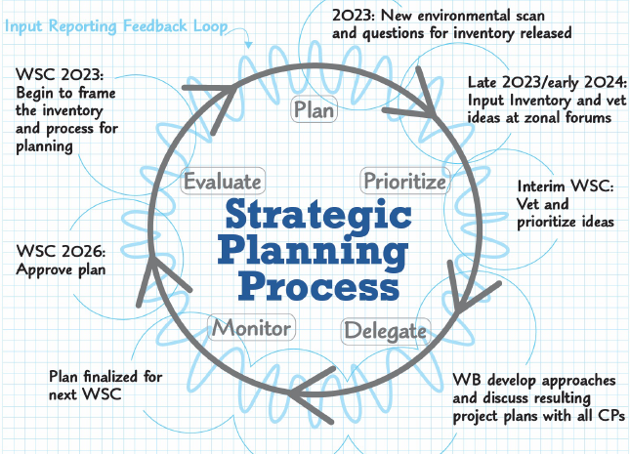
New Collaborative
Planning
Process
for NAWS
Notes:
At WSC 2023 we rebooted the strategic planning process. The new process is collaborative and includes extensive communication with and guidance from delegates throughout the process. The new planning process has been a big focus for us this cycle and the result should be a strategic plan that conference participants have collectively created.

Slide 18
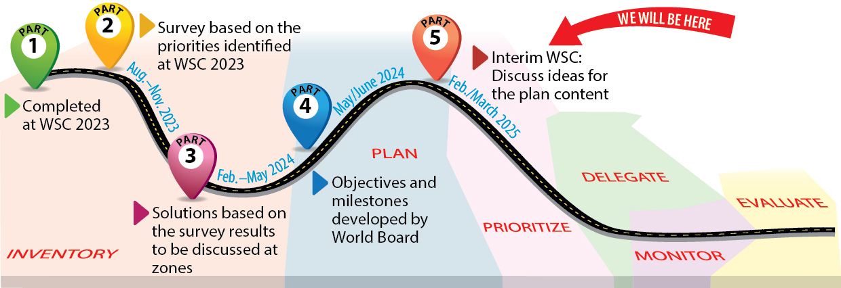
Strategic Planning
Participants will discuss plan issues and objectives at Interim WSC
Notes:
We are well into the process.
WSC 2023 agreed on a list of factors affecting NA. After the conference the factors were prioritized through a survey of conference participants, and then every zone workshopped the challenges and solutions related to each factor. The board met in June and discussed the workshop results and has drafted the strategic plan objectives for review at the interim WSC. We hope to dedicate a day of the interim WSC meeting to discussion of the plan.
For more information on the process, see the planning section of the conference page: na.org/conference.

Slide 19
Some of the motions adopted at WSC 2023
Changed the FIPT to recognize seated zonal delegates and clarify the definition of recovery literature
Recognized virtual meetings as groups
Added the ability for local stories to be
added to translated Basic Texts with
certain conditions
Approved a 3-year
conference cycle as a trial
for two cycles
And much more. . .
for a
full report
read the
NAWS News
June 2023
na.org/nawsnews
Notes:
WSC 2023 accomplished a lot! This slide lists just some of the significant decisions. The June 2023 NAWS News gives a full report. You can find that at na.org/nawsnews
The FIPT was changed to reflect conference decisions to create a zonal delegate position as a full voting conference participant. The definition of recovery literature was also clarified. And there were changes to the Operational Guidelines and the Use Policy. The 2023 CAR explains these changes in detail.
Virtual meetings were recognized as groups if they meet the 6 criteria described in The Group Booklet.
If a language community has local stories published in their Little White Book, up to six of those stories can be published in their Basic Text if they choose.
The conference decided to try a 3-year cycle for two cycles (6 years). There will be a partial virtual interim meeting mid-way through the cycle.

Slide 20

Work for the 2023-2026 Conference Cycle
Dealing with disruptive and predatory behavior
Gender-neutral and inclusive language in NA literature
Reimagining and revitalizing service committees
Welcoming members on DRT/MAT
Issue
Discussion Topics
na.org/idt
Notes:
Participants at WSC selected Issue Discussion Topics for the cycle. CAR survey results helped inform those decisions.
The 2023-2026 IDTs are:
Dealing with disruptive and predatory behavior
Gender-neutral and inclusive language in NA literature
Reimagining and revitalizing service committees
Welcoming members on DRT/MAT
All workshop materials can be found at na.org/idt
We will be devoting time at open web meetings throughout 2025 to these topics. See na.org/webinar for more information.

Slide 21
Virtual Service Basics
(including virtual service meetings, virtual meetings and areas participating in the service system, virtual workshops and trainings, etc.)
PR video
(explaining what NA is, how it works, and how to contact us)
Revise and update H&I Basics
Revise and update the service pamphlet Group Business Meetings
(with a section on using a CBDM process and the concept of delegation)
Service Material
Notes:
Participants selected a number of focuses for the Service Material project for the upcoming cycle, also informed by the CAR survey results. These resources will be worked on as we are able:
Virtual Service Basics
A PR video explaining what NA is, how it works, and how to contact us
Revise and update H&I Basics
Revise and update the service pamphlet Group Business Meetings (with a section on using a CBDM process and the concept of delegation)

Slide 22
Virtual Service Basics
Developing a tool
Any experience in virtual service outside of the group level, share your ideas
Review outline of the tool and share your input via the survey
na.org/toolbox
Deadline: 1 March
1
Revision to H&I Basics
First of three components has been posted—Corrections
Plan on 2 more pieces—Treatment and Committees
Send input to pr @na.org
na.org/revising-HI-basics
Deadline: 15 May
Notes:
We have service material for you to review!
An outline for Virtual Service Basics is posted along with an input form at na.org/toolbox until 1 March. Please share your ideas if you have any experience with virtual NA service beyond the group. The pandemic changed NA culture rapidly. Online groups are now common throughout NA, but we are, as a Fellowship, new at connecting virtual groups to the service system and serving online and in a hybrid environment. This resource will collect best practices on a range of related topics.
A review draft of the Corrections component of the H&I Basics revision has been posted to na.org/revising-HI-basics. Send us any input by 15 May. In the meantime, we are at work on part two, which covers treatment. The third part will be about H&I committee work.

Slide 23
Revise IP #21, The Loner
Survey the Fellowship about the Step Working Guide to address the following from the CAR survey:
Step working guide aimed at members not new to working the Steps
Step working booklet focused mainly on Steps 1–3, aimed primarily at new members and those in treatment and drug courts
Revise and simplify the Step Working Guides
Recovery Literature
(deadline 17 March 2025)
www.na.org/survey
Notes:
CAR survey results also helped shape participants’ decisions about the focus of the literature projects this cycle.
The conference decided to continue work on revising IP #21, The Loner.
We are also surveying the Fellowship about what they would like to see in new or revised step working materials. This would address several of the prioritized items in the CAR survey. The survey is posted at na.org/survey until mid-March.

Slide 24
2
Revision to IP #21,
Staying Clean in Isolation
Read the posted draft
Provide input via survey
na.org/revisingIP21
Deadline: 15 May
Approval draft to be included in the 2026 CAR
Notes:
The review draft of a revised IP#21 is posted at na.org/revisingIP21 along with an input form that will be open until 15 May. One of the big pieces of input we got in last cycle’s survey on the project was that we may want to rethink the term “loner.” We’ve titled the review draft simply Staying Clean in Isolation as a result of the survey input and focus group discussions which echoed the thoughts.
The approval draft will be in the 2026 CAR which will be posted in October 2025.

Slide 25
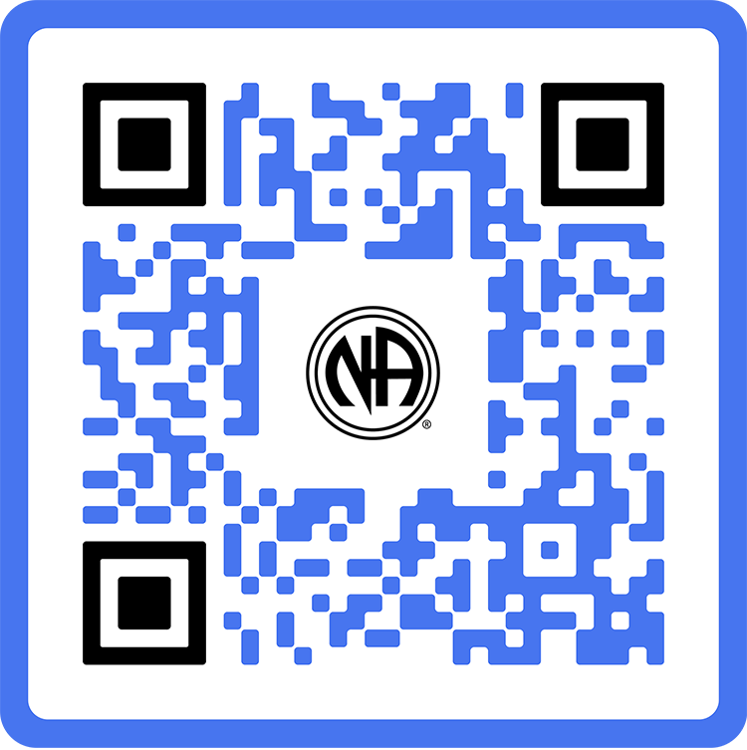
Resources /
Invest in Our Vision
www.na.org/contribute
Notes:
The biggest story for us in the past five years is about the impact of the pandemic on World Services’ resources and the ways in which we have attempted to be responsive.

Slide 26
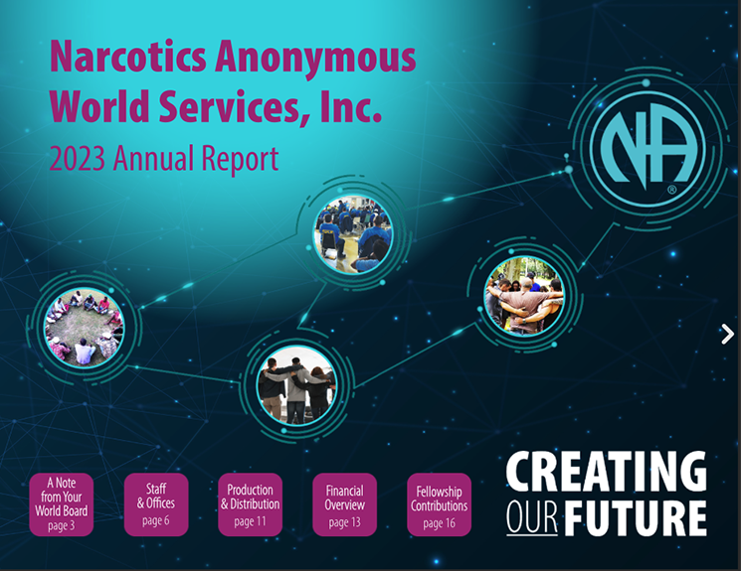
2023
Annual
Report
na.org/ar
Notes:
The Annual Report tells this story and more. The AR is the best picture of our financials. We publish a digital and PDF version.
It takes a long time to put together an AR. Our fiscal year ends June 30. We need to inventory the WSO, the branch offices and distribution centers, do an on-site audit, do currency conversions, summarize all contributions, and have a World Board review. Normally takes 6-9 months.
With all the locations operating in different currencies and operating under different legal systems, it isn’t really possible to produce a short, simple financial report. The closest we can get is the financial position provided by our auditors in the AR.
Present and past Annual Reports are posted to na.org/ar.

Slide 27

Financial Impact of the Pandemic
NAWS income 90% from literature sales pre-pandemic
March 2020—literature income decreased approx. 85%
Expenses cut: staff, periodicals, travel….
Notes:
Crisis = Danger + Opportunity
2020 was a financial crisis. Chinese word for crisis is commonly (but not entirely accurately) understood to be composed of the characters for danger + opportunity.
Pre-pandemic 90% of our income came from literature sales. March 2020 global shut down orders were issued, and lit sales dried up over night. Literature income decreased about 86%
We had to cut what we could—we were committed to contracts and leases. Cutting staff was the quickest way to cut costs. We discontinued paper mailings and haven’t published the NA Way since the shut downs. We resumed publishing Reaching Out in January 2023. NAWS stopped travelling to events and holding in-person board meetings or workgroup meetings. All of these things helped us save money. In July 2022 Board met in-person for the first time in over two years. They had virtual meetings regularly during the pandemic and continue to do so. There will be some travel for the 2023-2026 conference cycle, but not nearly at pre-pandemic levels. As of the beginning of 2025, staff numbers remain 25% below pre-pandemic levels.

Slide 28

The future
looks bright.
Our reserve funds helped us keep going
The crisis helped us move toward being self supporting through member contributions
For the 2021 and 2022 fiscal year, Fellowship contributions were 24% of our income
Notes:
We had ample reserve funds prior to the pandemic that helped keep us going.
For years, we have been saying that member contributions are the most sustainable source of income, and the most in line with our spiritual principle of self-support. Relying on literature income primarily from the US to fund our global efforts is not sustainable, and the pandemic forced a shift toward an income model that is more reliant on member contributions (including groups, service bodies and events).
Our financial picture has changed and continues to change but the future looks bright. We continue to encourage member contributions.
Interesting note: Non-Fellowship literature sales represented an unprecedented percentage of our total sales during the pandemic, as correctional facilities and treatment facilities were locked down and H&I panels were not occurring.

Slide 29
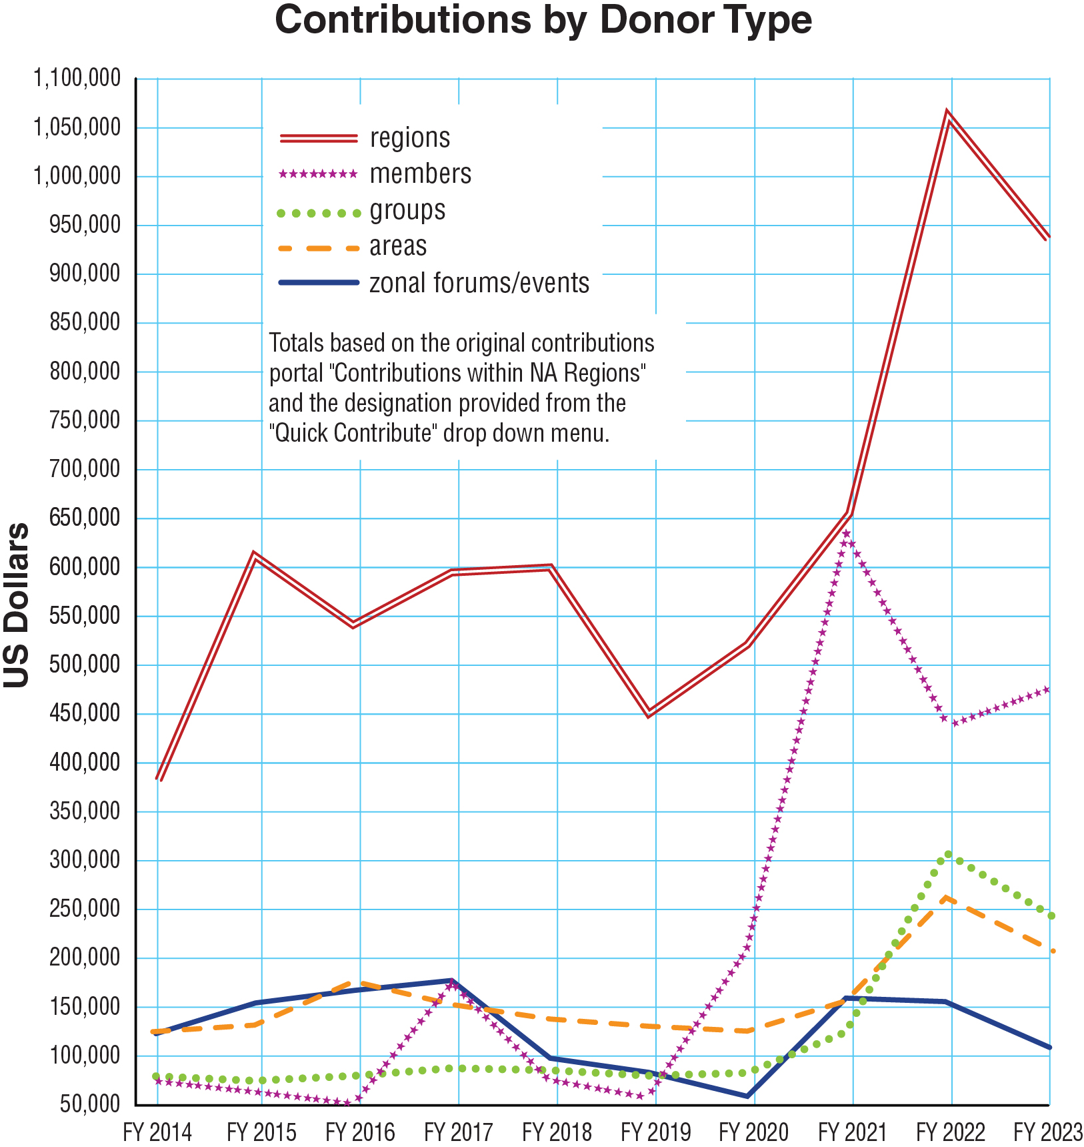
The reopening of meetings and the increased involvement of service bodies marks the growth for 2021-2022.
For 2023, as in-person groups reopened and local service bodies ramped up activities, more resources are going toward local service delivery and group expenses.
Profound increase in member contributions
for 2020-2021.
Notes:
Increases in Fellowship contributions are helping us recover from our financial crisis.
We are gradually building back our staff capacity. At WSC 2023 we relied on volunteers to complete some of the work.
Nonetheless, we still face challenges as our cost of goods keeps rising, as is the case for businesses around the world. We are trying to increase our stockpile of inventory to protect NA members from the unpredictability of the supply chain these days, and building those reserves costs money as well.
Contributions from members and service bodies continue to inspire us. During the 2021 fiscal year, contributions from groups, service bodies, and events all rose, but member contributions saw the most profound increase. The reopening of meetings and the increased involvement of service bodies accounts for the growth for 2021-2022.
For 2023, as in-person groups reopened and areas, regions, and zones have ramped up activities, more resources went toward local service delivery and group expenses. So we expected a downturn in contributions this year. And yet, member contributions increased, for which we are very grateful.
This chart is one of the many included in the 2023 Annual Report.

Slide 30

Our commitment
to self-support doesn’t mean we go it alone—it means we do it together.
Guiding Principles, Tradition Seven
Notes:
What we know about NA is that if everyone does a little we can accomplish a lot.
In that spirit, the World Board continues to focus on the benefits of increasing recurring member contributions.
If you’re a member, you can set up a recurring or a one-time contribution at na.org/give

Slide 31
Literature /
Carrying the Message
Production, translation, distribution…
Notes:
Making literature available is a huge part of what we do, and we could fill this whole presentation simply with the efforts to draft, translate, produce, distribute, and protect NA literature.
NAWS makes many choices that are purely about carrying the message that no ordinary corporation would make. Two examples are explained in the next two slides: giving away and subsidizing literature and providing literature for inmate tablets.

Slide 32
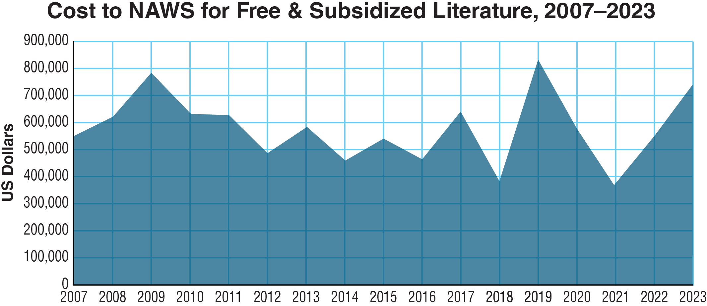
Notes:
This graph represents the cost of free and subsidized literature that NAWS distributes to communities around the world.
You can see that in the 2019 fiscal year, we distributed more than we ever have before—more than $832,000 dollars worth. In 2020, we continued to ship literature to places that couldn’t afford to purchase it even as we were cutting expenses in as many areas as we could. Despite the financial challenges of the 2021 fiscal year, sending literature to those in need continues to be a priority.
The total for FY 2020 was just under $580,000 and for FY 2021 was just over $368,000. The total for 2023 was $738,826 and for 2024 it was approximately $570,000 (figures for FY 2024 are not yet final). The need continues regardless of the pandemic or resources available.
None of these efforts would be possible without the support NA World Services has received from the Fellowship during the pandemic.
Note: We don’t report many of the details of where this literature goes partly not to embarrass or call attention to any communities. We never want to cause a community confusion or harm, even inadvertently.

Slide 33
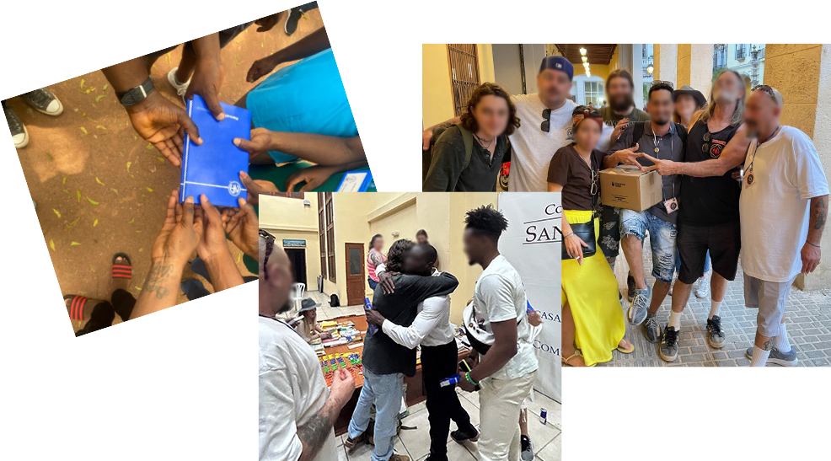
Notes:
Communities receiving free/subsidized literature.

Slide 34

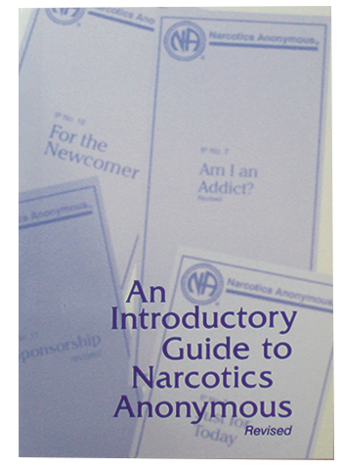
Free Literature
Online
Pamphlets and booklets are posted in 57 languages.
The Introductory Guide, which was developed specifically for the newcomer, is also online for free: na.org/literature
Notes:
We also make our message available for free reading, listening (audio BTs), and watching (ASL) online.
IPs and booklets in 57 languages are posted at na.org/literature.

Slide 35
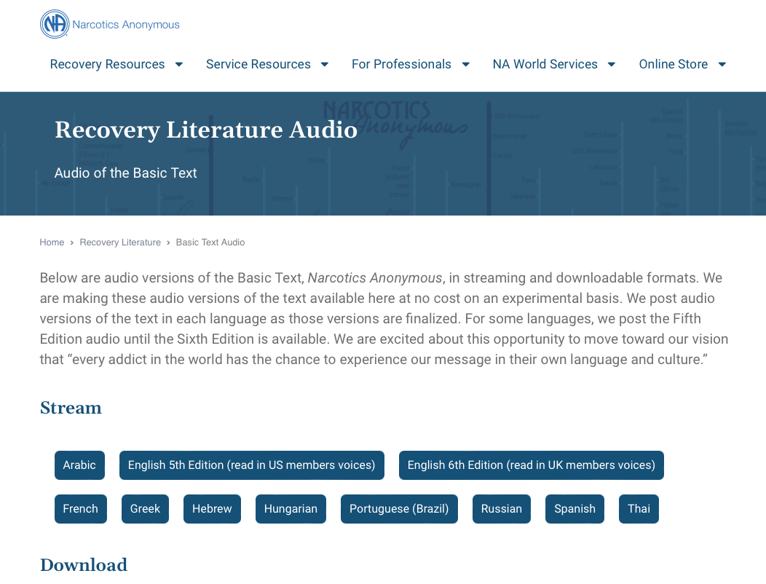


na.org/audio
Notes:
We have been posting free audio versions of the Basic Text as they become available.
So far, we have 11 versions: Arabic, two English versions—one fifth edition , French Canadian, Greek, Hebrew, Hungarian, Brazilian Portuguese, Russian, Spanish, and Thai posted.
You can find them at na.org/audio

Slide 36
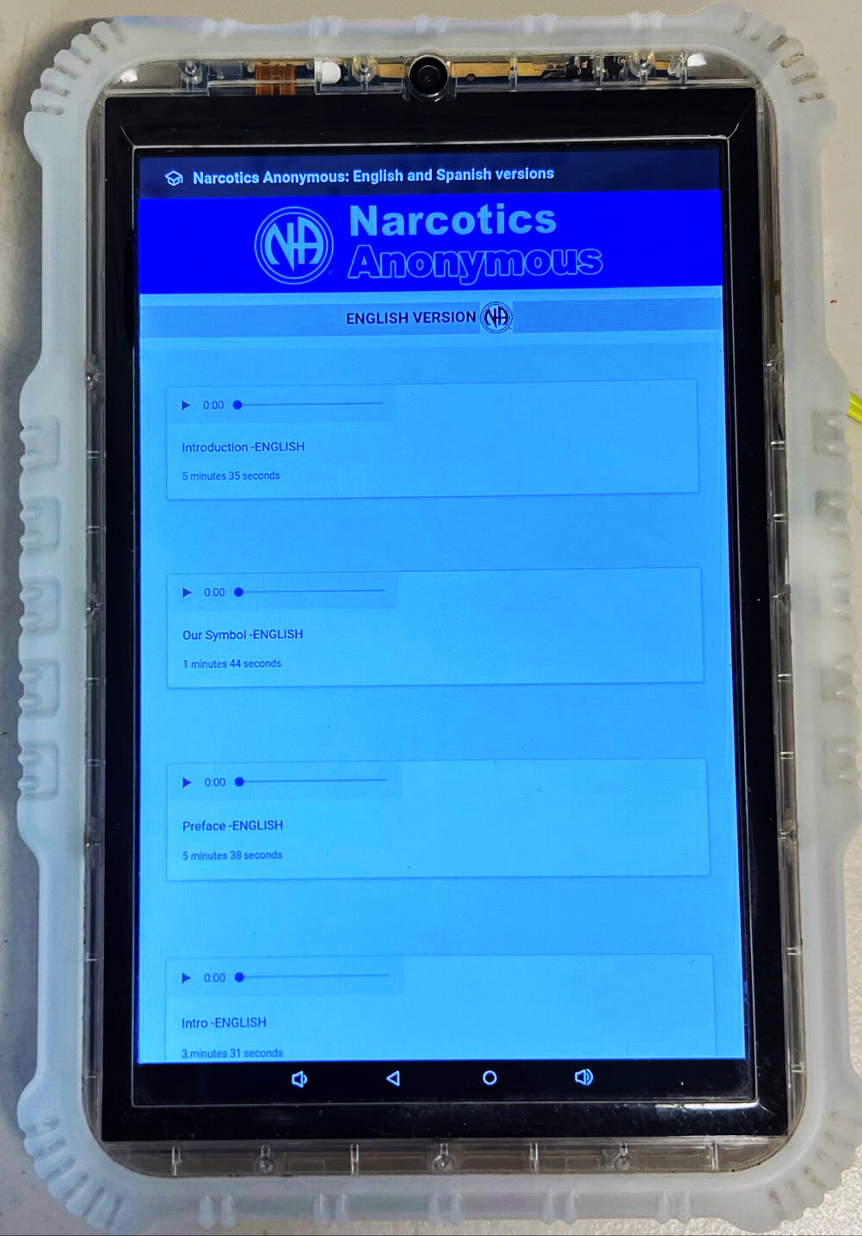
Inmate Tablets
Some facilities offer tablets to inmates
NAWS clears the way to share NA literature
  Audio BT
  Pamphlets
  Booklets
  Intro Guide
Notes:
We continue to get lots of inquiries from members about inmate tablets. The February 2022 NAWS News has more information about the subject. We will just touch on it briefly here.
Some correctional facilities offer inmates tablets pre-loaded with a variety of material, including, in some cases, NA recovery literature, at no cost to the inmate. One of the most important duties the Fellowship has assigned NA World Services is the protection of NA’s intellectual property and copyrights on behalf of the Fellowship. Inmate tablets are a new way to carry the message, and World Services must grant legal permission to load Narcotics Anonymous literature on tablets. Each of these agreements involves a lot of communication among corrections authorities, local NA members, and NA World Services.
The agreements we have made in these cases allow for the material that is currently posted on our website to be on tablets for inmates – audio Basic Texts, IPs, and booklets such as the White Booklet and the Intro Guide. This gives addicts ample exposure to NA and our message, and we continue to provide paper copies of the Basic Text to inmates upon request.
1.2 million incarcerated persons in the US now have access to free NA literature on tablets
The number of inmate tablets with NA literature in Arizona rose to almost 50,000 in 2022.
In Ohio, after seeing the success of inmate tablets, corrections officials have decided to purchase NA literature to give to inmates upon release.
There are over 3,000 counties in the US, and each agreement requires time and attention.
We have also been working on agreements with some communities outside the US. In 2024, we finalized our first such agreement.
NA World Services devotes much of our time and energy to efforts such as these, not because it makes good business sense, but because we are driven by a spiritual mission, not a profit motive.

Slide 37
Fellowship Intellectual Property Trust
The purpose of the Trust is:
“to hold and administer all recovery literature and other intellectual properties of the Fellowship of Narcotics Anonymous in a manner that will help addicts find recovery from the disease of addiction and carry that message of recovery to the addict who still suffers, in keeping with the Twelve Steps and Twelve Traditions of NA.”
Notes:
One of World Services’ most important responsibilities is protecting the Fellowship’s property—its name, logos, and literature for the current and future Fellowship.
The Fellowship Intellectual Property Trust (FIPT for short) is a legal document that contains the collective decisions the NA Fellowship has made to preserve the integrity of our published message and the accountability of our publishing services. The Fellowship of Narcotics Anonymous, as given voice by its groups through their regional delegates at the World Service Conference, created and makes decisions about the trust. NA World Services, Inc. manages the trust on their behalf, and the Fellowship of Narcotics Anonymous as a whole is the beneficiary.
There is a lot of misinformation about the FIPT. Here is what the document itself says. The purpose of the trust is:
“to hold and administer all recovery literature and other intellectual properties of the Fellowship of Narcotics Anonymous in a manner that will help addicts find recovery from the disease of addiction and carry that message of recovery to the addict who still suffers, in keeping with the Twelve Steps and Twelve Traditions of NA.”
If you want more information about what the FIPT is and why it is important, see the video on the FIPT page: www.na.org/fipt.
As we mentioned earlier, WSC 2023 made a decision to revise the Trust document as well as decisions to revise the Operational Rules and the Use Policy.

Slide 38
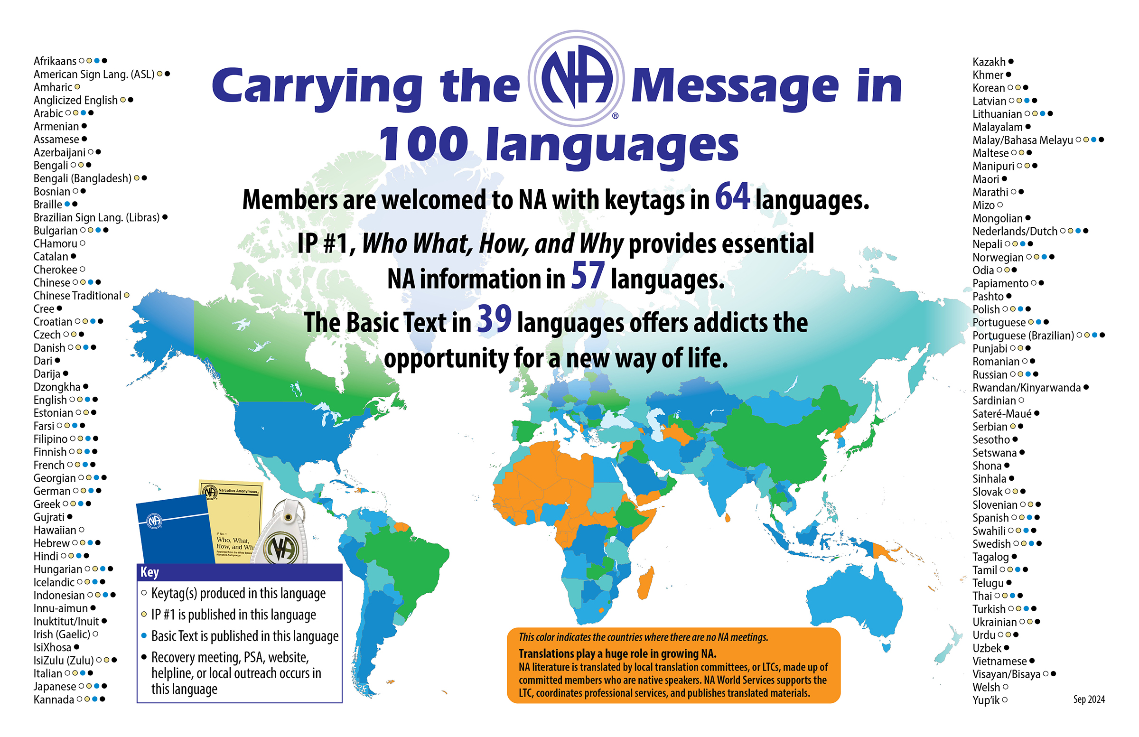
Notes:
This map shows the 100 languages NA members speak. We translate literature into 57 of those languages.
This “Carrying the message map” is revised each fiscal year to include in the Annual Report. The latest version is posted at na.org/maps. Most recently, we have started producing Armenian and Blackfoot keytags. Both will be included when we update the map.

Slide 39
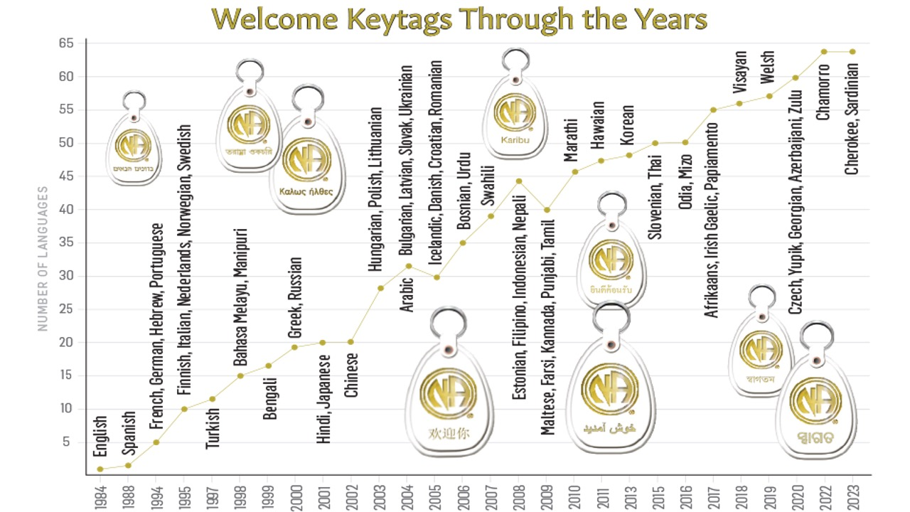
Notes:
Many of the languages in NA are reflected in our keytags. We produce welcome tags in 64 languages. Keytags are sometimes created in indigenous languages to better welcome members in their own language and culture, even if that language isn’t spoken in the meeting they are attending. Examples are Hawaiian, Welsh, and others.

Slide 40
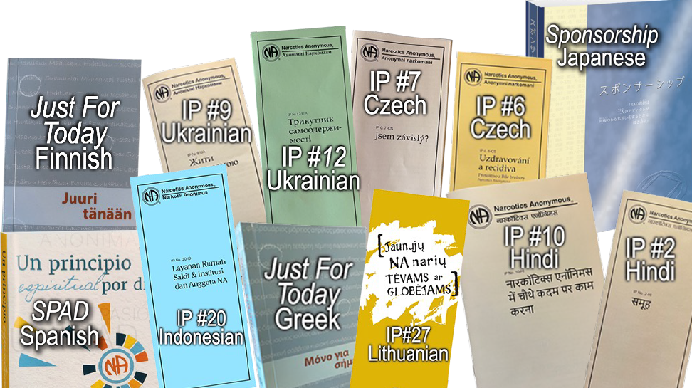
Some of our latest translations
Notes:
Having literature in your own language saves lives. It helps addicts hear our message understand the NA program and connect with the shared experience of members around the world.
Translations play a huge role in growing NA. Translations work is coordinated among a local translation committee, or LTC, made up of committed members who are native speakers; as well as contracted professionals; and NAWS staff.
It takes a great deal of resources to produce translated literature. It’s not just about money. The scarcest resource is human. If you want to learn more about translations, check out Translation Basics, which is posted at na.org.

Slide 41
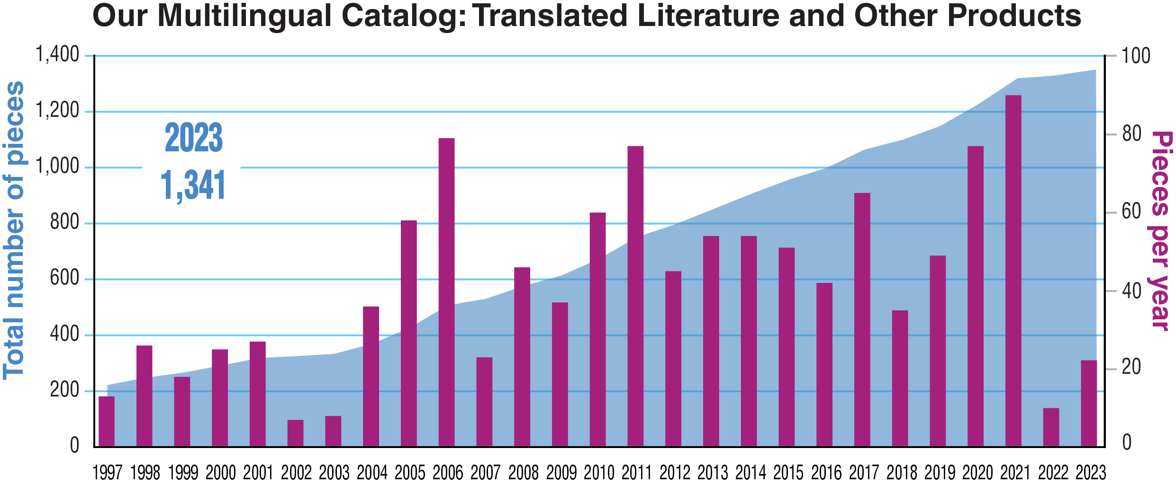
Total Published Translated Items & Pieces Per Year
for Fiscal Years 1997–2023
Notes:
This graph shows the number of translated items published at World Services as of the end of the 2023 fiscal year, which was June 2023. At that time, we had published 1,341 translated titles.
Local members do the heavy lifting in almost all translations. It takes dedicated members willing to devote countless hours to the work, even when a professional translator is used. We oversee translations to make sure conceptual fidelity is maintained, and we organize proofing, copyrights, layout, and production. For almost a year, during the pandemic, we had a translations staff of one and a production staff of one. We are slowly building back and now have a translations team of three and half.

Slide 42
By addicts, for addicts
(our literature development process)
Source material
submitted by members
Drafts developed
by the workgroup
Review drafts circulated
to gather Fellowship input
Approval draft appears in the Conference Agenda Report
Notes:
For the last 20 years, each literature project has the same basic process.
We survey the Fellowship for input about the project itself. This allows for input from members all across the globe, speaking many different languages. The input survey on step material, for instance, is posted in 12 languages.
We collect source material from members.
Form a workgroup of members who review all of the source material and the resulting drafts. For the IP#21 revision, we used focus groups, inviting any member who expressed interest.
Release drafts for Fellowship review
Revise based on input.
Publish an approval draft no later than with the CAR publication.
It’s a process that allows members all around the world, regardless of literacy level or language spoken to contribute.
Recently, we’ve been able to use the volunteer form posted on na.org/projects to form web meetings with any interested member to work on projects like the revisions to the Loner IP and H&I Basics, the creation of Virtual Service Basics, and the restructuring of our website.

Slide 43
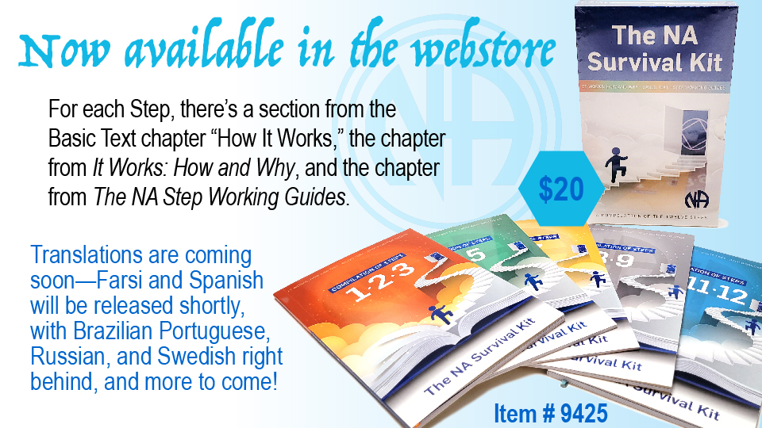
Notes:
NA’s Basic Text explains the significance of the Steps in this way:
The steps are our solution. They are our survival kit. They are our defense against addiction which is a deadly disease. Our steps are the principles that make our recovery possible.
“How it Works,” Narcotics Anonymous
Information about the Twelve Steps is included in three different NA books. It’s common for NA sponsors to advise sponsees to read about the Step they are working in the Basic Text and It Works: How and Why before answering the questions in The Narcotics Anonymous Step Working Guides.
In that spirit, we have published this material into one boxed set titled The NA Survival Kit. We are working on translated versions In Farsi and Spanish, then Brazilian Portuguese, Russian, and Swedish.
For each Step, the Survival Kit includes the section from the Basic Text chapter “How It Works,” the chapter from It Works: How and Why, and the chapter from The NA Step Working Guides, with the questions numbered rather than bulleted.
The NA Survival Kit consists of five bound packets together in one slip case:
• Steps One, Two, and Three
• Steps Four and Five
• Steps Six and Seven
• Steps Eight and Nine
• Steps Ten, Eleven, and Twelve
It can be found at www.na.org/webstore

Slide 44
Services & Communication
Notes:
2024 has ushered in some changes for NAWS.

Slide 45

NAWS has switched from an interface that lists meetings, to one that lists local websites and phonelines on the website and app.
Map pins show service body locations, not meeting locations
More information at na.org/meetingsearch
Notes:
Instead of trying to maintain information for individual meetings in more than 140 countries, our meeting search page and app now point people to local websites and phonelines. Meeting information maintained by local service bodies is more likely to be accurate and current. To make this change, World Services needed help from local service bodies with geotagging so that we could map search results and make sure our data for areas, regions, and phonelines is current.
More information at na.org/meetingsearch

Slide 46

Notes:
The 2023 World Service Conference passed a motion acknowledging that an NA meeting that meets regularly in person or virtually can choose to be an NA group if they meet the criteria described in The Group Booklet.
With increased virtual meetings since the pandemic, it has become more important then every to help members find them.
NAWS maintains list of virtual and hybrid meetings around the world.
There is also a new shortened URL na.org/virtualmeetings

Slide 47
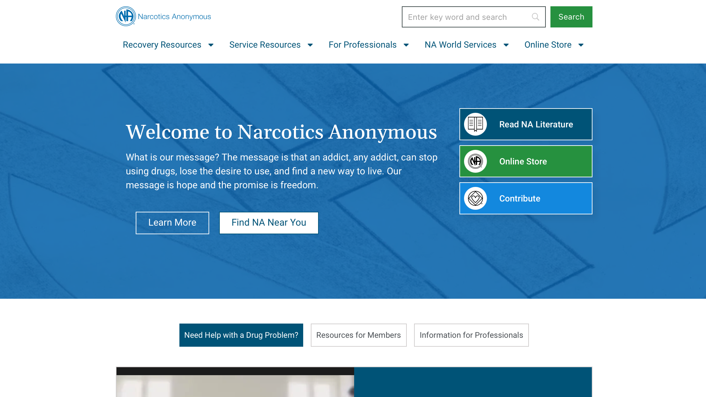
Notes:
We are delighted to announce that the new na.org website is up! Our IT team accomplished a minor miracle in getting this together. We have known for some time that the days our old website could stand would be numbered. When the website failed, our IT team went into overdrive.
What you see now at na.org looks different from the website you may be used to accessing, but nearly all the same information is still there. We believe it will be easier to navigate, less confusing, more readable, more secure, and less likely to leave us in the lurch again.
With the new website comes new links. If your service body website has links to readings and IPs, those will have to be updated. If you have other links to pages at na.org, please check to make sure your links are functional as soon as you (or your webservant) can.
We are continuing to add features, correct errors, and build out the site. We recently were able to add the search function back.
There are a few large files that are still unlinked, but fear not! They will be made available when we can. Nothing has been lost.
One advantage of the new site is that it is responsive (mobile friendly) now. We look forward to delivering the free recovery literature we have posted in a more mobile friendly format than ever before; watch this space! We’ll let you know when this much-desired improvement is in place.

Slide 48
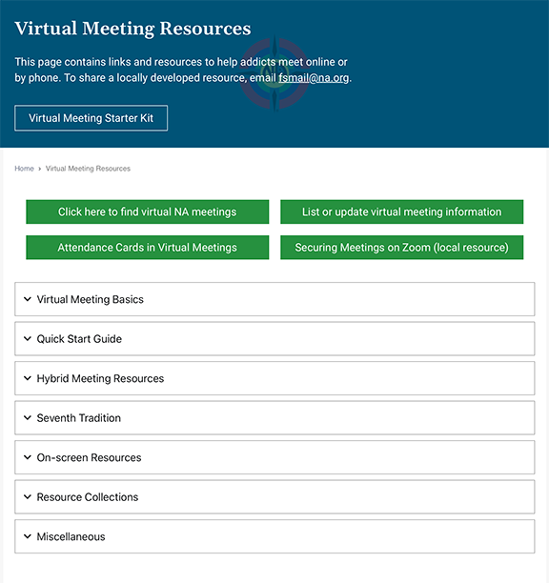
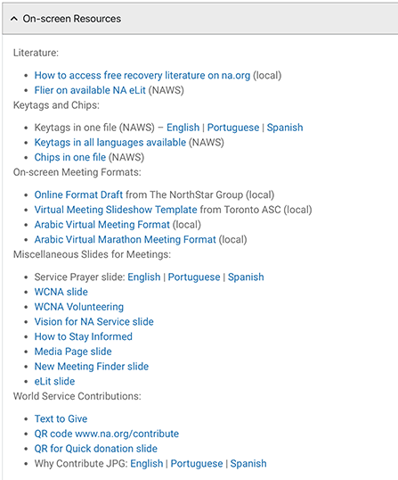
na.org/virtual
Notes:
Most of NA had to learn to do things differently during the pandemic. We provided a lot of online service and support for virtual meetings and service efforts.
One of the first things we did when so much of the world closed down was to post a page of resources to help addicts find virtual meetings and to help members who were serving meetings and service bodies virtually: na.org/virtual . It is a treasure trove. We post new materials here regularly.
The page includes: onscreen resources for virtual meetings, info on hybrid meetings, 7th tradition, and more. One of our most recent resources Electronic Funds—Money Management under the Seventh Tradition section.
Let us know if there’s something you’d like to see on this page.

Slide 49
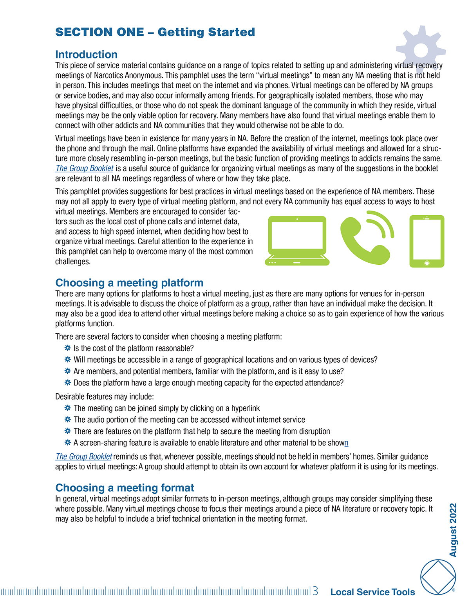
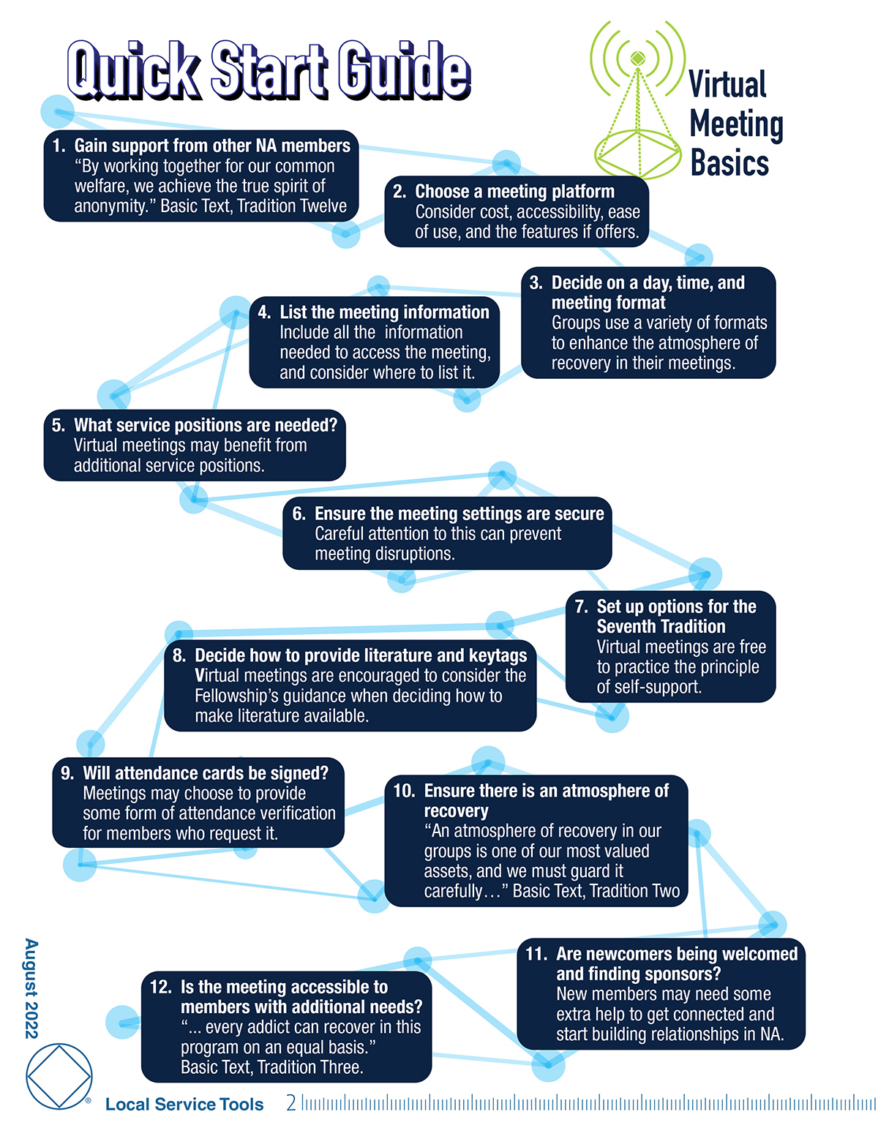
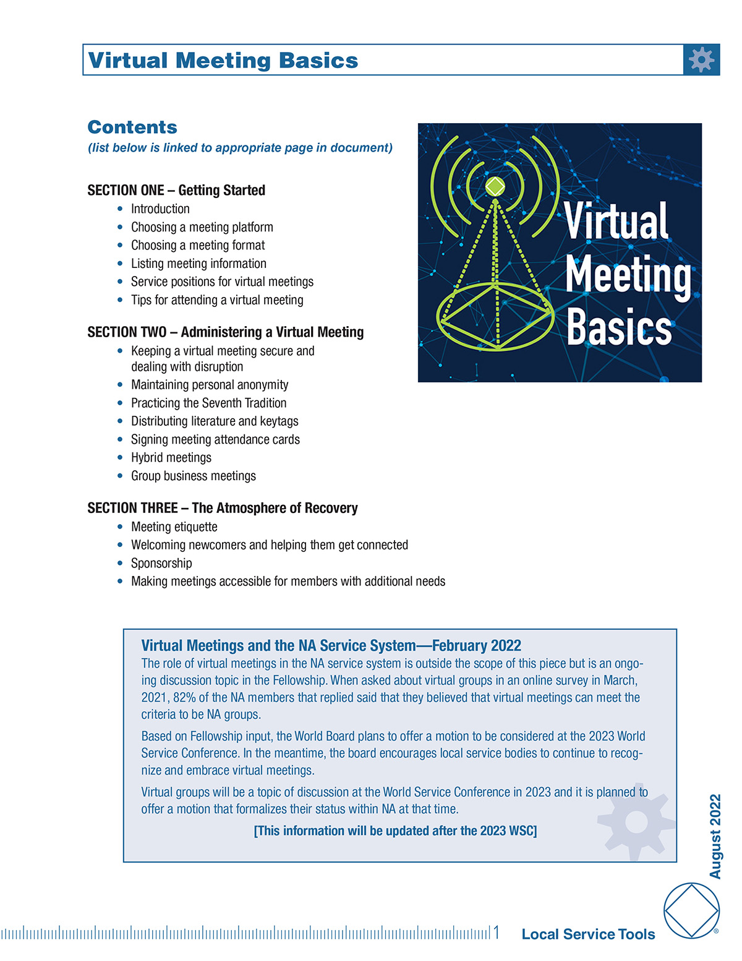
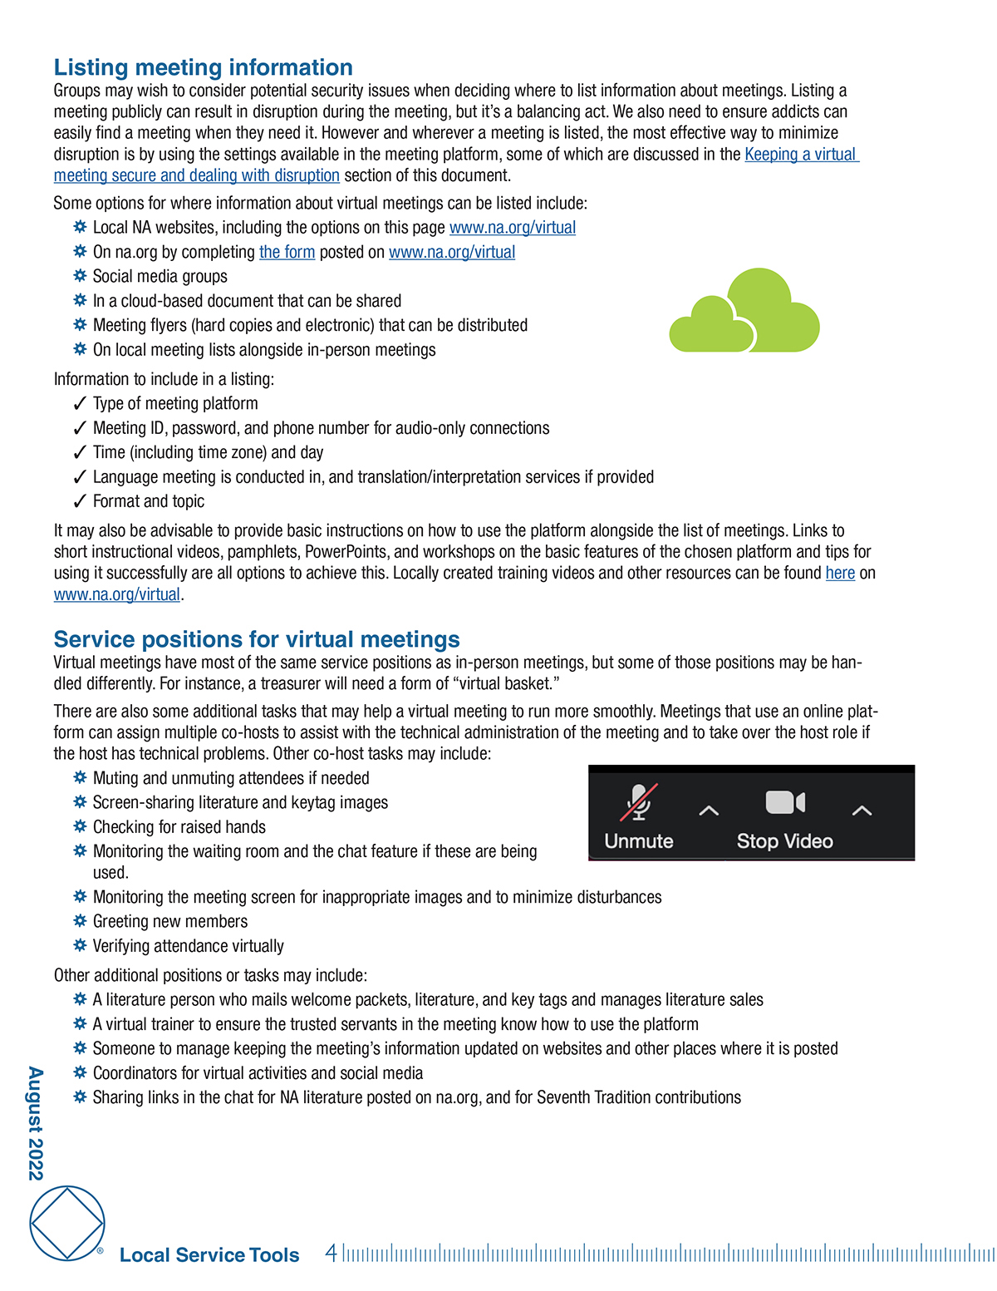
VISIT
na.org/virtual
or
na.org/toolbox
to download!
Notes:
Virtual Meeting Basics is posted at the top of the drop-down menus on the Virtual NA Meeting Resources webpage. It is also posted at na.org/toolbox. It is currently translated in Farsi, Hungarian, and Spanish.
This tool comes from the Local Service Toolbox project.
We held many open webinars on the topic. We also collected a lot of resources from trusted servants around the world. We posted several surveys to collect information. We used all of that information to put together a tool that compiles best practices for virtual meetings.
The tool covers a range of topics related to virtual NA recovery meetings, including
keeping meetings secure from disruption,
welcoming newcomers and sponsorship,
practicing the Seventh Tradition and signing attendance cards
making meetings accessible
hybrid meetings
and more
We hope to take a similar approach for Virtual Service Basics

Slide 50
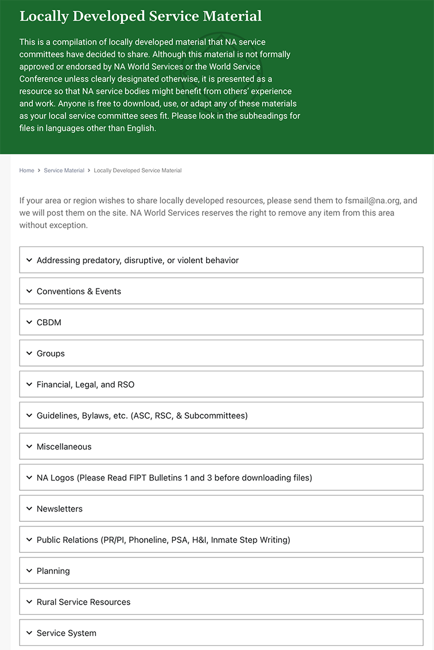
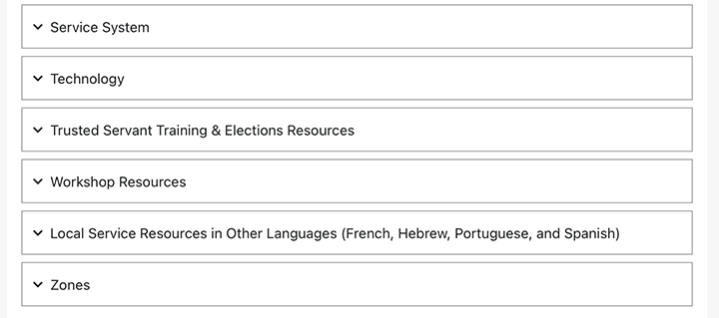
na.org/localresources
Notes:
Another place on our website that you can find lots and lots of resources for groups and service bodies is the Local Service Resources page: na.org/localresources
If you have a resource or tool that others might benefit from, please send it to worldboard@na.org.

Slide 51


Web Meetings
Public Relations
Hospitals & Institutions
Email pr@na.org for more info!
Notes:
We hold PR and H&I web meetings that are a great way to gather information and share experiences on service related topics.
These meetings are focused on members talking to each other and sharing successes and challenges. We’ve been holding them on a quarterly basis for years. You can find a complete list at na.org/webinar.
If you’re doing PR service work, and are interested, send an email to pr@na.org and we will keep you updated about dates and topics.
We have an open webinar coming up in March about H&I.

Slide 52
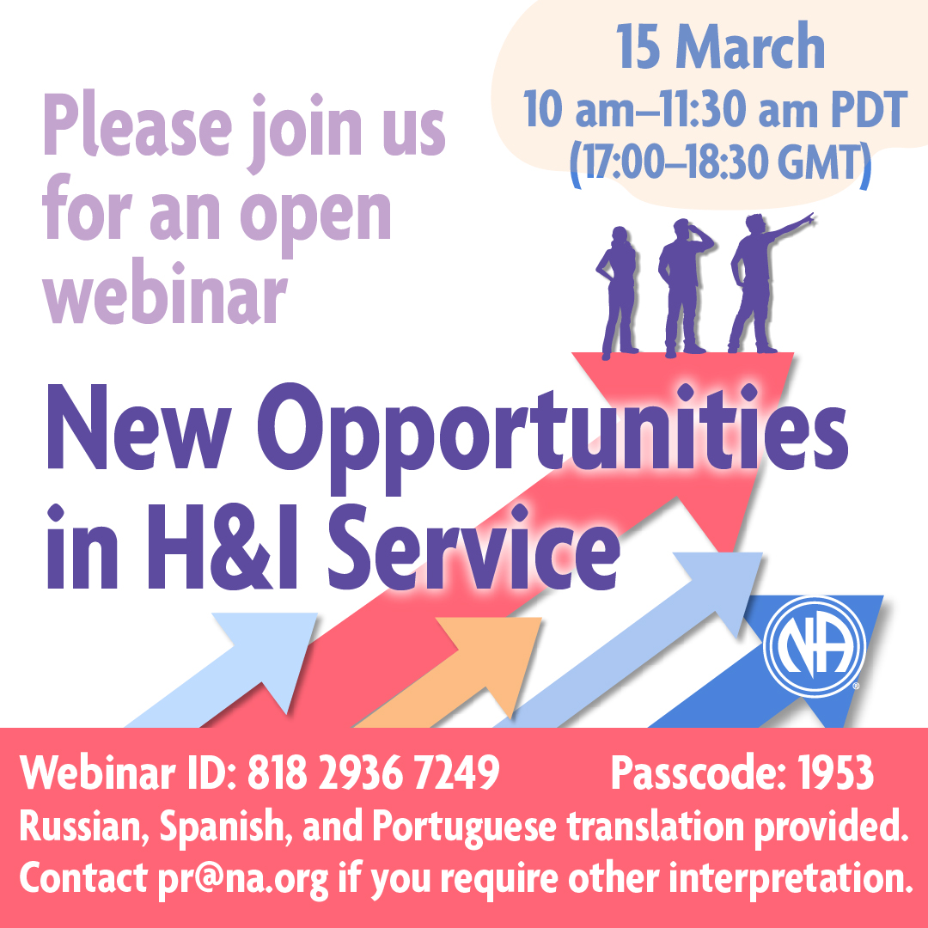
Upcoming Webinars
3 May 2025: Service Day–Reimagining and Revitalizing Service Committees IDT (11am PDT)
12 July 2025: Dealing with Disruptive and Predatory Behavior IDT (11am PDT)
6 September 2025: Unity Day (special event TBD)
na.org/webinar
Notes:
We also hold quarterly webinars open to any interested member on topics of general Fellowship interest. You can find the latest posted at na.org/webinar.
Note the next open webinar, on H&I service, will be an hour earlier than our usual 11am Pacific time start time. One of the presenters is Russian, and to accommodate the time differences, we will begin at 10am. We’re also providing Russian interpretation.

Slide 53

World Unity Day
6 September
24 hour celebration
Each ZONE gets an hour
to use as they wish
Contact wb@na.org if your zone wants to reserve a slot
Notes:
Unity Day happens every year, the first weekend in September. This year, we’re planning a round the clock celebration. Every zone and Iran gets an hour to share, present, celebrate however they want. If your zone is interested email wb@na.org to reserve a slot.
We’re looking forward to a celebration of service, recovery, and all things NA!

Slide 54
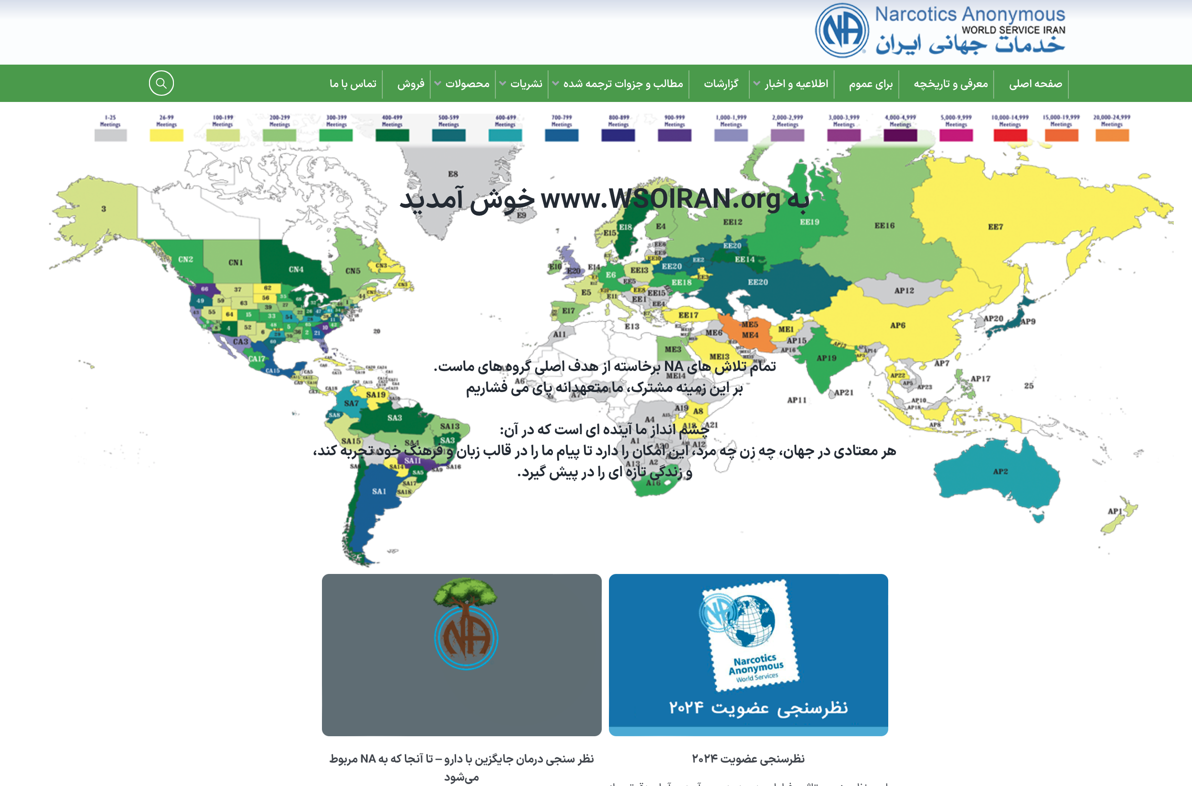
www.wsoiran.org
Notes:
WSO Iran continues to be steadfast in providing communications and translations for members who speak Farsi.

Slide 55
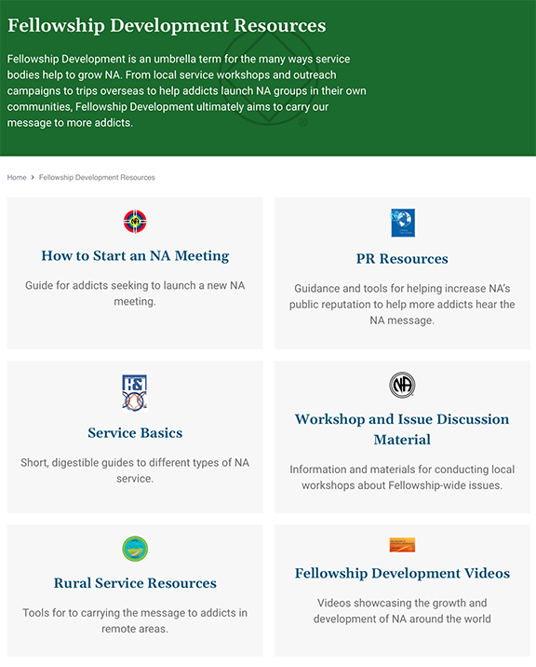
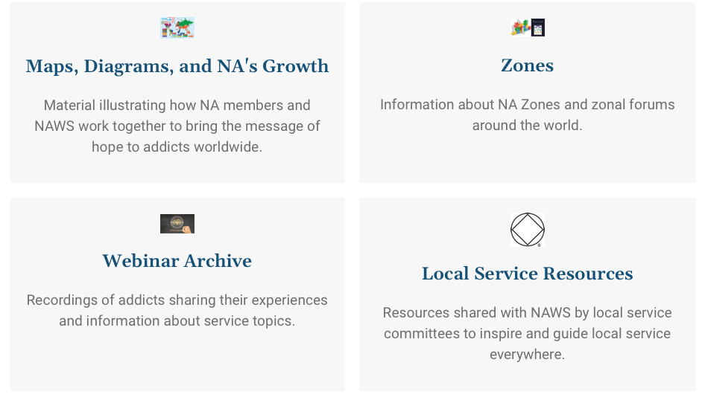
na.org/fdresources
na.org/videos
na.org/maps
Notes:
The old media page has been spread out to other locations on the new website.
You can start at na.org/fdresources where you can find the bulk of material for local service workshops and outreach campaigns.
From there you can access the videos page (shortcut is na.org/videos) or the page “Maps, Diagrams, and NA's Growth” (short cut is na.org/maps)

Slide 56
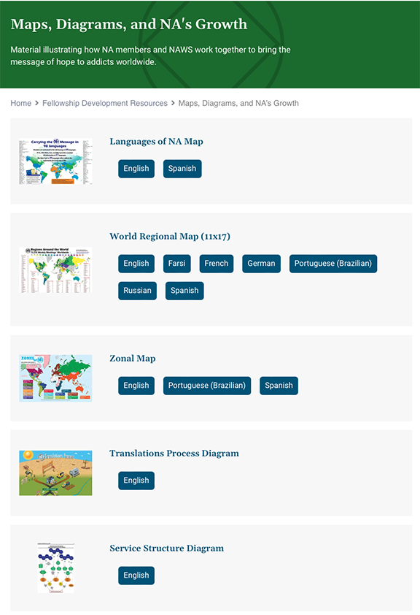
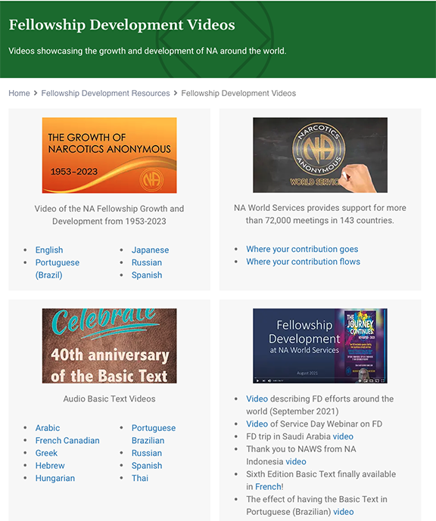
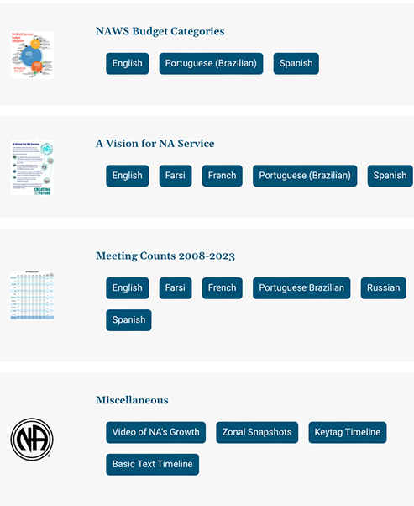
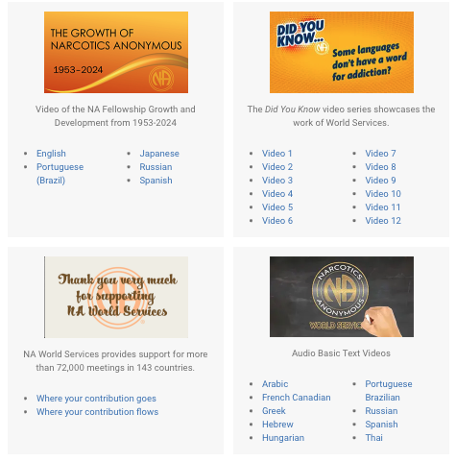
na.org/maps
na.org/videos
Notes:
On the na.org/videos page there are a few videos posted that would be great to play at workshops or events.
On the “Maps, Diagrams, and NA's Growth” page you will find all sorts of posters and documents that could be used in service meetings and some that illustrate how NA members and NAWS work together to bring the message of hope to addicts worldwide.

Slide 57
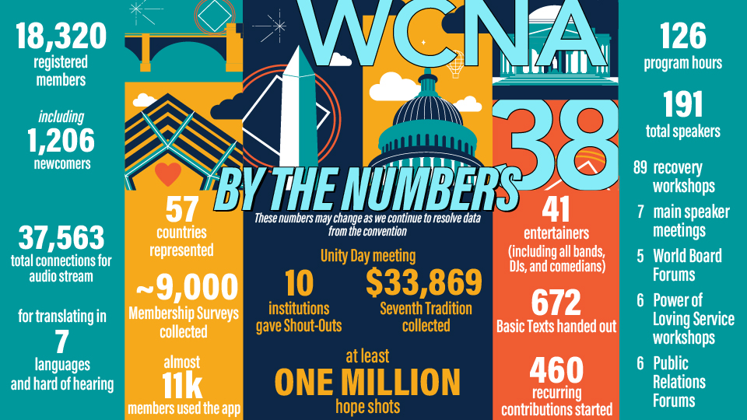
Notes:
A huge thank you to everyone who made WCNA 38 so powerful. We hope that all of us who were touched by the WCNA experience bring that Power of Love home to our communities, and use that energy to reach out just a little bit more than we did before. Addicts all over the world are dying to hear our message, and we each have work to do!
As you may have heard, registration was well below our projected break-even point. We know that there are many questions about WCNA 38’s financial outcome, but it is too early to provide exact information. We know that it will not be financially successful and will incur a significant loss, but at this time, we just are not sure to what degree. We are still paying bills and reconciling rebates, etc. It will take some time for the dust to settle. There were only 17,160 paid registrations with approximately 1,300 newcomer packages given away. We typically include a financial accounting of the convention in the Annual Report.

Slide 58
As a result of the COVID pandemic, to suspend the World Convention of NA (WCNA) rotation policy after 2024, to allow the World Board to determine what is possible and practical moving forward and then seek approval from conference participants.
Notes:
We’re not sure where and when the next world convention will be held. The 2023 World Service Conference passed the motion on your screen with consensus:
As a result of the COVID pandemic, to suspend the World Convention of NA (WCNA) rotation policy after 2024, to allow the World Board to determine what is possible and practical moving forward and then seek approval from conference participants.
Intent: Given the disruption in the rotation of WSC and WCNA that has already occurred, the increases in event costs, and the other changes brought about by the pandemic, to allow an evaluation by the World Board and approval by conference participants for what is possible and practical in the future.
The board has been in discussion about this and will report any recommendations to conference participants and seek their approval. We will report the board’s ideas about WCNA in NAWS News.
MWBR

Slide 59
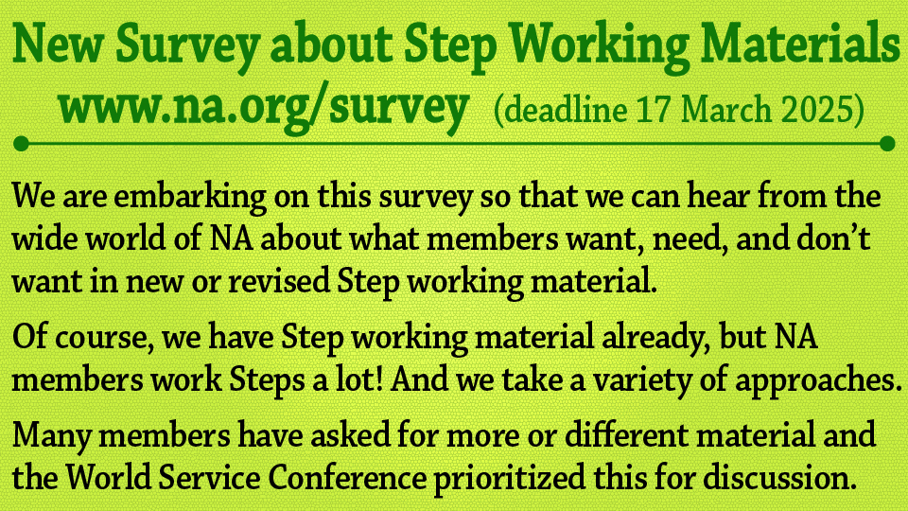
Notes:
Step working material (either new or revised) was prioritized in the 2023 Conference Agenda Report survey, and the 2023 World Service Conference reached consensus that it would be one of the focuses for the recovery literature project this cycle.
Of course, we have Step working material already—and as many of you know, existing material from NA’s books is being bundled into the 𝘕𝘈 𝘚𝘶𝘳𝘷𝘪𝘷𝘢𝘭 𝘒𝘪𝘵, which is now available. But NA members work Steps a lot! And we take a variety of approaches. Many members have asked for more or different material.
We have posted a survey to help determine what the Fellowship as a whole is looking for in new or revised Step working resources.
The responses to the survey will shape a project plan for the 2026 Conference Approval Track material. You can find it at na.org/survey

Slide 60
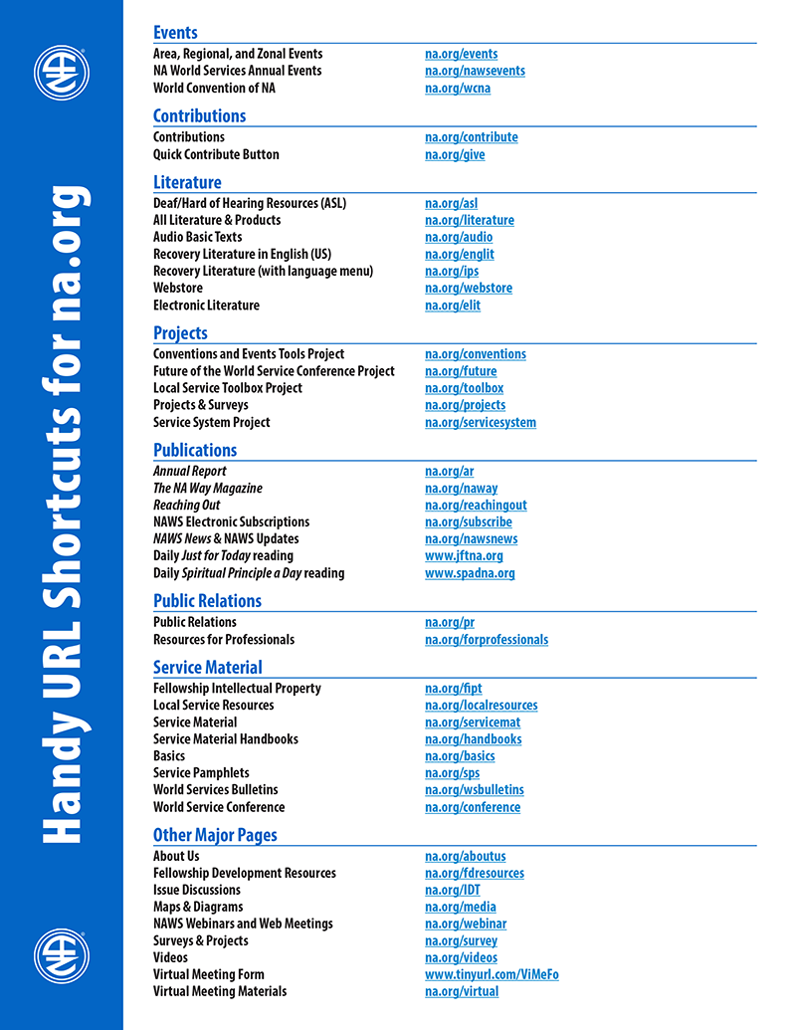
For more information
NAWS News: na.org/nawsnews
Annual Report: na.org/ar
About Us: na.org/aboutus
Projects & Surveys: na.org/projects
World Service Conference: na.org/conference
FD Resources: na.org/fdresources
A complete list of short URLs is posted in Miscellaneous on na.org/maps
Notes:
Most of our frequently accessed webpages have URL short cuts. Here are some of them. You can find a longer list of these shortcuts posted in Miscellaneous on na.org/maps
There is so very much more that we do at World Services, much more than we can cover in one presentation. For more information, see our FD resources page, NAWS News, and the Annual Report.

Slide 61

Join us on Social Media
Instagram: @narcoticsanonymous & @naglobalevents
FacebooK: @naworldservices
Send us your pictures, memes, event flyers, and ideas for posts:
If they are your creation or
in the public domain
Don’t show members’ faces
Have wide interest to NA around
the world
Share your joy
socialmedia@na.org
Notes:
Our Instagram handle is @narcoticsanonymous.
We also now have an official World Services’ Facebook page: @naworldservices
Check it out if you haven’t already
We also have an Instagram account just for events @naglobalevents where we post flyers for area, regional, and zonal celebrations and service events. If you have an event flyer you’d like posted or an idea for Instagram let us know: socialmedia@na.org.

Slide 62
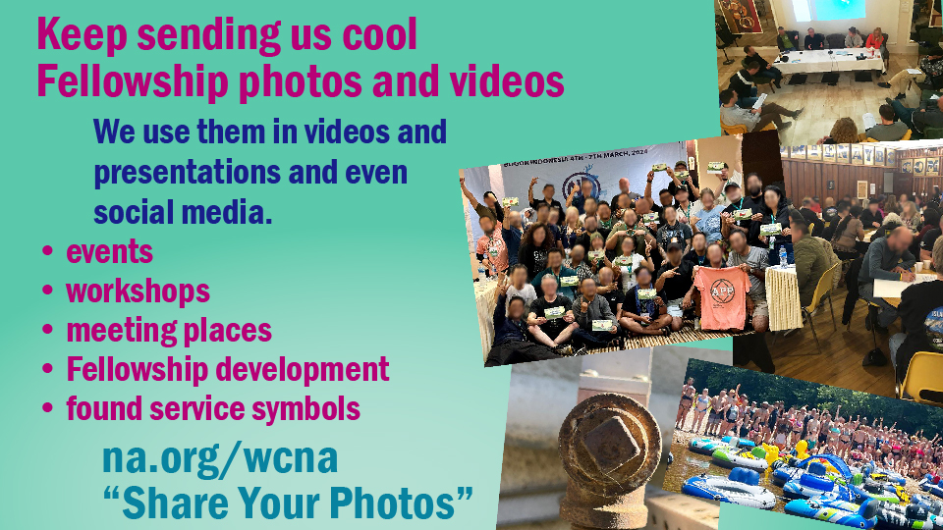
Notes:
There is a photo upload form at na.org/wcna for you to send us photos of NA events, celebrations, cool logos, found service symbols (see Instagram @narcoticsanonymous for examples)..
We need your images to make our PowerPoints, videos, and social media posts shine.

Slide 63
Questions and Answers

