Slide 1
Virtual Meetings, Generation Gaps, and Technology
Our Principles Don’t Change but Our Practices Do

Slide 5
Virtual Meetings
Virtual meetings reported to WSC
5,621
Hybrid meetings reported to WSC
1,249
7,265
Virtual.na.org
??????
Total worldwide

Slide 6
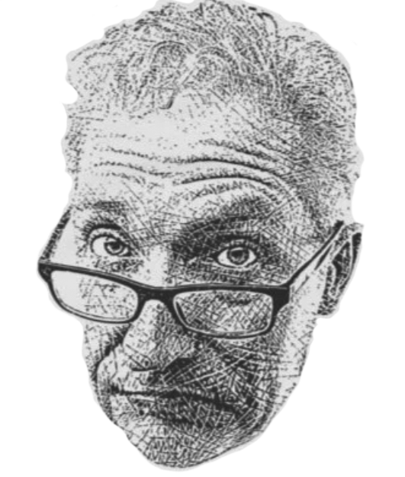
OK
Zoomer!
OK
Zoomer!

Slide 7
What’s a tool that’s either so old or so new that someone in the room won’t get it?

Slide 8
How can we unify across generational and technological differences?

Slide 9
Small group discussion
Imagine it’s five years from now. Online groups are connected to the service structure, and online and in-person meetings are working together to provide services. What did it take to get there?
What are some examples of NA’s generation gap that really annoy you?
What positive, concrete steps can we take as individuals, groups, or service bodies to bridge these gaps?
How can we use our differences to better learn from each other and strengthen NA?

Slide 10
What was an interesting idea you heard today that you want to take home with you?

Slide 11
What are some “bottom line” universals of NA recovery?
How do we change the way we do things without losing connection to those principles?

Slide 13
Thank you for attending!

