Slide 1
Helping Addicts Find Us:
Meeting Lists, Websites, and Flyers
This workshop is ideal for trusted servants involved with meeting information and flyers.

Slide 3
GETTING ADDICTS TO MEETINGS
Meeting info is easy to find
Meeting lists are printable (think of professionals giving addicts a printed list)
The meeting page is user-friendly (no acronyms and non-geographic labels)
For new members
For current members
For professionals (who use common city and county names to find meetings)

Slide 4
Clear information
It should be clear it is an NA event or NA meeting
It should have
the location
the meeting or event name
enough description to know what kind of event it is and who is hosting/sponsoring
If posted online, include town and state or country
WHAT SHOULD BE ON A FLYER

Slide 6
all images are stock photos

Slide 8
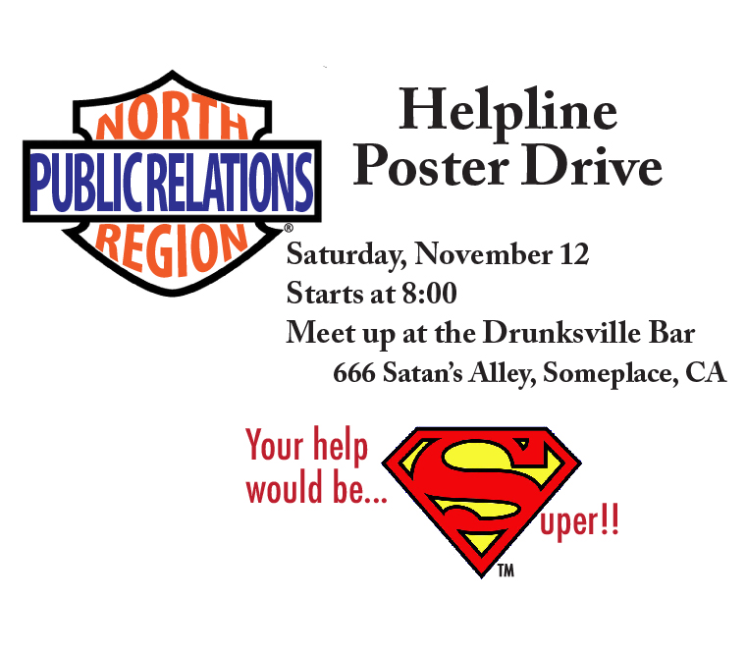

Slide 9
What are some considerations for posting flyers online?

Slide 10
Meeting info not prominent
Out of date meeting info
Only a map interface (doesn’t work if you’re searching from outside the area)
Data integrity (inconsistencies, spelling or grammar errors)
Broken links
Programming not working
Acronyms!
COMMON
WEBSITE
CHALLENGES

Slide 11
WHAT GETS IN THE WAY OF COMPLETE MEETING LIST INFORMATION
Cutting meetings from the list if not represented at area
Cutting meetings from the list because of ideological battles
Service bodies with boundaries that are not intuitive

Slide 12
LET’S DISCUSS
What else can get in the way of complete meeting list information?
What are some of the spiritual principles that can guide us when listing meetings?
What are some best practices that those spiritual principles give rise to?

Slide 13
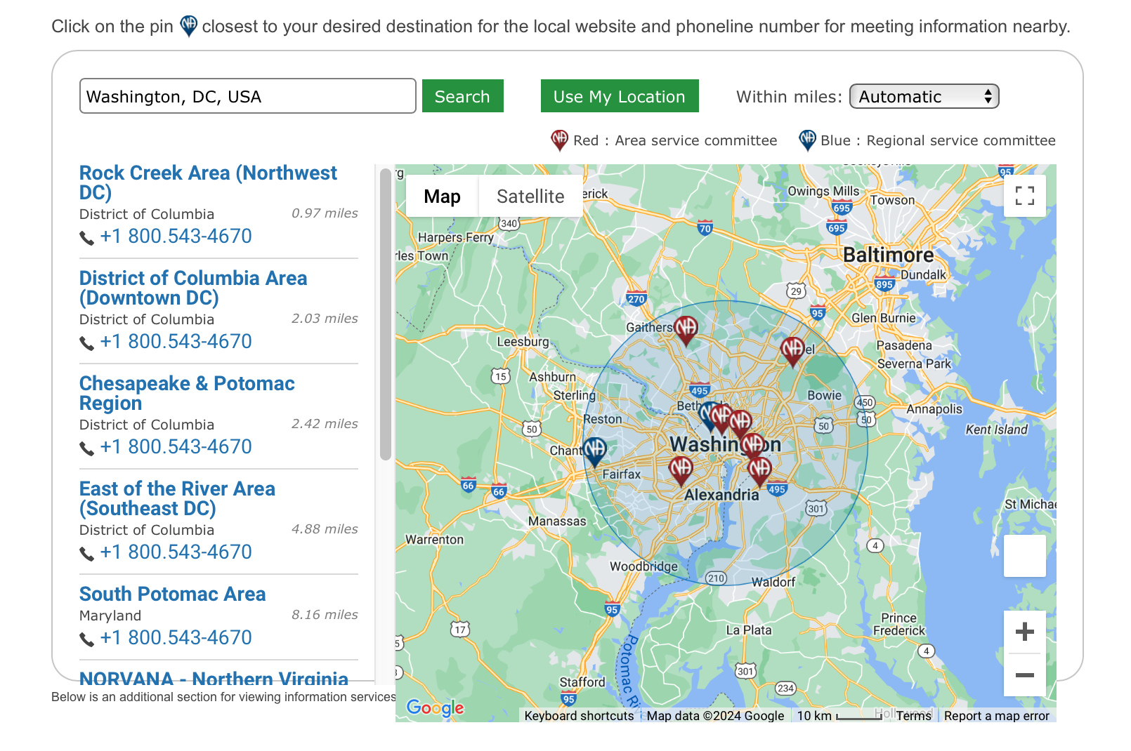
Helping Addicts Find Us webinar recording:
na.org/webarchive

Slide 14
Remember to post your photos using the form on na.org/wcna!
Thank You!

