Slide 1
Fellowship
Development
1 May 2021

Slide 2
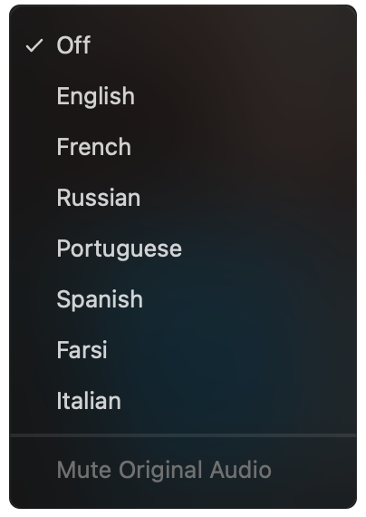

Select a language
Select English or one of the translation channels:
Farsi Greek Hebrew Polish
Portuguese Russian Spanish
English
Farsi
Greek
Hebrew
Polish
Portuguese
Russian
Spanish
1. Find at bottom of screen
2. Choose a language

Slide 3

Everything that occurs in the course of NA service must be motivated by the desire to more successfully carry the message of recovery to the addict who still suffers.
It was for this reason that we began this work. We must always remember that as individual members, groups and service committees, we are not and should never be in competition with each other. We work separately and together to help the newcomer and for our common good. We have learned, painfully, that internal strife cripples our Fellowship; it prevents us from providing the services necessary for growth. Basic Text Introduction

Slide 4


Slide 5
When we come together in service, we connect with each other in a vital way. Most of us feel better when we are productive, and doing something together that helps addicts stay clean gives us a sense of belonging. The friendships we develop in service are unlike any in our lives—not because they are always easy or pleasant, but because we work hard, walk through struggles, and solve problems together. In contributing to our common welfare, we find meaning and joy. In creative action we find love and purpose.

Slide 6
Our vision statement includes the hope that every addict will be able to hear the message and that every member has the chance to “experience spiritual growth and fulfillment through service.” We experience unity in service when we see our work as part of a greater whole, in service to our primary purpose, and connected to our personal recovery. In whatever way we serve, our vision must be at the center. We can be so focused on a task that we neglect to reach out to members who might be willing or interested. Vision is important, and we must constantly adjust our focus—zooming in on the task at hand, and pulling back to see how it fits in the larger frame. Guiding Principles, Tradition One

Slide 7
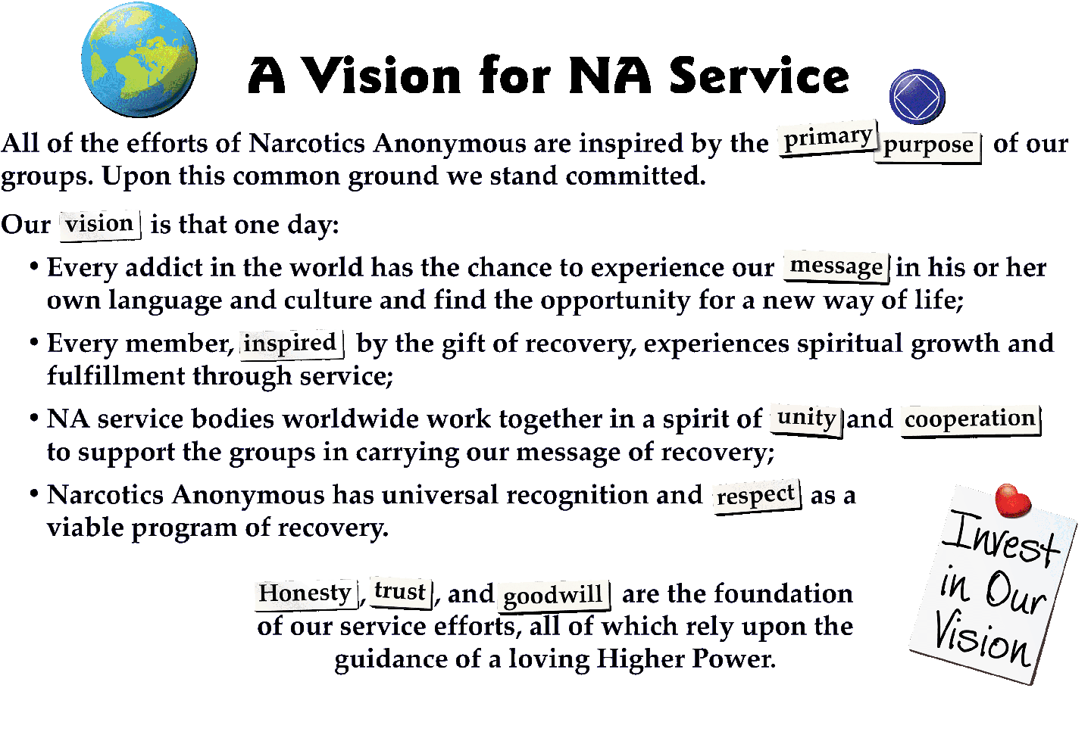
Notes:
Most of you have seen A Vision for NA Service before. This is the touchstone for all of the work of World Services.

Slide 8
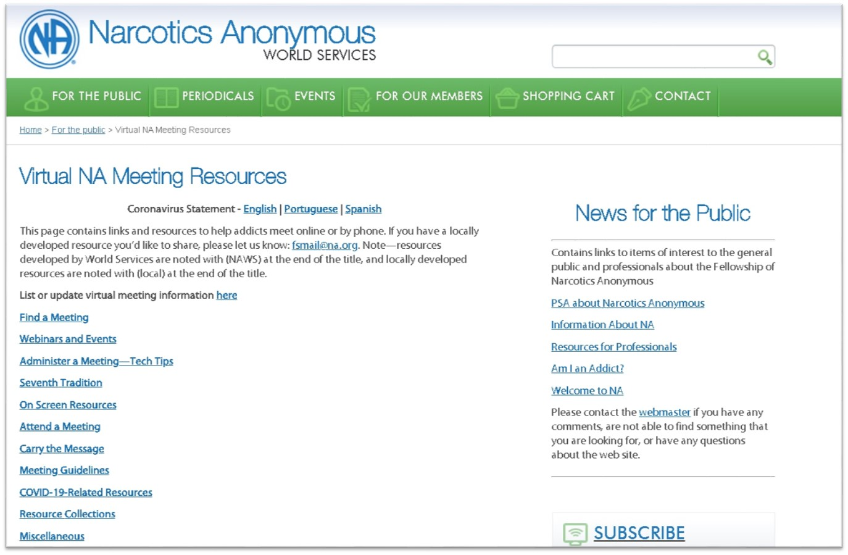
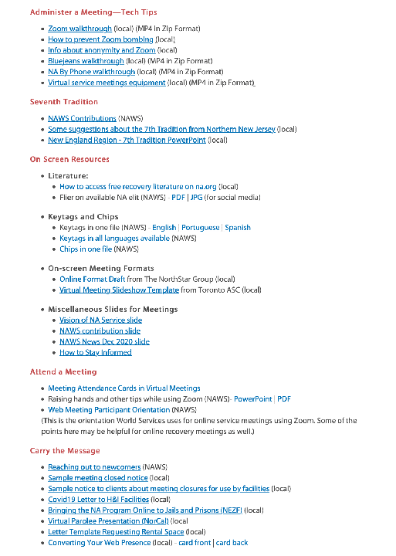
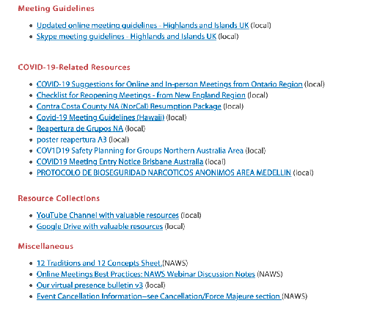
www.na.org/virtual
Notes:
We do already have a great collection of resources for virtual meetings posted at na.org/virtual. Reports, PowerPoints and other resources related to the open webinars are among the resources posted here. It really is a treasure trove of resources, and we add more often, so check it out if you haven't been there recently.
And if you have any tools that have helped your group, area, region, or zone with online recovery or service meetings, please send them to toolbox@na.org so that we can post them.

Slide 9
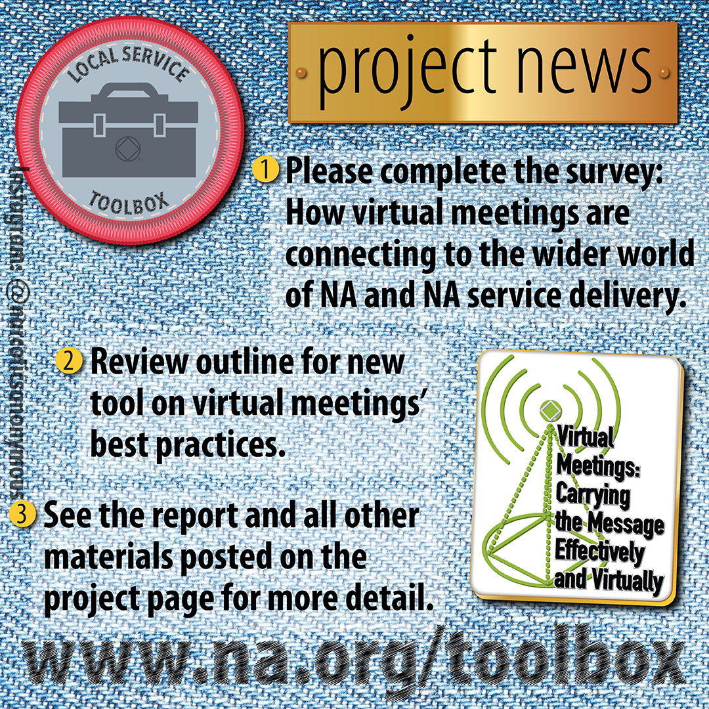
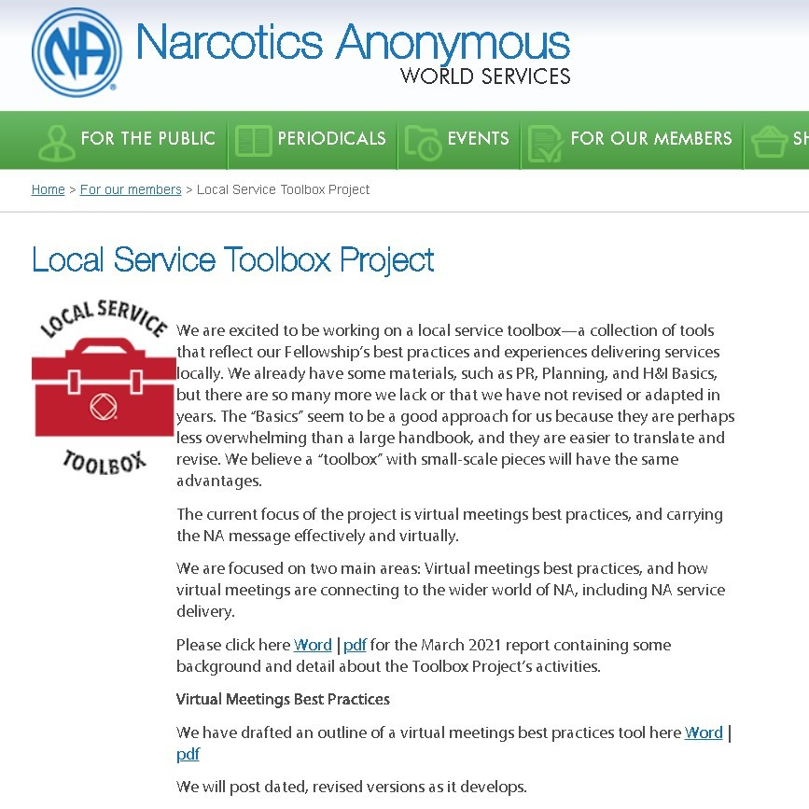
Notes:
Most of you have seen A Vision for NA Service before. This is the touchstone for all of the work of World Services.

Slide 10


ARGENTINA'S
MARATHON
MEETING
na.org.ar/maratonica

Slide 11


MARATHON
MEETING
24/7 since March 23th
It started as a Regional service in response to the Covid 19 lockdown so that addicts looking for their first meeting could receive a single link instead of an endless list
na.org.ar/maratonica
Notes:
Este es el enlace para la Reunión Maratónica de la Región Argentina y para unirse por telefono:
Unirse por Meet:
https://meet.google.com/mhk-rpve-mco
Unirse por telefono:
+54 11 3986-3700‬ PIN: ‪826 553 974 4649‬#
Estos participantes podrán silenciar y habilitar sus micrófonos pulsando *6

Slide 12
MARATHON
MEETING
24/7 since March 23th
… and it worked
na.org.ar/maratonica
Notes:
Este es el enlace para la Reunión Maratónica de la Región Argentina y para unirse por telefono:
Unirse por Meet:
https://meet.google.com/mhk-rpve-mco
Unirse por telefono:
+54 11 3986-3700‬ PIN: ‪826 553 974 4649‬#
Estos participantes podrán silenciar y habilitar sus micrófonos pulsando *6

Slide 13
4380
8760
500
190
Meetings
Newcomers
Servants
HOURS of non-stop service
MARATHON
MEETING
24/7 since March 23th
This is the equivalent of a meeting that opens 2 hours every day for more than 12 years
and countless visitors from outside the fellowship, institutions, governmental authorities and professionals
Members from all over the world came together to make this possible: Argentina, Chile, Uruguay, Peru, Ecuador, Honduras, Mexico, Costa Rica, Germany, France, Spain and USA
Consecutive meetings, 2 hours each
Numbers running from March 23th 2020 to March 23th 2021
(12 months of uninterrupted service)
na.org.ar/maratonica
Notes:
Este es el enlace para la Reunión Maratónica de la Región Argentina y para unirse por telefono:
Unirse por Meet:
https://meet.google.com/mhk-rpve-mco
Unirse por telefono:
+54 11 3986-3700‬ PIN: ‪826 553 974 4649‬#
Estos participantes podrán silenciar y habilitar sus micrófonos pulsando *6

Slide 14
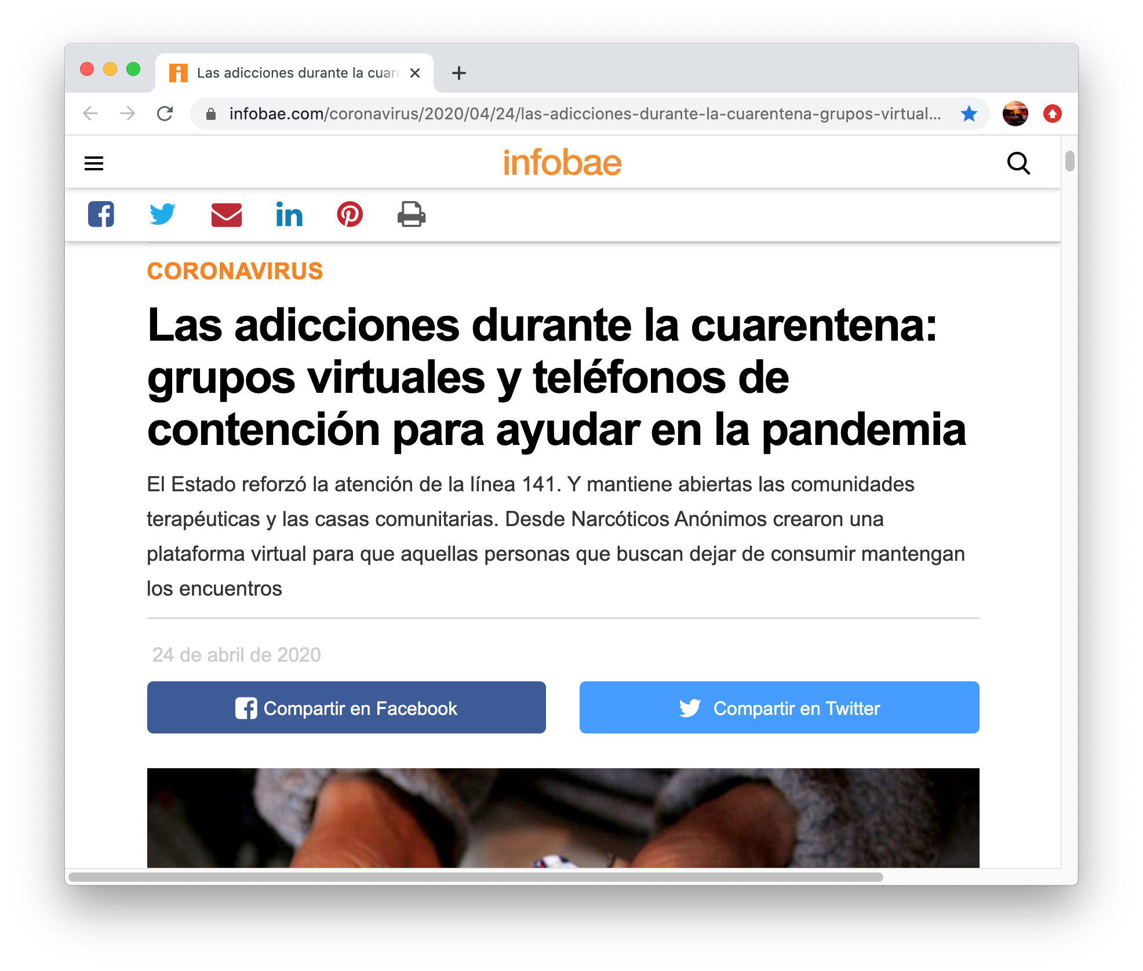
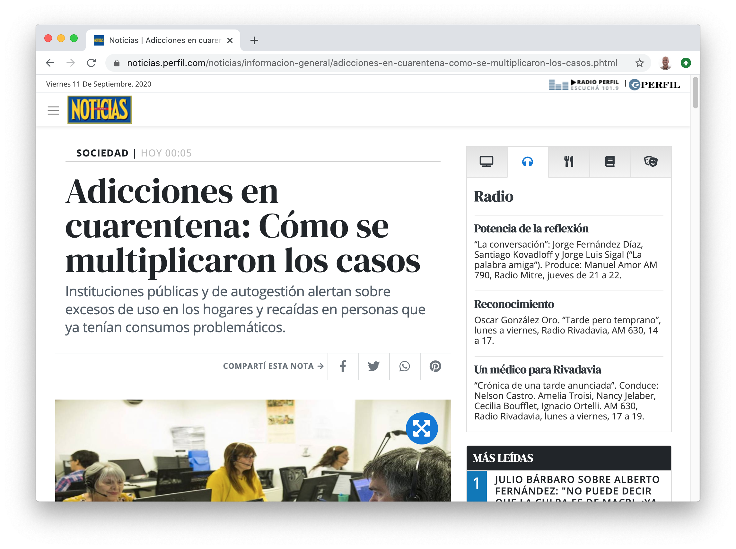
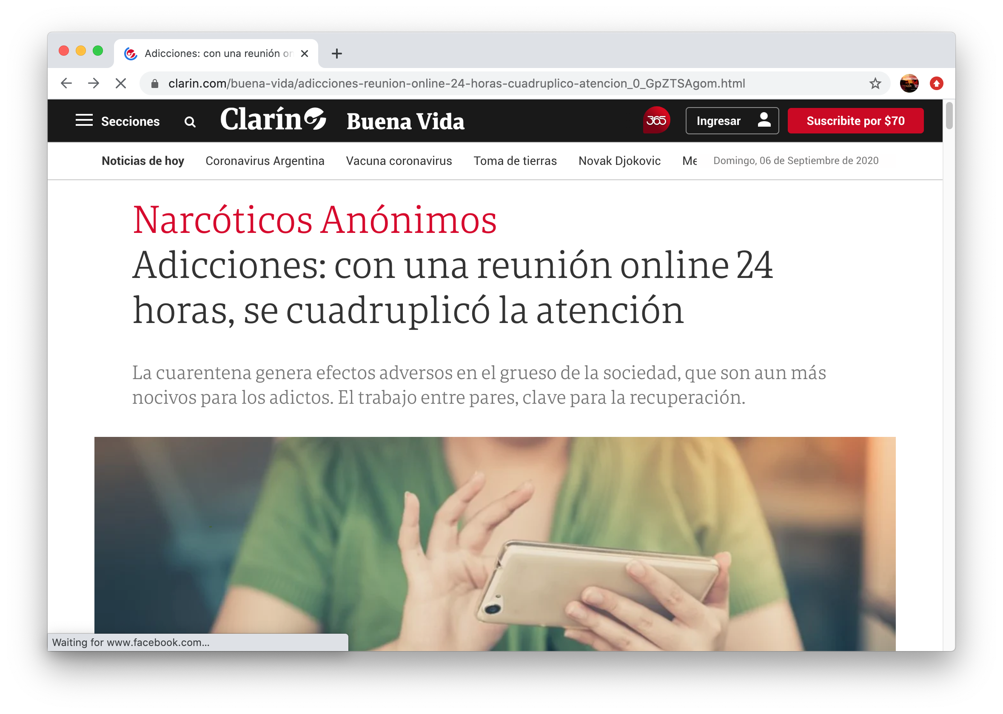
MARATHON
MEETING
24/7 since March 23th
Press Clippings
Major Media Appearances
na.org.ar/maratonica
Notes:
Este es el enlace para la Reunión Maratónica de la Región Argentina y para unirse por telefono:
Unirse por Meet:
https://meet.google.com/mhk-rpve-mco
Unirse por telefono:
+54 11 3986-3700‬ PIN: ‪826 553 974 4649‬#
Estos participantes podrán silenciar y habilitar sus micrófonos pulsando *6

Slide 15
MARATHON
MEETING
24/7 since March 23th
Our website and social networks redirect users to the Zoom meeting, and our 24/7 free phone helpline does it too. We added a WhatsApp Business service with a bot that also gives this information
na.org.ar/maratonica
Notes:
Este es el enlace para la Reunión Maratónica de la Región Argentina y para unirse por telefono:
Unirse por Meet:
https://meet.google.com/mhk-rpve-mco
Unirse por telefono:
+54 11 3986-3700‬ PIN: ‪826 553 974 4649‬#
Estos participantes podrán silenciar y habilitar sus micrófonos pulsando *6

Slide 16
MARATHON
MEETING
24/7 since March 23th
This service body is developing into an area on its own but is currently a Fellowship Development regional service
na.org.ar/maratonica
Notes:
Este es el enlace para la Reunión Maratónica de la Región Argentina y para unirse por telefono:
Unirse por Meet:
https://meet.google.com/mhk-rpve-mco
Unirse por telefono:
+54 11 3986-3700‬ PIN: ‪826 553 974 4649‬#
Estos participantes podrán silenciar y habilitar sus micrófonos pulsando *6

Slide 17
MARATHON
MEETING
24/7 since March 23th
Each 2 hour time slot is a group with their own GSR and business meetings. The marathon meeting has regional representatives, group support forums, public relations, and a tech support committee
na.org.ar/maratonica
Notes:
Este es el enlace para la Reunión Maratónica de la Región Argentina y para unirse por telefono:
Unirse por Meet:
https://meet.google.com/mhk-rpve-mco
Unirse por telefono:
+54 11 3986-3700‬ PIN: ‪826 553 974 4649‬#
Estos participantes podrán silenciar y habilitar sus micrófonos pulsando *6

Slide 18
RECRUITING
TECHNOLOGY
AUTONOMY
MARATHON
MEETING
24/7 since March 23th
Challenges and Difficulties
We opened the invitation to serve and welcomed everybody with the spirit to serve without asking for any background. We found out that some people started to serve with big resentments with the fellowship and it was very problematic
We started using Google Meet and changed to Zoom after a few months. Security issues are constantly something we have to attend to. We use a URL that redirects to the current Zoom meeting link that can change through time without anybody noticing the change
We understand this as an ongoing service effort and not necessarilly a group. Some members would like this to be considered an area with full autonomy but they still depend on the Fellowship Development Committee. This is still a focus of discussion.
na.org.ar/maratonica
Notes:
Este es el enlace para la Reunión Maratónica de la Región Argentina y para unirse por telefono:
Unirse por Meet:
https://meet.google.com/mhk-rpve-mco
Unirse por telefono:
+54 11 3986-3700‬ PIN: ‪826 553 974 4649‬#
Estos participantes podrán silenciar y habilitar sus micrófonos pulsando *6

Slide 19
MARATHON
MEETING
24/7 since March 23th
thank you and
Love from Argentina
na.org.ar/maratonica
Notes:
Este es el enlace para la Reunión Maratónica de la Región Argentina y para unirse por telefono:
Unirse por Meet:
https://meet.google.com/mhk-rpve-mco
Unirse por telefono:
+54 11 3986-3700‬ PIN: ‪826 553 974 4649‬#
Estos participantes podrán silenciar y habilitar sus micrófonos pulsando *6

Slide 20
Notes:
This map shows the 91 languages NA members speak.
We publish literature now in 56 of those languages! Georgian was our most recent addition. During the last calendar year, we published more than 100 new pieces of translated literature, bringing the total number of translated pieces to 1,276.
Local members do the heavy lifting in almost all translations, with very few exceptions. It takes dedicated members willing to devote countless hours to the work, even when a professional translator is used. We oversee translations to make sure conceptual fidelity to the literature is maintained, and we organize proofing, copyrights, layout, and production. For almost a year, we’ve had a translations staff of one and a production staff of one—now one and a half.

Slide 21

Total Published Translated Items
BY Fiscal year
2020
1,219
Notes:
This graph shows the number of translated items published at World Services as of the end of the last fiscal year. So as of the end of June 2020, we published 1,219 translated titles. The number is even higher now.
Translations play an important role in Fellowship development. Our experience is that a 3-pronged approach to translations is most effective. Translations work is coordinated among a local translation committee or LTC made up of committed members who are native speakers; contracted professionals; and NAWS staff. Generally, we use the professional translator as a proof reader and copyeditor to go over the LTC’s work. In some cases that professional will also do some of the initial translations, if the LTC is not able to. It takes a great deal of resources – human and financial – to produce translated literature. It’s not just about money. The scarcest resource is actually human.
If you want to learn more about translations, check out Translation Basics, which is posted at na.org.

Slide 22




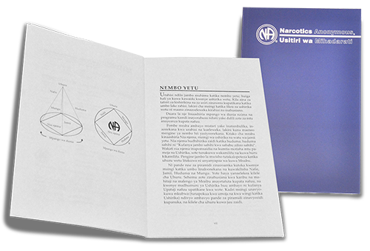








Newest
Translations

Slide 23




Carrying the Message

Slide 24

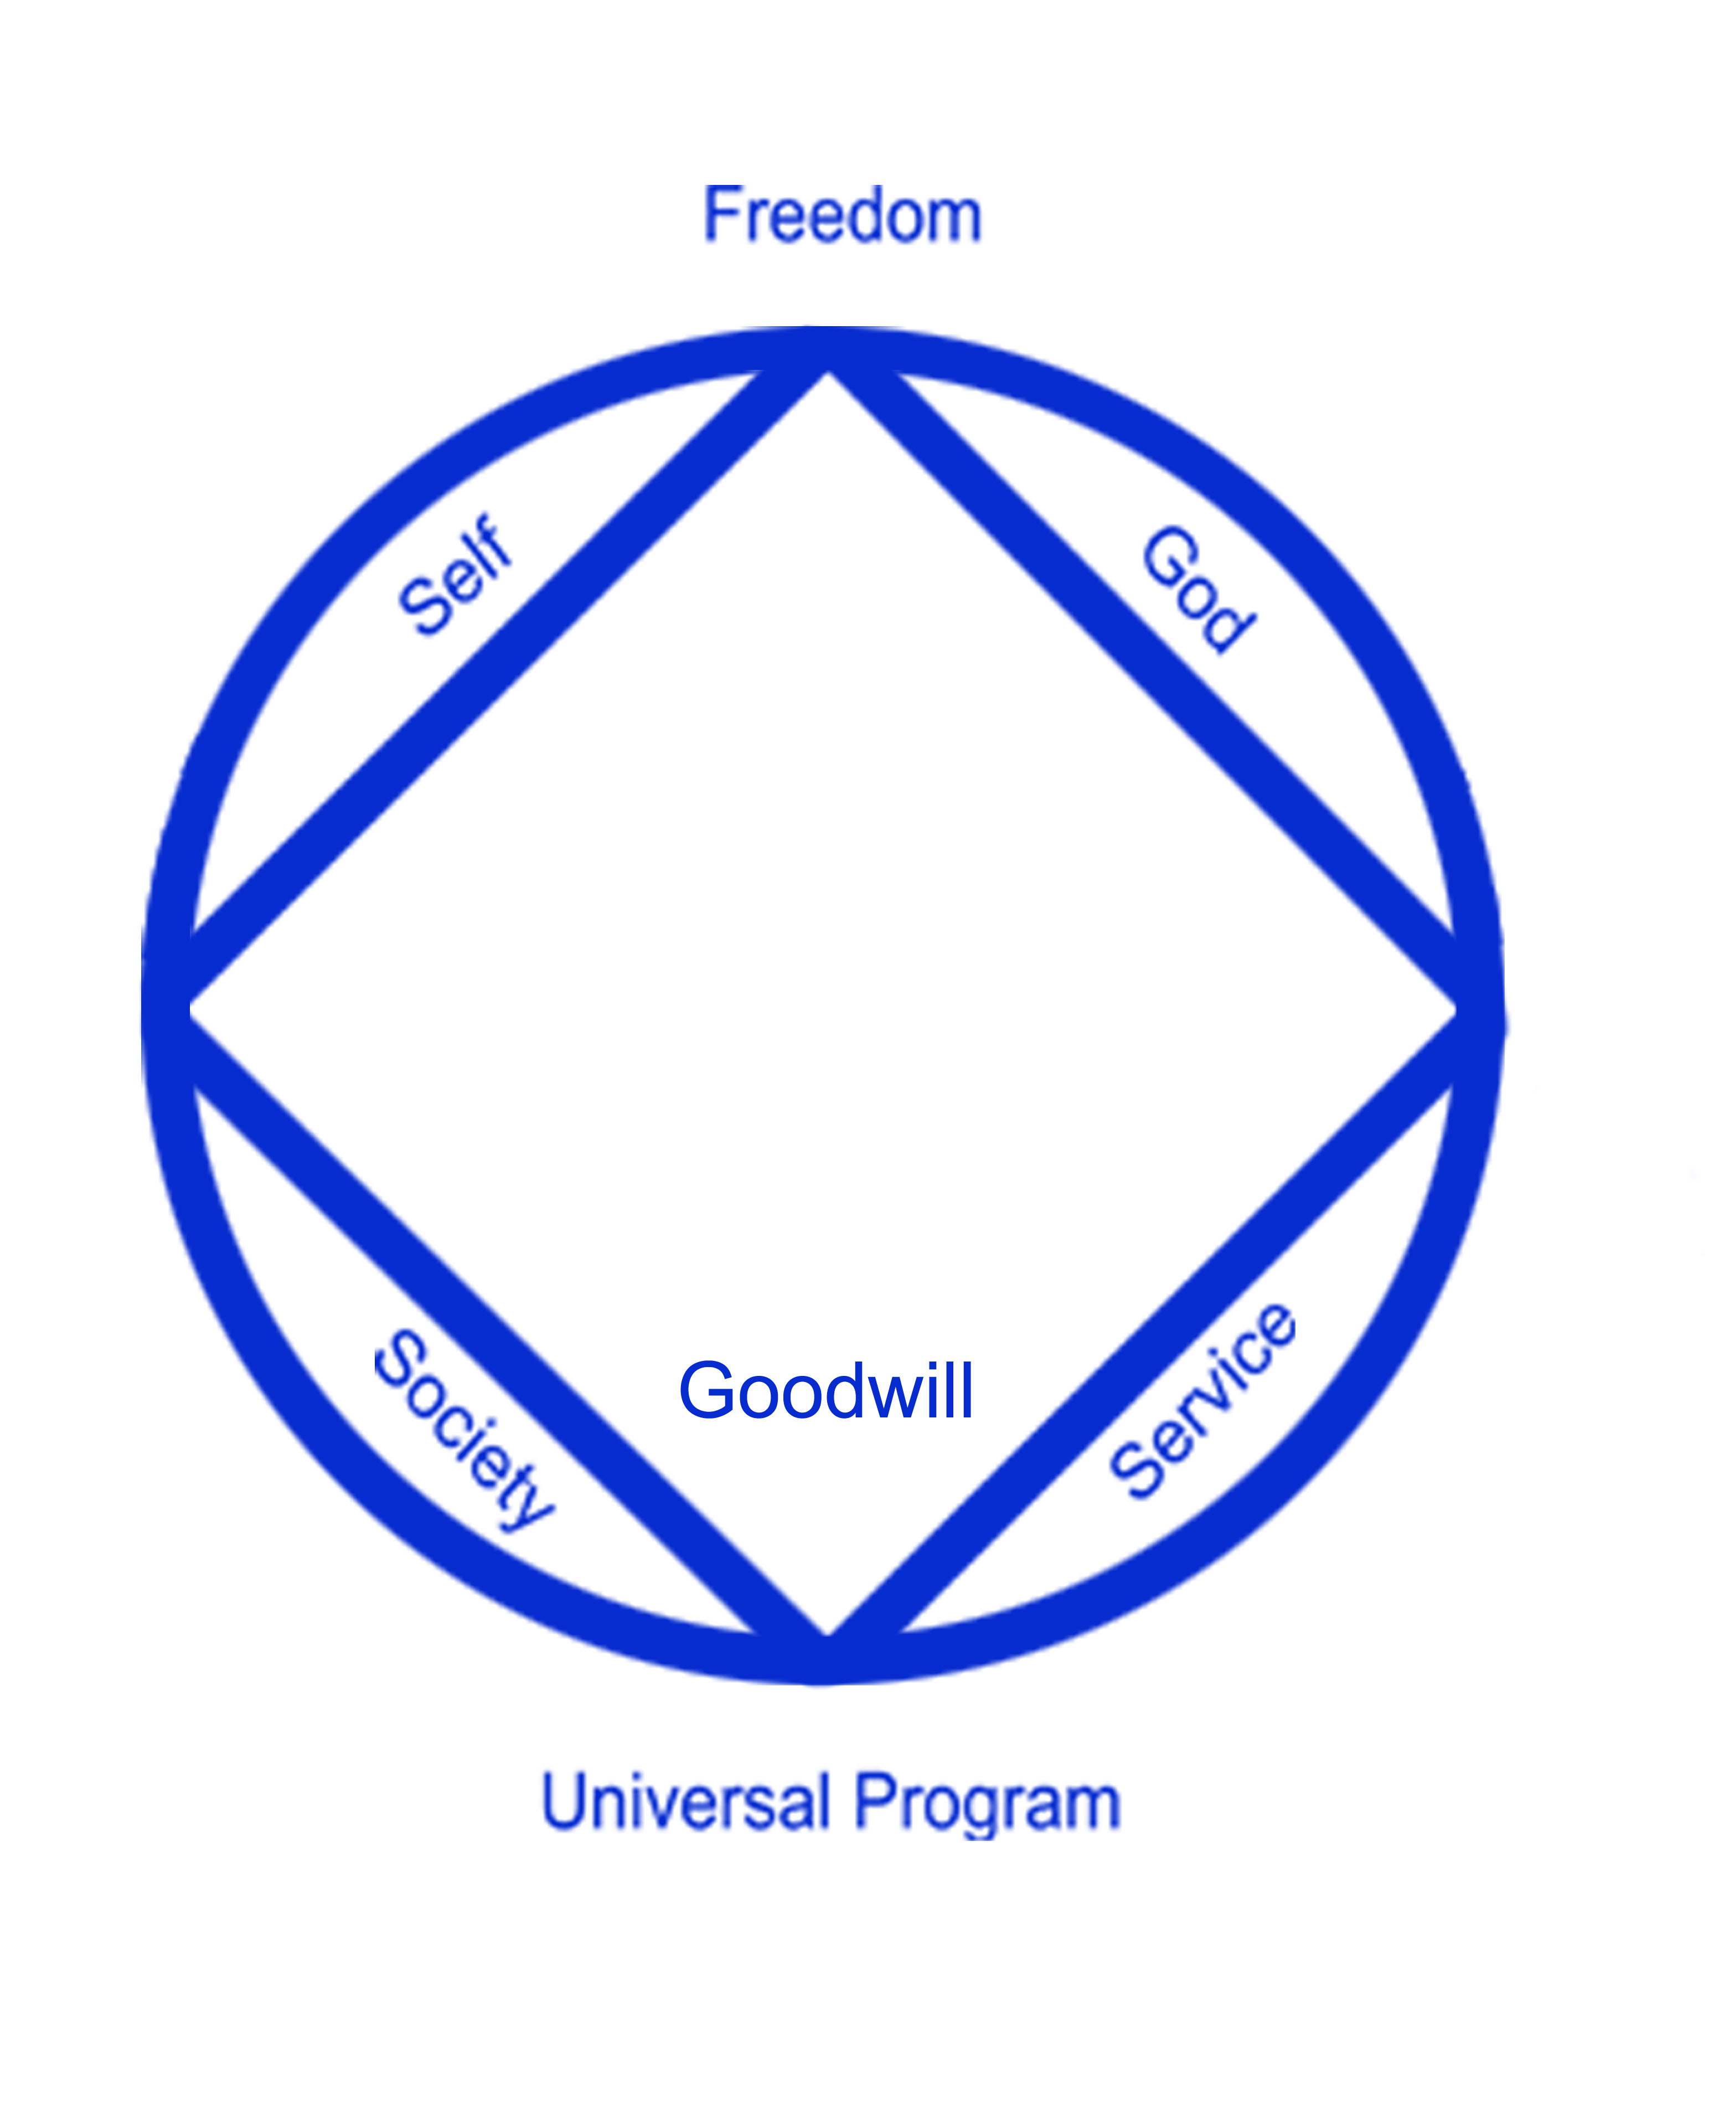

INTRODUCTION
NA meetings were started in Indonesia in 2000 in Jakarta and Bali. NA currently has 54 meetings in 16 Cities within Indonesia. NA Bali and NA Jakarta have hosted International NA conventions.
“Perkumpulan NA Indonesia” was registered as a legal entity with the Department of Justice of Indonesia in 2020.

Slide 25
How did it start
With English speaking members in Bali
Initial struggle because the fellowship was primarily expatriate based
H&I meeting started in a local rehab resulting in Indonesian speaking members coming to the meeting
Indonesian speaking member’s started a new homegroup
Indonesian speaking meetings became regular
Group’s got together to form NA area’s in Bali, Bogor and Jakarta
Translation from English to Bahasa Indonesia started to happen
In 2017 we managed to form our RSC with 12 area’s

Slide 26
Obstacles
Archipelago (17.000 Islands)
Diverse cultures and religions
Language (more than 35 languages)
Limited access to both English and translated literature
Limited workshops or learning days on traditions and the service structure

Slide 27
Solutions
Getting Bahasa Indonesia speaking members in to all level of service structure
Organized translations through area translation committees (leading to the official publication of the Bahasa Indonesia Basic Text in 2017)
The success in getting NA Indonesia recognized as a legal entity
APF annual meeting and convention in Bali 2019. 1st Regional PR event with NAWS and the Indonesian government.
Regular NA presentations to various Indonesian government departments, leading to acknowledgment from them recognizing NA as a viable resource in recovery from drug addiction

Slide 28
Post Pandemic Solutions
14 Regional virtual recovery meetings in a week, some bilingual.
Regional virtual learning days for H&I and PR
Hybrid H&I and recovery meetings in prison
Many jails in Indonesia now stock NA literature in their prison libraries.
The birth of Bahasa Indonesia speaking women’s only homegroup
Very active sponsorship and step working because of literature based or multiple topics meeting
Launch of PSA in Bahasa Indonesia during PR week (leading to many calls on the phone lines)
Literature supplies from NAWS got better
Better communication between ASC and RSC

Slide 29
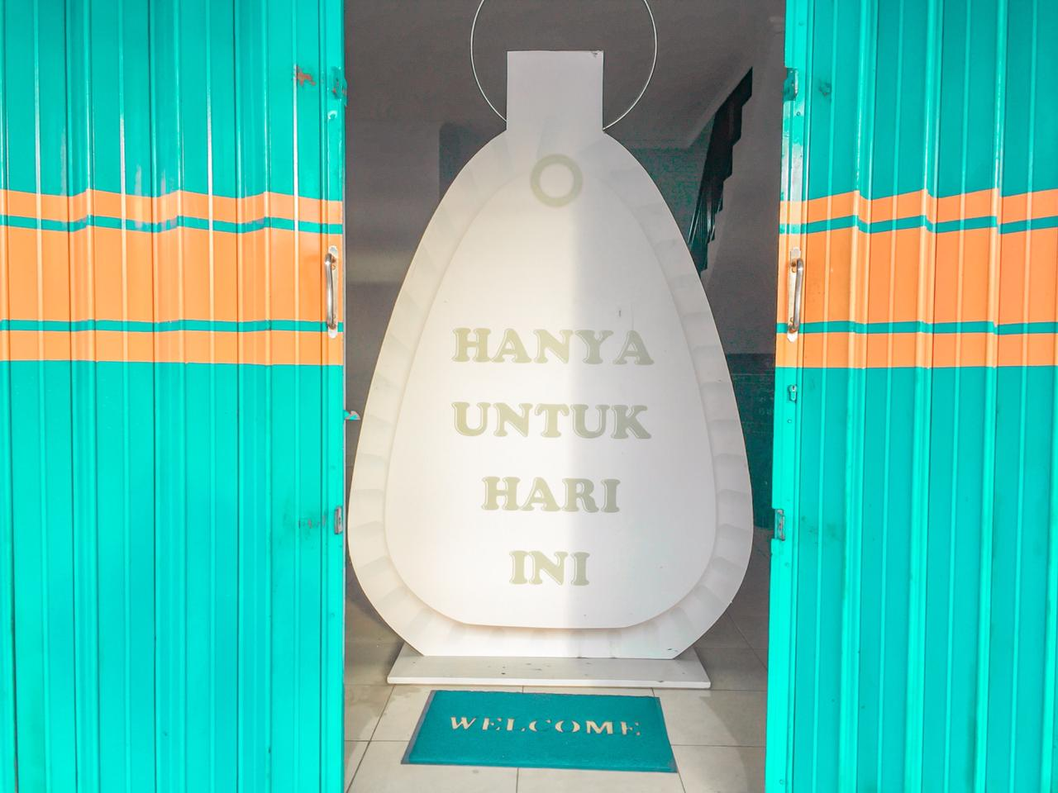
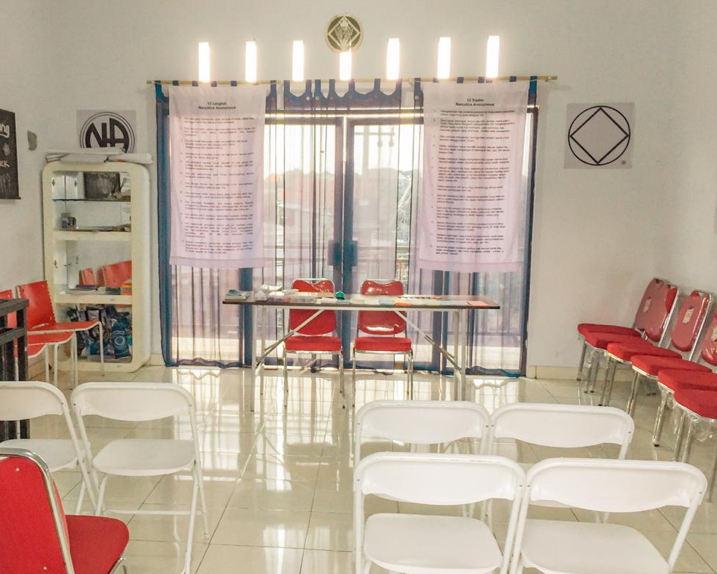
NA BALI MEETING ROOM - INDONESIAN SPEAKING
.

Slide 30
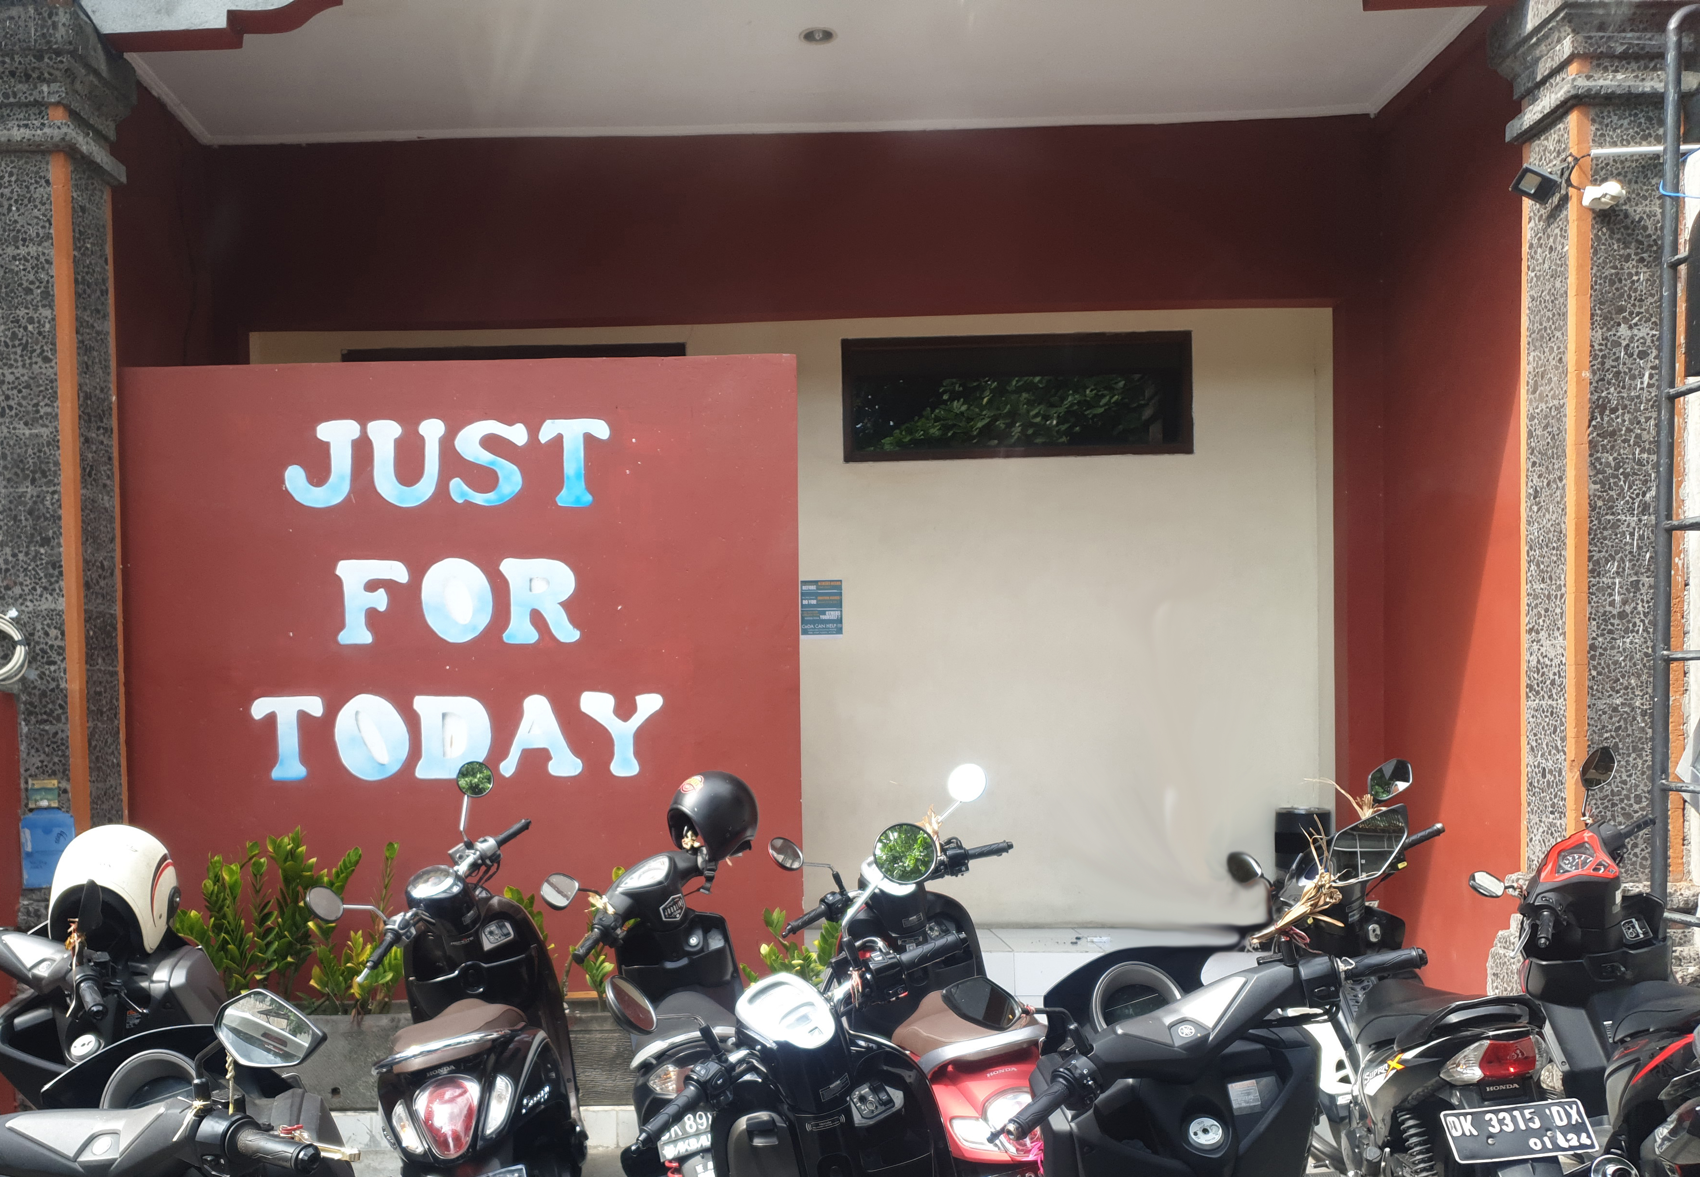
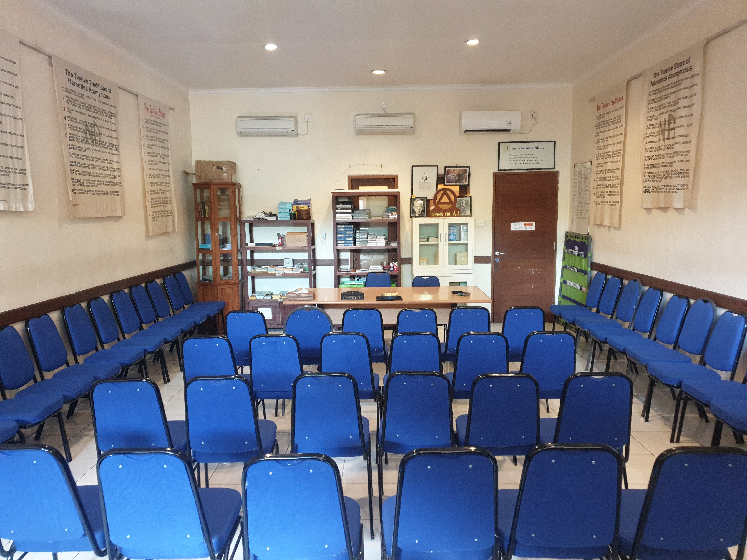
NA BALI MEETING ROOM - ENGLISH SPEAKING

Slide 31


NA MEETINGS IN INDONESIA
Bali: 28 meetings | Lampung: 2 meetings
Banda Aceh: 1 meeting | Makassar: 1 meeting
Bandung: 1 meeting | Medan: 1 meeting
Batam: 1 meeting | Pontianak: 1 meeting
Bogor: 5 meetings | Samarinda: 1 meeting
Bengkulu: 1 meeting | Solo: 3 meetings
Jambi: 1 meeting | Surabaya: 2 meetings
Jakarta: 4 meetings | Tarakan: 1 meeting

Slide 32



NA LITERATURE IN BAHASA INDONESIA
NA Indonesia Literature Translation Committee has translated the following items into Bahasa Indonesia.
  NA Basic Text
  12 recovery pamphlets
  2 service pamphlets

Slide 33

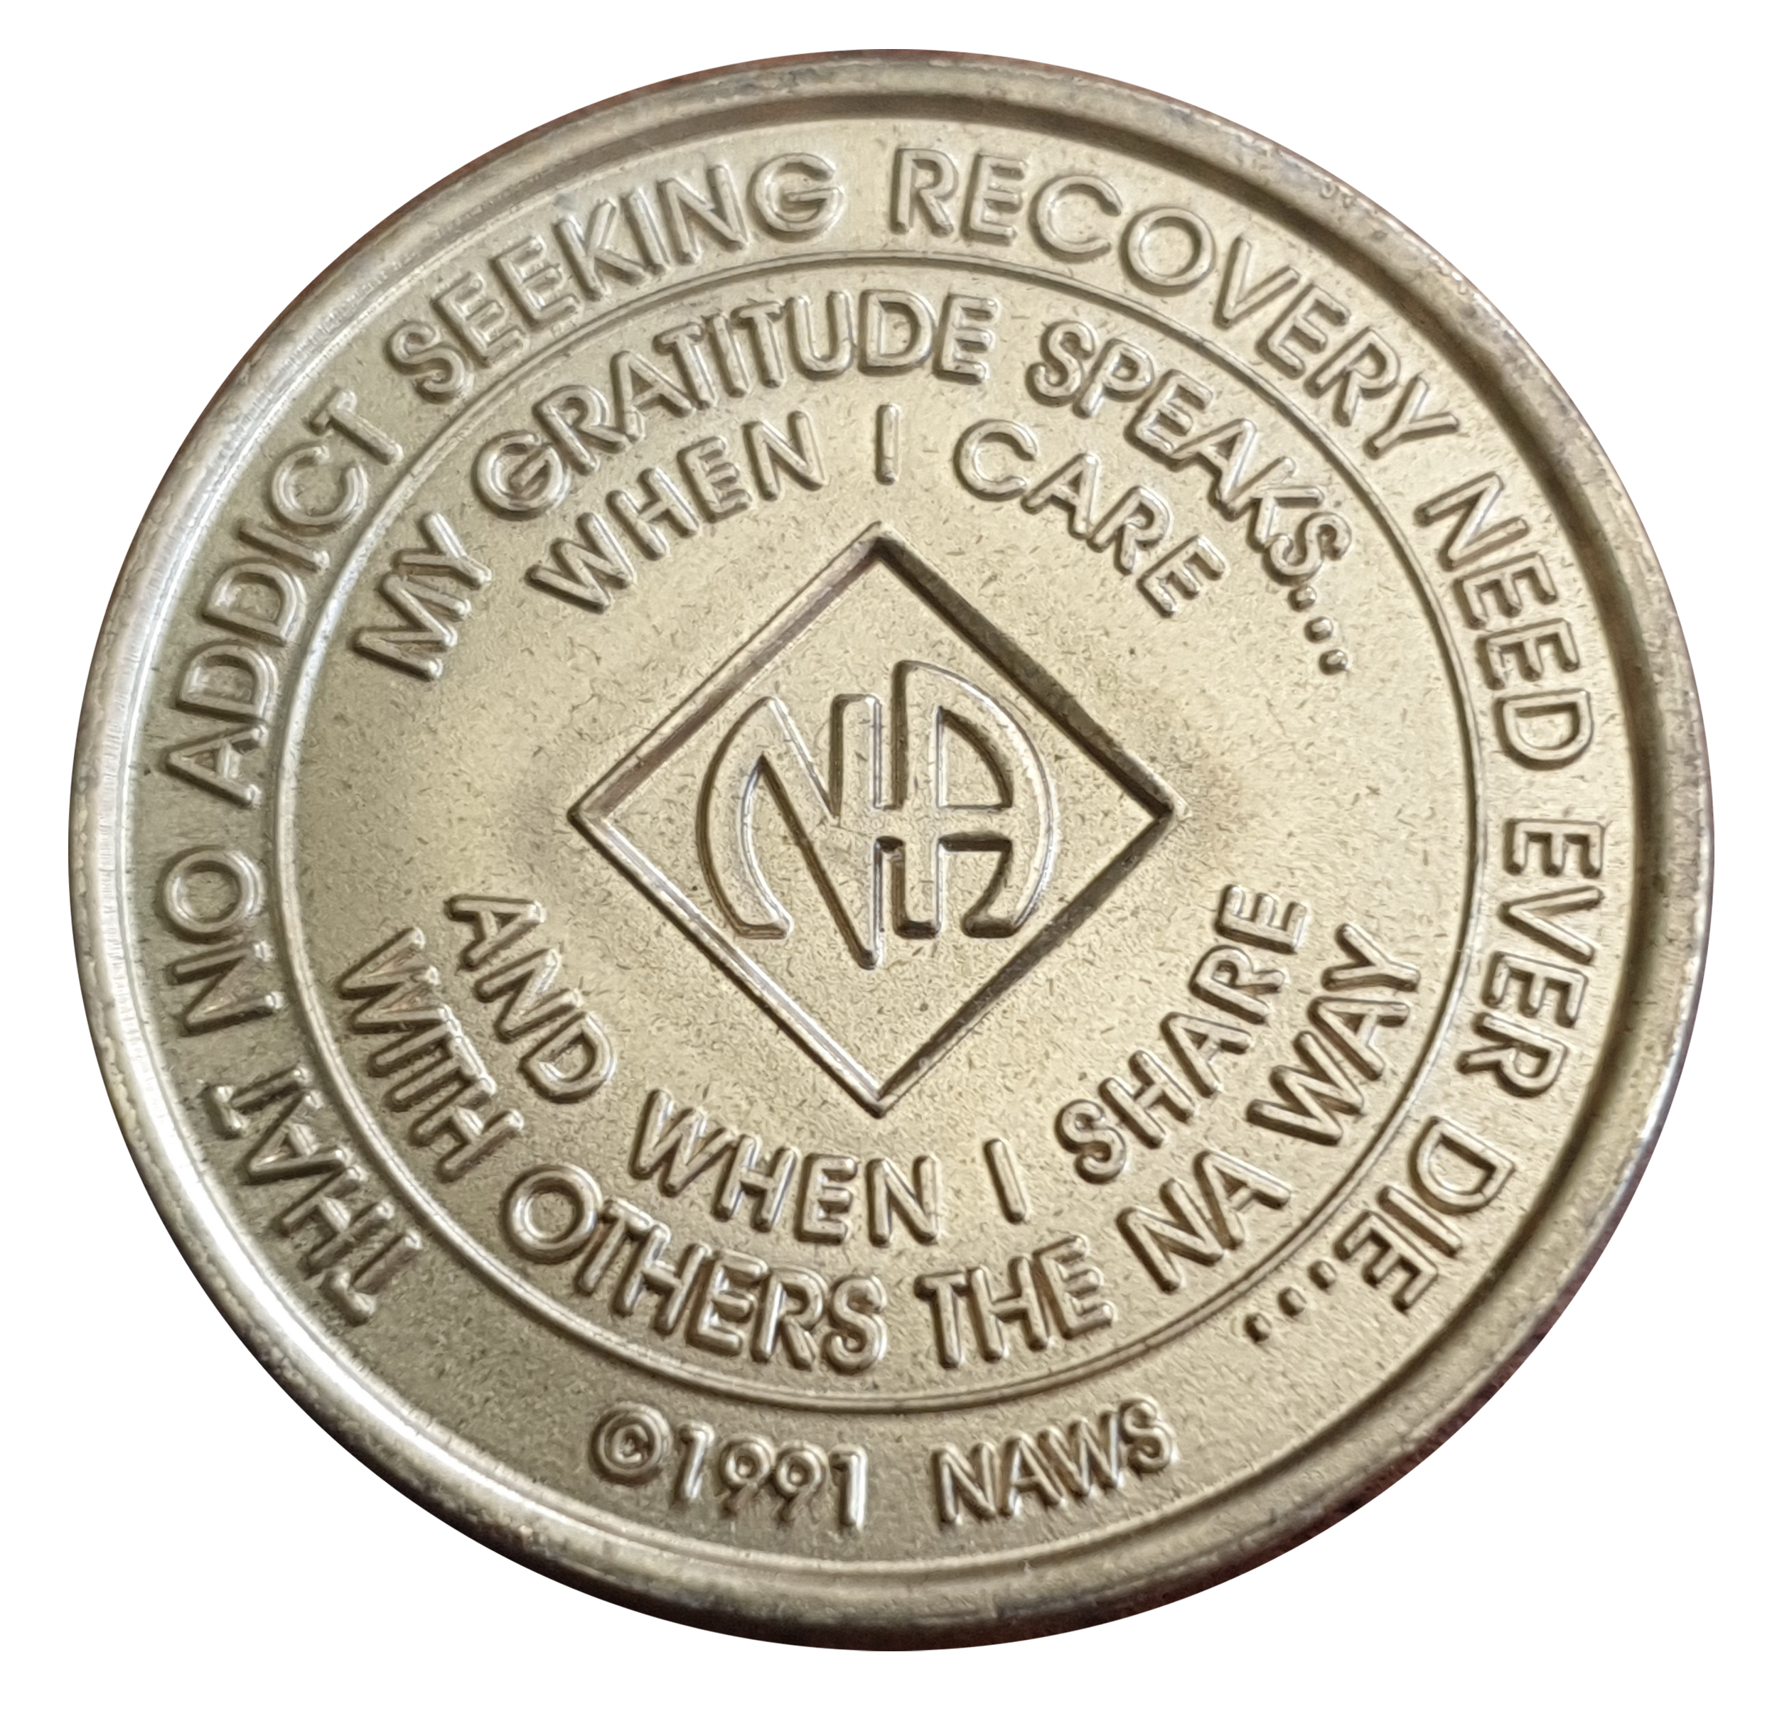
Terima Kasih

Slide 34
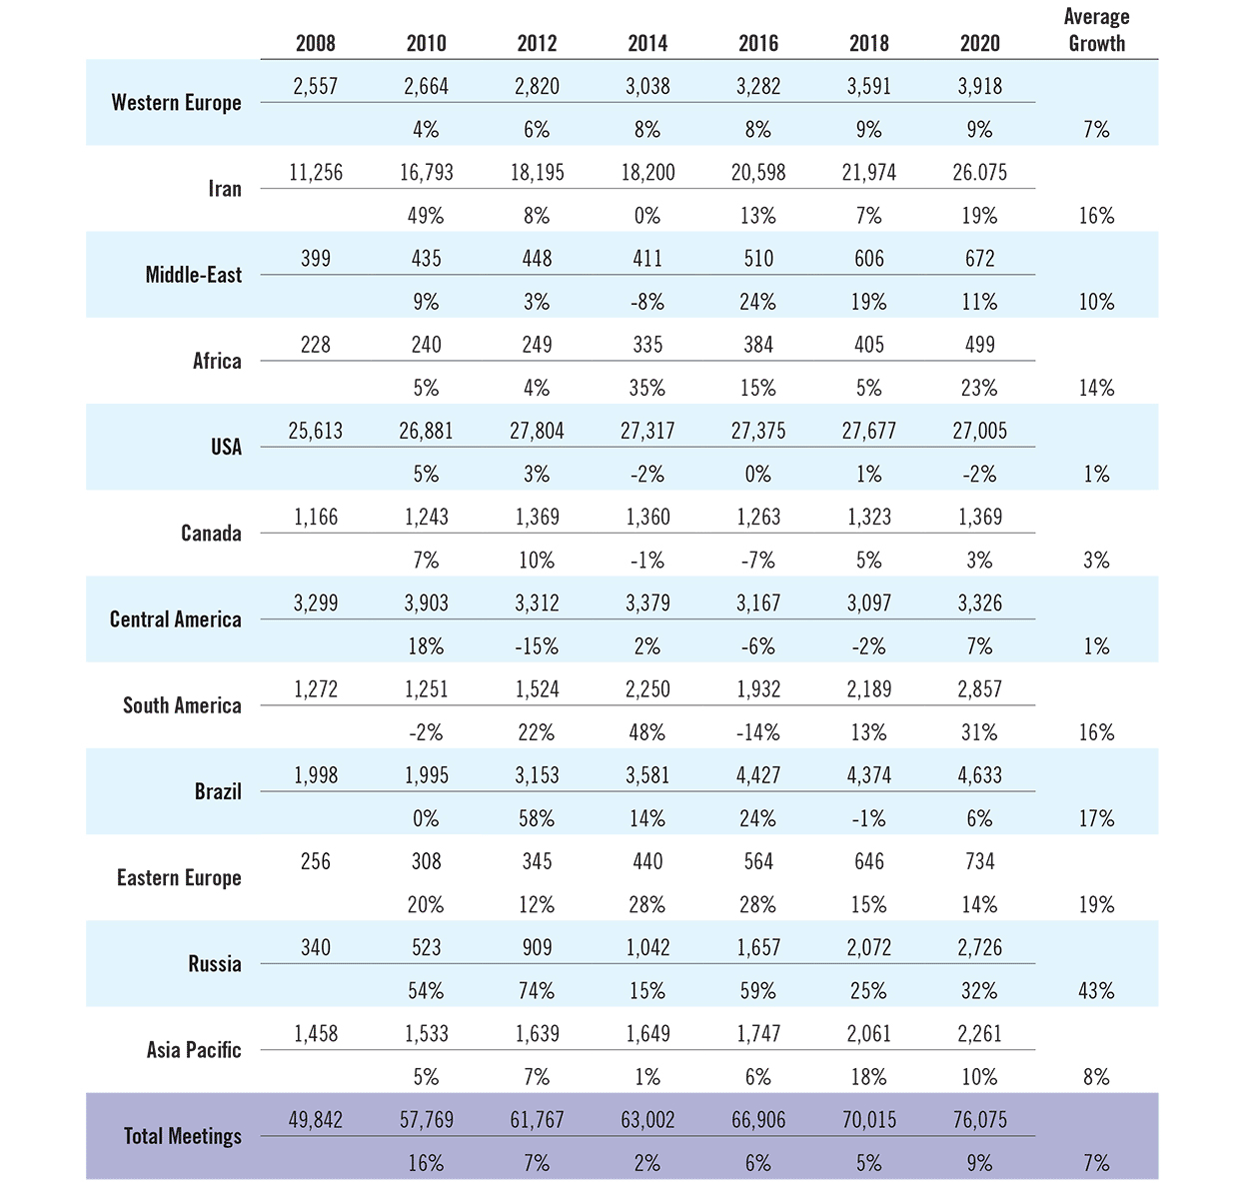
Twelve-Year
Meeting
Trends
www.na.org/media
Notes:
I know it’s hard to read this chart easily. It shows meeting growth trends in different parts of the world over the past ten years. We put this together for the World Service Conference when we still believed we would meet in person. With the limitations of a virtual environment we didn’t get a chance to discuss this, but it is a focus for us in the cycle ahead.
Mapping these trends makes it clear that NA is growing in most places—an average annual growth of 7% in Western Europe, 16% in Iran, and 19% in Eastern Europe for instance. Russia has a whopping 43% growth rate. But growth seems to be stalled in the US and Central America, with an average annual growth rate of 1%. (3% in Canada)
This is information to help inform the conversation about Fellowship Development that we know we need to have. We hope to devote a Conference participant webinar or a virtual meeting of all zones to this issue.

Slide 35
Fellowship Development in the Amazon
NA Service Day
May 1st, 2021

Slide 36
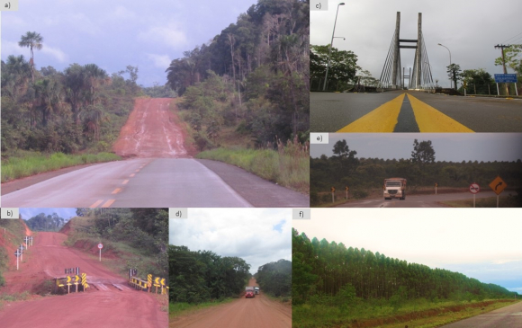
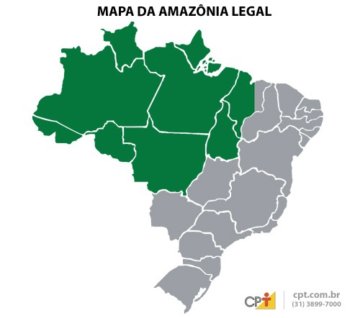
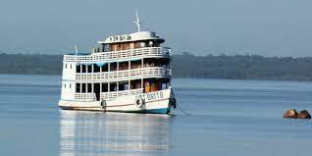
Where’S THE AMAZON?

Slide 37
Challenges in the Amazon
Physical distances;
Insufficient Internet access coverage;
Transportation Modes
  Mostly boat; plane is very expensive; quite a few roads;
COVID-19 pandemic and legal constraint rules;

Slide 38
What’s being done about the challenges?
But there’s something that makes all the difference: GOOD WILL
Many good servants;
Creativity;
Virtual service TOOLS;

Slide 39
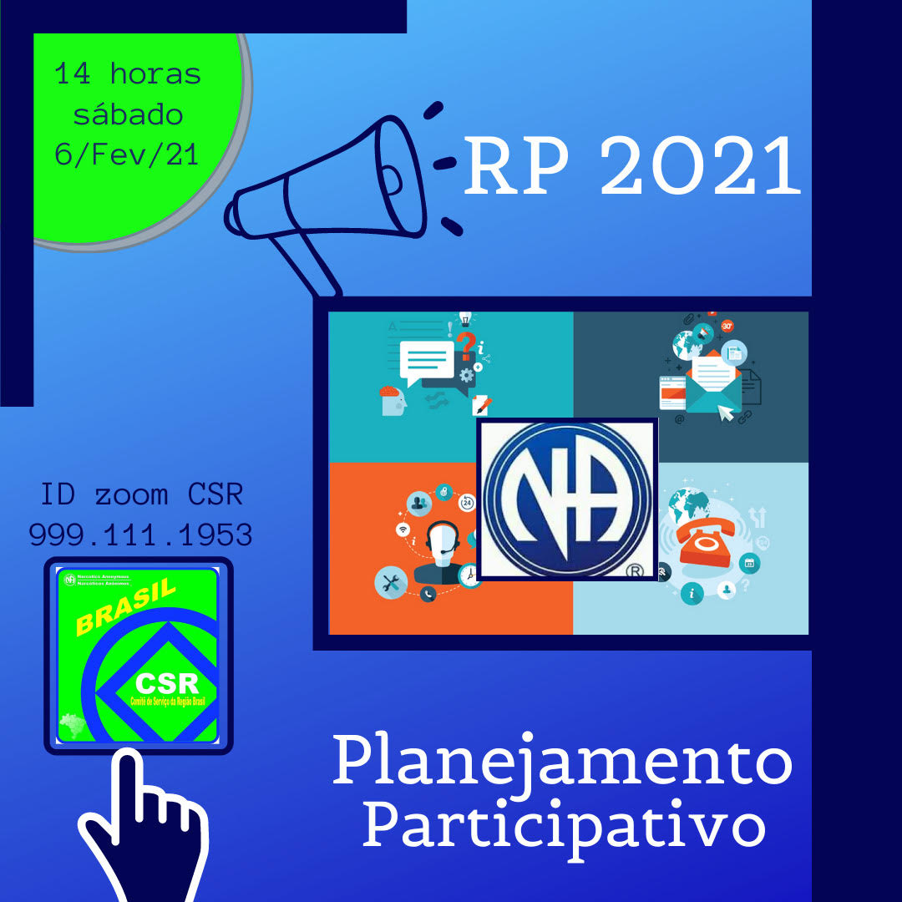
VIRTUAL FD/PR ACTIVITIES
VIRTUAL MEETINGS;
NEW NA GROUPS THAT “WERE BORN” FROM ONLINE MEETINGS;
FD/PR ONLINE WORKSHOPS;
SERVICE WORKSHOPS: HELP LINE, h&I, VIRTUAL MEETING SERVICE, how to use zoom;
VIRTUAL EVENTS ABOUT STEP STUDY, TRADITIONS, SERVICE CONCEPTS;
PEOPLE WHO LIVE OUTSIDE THE AMAZON are ALSO Of SERVICE in THE AMAZON!

Slide 40



THANK YOU FOR PARTICIPATING!
BE Of SERVICE!
www.na.org/br

Slide 42

RUSSIAN- speaking ZONAL FORUM

Slide 43
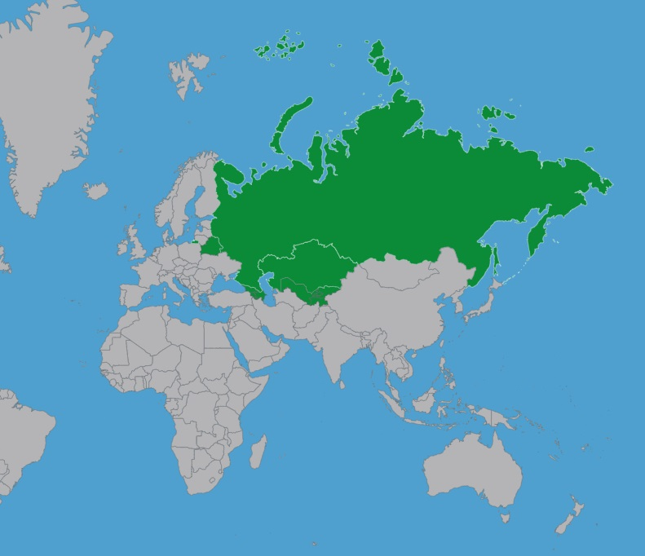
Countries
Russia
Abkhazia
Armenia
Azerbaijan
Belarus
Donetsk People’s Republic
Georgia
Kazakhstan
Kyrgyzstan
Lugansk People’s Republic
Tajikistan
Uzbekistan

Slide 44






8 REGIONS
282 towns
758 groups
2631 meetings every week

Slide 45
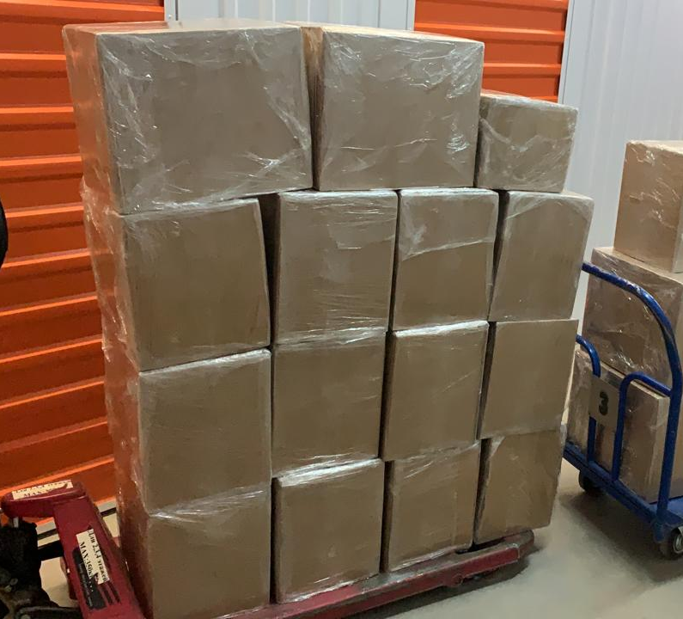
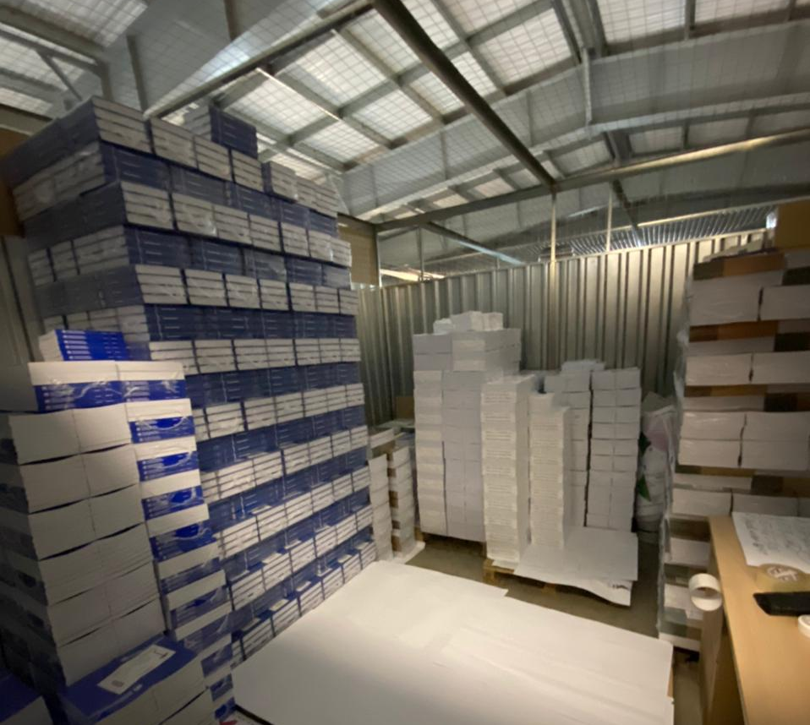
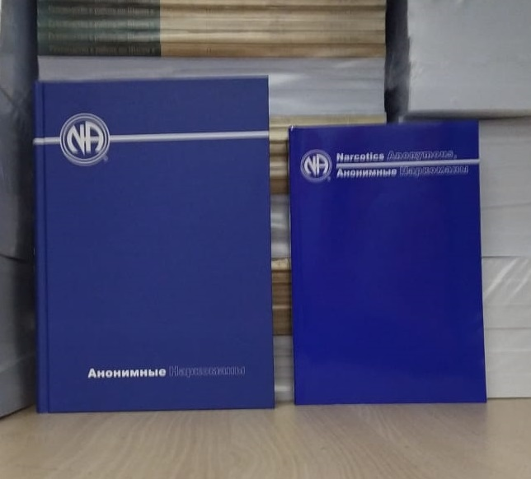
Literature and LTC
All recovery literature is translated
Agreement with NAWS on printing
First edition of BT 6 is printed

Slide 46

MY HOME PHARMACY
NA name cards and posters placed in:
pharmacies
drug treatment clinics
outpatient psychiatric clinics
tuberculosis dispensaries
pawn offices etc.

Slide 47
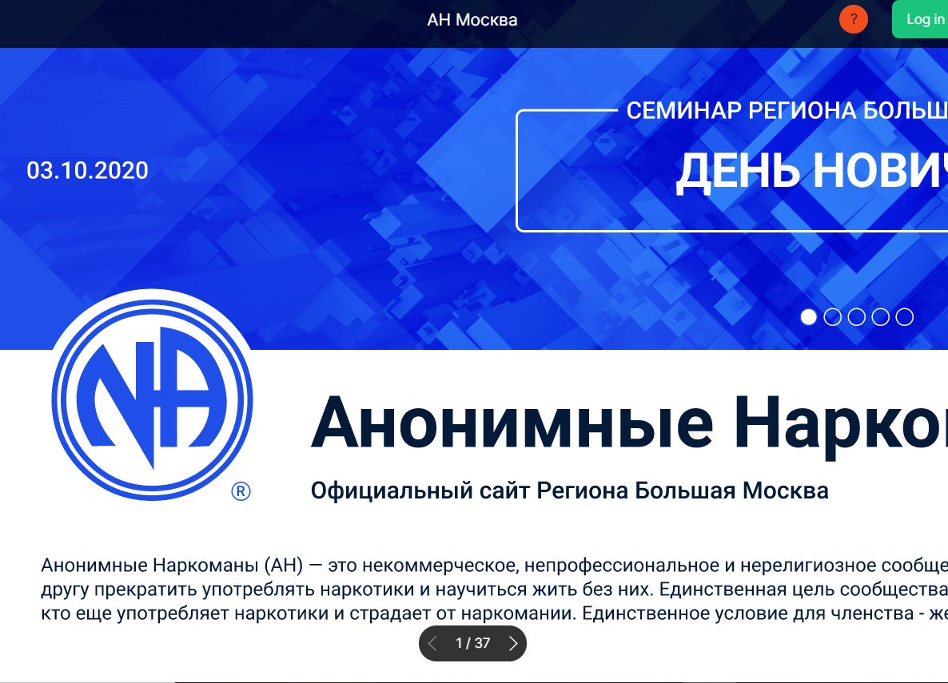
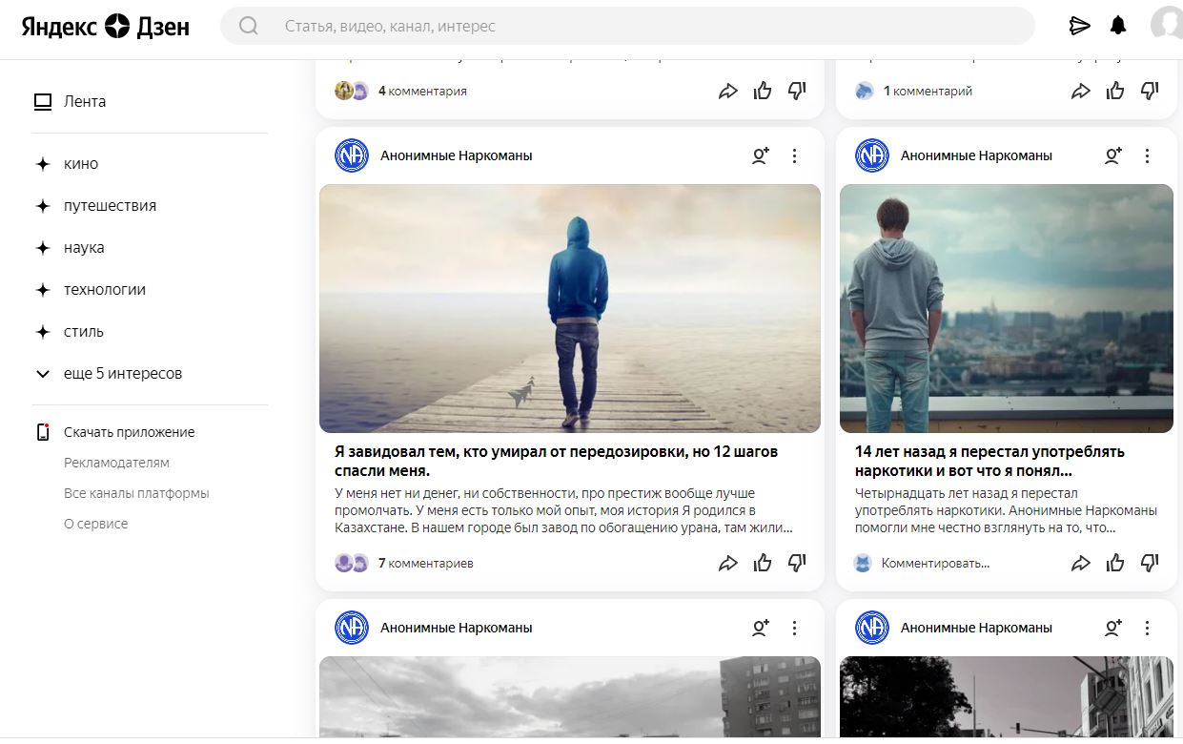
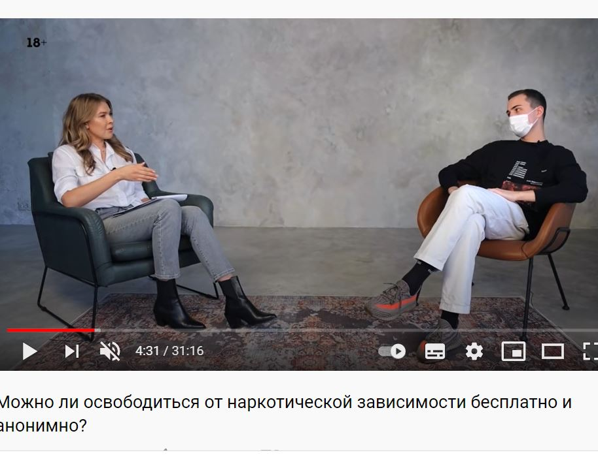
Digital
Website SEO (Search Engine Optimization)
Yandex Zen (Blog with addicts’ personal stories)
YouTube channel

Slide 48
NA Radio
24/7 Internet broadcast
Speakers
Interviews with trusted servants
Reading NA book excerpts

Slide 49

THANK YOU
STAY SAFE!!!
http://na-russia.org/

Slide 50

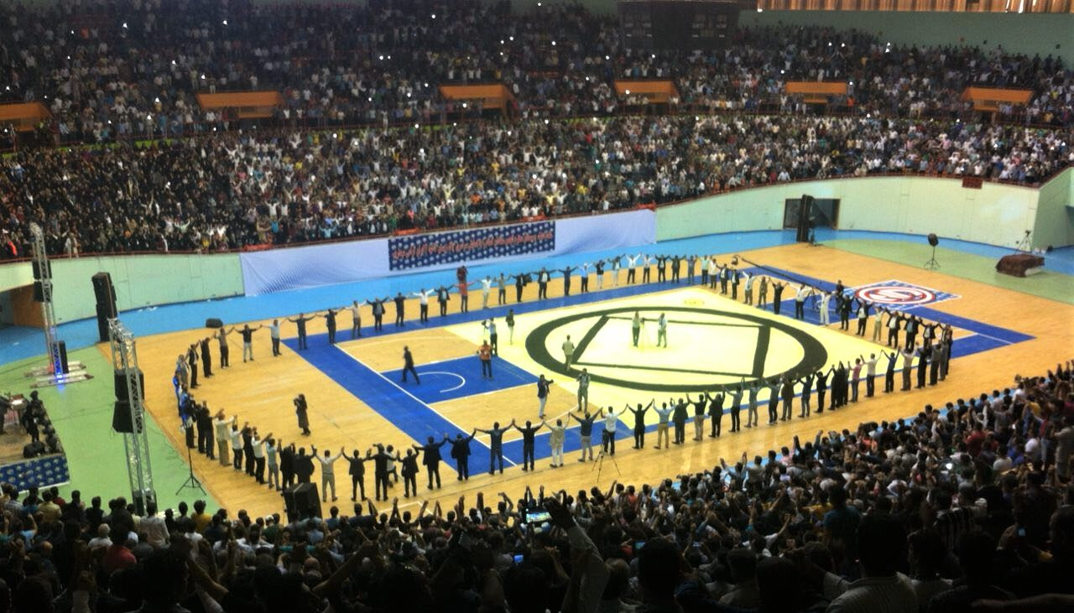
Iran Service Day flyer
Iran Convention 2015

Slide 51
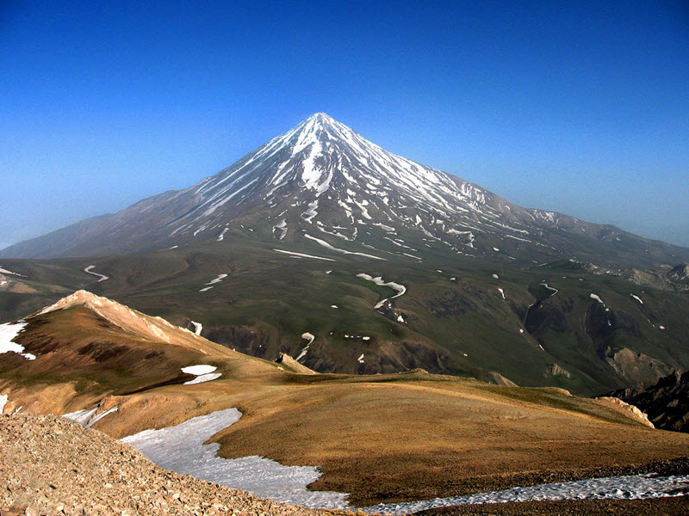
An Update of NA on Iran
over the Past 14 months of the Covid19 Pandemic
IRAN

Slide 52
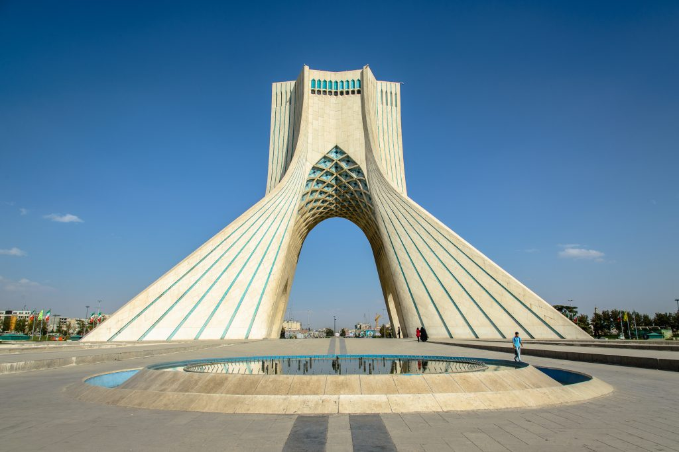
An Update of NA on Iran
over the Past 14 months of the Covid19 Pandemic
TEHRAN capital of IRAN

Slide 53
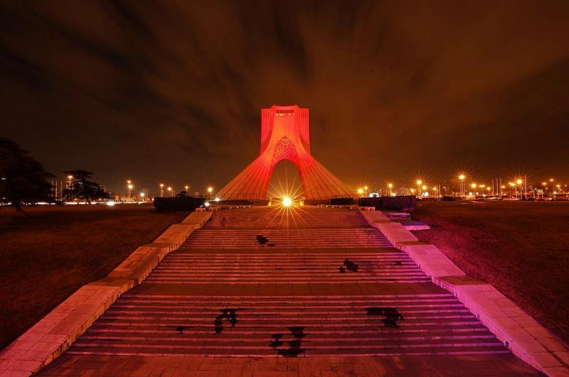
An Update on NA in Iran
over the Past 14 months of the Covid19 Pandemic

Slide 54

We have one of the World Service Offices here in Tehran, Iran. We translate all NA literature here, and we do it as fast as it is produced in US.
Milad Tower in Tehran

Slide 55
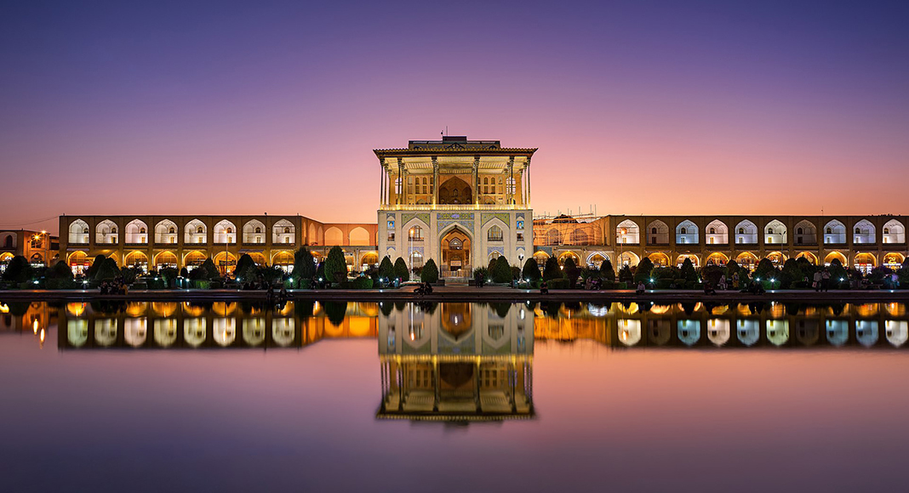
We offer in Farsi 10 books, 8 booklets, 34 pamphlets, many different bulletins, and have all of Key Tags.
City Isfahan

Slide 56
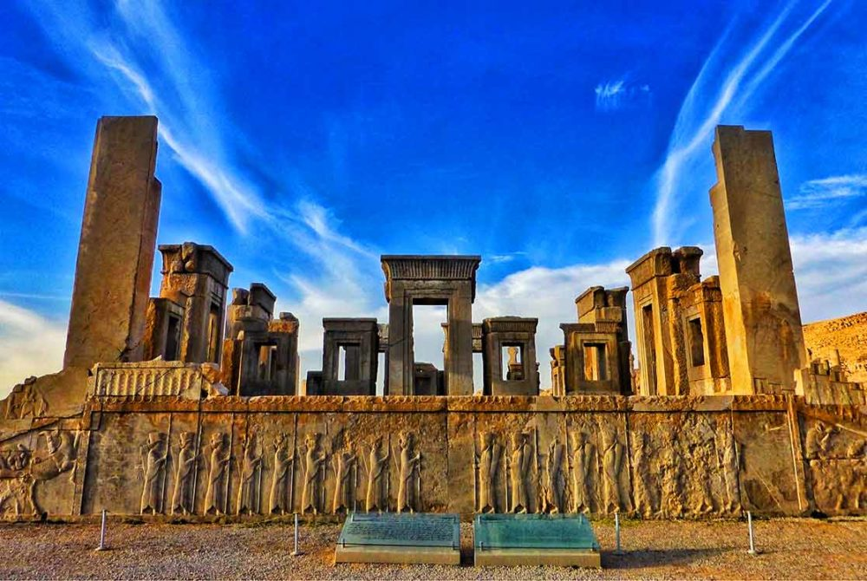
The Iranian fellowship puts great efforts into being up to date on all of the current topics and issues of our fellowship. We try to make them available to all Farsi speaking communities in Iran and around the world.
Persepolis
A city in ancient Persia

Slide 57

Aladaghlar - Colorful Mountains Near Tabriz
Amazing Nature Phenomenon

Slide 58

Iran’s service structure consists of 2 regions in the form of 37 Areas, and 306 metro committees, all who serve and help the groups hold their meetings and carry the message to the still suffering addict as best as they can.
Approximately 25,000 trusted servants are currently taking care of the service works in Iran.
Aladaghlar-Colorful Mountains Near Tabriz
Amazing Nature Phenomenon

Slide 59
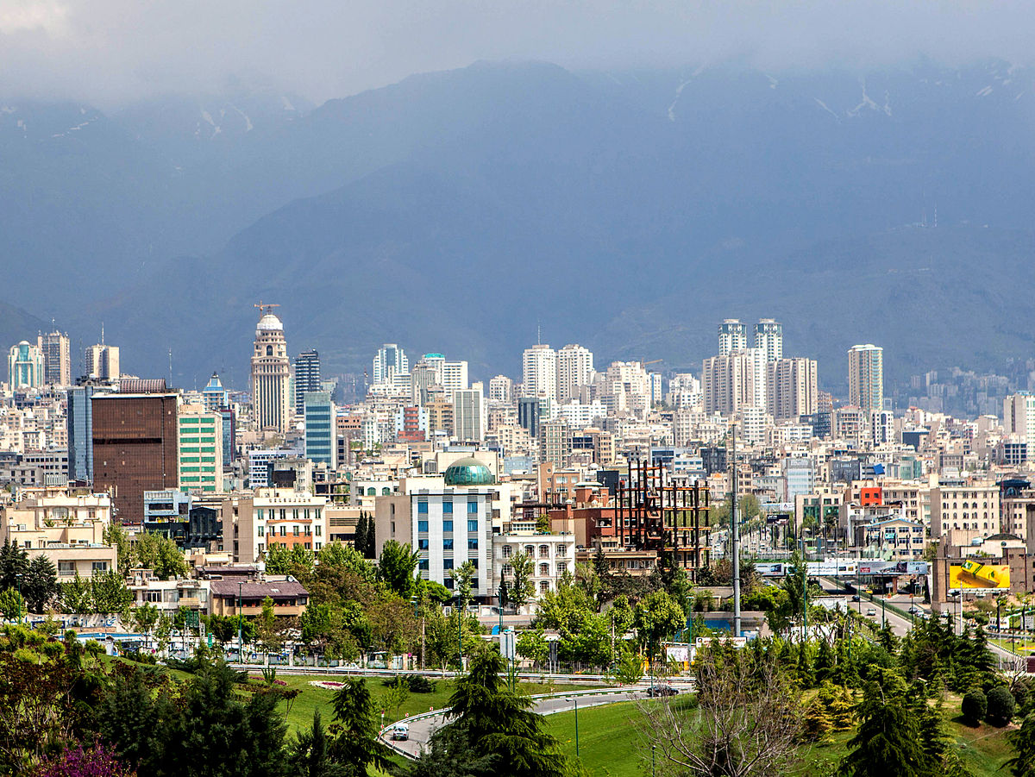
For Fellowship Development of Narcotics Anonymous of Iran and Farsi speaking communities in the neighboring countries and even other parts of the world; Iran’s service structure has had many online virtual workshops and ready to continue doing so. We are always available and ready to help.
Tehran

Slide 60
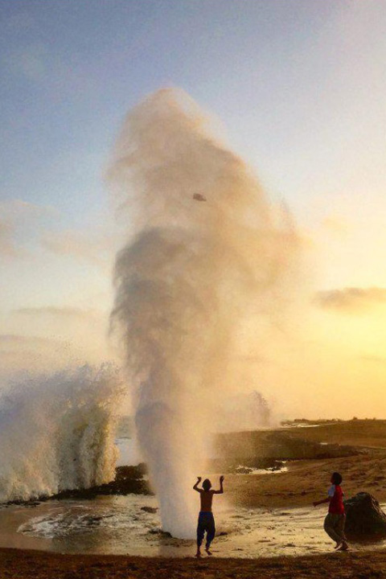
With the start of Covid19 pandemic and the lockdowns; Iran’s WSO was first to start using cyberspace for online virtual meetings. Our first zoom meeting stared on March 2nd 2020 With 3 meetings a week and quickly after, most groups followed this pathway.
Chabahar – South of Iran

Slide 61

Before the Pandemic we had 23,800 meetings per week. Now, after 14 months of the Pandemic, we have 1,500 online meetings per week, or about 215 meetings a day. We’ve also had over 150 different types of service meetings during this period.
Persepolis

Slide 62
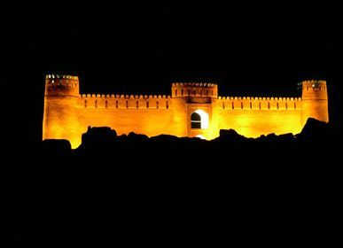
There has been more than 100 various online workshops with topics like literatures, sponsorship, traditions and concepts, FD, PR and so on…
Arg Bam Kerman

Slide 63
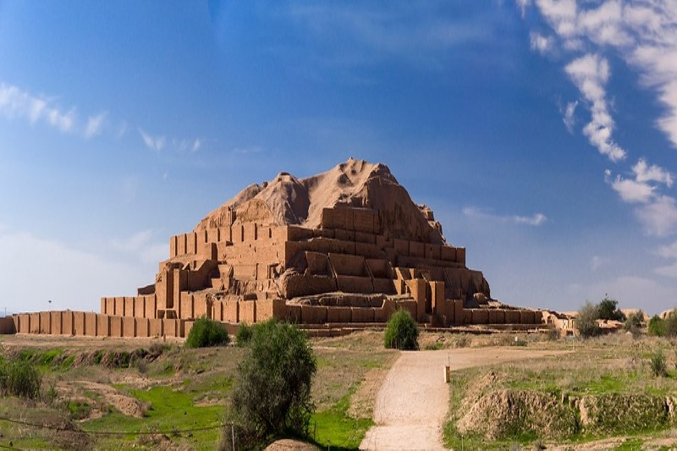
I know 10,000 key tags were sold to groups and we believe these were given to roughly 7,500 Newcomers during the Pandemic.
My own experience is I’ve seen many new people coming to our meetings and getting clean. My online Homegroup has had many newer members join and several just celebrated their first year clean!
Shoush City in Khozestan

Slide 64

Hugs & Tons of Love to you all from
NA IRAN
https://na-iran.org/
http://nairan1.org/
Tehran In Snow

Slide 65
Free and Subsidized Literature 2011-2020

Slide 67


Slide 68
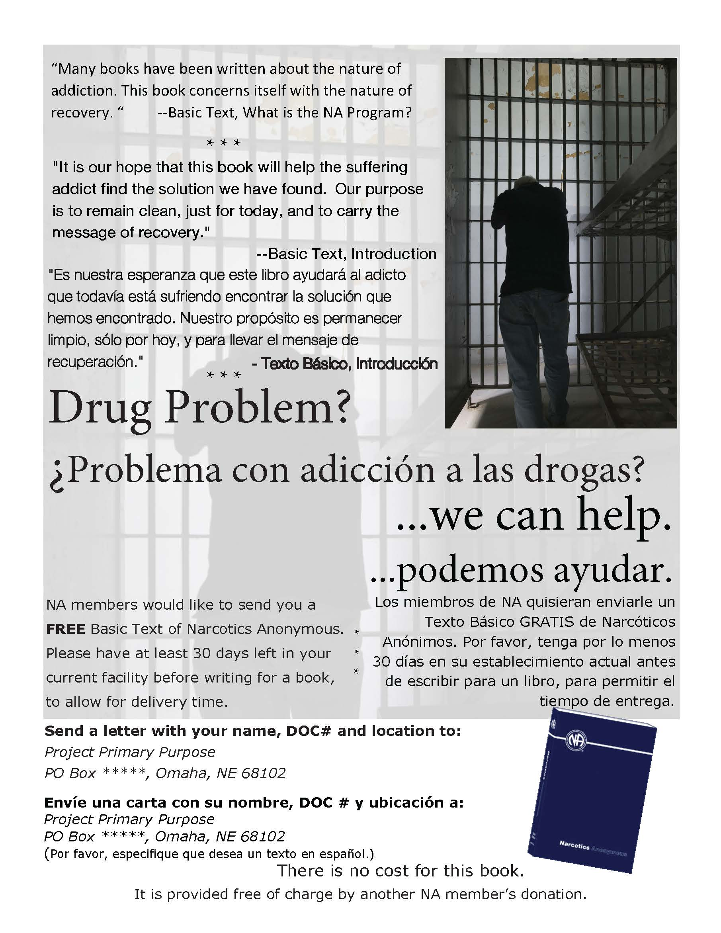

Slide 69
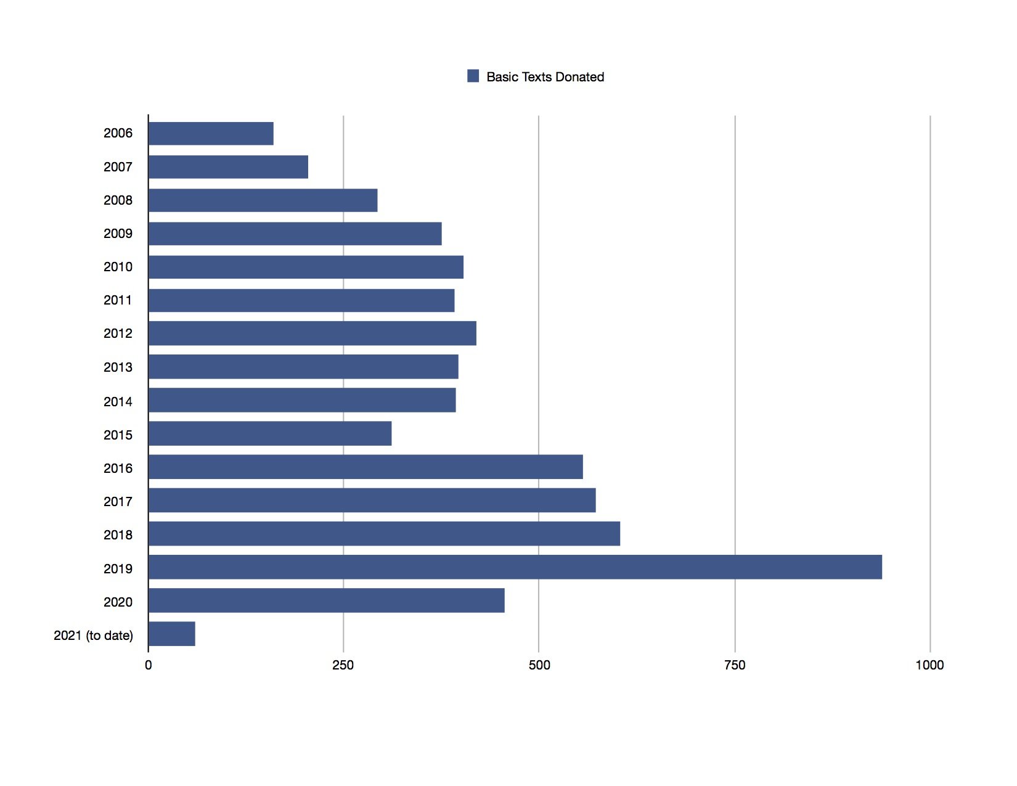

Slide 70
WHERE WE ARE AT NOW
STATE INSTITUTION MAILINGS ( NE, IA, KS, SD, OK, BLR )
OTHER REGIONS WE HAVE MAILED TO ( AR, CA, CO, ID, IL, FL, MA, MO, MN, NM & WY )
OVER 6500 BT SINCE 2006
Need more information or have questions?
Email ENNAPR@COX.NET

Slide 71
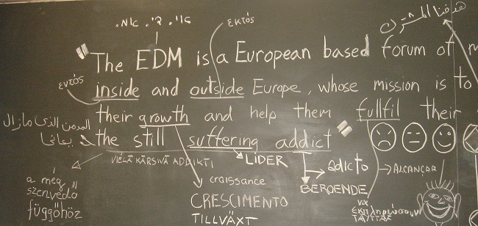

Slide 72


Slide 73


Slide 74
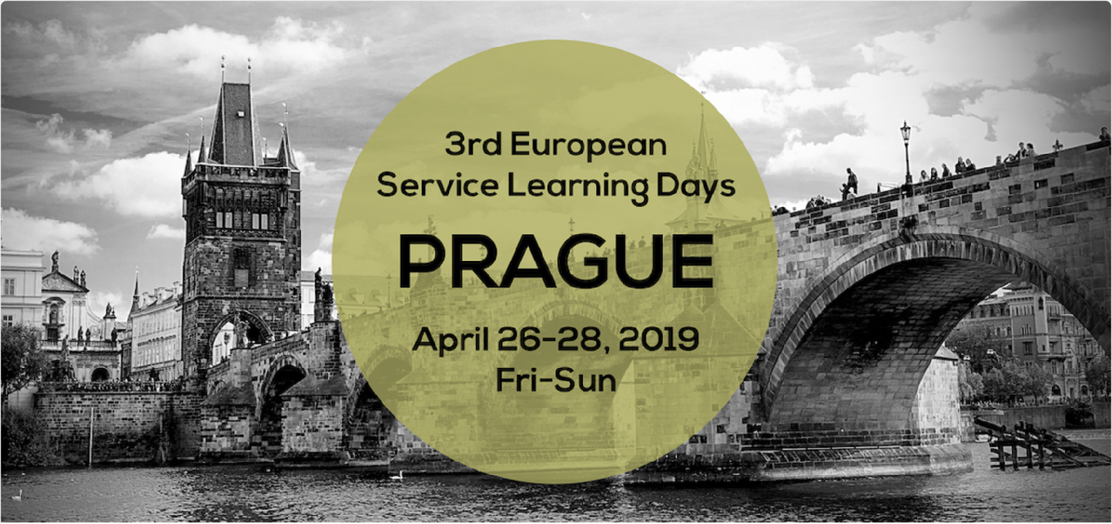

Slide 75


Slide 76


EUROPEAN SERVICE LEARNING DAYS 2021
PROGRAM (all in CET times):
DAY 1: (SATURDAY 8TH OF MAY 2021)
10:30 to 11:00 AM INTRODUCTION TO THIS YEAR ESLD
11:00 TO 12:30 RECOVERY MEETING
“SPEAKERS FROM GROWING FELLOWSHIPS AROUND THE EDM ZONE”
DAY 2: (SUNDAY 9TH OF MAY 2021)
10:30 TO 11:00 AM iNTRODUCTION TO TODAY’S PROGRAM
11:00 TO 12:30 RECOVERY MEETING
“SPEAKERS FROM GROWING FELLOWSHIPS AROUND THE EDM ZONE”
12:30 to 14:00
Lunch break (ENTERTAINEMENT)
14:00 to 15:30 PR WORKSHOP
“PR MOVING FORWARD”
14:00 TO 15:30
FD WORKSHOP
Our 7th tradition: contributions rather than fundraising 15:30 TO 16:00
ENTERTAINEMENT
16: TO 17:30 PM NAWS WORKSHOP
“VIRTUAL MEDIA MEETINGS AND SERVICES”
ZOOM MEETING DETAILS:
16:00 TO 17:30 PM EDM NEWS WORKGROUP
“CARRYING THE MESSAGE AND SOCIAL MEDIA”
DAY 1: Meeting ID: 840 2189 4474
Passcode: 806337
DAY 2: Meeting ID: 814 2380 6242
Passcode: 984017
7TH TRADITION CONTRIBUTIONS DURING ESL
Please note on the transfer: ESL 7th Tradition and who is making the contribution Bank name: ING Bank Account holder: European Delegates Meeting NA IBAN BE17 3634 4057 2121 SWIFT or BIC BBRUBEBB
Bank Address Bank ING, Av. de la Couronne, 449, 1050 Brussels, Belgium

Slide 77
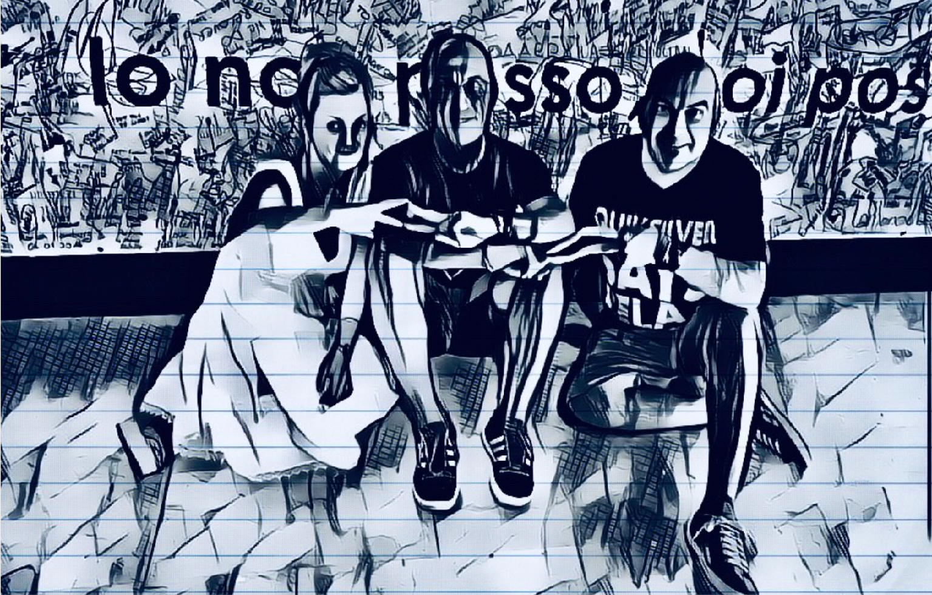

Slide 78
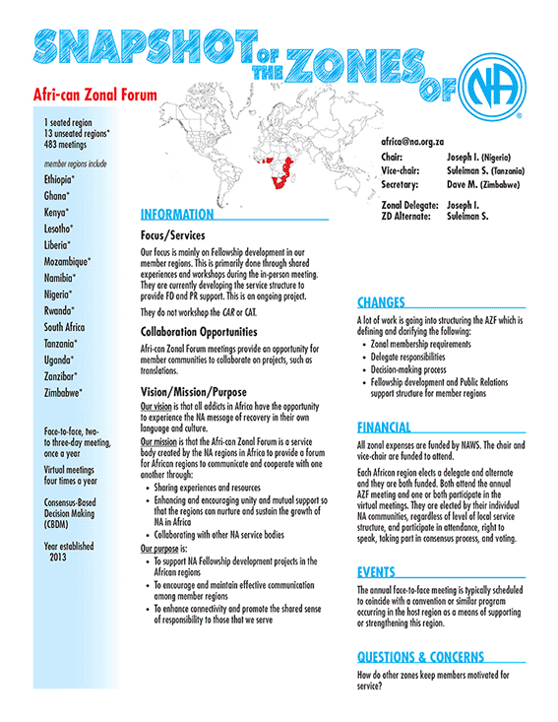
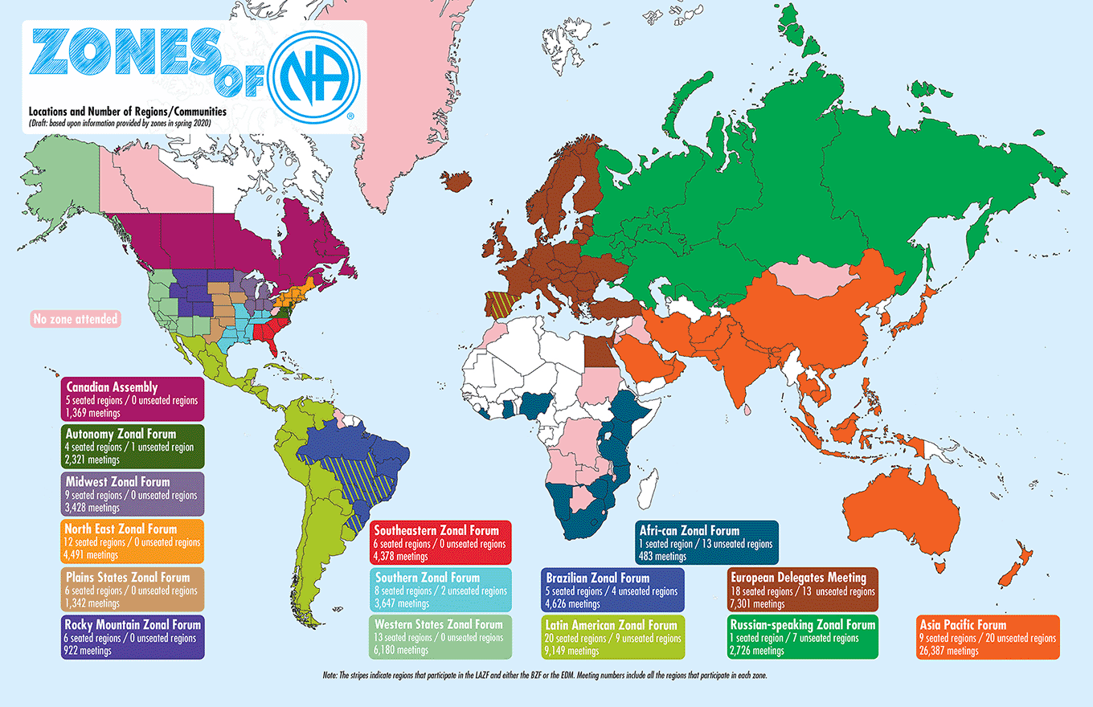
Notes:
On the subject of zones: We have been holding web meetings for zonal FD and PR and a virtual meeting of all zones. The virtual meeting of zones will be the workgroup for the Role of Zones project this cycle.
We published a resource, called the Snapshot of Zones, that gives a quick look at every zone. It’s posted on the WSC 2020 Virtual Materials page (which you can find by following the WSC 2020 link at the top of the Conference page),

Slide 79
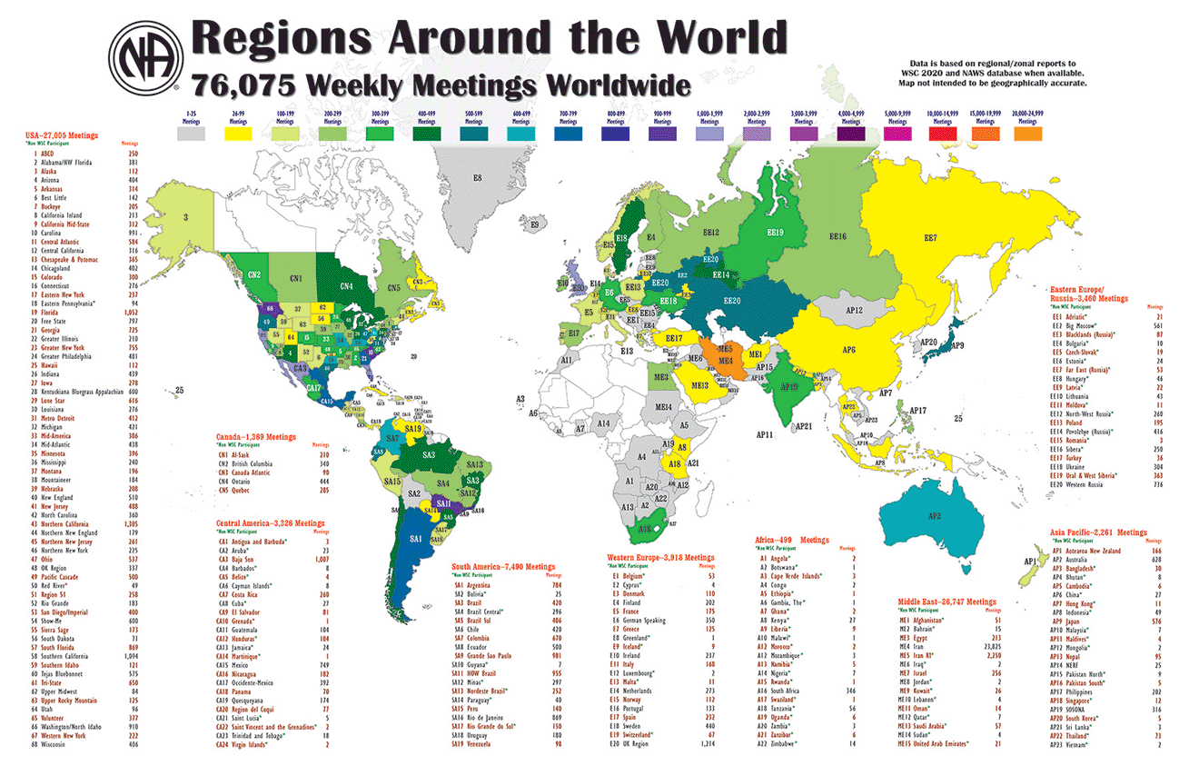
Notes:
Before the global shut-downs changed everything, there were more than 76,000 NA meetings weekly around the world.
But there’s still a lot to do. The white places on this map are the countries where NA hasn’t yet reached. And there are many spaces within existing NA regions where there are no meetings yet.
So many efforts are happening to color in this map and its life changing message around the world

Slide 80
Service in Nigeria
Managing Scarce Resources

Slide 81
NA in Nigeria
5 groups with about 8 meetings
Groups are concentrated around North-West Nigeria. But there are groups in other parts of the country and members are all over the country.
When we first reached out to NAWS to request literature to help us start our first group, we were surprised and grateful that we had this support, and pleased that the items were shipped to us.
Keep in Mind that it costs about 25USD to ship a 1kg parcel from Nigeria to the US (not sure what the cost is the other way around)

Slide 82
NA in Nigeria
With COVID, like the rest of the world, groups had to switch to Zoom and other virtual meeting platforms in order to have meetings.
This presented an opportunity for members to not just link up with other groups in Nigeria, but with the worldwide fellowship, as a lot more virtual meetings became available.
For the first time it was possible to ask a sponsee to attend meetings every day for a period of time (think 90 meetings in 90 days)

Slide 83
What are some of the Ideas we have come up with?
To help us all manage the cost, Literature management has been centralized at the “regional level”. Groups from across the country send their literature requests to the region, and then the region compiles and forwards this request to NAWS and receives the items from NAWS.
Selling the literature to members at the recommended prices would be prohibitively expensive to most members, as such, members are charged a token fee, and those funds are used by the groups to manage expenses including covering the costs of shipping of the items from the region to the group

Slide 84
What are some of the ideas we have come up with?
Virtual meetings have also given us the idea to link up as groups to other groups specifically for:
  Step working meetings
  Speaker meetings
  NA Workshops
  Sponsorship
The nascent nature of the fellowship in Nigeria means we do not have as much resources to support these domestically and so linking up with NA globally helps us tap into these resources.
Also funds for covering such linkups as groups can be raised from literature sales and member contributions.

Slide 85







Slide 86



Information about
MVP
MVP

Slide 87
MVP Who we are?
The multinational virtual panel of hospitals and institutions manages activities in conjunction with “reintegration and social rehabilitation” institutions starting in the state of Veracruz, Mexico since June 18, 2020. We formally began virtual links with penitentiary centers in Veracruz in September 2020.

Slide 88
Who and how we serve?
We serve 23 social reintegration centers (prisons)
We have had the presence of 868 inmates in our virtual meetings from January 1 to April 15, 2021
Just during those dates we have had 61 newcomers come for the first time to a 12-step recovery program
We hold meetings in 6 different formats so that the members stay interested and responsive.
To date we have 0 reports of indiscipline in any of the centers where we carry out the links.

Slide 89
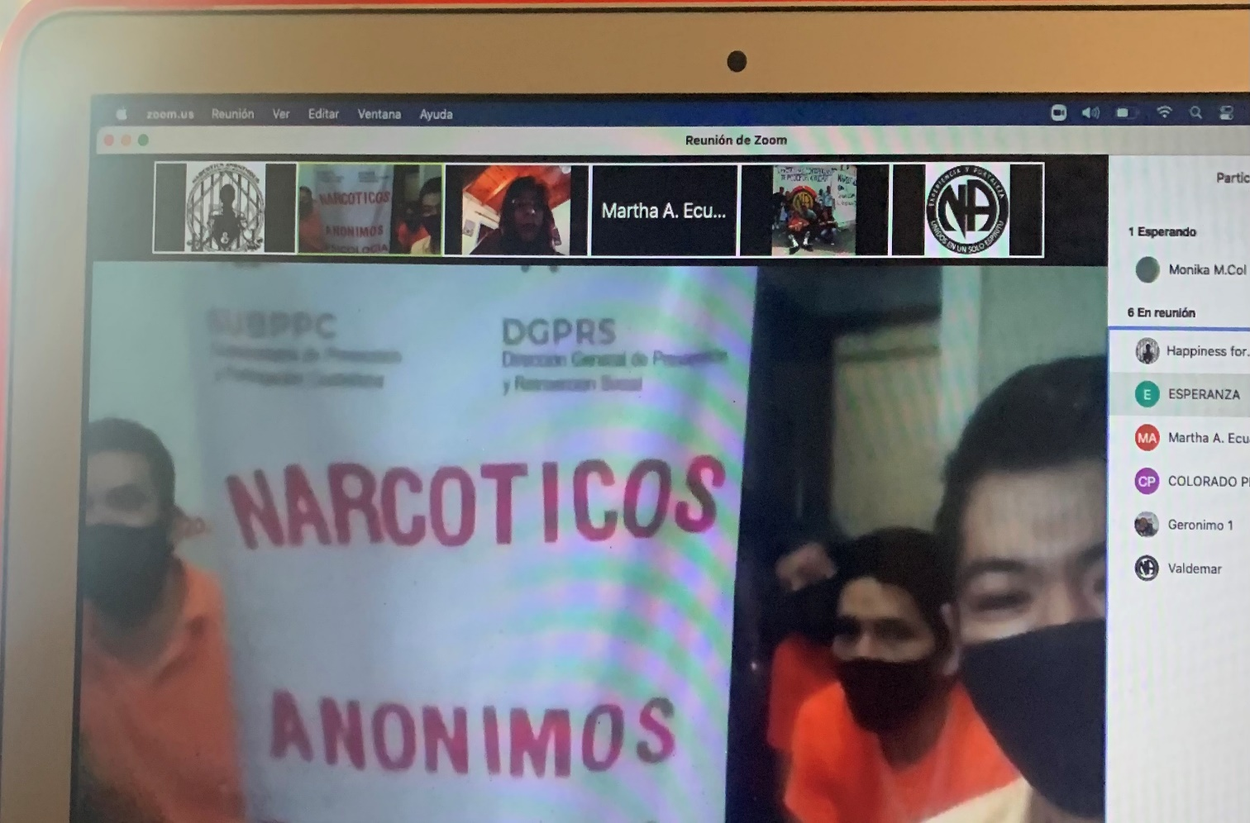
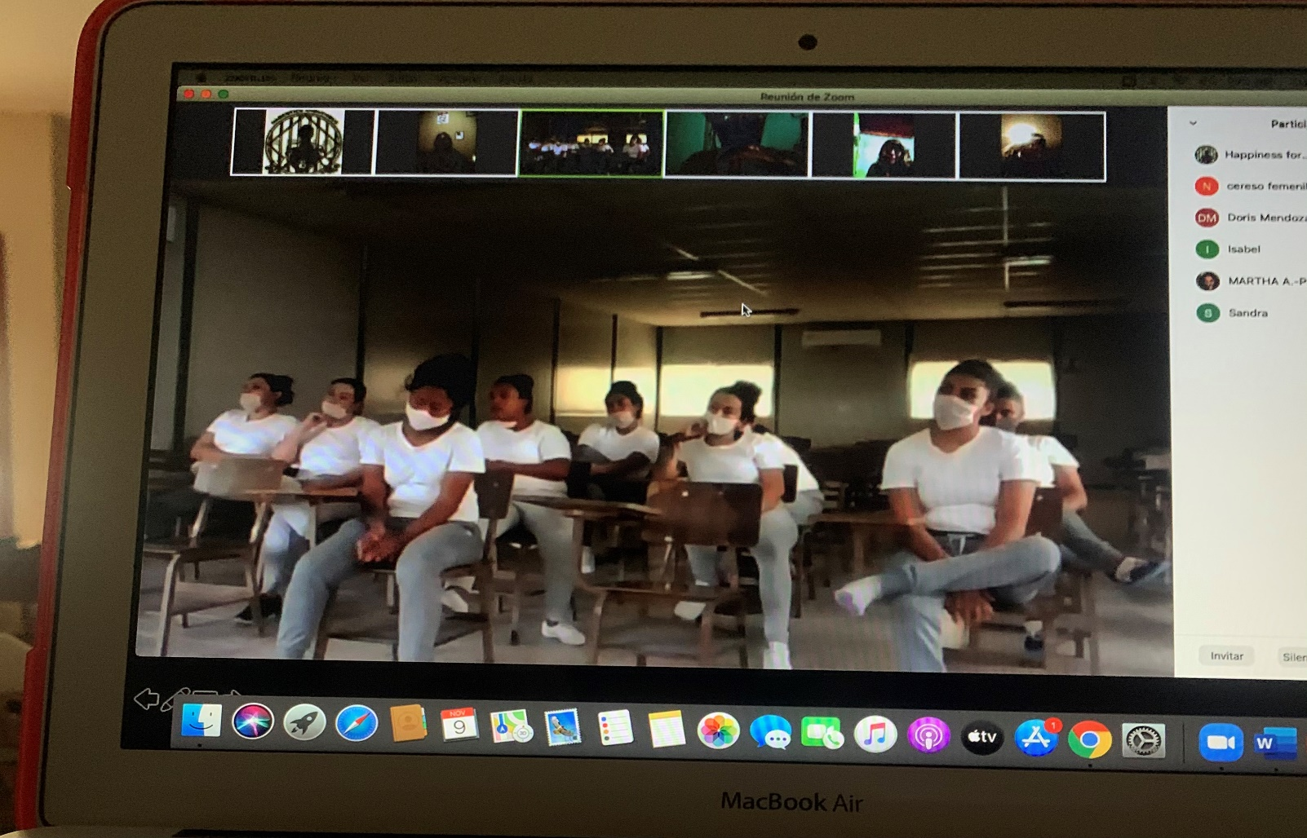
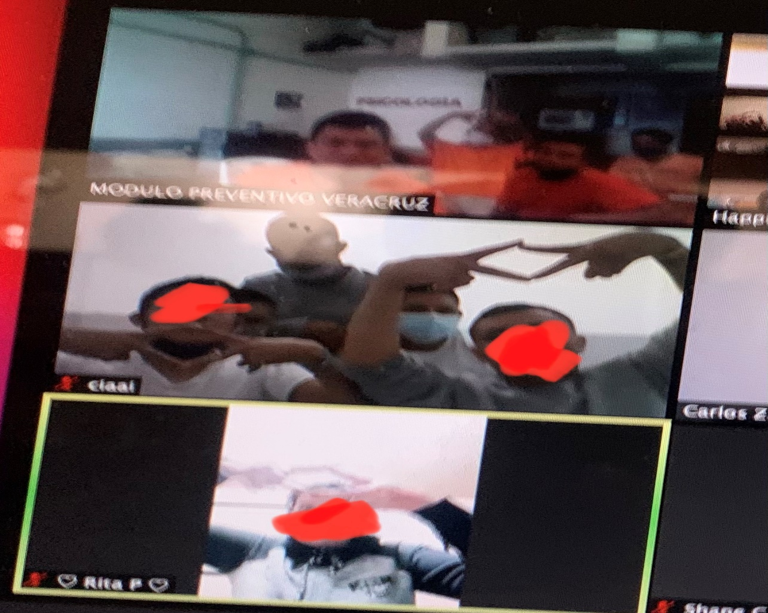



Our service in Images

Slide 90
Literature Donation
We have had the opportunity to carry out literature donations in prisons in Mexico and Ecuador by this virtual panel and recently the world service office reinforced this donation with the sending of 200 introductory guides that have already begun to be delivered to the members deprived of liberty.

Slide 91



México Prisons Donations
WSO donation boxes

Slide 92



Ecuador Prisons Donations
As a result of the meetings with the multinational virtual panel in Manabi, Ecuador, the institutional group "the last chance" was opened.

Slide 93
The multinational virtual panel appreciates the opportunity to continue sharing the message of recovery from the disease of addiction and reiterates its commitment ... we are waiting to serve in 3 more countries.
We have a team of more than 46 willing and available servers from several parts of the world trained and committed.

Slide 94


Contact
www.na.org
www.forozonalatino.org.
gtrrppfzla@gmail.com
panelvirtualna@gmail.com
(52)7821146953

Slide 95
Middle East Workshop
February 2005 - Bahrain

Slide 96


Slide 97

Background
22 Arabic-speaking countries
Half have no NA meetings
Other half do have NA meetings but vary in size and maturity
The idea of cooperation based on Arabic language was born during 5th NA ME workshop by NAWS , Dubai Nov 2017
The team was very small until sept 2020 (unity day event)
Many members have showed interest

Slide 98
Structuring the team
The team first service structure was formed on Oct 2020.
The team has become more organized and focused.
Team’s Vision and goals were created.
Four Goals were defined based on survey’s outcome.
Written R&R for each service position were provided.
Clear tasks for each position.
Specific KPI’s for each Goal leader.

Slide 99
Chair
Ala ( Egypt)
Secretary
Mohd. ( KSA)
Team 4
Humood ( Oman)
Team 3
Hassan ( Bahrain)
Team 2
Jasem(Qatar)+ Faisal (UAE)
Vice C
Ayed ( KSA)
Team 1
Jasem(Qatar)+ Faisal (UAE)
Treasure
Mohd ( Bahrain )
Members
Members
Members
Members
Team Structure

Slide 100
Vision
NA groups in the Arab communities to be source of hope for recovery from the disease of addiction.
Narcotics Anonymous to become a vital resource to Arab societies and to build relationships based on respect and cooperation.
Promote the spirit of unity and teamwork.

Slide 101
Goals
Contribute to starting new meetings in Arab countries which have no Arabic NA meetings. ( Team 1 )
Support growing NA Arab communities by providing appropriate expertise to help them grow and carry the message. ( Team 2 )
Provide the necessary resources and materials to support the old Arab fellowships in order to help improve the performance of their services in carrying the message and in order to be able to sustain and accelerate the growth process and make NA meetings available in a wider area in those countries. ( Team 3 )
Encouraging NA service groups and structures in Arab countries to unify the efforts of their service structures and meet in a cooperative framework that helps them exchange experiences and successful practices. ( Team 4 )
Each Goal has a team leader + members

Slide 102
2021 Plan
Timeline is 31 Dec 2021 - to continue if the Arab NA communities fail to establish a forum.
Start new meeting and support communalities to grow. Focus on Sudan, Jordan, Morocco, Iraq, Tunisia, and Yemen. (team 1&2).
Conduct Workshops (ASC planning & inventory, H&I, PR, Helplines and 12 Concepts), create service materials bank. Team 3
Create and submit collaboration forum initiative. Team 4
Review and assess the team performance after 6 months.

Slide 103
Managing the team
NASTAC was not formed by NA communities as it is basically an initiative by volunteer fellows.
Setting clear goals that enable the team to meet the vision.
Plan to implement goals.Time and resources.
Establish practical and appropriate procedures to implement the objectives.
Distribute tasks among team members in proportion to each goal (a team for each goal).

Slide 104
The four teams leaders are accountable to NASTAC service structure.
Specific tasks given to ease the leaders job.
Key performance indicators help the service structure to measure the performance of each team.
Follow-up and review the performance of the team and the sub-teams.
Meet virtually once a month, each team leader will provide a report.
In the monthly meeting thoughts are shared on issues addressed in the team’s report.

Slide 105
Things done so far
Surveys and data collected from NA Arab communities.
Virtual workshops on different topics (Group service, Traditions, Concepts, PR , H&I and ASC). One workshop every two weeks.
PR presentation for staff and addicts in one Tunisian treatment center.
Started NA meeting in Tunisia.

Slide 106
Created service materials bank. (cloud)
Link NA members in Iraq with fellows in Arab countries.
Workshop for Sudanese NA members.
PR for professionals in Sudan and participation in the group’s 4th anniversary.
Created detailed initiative to create NA Arabic Forum. Communities feed back By July 2021.
Monthly meetings (1st Sunday of each month).

Slide 107
Funding
NASTAC has not asked for donations. Not much money needed for the time being.
WSO is providing free literature to growing communities.
Sources of money in NA usually depend on donations from members, groups, service committees, and through fund raising events (conventions).

Slide 108
Thank you

Slide 109

Notes:
As members, we are all aware of the silver linings that can come from difficult times. One of the exciting silver linings for us has been the progress we have been able to make with providing increased access to some of our members or potential members that are incarcerated by providing NA literature through inmate tablets. This is still in its infancy stage for us and would not be happening without the dedication and work of local trusted servants and their ongoing communication with our public relations manager. This is a perfect example of the type of decision we face often that makes no sense as a business decision but is absolutely in keeping with our primary purpose. We are very excited about this new ability to get our message to those with limited or no access otherwise.

Slide 110

NA e-Lit on the tablets of
45,000 potential members incarcerated in Ohio.
How it happened.
Central Ohio Area of Narcotics Anonymous
nacentralohio.org
COASCNA@gmail.com
Facebook: Central Ohio Narcotics Anonymous PR
Instagram: CentralOhioNarcoticsAnonymous
Paul M, Public Relations Subcommittee Vice Chair

Slide 111
Short story:
Through NA unity, and newly established and existing relationships with professionals in the community.

Slide 112
The COVID lockdown actually inspired opportunities to reach out to criminal justice (CJ) professionals in new and creative ways.

Slide 113
In March 2020 with the help of other NA service bodies like the North East Zonal Forum and the New England Region of NA, COASCNA learned how to host virtual and hybrid meetings.

Slide 114
Starting in April 2020 we began reaching out to CJ professionals with the hope of establishing virtual meetings in prisons and jails.

Slide 115
In July we began participating in the NEZF’s planning committee for a CJ Professionals Conference to be held on three separate dates in September.
This was a conference with panelists from various criminal justice settings, including a panelist from our Franklin County Drug Court here in Central Ohio.
There were 8 other CJ professionals from Ohio who attended, along with many others from around the country.

Slide 116
During the Conference, after the main presentation, we went into breakout rooms to discuss barriers and to brainstorm solutions and generate new ideas.
It was here, in September 2020, that
COASCNA first learned about the possibility of getting NA literature on the computer tablets of inmates in Ohio institutions.

Slide 117
We reached out to Jane at NAWS to discuss options. She was very encouraging and said it was possible, and connected us with Dodie, a trusted servant in Sarasota, FL.
Years ago she had succeeded at getting literature pushed out onto tablets in a Sarasota County Jail.
She was kind enough to share the Letter of
Permission, which was a form letter from the Sheriff’s Office and which needed to be signed by both the Sarasota Sheriff’s Office and NAWS.

Slide 118

The Copyright Permissions letter that Sarasota Sheriff’s Office needed to get signed by NAWS.

Slide 119
When I refer to eLit being pushed out, I mean that the tablet manufacturer, GTL, makes the literature available on the tablets in a stand-alone library. For free.
This is at no cost to NAWS, the prison system, to GTL, COASCNA, or to the inmates.
It is made available to the inmates automatically; they do not need to use their commissary funds to purchase it, nor do they have to download it from a prison kiosk.

Slide 120
We connected with the Ohio professionals who attended the Criminal Justice Professionals Conference to propose the idea of pushing out eLiterature in Ohio.
Our main contacts were:
• Ohio Department of Rehabilitation & Corrections (ODRC)
• Ohio Department of Mental Health and Addiction Services (OHMAS)
• a State of Ohio initiative called Recovery Ohio.

Slide 121
We used the Sarasota, FL Letter of Permissions as a template and drafted a similar one.
We took the initiative of adding the logos of both ODRC and OHMAS to the letter, to make it look professional and to make the entire process as easy as possible for them.

Slide 122

The letter that our Area PR drafted for Ohio’s ODRC and OHMAS.

Slide 123


Slide 124
Through consultation with NAWS, the following five pieces of literature were pushed out to 45,000 inmates in the ODRC system:
• The NA White Booklet
• Behind the Walls
• Staying Clean on the Outside
• Self Acceptance
• The Triangle of Self Obsession

Slide 125
This initiative depended on:
Working with other members of
NA across the US via the NEZF…

Slide 126
This initiative depended on:
Existing COSCNA PR relationships in the community…

Slide 127
This initiative depended on:
New COASCNA PR relationships developed during the Professionals Day Conference.

Slide 128
As a matter of fact, the ODRC required that OHMAS be a signatory on the Letter of Permissions.
The very person responsible for signing the letter on behalf of OHMAS was one of the attendees at the Conference in September.

Slide 129
NOTE: There are a few tablet manufacturers.
So far we have worked only with GTL via the ODRC.
To find out if GTL provides tablets to any institutions in your area or region, go to this link and sort by state: https://web.connectnetwork.com/facilities-list/

Slide 130
  After we were successful, we worked with the Arizona Region, sharing our ESH, and in April they experienced similar success.
  Now 40,000 inmates in Arizona have easy and free access to our literature.

Slide 131
On May 30, 2021 the three of us—
— Sarasota Shark & Sun Coast Area
— Central Ohio Area
— Arizona Region will host a virtual service learning event.
Each will talk in more depth about how we accomplished this. The email for the event is:
NAeLit2021@gmail.com

Slide 132


Slide 133


www.na.org/contribute
Notes:
One of the other new pages we created shortly after the global shut-downs was this contributions page, which you’ll find at na.org/contribute along with a button on the meeting finder app.
As we mentioned at the beginning of this presentation, the pandemic had an immediate effect on World Services’ income. We’ve known for a long time that we needed to shift our reliance from literature sales to member contributions, and maybe this is the universe conspiring to make that happen more quickly. We’ve made it easier to contribute, which you can now do through PayPal or a credit card. If you want to be sure your contribution gets noted as coming from your group or service body, however, you will want to use the original contributions portal, which is linked to on this page.

Slide 134







What’s coming up?
www.na.org/survey
@narcoticsanonymous
www.na.org/subscribe
www.na.org/fipt
wb@na.org
www.na.org/spad

