Slide 1
Fellowship Development
It’s not just something that happens “somewhere else”

Slide 2
Twelfth Step
Having had a spiritual awakening as a result of these steps, we tried to carry this message to addicts, and to practice these principles in all our affairs.
What is Fellowship Development?

Slide 3
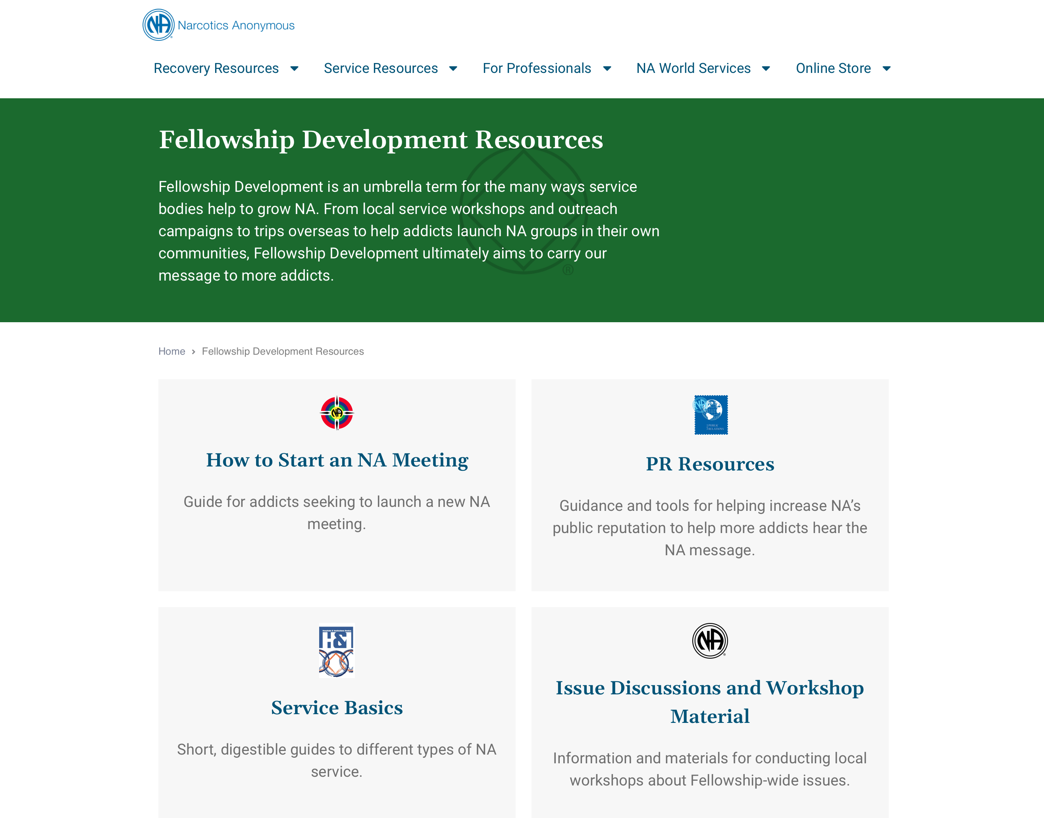
na.org/fdresources

Slide 4
1
Which country has the most NA meetings in the world?

Slide 5
2
Outside of Iran, what region has the most NA meetings?

Slide 9
What ingredients do we need to make FD soup?
Such as…
Assets: passion and humor
Principles: love and willingness
Resources: talent, money, and experience
Practical ideas: outreach and planning

Slide 11
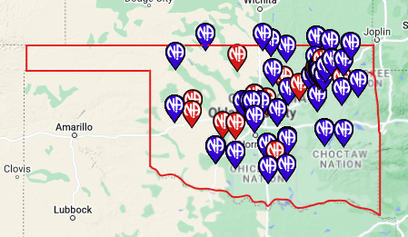
Current Meetings & Locations in the OK Region It Looks Like There Plenty of Meetings – Right?
(By the way……….…This Map of Meeting Locations was generated on: SDLE.ORG - A Great Tool to see where meetings are………… and where they are not!)

Slide 12
But when you zoom in……. This map shows the NW quadrant of the OK Region, a space approximately 100 miles by 150 miles or 15,000 square miles, with 50+ communities served by only 3 groups according to the BMLT!

Slide 13
A Regional Inventory, Long-Term Goal & In-Person Efforts
As a result of an inventory, the OK Region resolved to:
Assist in development of more in-person meetings in rural communities. Set a goal of establishing at least one N A meeting accessible to each county in the Region.
Form a workgroup to explore how to achieve the goals. The workgroup expanded the task to include better serving existing isolated groups and underserved NA communities.
To bridge the gap and in the short term:
Start a virtual regionally hosted meeting to carry the message while also supporting and nurturing target communities.
Trusted Servants will remain online after the meeting closes to be of service and support.
Trusted Servants are working to coordinate with Area subcommittees, offering in-person support to existing isolated NA communities, keeping pardon and parole offices stocked with literature, and helping to start what appears to be the first sustainable Spanish-speaking group in Oklahoma City.

Slide 14
Got its start as:
Rural Outreach and Online Meeting Project a Workgroup of the MRSC Public Relations Subcommittee 2017 – Winter 2020

Slide 15
MRSC Rural Outreach and Online Meeting Project
SLOW PROGRESS: Plan, Test, Launch
2010 – Begin to Explore Video Conf. Tech
Aug 2019 – 1st Online Rural Outreach Meeting
COVID CRISES MOBILIZATION, 2020
March 15 – In-person Meetings Close; Decide to Offer 2 Zoom Meetings Every Day
March 22 – 17 Meetings Total
March 29 –Hosts & Trainings for All Meetings, Temp Sponsors

Slide 16
MRSC Rural Outreach and Online Meeting Project
Projects
Events (i.e. Open House & Rendezvous)
Meeting Verifications
Get Basic Text into all 115 State Libraries
Informational email: welcome@namontana.org

Slide 17
Isolated addicts were attracted to a group of rural addicts, as they could more easily identify with them.
Other addicts were attracted because they felt comfortable in an atmosphere of recovery that was laid back and easygoing. Rural addicts got to experience the experience, strength and hope of a broad variety of addicts from around the world.

Slide 18
Discussion time!
Small group facilitator: ensures all have opportunity to share
Facilitator’s Instructions
Groundrules
Brainstorming Guidelines
Note taker: captures the discussion on note sheet and may report back

Slide 19
Small Group Discussion
Thinking of all the examples of the ways that Fellowship development can happen, what’s the biggest challenge where you live?
What’s one thing you’ve done, or could do, to help overcome those challenges?
1
2

Slide 20
What is one thing you heard in your small group that inspired you the most?

Slide 21
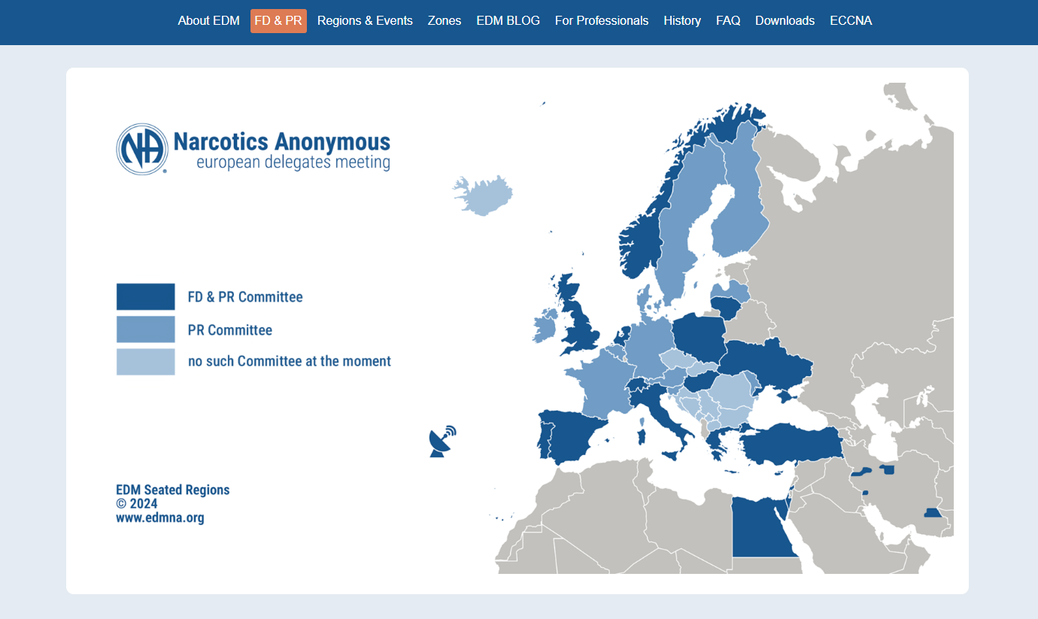

Slide 22
Thank you!
Please upload a photo of your soup bowls using the “Share Your Photos” form on na.org/wcna

