Slide 1
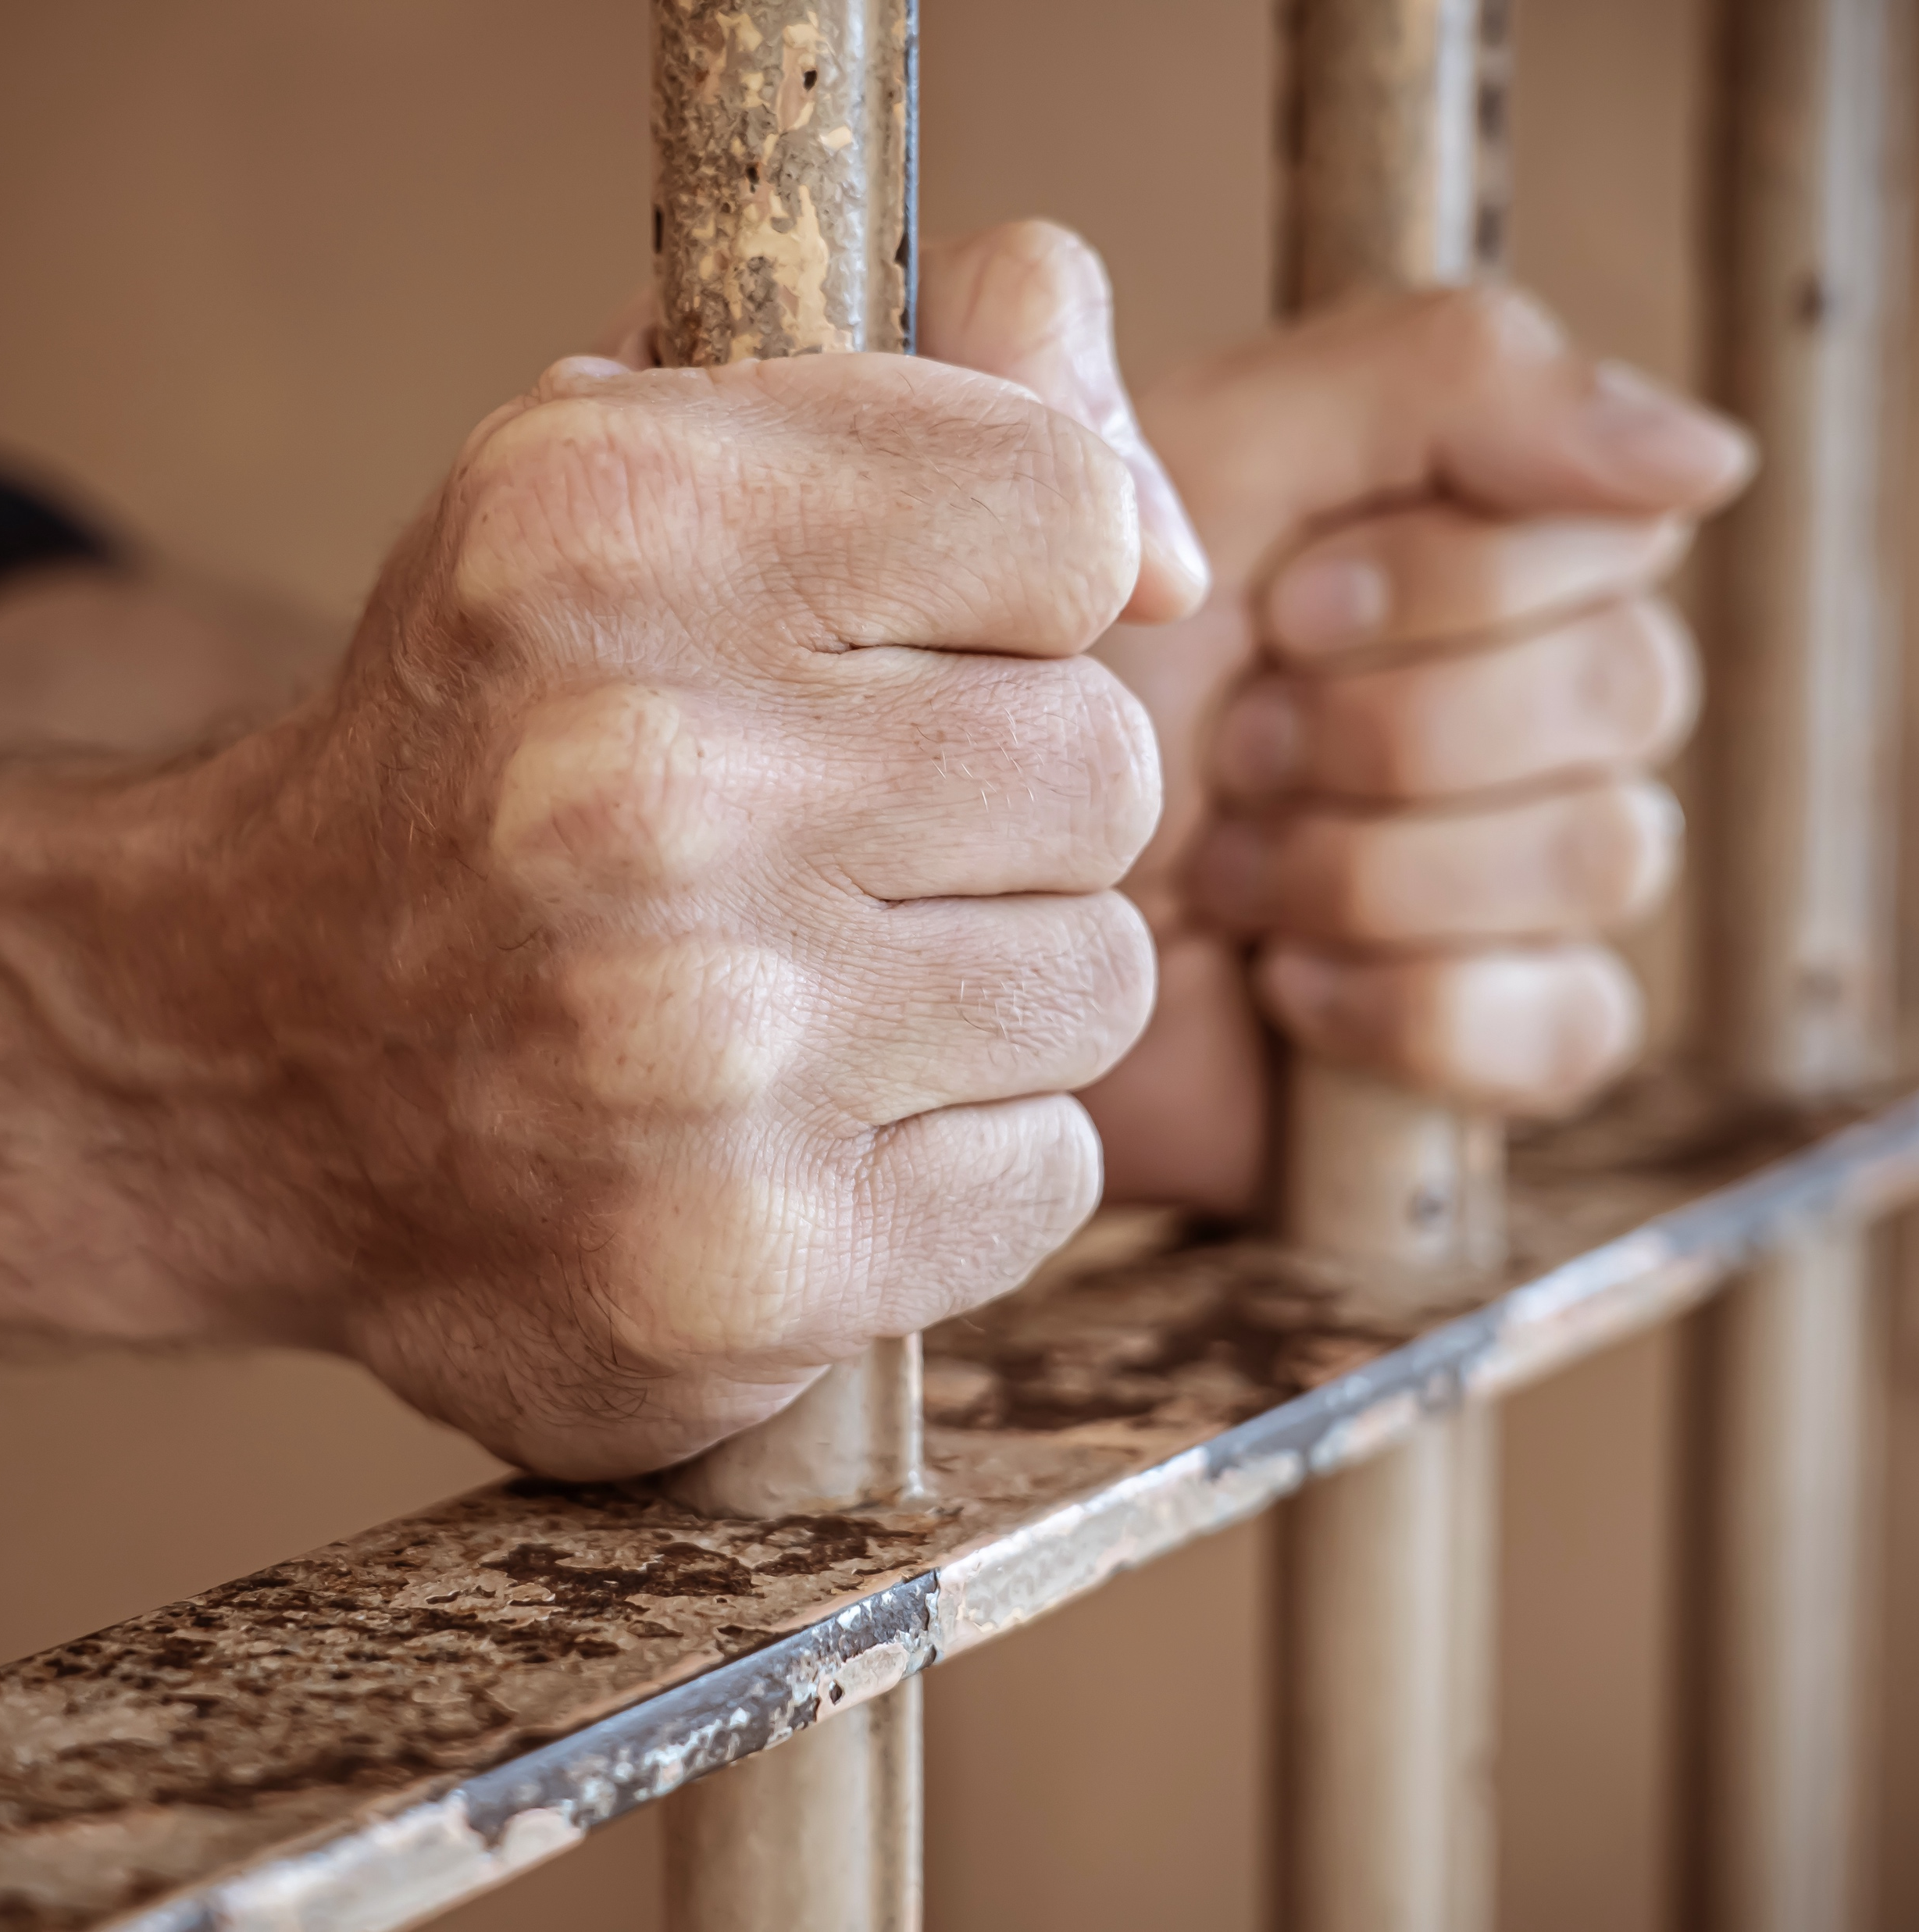
EVERY Addict
Expanding Accessibility in NA

Slide 2
A Vision for NA Service
All of the efforts of Narcotics Anonymous are inspired by the primary purpose of our groups. Upon this common ground we stand committed.
Our vision is that one day:
Every addict in the world has the chance to experience our message in their own language and culture and find the opportunity for a new way of life;
Every member, inspired by the gift of recovery, experiences spiritual growth and fulfillment through service;
NA service bodies worldwide work together in a spirit of unity and cooperation to support the groups in carrying our message of recovery;
Narcotics Anonymous has universal recognition and respect as a viable program of recovery.
Honesty, trust, and goodwill are the foundation of our service efforts, all of which rely upon the guidance of a loving Higher Power.

Slide 3
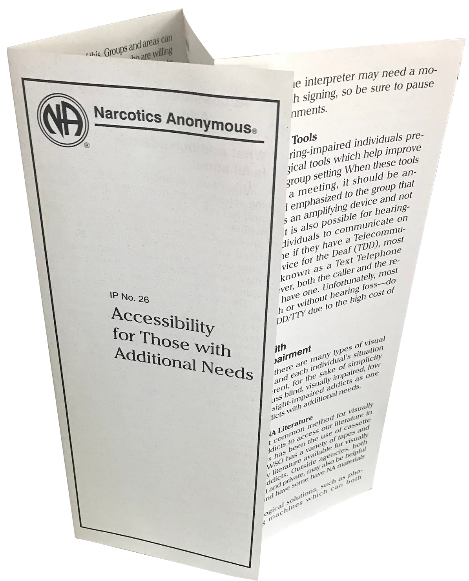
na.org/handbooks
na.org/ips

Slide 4
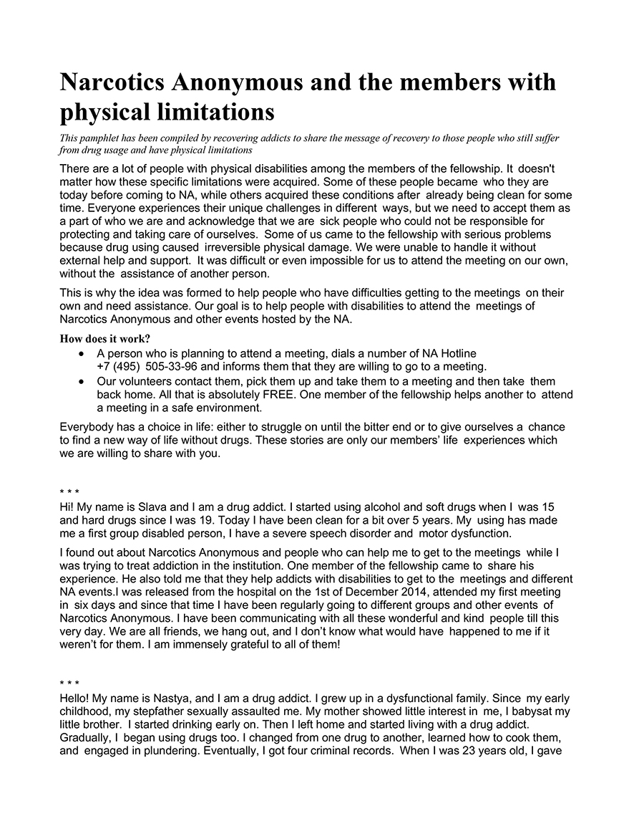
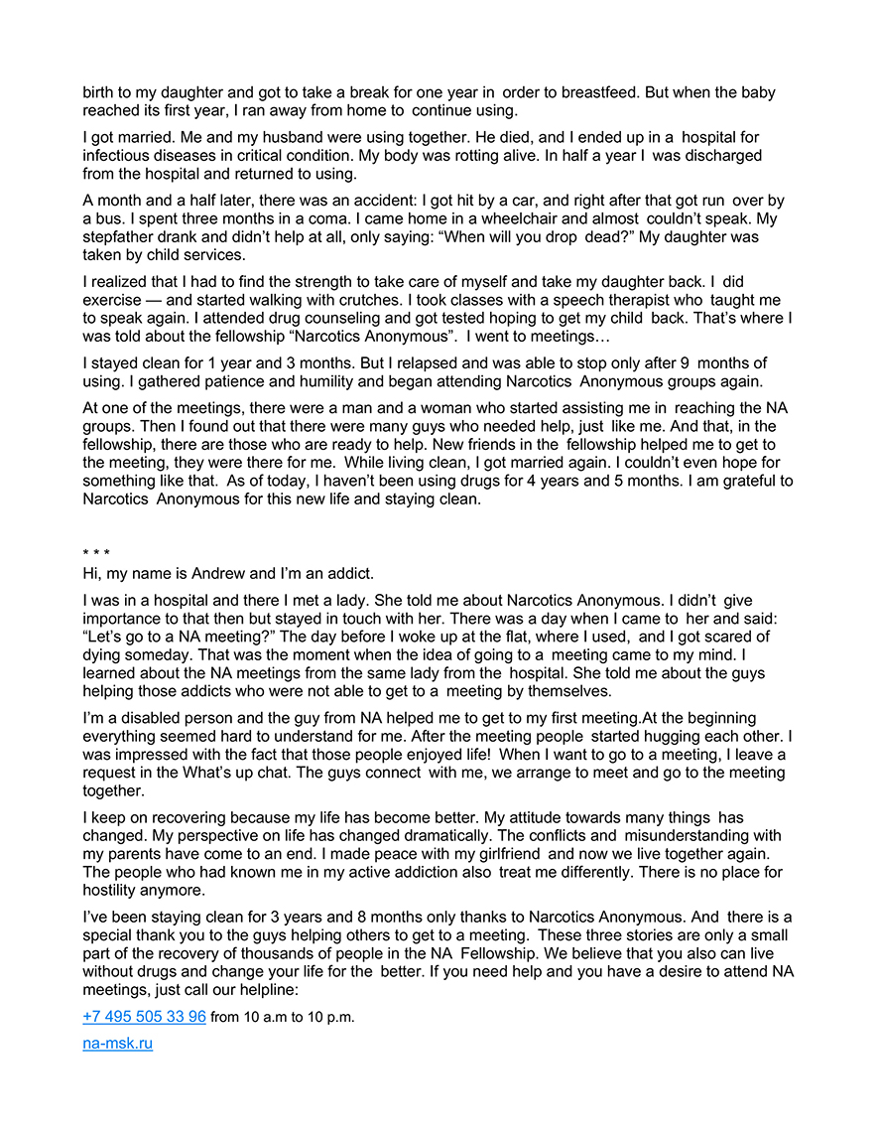
na.org/localresources
(under miscellaneous)
fsmail@na.org

Slide 5
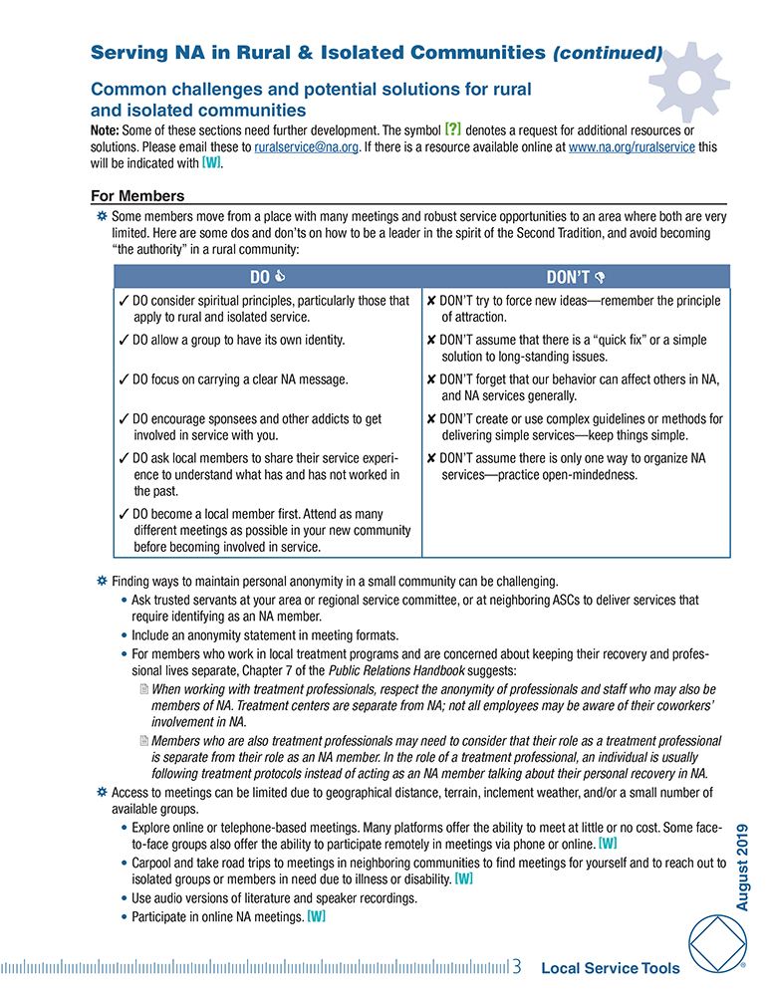
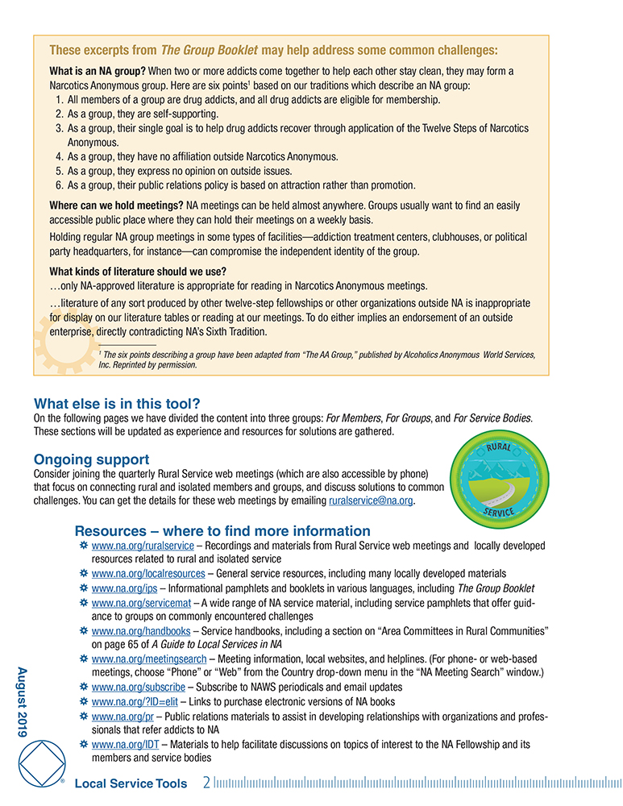
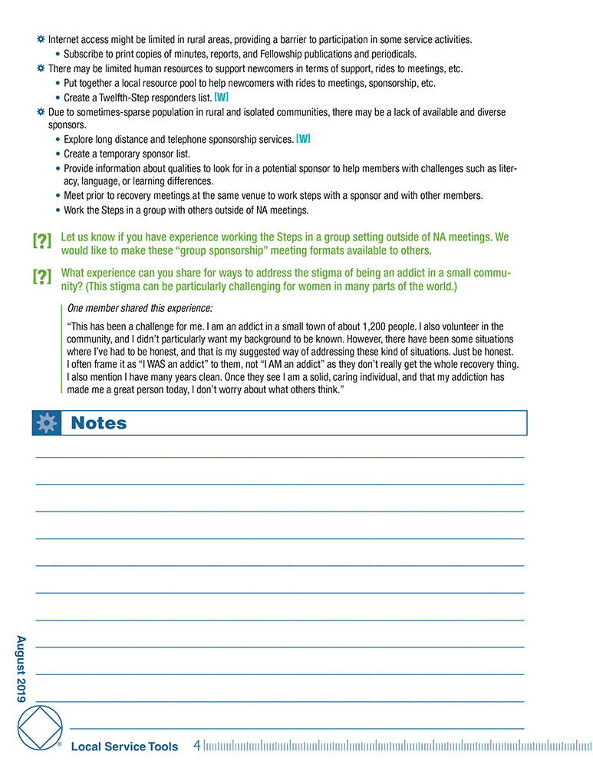
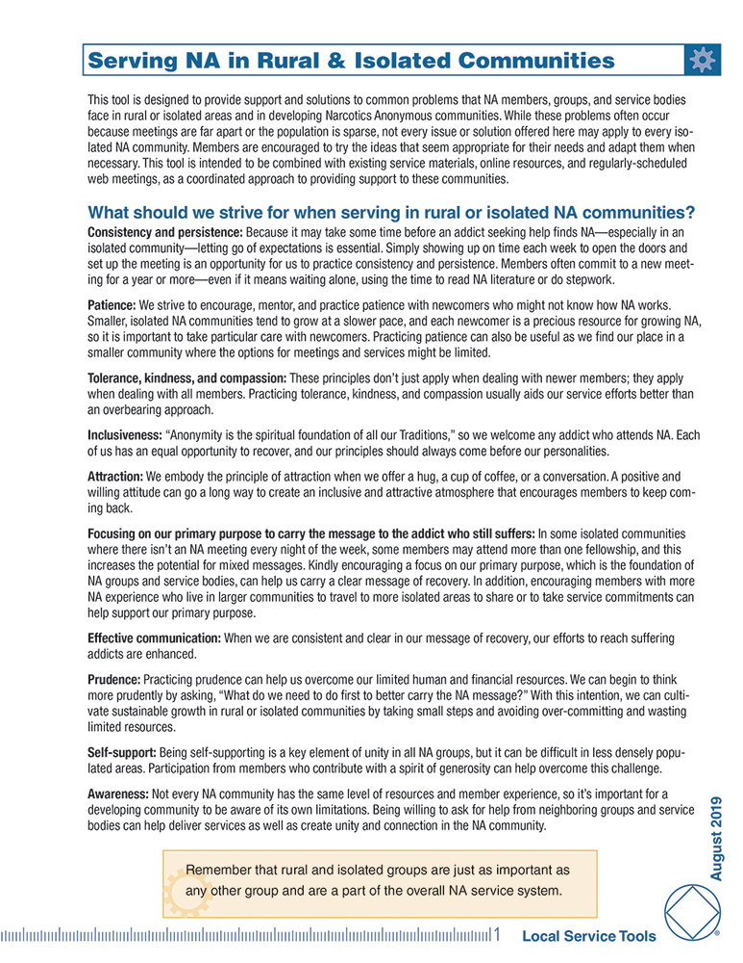
na.org/ips
na.org/basics

Slide 6
Any time information is shared onscreen, remember to read the information out loud and describe any graphics
Provide sign language interpretation during meetings and include instructions in the meeting format for how to access the service
Ensure that members understand how to continue viewing sign language interpreters during screen sharing, and provide instructions if needed
Provide subtitles during meetings
Provide information about literature in audio and sign language formats
Ask members with additional needs how the group can help
Designate a contact person in the meeting who can provide additional assistance
If voting is taking place during a group business meeting, please remember to read the result out loud to assist members who are unable to see raised hands
na.org/basics
na.org/virtual

Slide 7
na.org/asl

Slide 9
Challenges
What disabilities or circumstances limit addicts’ access to NA meetings?
What can we do to manage obstacles?
What resources do your group, area, or region provide?
What do you wish they would do? What do you wish they wouldn’t do?

Slide 10
Small group facilitator: ensures all have opportunity to share
Facilitator’s Instructions
Groundrules
Brainstorming Guidelines
Note taker: captures the discussion on note sheet and may report back

Slide 11
Small Group Discussion
What is something you heard during this workshop that you would like to do as a member? As a service body?
What are some ways you can go about making that happen?

Slide 12
Share a highlight from your discussion

Slide 13
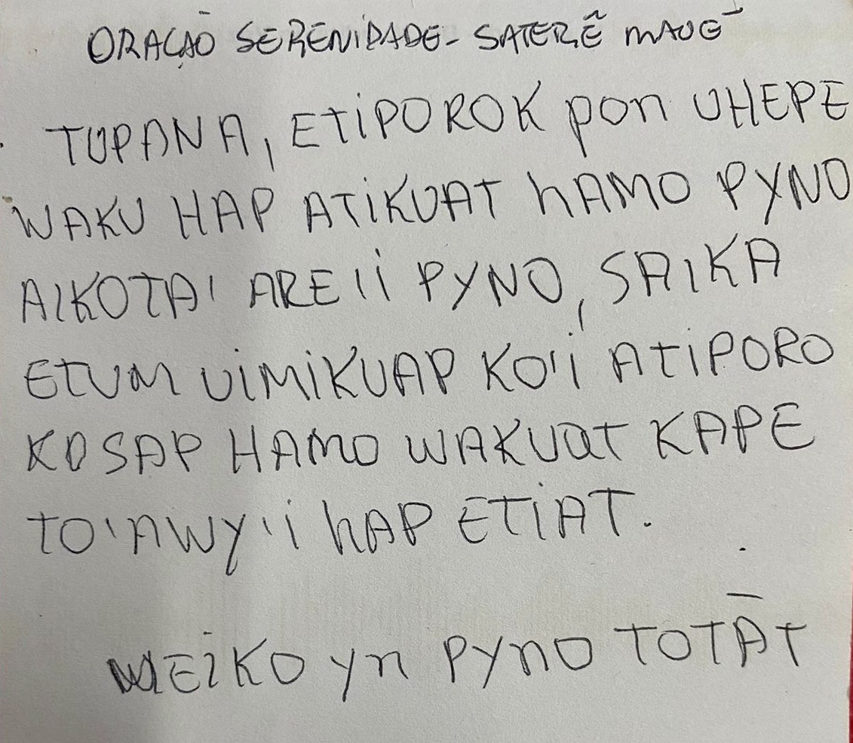

Slide 14
Thank you for attending!

