Slide 1

Revitalizing
H&I
A webinar
brought to you by
Narcotics Anonymous World Services, Inc.

Slide 2
God
Grant me the serenity
To accept the things I cannot change
The courage to change the things I can
And the wisdom to know the difference

Slide 3
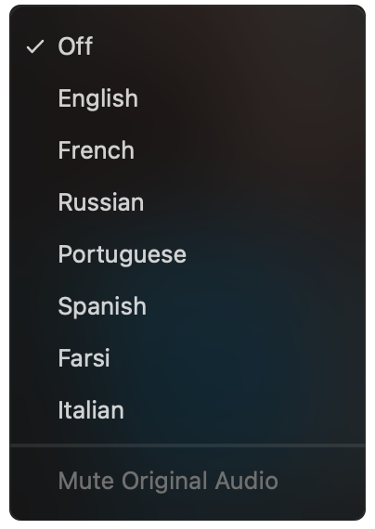

PLEASE SELECT A LANGUAGE
English speakers, please select English.
Everyone else select one of the translation channels:
Arabic, Farsi, Hebrew, Hungarian, Italian, Portuguese, Spanish & Ukrainian
✓ Off
English
Arabic
Farsi
Hebrew
Hungarian
Italian
Portuguese
Spanish
Ukrainian
Click on this icon at the bottom of your screen
Choose a language

Slide 4
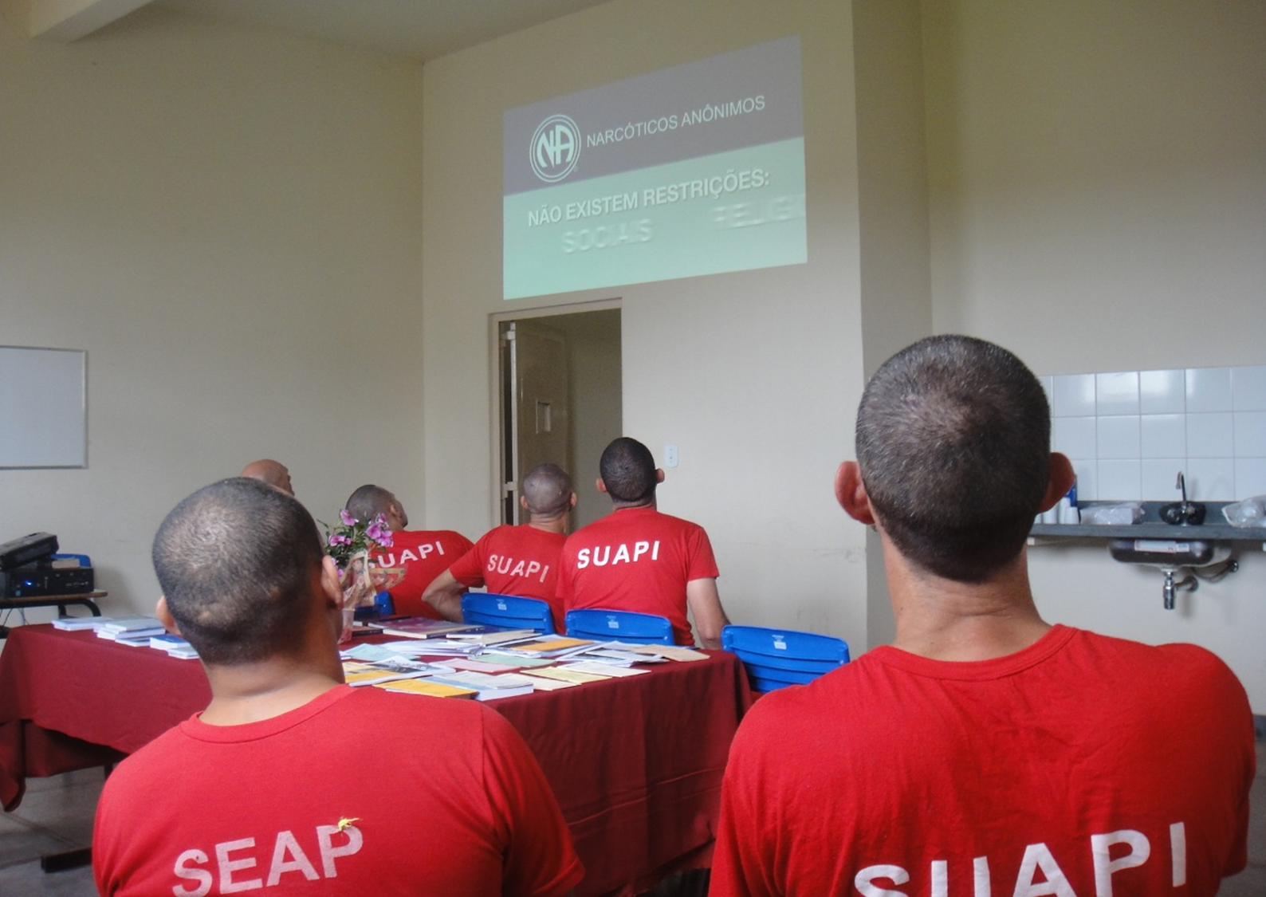

pr@na.org
www.na.org/webarchive

Slide 5

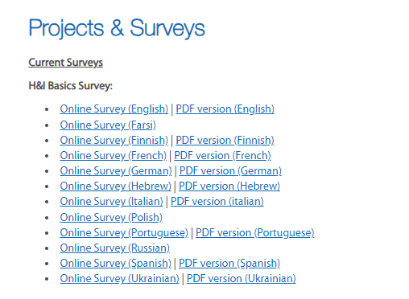
H&I Basics
www.na.org/survey

Slide 6

Volunteers!
www.na.org/survey

Slide 7
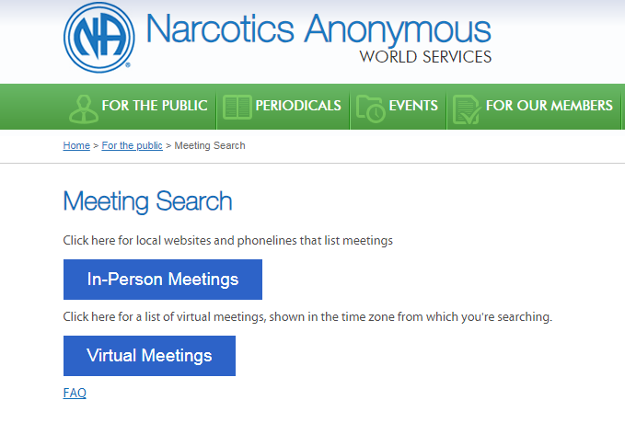
www.na.org/meetingsearch

Slide 8

WCNA 38
The Power
of Love
Washington, DC
29 August – 1 September 2024
www.na.org/wcna

Slide 9


Slide 10

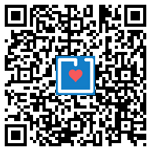
www.na.org/give
Recurring contributions are the most sustainable form of income for World Services.
Thank you for
considering this.

Slide 11
PLEASE SELECT A LANGUAGE
English speakers, please select English.
Everyone else select one of the translation channels:
Arabic, Farsi, Hebrew, Hungarian, Italian, Portuguese, Spanish & Ukrainian
✓ Off
English
Arabic
Farsi
Hebrew
Hungarian
Italian
Portuguese
Spanish
Ukrainian
Click on this icon at the bottom of your screen
Choose a language

Slide 12


Slide 13
Mark B. – Nebraska
Yevhen – Ukraine
Anita – Georgia
John – UK
Eddy – Tennessee/Virginia

Slide 14




UKNA Prison Sponsorship
“WE only keep what WE have by giving it away”

Slide 15
What is Prison Sponsorship.?
Prison Sponsorship is a subcommittee of the UK NA Region of Narcotics Anonymous, offering 12 step NA sponsorship VIA CORRESPONDENCE, to NA members in prisons and other locked institutions across the United Kingdom regardless of their physical environment or geographical location.
Why was this committee formed.?
Through the work our fellowship offers, carrying the message to people who are unable to freely attend meetings it was felt that more could be done to further our fellowships primary purpose, which is:
“carrying the message to the addict who still suffers”

Slide 16
Who is it aimed at.?
Prison Sponsorship is aimed at anybody behind the walls who has a desire to STOP USING,
And cannot obtain the precious gift of sponsorship through the 12 steps in the conventional way.
How it Works.
Prison Sponsorship offers any NA member in jail or lockdown institution the freedom to recover from active addiction by working the 12 steps of Narcotics Anonymous, through written correspondence with a member who has already experienced this miracle.

Slide 17


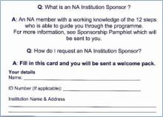
The Sponsee Process…
This is the card that the NA Member in the institution fills out and sends to PS. These cards are on the tables in meetings in prisons or lockdown institution. It is the meeting co-ordinators responsibility to make sure these cards are available. Cards can also be requested direct from
Prison Sponsorship. Email: ps@ukna.org

Slide 18
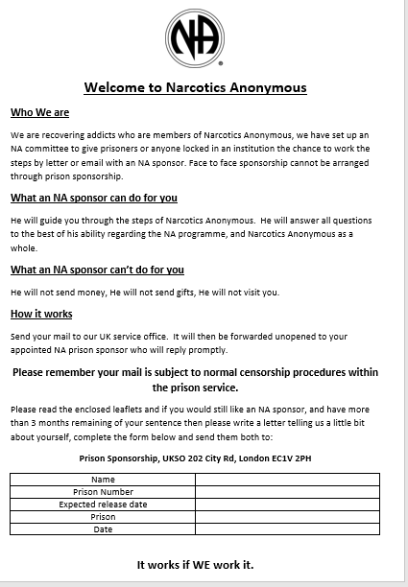


Once this card is received By Prison Sponsorship the post person will log the details onto a database, They will then notify the welcome pack person as well as the book distribution person. These trusted servants will then send out both a Welcome Pack, and a free Basic Text.
The Welcome pack consists of a covering letter, And IP pamphlets, Welcome to Narcotics Anonymous and Sponsorship.
As well as more information on Prison Sponsorship.

Slide 19
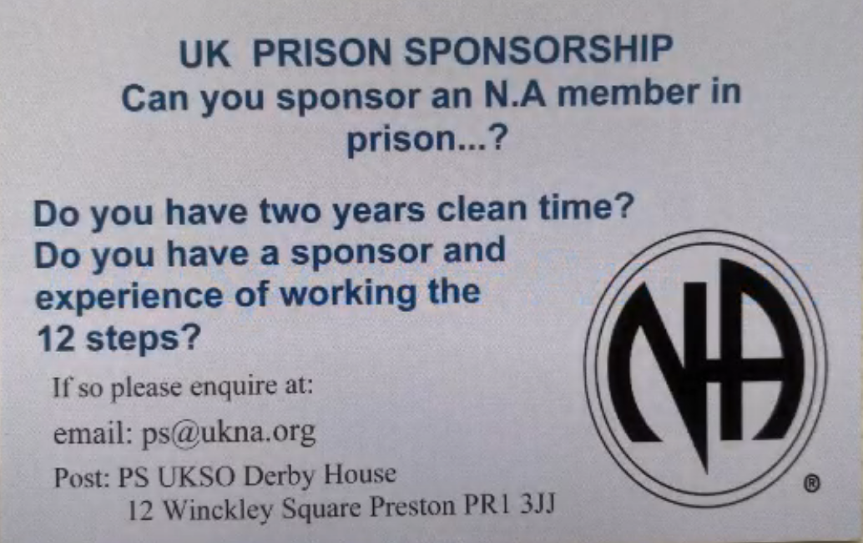
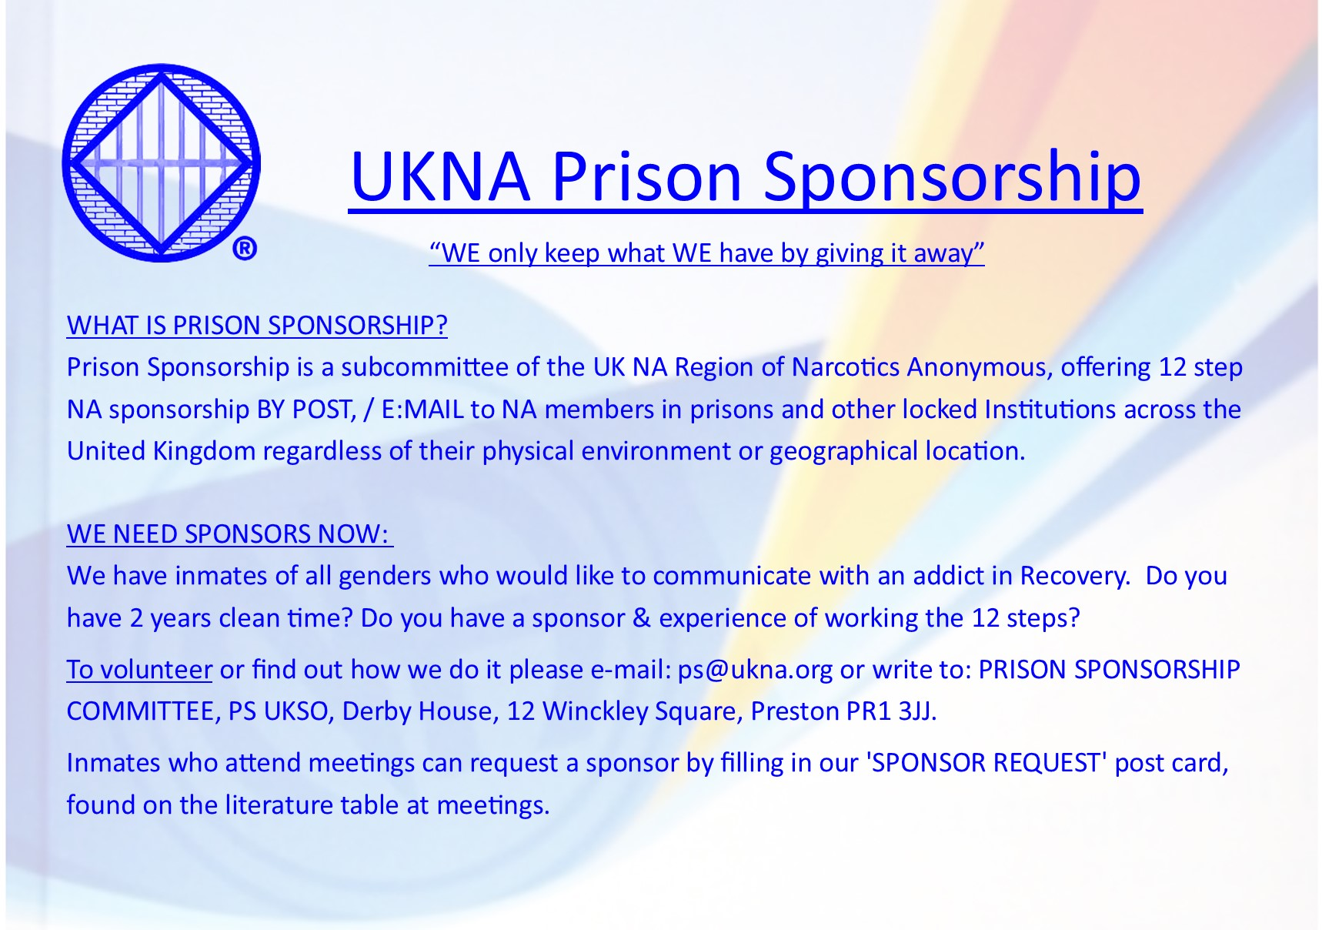
The Sponsor process…
These cards & flyers/posters go out to meetings and at events like unity days and conventions, As well as being available through PS.
Once PS have received your request, some information and PS sponsorship guidelines will be sent out along with an application form with various questions to be answered. On return receipt of this form all the PS committee will read it and vote to ratify the sponsor, once the sponsor is ratified they will then be allocated a Sponsee.

Slide 20
The Mail Process…
The sponsor once allocated a Sponsee has two options, communicate by Post or Email.
By Post: The sponsor sends their letters etc straight to the NA member in prison. The PS Sponsee then sends their reply / step work to the UKSO, the UKSO then sends all PS mail to the post person on the PS committee, this is then forwarded on to the sponsor.
By Email: After setting up an email account following the PS guidelines, communication is then done via email.
Both these ways maintain anonymity.
All mail is subject to the usual prison checks.

Slide 21
PS Sponsee & NA Literature…
If the Sponsee engages with PS at the beginning and requests information from prison sponsorship, as previously mentioned , They will receive a free basic text immediately.
If they are allocated and engage with a Prison Sponsor they can then also request a free book bundle containing a “Step Working Guide”
As well as a
“It Works: How and Why”
Book.
Moving Forward…
Prison Sponsorship is currently looking at also adding the
“Just For Today” Book to its free bundle collection.

Slide 22
Prison Sponsorship Positions Of Service…
PS committee Service positions are all for 2 years.
Chair = 5 years clean time & experience of NA service structure.
Secretary = 2 years clean time. To take minutes & distribute
Treasurer = 4 years clean time. To deal with all expenses regarding PS.
Welcome pack person = 2 years clean time. To send out welcome packs and cards for meetings.
Post person = 2 years clean time. To receive post from UKSO and send on to sponsors.
Sponsor Liaison = 2 years clean time. Send out sponsor application forms and deal with ratification process.
Book distribution Person = 2 years clean time. Sending out all Basic Texts and book bundles.
All service positions have a vice position.
For a full description of roles and responsibilities see the PS Guidelines.

Slide 23
For further Information on Prison Sponsorship
Including becoming a Sponsor.
OR
For cards and posters for meetings,
conventions or unity days.
Please contact:
Email ps@ukna.org
Or by writing to us,
PS UKSO Derby House, 12 Winckley Square,
Preston PR1 3JJ.

Slide 24

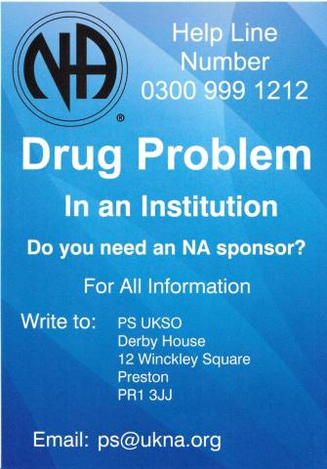

Slide 25
Statistics…
Sent from Prison Sponsorship in 2023
To members with a desire to stop using,
within prisons and locked institutions.
628 Basic Texts sent in total (this includes 1 Basic Text and 1 behind the walls booklet).
Bundles, (which includes 1 Step Working Guide and
1 It works: How and Why) 46 of each book to the Sponsees who had the desire to find a new way of life.
127 Sponsors allocated (all) who had a willingness to give away this precious gift.
Through the 12 Steps of Narcotics Anonymous.
Notes:
MASTER COPY - PLEASE DO NOT EDIT/ DELETE

Slide 26
Keep Coming Back!
Notes:
MASTER COPY - PLEASE DO NOT EDIT/ DELETE

Slide 27
pr@na.org handi@na.org www.na.org/wcna www.na.org/survey

