Slide 1

2 September 2023
A webinar brought to you by
Narcotics Anonymous World Services, Inc.

Slide 2
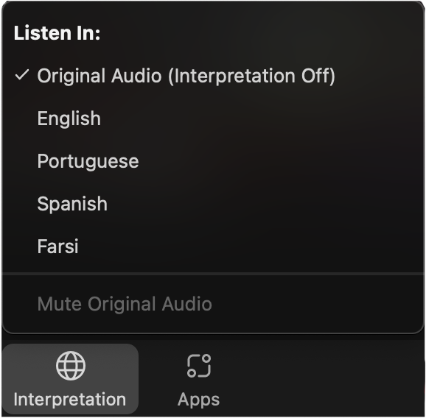
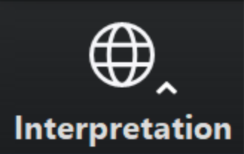
Select a language
Select English or one of the translation channels:
Arabic Farsi Hebrew Portuguese
Russian Spanish
English
Arabic
Farsi
Hebrew
Portuguese
Russian
Spanish
1. Find at bottom of screen
2. Choose a language

Slide 3

God, grant us
the serenity to
ACCEPT
the things we
cannot change, the
COURAGE
to change the
things we can, and the
WISDOM
to know the difference.

Slide 4
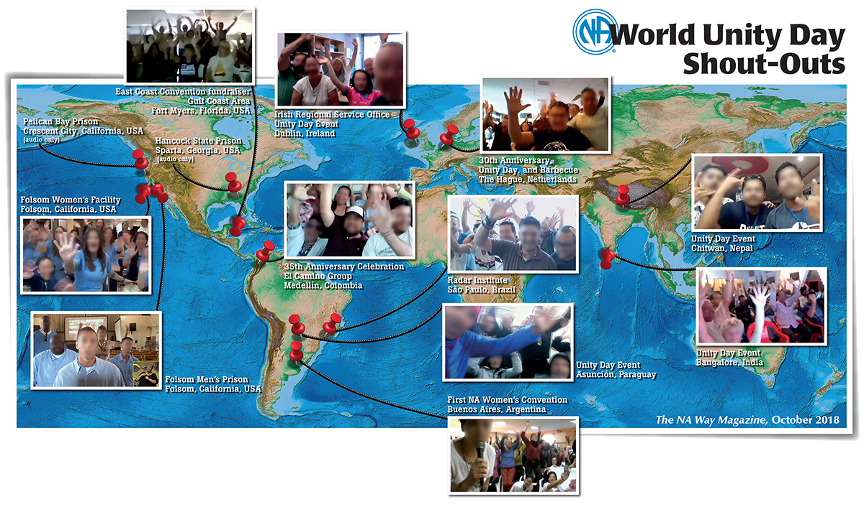
from WCNA 37

Slide 5
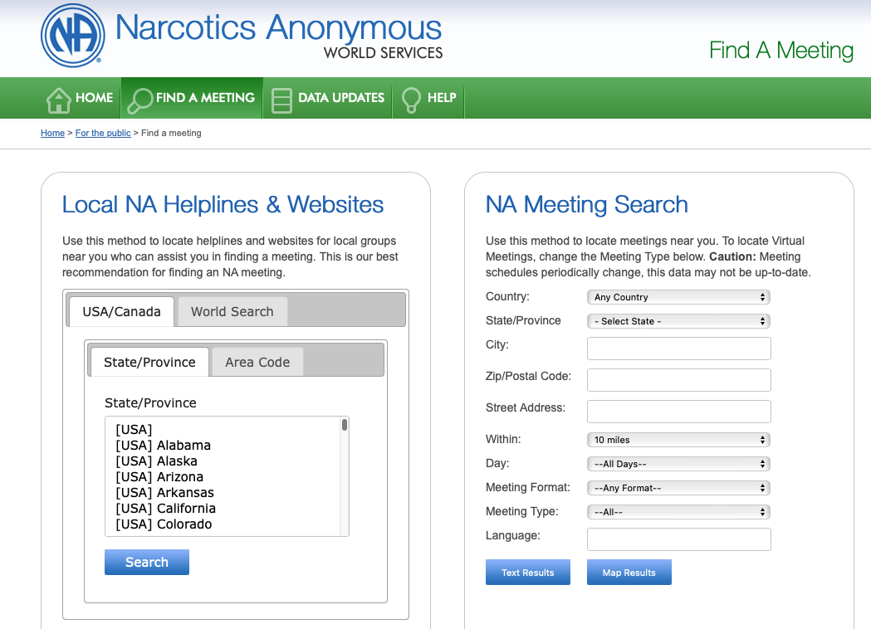

Trying to make transition by end of calendar year
Need the most accurate information for local service bodies

Slide 6


www.na.org/survey
Both Available Now
Survey on possible revisions to
H&I Basics
Participation Opportunities Form
• H&I experience
• Experience with geographic or physical isolation in recovery to help with The Loner IP revision.
• Experience with virtual service bodies or with connecting virtual meetings to the service system to help with Virtual Service Basics
• Willingness to help evaluate speaker recordings for WCNA
And much more…
Please sign
up today

Slide 7


Slide 8
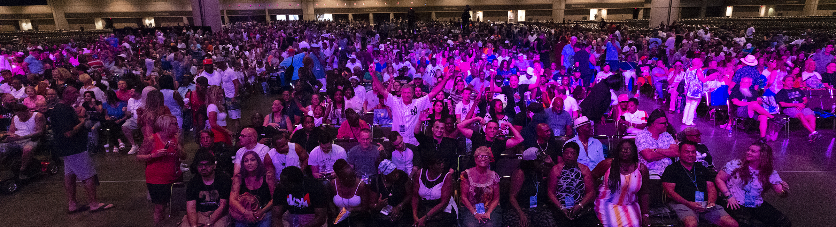
World Convention 38
Washington, DC
29 August – 1 September 2024
www.na.org/subscribe

Slide 9


The NA Survival Kit
parts of the Basic Text,
It Works: How and Why, and
The NA Step Working Guides www.na.org/fipt

Slide 10

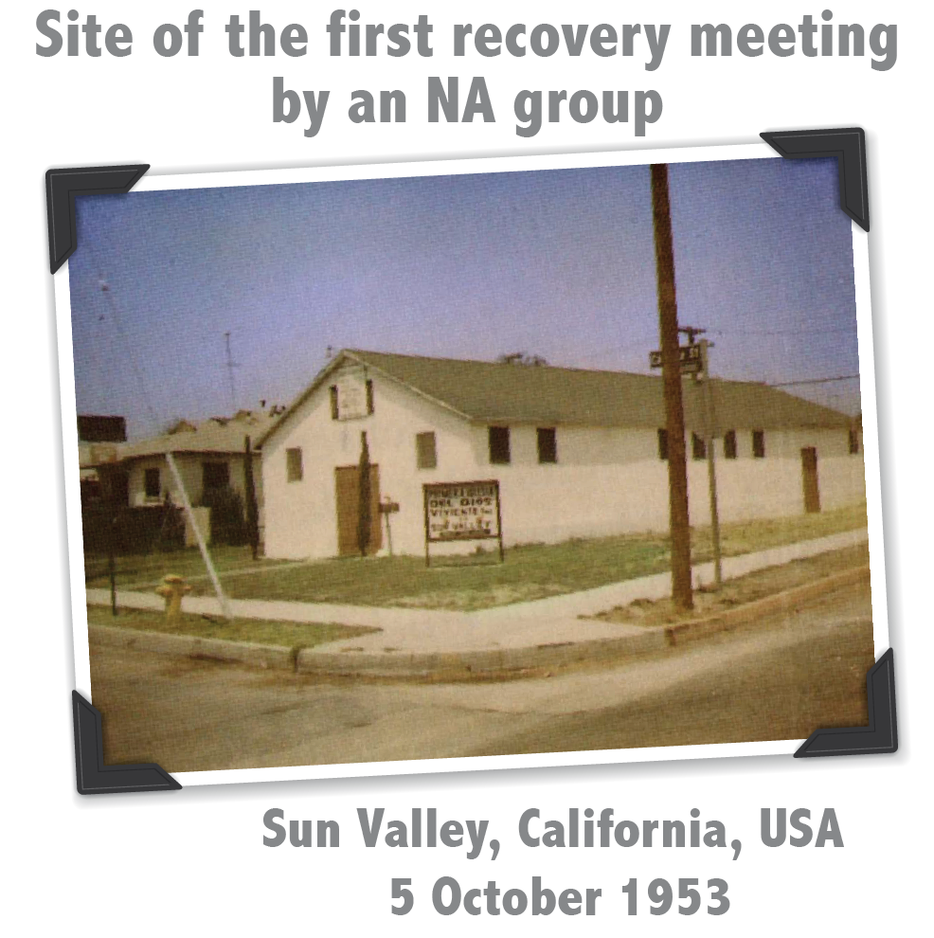

Slide 11


Slide 12
Select a language
Select English or one of the translation channels:
Arabic Farsi Hebrew Portuguese
Russian Spanish
English
Arabic
Farsi
Hebrew
Portuguese
Russian
Spanish
1. Find at bottom of screen
2. Choose a language

Slide 13
Today’s panelists
Mark – Pennsylvania
Tala – Iran
Shane – Northern California
Allison – UK
Karen – Brazil
Sean – Rhode Island

Slide 14


Slide 15


Join members, from around the world, for a heartfelt expression of NA’s worldwide unity as we take a moment to share the Serenity Prayer and reflect on our global Fellowship and our primary purpose: to carry the NA message to the addict who still suffers.
God, grant us the serenity to accept
the things we cannot change,
the courage to change the things we can,
and the wisdom to know the difference.

Slide 16
Thank you everyone
Goodbye for now!
Happy Unity Day

