Slide 1


How Do
Virtual Meetings Connect to the Service System?
A webinar
brought to you by
Narcotics Anonymous
World Services, Inc.

Slide 2
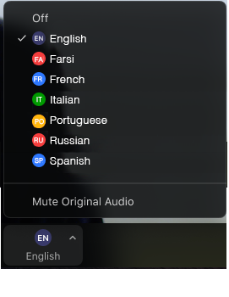

Select a language
Select English or one of the translation channels:
    Farsi French Italian Portuguese Russian Spanish
1. Find at bottom of screen
2. Choose a language

Slide 3
March 13 That one special person
“A sponsor is not necessarily a friend, but may be someone in whom we confide. We can share things with our sponsor that we might not be comfortable sharing in a meeting.” IP No. 11, Sponsorship, Revised
We’ve asked someone to sponsor us, and the reasons we have for asking that particular person are as many as the grains of sand on a beach. Perhaps we heard them share at a speaker meeting and thought they were funny or inspiring. Perhaps we thought they had a great car and we would get one by working the same program they work. Or maybe we live in a small town and they were the only person who had the time available to help.
Whatever our initial reasons for getting the sponsor we have, we’re sure to find that our reasons for keeping them are quite different. Suddenly they’ll amaze us with some stunning insight, making us wonder whether they’ve been sneaking peeks at our Fourth Step. Or maybe we’re going through some sort of life crisis, and their experience with the same problem helps us in ways we never dreamed possible. We call them in pain, and they come up with a special combination of caring words that provide genuine comfort.
None of these remarkable feats on the part of our sponsor are mere coincidence. They’ve simply walked the same path before us. A Higher Power has placed that one special person in our lives, and we are grateful for their presence.
Just for today: I will appreciate that one special person in my life—my sponsor.

Slide 4

Challenges and Opportunities
NA worldwide rose to the challenge
New ways to provide services
  Challenges for some
The landscape may change again
There may not be answers to every question
What is happening where you are?

Slide 5

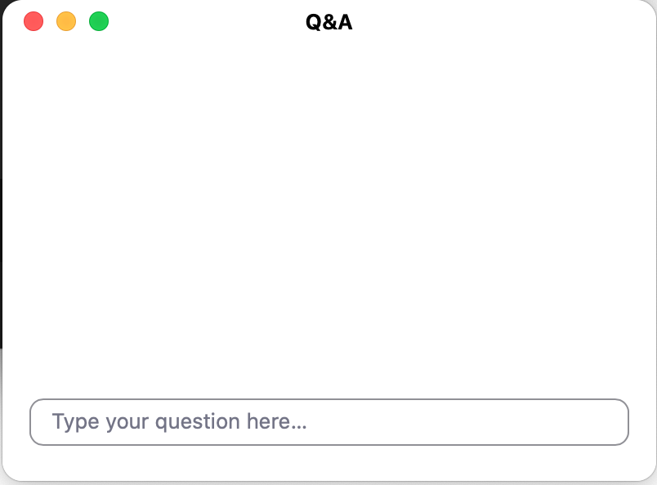
Webinar format
Great for large groups
Streaming on YouTube: link at
www.na.org/toolbox
  Type questions in the Q&A box
  If your question doesn’t get
  addressed please write to
  toolbox@na.org
  Report will contain a summary
  of presentations and answers
  to questions www.na.org/virtual

Slide 6

Local Service Toolbox Project
    Several tools produced in
    previous years:
          GSR Basics, CBDM Basics, and Serving NA in Rural and Isolated Communities
These are posted on the project page:
www.na.org/toolbox
Now the project is focused on
virtual meetings and carrying the
message effectively and virtually

Slide 7
Select a language
Sélectionnez une langue
Seleziona una lingua
Selecione um idioma
Выберите язык
Selecciona un idioma
یک زبان را انتخاب کنید
1.
2.

Slide 8
Not one, but two developments
Draft outline of a virtual meetings best
practices tool is posted
      One topic concerns literature distribution.
      Reminder: An Introductory Guide to Narcotics Anonymous
Second survey:
#1: How are virtual meetings connecting to the service structure and participating in the NA service system?
Everything can
be found on the
project page: www.na.org/toolbox

Slide 9
Second survey:
#2: Do you believe virtual meetings should be recognized as NA groups?
What is an NA group?
When two or more addicts come together to help each other stay clean, they may form a Narcotics Anonymous group. Here are six points based on our Traditions which describe an NA group:
All members of a group are drug addicts, and all drug addicts are eligible for membership.
As a group, they are self-supporting.
As a group, their single goal is to help drug addicts recover through application of the Twelve Steps of Narcotics Anonymous.
As a group, they have no affiliation outside Narcotics Anonymous.
As a group, they express no opinion on outside issues.
As a group, their public relations policy is based on attraction rather than promotion.

Slide 10

The link is on top of the virtual materials page: www.na.org/virtual

Slide 11
Presenters
Resources posted: www.na.org/virtual
Type questions into Q&A box
Only able to respond to questions typed in English
Keep your questions brief
Email questions or experiences: toolbox@na.org
Brian: The No Matter What Group
Dan: Virtual Support Forum
Kim and Stuart: Saturday Night Virtual Speaker Meeting, Washington State
Soliman and Mohamed, Egypt
Anna: Quarantined NA San Diego group
Rusty: Stay at Home Group, Alabama
Beverly: Internationally Known Recovery group

Slide 12
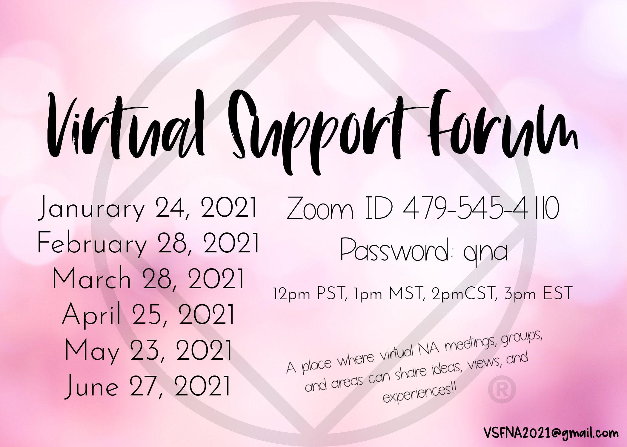

Slide 13
Background and Creation of the VSF
A couple of years ago discussions started between various virtual groups. Questions arose as to how virtual meetings fit in our fellowship. Some virtual groups and areas are a part of existing areas or regions. Other virtual groups are neither connected nor want to be connected to the existing service structure. Many of these groups are questioning their role in the NA fellowship.
Over the past year there have been several ad-hoc workshops and learning days sponsored by NAWS, Zones, Regions, and Virtual Groups that presented an opportunity for virtual entities to meet and learn from one another. But there has never been a consistent forum where we could meet on a regular basis, like an area service committee, to support one another, share ideas, and look towards the future. For these reasons, the VSF was created.

Slide 14
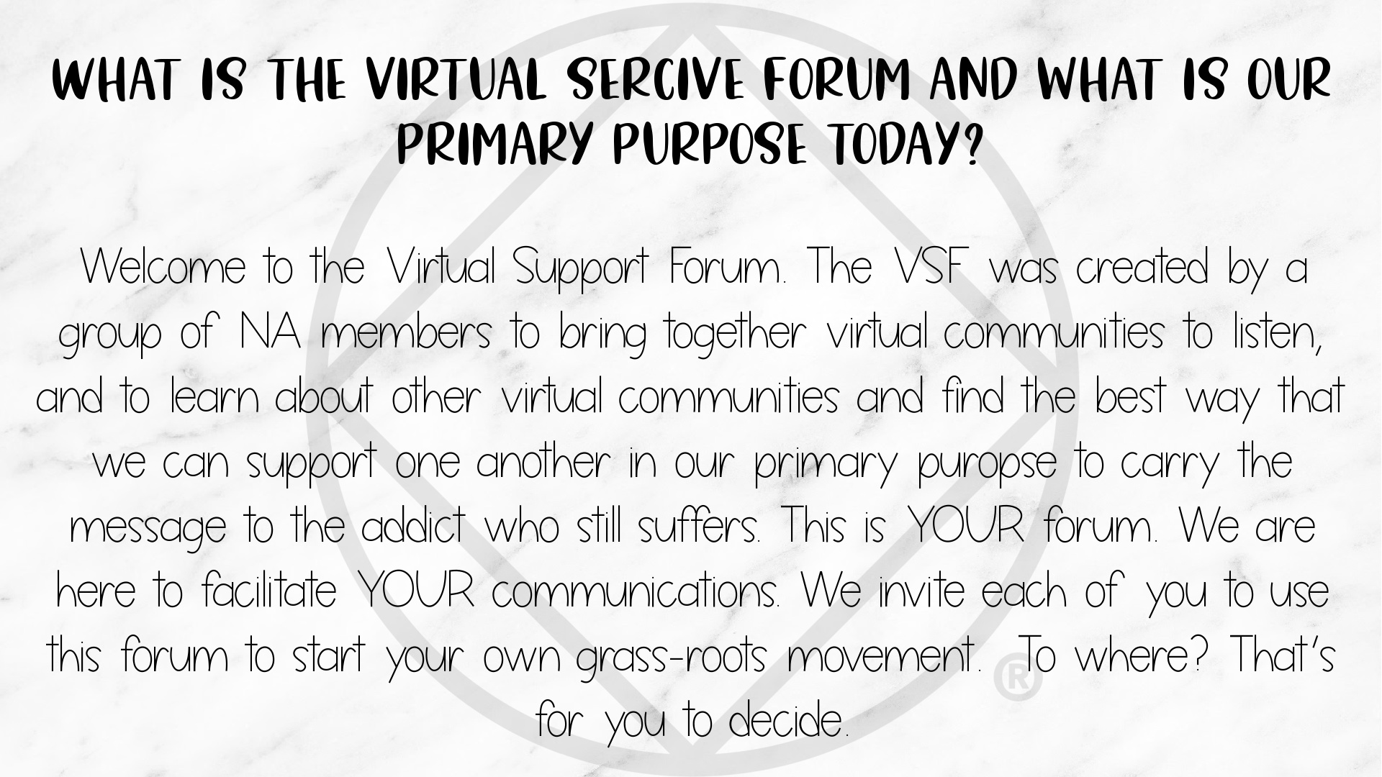

Slide 15


Slide 16
VSF 1 – Think Tanks
Held four Think Tank meetings prior to VSF 1.
Determined VSF purpose & goal.
Decided VSF would be a facilitator not an overseer.
Wanted groups to decide what form would follow function.
VSF 1 - January 24, 2021.
Attended by approximately 65 groups.
Had 5 pre-selected presenters from established virtual groups.
Broke up group into two sessions to allow all participants time to share.
Gathered at the end for Q&A and to summarize the discussions.

Slide 17
VSF 2 - February 28, 2021.
VSF 2 – Think Tanks
Held three Think Tank meetings prior to VSF 2.
Reviewed discussions from VSF 1
Decided to create a Poll based on input received from VSF 1.
Attended by approximately 60 groups.
Poll determined what breakout rooms to facilitate discussions.
Attendees could jump in and out of breakout rooms
Gathered at the end for Q&A and to summarize the discussions.

Slide 18

Future VSF’s - Zoom: 479-545-4110 pwd: qna
4th Sunday 3pm EST
VSF 3 - Sunday March 28th
VSF 4 – Sunday April 25th
VSF 5 – Sunday May 23rd
VSF 6 – Sunday June 27th
Contact: VSFNA2021@gmail.com

Slide 20
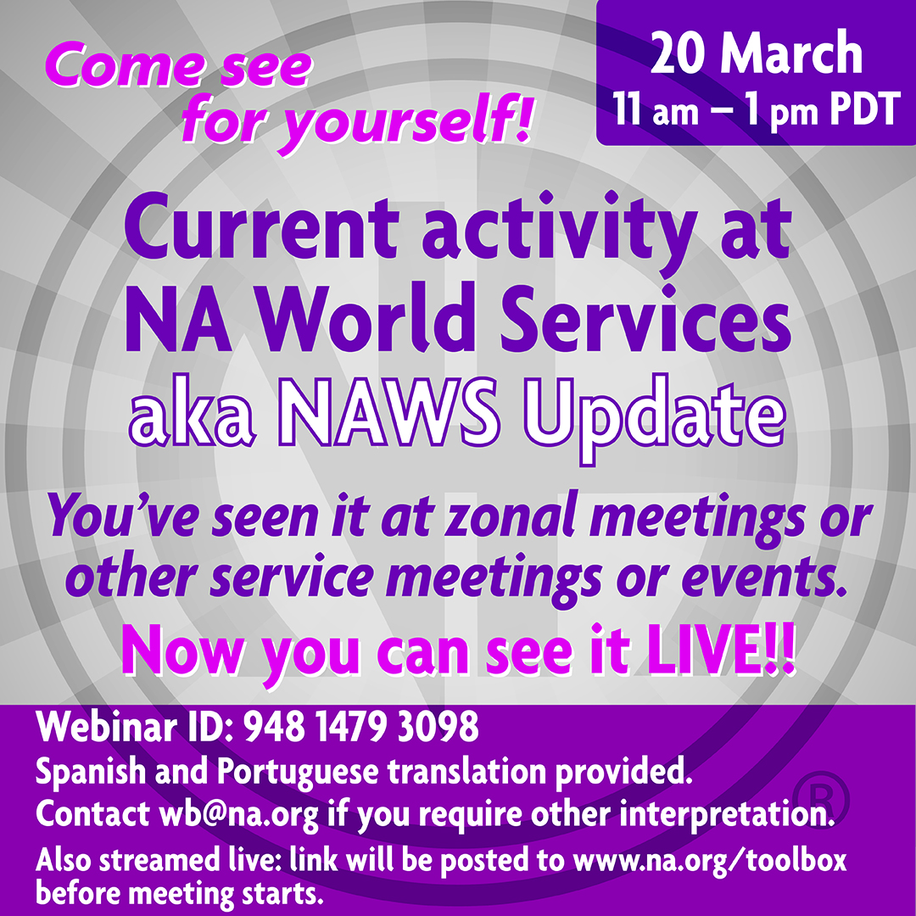

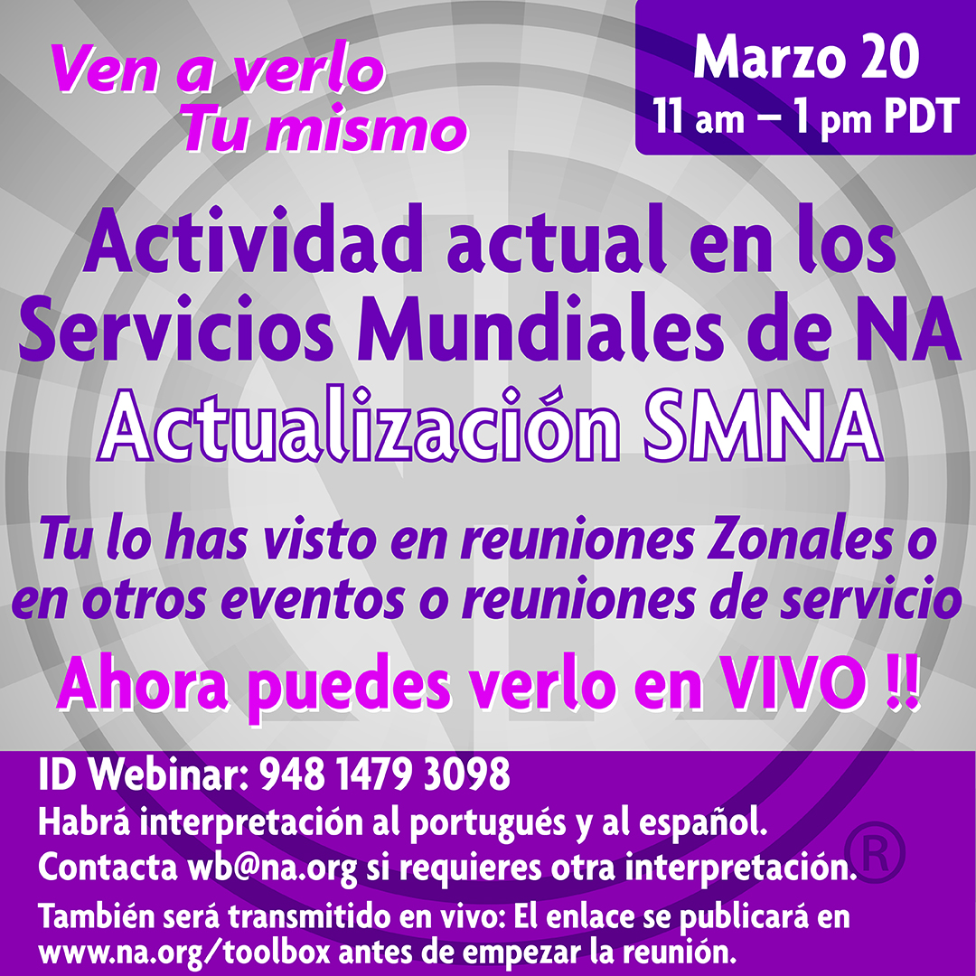
Next Saturday!
www.na.org/
webinar

Slide 21

1 May
NAWS will be hosting a webinar devoted
to the gifts of
NA service
11:00am-1:pm PDT
More information:
www.na.org/webinar

Slide 22
Thank you
متشکرم
Merci
Grazie
Obrigado
Спасибо
Gracias

