Slide 1

A webinar
brought to you by
Narcotics Anonymous
World Services, Inc.
Please standby the webinar will begin shortly

Slide 2
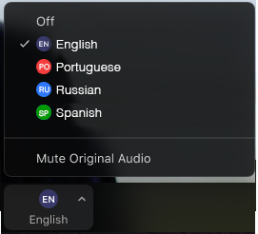


Select a language
Select English or one of the translation channels:
    Portuguese Russian Spanish
1. Find at bottom of screen
2. Choose a language

Slide 3
Our relationship with a Higher Power October 31
“Ongoing recovery is dependent on our relationship with a loving God who cares for us and will do for us what we find impossible to do for ourselves.” Basic Text, p. 99
Working the Twelve Steps of Narcotics Anonymous gives us a fresh start in life and some guidance for living in the world. But the steps are more than a fresh start. When we do our best to work the steps, we develop a relationship with our personal Higher Power.
In the Third Step, we decide to allow a loving God to influence our lives. Much of the courage, trust, and willingness we need to continue through the succeeding steps comes from this decision. In the Seventh Step, we go even further by asking this Higher Power to change our lives. The Eleventh Step is a way for us to improve the relationship.
Recovery is a process of growth and change in which our lives are renewed. The Twelve Steps are the roadmap, the specific directions we take in order to continue in recovery. But the support we need to proceed with each step comes from our faith in a Higher Power, the belief that all will be well. Faith gives us courage to act. Each step we work is supported by our relationship with a loving God.
Just for today: I will remember that the source of my courage and willingness is my relationship with my Higher Power.

Slide 4

Agenda
Webinar format
Introduction to project
Survey to launch project
  Presentations
  North Star Group, Argentina marathon meeting, 7am Coffee Time meeting, Virtual meetings in Brazil, UKNA Communications Committee, Polish International Meeting, Montana Rural Outreach Workgroup, Russian speaking Tranzit Region
Q&A

Slide 5

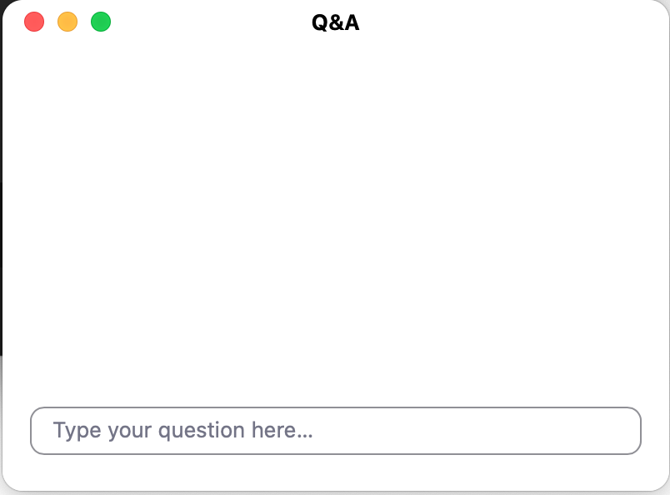
Webinar format
Emphasis on presenters
Streaming on YouTube:
link at www.na.org/toolbox
Type questions in the
Q&A box
If your question doesn’t
get addressed please
write to toolbox@na.org

Slide 6

Virtual meetings
Using term virtual meetings to refer
to online, phone, and chat-based meetings
Resources collected
at www.na.org/virtual
Virtual H&I resources at www.na.org/localresources

Slide 7

Local Service Toolbox Project
Several tools: CBDM Basics, Serving NA in Rural and Isolated Communities, and GSR Basics
Collect experience to answer the question: What is our experience, and what do we want to say
about it in a resource?
Survey is first step

Slide 8
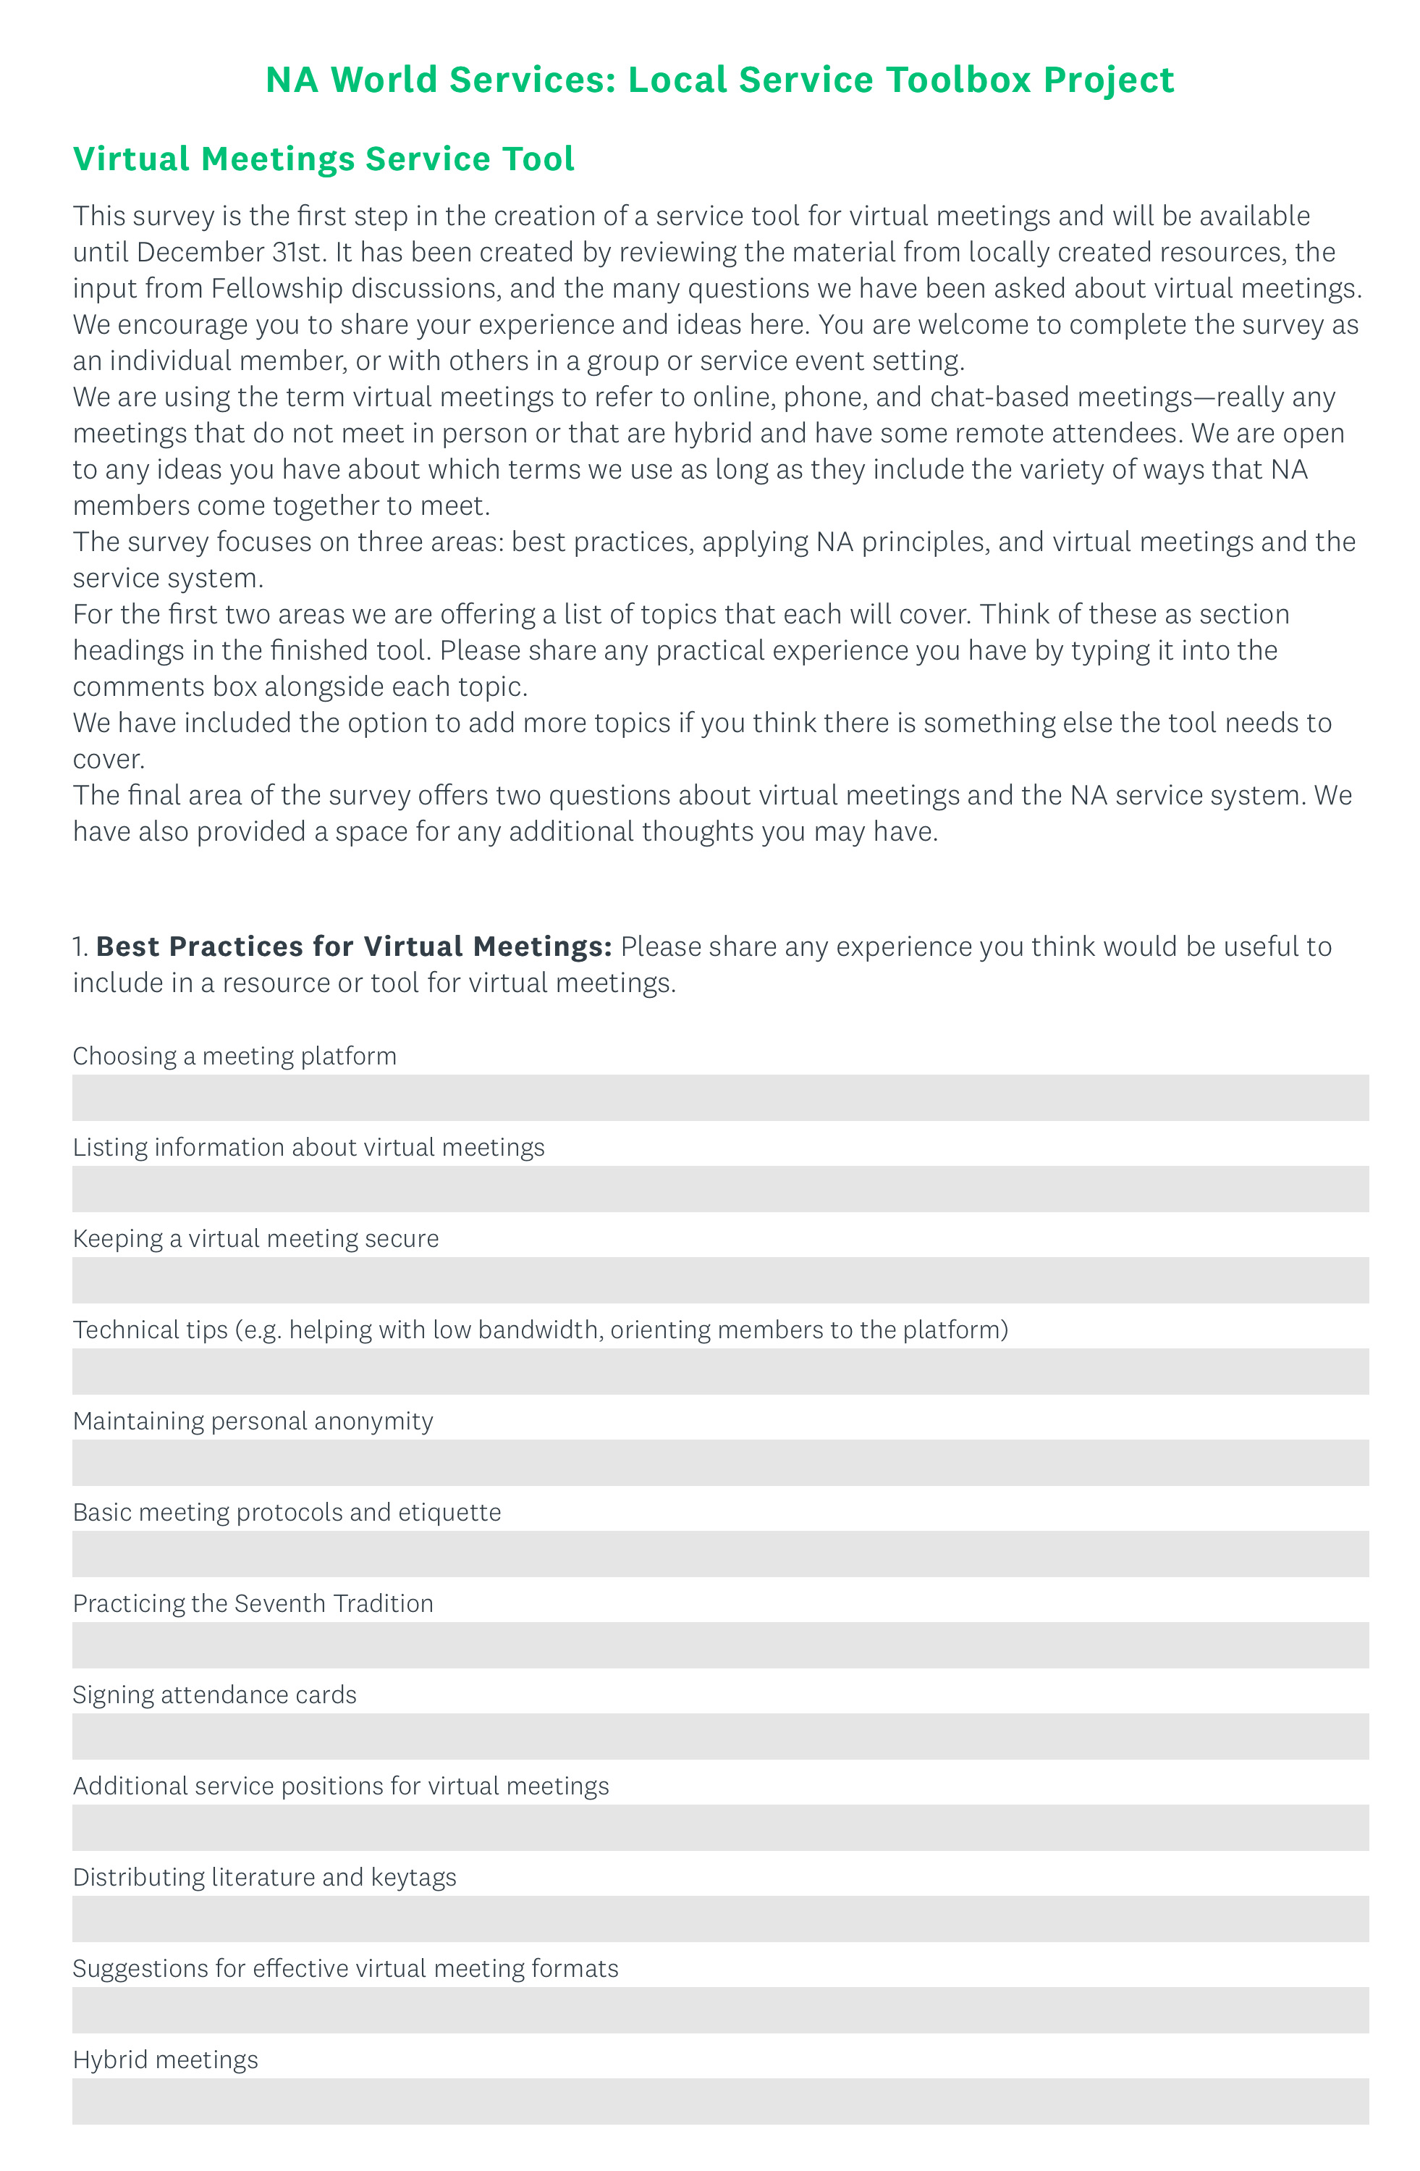
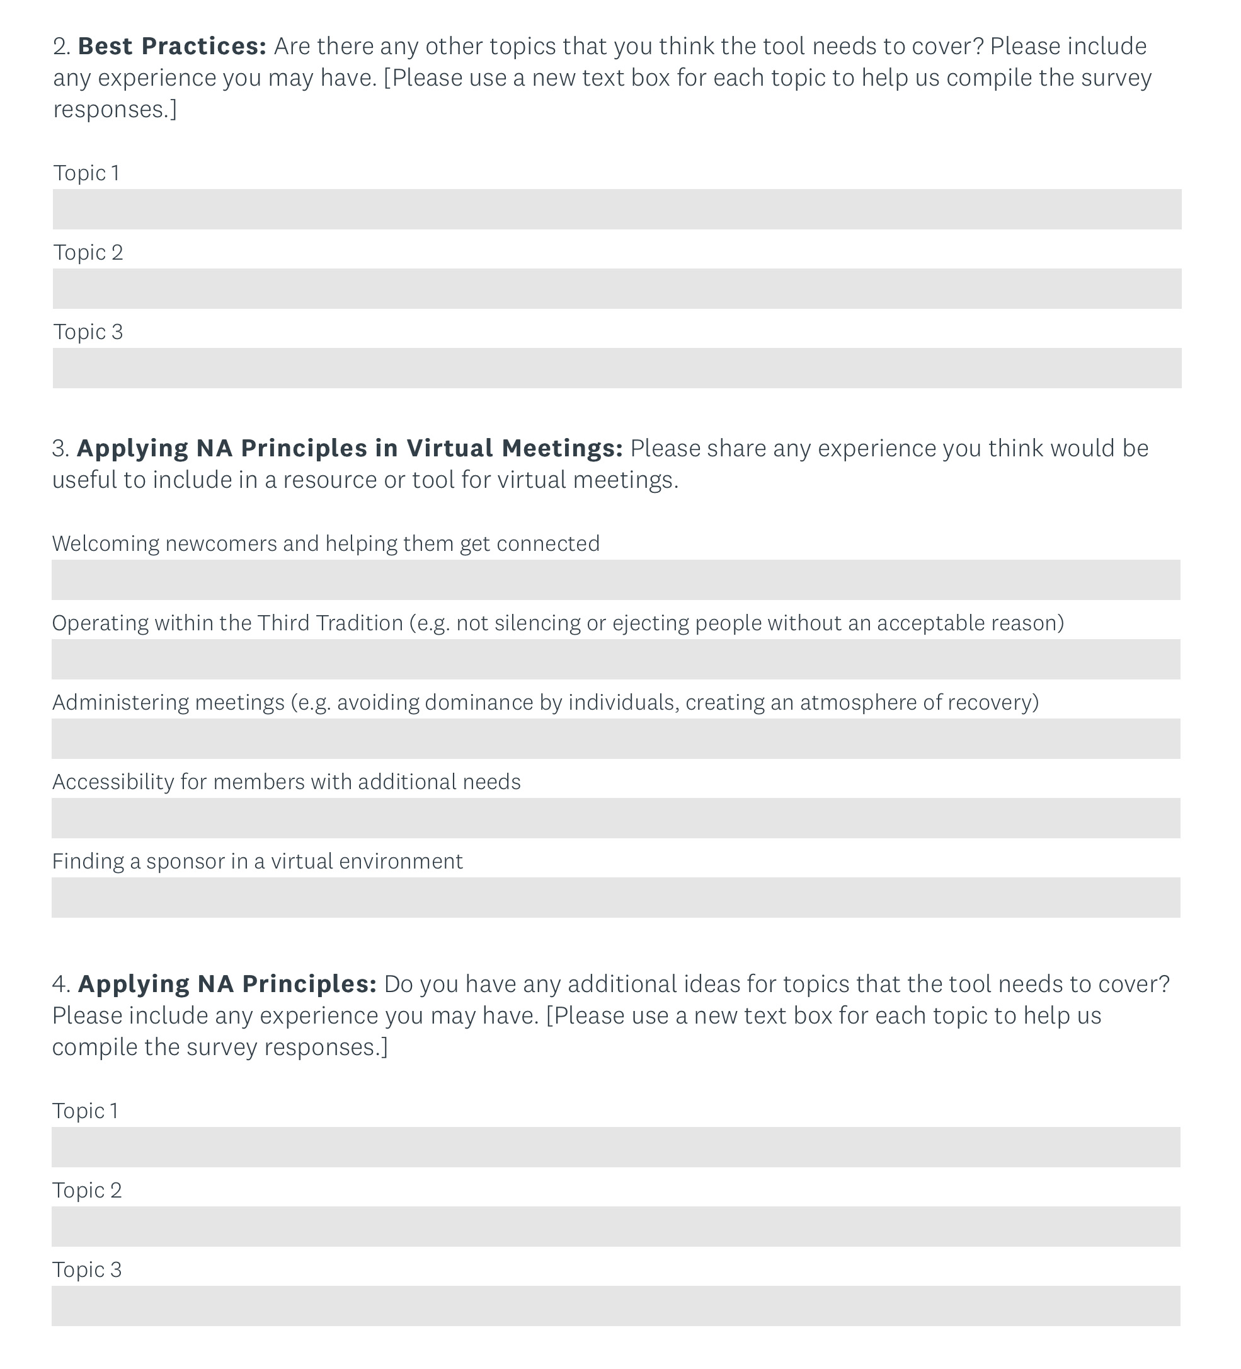
Survey for Project
Survey online
until 31 December
Focus:
Best practices
Applying
NA principles
Virtual meetings
and the service
system

Slide 9
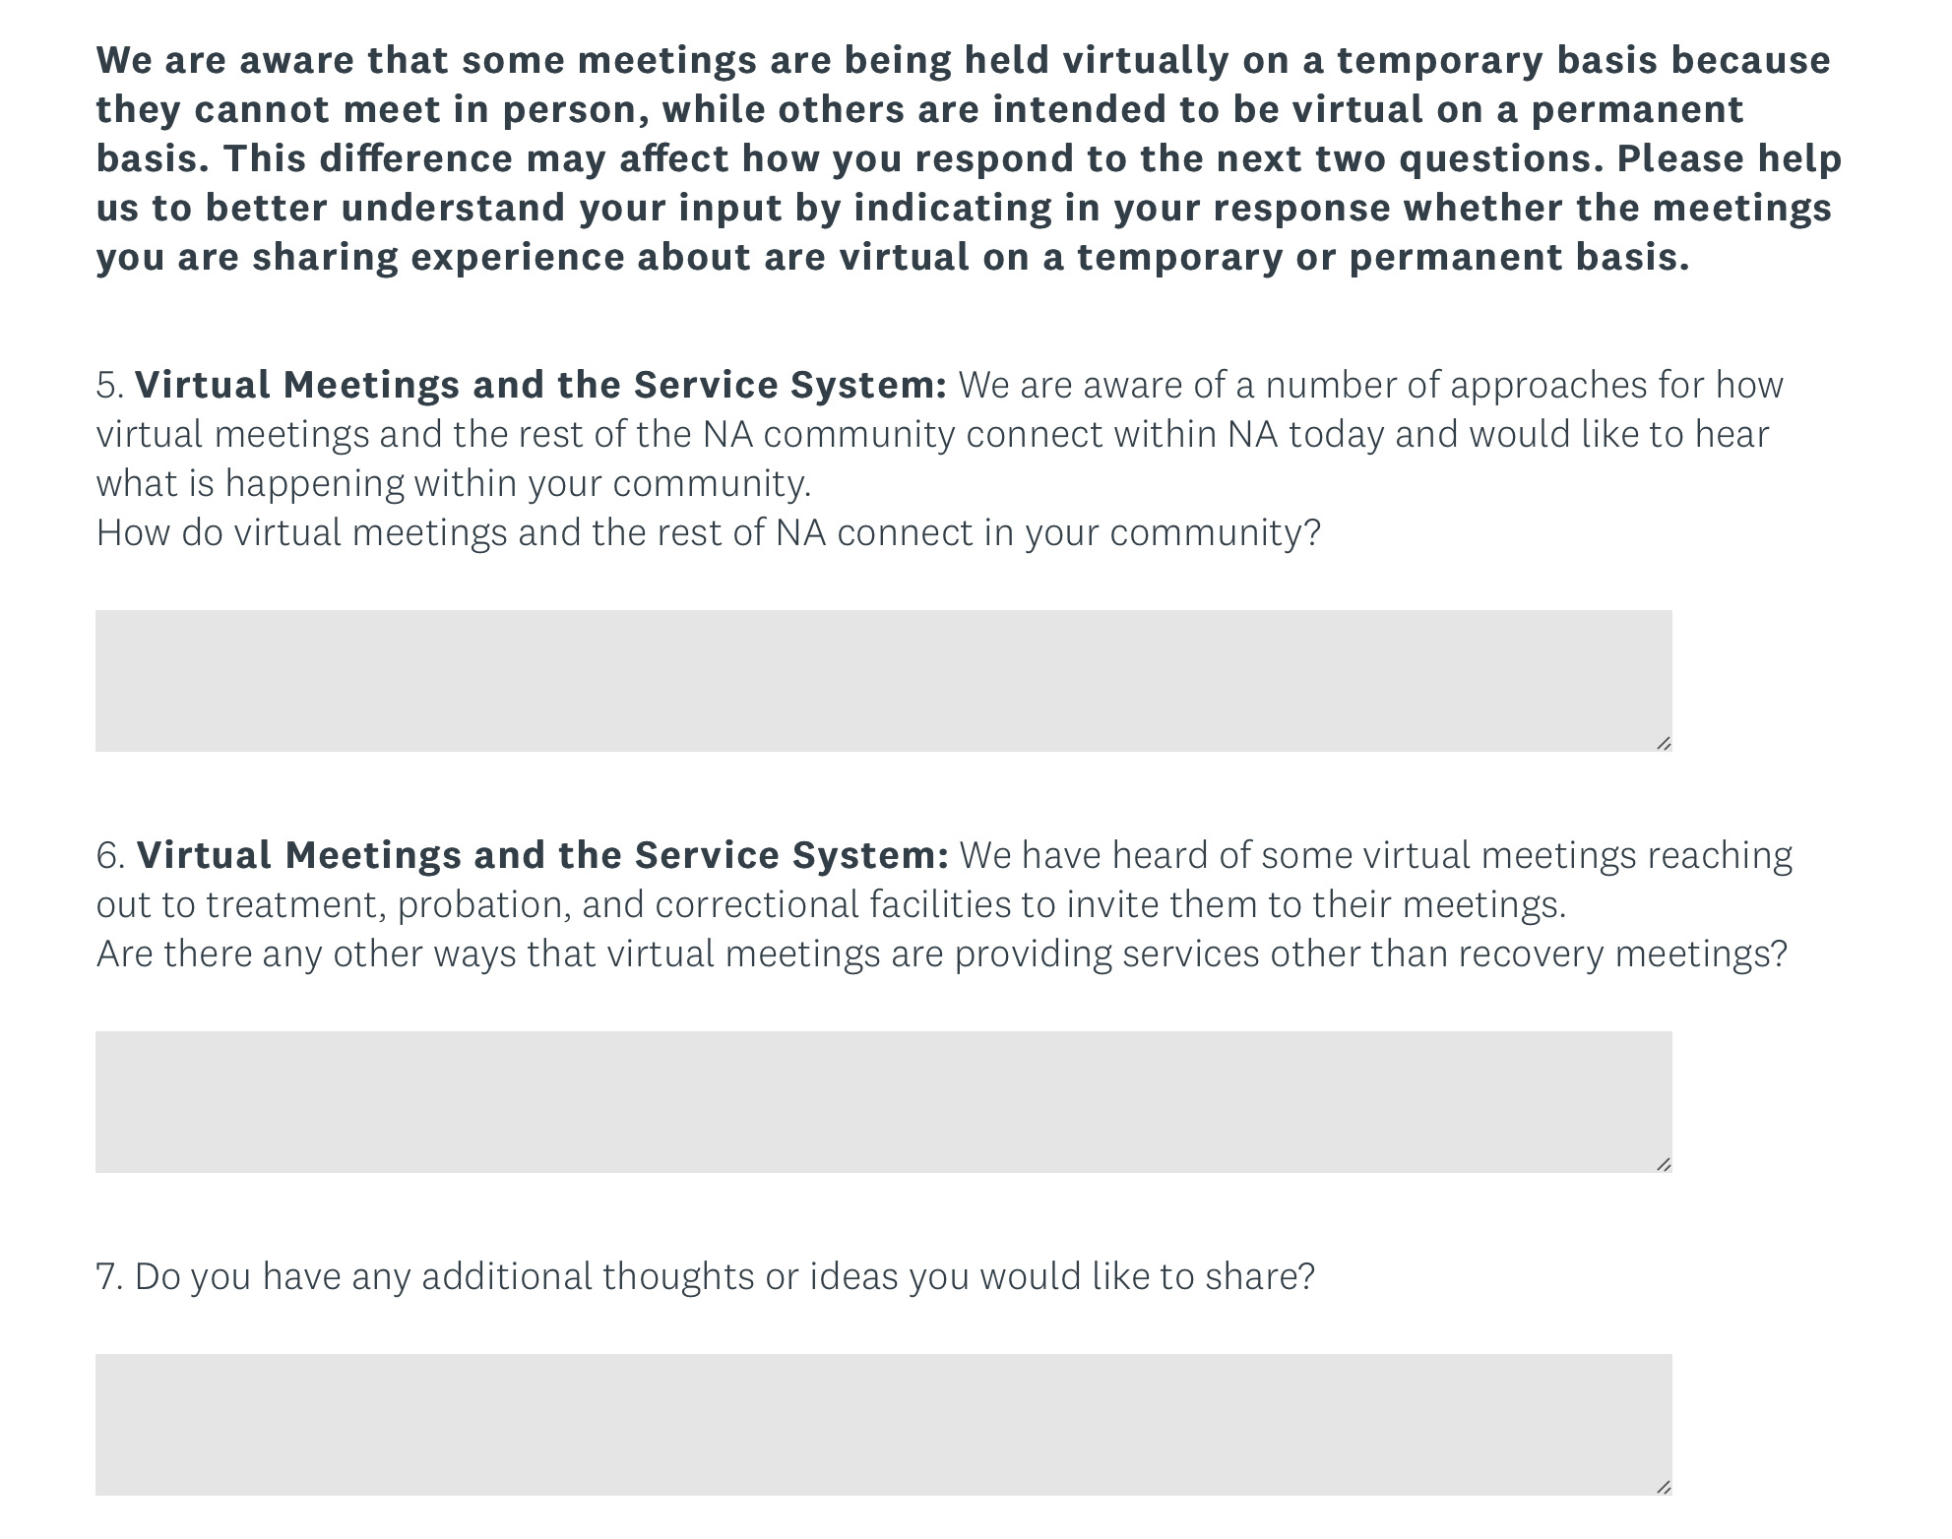
Survey for Project
How do virtual meetings and the rest of NA connect in your community?
Are there any other
ways that virtual
meetings are
providing services
other than recovery
meetings?

Slide 10
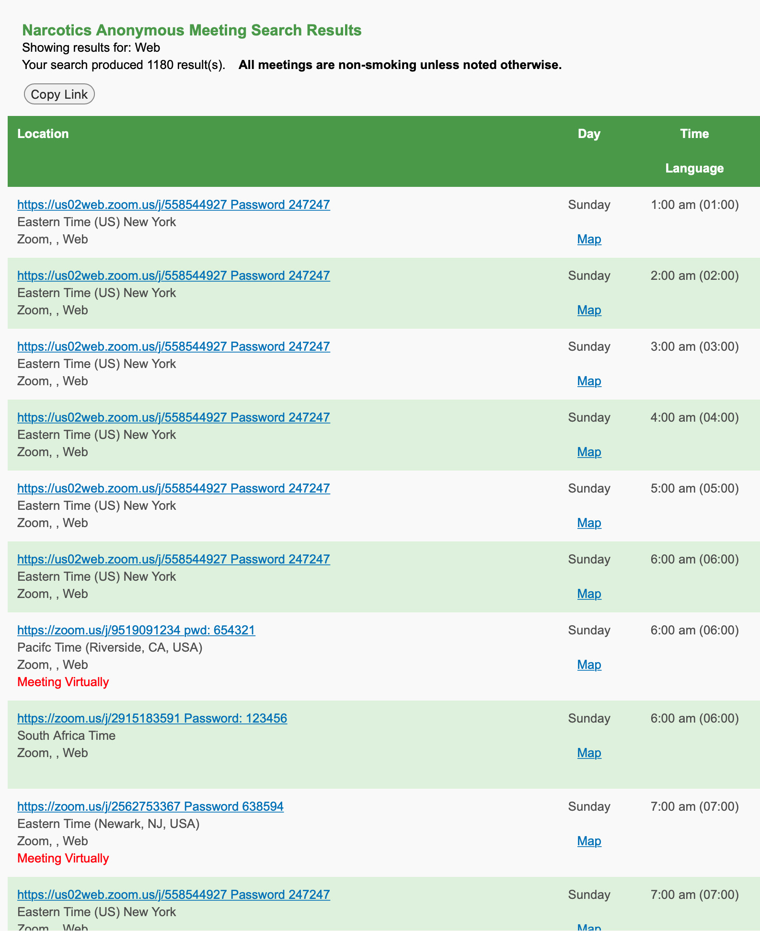
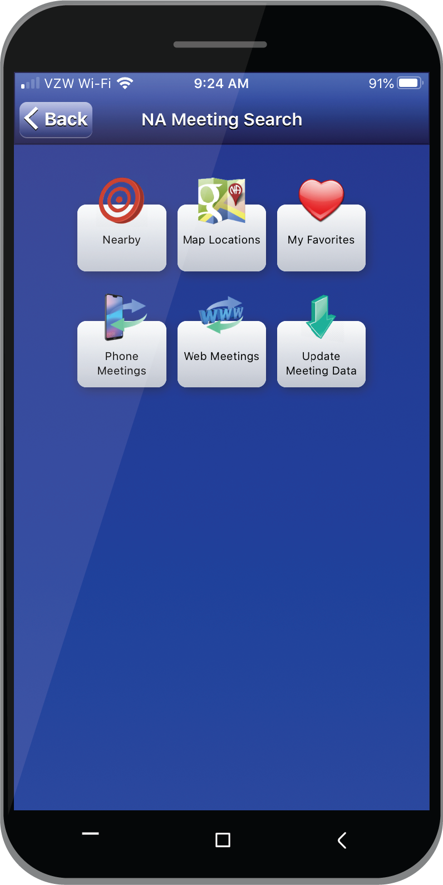
Meeting Finder App /
NA Meeting Search
on na.org
Registering virtual meetings
Will be a discussion at WSC 2022
Still searchable in the app and na.org
Survey will help inform the work of the project

Slide 11
Select a language
Select English or one of the translation channels:
    Portuguese Russian Spanish
survey you want our groups to fill out?
1. Find at bottom of screen
2. Choose a language

Slide 12

Building a Virtual Community
NorthStar Online NA Group, SINCE MAY 10TH, 2018
KENTUCKY SURVIVORS AREA, https://kysurvivors.com
Bluegrass-Appalachian region, https://barcna.com
northstaronlinegroup@gmail.com

Slide 13
JUST THE FACTS: ZOOM 201-257-2764
WE BEGAN MEETING IN MAY 2018 ON THE ZOOM PLATFORM AS AN AREA OUTREACH PROJECT
WE TRANSITIONED TO A VOTING HOMEGROUP IN OUR AREA ON JULY 14TH, 2019
WE OWN 2 “PRO ACCOUNTS” (1 WITH 500 CAPACITY FOR EVENTS)
WE MEET EVERYDAY 7:00-8:30PM EASTERN U.S. TIME (NEW YORK)
OUR DAILY ATTENDANCE IS 40-75 ATTENDEES (MOSTLY FROM USA)
WE CONSISTENTLY HAVE 4-7 OUTSIDE ORGANIZATIONS ATTENDING OUR MEETINGS THROUGH HYBRID TECHNOLOGY
OUR 7TH TRADITION PRUDENT RESERVE: $1,500-$1,800 (U.S.) FOR 3 MONTHS (PHONELINE COST FLUCTUATES)
WE HAVE 25-30 HOMEGROUP MEMBERS, EACH ONE SERVING IN SOME CAPACITY (THE MAJORITY DURING OUR RECOVERY MEETINGS)

Slide 14
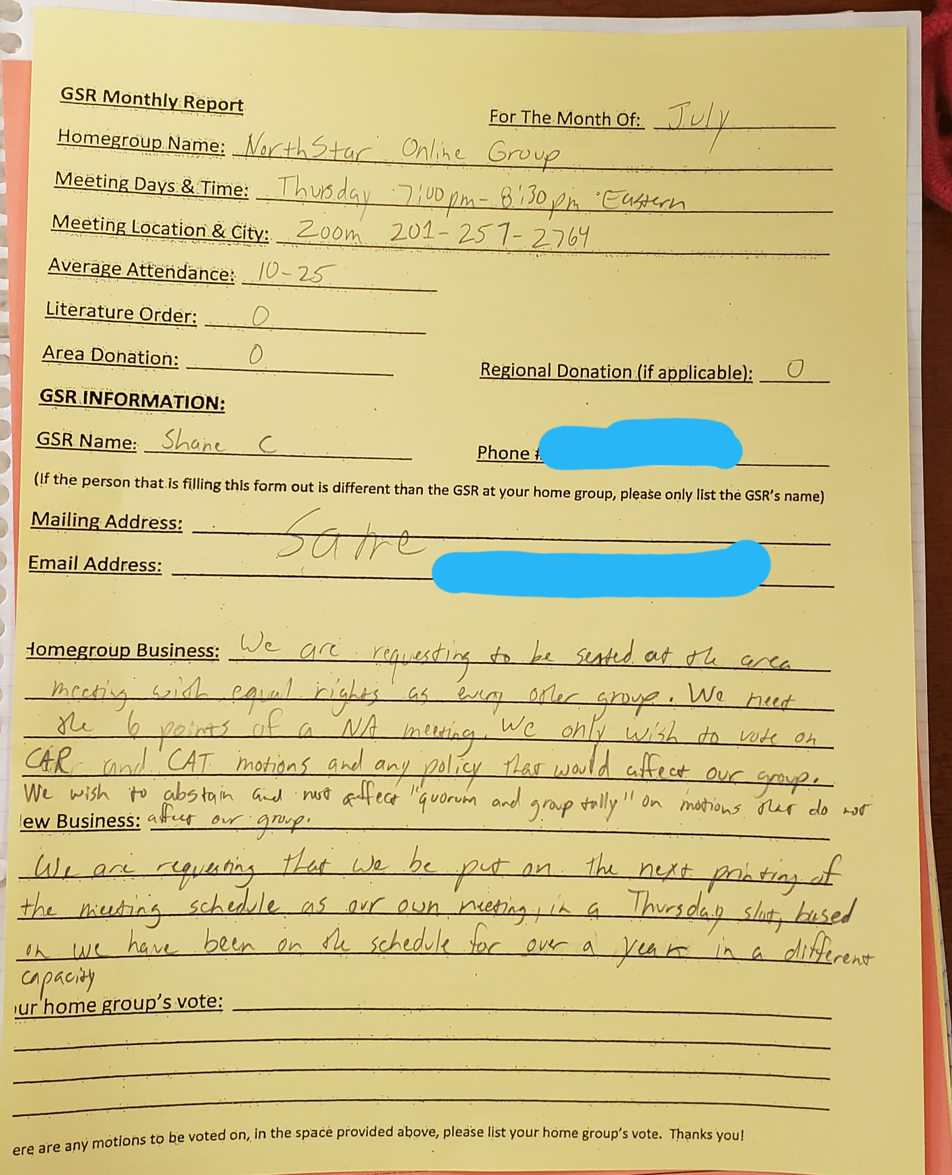

WE BECAME FULLY
SELF-SUPPORTING
JULY 14TH, 2019

Slide 15

Where dO we Focus?

Slide 16
BE PUNCTUAL
BE CONSISTENT
GET THERE EARLY,
STAY LATE
ESTABLISH CLEAR EXPECTATIONS
THIS PROVIDES AN OPPORTUNITY FOR MEMBERS TO RESOLVE VIDEO AND AUDIO TECHNICAL ISSUES . IT ALSO ALLOWS TIME FOR INSTRUCTION OF ATTENDEES THAT ARE NEW TO THE MEETING PLATFORM (RAISE HAND, CHAT, ETC.). ASSIGNING READINGS AND OTHER TASKS BEFORE THE MEETING IS HELPFUL. AFTER THE MEETING WE ALLOW PEOPLE TO SHARE WHO WERE NOT ABLE TO SHARE DURING THE MEETING. THIS IS ALSO A TIME FOR SOCIALIZING.
A CONSISTENT ATMOSPHERE HELPS NEW ATTENDEES MAKE A DECISION IF THEY WOULD LIKE TO RETURN TO OUR MEETING. WE ASK OURSELVES QUESTIONS LIKE: ARE WE TREATING ATTENDEES EQUALLY WHILE COMMUNICATING? ARE WE SHARING THE TIME FAIRLY? ARE WE SHOWING AND TELLING ALL OF OUR ATTENDEES THAT THEY ARE IMPORTANT TO US?

Slide 17

Slide title 29
PROVIDE A SAFE MEETING SPACE
MEMBERS ARE LIKELY TO RETURN WHEN THEY FEEL THAT THE HOSTS ARE DOING THEIR BEST TO CONTROL THE MEETING SPACE. CONTROLLING THE MUTE/UNMUTE, SCREENSHARE, CHAT, AND VIDEO FEED OPTIONS OF THE MEETING ARE ALL GOOD PRACTICES. WE ASK ATTENDEES TO ALERT THE HOST IF SOMEONE IS BEING DISRUPTIVE.

Slide 18

PROVIDE OPPORTUNITIES
TO SERVE
WE CREATE OPPORTUNITIES FOR ANYONE TO SERVE DURING OUR MEETINGS, REGARDLESS OF THEIR TECHNICAL SKILL LEVEL OR CLEAN TIME. THE DEVICE THAT THEY ATTEND THE MEETING WITH WILL DICTATE WHAT TECHNICAL RESPONSIBILITIES THEY ARE ABLE TO FULLFILL. DUTIES AT OUR MEETING INCLUDE HOST/CHAIRPERSON, CHAT, 12TH STEP PHONE LIST SERVANT, TIMER (FOR EACH SHARE), AND VIDEO PATROL.

Slide 19

WE OFFER SPONSORSHIP
OUR MEETING REGULARLY HAS THREE GENERATIONS (OR MORE) OF SPONSORSHIP IN ATTENDANCE. WE ANNOUNCE OUTLOUD AND IN THE CHAT THAT WE PROVIDE A LIST OF WILLING AND CAPABLE MEMBERS WHO WILL SPONSOR. WE ENCOURAGE ANYONE WITHOUT A SPONSOR TO STAY AFTER THE MEETING TO ASK QUESTIONS AND GET PHONE NUMBERS.

Slide 20

JOIN OUR GROUP CONSCIENCE
WE ENCOURAGE ALL MEETING ATTENDEES TO JOIN OUR MONTHLY GROUP BUSINESS MEETING, EVEN IF THEY ALREADY HAVE A HOMEGROUP. IF YOU ATTEND OUR MEETING REGULARLY, WE ARE INTERESTED IN YOUR OPINION. THIS IS WHERE NEW IDEAS ARE INTRODUCED, AND WHERE WE MAKE FINANCIAL DECISIONS REGARDING OUR 7TH TRADITION DONATIONS.

Slide 21
7TH TRADITION
WE ACCEPT MONETARY DONATIONS AT OUR MEETINGS VIA VENMO AND CASHAPP. WE USE SOME OF OUR DONATIONS TO PAY THE BILL FOR OUR MEETING ROOM ON ZOOM. WE FUND A NORTH AMERICAN VIRTUAL MEETING PHONELINE VIA YAP AND BMLT TECHNOLOGY. WE ALSO FUND PUBLIC SERVICE ANNOUNCEMENTS THAT LEAD THE PUBLIC TO NA WORLD SERVICES, VIRTUAL-NA.ORG, THE BLUEGRASS-APPALACHIAN REGION, AND THE KENTUCKY SURVIVORS AREA. WE ARE GRATEFUL TO SHARE RESPONSIBILITIES WITH ALL LEVELS OF OUR SERVICE STRUCTURE IN A TIME WHERE VOLUNTEERS AND SPECIAL WORKERS HAVE BEEN GREATLY AFFECTED BY THIS PANDEMIC.

Slide 22
MEETING ATTENDANCE VERIFICATION:
WE PROVIDE MEETING ATTENDANCE VERIFICATION THROUGH AN AUTOMATED EMAIL SYSTEM, WHICH IS MONITORED BY 2 TRUSTED SERVANTS. THIS PROVIDES AN OPPORTUNITY FOR MORE POTENTIAL MEMBERS TO ATTEND OUR MEETINGS. AS A RESULT, SOME MEMBERS NEEDING VERIFICATION HAVE JOINED OUR HOMEGROUP AND ARE PART OF OUR COMMUNITY TO THIS DAY.

Slide 23
COMMUNICATING THROUGH ANNOUNCEMENTS
WE COMMUNICATE EVERY ASPECT OF OUR RECOVERY MEETING AND BUSINESS MEETING DURING OUR ANNOUNCEMENTS. WE SPEAK THEM OUT LOUD DURING EVERY MEETING AND PLACE THEM IN THE CHAT.
TOPICS INCLUDE:
- THE MEETING FORMAT / TOPIC - OUR 7TH TRADITION OPTIONS
- FREE LITERATURE AT NA.ORG - MEETING ATTENDANCE VERIFICATION
OUR 12th STEP PHONE LIST - DATE OF BUSINESS MEETING
- CAN WE CONNECT YOU TO YOUR - DO YOU NEED A SPONSOR?
LOCAL NA COMMUNITY?

Slide 24
ATTRACTING EXPERIENCED MEMBERS:
OUR PHILOSOPHY
HAVING GUEST SPEAKERS ON A REGULAR BASIS HAS BEEN HELPFUL IN EXPOSING EXPERIENCED MEMBERS TO OUR COMMUNITY. MANY HAVE COME TO SPEAK AND DECIDED TO RETURN. ALSO, ADAPTING OUR MEETING FORMAT TO INCLUDE A PIECE OF OUR GUEST’S LOCAL NA CULTURE HAS HELPED THEM TO MAKE A DECISION TO JOIN THE GROUP. SOME CHANGES THAT WE HAVE ADOPTED OVER TIME HAVE INCLUDED: NA TERMINOLOGY IN THE FORMAT, THE ORDER OF RECOVERY MEETING OPERATIONS, AND ADOPTING NEW “DECISION MAKING RULES OF ORDER” FOR A RAPIDLY CHANGING COMMUNITY.
WHEN WE WERE HONEST WITH OURSELVES THAT THE MAJORITY OF THESE PIECES ARE PERSONAL PREFERENCES INSTEAD OF SINGULAR TRUTHS, IT WAS EASIER TO ACCEPT CHANGE IN THE INTEREST OF BEING MORE WELCOMING AND INCLUSIVE. WE FOUND THAT HUMILITY AND A WILLINGNESS TO COMMUNICATE WERE THE MOST IMPORTANT TOOLS DURING THESE TRANSITIONS.

Slide 25
EACH MEMBER IS IMPORTANT:
WITH THE FOCUS ON MAKING INDIVIDUALS FEEL WELCOME, WE HAVE CONTINUED TO GROW.
THANK YOU FOR ALLOWING US TO BE OF SERVICE TODAY.

Slide 26

Latin American Zonal Forum (LAZF)
Membership Survey on Virtual Meetings

Slide 27
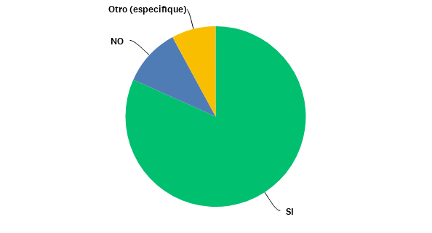
P7: Is your home group closed due to the pandemic?
Other
Yes

Slide 28
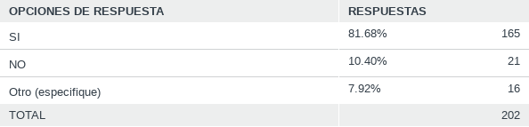
P7: Is your home group closed due to the pandemic?
Answers Options
%
Answers
YES
OTHER

Slide 29
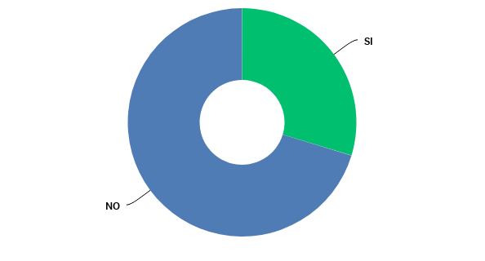
P9: Is your home group already functioning normally?
Yes

Slide 30
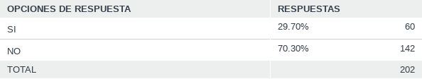
P9: Is your home group already functioning normally??
Answers Options
%
Answers
YES

Slide 31
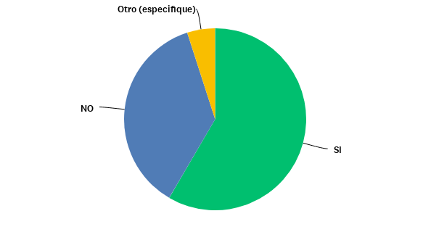
P13: Does your home group continue to offer literature to its members? Selling?
Other
Yes

Slide 32
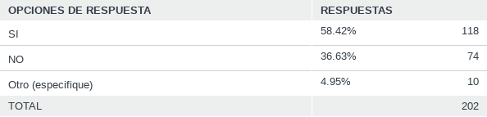
P13: Does your home group continue to offer literature to its members? Selling?
Answers Options
%
Answers
YES
OTHER

Slide 33
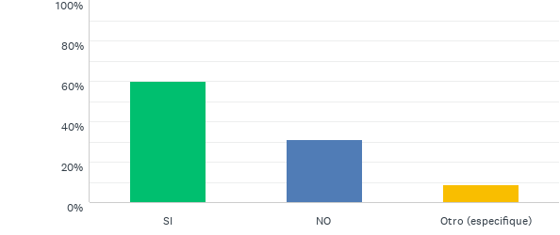
P15: Is your home group contributing financially to the service structure?
Yes
Other

Slide 34
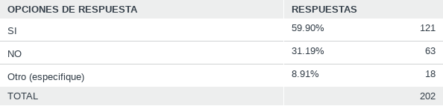
P15: Is your home group contributing financially to the service structure?
Answers Options
%
Answers
YES
OTHER

Slide 35
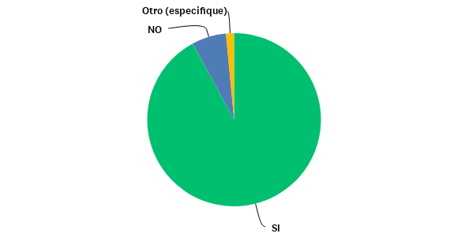
P17: Are you attending virtual meetings?
Other
Yes

Slide 36
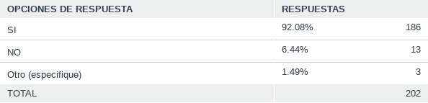
P17: Are you attending virtual meetings?
Answers Options
%
Answers
YES
OTHER

Slide 37
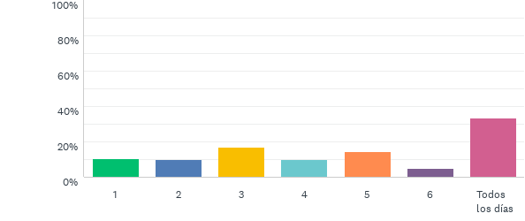
P18: How many times a week do you attend a virtual meeting?
EVERY DAY

Slide 38
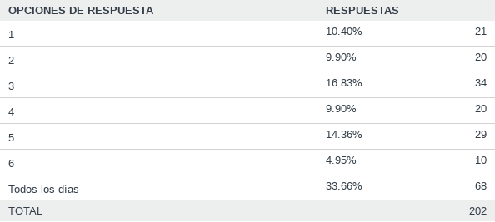
P18: How many times a week do you attend a virtual meeting?
Answers Options
%
Answers
EVERY DAY

Slide 39
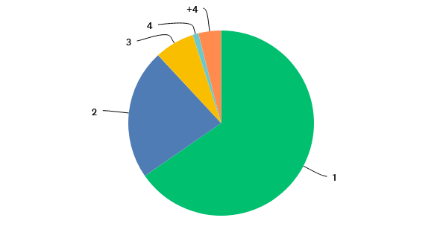
P19: How many times a day do you attend a virtual meeting?

Slide 40
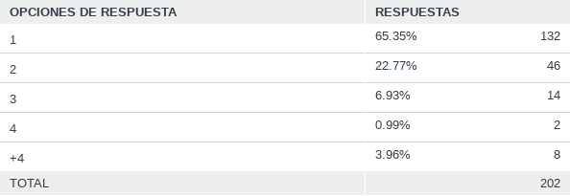
P19: How many times a day do you attend a virtual meeting?
Answers Options
%
Answers

Slide 41
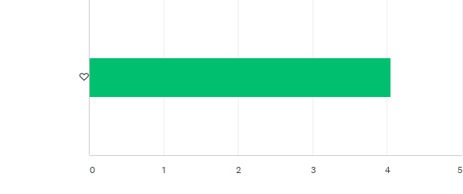
P22: Do you like virtual meetings?

Slide 42

P22: Do you like virtual meetings?
RATING

Slide 43
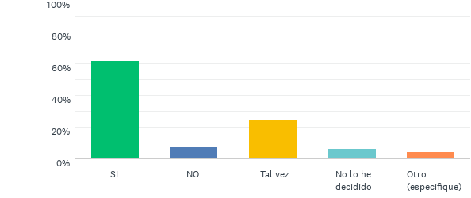
P27: After the pandemic, do you plan to continue attending online meetings?
Yes
MAYBE
I HAVEN’T DECIDED YET
Other

Slide 44
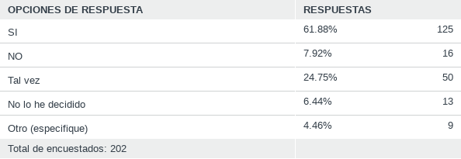
P27: After the pandemic, do you plan to continue attending online meetings?
Answers Options
%
Answers
Yes
MAYBE
I HAVEN’T DECIDED YET
Other

Slide 45


ARGENTINA'S
MARATHON
MEETING
na.org.ar/maratonica

Slide 46


MARATHON
MEETING
24/7 since March 23th
It started as a Regional effort as soon as our physical meetings began closing so the addicts looking for their first meeting could receive a single link instead of an endless list
na.org.ar/maratonica
Notes:
Este es el enlace para la Reunión Maratónica de la Región Argentina y para unirse por telefono:
Unirse por Meet:
https://meet.google.com/mhk-rpve-mco
Unirse por telefono:
+54 11 3986-3700‬ PIN: ‪826 553 974 4649‬#
Estos participantes podrán silenciar y habilitar sus micrófonos pulsando *6

Slide 47
MARATHON
MEETING
24/7 since March 23th
… and it worked
na.org.ar/maratonica
Notes:
Este es el enlace para la Reunión Maratónica de la Región Argentina y para unirse por telefono:
Unirse por Meet:
https://meet.google.com/mhk-rpve-mco
Unirse por telefono:
+54 11 3986-3700‬ PIN: ‪826 553 974 4649‬#
Estos participantes podrán silenciar y habilitar sus micrófonos pulsando *6

Slide 48
MARATHON
MEETING
24/7 since March 23th
Our website and social networks redirect users to the zoom meeting. Our 24/7 free phone helpline does it as well. We added a corporate Whatsapp service with a bot that gives this information as well
na.org.ar/maratonica
Notes:
Este es el enlace para la Reunión Maratónica de la Región Argentina y para unirse por telefono:
Unirse por Meet:
https://meet.google.com/mhk-rpve-mco
Unirse por telefono:
+54 11 3986-3700‬ PIN: ‪826 553 974 4649‬#
Estos participantes podrán silenciar y habilitar sus micrófonos pulsando *6

Slide 49
2570
5140
350
140
NA MEETINGS
Newcomers
Servants
HOURS of non-stop service
MARATHON
MEETING
24/7 since March 23th
This is the equivalent of a meeting that opens 2 hours every day for more than 7 years
and countless visitors from outside the fellowship, institutions, governmental authorities and professionals
Members from all over the world came together to make this possible: Argentina, Chile, Uruguay, Peru, Ecuador, Honduras, Mexico, Costa Rica, Germany, France, Spain and USA
2 hours per meeting one after the other
Numbers running from March 23th to October 23th
(7 months of uninterrupted service)
na.org.ar/maratonica
Notes:
Este es el enlace para la Reunión Maratónica de la Región Argentina y para unirse por telefono:
Unirse por Meet:
https://meet.google.com/mhk-rpve-mco
Unirse por telefono:
+54 11 3986-3700‬ PIN: ‪826 553 974 4649‬#
Estos participantes podrán silenciar y habilitar sus micrófonos pulsando *6

Slide 50
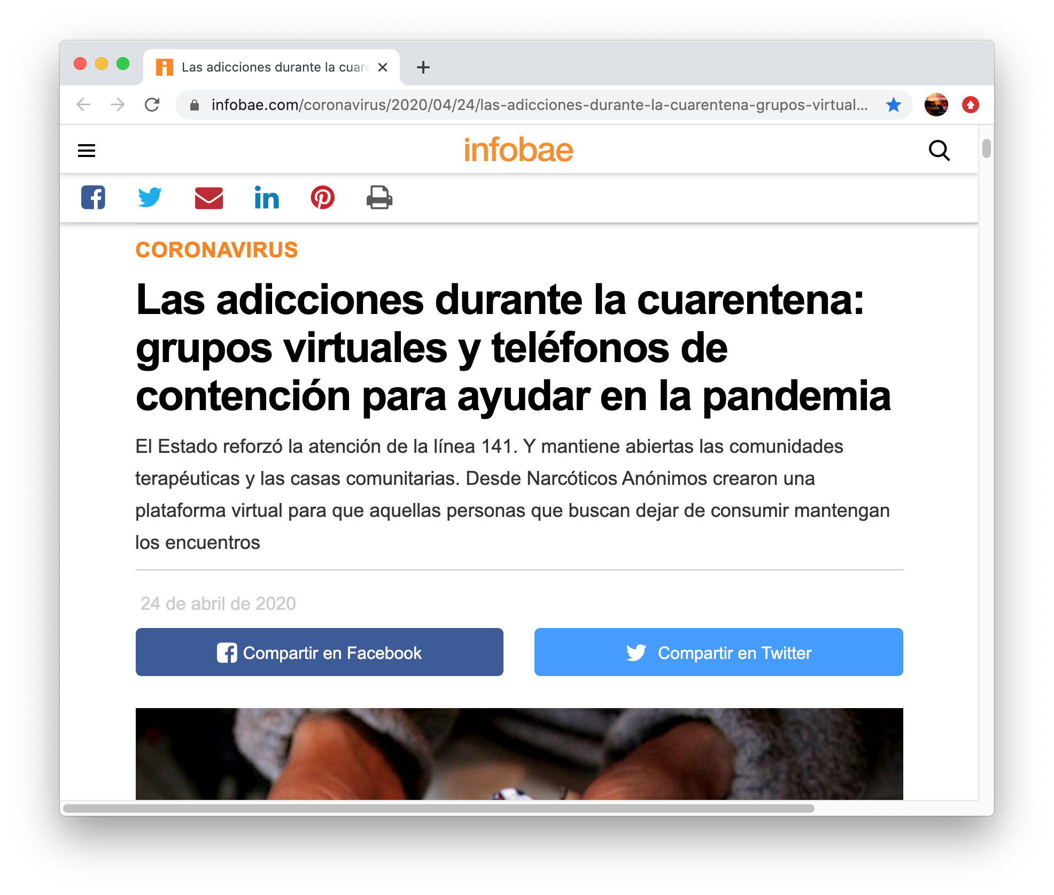
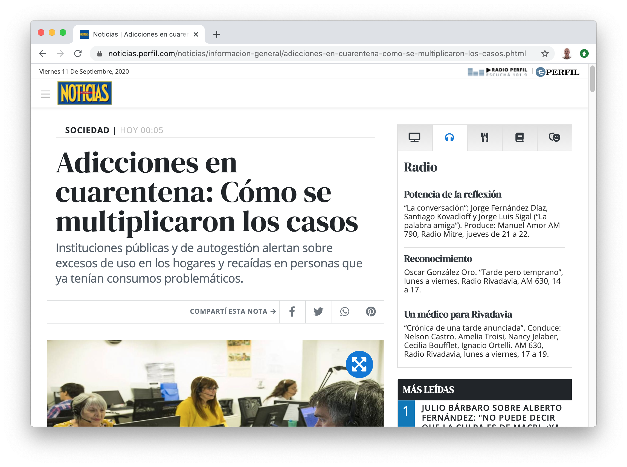
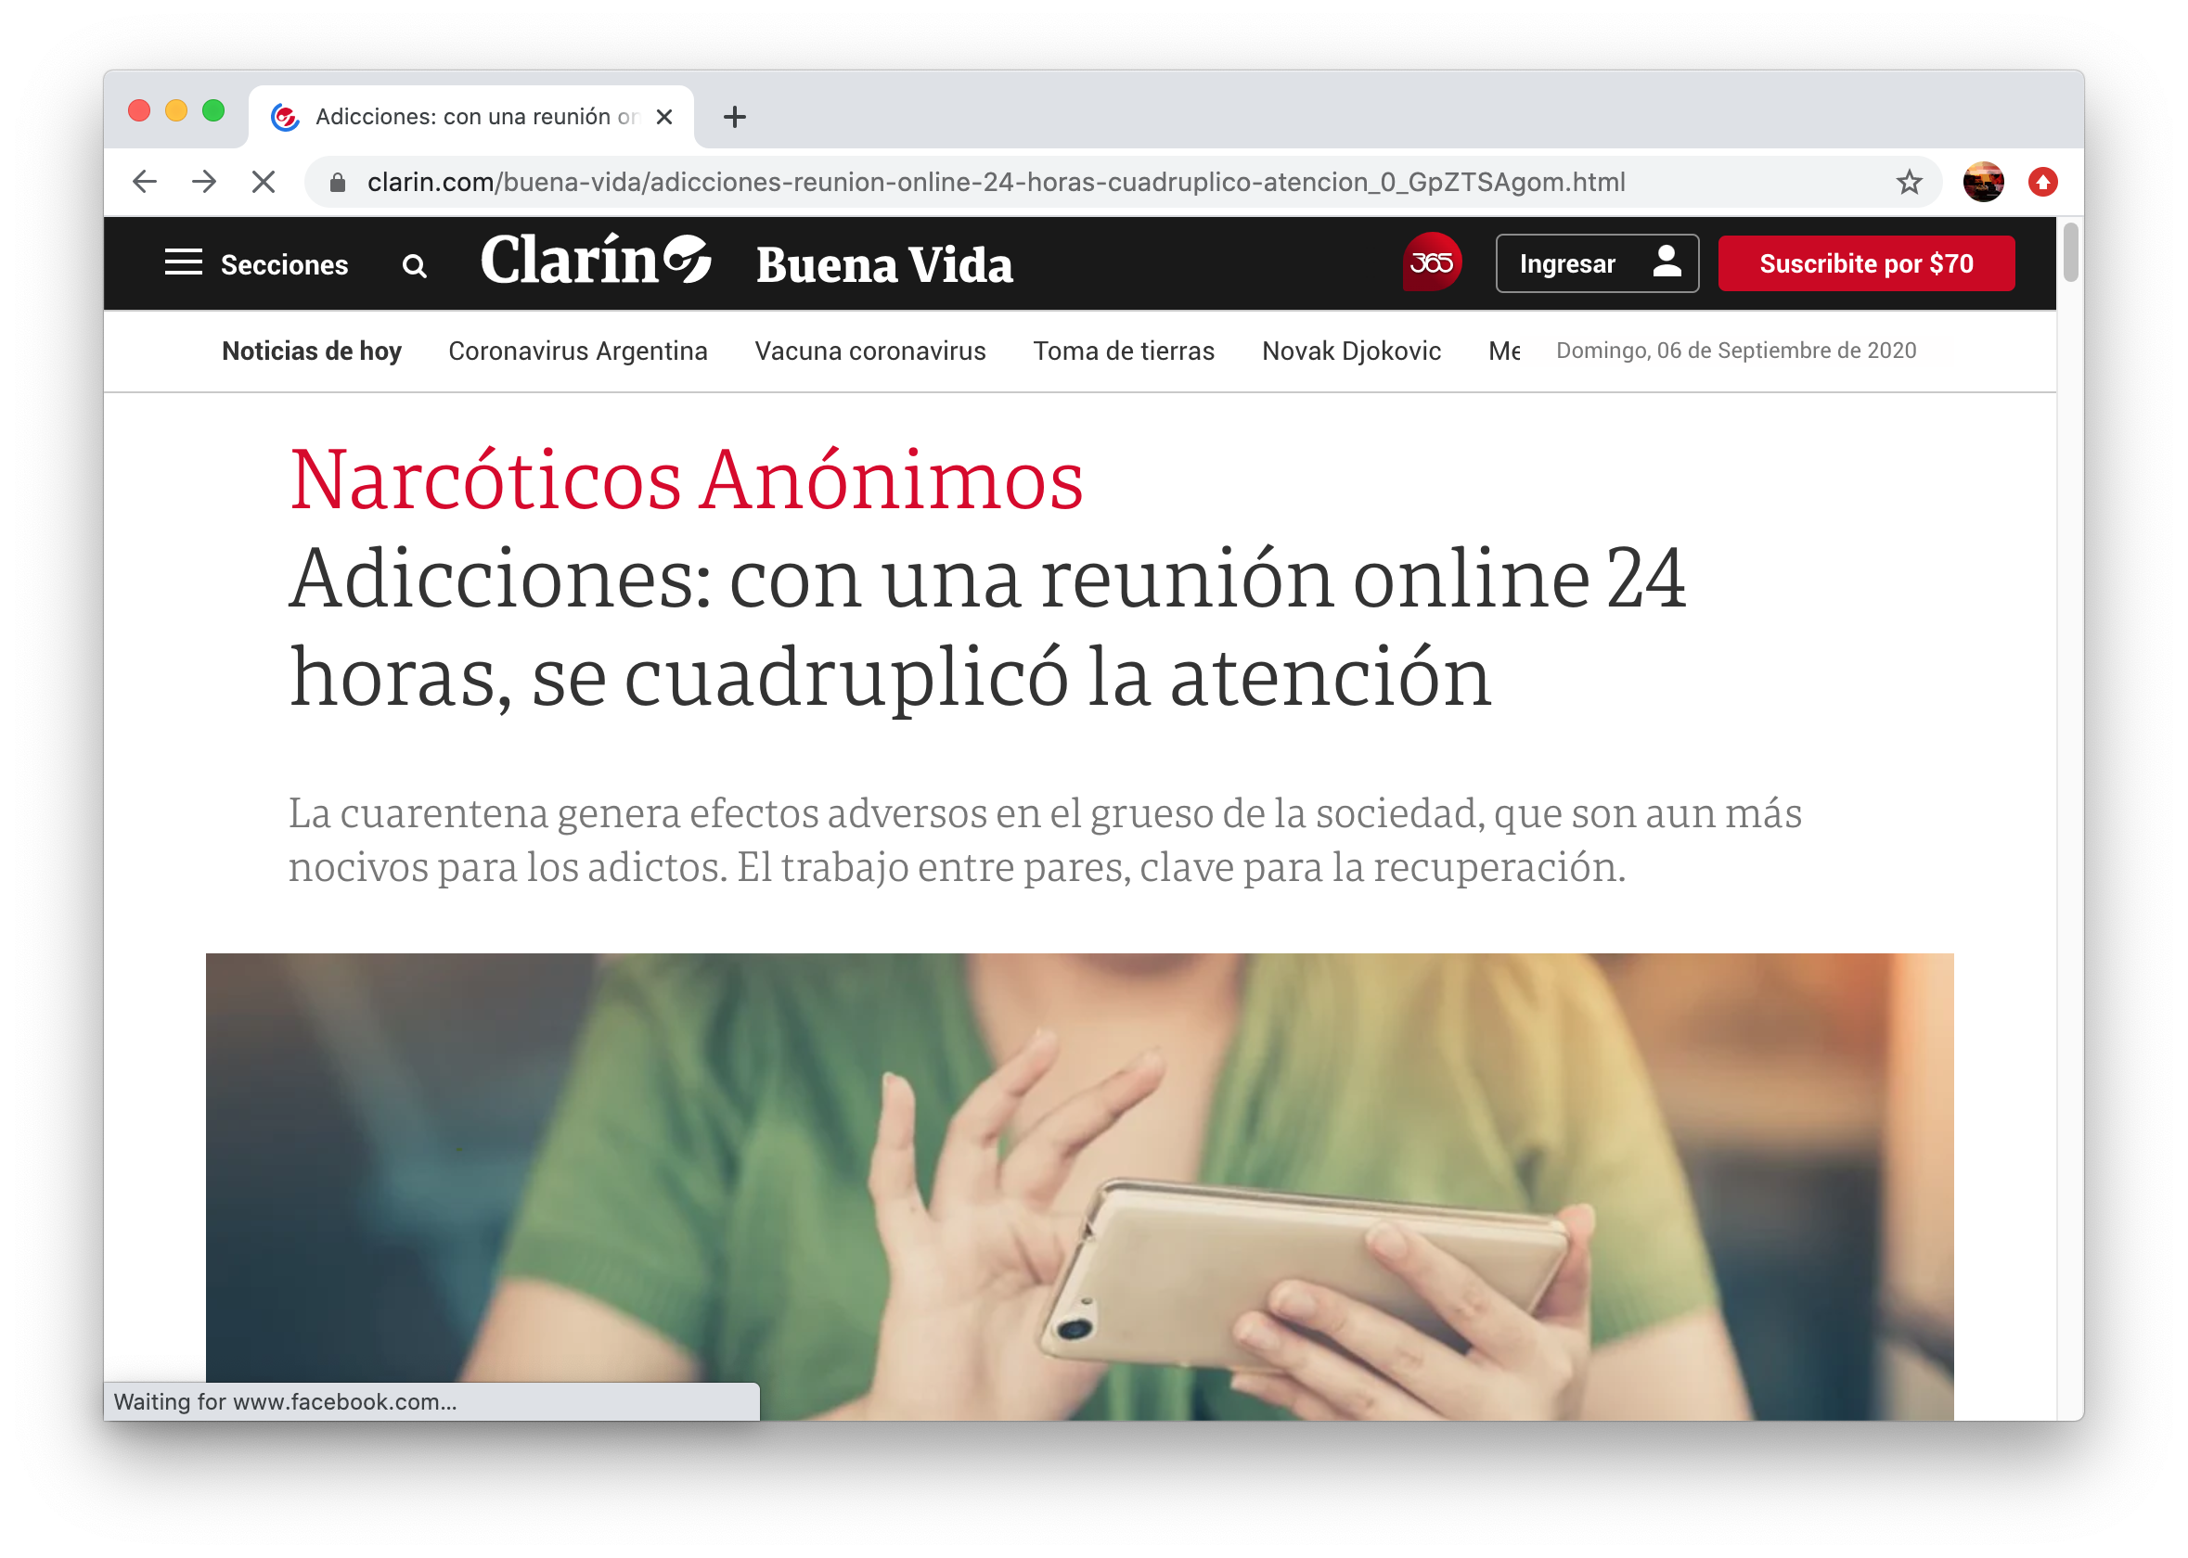
MARATHON
MEETING
24/7 since March 23th
Press Clippings
Major Media Appearances
na.org.ar/maratonica
Notes:
Este es el enlace para la Reunión Maratónica de la Región Argentina y para unirse por telefono:
Unirse por Meet:
https://meet.google.com/mhk-rpve-mco
Unirse por telefono:
+54 11 3986-3700‬ PIN: ‪826 553 974 4649‬#
Estos participantes podrán silenciar y habilitar sus micrófonos pulsando *6

Slide 51

“REMOTE” REACHING OUT SERVICE

Slide 52
“SISTEMA RAD” = Distance or Remote Recovery System
  RAD is a Reaching Out service, working as a recovery support tool, through two basic formats: online meetings and semi-in person meetings (hybrid), both closed meetings for people who have or believe to have a drug problem.

Slide 53
OBJECTIVE
To serve as support for NA Fellowship development, to integrate members from all around the world, to bring recovery to remote locations where NA is currently initiating or where there are no NA meetings, and to provide NA public information service.

Slide 54
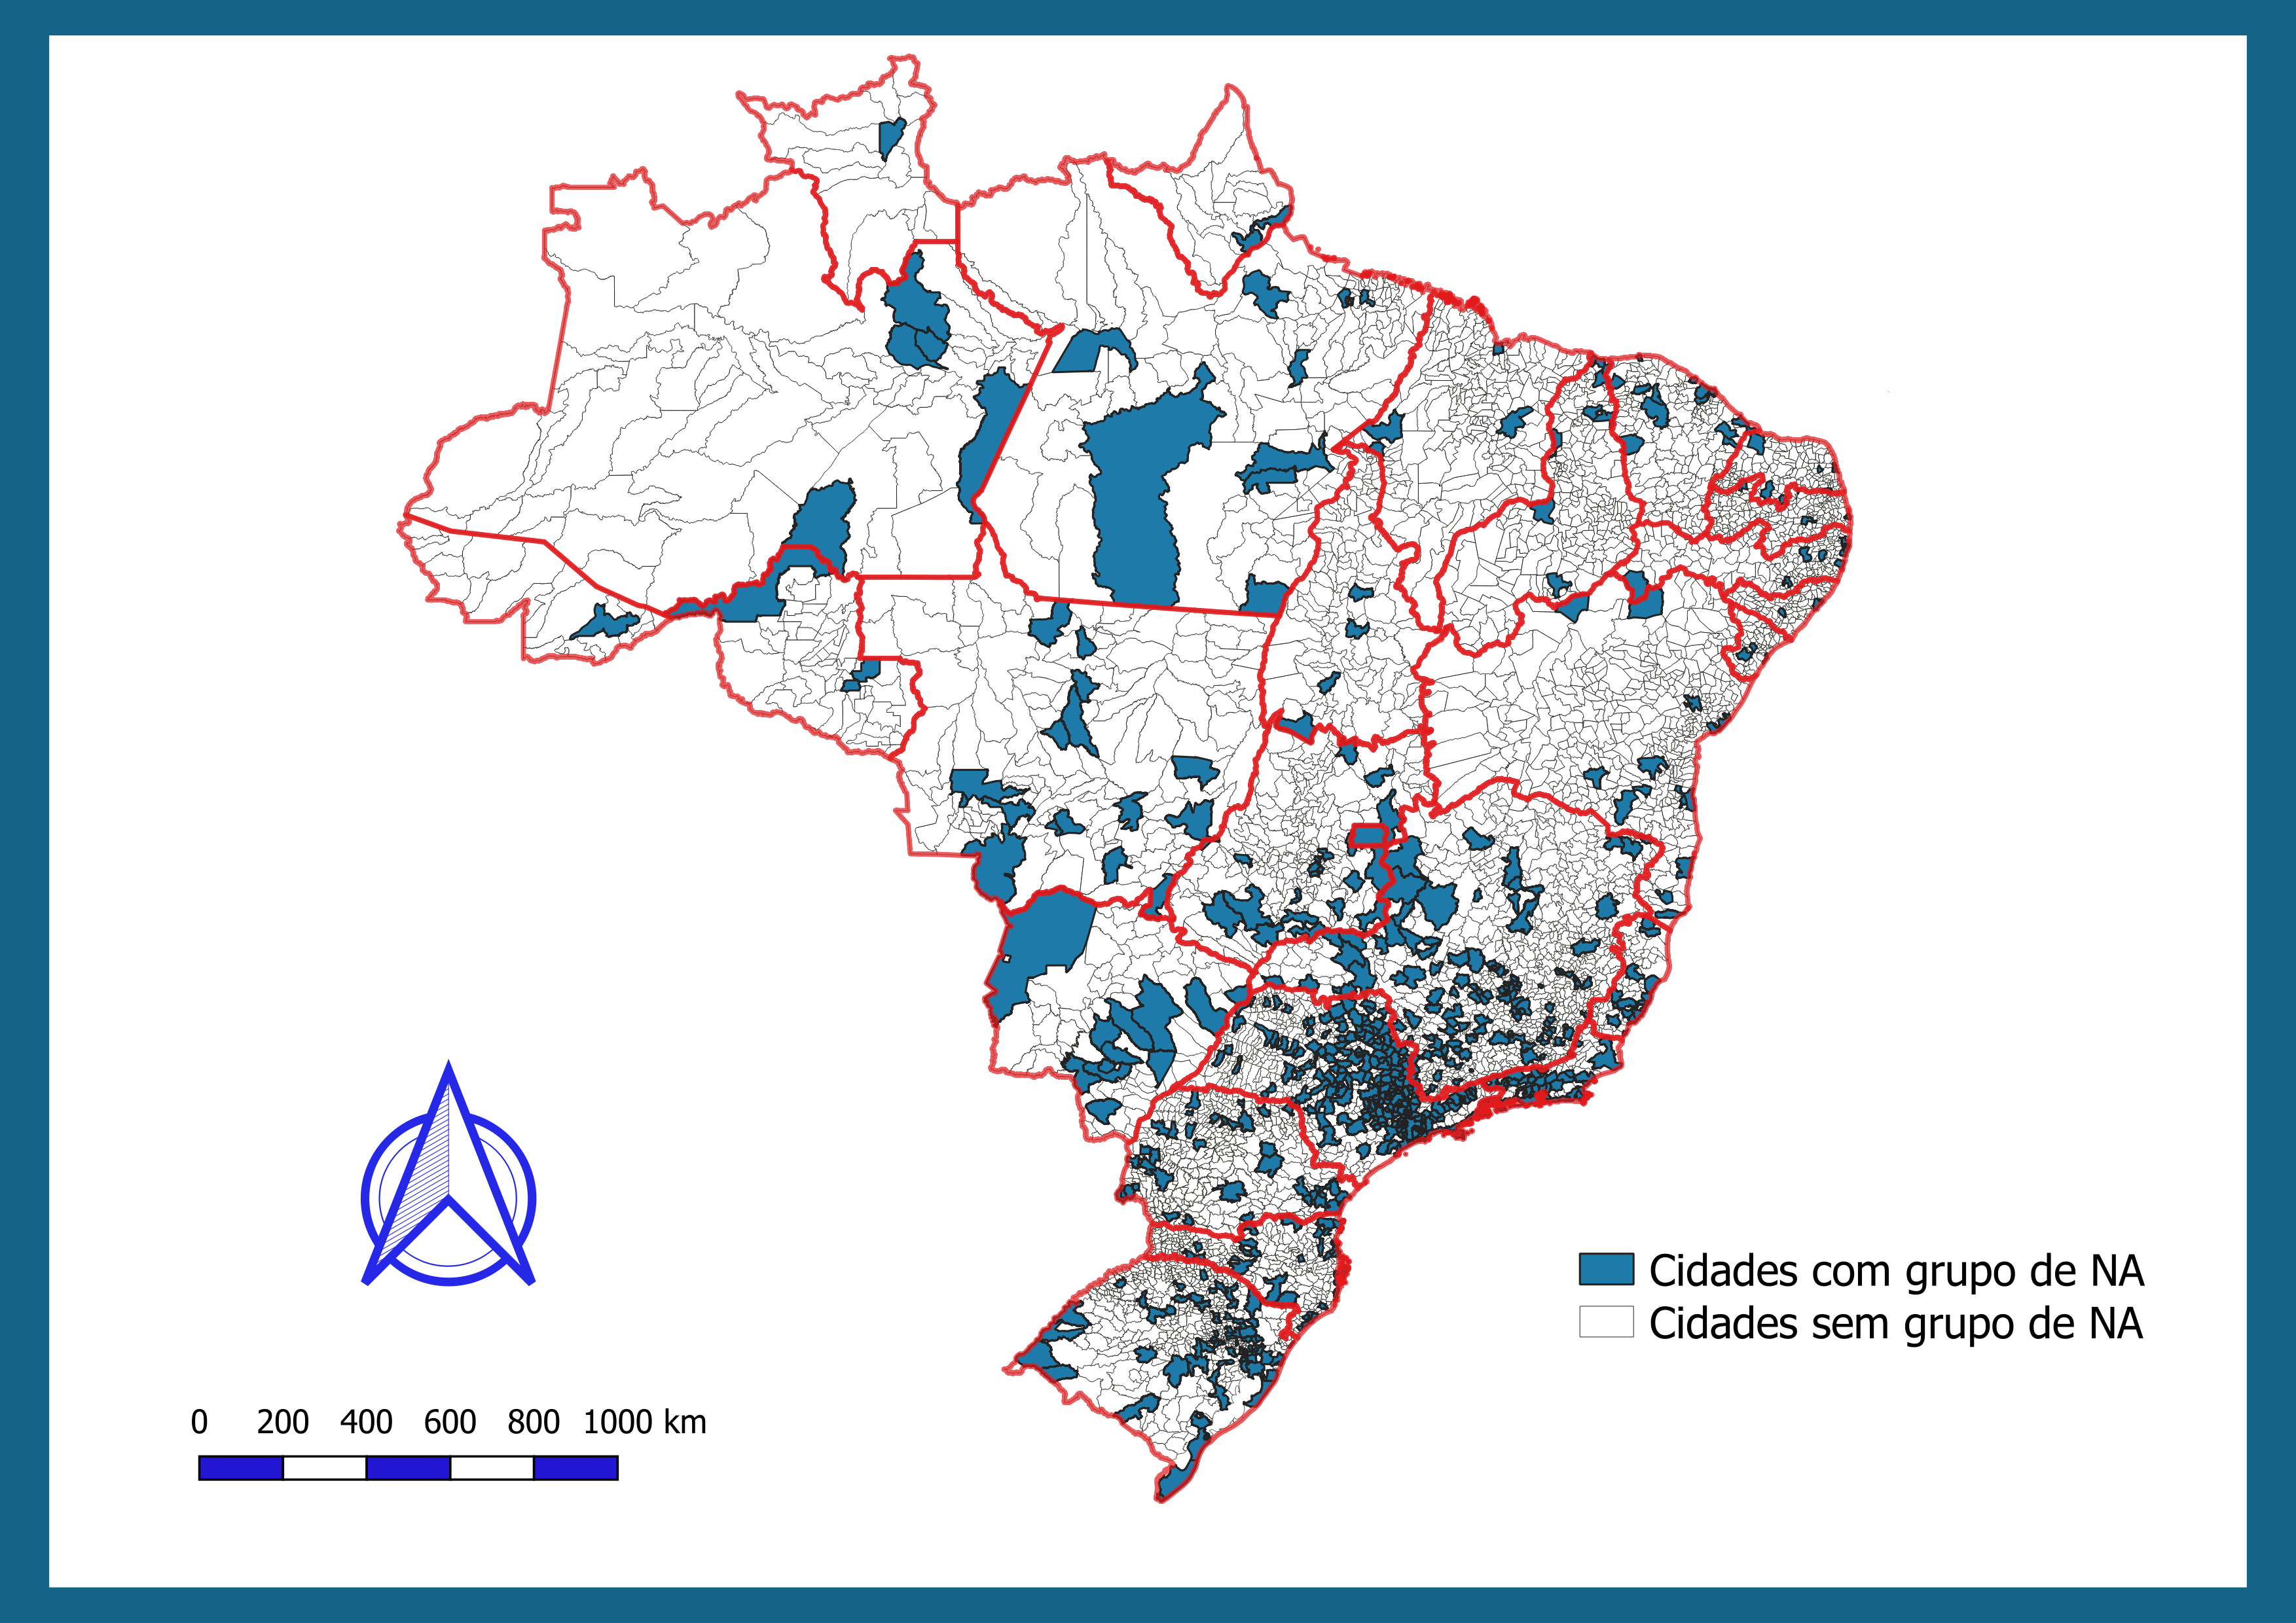
5570
Municipalities
700
Of which have meetings
Cities with NA
Cities without NA

Slide 55
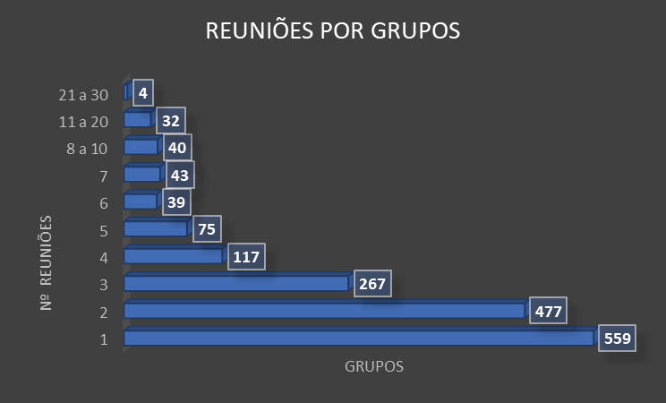

MEETINGS PER GROUPS
*Dados Lista de grupos FEV2020

Slide 56
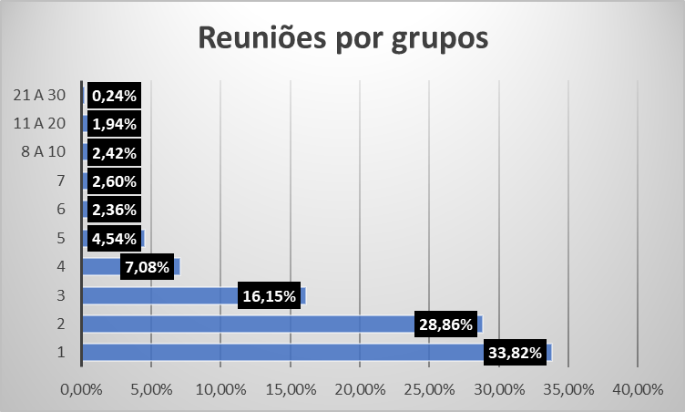
MEETINGS PER GROUPS

Slide 57
GUIDING PRINCIPLES
Fellowship development meetings, to provide a space for accountability, and enable new members to be integrated to the service body
To follow the RAD (Distance Recovery) service guide, specific material developed on this type of service format thus providing sponsorship and training to new trusted servants.
To annually organize a service conference, offering in person experience between the servants, to discuss past projects and plan future service.
To part of the Narcotics Anonymous service structure, to be accountable to Narcotics Anonymous, and to follow guidelines provided by the fellowship on a continuous basis.

Slide 58
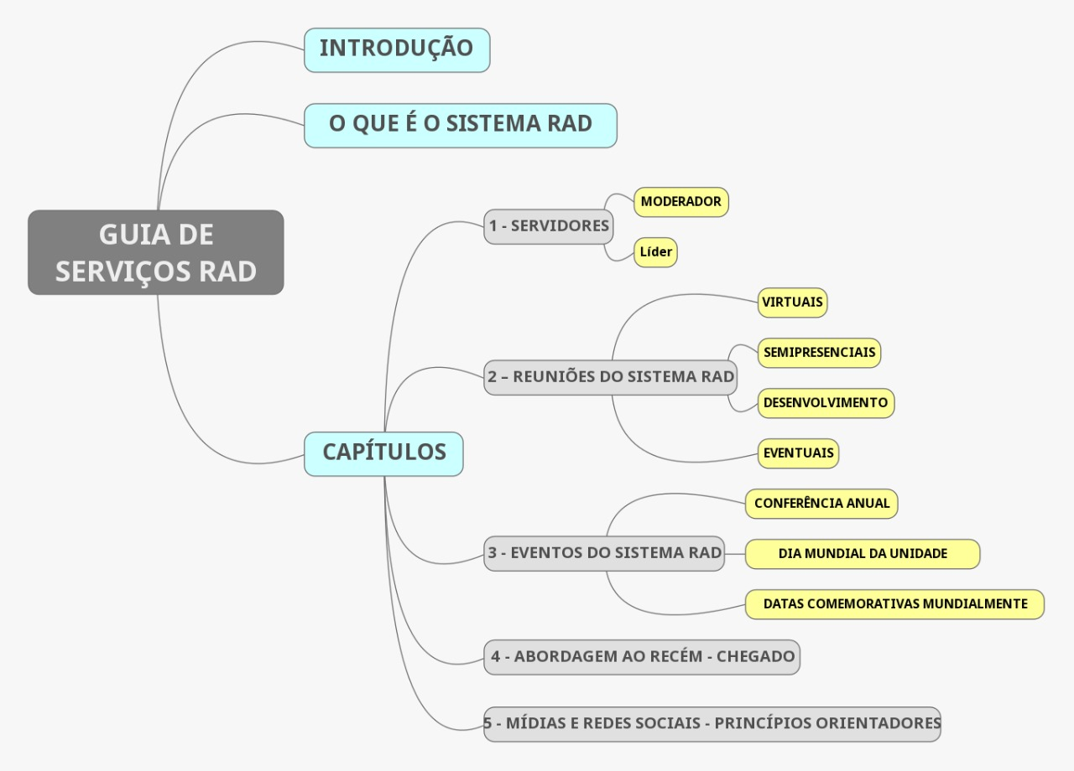

Slide 59
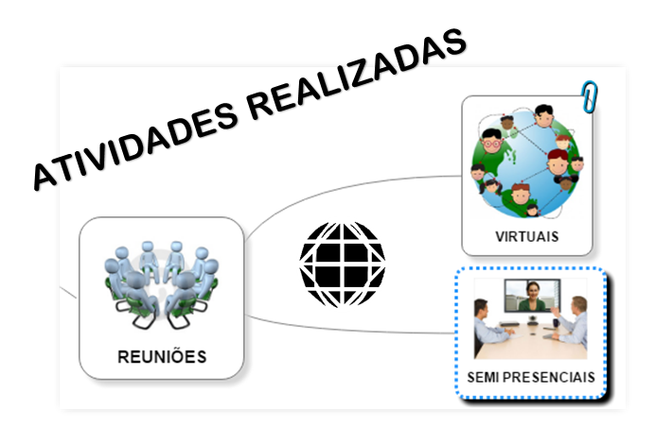

Slide 60
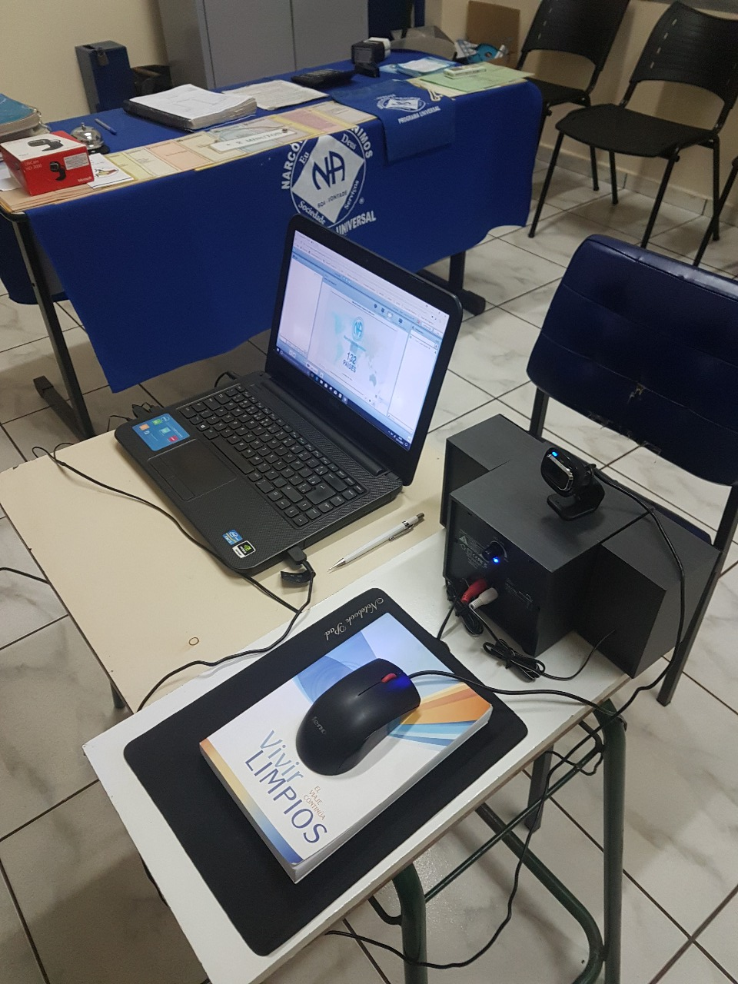

Slide 61
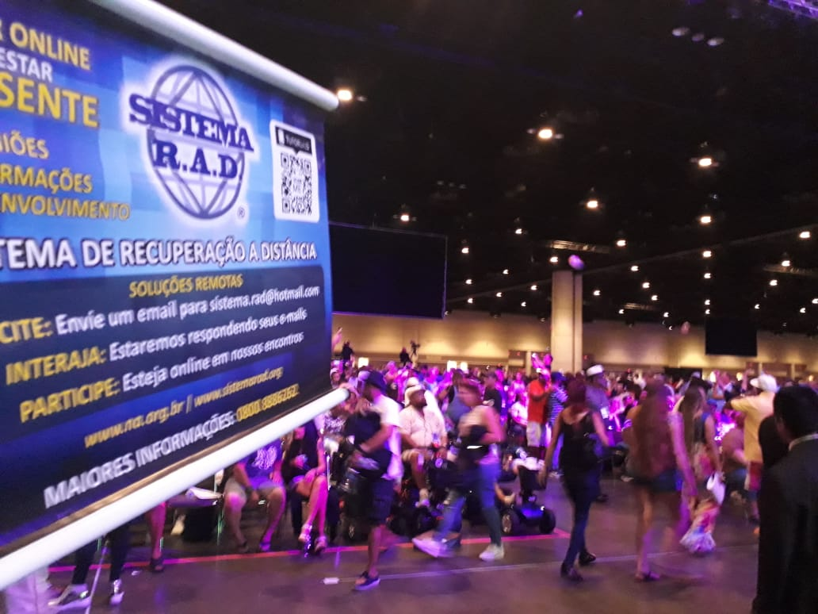

Slide 62
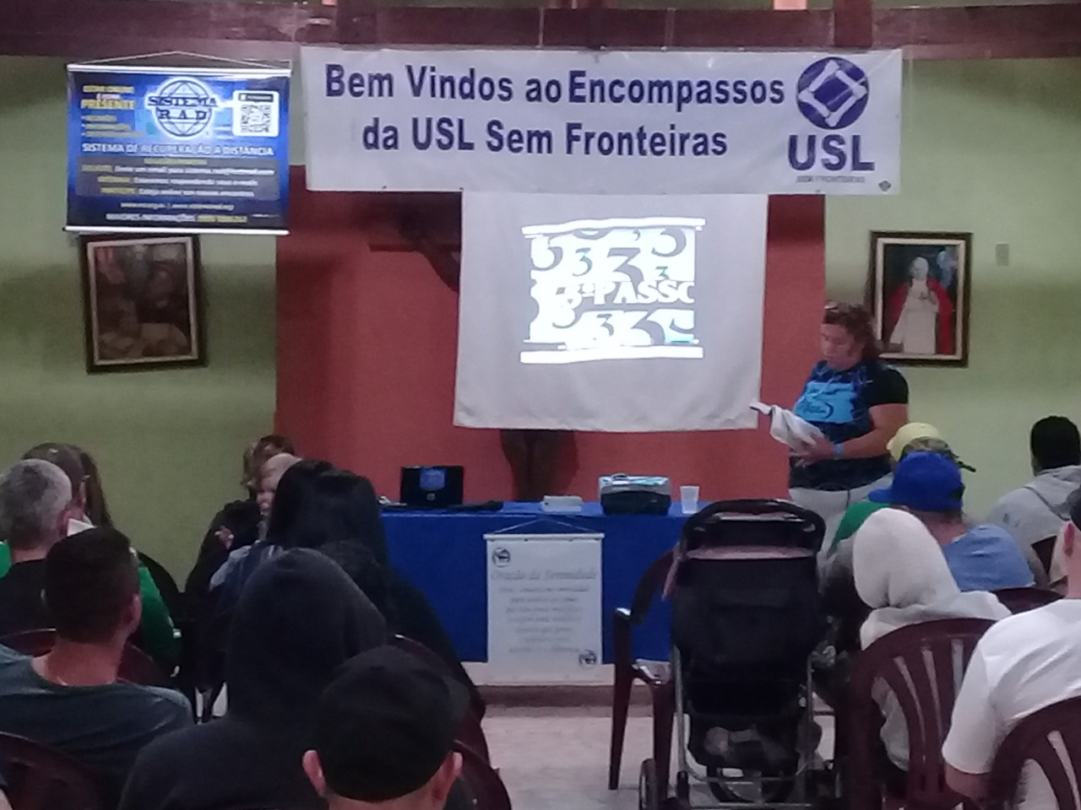

Slide 63
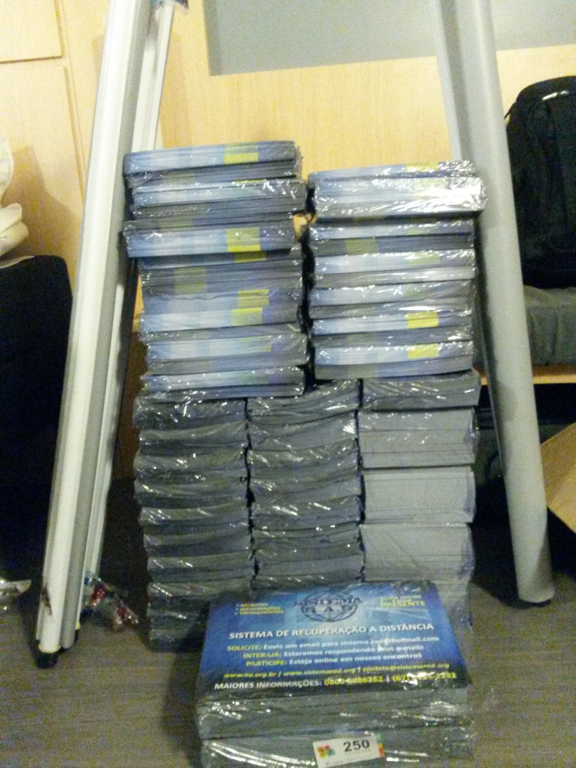
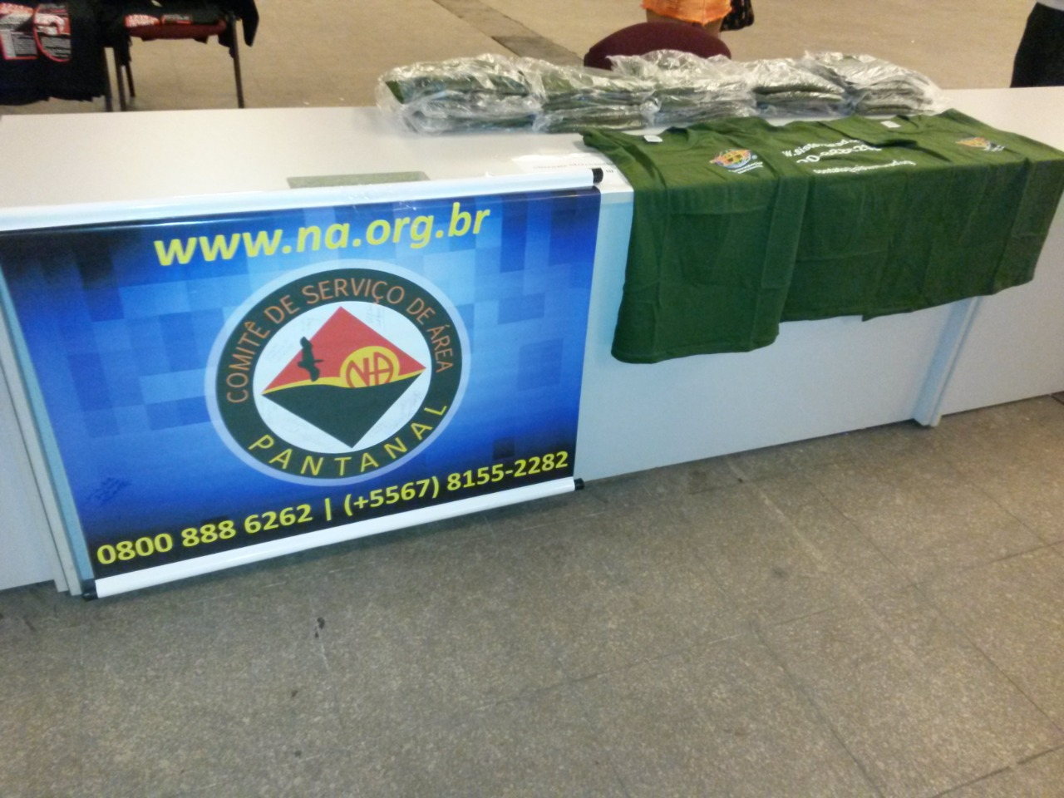

Slide 64

7 years and still going…
Over 4000 thousand meeting
9 groups as hybrid meeting HQ’s.
3 in person events with 2 service conventions
1 virtual service convention
Various on-line transmissions, including one in a Regional Convention in the city of Olimpia, SP, Brazil.
Efective participation in the World Unity Day.
Local Service Guide being updated to it’s fourth version in September 2020
RAD convention (on-line) with 72 hours of uninterrupted meetings.

Slide 65
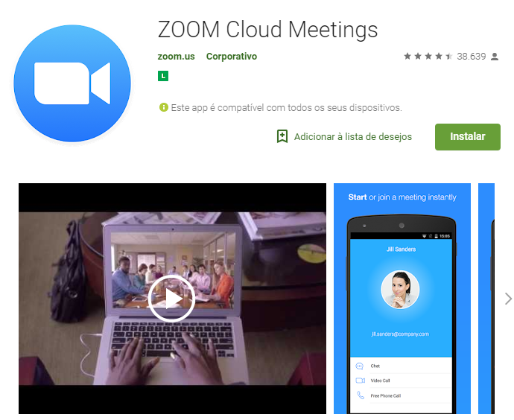
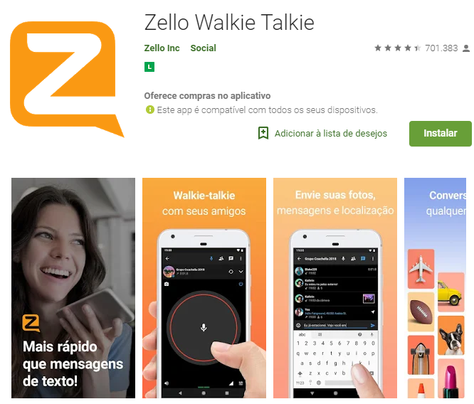
HOW TO PARTICIPATE
ID – 999 888 6262
Channel – Sistema.RAD

Slide 66
“Neve before have so many addicts clean by their own choice and free been able to come together, regardless of where they are, to maintain their recovery and total creative liberty.”

Slide 67



0800 888 6262
www.sistemarad.org
For more information:
sistema.rad@na.org.br

Slide 69
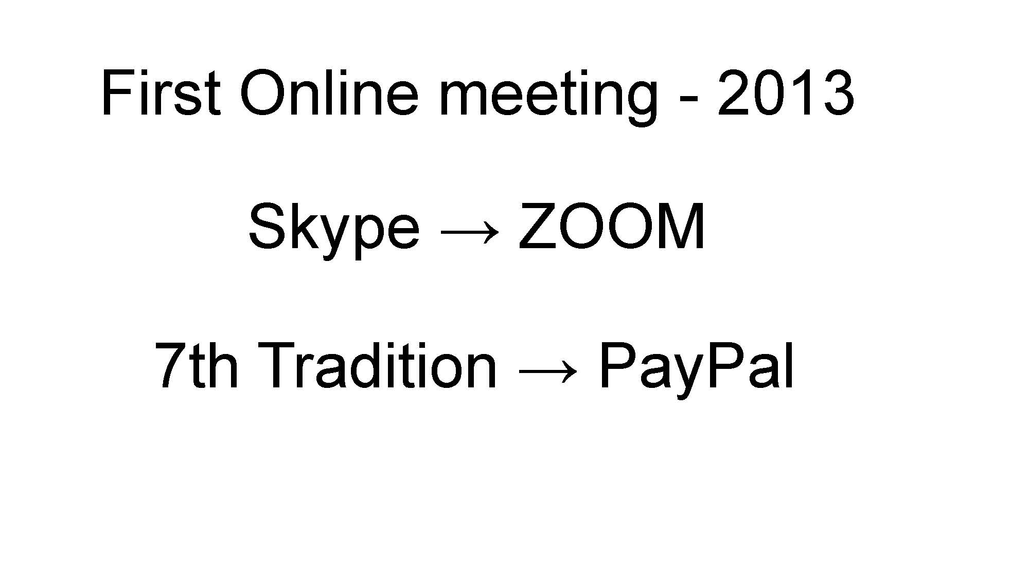

Slide 70
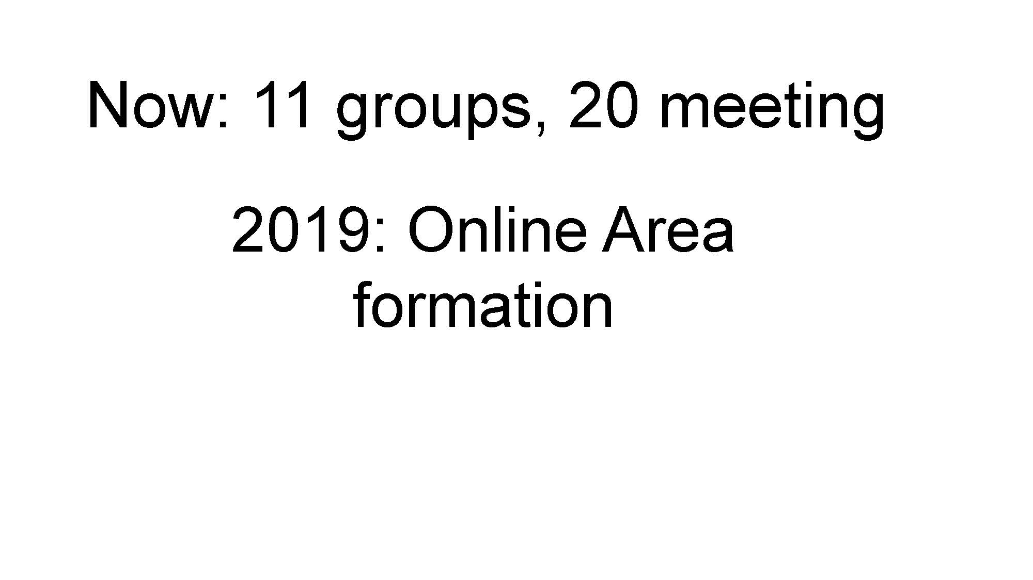

Slide 71


Montana Regional Service Committee
Rural Outreach and Online Meeting Project
a Workgroup of the MRSC Public Relations Subcommittee
October 26, 2020
www.namontana.org
Notes:
I am Rick G and I am an addict, grateful to be clean, alive and for this opportunity to be of service to Narcotics Anonymous. Thanks to the presenters and NAWS staff and World Board for the work holding this important event. Our fellowship will be forever changed by the pandemic and by online meetings. Home Groups and service committees face many new challenges. But I believe online meetings have brought us so many new opportunities to interact with the worldwide fellowship in recovery meetings and in services and will be a real blessing as we move forward.
I want to tell you a bit about Montana and then talk about what makes our Online Work Group somewhat unique. Montana is a geographically huge, small town with a really long main street. We have 7 people and 18 cows per square mile. Most of our about 1 million population is very rural.

Slide 72

MRSC Rural Outreach and Online Meeting Project
INTRODUCTION
  Montana Regional Service Committee
  Public Relations Subcommittee
  Working within the MRSC Service Structure
Notes:
The MRSC - formed in 1992 and was seated in 1993. Rural Recovery has been our mission and a function of our events and services since then.

Slide 73

MRSC Rural Outreach and Online Meeting Project
A REGIONAL PR APPROACH
  Discuss Rural Recovery, Problems
  Role of Technology as Part of Solution
  Leverage Existing Regional Resources
  Work with Area and Group Needs in Mind
  Figure Out How to Engage Rural Addicts
Notes:
We have evolved a PR Committee that contains virtually all our services and internal and external communication that meets monthly. Our PR committee is project driven and our online meetings have been a part of our service structure from the beginning of the project.

Slide 74

MRSC Rural Outreach and Online Meeting Project
SLOW PROGRESS: Plan, Test, Launch
  2010 – Begin to Explore Video Conf. Tech
  2017 – Initiate Rural Outreach Project
  March 17, 2019 – Brainstorm Using Zoom for Rural Outreach Meetings
  Aug 11, 2019 – 1st Zoom Rural Outreach Meeting
Notes:
Slow Progress -We have been working with video conferencing for service meetings for 10 years and launched our first online recovery meetings in August of 2019.

Slide 75

MRSC Rural Outreach and Online Meeting Project
CRISES MOBILIZATION, 2020
  March 15 – In-person Meetings Close; Decide to Offer 2 Zoom Meetings Every Day
  March 16 – Opened 13 New Zoom Meetings
  March 22 – Add 3 More; 17 Meetings Total
  March 29 – Added Hosts & Trainings for All Meetings, Announcements, Temp Sponsors
Notes:
In March of 2020 everything changed. We had been talking about expanding as we had found real value to – older members – member with illnesses, single moms etc. Our Project became a workgroup. We were able to quickly expand to at least two meetings a day and using Regional resources and communication tools to establish a work group of about 20 active members that meets weekly and communicates daily.

Slide 76

MRSC Rural Outreach and Online Meeting Project
STEP BACK & LOOK AT BIG PICTURE
  April 5, 2020 – Working Within the Service Structure: Individuals, Groups, Areas, PR
  June 6 – Seventh Tradition Added to Website
  June 19-21 – Assisted with Virtual Montana Gathering
Notes:
Were quickly able to assist groups, hold our Montana Gathering virtually and establish self-support.

Slide 77

MRSC Rural Outreach and Online Meeting Project
PROGRESS NOT PERFECTION
  July - Deal With Online Listings & Security
  Balance Atmosphere of Recovery w/Security
  Offer H&I and P&I Outreach Opportunities
  Realize Benefits of Expanded Range of Broad Fellowship & Connections to Rural Recovery
  August – Start Work on Hybrid Meetings
Notes:
While dealing with balancing security and the atmosphere of recovery – we have supported H&I and PI outreach and have coordained with our Help line to get information to members looking for meetings and contact with NA in Montana. In August we hosted our first hybrid meeting.

Slide 78

MRSC Rural Outreach and Online Meeting Project
BRANCH OUT & GET IN THE GROOVE
  Sept 4-6 – Celebrate NA Unity Weekend
  Sept 26 – Assist with the MTRCNA
  Sept – Nov 2020, Ongoing:
    Maintain and Adapt Security Vigilance
    Work to Attract New Trusted Servants
    Trainings
    Rotations
    Policies
Notes:
We held Unity Weekend events and provided technical planning and support to the Virtual Fall MTRCNA 10 Convention. We have become a resource for our fellowship. We continue our ongoing work to make our work group sustainable even after the pandemic disruption abates. We have found so much value to our rural fellowship in having members from around the country and world share in our recovery meetings and being able to help “carry the message” to new and returning addicts no matter where they are in the world. We currently have 1200- 1500 addicts per month in our meetings and have 1-4 treatment centers or recovery houses daily. Our project will carry on.

Slide 79
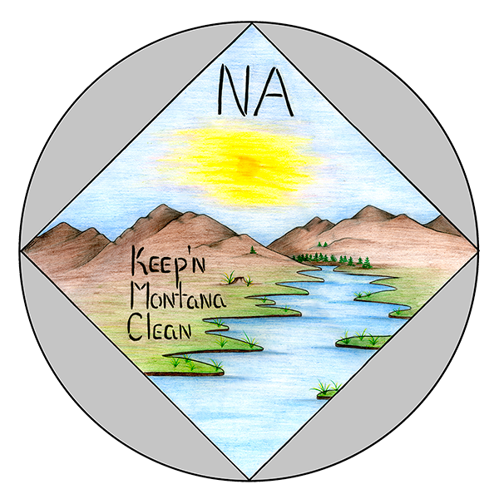
MRSC Rural Outreach and Online Meeting Project
MOVING FORWARD
  Chair and Other Trusted Servant Rotations
  Adjust Regional Service Positions, i.e. Moving Tech Duties to Regional Tech Webservant
  Maintain Ongoing Daily, Weekly, Monthly and Quarterly Communications within Service Structure

Slide 80

MRSC Rural Outreach and Online Meeting Project
MAINTENANCE
  Quarterly Reviews & Commitments
  Offer Ongoing Opportunities to be of Service
  Atmosphere of Recovery & Security
  Be Transparent, Accountable & Responsible to Members & Service Structure

Slide 81

MRSC Rural Outreach and Online Meeting Project
FUTURE
  Events (i.e. Thanksgiving Open House)
  New H&I and P&I Opportunities
  Meeting Verifications
  Recordings: Archive and Post to Website
  Find New Ways to Attract Members
  Explore Expanded Service Opportunities

Slide 82
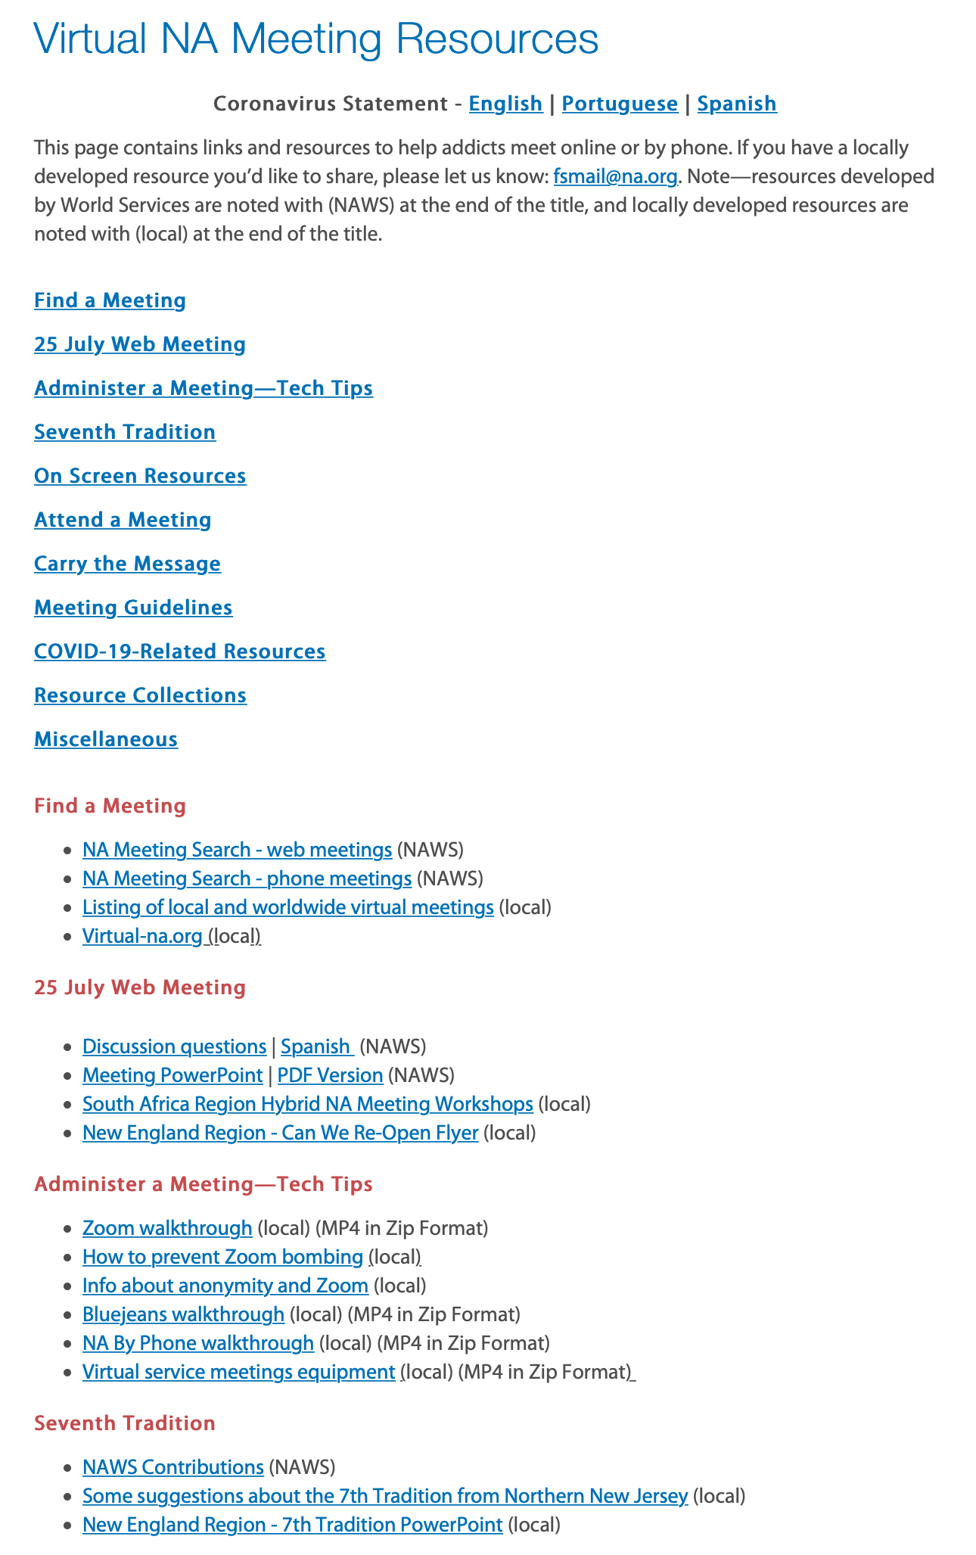
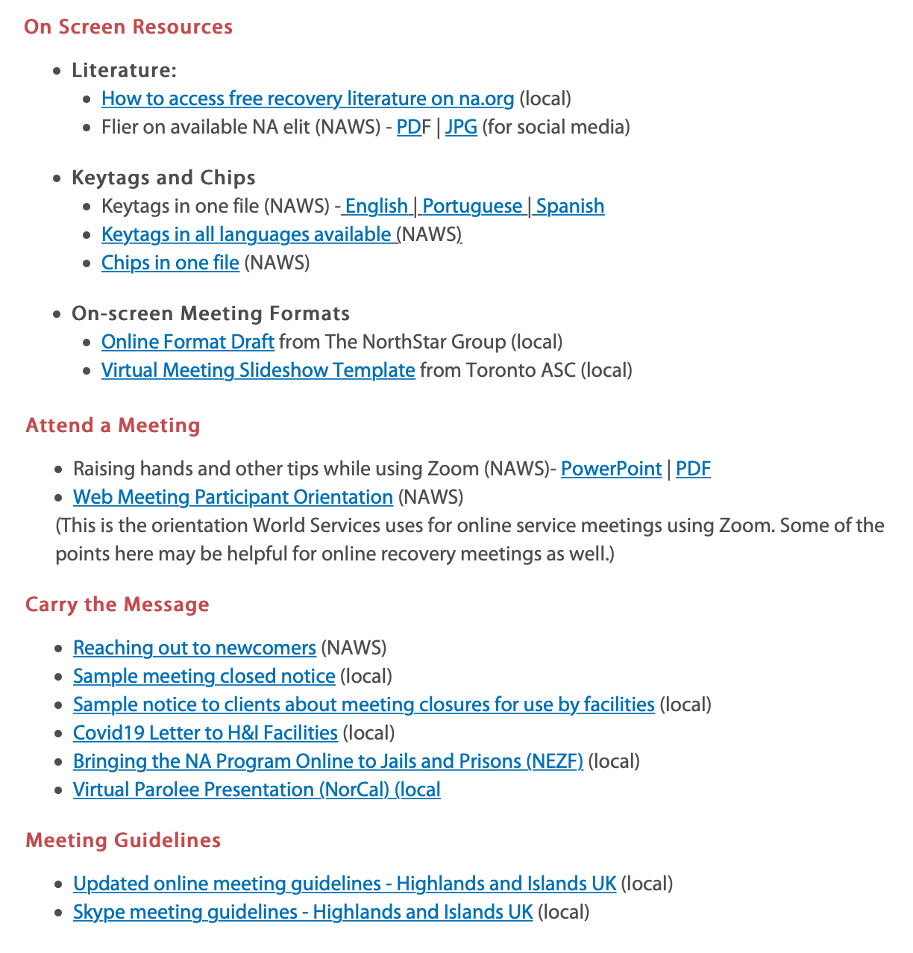
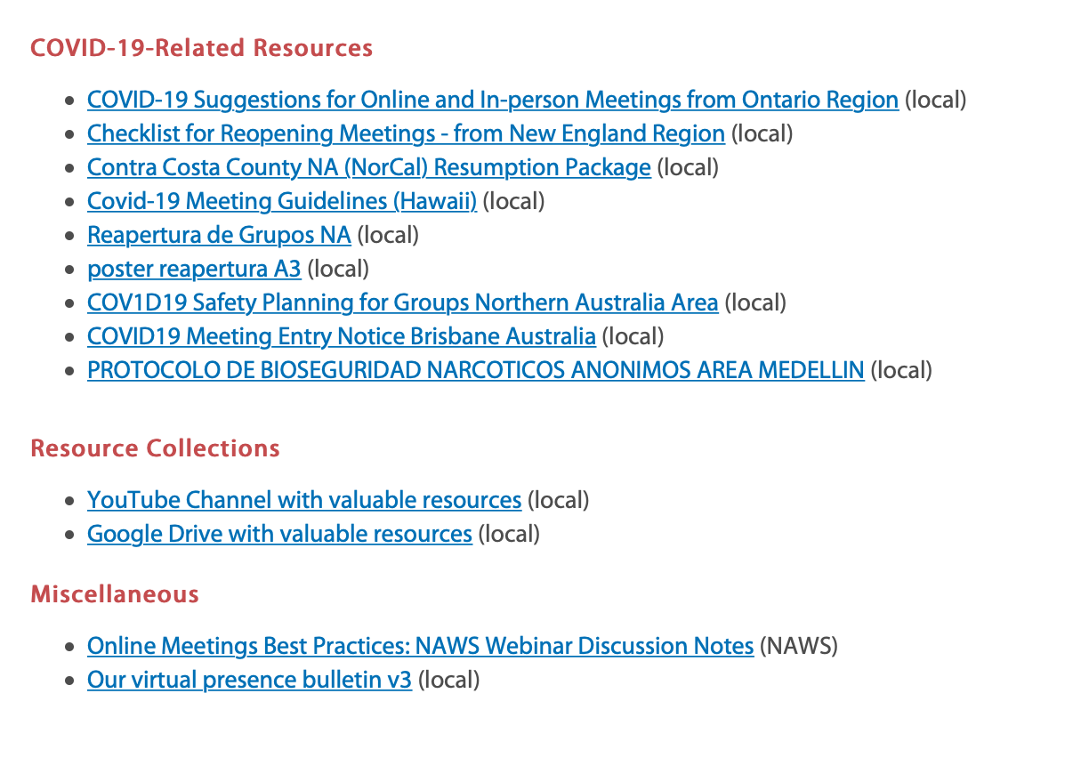
www.na.org/virtual
Don’t forget to
fill out the survey
www.na.org/toolbox

Slide 83

www.na.org/spad
The book is being put together
using writing from members.
Anyone can contribute :
      click one of the spiritual principles
      select a quote
      write about how you practice the principle
Fourth batch of review and input is available:
Anonymity, Discernment, Empathy, Faith, Gratitude, Honesty, Hope, Open-mindedness, Vigilance, and Willingness

Slide 84

www.na.org/contribute
Thank you to the members who have set up recurring monthly contributions.

Slide 85
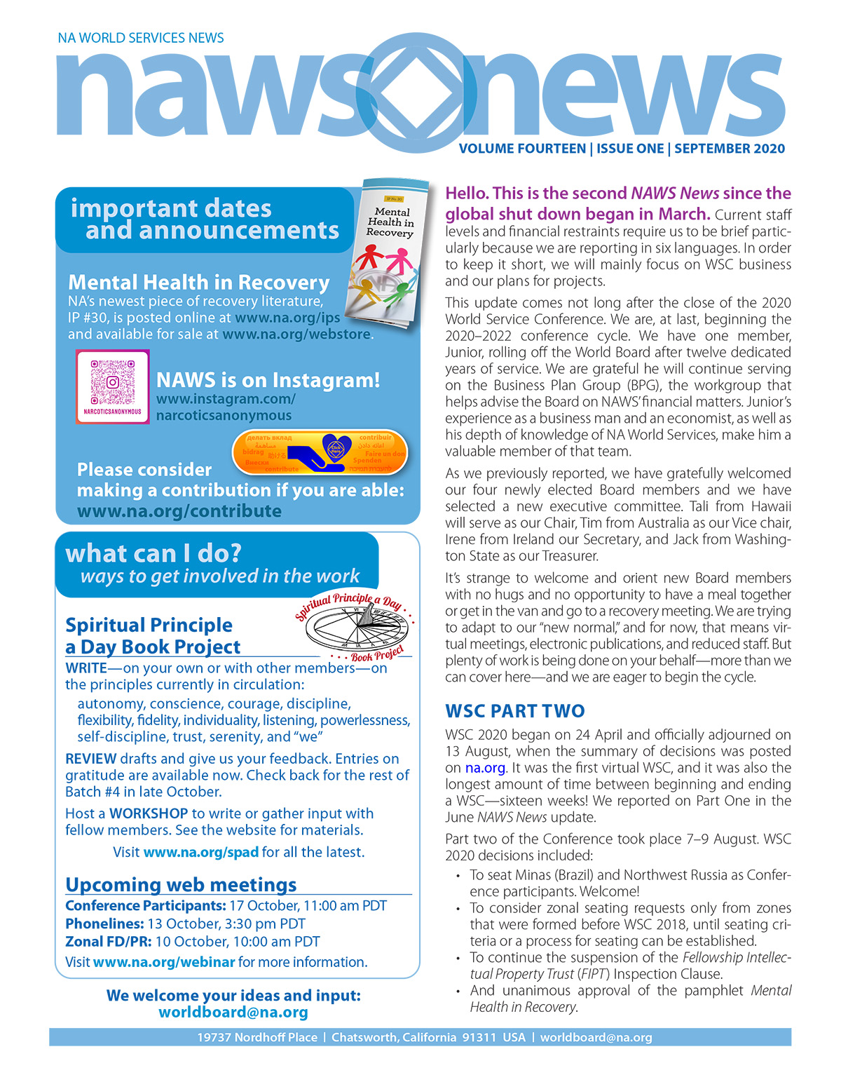
www.na.org/nawsnews
www.na.org/subscribe
Keep up to date.
Stay informed.

Slide 86


www.na.org/webstore

