Slide 1
Hear members share their experiences about
and celebrate Sponsorship Day!
A webinar brought to you by Narcotics Anonymous World Services, Inc.

Slide 2
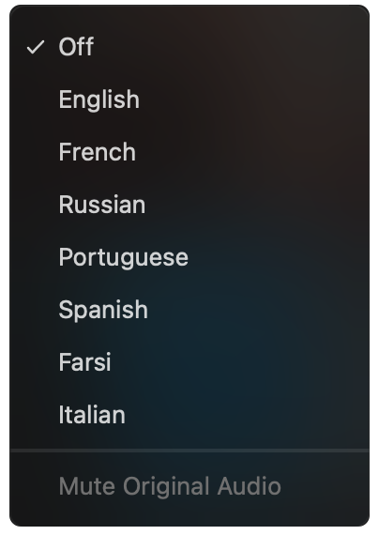
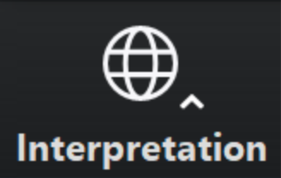
Select a language
Select English or one of the translation channels:
Farsi Italian Portuguese Russian Spanish Ukrainian
English
Farsi
Italian
Portuguese
Russian
Spanish
Ukrainian
1. Find at bottom of screen
2. Choose a language

Slide 3
Sponsorship, Chapter One
The simplicity of the sponsor/sponsee relationship—that of one addict helping another—can help both members get in touch with their own humanness while going through life’s struggles together. The message of recovery does not only come from the sponsor; in many cases the sponsee shares insight and wisdom. This is part of the two-way street: the give-and-take that makes the Twelfth Step such a necessary part of the recovery process. Carrying the message to other addicts and giving away what was so freely given to us is not only an honor and a privilege, it is vital to enhancing our spiritual condition.

Slide 4
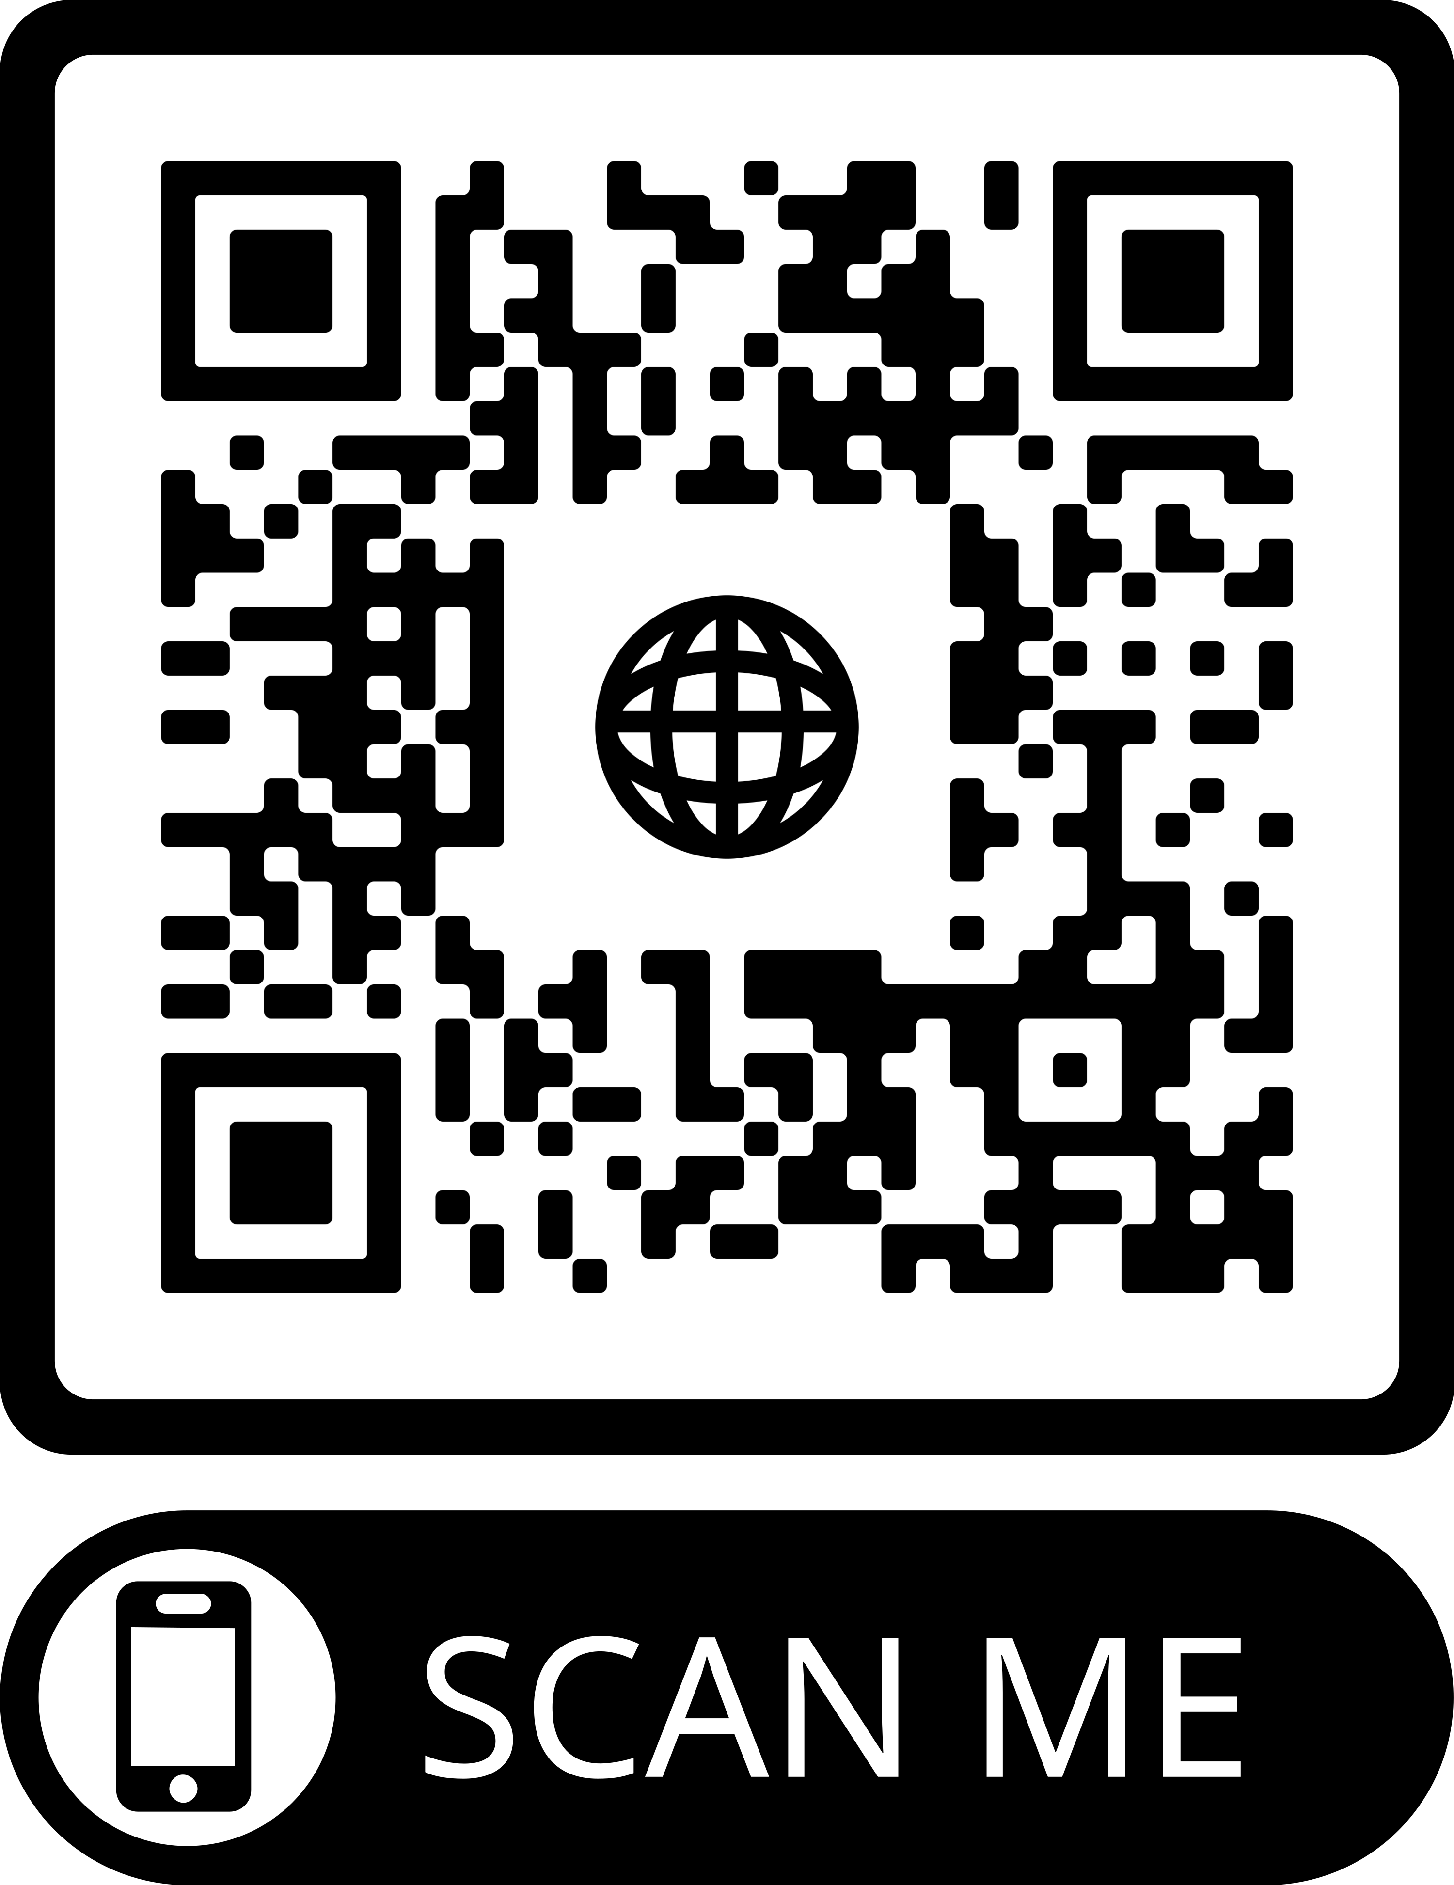
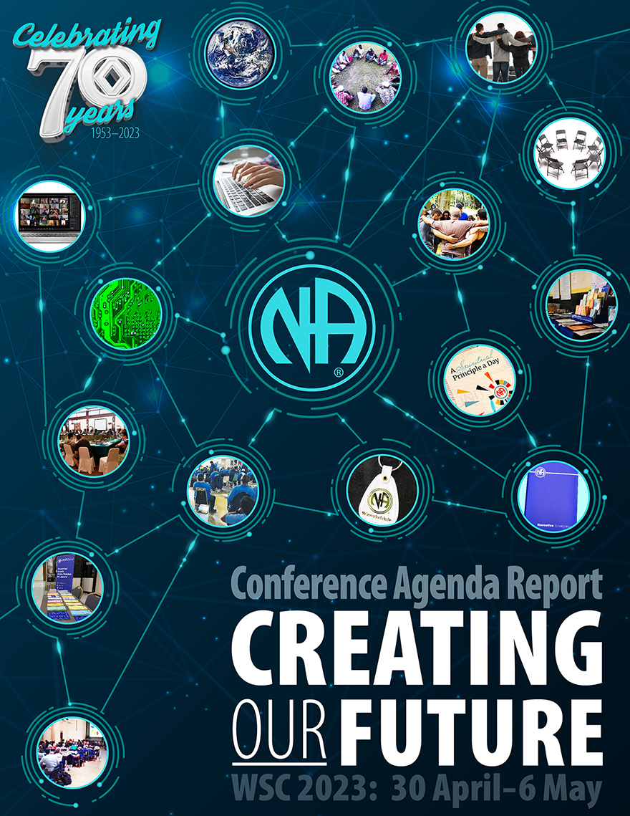
www.na.org/conference
Download CAR
PowerPoints/Videos
Link for Survey
www.na.org/survey
List of virtual workshops

Slide 5
A Spiritual Principle a Day, available for sale
$13 plus s+h
www.na.org/webstore
Free email subscription to each day’s reading
www.na.org/subscribe

Slide 6
Select a language
Select English or one of the translation channels:
Farsi Italian Portuguese Russian Spanish Ukrainian
English
Farsi
Italian
Portuguese
Russian
Spanish
Ukrainian
1. Find at bottom of screen
2. Choose a language

Slide 7
Sponsorship in
Six members to share their experience of sponsorship in NA with us.
Audio recording from meeting will be posted on www.na.org/webarchive

Slide 8
Today’s panelists
Billy R – Arizona
Grainne – Ireland
Marla – Illinois
Krissy – Australia
Luis – Puerto Rico
Arnold – Southern California

