Slide 1




Let’s hear inspiring stories from around the world and celebrate. . .
A webinar
brought to you by
Narcotics Anonymous World Services, Inc.

Slide 2
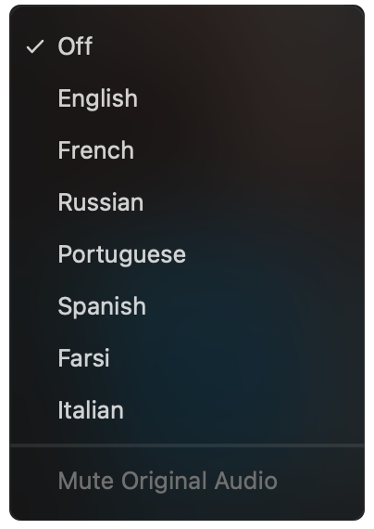
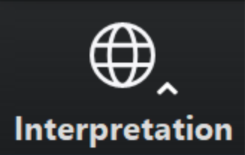
Select a language
Select English or one of the translation channels:
Farsi Italian Portuguese Spanish
English
Farsi
Italian
Portuguese
Spanish
1. Find at bottom of screen
2. Choose a language

Slide 3
Sponsorship: Chapter Five, An Ongoing Journey
“For many of us, our first truly spiritual connection to another human being occurs when we open up and share honestly with our sponsors. The support and love we receive when we walk together on our journey through the Twelve Steps helps to free us from the self-centered fear that lies at the core of our disease. Sponsorship offers us a pathway to change and a bridge to develop other relationships. Addiction robs us of the ability to relate. Recovery restores our connection to ourselves and the world. We now have the freedom to live a life of meaning. From the goodwill that forms the foundation both of the NA symbol and of sponsorship, we are able to grow in our relationships with self, society, service, and God.”

Slide 4
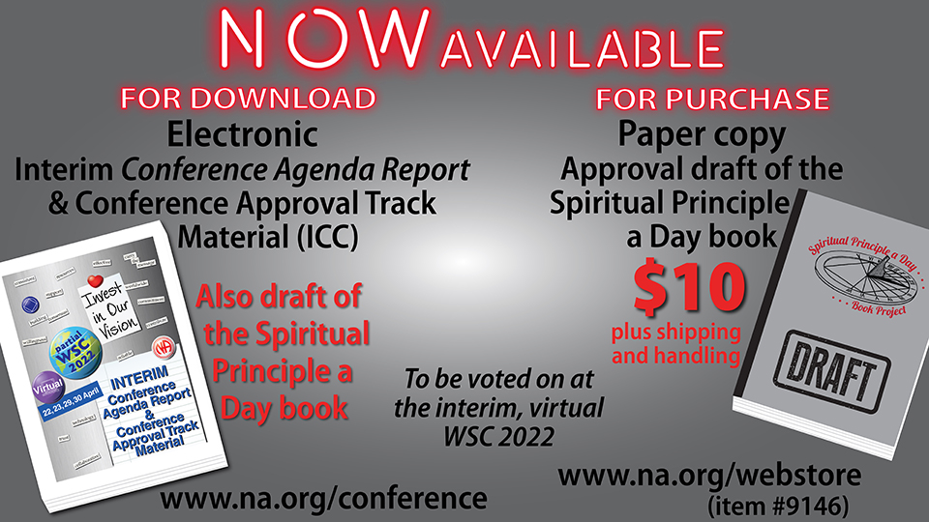

Slide 5
Future of the World Service Conference after 2023
How often does the WSC need to meet in person?
How can we improve the virtual aspect of the WSC?
Who needs to attend the face-to-face meetings in the future? Who could attend virtually?
Who pays for attendance to the WSC?
What needs to be or benefits from being discussed
or decided at an in-person conference, and what
can be done virtually?
How can we use our time together at the WSC
more effectively?
How can we use the time between meetings more
effectively?
Survey page www.na.org/survey
Conference page www.na.org/conference

Slide 6

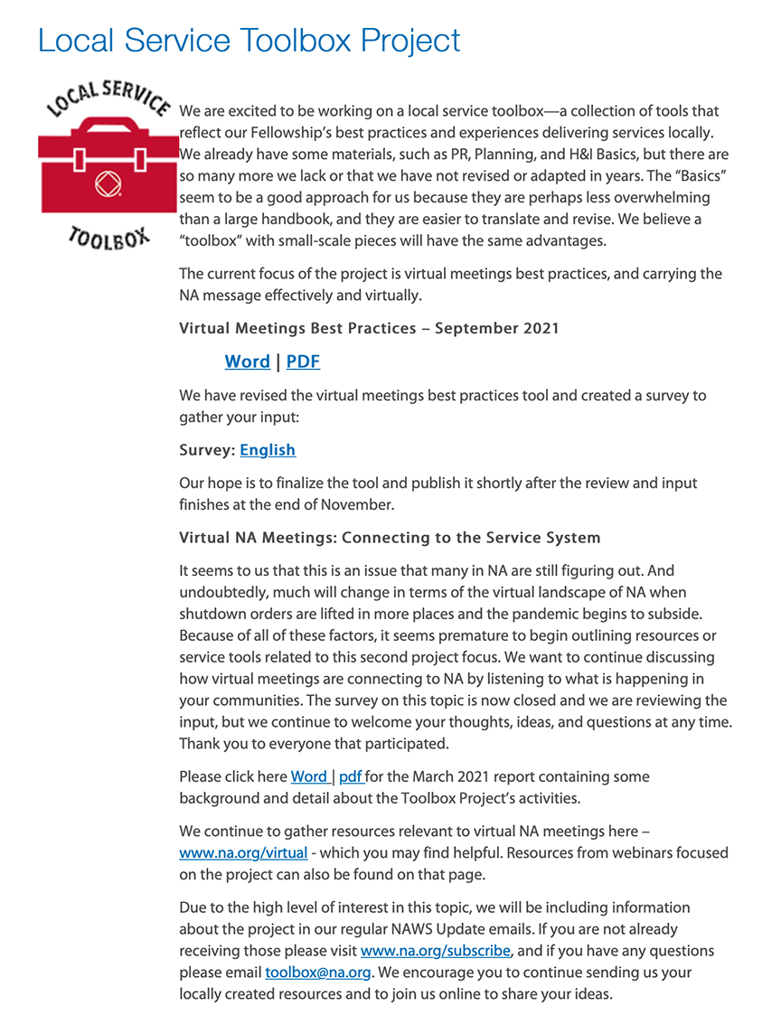

Slide 7


Slide 8



Product updates
$15
(item #9500)
$5
(item #9603)

Slide 9
Select a language
Select English or one of the translation channels:
Farsi Italian Portuguese Spanish
English
Farsi
Italian
Portuguese
Spanish
1. Find at bottom of screen
2. Choose a language

Slide 10

Sponsorship in
Ten panelists in today’s meeting
Meeting will be streamed live on YouTube – link at www.na.org/webinar
Attendees will be muted to minimize disruption
Materials from meeting will be posted on www.na.org/virtual

Slide 11
Today’s panelists
Siamak – Iran
Lynne – New York, USA
Ron M – Florida, USA
Ayubu – Rwanda
Veronica – Sweden
Zeynep – Turkey
Kyle – California, USA
Teresa – Brazil
Bruno – California, USA
Bella – Australia

Slide 12
