Slide 1



Hear members share their experiences about
and celebrate Sponsorship Day!
A webinar
brought to you by
Narcotics Anonymous World Services, Inc.

Slide 2

We are streaming the audio of this meeting in English, Spanish, and Portuguese on Mixlr today.
Links are here: www.na.org/webinar

Slide 3
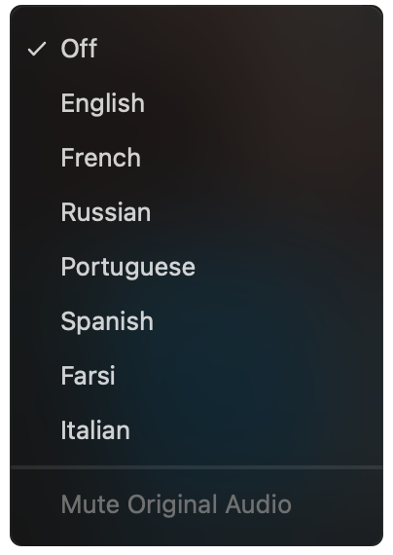
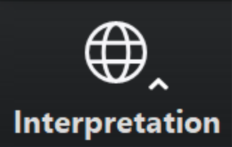
PLEASE SELECT A LANGUAGE
English speakers, please select English.
Everyone else select one of the translation channels:
Farsi Italian Portuguese Spanish Ukrainian
✓ Off
English
Farsi
Italian
Portuguese
Spanish
Ukrainian
Click on this icon at the bottom of your screen
Choose a language

Slide 4
Sponsorship, Chapter Five
For many of us, our first truly spiritual connection to another human being occurs when we open up and share honestly with our sponsors. The support and love we receive when we walk together on our journey through the Twelve Steps helps to free us from the self-centered fear that lies at the core of our disease. Sponsorship offers us a pathway to change and a bridge to develop other relationships.

Slide 5

WCNA 38
The Power
of Love
Washington, DC
29 August –
1 September
2024
www.na.org/wcna

Slide 6
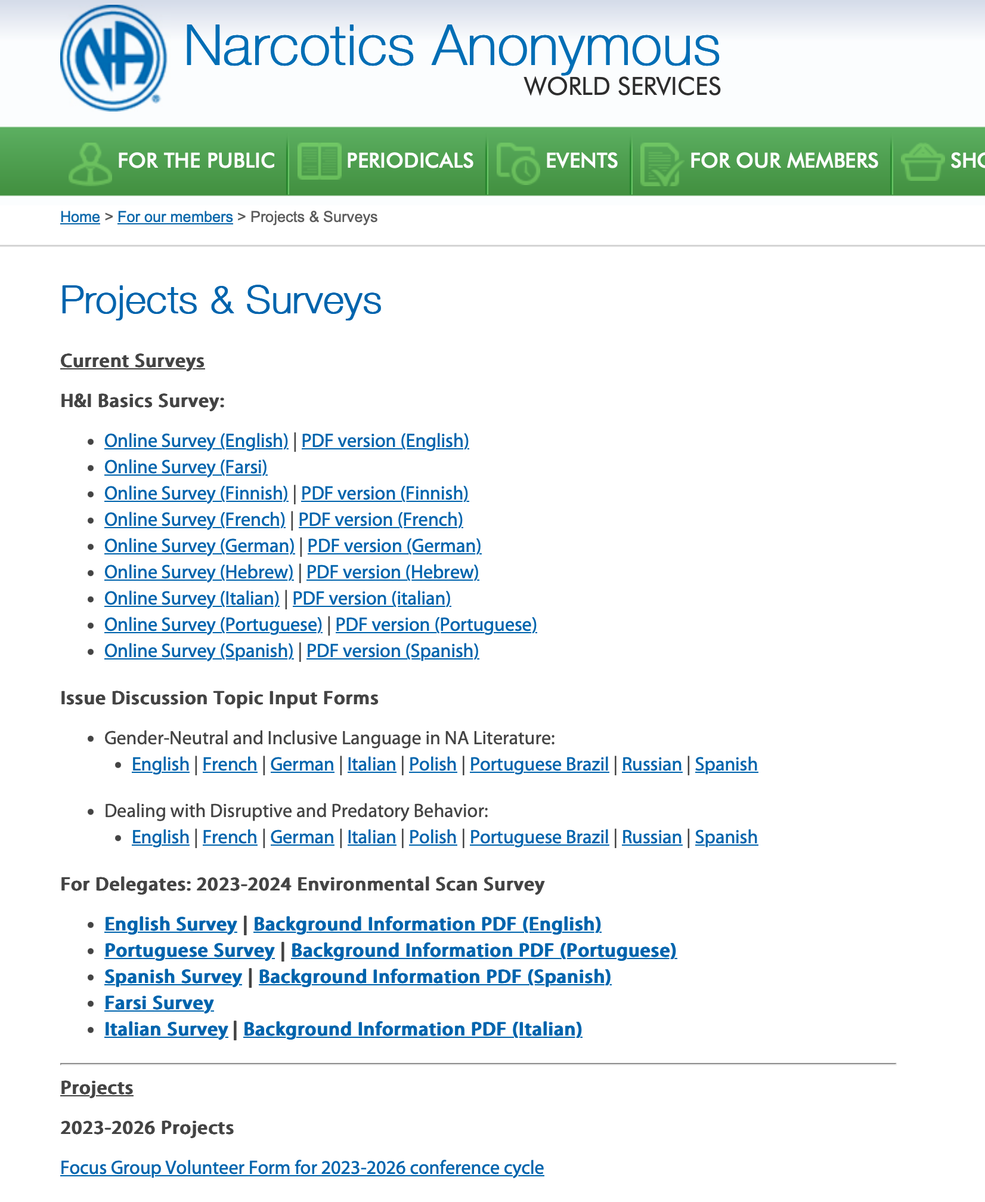

www.na.org/survey

Slide 7
Issue Discussion Topics
Gender Neutral and Inclusive Language
in NA Literature
Dealing with Disruptive and Predatory Behavior
DRT/MAT as it Relates to NA
Reimagining and Revitalizing Service Committees
POSTED
POSTED
SOON
SOON
www.na.org/idt

Slide 8

NA Survival Kit
Sections from:
Basic Text
It Works: How and Why
The NA Step Working Guides
120 day notice posted in July

Slide 9

Moving to a new system for providing meeting information
Local trusted servants: nadata@na.org
More information can be found in the recording of the web meeting we hosted a few weeks ago: www.na.org/meetingsearch

Slide 10

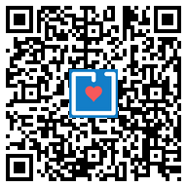
www.na.org/give
Recurring contributions are the most sustainable form of income for World Services.
Thank you for
considering this.

Slide 11
PLEASE SELECT A LANGUAGE
English speakers, please select English.
Everyone else select one of the translation channels:
Farsi Italian Portuguese Spanish Ukrainian
✓ Off
English
Farsi
Italian
Portuguese
Spanish
Ukrainian
Click on this icon at the bottom of your screen
Choose a language

Slide 12

Sponsorship in
Six members to share their experience of
sponsorship in NA with us.
Audio recording from meeting will be posted on www.na.org/webarchive

Slide 13
Today’s panelists
Carla – Wyoming
Wendell – North Carolina
Louise – UK
Mohammed – Iran
Hammed – Kuwait
Tom – Hawai’i

Slide 14
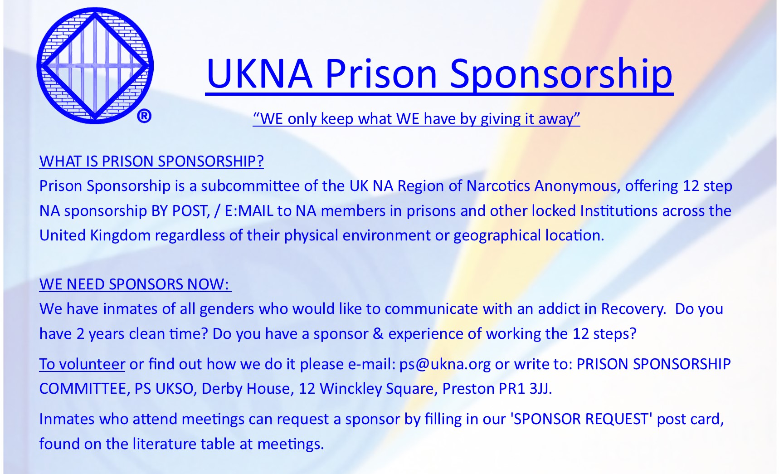

Slide 15



