Slide 1


NA in the Time of Coronavirus
25 July 2020
Many of the slides in this PowerPoint were developed by members from around the world and are examples of how local meetings and NA communities are handling the pandemic. As such, they should be regarded as shared experience and not recommendations from World Services.

Slide 2
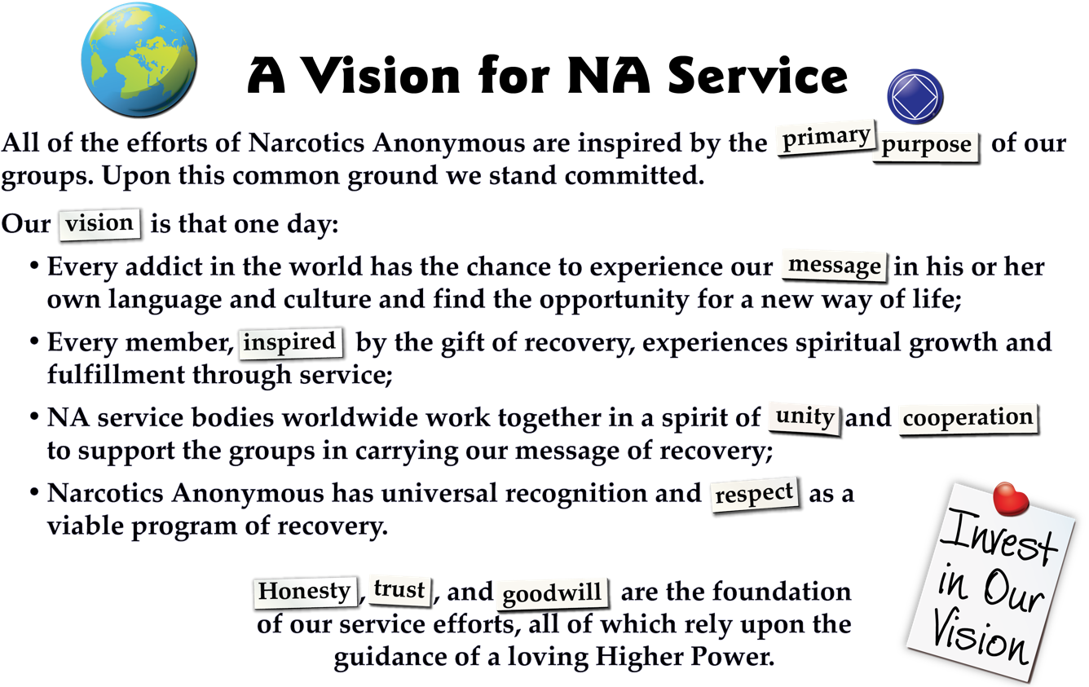

Slide 3
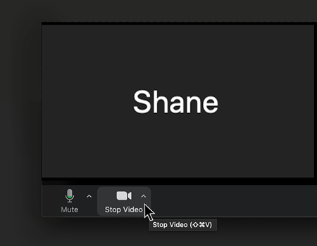
Anonymity concerns
This web meeting is like an open meeting
Topic of interest to all
12-step Fellowships
Announced publicly on na.org
You can turn off video and omit your last name

Slide 4
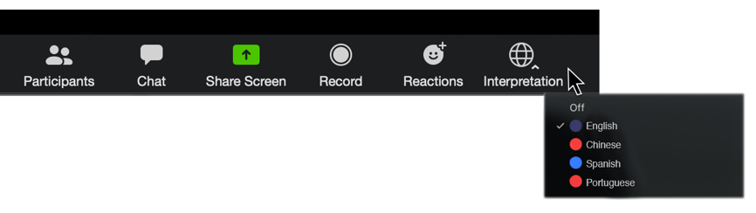
Translations
Simultaneous translation in English, Spanish, Portuguese, and Arabic
Please choose a language at the bottom of your screen
If you are not having the meeting interpreted, you need to select English
No interpretation
feeds in
small groups

Slide 5
Structure of the Meeting
Start out with short presentations from some experienced members
Then have facilitated small-group discussion
End with what we heard today that we found most useful
Summary notes will be posted at some point after the web meeting

Slide 6
Focus of the meeting
Sharing experience and challenges with next steps for groups that took their meetings online
This is simply a forum where members from around the world can share their experience with each other
As many places are opening back up, groups are faced with many challenges
We hope this web meeting will help members get a better picture of the different options available

Slide 7
Presentations
What groups need
to consider as they decide whether to meet in person again
How to coordinate a hybrid meeting
Resources on www.na.org/virtual

Slide 8
What groups need to consider as they decide whether to meet in person again
John–PR chair/New England Region’s Crisis Response Team

Slide 10
Checklist for reopening meetings
It is suggested that groups have a detailed plan for reopening in-person meetings. As NA groups, we need to keep our Traditions in mind
(paraphrased here):
    4th Tradition – Groups are autonomous, except when our actions may affect other groups or NA as a whole.
    10th Tradition – We have no opinion on outside issues, and so should avoid being drawn into public controversy.
    12th Tradition – We should practice spiritual principles in all our affairs, including selflessness, responsibility, trustworthiness and compassion.
Below are items groups should take into consideration when planning to reopen, and suggestions for addressing them:
Have we visited the websites to CDC and state local guidelines to be sure we are in compliance with them?

Slide 11
Have we spoken to the facility; do we have permission to meet where we rent? Does the facility have any specific requirements that must be adhered to when using the facilities going forward?
Do we have plans for sanitizing before and after the meeting?
  - Clean all tables and chairs before members arrive; and after members leave.
  - Have spray cleaner and paper towels available for those who want to clean their own areas.
  - Make sure that restrooms (if open) have soap for washing hands.
Have we thought about ways to encourage personal safety?
- Wear your masks/face coverings to meetings.
- Consider not serving coffee, and suggest that members bring their own drinks.
- Have hand sanitizer available if possible.
Do we have a socially distant seating plan?
- Move chairs to allow for space between members.
- Consider designating a separate area for members with compromised immune systems – could use “reserved” signs on seats; make sure the designated space is away from high-traffic areas.

Slide 12
Are we prepared to take every precaution we can during the meeting?
- Readings: Download readings/books/IPs to avoid passing literature around the meeting.
- Contributions: Put the basket in a stationary place; or consider using a money app for donations.
- Have gloves and sanitizer available for anyone signing papers.
- Spray keytags with disinfectant prior to the meeting; wear gloves when handing them out.
- Create electronic versions of phone lists, or exchange phone numbers via text.
- Refer attendees to websites or apps for meeting schedules instead of using paper lists.
- Circle up without touching, and maintain physical distance.

Slide 13
Have we thought about ways to accommodate those not yet able to meet in person due to health or other concerns? (Example: hybrid-virtual/physical meeting)
Have we come up with a plan on how to handle situations where we may have an overflow in attendance?
- Is there a completely separate space we have permission to use? (A large group, divided within a single room or space, is still a large group)
Have we carefully considered how reopening our meeting will affect our public image?
- Communicate with members and the public (as needed) about the precautions the group is taking to protect the safety of meeting attendees and the public as a whole.
- Add an announcement in the meeting format to clearly state and reiterate the precautions being taken to protect members.

Slide 14
The following is an EXAMPLE of information that can be posted on the meeting door:
WELCOME TO THE _______________ GROUP OF NARCOTICS ANONYMOUS
To protect the safety of our members:
- Please do not move the chairs
- We normally hug – Please be mindful that due to covid-19 and social distancing guidelines we are advised to not have physical contact at this time.
- If you feel sick, or have had a fever in the past 14 days, please refrain from attending the meeting in person. Virtual meetings are still available at (insert virtual meeting information here).

Slide 15
What groups need to consider as they decide whether to meet in person again
Amy–Contra Costa Area FD team lead

Slide 16
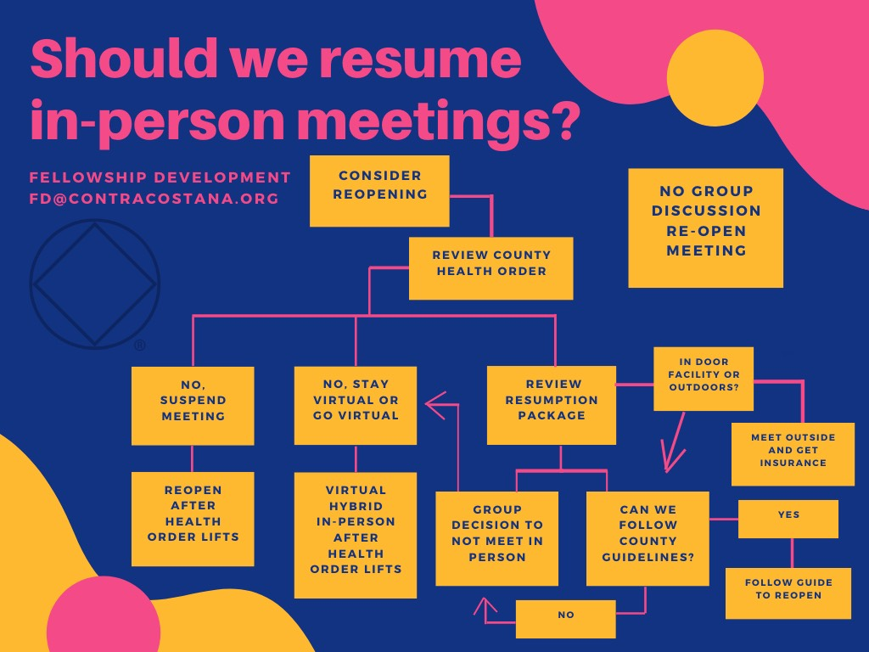

Slide 17


Slide 18
What groups need to consider as they decide whether to meet in person again
Bonnie–Northern Australia service area board member (under new service system).

Slide 19
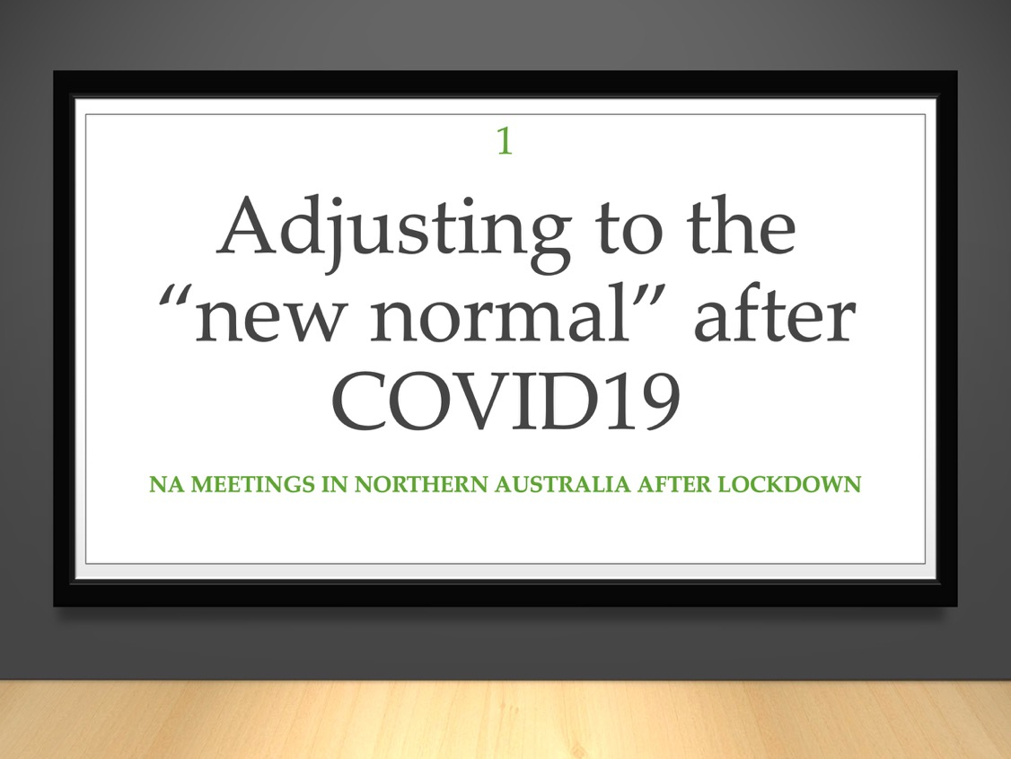
Notes:
In some ways adjusting to the “new normal” after COVID19 is taking more work than it did to adapt to the lock-down.
Here are some of the things we have had to think about and prepare for my own area and my home group in Australia.

Slide 20
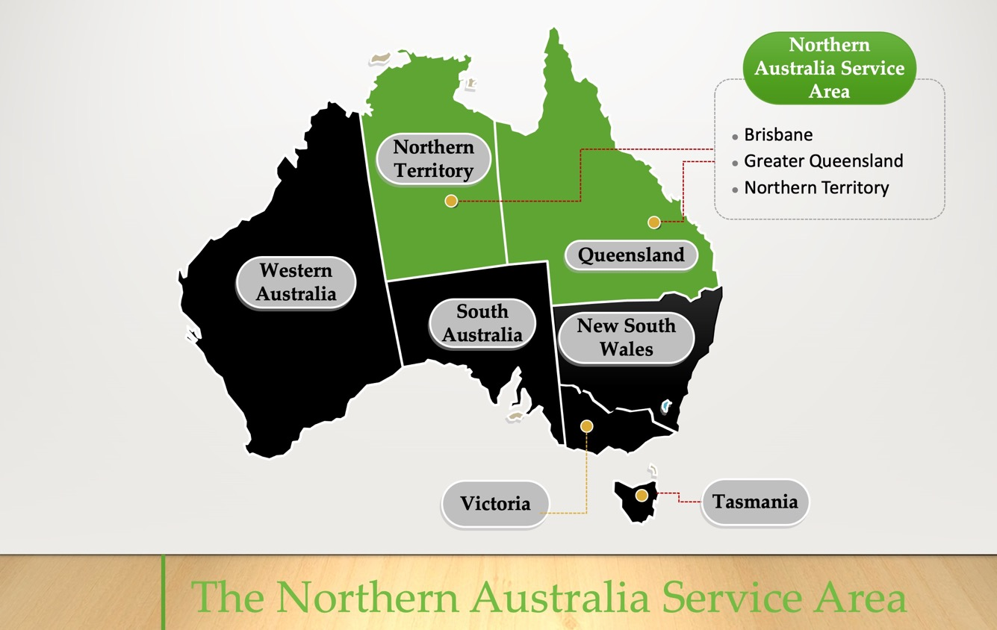
Notes:
Australia is made up of states and territories which each have their own government.
My service area is the Northern Australian Service Area.
It includes two different governments with different policies and COVID19 impacts.
This means that we have not had a single set of guidelines for all our meetings throughout the pandemic.

Slide 21
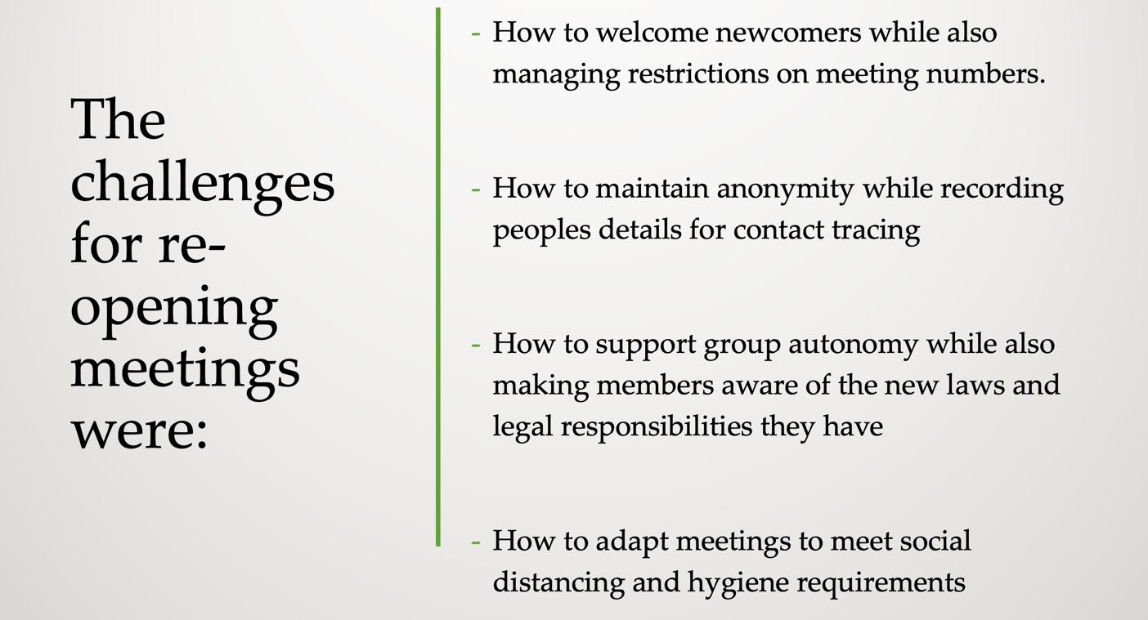
Notes:
Many groups have been returning to face to face meetings as lock-down restrictions gradually lifted.
The challenges for re-opening meetings were:
How to welcome newcomers while also managing restrictions on meeting numbers.
How to maintain anonymity while recording people’s details for contact tracing
How to support group autonomy while also making members aware of the new laws and legal responsibilities they have
How to adapt meetings to meet social distancing and hygiene requirements

Slide 22
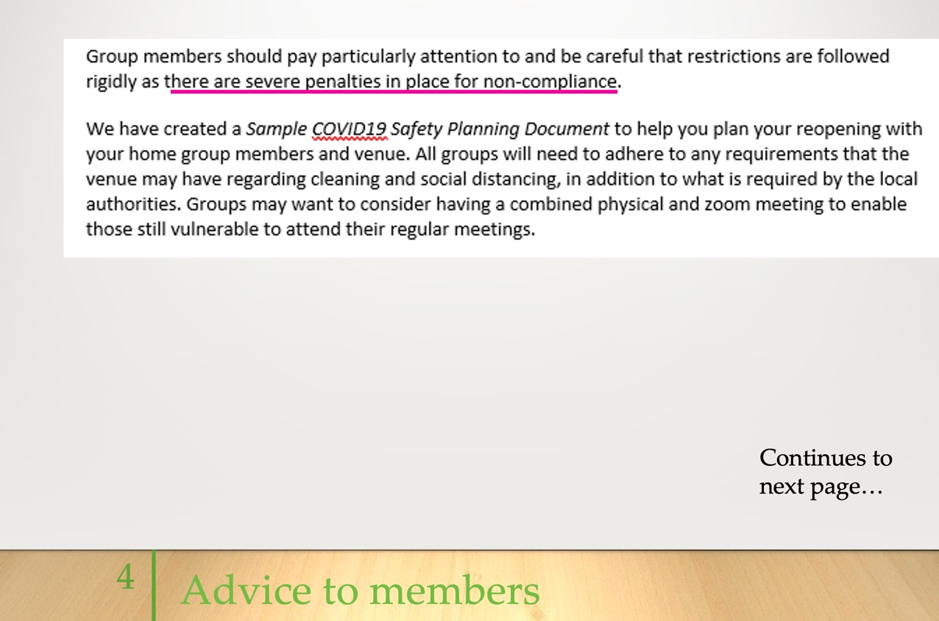
Notes:
Here is a section of a letter of advice to members in our service area written by the service board.
This letter explains that there are a number of new legal requirements which will change their meeting procedures.
We ask members to follow their local government advice and laws about COVID19.
We also encourage members to consider running Hybrid meetings.

Slide 23
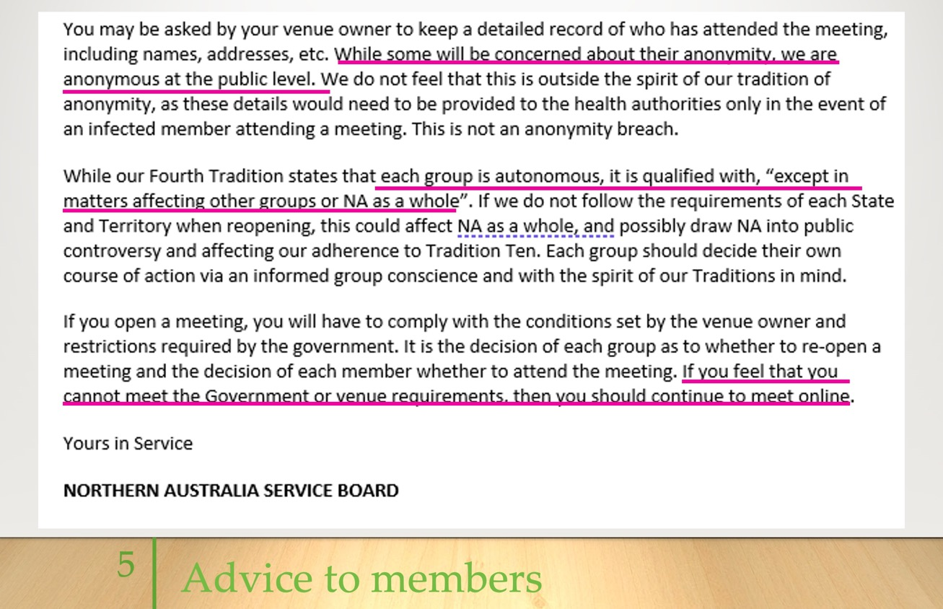
Notes:
In the second part of this letter we explain that maintaining contact records is a legal requirement.
We explain that this is not an anonymity breach.
The information is not made publicly available and is only used if an infected member attends a meeting.
This letter also suggests that if they are not comfortable with following these new procedures then members should continue to meet online.
This is another reason why continuing to offer online and hybrid meetings is important.
The full letter is available on the Virtual NA Meeting Resources page.

Slide 24
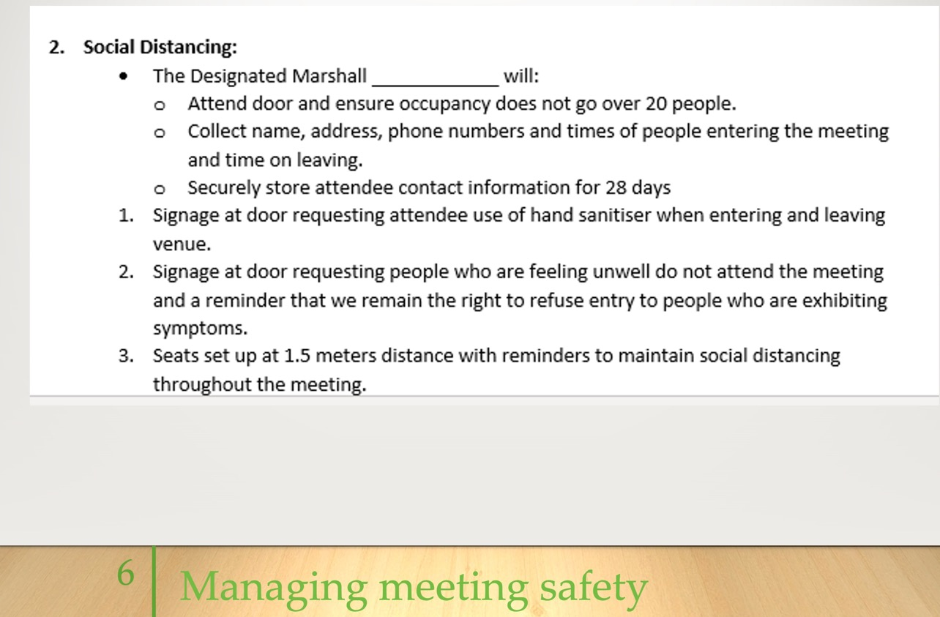
Notes:
My home group decided to open back up as a Hybrid meeting.
We created a COVID19 meeting safety plan to help us manage all the new cleaning and safety procedures.
The full document is available on the Virtual NA Meeting Resources page.

Slide 25
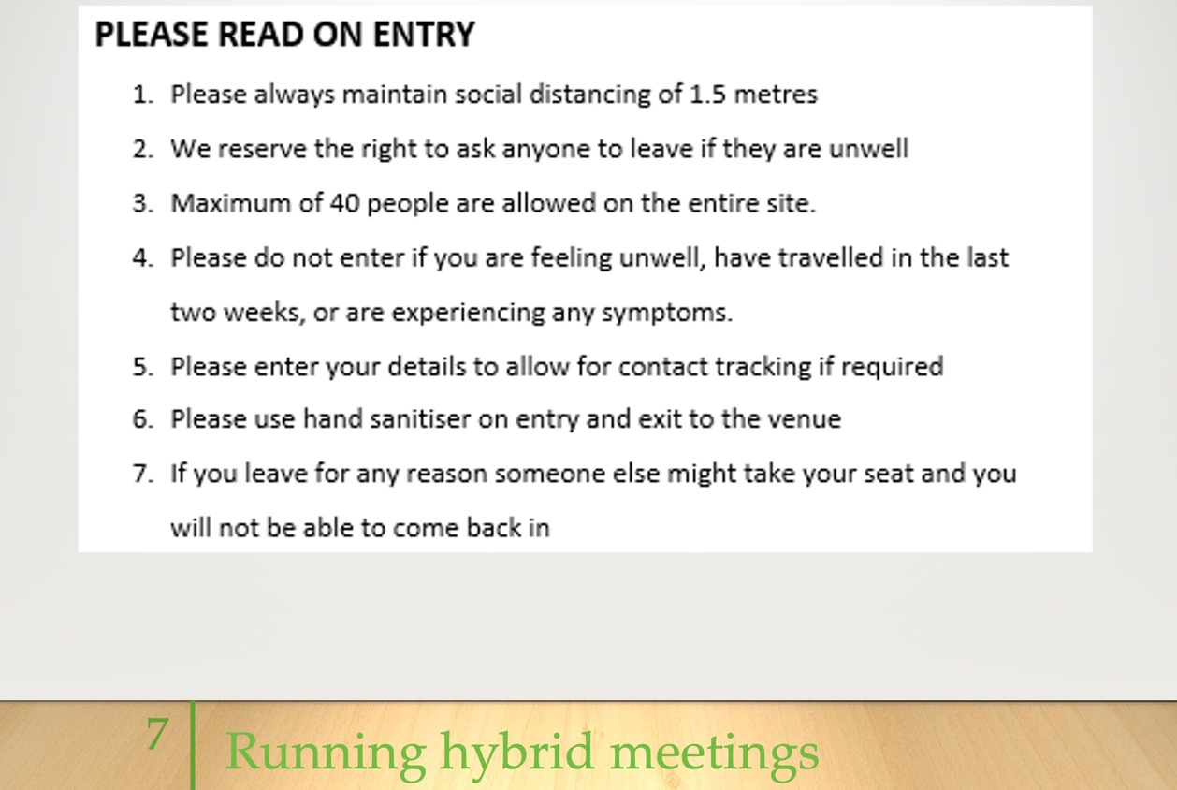
Notes:
This is the Meeting Entry Notice we put up on our door at our Hybrid meeting.
This notice advises members on both hybrid meeting procedures and COVID19 safety and legal requirements.
All member contact information is stored safely with a trusted home group member.
So far, we have had equal people attend each week online and face-to-face.
This document is available on the Virtual NA Meeting Resources page.

Slide 26
How to coordinate a hybrid meeting
Kelly–Alabama, USA
Caitlin/Shane–Kentucky, USA
Darren/Victor–South Africa

Slide 27
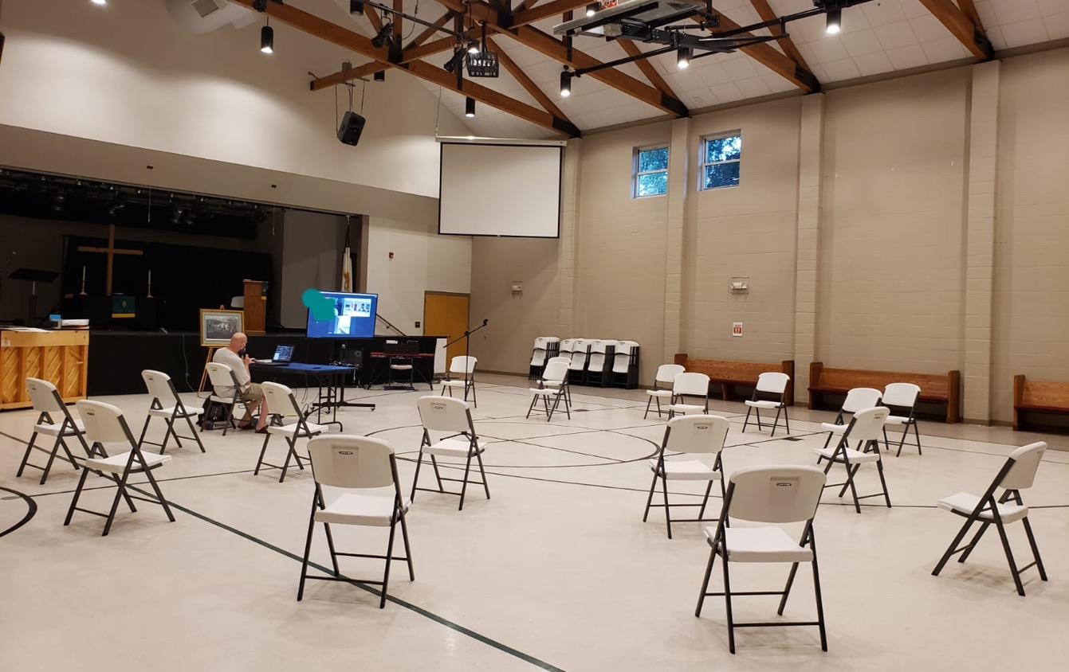

Slide 28



HYBRID MEETINGS
SOME PROVEN PRACTICES

Slide 29

PRIORITY #1: Establish Accessibility
Does your meeting location have Telephone or Internet capabilities?
Notes:
PRIORITY #1: ESTABLISH CONNECTIVITY POSSIBILITIES --- Common connections to Remote Conferencing Applications are a landline telephone connection, a mobile telephone or internet signal, hard wired internet connection, or wireless internet signal (wifi)

Slide 30

Priority #2: choose a host device based on accessibility
The Host Device(s) is responsible for streaming the audio and video signal to and from remote participants
Notes:
PRIORITY #2: CHOOSE A HOST DEVICE BASED ON YOUR ACCESSIBILITY --- Audio and video equipment options will be dictated by the input and output capabilities of your Host Device. Common Host devices are mobile phones, tablets, and Laptop Computers.

Slide 31

Priority #3:
Establish Quality audio input
Audio quality is the HIGHEST PRIORITY of a Hybrid Meeting
Telephone Dial In = Analog Signal
Internet = Digital Signal
Microphones are categorized by TYPE and MODEL
Notes:
Priority #3: ESTABLISH Quality AUDIO INPUT --- YOUR MICROPHONE IS THE HIGHEST PRIORITY PIECE OF EQUIPMENT FOR A HYBRID MEETING. IF OTHER MEETING ATTTENDESS CANNOT HEAR YOU CLEARLY, THE ENTIRE SHARING PROCESS BREAKS DOWN --- Many Host Devices have an integrated microphone. However, some are not powerful enough to facilitate a larger meeting size. Analog or Digital Input Signal will dictate the type of external microphone that you can use. The particular model of microphone will be dictated by compatibility with your Host Device. Also be mindful to choose a model with the correct pick-up pattern for the size of your meeting space.

Slide 32
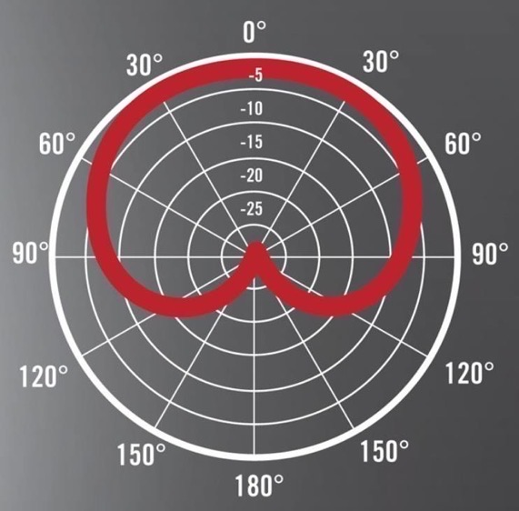
Cardioid and Dynamic microphones:
Gather sound from directly in front of the microphone
Notes:
CARDIOID AND DYNAMIC MICROPHONES GATHER SOUND FROM DIRECTLY IN FRONT OF THE MICROPHONE. These are commonly used for a single individual who is speaking.

Slide 33
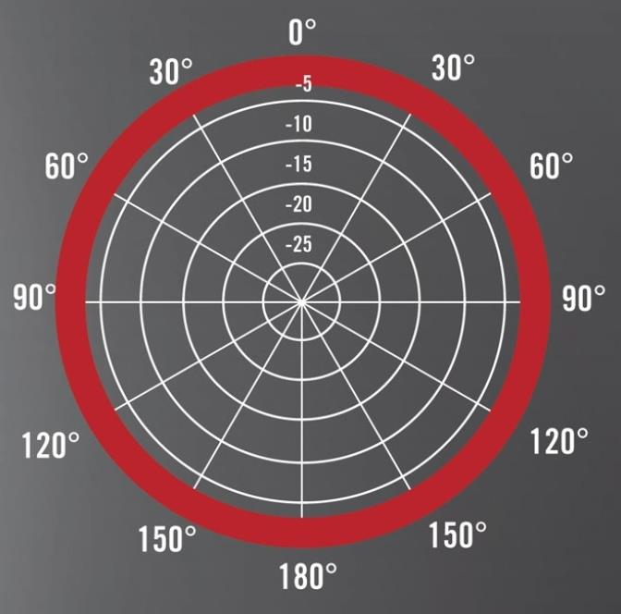
Omni-directional and condenser microphones:
Gather sound from
all directions
Notes:
OMNI-DIRECTIONAL AND CONDENSER MICROPHONES GATHER SOUND FROM ALL DIRECTIONS AT ONCE . These are commonly used for entire groups who are speaking in a single space.

Slide 34

Priority #4:
Establish clear audio output
Speakers vary in size and method of connecting to your Host Device
Notes:
PRIORITY #4: ESTABLISH CLEAR AUDIO OUTPUT --- 1) Many Host Devices have an integrated speaker. However, some are not powerful enough to facilitate a larger meeting size. The size of your meeting space, number of attendees, and compatibility with your Host Device will dictate the model of external speaker that you may choose.

Slide 35
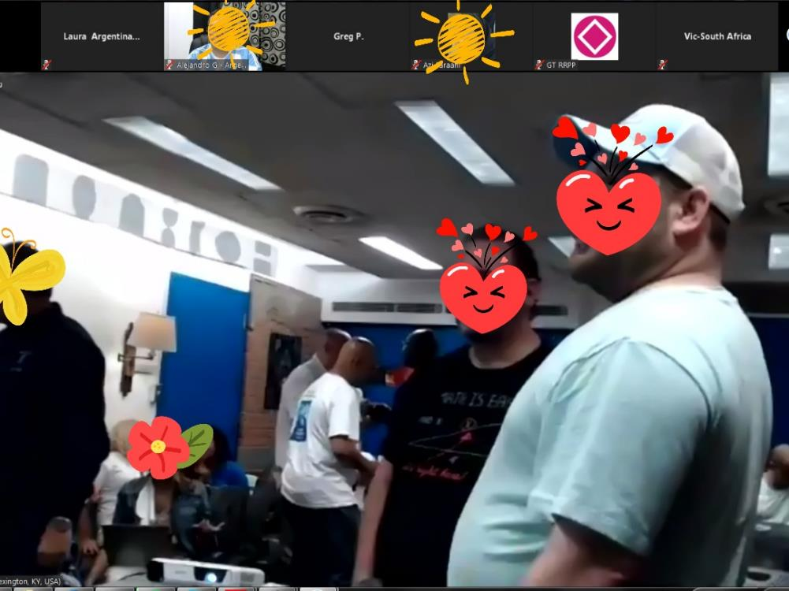
Priority #5:
Video Input
Some Hybrid Meetings choose to stream video if they have Internet Accessibility
Notes:
PRIORITY #5: VIDEO INPUT --- Many Host Devices have an integrated camera. However, the shape and aspect ratio of the video stream can be unsatisfactory in some situations. If you choose to connect an external webcam, check compatibility with your Host Device. Be mindful that streaming video can greatly affect the audio quality in locations where the internet signal is not very strong. It is a considerate practice to create a portion of your meeting space for attendees who do not wish to be streamed on camera.

Slide 36
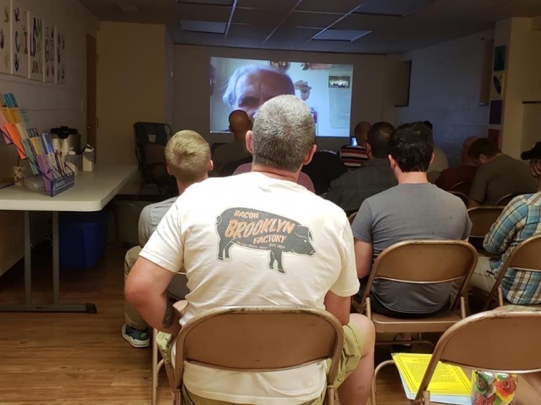
Priority #6:
Video Output
Some Hybrid Meetings choose to stream video of the Remote Participants
Notes:
PRIORITY #6: VIDEO OUTPUT --- Common methods for Video Output include Laptop or Tablet Monitors, Television Screens, and Projectors. Always check compatibility with your Host Device, and be mindful to purchase necessary cables and connectors.

Slide 37
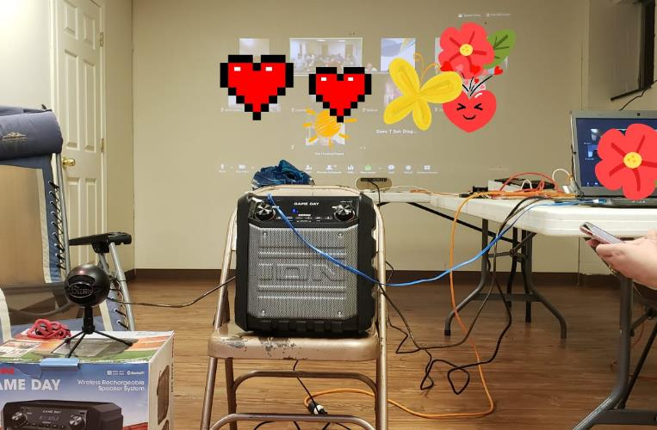
Use whatever you have available:
NorthStar Online NA Group began as a Hybrid Outreach Meeting on Thursday May 10th 2018.
Outreach Service Provided by: Kentucky Survivors Area to the Clean And Crazy/Never Alone Group
We had access to stable internet through our meeting facility
We chose the full two way Audio and Visual experience
Notes:
Here you can see some basic information about the beginning of what is now the NorthStar Online NA Group. You can see from the picture that things were a bit disorganized in the beginning. Many cables and connectors everywhere.

Slide 38
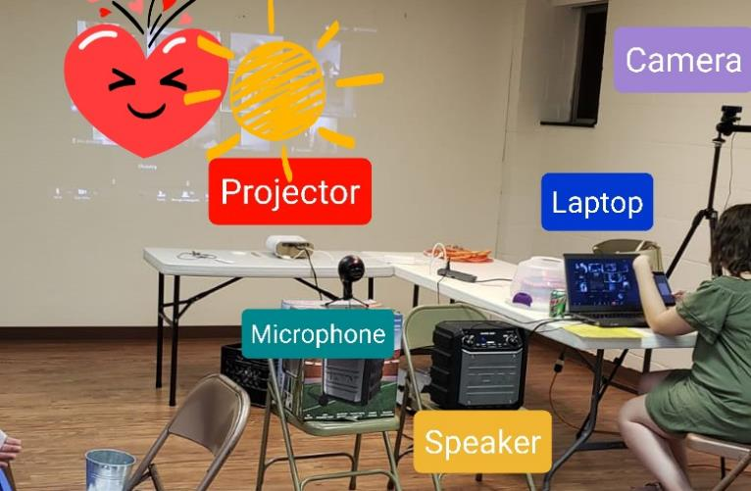
You can persevere.
Just keep trying.
Making A Checklist Was Helpful:
1. Turn on the Host Device and connect to your chosen Remote Conferencing Application
2. Connect microphone and test
3. Connect speaker and test
4. Connect Webcam and turn on video stream
5. Connect Projector and turn on remote video feed
Notes:
YOU CAN PERSEVERE LIKE WE DID --- 1) We developed a repeatable process and checklist for setting up the equipment. This was helpful in training new volunteers and relieving stress from the meeting Hosts. #1 Turn on Host Device and connect to the our chosen Remote Conferencing Application. #2 Connect the microphone and test. #3 Connect the speaker and test. #4 Connect the webcam and check the video stream. #5 Connect the projector and check the video feed. --- 2) As you can see from this picture, we became much more organized as we gained experience.

Slide 39

Group conscience will guide the way:
Accessibility is the key factor for how you will facilitate your hybrid meeting
You can use as much or as little equipment as you have available
Seek mentorship from experienced groups
More resources available at:
www.na.org/virtual
Notes:
HERE ARE SOME FINAL THOUGHTS --- Accessibilty is the key factor in Hybrid Meetings. Match your equipment to your experience level and available finances. Mentors are available to help you. There are also many resources to help you at www.na.org/virtual. Thank you for allowing us to share with you today!!!!!!

Slide 40

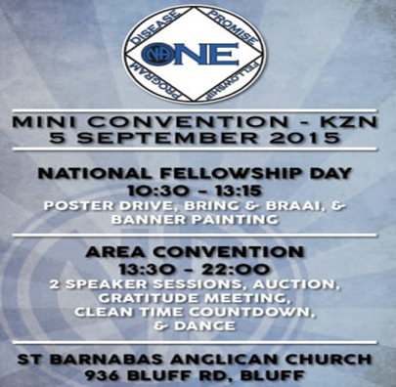
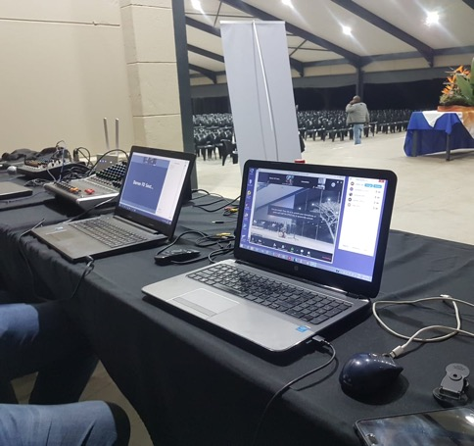

SOUTH AFRICA REGION – NARCOTICS ANONYMOUS
Transition from World Unity Days to Hybrid Area Conventions to Outreach/Online meetings to hybrid speaker jams, hybrid workshops, hybrid meetings as well as an annual hybrid regional face to face all culminating in a hybrid Regional Convention in South Africa in October 2019 -
Notes:
Slide 1
Hello, my name is Vic I am an addict …
Thanks for this exciting opportunity to share our experience in the South Africa Region with hybrid meetings.
We have had experience with Hybrid meetings right from the group level all the way to the South African Regional Convention.
Even as I sit here, I’m talking to you from a little village in the Eastern Cape of South Africa with a population of 300 people. We have used Hybrid meetings to grow our meetings and connect with NA on a much larger scale than we could have ever hoped for.

Slide 41






SOUTH AFRICA REGION – NARCOTICS ANONYMOUS
So why is that history important – experience has shown us you need these 4 ingredients to host a hybrid meeting
Note - NA does not endorse any of the above outside organisations
Notes:
Slide 2
Following on from Kelly, Cailin and Shane, here are the ingredients that we have also found that make a hybrid meeting possible for a successful atmosphere of recovery.
The Challenge is to connect a group of people in a room at a face to face meeting or event and have them connect effortlessly to a group of people who are connected over the internet.

Slide 42
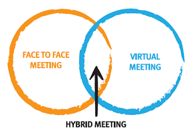
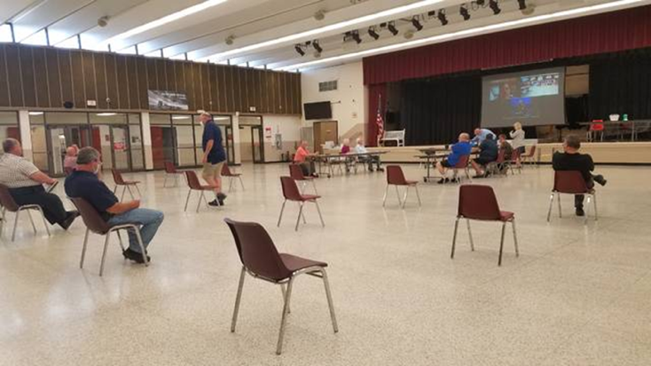
SOUTH AFRICA REGION – NARCOTICS ANONYMOUS
Why is it important now in SA – Health and Safety rules ?
  Social distancing, ethical reasons, co morbidity, elderly, vulnerable, Person under investigation, incapacitated members – gives options ….
Notes:
Slide 3
Hybrids in our experience can help to create options for NA groups … The idea of Hybrid meetings is larger than just dealing with the covid crises, we can use them to get anyone who cant get to a meeting, to a meeting.

Slide 43
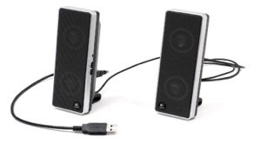
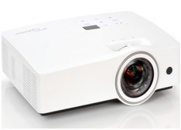
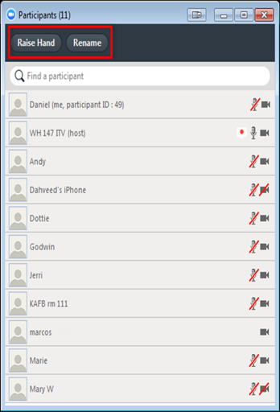
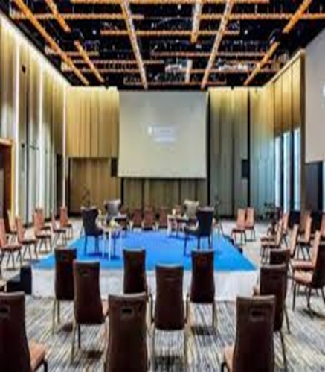


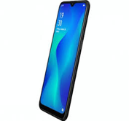
SUMMARY EQUIPMENT NEEDED
Online meeting
In person Meeting
Online meeting
In person Meeting
Notes:
Slide 4
This slide is an example of some of the equipment that can be used to create hybrid meetings but I want to tell you that you can make hybrid meetings work even with simple devices like a telephone dialed into a meeting with a phone number, its all about taking what you have access to and making it work for you.

Slide 44
12 Steps of hosting Hybrid Meetings
Ensure you have a stable and fast internet – 2 mbps – down / 2 mbps up – do speed test
Preferably chair from a laptop/desktop – meeting controls dashboard is more visible / projector option
Make use of correct audio equipment – use of smart phone as attendee is best mic option – both quality and Health&Safety benefits & head phones for virtual attendees
Make use of correct video equipment – use of smart phone as attendee is best video option under lockdown (don’t recommend video)
Notes:
Slide 5
Test your internet, using online speed tests from your browser, download is a pull and upload is a push, you need both for good communication.
We like to use a laptop preferably to host a meeting because of the meetings controls being more visible and easier to use.
Use audio and video equipment that works, even a cellphone connected to the meeting as an attendee can be used as a microphone and video camera, if done controlled by one person it meets the health and saftey regulations of social distancing.

Slide 45
12 Steps of hosting Hybrid Meetings
Make sure venue has sufficient tables for equipment and access to power source / bring extension chords and adapters
Use a tech preamble to help guide both face to face and virtual attendees on the use of technology and help them understand the interface between in-person and virtual members (read before the meeting)
Develop an online friendly meeting format with preferred sequence of meeting, imbedded readings and announcements all incorporated into 1 document for the entire meeting e.g. power point
Notes:
Slide 6
Check your space that you are using that your tables, your cables and plug setup is all in order.
We like to do a technical run through before each meeting actually starts so that everyone understands how the technology works, we build this into our meeting structure.

Slide 46
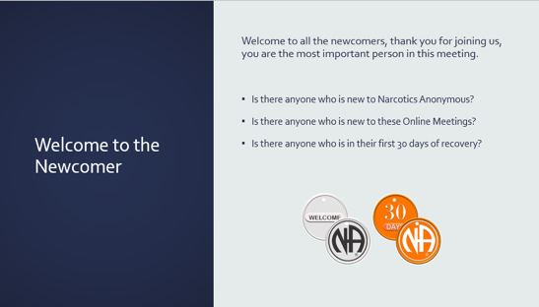
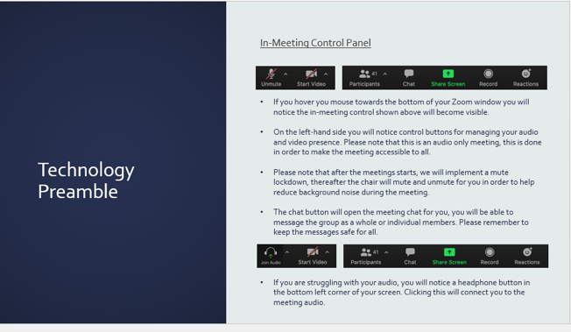
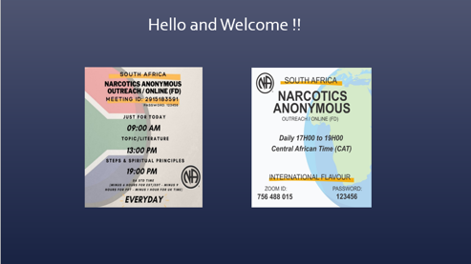
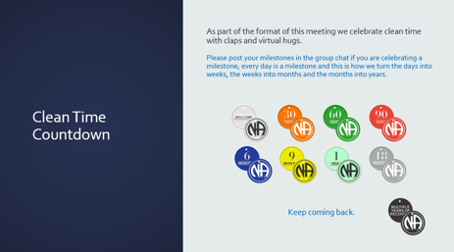
12 Steps of hosting Hybrid Meetings
Develop an online friendly meeting format…
  Longer meetings better
  Tech preamble pre meeting
  Open up early for testing
  Power point meeting structure / readings – helps
Notes:
Slide 7
Have an appealing and complete meeting preamble inclusive of readings, format, announcements etc as far as possible
Need as much structure done that makes use of one document.
We like to have an easy to use structure that ensures chairing is smooth and easy to do and that we have an effective way of bringing in outside speakers into our meetings and a process for this too.

Slide 47
12 Steps of hosting Hybrid Meetings
Make sure communications are strong – What's App groups, virtual posters drives, Online/Virtual/Regional Websites, email meeting lists, Private FB Groups
Where possible have a meeting host /chair and 2 x Co-hosts to manage virtual/in person microphones, videos, chat and bombers – min x 3 service team members
Create new service position linked to Health and Safety who will toggle smart phone mic off and on behalf of readers and speakers
Notes:
Slide 8
Use other virtual groups like what app or email for group communications – virtual poster drives, keep invites going and give everyone the information
We have service positions in our meetings that can full fill roles like Mic mute / unmute, speaker seeker and any position that helps with the meeting structure.

Slide 48
12 Steps of hosting Hybrid Meetings
Anticipate problems – open up early – do testing and have spare batteries / power chords / ensure phones are charged / extra adaptors
Mostly have fun – open mindedness, willingness, perseverance and acceptance are required !
In reality – everyone opening a hybrid meeting is opening a “new” meeting and so expectations that “new” meetings work smoothly from day 1 is not our experience for In Person meetings and this has been our experience for hybrid meetings as well –
trial and error wins the day !!
Notes:
Slide 9
Trial error – This is how we learnt, we go out and do our best, come back, ask for help and go out and try again, it worked for us.

Slide 49
Resources
How to chair/host a NA Hybrid meeting?
Mondays till end August 2020 (starting Mon 27th July 2020 – next x 6 Mondays)
11am–1pm EDT/8am-10am PDT/4 pm to 6 pm UK/5 – 7 pm South African time
Link- just click in to join. https://zoom.us/j/756488015?pwd=KzBlcFlhRGppamNkV0ZZeklFLy9Wdz09
Meeting ID: 756488015 /Password: 123456
Notes:
Slide 10
For those that are interested in the resources, videos, and templates or who want to learn more –
All welcome to attend Mon 27th July and every Monday thereafter for 6 weeks from 11 am to 1 pm Eastern time or email fd-chair@na.org.za for locally developed resources / templates etc
Virtual Vic you tube videos
Thank you so much for letting me be of service, Victor and I’m an addict.

Slide 50
Ground rules
Listening is an act of respect for others
Be sure that everyone participates; don't dominate
Don't forget our Fifth Tradition; We all love NA!
Stay focused on the subject at hand
To disagree without being disagreeable...that is OUR process!
One more time-avoid repetition

Slide 51
Two main questions=30 minutes each
What challenges do you anticipate reopening face-to-face meetings? What ideas might address those challenges?
What challenges do you anticipate hosting hybrid meetings? What ideas might address those challenges?
Don’t worry if you have ideas that you don’t have time to share. You can always email them to wb@na.org.

Slide 52
What did you hear that you found most useful?
www.na.org/virtual

Slide 53
Best practices
Still collecting experiences about and resources for online recovery and service meetings, apart from pandemic-related concerns
Resources we have collected so far on our virtual meetings page: www.na.org/virtual
If you have tools that have helped your group or service body with these or any topic related to online meetings, please send them to: pr@na.org

Slide 54
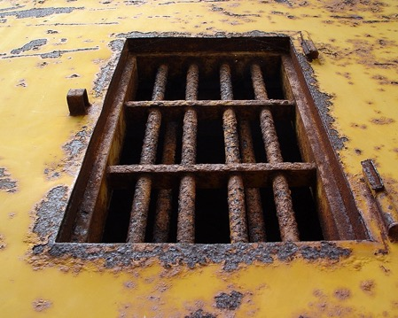
NAWS Update
Filling orders from regions, areas,
members, and institutions
Resumed shipping to inmates
requesting a book, which will help save lives
Published Filipino Basic Text and Georgian IP #1.
Finalizing Nepali Basic Text
Service related web meetings—PR, phonelines, zones,
World Service Conference and more
New Contracts and Negotiations tool for the Conventions and Events Toolbox: www.na.org/conventions GSR Basics posted for review on Local Service Toolbox page www.na.org/toolbox

Slide 55


Contribute
We have the opportunity to each do our part to sustain World Services and pay it forward.
Set up a recurring or one time contribution at www.na.org/contribute
Thank you everyone for considering that and for everything you do for NA to keep the doors open

Slide 56
