Slide 1
New Ideas for Fellowship Development
9 July, 2022
A webinar brought to you by Narcotics Anonymous World Services, Inc.

Slide 2
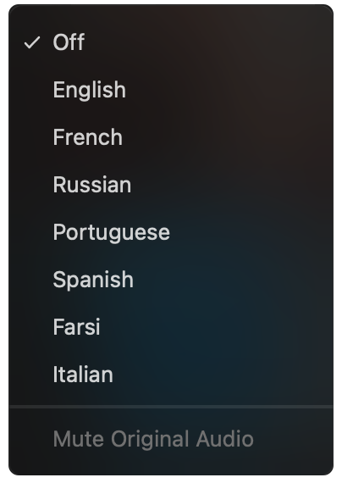
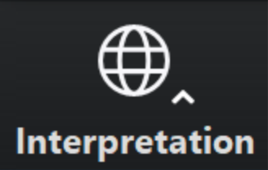
Select a language
Select English or one of the translation channels:
Farsi French Polish Portuguese Russian Spanish
English
Farsi
French
Polish
Portuguese
Russian
Spanish
1. Find at bottom of screen
2. Choose a language

Slide 3
It Works: How and Why, Step Twelve
The spiritual void we felt at the beginning of our recovery has been filled with gratitude, unconditional love, and a desire to be of service to God and others. Undeniably, we have experienced a spiritual awakening.
In order to cultivate this awakening, we have found it essential to express our gratitude and practice the principles of recovery in every area of our lives. However, this isn’t something we do only to ensure that our own recovery continues. Narcotics Anonymous is not a selfish program. In fact, the spirit of the Twelfth Step is grounded in the principle of selfless service. Upholding this principle in our efforts to carry the message is of the utmost importance, both to our own spiritual state and to those to whom we are trying to carry the message.

Slide 4
Download this slide for meetings and the NAWS News PDF to read
www.na.org/nawsnews

Slide 6
…to those who have already set up their recurring contributions.
www.na.org/contribute

Slide 9
Select a language
Select English or one of the translation channels:
Farsi French Polish Portuguese Russian Spanish
English
Farsi
French
Polish
Portuguese
Russian
Spanish
1. Find at bottom of screen
2. Choose a language

Slide 10
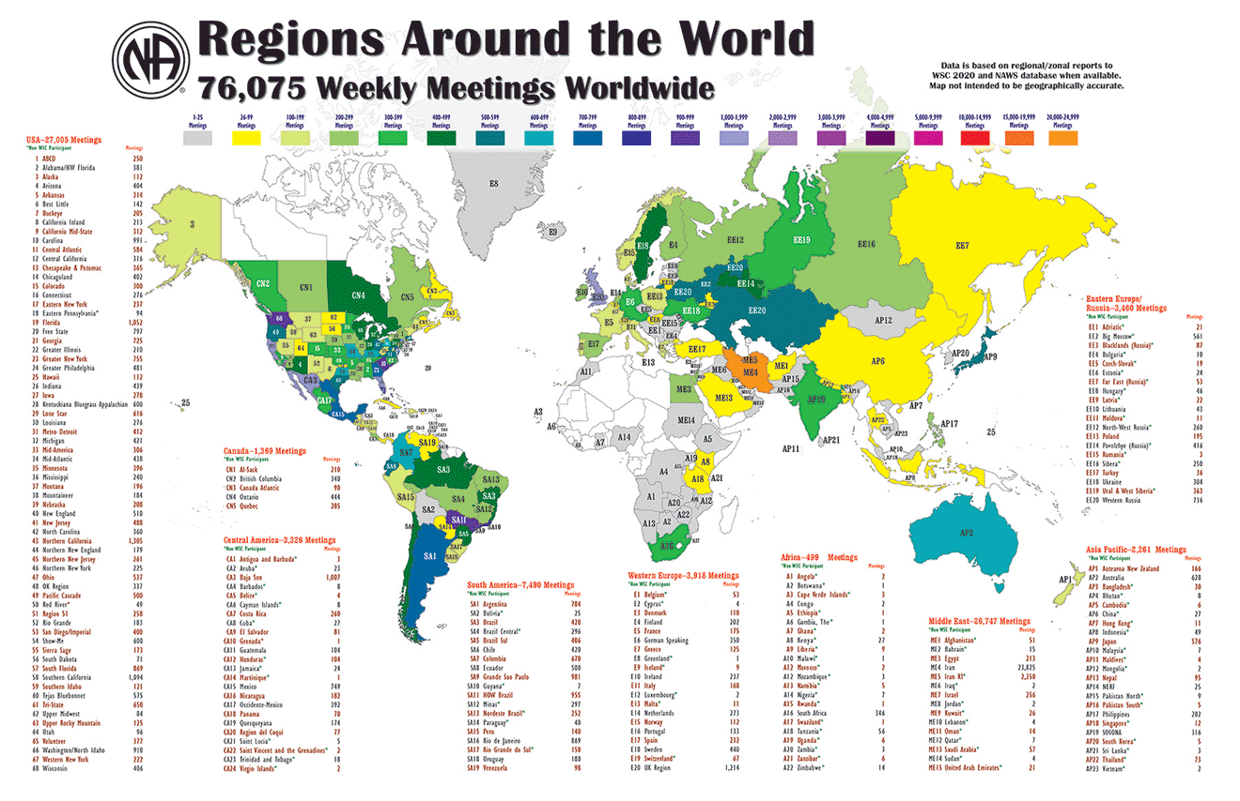
Report and today’s recording posted to www.na.org/virtual

Slide 11
Today’s panelists
Jean, Gérico, and Kanessa – Northern Quebec
Clarence – Greater Philadelphia Region
Alexey and Natasha – Russia
Gil – Portugal Region
Cyro – Brazil

Slide 12
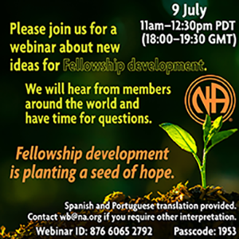
PORTUGUESE REGION OF
Local FD Experience
36 years of existence;
Different actions;
Developed fellowship;
Challenges
https://na-pt.org/
Notes:
Introduction: Hello everyone, I'm Gil and I'm a recovering addict,…
It is important to say that Portugal does not have an FD service committee, or at least one named FD and with exactly the guidelines that describe it. We do have service bodies that have more or less the same goals, but at the end of the day, all these activities that have brought us where we are today are fellowship development activities. We are the result of the development of the fellowship, as we started from scratch almost 40 years ago and today we are a sufficiently developed and active region in service, despite the challenges that we face…, that the whole fellowship faces…, such as the lack of volunteers to do service.
And all this was made possible, thanks to the willingness, love and help of other members, who were already here, and to whom we are deeply grateful and which we try to return today by doing service for those who will come…

Slide 13
1
104 Face to Face Meetings 67 On-line meetings
Areas
PR & H&I
Legal Entity (APNA)
PORTUGUESE REGION
Overview
171
9
8
1
Unity & Service
7 Active area PR service bodies
1 Regional PR service body
Only active body
that does “FD” activities
Translations, literature, helpline
7 Active area service bodies
About 24 meetings a day
1 Regional service body,
meets 4 times a year - 2 face to face; 2 on-line
https://na-pt.org/
Notes:
So this is the overview of the universe of the Portuguese region.
We are currently, 171 groups of which 104 are face-to-face. before the pandemic we were around 140 face to face groups…
In Portugal NA is constituted as a legal entity through the APNA (PNAA), which includes in its body the subcommittees of Translations, Literature and Helpline.
It reports to the regional service body, which is made up of 9 areas…currently, and hopefully temporarily, only 7 areas are active and organized in service bodies.
About every area organized into an area service body has a PR & H&I subcommittee that works together with the regional PR & H&I committee.
We also have a service body called unity and service, as you can see here on the right, which is what most closely resembles Fellowship Development. Currently there is only one such body active in the North of Portugal. Until a few years ago we also had it in Lisbon, but it closed.
All area service bodies have this service subcommittee, despite the fact that, unfortunately at the moment only one is active.

Slide 14
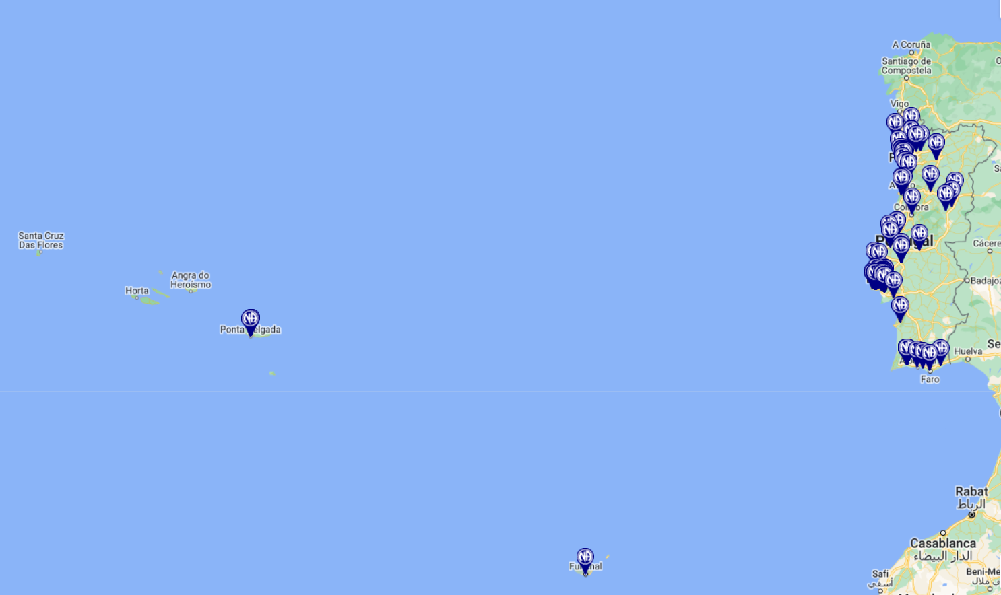
MEETINGS MAP
The Azores
Madeira
https://na-pt.org/
Notes:
And this is how the NA presence looks in the Portuguese Region. We also have meetings in the islands as you can see.
Some FD actions have been carried out on Madeira Island over the years by PR & H&I, and by the RD´s as well. Not long ago Madeira was organized as an area service body and was represented in the regional service body. There are currently no delegates, but hopefully this is temporary.
There are also regular meetings in the Azores. We have made some contact recently, but we currently do not have a FD plan.. but surely, we´ll develop the idea and see about it…

Slide 15
104 Face to Face Meetings 67 On-line meetings
PORTUGUESE REGION
Overview
171
1
9
8
1
Areas
PR & H&I
Unity & Service
Legal Entity (APNA)
7 Active area PR service bodies
1 Regional PR service body
Only active body that does “FD” activities
About 24 meetings a day
Translations, literature, helpline
7 Active area service bodies
https://na-pt.org/
Notes:
…So, the activities that we currently carry out that resulted in the development of the Portuguese fellowship are largely initiated in PR & H&I actions..., by the area service committees together, and for a few years now, also together with the regional PR committee

Slide 16
PR & H&I
Support, communication, “tools”
8
Activities, planning
Meets with area committes regularly
PR & H&I
7 Active area PR service bodies
1 Regional PR service body
Alpha Project
PR & H&I actions aimed at developing fellowship
The aim is to create awareness, involve local fellowship and addicts, show the community NA is another resource in the community
relacoespublicas.na@gmail.com
https://na-pt.org/
Notes:
…in this case the Regional PR & H&I body also helps to centralize and flow communication…, provides support tools (presentations, posters, templates, etc. ) and they develop activities together..., They regularly meet together (all bodies in the areas together with the regional body) to share activities, experiences and progress…
They recently started a project, called the Alpha Project. It’s a PR H&I project with some aspects of Fellowship Development, which was based on ideas and experiences shared by members of the Brazilian fellowship living in Portugal, in the Lisbon Area. Together they came up with the idea adjusted to our local reality.
This project consists of a series of public information actions…, with several volunteers during an entire weekend…, in the less developed or more remote areas..
It aims to raise awareness in the population about Narcotics Anonymous…, that we are another resource in the community, and thus motivate the development of the local fellowship involving local members and volunteers when there are groups…It’s starting now in the Algarve with the recently reactivated area PR body, …This PR body and the area committee had stopped for some years but thankfully they are back and active again.
If you need some further information about this project, I’ll leave the email here where you can submit your questions.

Slide 17
1
Areas
PR & H&I
Legal Entity (APNA)
104 Face to Face Meetings 67 On-line meetings
UNITY & SERVICE “FD”
Overview
171
9
8
1
Unity & Service
Only Active body that does “FD” activities
7 Active area PR service bodies
1 Regional PR service body
Translations, literature, helpline
7 Active area service bodies
About 15 meetings a day
https://na-pt.org/
Notes:
And that brings us to Unity and Service, which as I said…, is the service body that most closely resembles Fellowship Development.
Currently there is only one active subcommittee ,,,(next slide)

Slide 18
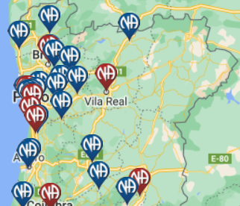
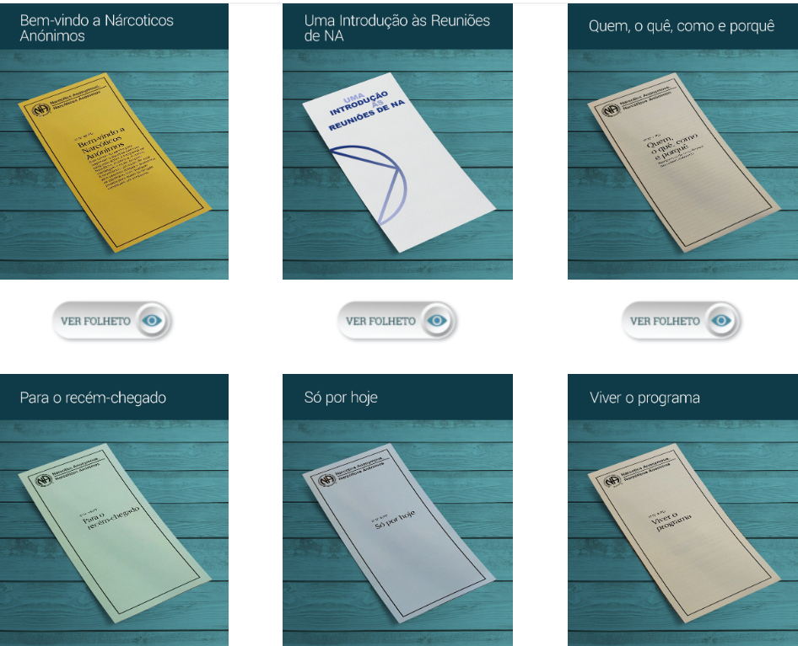
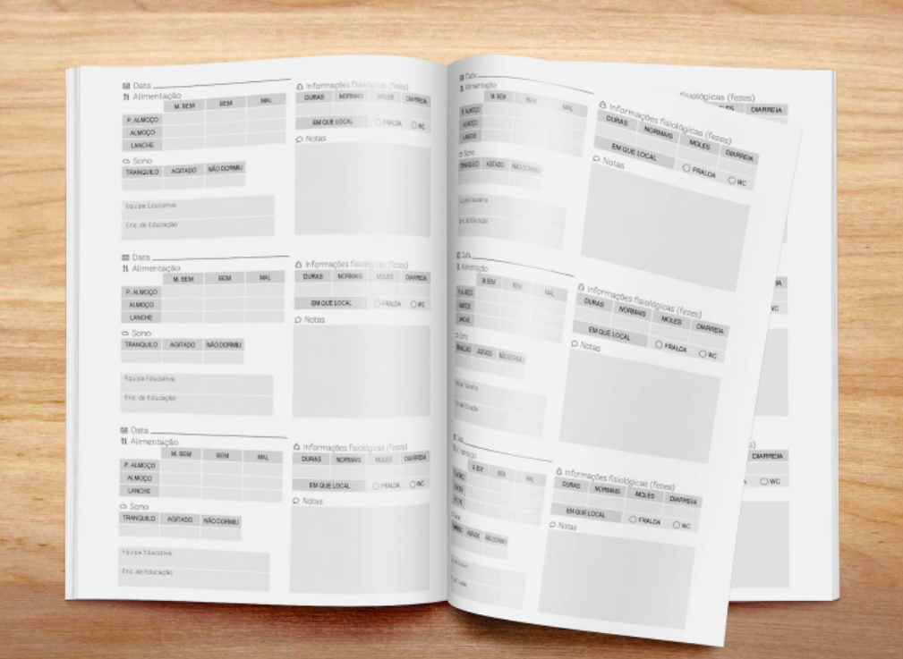
UNITY & SERVICE “FD”
1
Unity & Service
Only active body that does “FD” activities
https://na-pt.org/
Notes:
It is located in the north, in the Porto area, which is here on the map... (next animation…)
Unity and Service helps groups located in the remote, rural areas..., to carry out tasks that we sometimes take for granted..., such as: filling out literature order sheets...(next animation)
... , providing tools..., templates for meeting attendance records…, (next animation…) for the treasury, 7th tradition records…things that can be quite difficult for new members…, newcomers, or just with no experience in service at all… or with no experience using certain tools…so here is a clear example that in the most developed areas, in our case the coastal ones…, these things apparently that we take for granted in certain areas can be a real challenge.

Slide 19
UNITY & SERVICE “FD”
Support, communication, “tools”
1
Events, planning
Meets with area committes regularly
Unity & Service
Only active body that does “FD” activities
Visits all area groups. Provides all support needed
The aim is to connect with remote groups, give voice to local members, fulfill 1st and 5th Traditions
https://na-pt.org/
Notes:
…therefore, Unity and Service provides this support…, provides tools in these more remote locations.., and helps with the communication between groups and the area service body.
It is also responsible for organizing events…,
…meets regularly with these more remote groups, and not just the remote ones…, it provides all the necessary support for the functioning of existing groups or the opening of new groups.
Manages and redistributes literature stocks accumulated from other groups that in the meantime closed.
…and this is all very gratifying, from my experience in PR & H&I…, it is gratifying when new members arrive, and after a while we watch them involved in service activities.., helping, participating in the development of the fellowship…it is very gratifying and overwhelming…
So…wrapping it all up, Unity in Service aim is to create connections with groups, or members in the most remote areas, provide the necessary means… the necessary support for them to develop locally and get to be self sufficient to be able to carry the message of recovery.

Slide 20
SUMMARY
We are a result of fellowship development activities;
Combined with support of other service bodies and volunteers;
The importance of involvement in Service;
Sponsorship, communication.
https://na-pt.org/
Notes:
our region is also the result of Fellowship development activities;
Which in our case, are a combination of a series of activities from various service bodies and the willingness of our members…, our volunteers…, as well as all of us in the fellowship in some way…That is why it is very important to do service, to get involved in the fellowship and to give freely what we freely have been given…,That's why sponsorship has been an important factor, and of course, communication between all service bodies…as we saw in the Alpha Project case…(next slide)

Slide 21
PORTUGUESE REGION OF
Obrigado a todos!
Thank you all!
https://na-pt.org/
Notes:
And that is all…,

Slide 22
LOCAL SERVICE ACTION

Slide 23
DEFINITION
The Local forum of action is an activity which aims to develop the local community, and consists of the execution of NA basic services (H&I – PR – FD – Helpline), promoting cultural diversity in service (members of different places serving together) and member experience exchange after the practical activities.

Slide 24
It is a challenge to demonstrate in a simple presentation all the spiritual growth and fulfillment obtained by doing this service. We believe that an effective way for this material to encourage other areas is to divide the presentation into 3 parts:
Before
During
After

Slide 25
BEFORE
Because it is an event that involves people from other cities and states (cultural diversity), it is important to plan well in advanced, we suggest 10 months at least. The whole process of planning meetings, PR, scheduling panels, publicity, and organization, brings much growth and development for the locality that hosts it.

Slide 26
DURING
The feeling of participating in NA activities with members of other communities is such a fantastic experience. While doing the service, it is possible to add other practices that members from other localities do. It is important for the community that hosts the forum to always have some members who may not be ready to execute panels and specific activities available to help with the logistics to ensure the forum will run as planned.

Slide 27
AFTER
An event like this has dozens or even hundreds of activities, and has increased the demand for services. These have to be conducted with the same commitment as when they were started. Something important is that this model of event is good for the newcomers to get excited with service, as well as the members who have been in the fellowship for some time but unmotivated to serve, thus we have more members to do all the service in the forum.

Slide 30
NEXT
FORUM

Slide 31
THANK YOU!

Slide 32
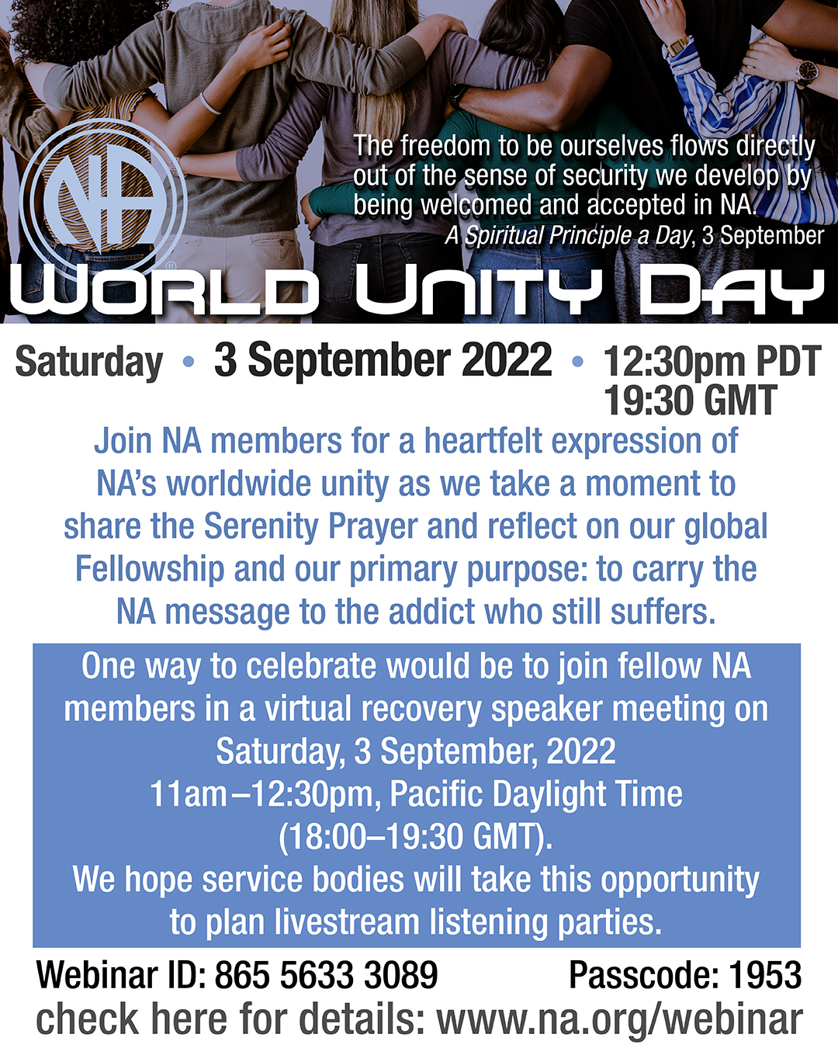
Virtual recovery speaker meeting to celebrate World Unity Day
11:00 am-12:30 pm Pacific Daylight Time
www.na.org/webinar

