Slide 1
HYBRID MEETINGS
SOME PROVEN PRACTICES

Slide 2
PRIORITY #1: Establish Accessibility
Does your meeting location have Telephone or Internet capabilities?
Notes:
PRIORITY #1: ESTABLISH CONNECTIVITY POSSIBILITIES --- Common connections to Remote Conferencing Applications are a landline telephone connection, a mobile telephone or internet signal, hard wired internet connection, or wireless internet signal (wifi)

Slide 3
Priority #2: choose a host device based on accessibility
The Host Device(s) is responsible for streaming the audio and video signal to and from remote participants
Notes:
PRIORITY #2: CHOOSE A HOST DEVICE BASED ON YOUR ACCESSIBILITY --- Audio and video equipment options will be dictated by the input and output capabilities of your Host Device. Common Host devices are mobile phones, tablets, and Laptop Computers.

Slide 4
Priority #3: Establish Quality audio input
Audio quality is the HIGHEST PRIORITY of a Hybrid Meeting
Telephone Dial In = Analog Signal
Internet = Digital Signal
Microphones are categorized by TYPE and MODEL
Notes:
Priority #3: ESTABLISH Quality AUDIO INPUT --- YOUR MICROPHONE IS THE HIGHEST PRIORITY PIECE OF EQUIPMENT FOR A HYBRID MEETING. IF OTHER MEETING ATTTENDESS CANNOT HEAR YOU CLEARLY, THE ENTIRE SHARING PROCESS BREAKS DOWN --- Many Host Devices have an integrated microphone. However, some are not powerful enough to facilitate a larger meeting size. Analog or Digital Input Signal will dictate the type of external microphone that you can use. The particular model of microphone will be dictated by compatibility with your Host Device. Also be mindful to choose a model with the correct pick-up pattern for the size of your meeting space.

Slide 5
Cardioid and Dynamic microphones:
Gather sound from directly in front of the microphone
Notes:
CARDIOID AND DYNAMIC MICROPHONES GATHER SOUND FROM DIRECTLY IN FRONT OF THE MICROPHONE. These are commonly used for a single individual who is speaking.

Slide 6
Omni-directional and condenser microphones:
Gather sound from
all directions
Notes:
OMNI-DIRECTIONAL AND CONDENSER MICROPHONES GATHER SOUND FROM ALL DIRECTIONS AT ONCE . These are commonly used for entire groups who are speaking in a single space.

Slide 7
Priority #4: Establish clear audio output
Speakers vary in size and method of connecting to your Host Device
Notes:
PRIORITY #4: ESTABLISH CLEAR AUDIO OUTPUT --- 1) Many Host Devices have an integrated speaker. However, some are not powerful enough to facilitate a larger meeting size. The size of your meeting space, number of attendees, and compatibility with your Host Device will dictate the model of external speaker that you may choose.

Slide 8
Priority #5: Video Input
Some Hybrid Meetings choose to stream video if they have Internet Accessibility
Notes:
PRIORITY #5: VIDEO INPUT --- Many Host Devices have an integrated camera. However, the shape and aspect ratio of the video stream can be unsatisfactory in some situations. If you choose to connect an external webcam, check compatibility with your Host Device. Be mindful that streaming video can greatly affect the audio quality in locations where the internet signal is not very strong. It is a considerate practice to create a portion of your meeting space for attendees who do not wish to be streamed on camera.

Slide 9
Priority #6: Video Output
Some Hybrid Meetings choose to stream video of the Remote Participants
Notes:
PRIORITY #6: VIDEO OUTPUT --- Common methods for Video Output include Laptop or Tablet Monitors, Television Screens, and Projectors. Always check compatibility with your Host Device, and be mindful to purchase necessary cables and connectors.

Slide 10
Use whatever you have available:
NorthStar Online NA Group began as a Hybrid Outreach Meeting on Thursday May 10th 2018.
Outreach Service Provided by: Kentucky Survivors Area to the Clean And Crazy/Never Alone Group
We had access to stable internet through our meeting facility
We chose the full two way Audio and Visual experience
Notes:
Here you can see some basic information about the beginning of what is now the NorthStar Online NA Group. You can see from the picture that things were a bit disorganized in the beginning. Many cables and connectors everywhere.

Slide 11
You can persevere. Just keep trying.
Making A Checklist Was Helpful:
1. Turn on the Host Device and connect to your chosen Remote Conferencing Application
2. Connect microphone and test
3. Connect speaker and test
4. Connect Webcam and turn on video stream
5. Connect Projector and turn on remote video feed
Notes:
YOU CAN PERSEVERE LIKE WE DID --- 1) We developed a repeatable process and checklist for setting up the equipment. This was helpful in training new volunteers and relieving stress from the meeting Hosts. #1 Turn on Host Device and connect to the our chosen Remote Conferencing Application. #2 Connect the microphone and test. #3 Connect the speaker and test. #4 Connect the webcam and check the video stream. #5 Connect the projector and check the video feed. --- 2) As you can see from this picture, we became much more organized as we gained experience.

Slide 12
Group conscience will guide the way:
Accessibility is the key factor for how you will facilitate your hybrid meeting
You can use as much or as little equipment as you have available
Seek mentorship from experienced groups
More resources available at:
www.na.org/virtual
Notes:
HERE ARE SOME FINAL THOUGHTS --- Accessibilty is the key factor in Hybrid Meetings. Match your equipment to your experience level and available finances. Mentors are available to help you. There are also many resources to help you at www.na.org/virtual. Thank you for allowing us to share with you today!!!!!!

Slide 13
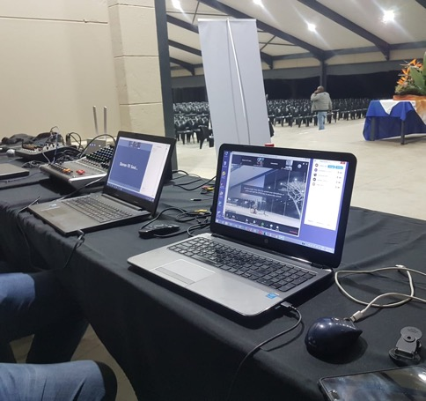
SOUTH AFRICA REGION – NARCOTICS ANONYMOUS
Transition from World Unity Days to Hybrid Area Conventions to Outreach/Online meetings to hybrid speaker jams, hybrid workshops, hybrid meetings as well as an annual hybrid regional face to face all culminating in a hybrid Regional Convention in South Africa in October 2019 -
Notes:
Slide 1
Hello, my name is Vic I am an addict …
Thanks for this exciting opportunity to share our experience in the South Africa Region with hybrid meetings.
We have had experience with Hybrid meetings right from the group level all the way to the South African Regional Convention.
Even as I sit here, I’m talking to you from a little village in the Eastern Cape of South Africa with a population of 300 people. We have used Hybrid meetings to grow our meetings and connect with NA on a much larger scale than we could have ever hoped for.

Slide 14
SOUTH AFRICA REGION – NARCOTICS ANONYMOUS
So why is that history important – experience has shown us you need these 4 ingredients to host a hybrid meeting
Note - NA does not endorse any of the above outside organisations
Notes:
Slide 2
Following on from Kelly, Cailin and Shane, here are the ingredients that we have also found that make a hybrid meeting possible for a successful atmosphere of recovery.
The Challenge is to connect a group of people in a room at a face to face meeting or event and have them connect effortlessly to a group of people who are connected over the internet.

Slide 15
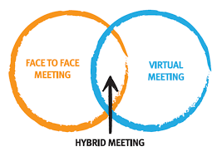
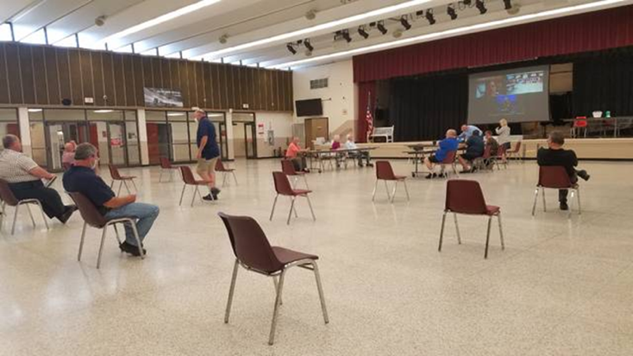
SOUTH AFRICA REGION – NARCOTICS ANONYMOUS
Why is it important now in SA – Health and Safety rules ?
Social distancing, ethical reasons, co morbidity, elderly, vulnerable, Person under investigation, incapacitated members – gives options ….
Notes:
Slide 3
Hybrids in our experience can help to create options for NA groups … The idea of Hybrid meetings is larger than just dealing with the Covid crisis, we can use them to get anyone who can’t get to a meeting, to a meeting.

Slide 16
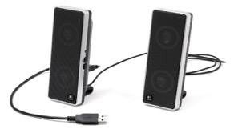
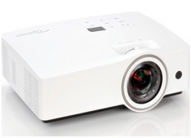
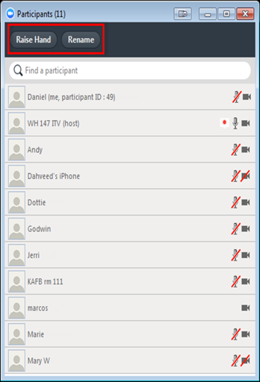
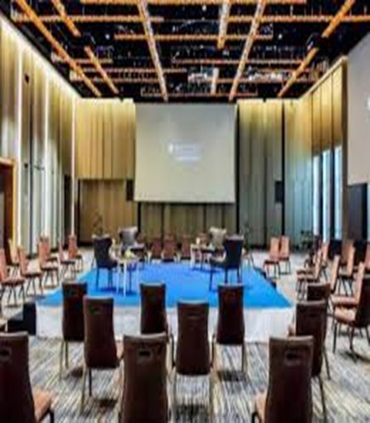
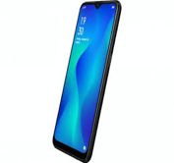
SUMMARY EQUIPMENT NEEDED
Online meeting
In person Meeting
Online meeting
In person Meeting
Notes:
Slide 4
This slide is an example of some of the equipment that can be used to create hybrid meetings but I want to tell you that you can make hybrid meetings work even with simple devices like a telephone dialed into a meeting with a phone number, its all about taking what you have access to and making it work for you.

Slide 17
12 Steps of hosting Hybrid Meetings
Ensure you have a stable and fast internet – 2 mbps – down / 2 mbps up – do speed test
Preferably chair from a laptop/desktop – meeting controls dashboard is more visible / projector option
Make use of correct audio equipment – use of smart phone as attendee is best mic option – both quality and Health&Safety benefits & head phones for virtual attendees
Make use of correct video equipment – use of smart phone as attendee is best video option under lockdown (don’t recommend video)
Notes:
Slide 5
Test your internet, using online speed tests from your browser, download is a pull and upload is a push, you need both for good communication.
We like to use a laptop preferably to host a meeting because of the meetings controls being more visible and easier to use.
Use audio and video equipment that works, even a cellphone connected to the meeting as an attendee can be used as a microphone and video camera, if done controlled by one person it meets the health and saftey regulations of social distancing.

Slide 18
12 Steps of hosting Hybrid Meetings
Make sure venue has sufficient tables for equipment and access to power source / bring extension chords and adapters
Use a tech preamble to help guide both face to face and virtual attendees on the use of technology and help them understand the interface between in-person and virtual members (read before the meeting)
Develop an online friendly meeting format with preferred sequence of meeting, imbedded readings and announcements all incorporated into 1 document for the entire meeting e.g. power point
Notes:
Slide 6
Check your space that you are using that your tables, your cables and plug setup is all in order.
We like to do a technical run through before each meeting actually starts so that everyone understands how the technology works, we build this into our meeting structure.

Slide 19
12 Steps of hosting Hybrid Meetings
Develop an online friendly meeting format…
Longer meetings better
Tech preamble pre meeting
Open up early for testing
Power point meeting structure / readings – helps
Notes:
Slide 7
Have an appealing and complete meeting preamble inclusive of readings, format, announcements etc as far as possible
Need as much structure done that makes use of one document.
We like to have an easy to use structure that ensures chairing is smooth and easy to do and that we have an effective way of bringing in outside speakers into our meetings and a process for this too.

Slide 20
12 Steps of hosting Hybrid Meetings
Make sure communications are strong – What's App groups, virtual posters drives, Online/Virtual/Regional Websites, email meeting lists, Private FB Groups
Where possible have a meeting host /chair and 2 x Co-hosts to manage virtual/in person microphones, videos, chat and bombers – min x 3 service team members
Create new service position linked to Health and Safety who will toggle smart phone mic off and on behalf of readers and speakers
Notes:
Slide 8
Use other virtual groups like what app or email for group communications – virtual poster drives, keep invites going and give everyone the information
We have service positions in our meetings that can full fill roles like Mic mute / unmute, speaker seeker and any position that helps with the meeting structure.

Slide 21
12 Steps of hosting Hybrid Meetings
Anticipate problems – open up early – do testing and have spare batteries / power chords / ensure phones are charged / extra adaptors
Mostly have fun – open mindedness, willingness, perseverance and acceptance are required !
In reality – everyone opening a hybrid meeting is opening a “new” meeting and so expectations that “new” meetings work smoothly from day 1 is not our experience for In Person meetings and this has been our experience for hybrid meetings as well –
trial and error wins the day !!
Notes:
Slide 9
Trial error – This is how we learnt, we go out and do our best, come back, ask for help and go out and try again, it worked for us.

