Slide 1
Scanning as a part of Planning for Services
Northern California Fellowship services

Slide 2
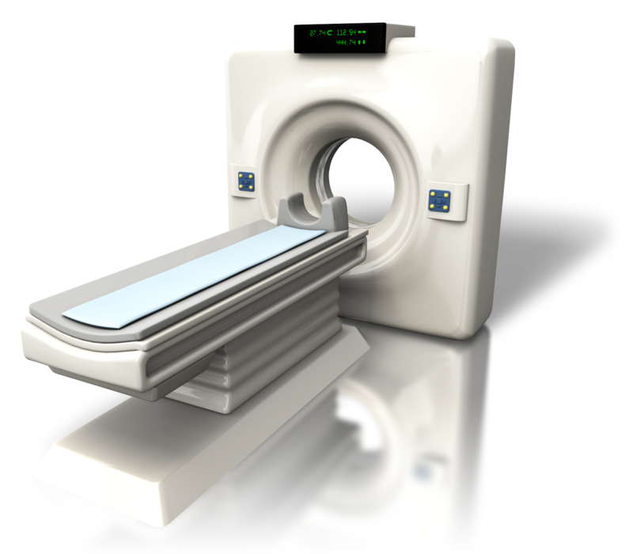
Session 1: Scanning

Slide 3
Goals for Session 1:
Goal 1
Clarify “what is Scanning?”
Goal 2
Look at two types of Scanning: Internal and External
Goal 3
Learn how to Scan, including where to look for data
Goal 4
Participate in some sample Scanning Exercises to get familiar with the process

Slide 4
What is Scanning?
Scanning is a process for identifying & assessing factors that are shaping our environment
Data provides insight into the potential challenges and opportunities we may face, and into the strategies we will need
Looking at the environment we exist in (scanning) is a critical step in the planning cycle
Helps us understand how a changing world can impact our ability to realize our vision

Slide 5
What is Scanning?
The World Board does this as part of their biennial planning cycle
Without Scanning, we stay with our current routine without asking whether there is something else we should focus on

Slide 6
Internal Scanning
Perhaps we have asked “who is missing from our meetings?” and have identified young people as a missing population. They come to meetings for a short time, but don’t stay.
Maybe we’ve noticed a decline in our seventh tradition giving locally, or that we have a lot of relative newcomers serving in positions they’re not really trained for.

Slide 7
External Scanning
EXAMPLE: We may learn that some shift in funding locally has had nearly all professionals leaning toward methadone and/or suboxone in treating addicts, and that they are being encouraged to take key tags for clean time in spite of being on drug replacement.
There is a distinction to be made between having an opinion on an outside issue and having an awareness of an outside issue that may be impacting us and considering whether we need strategies in response.

Slide 8
External Scanning
what can we do within the scope of our traditions to address the “inside issues” that this presents?
what should we avoid?
Is there an initiative that we want to assign to our PR workgroup or a temporary focused workgroup related to this?

Slide 9
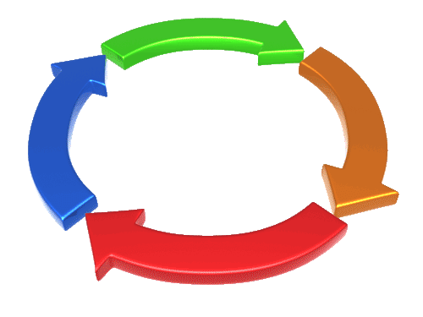
Planning Cycle
SCANNING
Plan
Prioritize
Planning is Cyclical
Evaluate
Scanning ensures that fresh, new inputs to the process are continually introduced
Monitor
Delegate

Slide 10
Where to look?
ASC Minutes - group, PR/H&I Reports
Income trends over past couple of years
Head counts and demographics at events
Map out meetings in your County
Internet: Local politics and news on addiction treatment

Slide 11
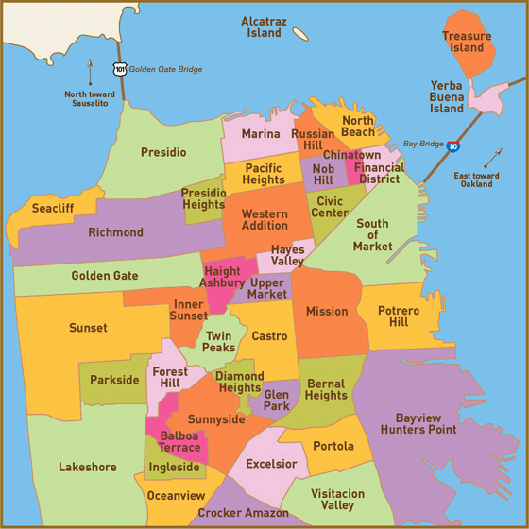
Basic Scanning Process
Sometimes just mapping out underserved communities can help
San Francisco:
0 Meetings in
Chinatown

Slide 12
Basic Scanning Process
Identify trends & issues in the internal & external environments
Consider implications of trends for ASC actions, or “What might we do?”
In response to the external environment
In considering our internal environment
ID sources of information used for these trends and issues to confirm their validity.

Slide 13
Preparing to Scan
Leading up to an environmental scan, trusted servants can be asked to do some research or homework.
One might be asked to find out more about a trend in medicine as practiced locally that is impacting us, or to assess local doctors’ familiarity with NA.
Another looks at the courts/probation practices, another treatment centers, etc.
Again, we’re not forming opinions about outside issues, just asking, “are there trends/issues impacting us, and is there something we should/could do?”

Slide 14
Example: NAWS Environmental Scan
TREND ANALYSIS:
The continued increase in drug usage by 18-25 year olds, as well as the growing number of baby boomer addicts (age 45-60) who suffer primarily from pharmaceutical addiction.

Slide 15
Example: NAWS Environmental Scan
Sources:
Review of UN 2008 World Drug Report
Review of National Institute for Drug Abuse (NIDA) Drug Report 2008
Review of Substance Abuse and Mental Health Services Administration (SAMHSA)
NAWS operational records and reports, fellowship inquiries, literature orders, financial performance, etc.

Slide 16
Potential Implications of Trend:
More professional or ‘high bottom’ members
High turnover of young people coming in and out of NA
Attitude of young people that recovery is not exciting/fun
Many will feel out of place at meetings, not welcome and that NA is not for them
Greater number of members focusing on differences
Professionals recommending AA as more suitable;
increased disappointment of professionals about local NA
Growing lack of identification in meetings
Growing push to create young people’s fellowship

Slide 17
Northern CA PR Response:
PR Opportunities:
Booths at universities, community colleges, high schools, continuity schools, etc.
Counseling services presentations and literature
Presentations to possible referrals - youth organizations, nursing homes, etc.
H & I Opportunities:
Shelters, youth organizations
Hospitals, Veteran’s Association Hospitals/Clinics, nursing homes
Fellowship Opportunities:
Meetings for professionals and youth
Providing an environment for younger members in service
Presentations to Human Resources at large organizations such as casinos, etc.

Slide 18
Scanning Exercise 1
Trend/Issue:
Decrease in group contributions to the ASC
Internal or External?
Supporting data: 12 months of treasurer’s reports confirm the downward trend
Implications for planning: what might we do?

Slide 19
Scanning Exercise 2
Trend/Issue:
Lack of Trusted Servants
Smoking law changes
Groups report influx of Court Card attendees
Questions for You:
Internal or External issue?
What might be supporting data?
What actions might be considered?

Slide 20
Scanning Exercise 3
Using the Area Scan Worksheet:
Divide up into small groups and go through the Sample Area Scan Worksheet
Don’t be discouraged if you don’t finish; this is just the beginning!

Slide 21
Final Thoughts
Scanning is a critical step to keep the planning process continually renewed and fresh
If we don’t do it, we will be forced to do it as crises arise
Can be messy at first… give yourself a break!
Stay abreast of the Service System project for more on this topic:
www.na.org/servicesystem

Slide 22
Questions? Comments?
We are happy to help you!
Northern California Fellowship Services Team
www.norcalna.org

