Slide 1
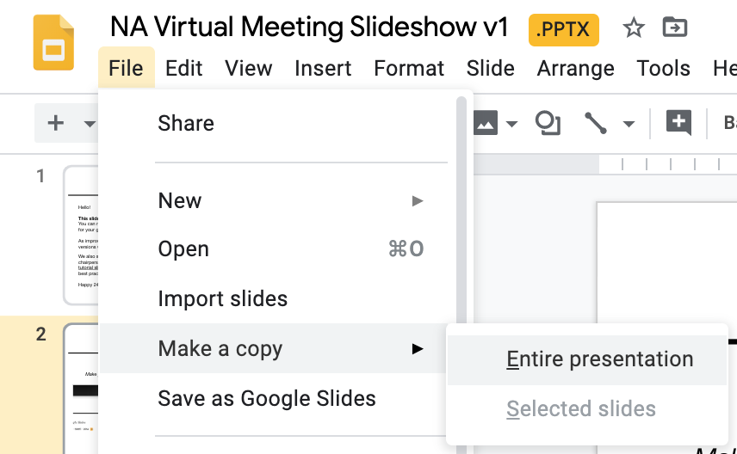
FIRST THING:
MAKE YOUR OWN COPY
3. File > Make a Copy > Entire Presentation
Login to your Google Account
2. Select “Open with Google Slides”

Slide 2
TASC Virtual Meeting Slideshow Template
v2.0 (April 6, 2020)
ZOOM PASSWORD UPDATE
On April 5, Zoom made passwords mandatory. Please update your meeting and listing settings. Instructions here.
Hello!
This slideshow is meant to be a guide. After making your own copy, you modify it in any way for your group.
More will be revealed,
Happy 24!
Toronto NA neither endorses nor is affiliated with any virtual meeting provider.

Slide 3
Tip
This Presentation
This presentation is constantly being updated with new slides and content.
You can always access the most up to date version of this presentation here:
https://drive.google.com/file/d/1OuhgBe2YAuPPvDdeRCf9UEu1R3nM9Ep5/view?usp=sharing
Once you make your own copy, it will not be updated, but you can always visit the above link to copy/paste new slides and information into your own presentation.

Slide 4
Tip
Webinar, Zoom Settings, Breakout Rooms, Posting Your Meeting Online
Webinar
TACNA PR is hosting a webinar on “How to Host an Online Meeting” on Thursday April 2 at 7pm.
https://zoom.us/j/2891296519
KEY RESOURCES
ZOOM SETTINGS SLIDESHOW
BREAKOUT ROOMS SLIDESHOW

Slide 5
Tip
put this slide up while you are waiting for meeting to begin
Group Name
Meeting Starts @ 7:00 PM EST
This is a closed Narcotics Anonymous meeting for addicts.
It costs nothing to belong to our fellowship,
you are a member when you say you are.
Please respect this meeting by: not recording at any time (recording has been disabled), ensuring you are in a private space or using headphones, and respecting the chairperson.
We are presented with a dilemma; when NA members identify themselves as addicts and alcoholics, or talk about living clean and sober, the clarity of the NA message is blurred. To speak in this manner suggests that there are two diseases, that one drug is somehow separate from the rest, requiring special recognition.
Narcotics anonymous makes no distinction between drugs. Our identification as addicts is all-inclusive, which allows us to concentrate on our similarities, not our differences.

Slide 6
Your Group Name Here
Online NA Meeting
March 17, 2019
7:00 PM - 8:30 PM

Slide 7
Agenda
Welcome
Overview of Online Meeting
Readings
Key Tags
Announcements
Sharing Guidelines
Sharing Portion of Meeting

Slide 8
Virtual Meetings
Please activate video if you’re comfortable
Laptop / Desktop
Download desktop Zoom app (browser has limited functionality)
www.zoom.us/download
Mobile
Download mobile Zoom app
iOS App Store
Google Play
Chairperson may mute everyone’s audio during share

Slide 9
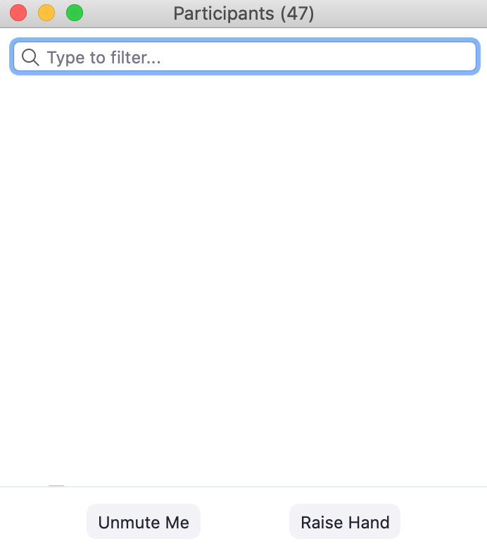
Participation
Raise Hand to Speak
Raise Hand to Speak
Respect Time Limit
4 minutes
1
Tap Screen
1
2
2
Dial In Controls
*6 mute/unmute
*9 raise hand
Mute Audio / Video
Mute Audio / Video
Tip
read aloud these instructions for dial-in members

Slide 10
Tip
Choose the Guideline Badges
That You’d Like To Share
This is a non-smoking / vaping meeting
No recording of this meeting in any way.
Please keep distractions
to a minimum.
We suggest that you turn off your video if you are eating, moving around, or browsing on your phone.
Respect Anonymity Private area or use headphones.

Slide 11
Tip
Readings
All basic readings are posted in this slideshow. You can choose what readings to include in your group and delete the slides you don’t want.
There is more literature (pamphlets, etc) available here:
https://na.org/?ID=ips-eng-index

Slide 12
Why Are We Here?
Who wants to read…

Slide 13
Why Are We Here?
Before coming to the Fellowship of NA, we could not manage our own lives. We could not live and enjoy life as other people do. We had to have something different and we thought we had found it in drugs. We placed their use ahead of the welfare of our families, our wives, husbands, and our children. We had to have drugs at all costs. We did many people great harm, but most of all we harmed ourselves. Through our inability to accept personal responsibilities we were actually creating our own problems. We seemed to be incapable of facing life on its own terms.
Most of us realized that in our addiction we were slowly committing suicide, but addiction is such a cunning enemy of life that we had lost the power to do anything about it. Many of us ended up in jail, or sought help through medicine, religion, and psychiatry. None of these methods was sufficient for us. Our disease always resurfaced or continued to progress until, in desperation, we sought help from each other in Narcotics Anonymous.
After coming to NA we realized we were sick people. We suffered from a disease from which there is no known cure. It can, however, be arrested at some point, and recovery is then possible.

Slide 14
Who is an Addict?
Who wants to read…

Slide 15
Who is an Addict?
Most of us do not have to think twice about this question. We know! Our whole life and thinking was centred in drugs in one form or another—the getting and using and finding ways and means to get more. We lived to use and used to live.
Very simply, an addict is a man or woman whose life is controlled by drugs. We are people in the grip of a continuing and progressive illness whose ends are always the same: jails, institutions, and death.

Slide 16
How It Works
Who wants to read…

Slide 17
How it Works
1/2
If you want what we have to offer, and are willing to make the effort to get it, then you are ready to take certain steps. These are the principles that made our recovery possible.
We admitted that we were powerless over our addiction, that our lives had become unmanageable.
We came to believe that a Power greater than ourselves could restore us to sanity.
We made a decision to turn our will and our lives over to the care of God as we understood Him.
We made a searching and fearless moral inventory of ourselves.
We admitted to God, to ourselves, and to another human being the exact nature of our wrongs.
We were entirely ready to have God remove all these defects of character.
We humbly asked Him to remove our shortcomings.

Slide 18
How it Works
2/2
We made a list of all persons we had harmed, and became willing to make amends to them all.
We made direct amends to such people wherever possible, except when to do so would injure them or others.
We continued to take personal inventory and when we were wrong promptly admitted it.
We sought through prayer and meditation to improve our conscious contact with God as we understood Him, praying only for knowledge of His will for us and the power to carry that out.
Having had a spiritual awakening as a result of these steps, we tried to carry this message to addicts, and to practice these principles in all our affairs.

Slide 19
The Twelve Traditions of NA
Who wants to read…

Slide 20
The Twelve Traditions of NA
1/4
The Twelve Traditions of NA We keep what we have only with vigilance, and just as freedom for the individual comes from the Twelve Steps, so freedom for the group springs from our Traditions. As long as the ties that bind us together are stronger than those that would tear us apart, all will be well.
1. Our common welfare should come first; personal recovery depends on NA unity.
2. For our group purpose there is but one ultimate authority— a loving God as He may express Himself in our group conscience. Our leaders are but trusted servants; they do not govern.
3. The only requirement for membership is a desire to stop using.
4. Each group should be autonomous except in matters affecting other groups or NA as a whole.
5. Each group has but one primary purpose—to carry the message to the addict who still suffers.
6. An NA group ought never endorse, finance, or lend the NA name to any related facility or outside enterprise, lest problems of money, property, or prestige divert us from our primary purpose.
7. Every NA group ought to be fully self-supporting, declining outside contributions.

Slide 21
The Twelve Traditions of NA
2/4
8. Narcotics Anonymous should remain forever nonprofessional, but our service centers may employ special workers.
9. NA, as such, ought never be organized, but we may create service boards or committees directly responsible to those they serve.
10. Narcotics Anonymous has no opinion on outside issues; hence the NA name ought never be drawn into public controversy.
11. Our public relations policy is based on attraction rather than promotion; we need always maintain personal anonymity at the level of press, radio, and films.
12. Anonymity is the spiritual foundation of all our Traditions, ever reminding us to place principles before personalities.

Slide 22
The Twelve Traditions of NA
3/4
Understanding these Traditions comes slowly over a period of time. We pick up information as we talk to members and visit various groups. It usually isn’t until we get involved with service that someone points out that “personal recovery depends on NA unity,” and that unity depends on how well we follow our Traditions. The Twelve Traditions of NA are not negotiable. They are the guidelines that keep our Fellowship alive and free.
By following these guidelines in our dealings with others, and society at large, we avoid many problems. That is not to say that our Traditions eliminate all problems. We still have to face difficulties as they arise: communication problems, differences of opinion, internal controversies, and troubles with individuals and groups outside the Fellowship. However, when we apply these principles, we avoid some of the pitfalls.

Slide 23
The Twelve Traditions of NA
4/4
Many of our problems are like those that our predecessors had to face. Their hard won experience gave birth to the Traditions, and our own experience has shown that these principles are just as valid today as they were when these Traditions were formulated. Our Traditions protect us from the internal and external forces that could destroy us. They are truly the ties that bind us together. It is only through understanding and application that they work.

Slide 24
What is the Narcotics Anonymous Program?
Who wants to read…

Slide 25
What is the Narcotics Anonymous Program?
NA is a nonprofit fellowship or society of men and women for whom drugs had become a major problem. We are recovering addicts who meet regularly to help each other stay clean. This is a program of complete abstinence from all drugs. There is only one requirement for membership, the desire to stop using. We suggest that you keep an open mind and give yourself a break. Our program is a set of principles written so simply that we can follow them in our daily lives. The most important thing about them is that they work.
There are no strings attached to NA. We are not affiliated with any other organizations. We have no initiation fees or dues, no pledges to sign, no promises to make to anyone. We are not connected with any political, religious, or law enforcement groups, and are under no surveillance at any time. Anyone may join us regardless of age, race, sexual identity, creed, religion, or lack of religion.
We are not interested in what or how much you used or who your connections were, what you have done in the past, how much or how little you have, but only in what you want to do about your problem and how we can help. The newcomer is the most important person at any meeting, because we can only keep what we have by giving it away. We have learned from our group experience that those who keep coming to our meetings regularly stay clean.

Slide 26
We Do Recover
Who wants to read…

Slide 27
We Do Recover
When at the end of the road we find that we can no longer function as a human being, either with or without drugs, we all face the same dilemma. What is there left to do? There seems to be this alternative: either go on as best we can to the bitter ends—jails, institutions or death—or find a new way to live. In years gone by, very few addicts ever had this last choice. Those who are addicted today are more fortunate. For the first time in man’s entire history, a simple way has been proving itself in the lives of many addicts. It is available to us all. This is a simple spiritual—not religious—program, known as Narcotics Anonymous.

Slide 28
Just for Today
Who wants to read…

Slide 29
Just for Today
Tell yourself:
JUST FOR TODAY my thoughts will be on my recovery, living and enjoying life without the use of drugs.
JUST FOR TODAY I will have faith in someone in NA who believes in me and wants to help me in my recovery.
JUST FOR TODAY I will have a program. I will try to follow it to the best of my ability.
JUST FOR TODAY, through NA, I will try to get a better perspective on my life.
JUST FOR TODAY I will be unafraid. My thoughts will be on my new associations, people who are not using and who have found a new way of life. So long as I follow that way, I have nothing to fear.

Slide 30
Tip
Keytags
Welcoming Newcomers
Have a designated group member for newcomers to contact
Make them co-hosts so they can receive private chats
Some groups will stay after the meeting specifically for newcomers
Key Tag Tips
You can choose to go through each key tag or just use the main keytag page
You can choose to have people message the group to indicate they want a keytag in chat, or raise their hand

Slide 31
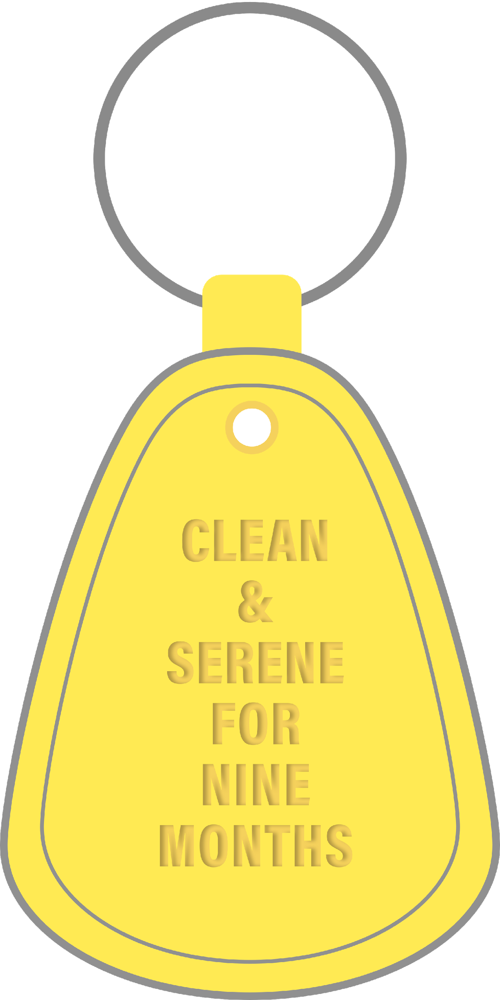
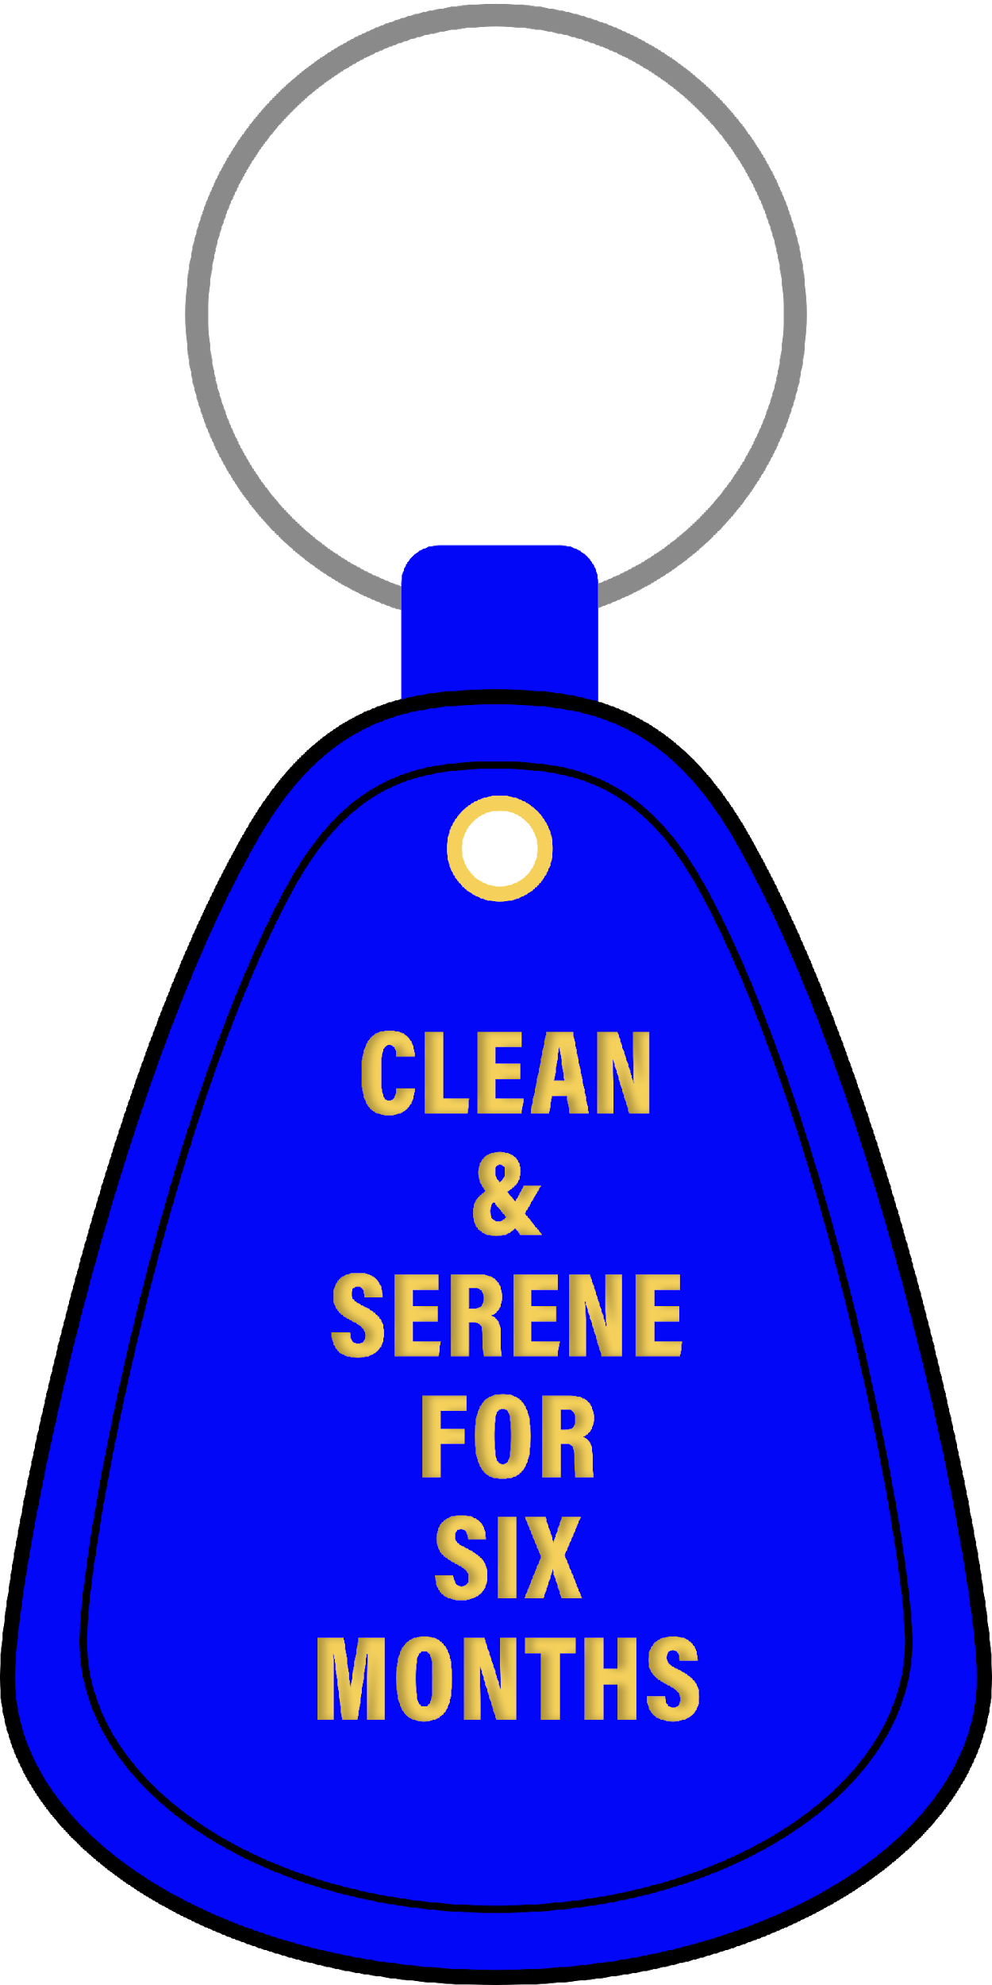
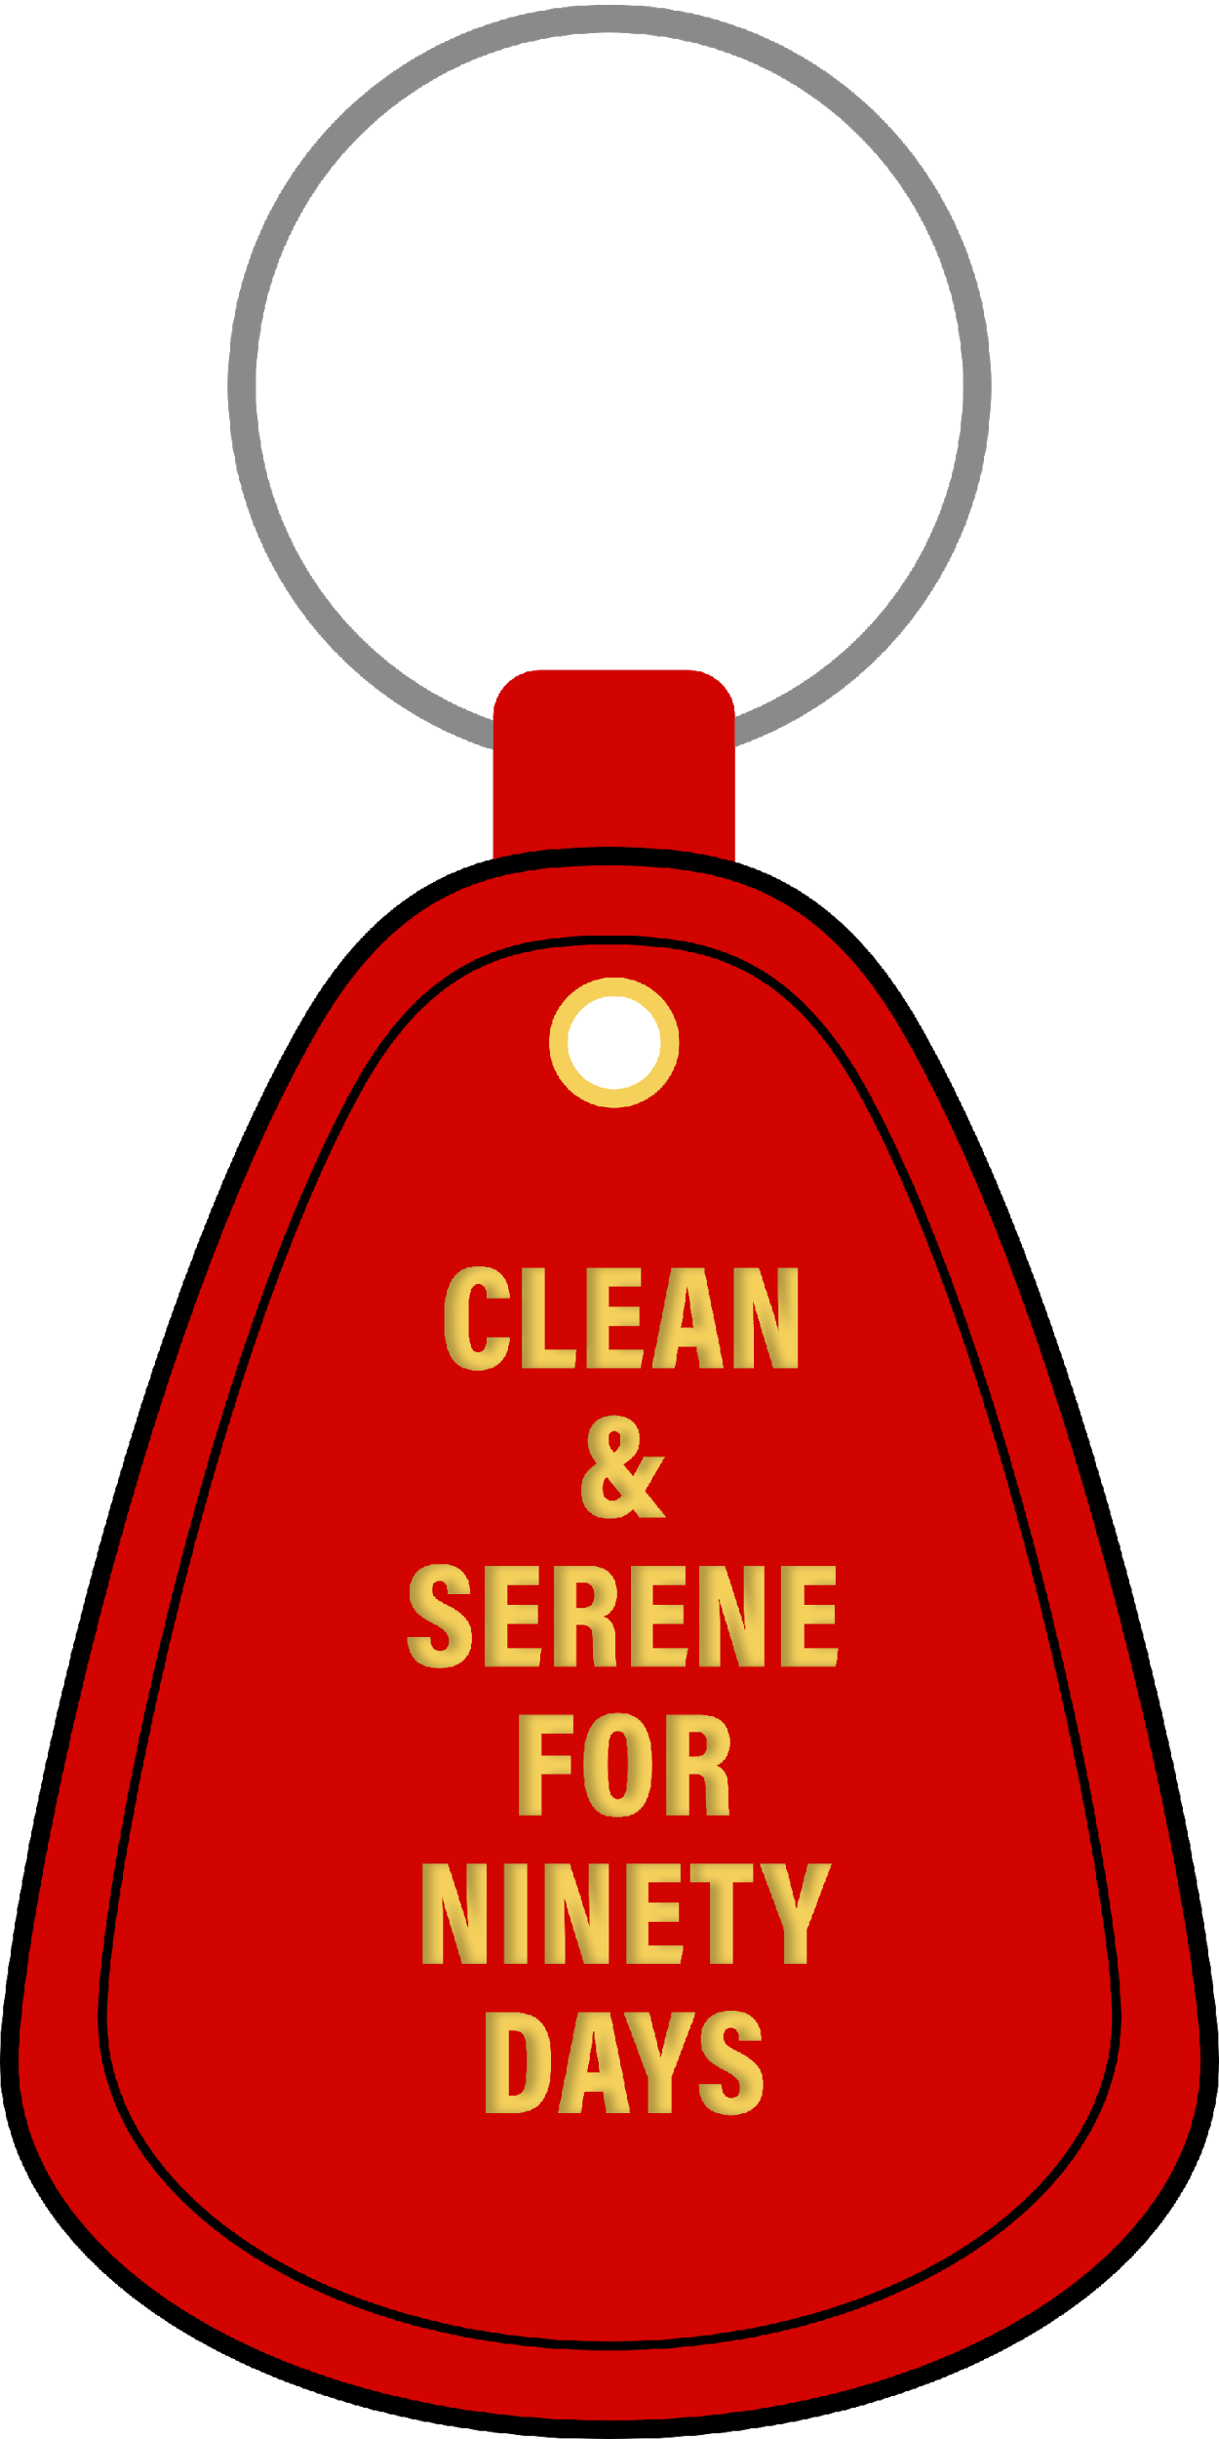
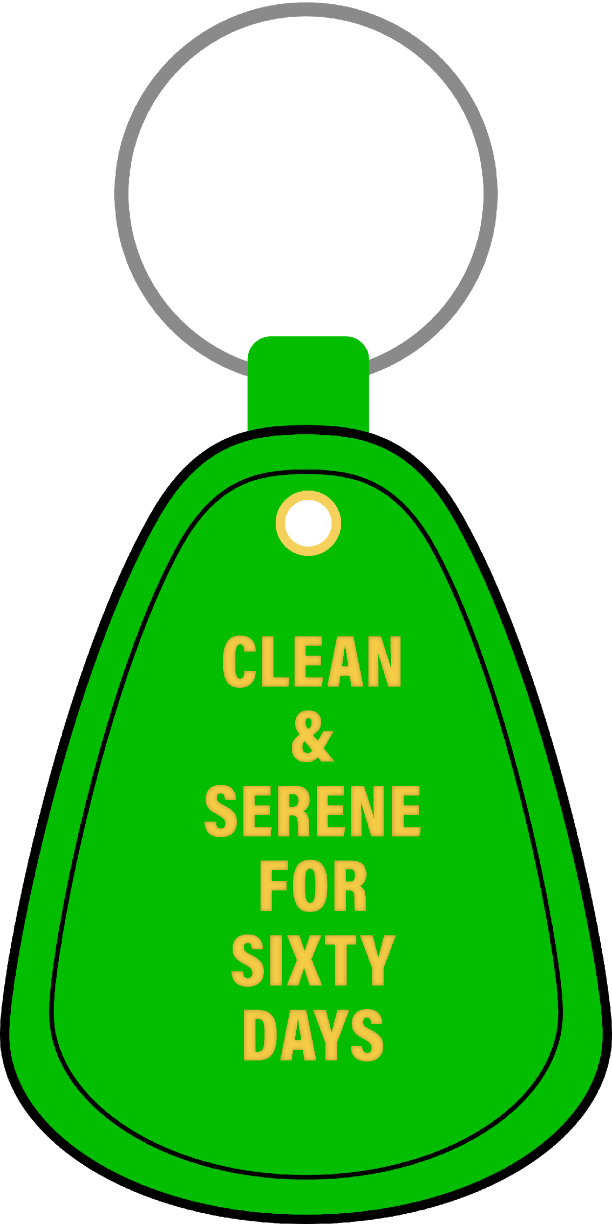
Key Tags
Who wants to hand out…

Slide 32
Any Newcomers?
24 hours
Coming Back
Here for First Time
Desire to Stop Using

Slide 33
Thirty Days

Slide 34
Sixty Days

Slide 35
Ninety Days

Slide 36
Six Months

Slide 37
Nine Months

Slide 38
One Year

Slide 39
Eighteen Months

Slide 40
Multiple Years

Slide 41
One more time for…
24 hours
Coming Back
Here for First Time
Desire to Stop Using

Slide 42
Give Your Higher Power a Round of Applause!

Slide 43
Tip
Gathering a 7th Tradition
At this time, more than any, it is vital that we continue to practice the 7th tradition to be self-supporting of our services.
In the meantime, groups and members are encouraged to post the link to make direct contributions to NA WOrld Services on a slide and their their chat during the meeting
https://www.na.org/?ID=contribute-now

Slide 44
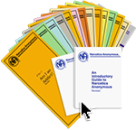
NA Literature
Available Online:
All pamphlets
Booklets
Readings
Audio version of Basic Text
https://na.org/?ID=literature

Slide 45
Announcements
Raise Hand to Speak
Raise Hand to Speak
1
Tap Screen
1
2
2

Slide 46
Just for Today Meditation
Who wants to read…
Just for Today here: https://jftna.org/jft/
More literature here: https://na.org/?ID=ips-eng-index

Slide 47
“The Full Message”
March 18
"There is a special feeling for addicts when they discover that there are other people who share their difficulties, past and present."
Basic Text, pp. 55-56
The wealth of our recovery is too good to keep to ourselves. Some of us believe that when we talk in meetings, we should "remember the newcomer" and always try to carry a positive message. But sometimes the most positive message we can carry is that we are going through difficult times in our recovery and are staying clean in spite of them!
Yes, it's gratifying to send out a strong message of hope to our newer members. After all, no one likes a whiner. But distressing things happen, and life on life's terms can send shock waves even through the recovery of long-time members of Narcotics Anonymous. If we are equipped with the tools of the program, we can walk through such turmoil and stay clean to tell the tale.
Recovery doesn't happen all at once; it is an ongoing process, sometimes a struggle. When we dilute the fullness of our message by neglecting to share about the tough times we may walk through on our journey, we fail to allow newcomers the chance to see that they, too, can stay clean, no matter what. If we share the full message of our recovery, we may not know who benefits, but we can be sure someone will.
Just for Today: I will honestly share both the good times and the difficult times of my recovery. I will remember that my experience in walking through adversity may benefit another member.

Slide 48
Sharing Portion
Raise Hand to Speak
Please activate video if you’re comfortable
Chairperson may mute your audio during someone’s share
1
1
Tap Screen
Respect Time Limit
*this can be modified based on group size*
4 minutes
2
2

Slide 49
Jessica E
Tip
use this slide for speaker meetings
Please Welcome our Speaker!

Slide 50
Let’s Circle Up!
Many of us have said…
Take my will and my life, show me how to live, CLEAN!
Keep coming back...it works if you work it so work it you’re worth it!

Slide 51
End of Meeting
more digital meetings:
https://virtual-na.org/

Slide 52
Please email questions to:
PR@TORONTONA.ORG
Please email meeting list changes to:
MEETINGLIST@TORONTONA.ORG

