Slide 1
Costa Rica

Slide 2
Group Support Forums (GSFs)
2010 – first GSFs created in Costa Rica
7 GSFs at first – now there are 4
GSFs are informal bodies that focus on group needs
Groups that participate in the GSF are strong and well run

Slide 3
Group Support Forums (GSFs)
GSFs hold regular workshops
Workshops are organized by the projects chair, who is a member of the local service committee (LSC)
Topics include:
Festivals on the Steps, Traditions, and Concepts
Sponsorship
Treasurers
Secretaries

Slide 4
Local Service Conference (LSC)
LSC serves the whole of Costa Rica
The executive committee (EC) works with the LSC to provide services including:
GSF workshops
Regional service office
Fundraising
Regional convention

Slide 5
Communication Challenges
GSFs don’t send a delegate to the LSC
LSC trusted servants don’t attend the GSFs
Regional assemblies are the only time groups and LSCs communicate
Communication is one-way – from LSC/EC to groups

Slide 6
Other Challenges
The LSC is focused mainly on the convention and fundraising to keep the RSO open
CBDM has been unsuccessful
Difficultly in obtaining the right trusted servants

Slide 7
HOW Brazil

Slide 8
Group Support Forums (GSFs)
2012 – first GSF created in HOW Region
First GSFs formed after consensus at ASC – problems included:
Geographic distance
Lack of trusted servants
Lack of communication
Poor service atmosphere
4 more GSFs formed in another ASC after studying the SSP material

Slide 9
Group Support Forums (GSFs)
6 GSFs currently
GSFs usually meet every month – 15 before the ASC and 15 days after
Issues are discussed before the ASC and solutions are brought to the GSF after the ASC meeting
Most ASCs meet every 60 days

Slide 10
Group Support Forums (GSFs)
GSFs are informal meetings focused on supporting groups, including:
Strong personalities
Improving the 7th Tradition
Help with PR efforts
Training new members
How to serve the fellowship on the group level

Slide 11
Challenges and Successes
Challenges:
Resistance to change from old-timers
Effective communication because of having a single GSF delegate to the ASC
Successes:
More unity amongst groups
Attracting more trusted servants
Support for new groups
Saving money

Slide 12
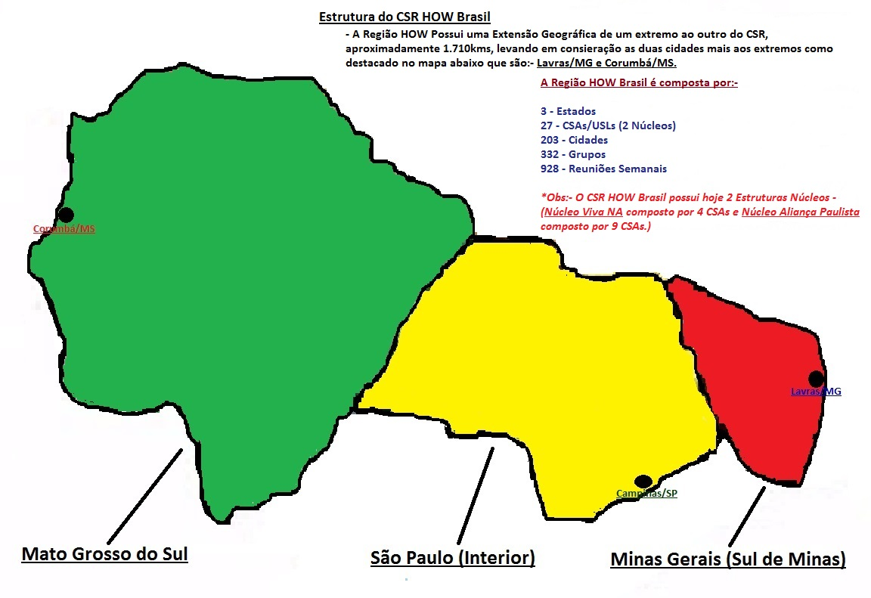

Slide 13
Intermediate Bodies – “Nucleos”
Different from regional nucleos
Most don’t provide services
Trusted servants – Chair, vice-chair, treasurer
2 delegates to region
Geographic distance main reason for forming nucleos

Slide 14
Intermediate Bodies – “Nucleos”
Successes include:
Helps with communication and sharing experience between the ASCs and the region
Allows ASCS to support each other and provide services together
Saves money – 1 delegate instead of 7
Problems are solved at nucleo that previously came to the region

