Slide 1
Leadership Identification and the RBZ process

Slide 2
As stated in GWSNA,
The HRP’s purpose is “to identify NA members whose skills, talents, and experience support their ability to be most qualified as NA world service trusted servants.”

Slide 3
Nominations & RBZ Process
HRP receives RBZ* recommendations
From *Regions, World Board, and Zones
RBZ = Region, Board, Zone
HRP evaluates
all candidates
All candidates move to the next phase
HRP interviews all candidates
All HRP members observe each interview
HRP meets to decide the ballot
The most qualified are identified for nomination
HRP offers nominees to the WSC

Slide 5
As our Fourth Concept reminds us…
Effective leadership is highly valued in Narcotics Anonymous. Leadership qualities should be carefully considered when selecting trusted servants.

Slide 6
Word Cloud Question
What qualities are most important for effective leadership in NA?

Slide 7
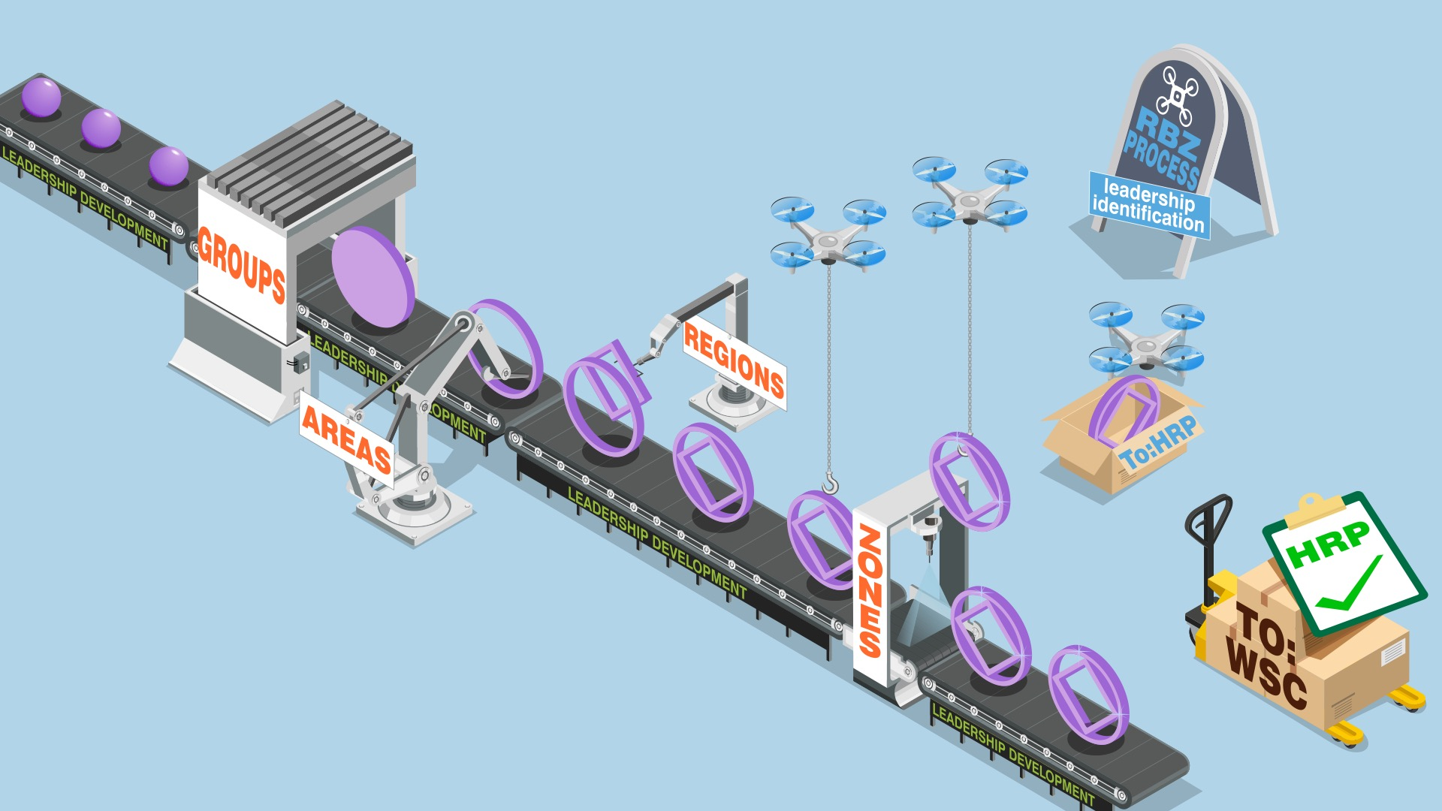

Slide 8
The service pamphlet, Principles and Leadership in NA Service offers this
The qualities of an effective leader are based both on the principles of our program and on the tasks relevant to the specific service position.

Slide 9
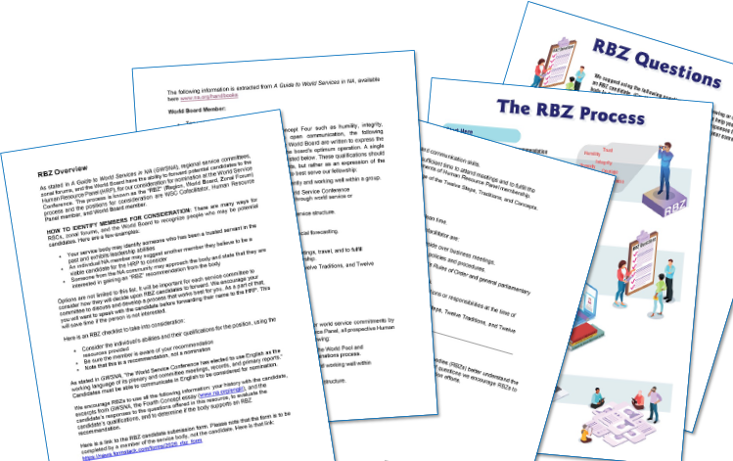
Resources to support local efforts
Can be found at www.na.org/conference

Slide 10
What steps can our service body take to seek out members with leadership qualities to forward as an RBZ recommendation?
Have a process for considering RBZs?
Please send it to hrp@na.org

Slide 11
More resources
www.na.org/ips
www.na.org/sps

Slide 12
What can I do?
Host workshops like this one
Use the RBZ process documents
Develop and share your own RBZ process
Identify leaders in your community

Slide 13
HRP Timeline
1 October 2024
30 September 2025
November 2025
March 2026
WSC 2026
October 1, 2024, we will begin to collect RBZ recommendations. The deadline for submissions is September 30, 2025.
In November of 2025, the HRP begins our evaluations
In March of 2026, we will determine our nominations and forward the ballot to conference participants
Elections will take place at WSC 2026 (3-9 May 2026)

Slide 14
Thank YOU!
Questions or comments?
Email: hrp@na.org

