Slide 1


Introducing…
  the 2018 Conference Approval Track (or CAT)
Following is a summary of 2018 CAT material.
For more, see: www.na.org/conference
Notes:
This presentation only summarizes CAT material.
Please read the complete CAT for comprehensive information and reports: www.na.org/conference.

Slide 2

CAT Contents
2018-2020 Strategic Plan & Proposed Project Plans
2018-2020 Proposed Budget & Budget Explanation
2018-2020 Proposed Reimbursement Policy
Proposed Rules & Tools for WSC Decision Making
WSC 2018 Seating Report
Proposals for Service Tools Approval Process
Addendum: NAWS Environmental Scan—Regional Input
Notes:
The cover memo in the CAT gives a good overview of the contents. Here is a list of what you will find in the CAT.

Slide 3



The CAT and the Conference
CAT material is considered New Business at the World Service Conference (WSC).
Exception: “Proposed Rules & Tools related to WSC Decision Making” will first be presented in a motion at the start of Old Business.

Slide 4


  Also mailed with CAT Materials…
Regional ideas for WSC consideration
Human Resource Panel update
Delegates Sharing Newsletter
Visit www.na.org/conference to access these materials, the CAT, and more

Slide 5
Proposed Process for
Approving Service Materials

Slide 6



Context & Recent History
Service Material Project 2016-2018
www.na.org/toolbox | www.na.org/conventions
Online projects open to all. First two draft tools:
“Consensus-Based Decision Making (CDBM) Basics” | “The Program Committee & Developing the Program”
Drafts were mailed to Conference participants & posted online for a 90-day review. After delegate review and before WSC 2018, approval drafts will be posted.

Slide 7

But now what?
  WSC 2016 did not identify an approval process for materials developed by these projects
  The World Board will offer the following proposal at WSC:
All service materials produced by the Local Service Toolbox Project and the Conventions and Events Project will be identified as World Board-approved material, and follow the same approval process as service pamphlets. That means after the World Board signs off on them, drafts will be distributed to Conference participants for a 90-day review before being identified as approved.

Slide 8
2018-2020 Strategic Plan and Proposed Projects

Slide 9
Some Highlights of the Strategic Plan & Project Plans
  Regional input to the environmental scan helped shape the 17 approaches.
  Four project plans build on work from 2016-2018.
  Continued opportunities to collaborate and work economically
    Mix of virtual and face-to-face meetings
    Use of focus groups
    Virtual discussions via email, web meetings, etc.
  Continued use of Fellowship surveys and discussions
  Proposal: Zones select members for the “Future” workgroup
Notes:
Same simpler format as last cycle. May serve as a model for other service bodies. Project plans explain the scope of the work
We usually propose more projects than we expect to be able to complete in the cycle
Last cycle we used CAR Survey results to determine focus of some projects
Most 2018-2020 projects represent continuing work
2018 CAR Survey will help set goals for future work (2020-2022)

Slide 10

WSC of the Future Project
OBJECTIVE 1: Continue work toward a sustainable, effective WSC
Continuing approaches from 2016-2018
  Further discussion, frame viable options for seating
  Refine decision-making processes, discussion protocols, consensus-building strategies, and use of time during WSC meetings
  Improve effectiveness of time between WSCs: working on processes to forward issues and discuss ideas
  New ideas
  Create a workgroup with members selected by willing zonal forums
  Create a common understanding of “effective” and “sustainable”
  Strengthen collaboration among zonal forums and between
  NAWS and zonal forums.
  Collect and share best practices of zonal forums.

Slide 11

New Daily Meditation Book Project
OBJECTIVE 2: Maximize communication vehicles and craft content that will better connect members to NA as a whole.
Begin work on a new daily meditation book
  Implement ideas supported in 2017 survey:
      Address a spiritual principle each day, repeating as necessary
      Format like Just for Today: quotation, elaboration, reflection
      Draw from Living Clean and other literature for the quotations
      Reflect the voices and experiences of our members.
  9-member workgroup meeting face-to-face 3 times in the 2018-2020 cycle
  Fellowship engagement in drafting material
  Material released in 3-4 batches for Fellowship review and input
  Project ends in November 2021 when an approval draft is published in the 2022 CAR
Notes:
One of two project plans to develop recovery literature

Slide 12

Mental Health / Illness IP Project
OBJECTIVE 3: Improve communication to underserved populations, including development and distribution of targeted literature.
Create an approval draft of the mental health/ mental illness informational pamphlet.
  Framework suggested by the 2017 survey, which provided front-end input
  Will gather additional input from members and hold focus groups of members with direct experience on this topic
  Workgroup of 7-8 members from June 2018-September 2019 with at least two face-to-face meetings
  Aim to solicit Fellowship review and input of a draft in Spring of 2019
  Publish an approval draft for Conference consideration in the 2020 CAR

Slide 13

Training and Tools Project
OBJECTIVE 4: Continue to develop easy-to-use, relevant training and tools.
OBJECTIVE 5: Increase the responsiveness of the tool-development process.
Continue development of items for local service toolbox & conventions and events toolbox
Priorities will continue to be chosen by survey and input
No formal workgroup; any interested members can join web meetings and/or email input.
Clarify approval process for materials created

Slide 14
Proposed Budget for 2018-2020

Slide 15


Proposed Budget for 2018-2020
Forecast of income & expenditures
  Based on experience; previous cycle’s figures (budget & actual) appear next to what’s proposed for the upcoming cycle.
  Reflects our collective decision to use proceeds from literature sales to fund NA service worldwide
Suggestion:
Read “Understanding the Proposed Budget” for explanation of what’s represented in the spreadsheets

Slide 16
Proposed Budget for 2018-2020
There is an anticipated net loss in the second year of the budget and for the overall cycle.
  This is why we have worked so hard to build our reserves.
  We had budgeted for a net loss in the 2016–2018 cycle as well, and, largely due to Guiding Principles, we expect to have net income for this cycle. Unfortunately, that extra income is not expected to continue for the upcoming cycle.

Slide 17
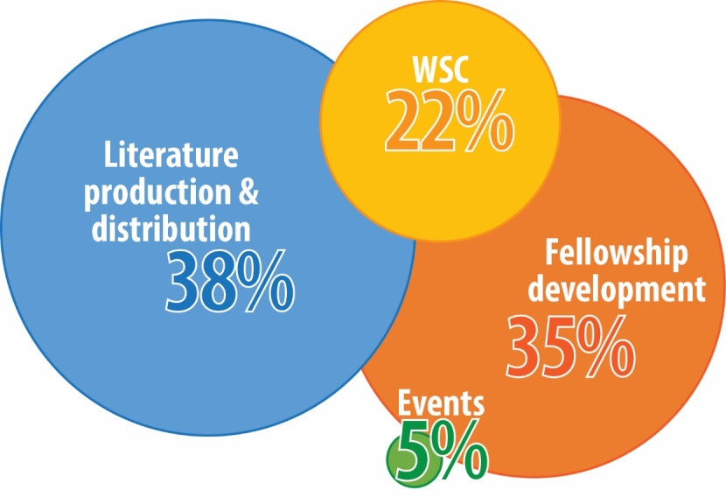
Four activity categories
Proposed expenses—percentages indicate the proportion of operational costs assigned to each area
See page 30 of the 2018 CAT for a snapshot of what’s included in each activity area.

Slide 18


Three kinds of expenses
  Fixed Operational Costs: Expenses that are ongoing, repeated, or regular
  Variable Operations: Project expenses
  Reserve: An operational fund set aside for the unexpected

Slide 19
Other financial notes
The budget projects an increase of 2% per year for personnel, overhead, and technology
2018-2020 reimbursement policy: The CAT includes a proposed increase to the allowance for meal and incidental expenses from $55 to $60/day (see page 41)

Slide 20
Proposed Rules and Tools for WSC Decision Making

Slide 21

Proposed Rules and Tools
Objective 4: Continue to work to make the WSC a more effective resource to help achieve the Vision for NA Service.
Strategy B: Improve the effectiveness of the WSC meeting by continuing to refine decision-making processes, discussion protocols, consensus-building strategies, and use of time during the week.
Part of the ongoing evolution of WSC practices
  More effective use of time at and between Conferences
  More discussion and consensus-based processes
Ideas addressed in 2 reports and discussed in webinars this cycle
With the consent of the WSC at the start of Old Business, WSC 2018 will test new approaches to our decision-making threshold and to Old Business, CAT Business, and New Business

Slide 22

A Snapshot of Proposed Changes
Two-thirds majority needed to pass all motions and proposals
New approaches to Old Business
  Merge discussion & decision-making into “CAR Discussion & Decisions” session eliminating “Formal Old Business”
  When an initial straw poll reflects consensus (80%), CPs may opt to discuss and decide on the motion as written
Break New Business into 2 categories w/different processes
  CAT Material Discussion & Decisions
  New business proposals submitted at the WSC
Notes:
All decisions at WSC 2018, excluding WSC elections, but including changes to motions or proposals and requests for a roll call vote or other procedural decisions, require a two‐thirds majority of those present and voting to vote in the affirmative to be adopted.

Slide 23


CAT Material Discussion & Decisions
Session addresses the following CAT material
  Budget
  Project plans
  Seating requests
  World Board proposals in the CAT
  Proposals to change any of these
  Handle CAT material like CAR business:
  Eliminate the formal business session
  Discussions and decisions in one session
  When an initial straw poll reflects consensus, CPs may opt to discuss and decide on the motion as written

Slide 24

New proposals submitted at the WSC
  Since there is never enough time at the WSC, we are proposing a new process to help the WSC to choose where it spends its discussion time

Slide 25
New proposals submitted at the WSC
  Proposals will be compiled & topics grouped for survey distributed Wednesday night & due by Thursday noon
  Survey will determine priorities
  Small groups will discuss high-interest items; others will be included in an appendix to the minutes
  A whole-group wrap up will determine next steps
  Decisions, where needed, will take place on Saturday

Slide 26
2018 Seating Report

Slide 27
WSC Seating Requests & WB Recommendations
We received 10 complete seating applications before the deadline
A workgroup of three RDs and one WB member evaluated each in the light of the seating criteria
Workgroup’s recommendation: Seat just one of the applicants

Slide 28
World Board seating recommendations
  The Board discussed two additional regions at length and is recommending three regions for seating:
      Netherlands
      Mexico-Occidente
      Ukraine

Slide 29
Seating and its Challenges
Continuing challenge to respond to regions that apply for seating while also considering how to safeguard the sustainability and effectiveness of the WSC
Full report starting on page 51 of the CAT includes
  Summary of background and recent decisions related to seating
  World Board and workgroup’s thoughts on applications
  Criteria for Recognition of New Conference Participants from GWSNA
  Seating requests from each region and background information about Brazil

Slide 30
Regional Ideas Submitted for Conference Participants’ Consideration

Slide 31

Background and Purpose
Regions were invited to submit ideas they’d like distributed with the CAT
Allows Conference participants to consider ideas before the WSC
WSC action would require submission of a New Business Proposal
Another opportunity for pre-Conference idea circulation:
  Regions may submit ideas by 15 February 2018 to be published with Conference Report
Notes:
Second time World Board has opened the CAT mailing to regions that want to submit ideas

Slide 32

Regional Ideas Circulating with the CAT
  Develop a plan for a PR pamphlet directed to health professionals (Argentina Region)
  Discussion/Planning of WSC agenda (Mountaineer Region)
  Three-year Conference cycle (Mountaineer Region)
  Extend the timing for the release of the CAR (Brazil, HOW Brazil, and Rio de Janeiro Regions)
  Proposed discussion: “Where we are going with the Service System Project?” (Venezuela Region)
  Proposed discussion: “How do we to involve more members in WSC & NAWS issues and affairs?” (Venezuela Region)

Slide 33


For further reading & additional prep for 2018 WSC
Visit www.na.org/conference for everything WSC!
  Conference Agenda Report (CAR)
  Conference Approval Track (CAT) Materials
  Important Dates & Deadlines
Mark your calendars
  15 February 2018
      Regional reports deadline
      Last call to get regional ideas published with the Conference Report
  15 March 2018
      CAR survey deadline
      WSC travel deadline
Questions, Comments, Ideas:
worldboard@na.org

