Slide 1

This is the seventh of seven PowerPoints covering material
in the 2023
Conference Agenda Report
Human Resource Panel Report
Notes:
This is the seventh of seven PowerPoints covering material in the 2023 Conference Agenda Report (or CAR for short).

Slide 2
2023 CAR
PowerPoints
1. Introduction to CAR : Creating Our Future,
Fellowship Intellectual Property Trust (Motions 1–3)
2. Virtual meetings (Motion 4), Vision for NA Service (Motion 5), Basic Text (Motion 6),
WB terms (Motion 7), WCNA (Motion 8)
3. Future of the WSC (Motions 9–12)
4. CAR Survey
5. Regional Motions 13–18
Regional Motions 19–25
Human Resource Panel Report
Notes:
This PowerPoint will review the material covered in the Human Resources Panel report, beginning on pg. 43 of the CAR.

Slide 3

2023 CAR
PowerPoints
These PowerPoints only cover the main points of the CAR.
We encourage all members to read the CAR itself.
Please visit www.na.org/conference
for the complete 2023 CAR.
Notes:
These PowerPoints cover only the main points of the CAR. We encourage all members to read the CAR itself for more information, Please visit www.na.org/conference for the complete 2023 CAR, the other CAR PowerPoints, videos, and other Conference materials.

Slide 4
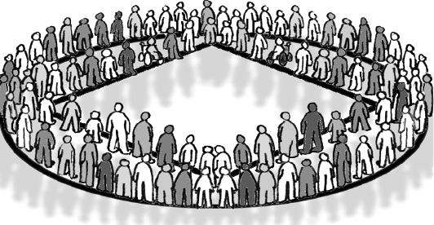
HRP Overview
Four NA members elected at the WSC
Charged with identifying NA members for possible nomination and election at the WSC
World Board
Human Resource Panel
WSC Cofacilitators
Formed in 1998 as a result of WSC inventory and reflection
Notes:
For those who may not be aware, the Human Resource Panel is a panel of four NA members elected at the World Service Conference (WSC). Our charge is to identify other NA members best suited for nomination and potential election at the WSC for the World Board, HRP, and WSC Cofacilitator positions. The Human Resource Panel was formed in 1998 as a result of the multiyear WSC inventory and transition process. At that time, it was determined that the WSC would benefit from an independent panel to evaluate potential trusted servants.

Slide 5

World Pool
A database that retains information on NA members interested in World Service
Created with the HRP as two components of a new approach to identifying candidates
Notes:
As a part of that WSC determination, the World Pool, a database that retains information on NA members interested in being of service at the world level, was created. The HRP and the World Pool are two components of a system that was intended to provide a new approach to identifying and selecting trusted servants. As we moved forward from 1998, conference participants saw a need for service bodies to be able to offer candidates for consideration directly to the HRP and separate from the HRP’s initial screening. In 2006, the WSC adopted a process for just that.

Slide 6
World Pool Members
Regions, Zones,
and World Board
With 8 years clean &
interest in serving
gain an RBZ
Identify potential candidates and forward them as RBZs
RBZ Candidates
All RBZs are evaluated by the HRP
Evaluations based on written responses (CPR) and HRP interviews
RBZ Process
The most qualified candidates are identified for nomination
HRP Nominees
to the WSC
Notes:
The RBZ process, as it has come to be called, provides NA regions, the World Board, and zonal forums the ability to recommend members who they think would make viable candidates for nomination at the WSC. RBZ recommendations provide a point of reference, typically based on the service body’s direct experience with the candidate, for the HRP to consider when identifying nominees for election at the World Service Conference. So, the RBZ process became another opportunity for nomination at the WSC. These RBZs, along with members from the World Pool, are evaluated by the HRP each cycle. In addition, in a carryover from the old system before 1998, members of the WSC can offer a nomination from the floor of the WSC, separate from the HRP’s evaluation. These are the avenues for nomination at the WSC.

Slide 7

RBZ Data
Since the start of the RBZ process in 2006, the WSC has elected :
43 World Board members
41 had at least one RBZ recommendation
Altogether, 74 WSC trusted servants (WB, HRP, Cofacs) have been elected since 2006, and 54 had an RBZ recommendation.
Since 1998, only one nomination that came from the floor of the WSC was elected.
Notes:
Since the start of the RBZ process in 2006, the WSC has elected 43 World Board members. Forty-one (95.5 percent) have had at least one RBZ recommendation. Most RBZ recommendations are for World Board positions, but RBZs are also submitted for HRP and Cofacilitators. Altogether, 74 WSC trusted servants have been elected since 2006, and 54 (73 percent) have had an RBZ recommendation. The other 20 (27 percent) did not. And since the start of the RBZ process, those 20 represent 0.36 percent, or just over one-third of 1 percent, of the 5,500 members in the World Pool. Finally, since 1998, only one nomination from the floor, back in 2002, has resulted in a WSC election. This historical data from WSC elections indicates to us that voting participants have the greatest confidence in nominees with an RBZ recommendation. We have stopped asking for candidate references, and instead use the RBZ recommendation, since it is, in fact, a committee reference. Simply put, the RBZ process is the most effective means to identify the most qualified candidates for election at the WSC.

Slide 8
Unify the process
Asking all 2023 candidates to acquire an RBZ recommendation
Intend to ask the WSC to change policy to require that all candidates go through the RBZ process moving forward
Notes:
Based on all of this, and for the first time, we have asked all members who wish to be considered for nomination at WSC 2023 to acquire an RBZ recommendation. With this experience and information as a foundation, we believe we will be ready to suggest a few changes to the process for decision at WSC 2023. Once the elections process is completed, we intend to ask the WSC to change policy to require that all candidates go through the RBZ process moving forward. With that, the World Pool would no longer be needed to collect information on members willing to be of service at the world level. We would repurpose
the database to collect information on RBZ candidates each conference cycle. A WSC decision to rely on regions, the board, and zones to forward candidates (RBZs) would also retire the process that provides for nominations from the floor of the WSC.

Slide 9

World Pool
Originally purposed to identify trusted servants
Direct communications have been the most successful method
The HRP is not responsible for
creating workgroups
Notes:
One point of common confusion related to this discussion is the purpose and use of the World Pool. At the onset, the hope was that the World Pool would become a resource for the World Board and the World Service Conference to identify trusted servants not only for nomination, but also for workgroups and focus groups. That has not proved to be the case. For many cycles now, the most productive path has been for the World Board to announce workgroup opportunities in direct communications to conference participants and to all members via NAWS News or NAWS Update emails. It has never been the responsibility of the HRP to select workgroup members. The changes we are suggesting will not affect the process of selecting workgroup members.

Slide 10

Take it all in
Not asking for any decisions
We’ll complete the cycle using the approach offered above
Then ask the 2023 WSC to affirm the changes
Notes:
That was probably a lot to absorb, and the CAR is filled with other very important information. We are not asking for any decisions now, and there are no motions to consider here. As has become the process for a change of policy at the WSC, we will complete this cycle using the approach offered above, and if all goes smoothly, we will ask participants to affirm these changes at WSC 2023. Thanks to all.

Slide 11
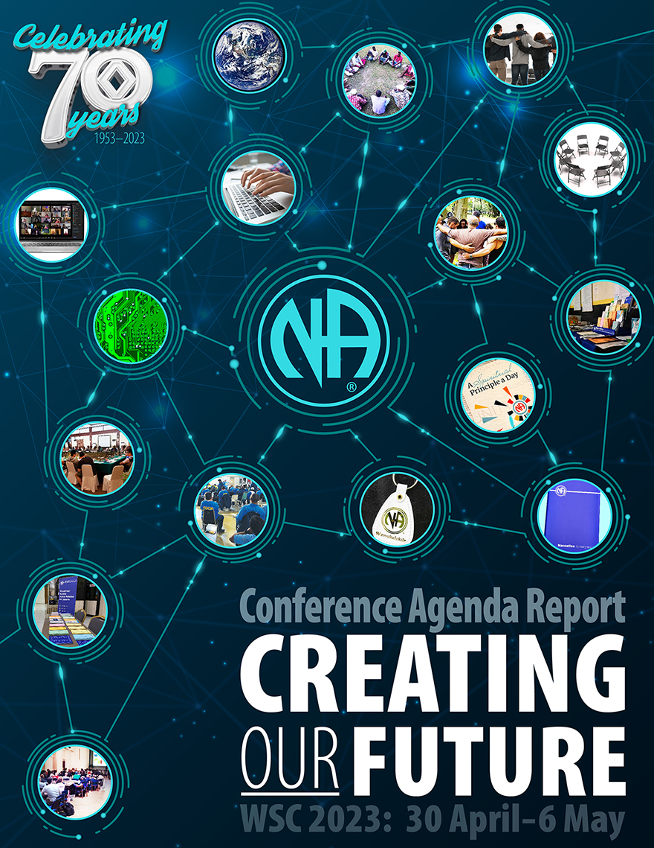
Six other PowerPoints available online
CAR survey also available online
CAR available for download
      worldboard@na.org
      www.na.org/conference
Notes:
We hope this PowerPoint has helped in your discussion of this material. Please note that there are other PowerPoints that focus on other CAR contents. These resources, the Conference Agenda Report, and the CAR survey are available online at www.na.org/conference.
We welcome your questions and your feedback on the CAR, and all other issues at worldboard@na.org.

