Slide 1

This is the fourth of seven PowerPoints covering material
in the 2023
Conference Agenda Report
CAR Survey
Notes:
This is the fourth of seven PowerPoints covering material in the 2023 Conference Agenda Report (or CAR for short).

Slide 2
2023 CAR
PowerPoints
1. Introduction to CAR : Creating Our Future,
Fellowship Intellectual Property Trust (Motions 1–3)
2. Virtual meetings (Motion 4), Vision for NA Service (Motion 5), Basic Text (Motion 6),
WB terms (Motion 7), WCNA (Motion 8)
3. Future of the WSC (Motions 9–12)
4. CAR Survey
5. Regional Motions 13–18
Regional Motions 19–25
Human Resource Panel Report
Notes:
This PowerPoint covers the Literature, Service Material, and Issue Discussion Topic survey.

Slide 3
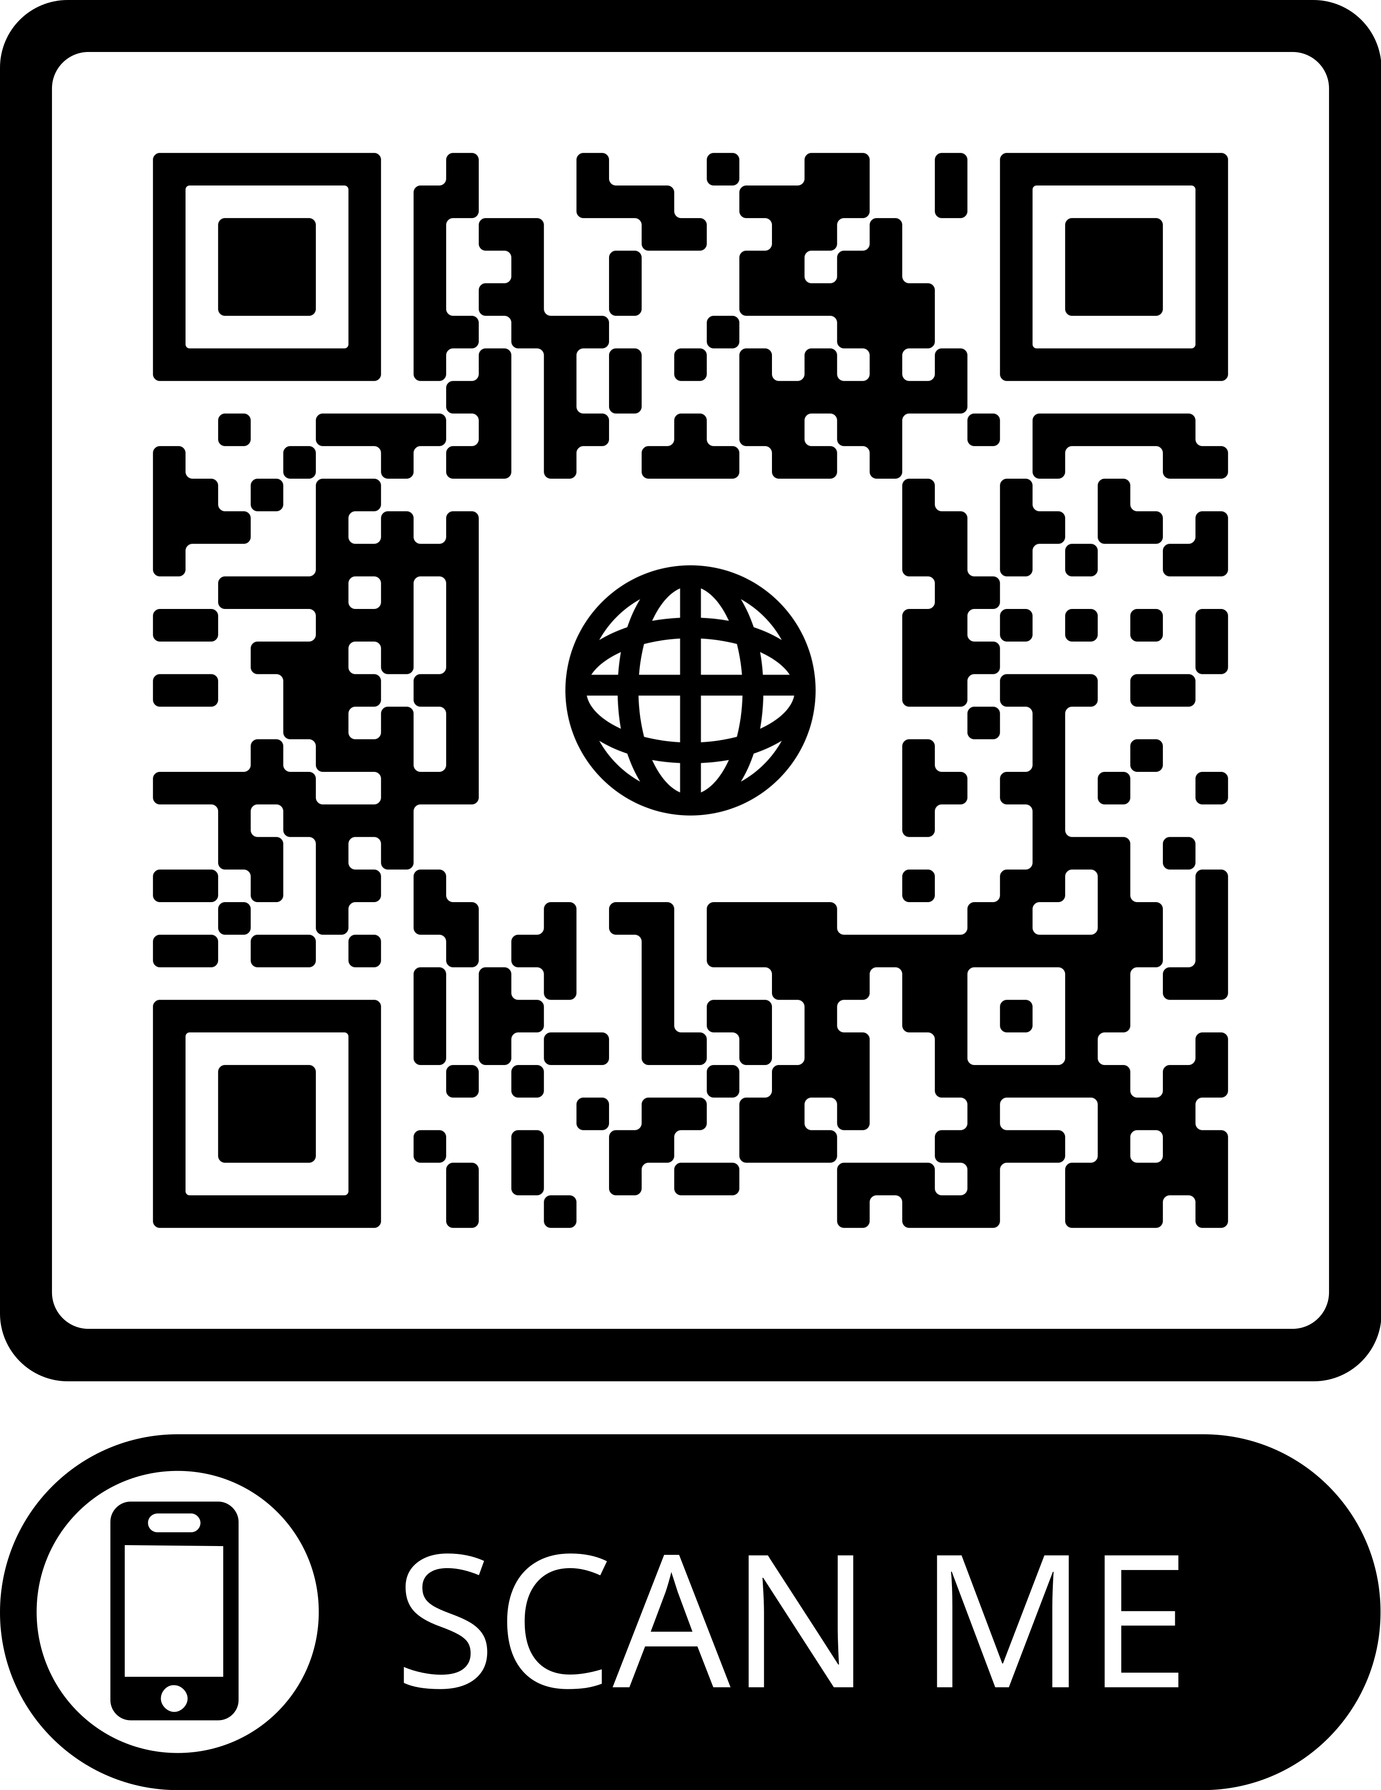
2023 CAR
PowerPoints
These PowerPoints only cover the main points of the CAR.
We encourage all members to read the CAR itself.
Please visit www.na.org/conference
for the complete 2023 CAR.
Notes:
Please keep in mind, these PowerPoints only cover the main points of the CAR. We encourage all members to read the CAR itself. Please visit www.na.org/conference for the complete 2023 CAR, the other PowerPoints, and other conference materials.

Slide 4
CAR Survey
Please see the CAR introduction, particularly pages 4 through 6, for more detail.
Opening essay of the CAR provides some background about the resource challenges the pandemic created for NAWS and the role of CAR survey in trying to unite two streams of ideas for projects.
Notes:
The opening essay of the CAR provides some background about the resource challenges the pandemic created for NA World Services and the role of the CAR survey in trying to unite two streams of ideas for projects: World Services’ strategic planning process and CAR motions. Despite achieving more than we imagined possible with fewer resources than we’ve had in decades, World Services is still facing a considerable backlog of work. The results of the CAR survey help the conference select Issue Discussion Topics and prioritize literature and service material projects to work on in the cycle ahead. This prioritization process is important because there are more good ideas than there are resources to accomplish the work.
Please see the CAR introduction, particularly pages 4 through 6, for more detail.

Slide 5
What is in the survey?
Four items in the survey come from regional motions the WSC has already approved
Most of the remaining ideas are carryovers from previous surveys
Also included are ideas from regional and zonal motions in this CAR
And ideas found through the planning process.
Notes:
This is the fourth time we are including a survey in the CAR. Four of the items in this survey come from regional motions the WSC has already approved to create project plans, and those are shown in blue with an asterisk after the title. The date in parentheses after these items is the year the motion was passed.
Most of the remaining ideas are carryovers from the previous three surveys. We have also included the applicable ideas contained in regional and zonal motions in the 2023 CAR as well as ideas we have heard since the last conference through conversations, emails and phone calls, workshops, and input to the planning process.
The survey keeps getting longer and longer, and it can be a bit overwhelming. To keep the size of the lists practical, the board tried to group similar ideas, and eliminated some items from previous CAR surveys that had a very low selection rate.
After compiling all of the ideas, the board distributed a draft of this survey to conference participants for input, and then incorporated their ideas for changes where possible. Some participants suggested they would like to see an even more abbreviated list of choices, and perhaps in the future we will have a process for participants to collaboratively vet the CAR survey lists.

Slide 6

Survey Availability
Everyone has until 1 April to fill out the survey online at: www.na.org/survey
Notes:
Members can fill in the online version of the survey posted at www.na.org/survey by the first of April, 2023. The board is also asking conference participants to submit the conscience of their regions and zones by that same date. All of the survey results will be compiled for the conference to consider and included in the WSC minutes.

Slide 7

RECOVERY LITERATURE
Unless otherwise directed at the WSC, work will continue on The Loner IP revisions
“DRT/MAT as it relates to NA—what do we want to say in a piece of NA literature?” was an IDT last cycle
This section of the survey will help the WSC decide on future literature projects
Notes:
Unless otherwise directed by WSC 2023, the board is planning to continue work on finalizing revisions to The Loner IP, which was a project passed in 2020. Members were clear in their responses to the Loner survey about what they would like to see changed or included.
We have also surveyed the Fellowship about their ideas for material to be in an IP about drug replacement therapy/medication-assisted treatment (DRT/MAT) as it relates to NA. WSC 2018 approved a motion to create a project plan to create that IP, and the 2020 WSC approved the idea for a survey and to accept “DRT/MAT as it relates to NA—what do we want to say in a piece of NA literature?” as the first Issue Discussion Topic for the cycle.
The results of both surveys will be included in the Conference Report.
The Recovery Literature section of the survey will help the WSC set possible priorities for future work/project plans

Slide 8
NEW LITERATURE TO SUPPORT STEPWORK
Booklet of Step study questions taken from Chapter Four, “How It Works,” in the Basic Text
Step working booklet focused mainly on Steps 1–3, aimed primarily at new members and those in treatment and drug courts
Step working guide aimed at members not new to working the Steps
CREATE A NEW IP OR BOOKLET
DRT/MAT as it relates to NA* (2018)
On using social media in NA* (2018)
Members’ experience, strength, and hope on trustworthiness and trusting the process
IP for a daily personal gratitude inventory
Personal stories about relationships and families in recovery
An IP for newcomers containing the NA suggestions
An IP focused on meditation
Dealing with trauma/PTSD in recovery
Spirituality in service: Atmosphere of recovery and spiritual benefits of service
Dealing with grief in recovery
Spirituality in NA: What does it mean that NA is a spiritual, not religious program? Including a list of spiritual principles with definitions
No new recovery lit
Other
TARGETED LITERATURE
Literature for women in recovery* (2020)
Literature for atheists and agnostics
Literature for younger members
Literature for older members
Literature for experienced members/“oldtimers”
Literature for LGBTQ+ members
Literature for First Nations/indigenous members
Literature for members who are veterans
New Recovery Literature
choose up to 3
Pause for discussion
Notes:
This is the full list of items in the New Recovery Literature section of the survey. Please select up to three from this list.

Slide 9
REVISE AN EXISTING PIECE OF NA LITERATURE
Add “gender” to “What is the NA Program?” to read: “Anyone may join us regardless of age, race, gender, sexual identity, creed, religion or lack of religion.”
Review currently approved recovery literature to gender neutralize NA literature, where possible
Revise and simplify the Step Working Guides
Revise the Sponsorship book
Revise Recovery and Relapse
Revise Accessibility for Those with Additional Needs
Revise Am I an Addict?
Revise H&I Service and the NA Member
Revise PI and the NA Member
Revise The Concepts booklet
No revisions to recovery literature
Other
Revisions to Existing
Recovery Literature
choose up to 2
Pause for discussion
Notes:
This is the full list of items in the Revisions to Existing Recovery Literature section. Please choose no more than two from this list.

Slide 10
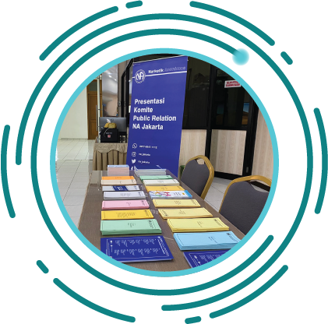
SERVICE MATERIAL
This section will help focus a Service Tools project for this cycle
May also help set future work/project plans
In recent years, the focus has moved to “basics” that are easier to translate
Notes:
The Service Material section of the survey will help the WSC prioritize the focus of a service tools project for the upcoming cycle, and it may help set possible priorities for future work/project plans. Virtual Meeting Basics, which is posted at www.na.org/virtual and na.org/basics, was created during the pandemic as a direct result of our experience and the responses to the CAR survey.
NA service material used to be dominated by weighty handbooks—those are posted at www.na.org/handbooks. In more recent years, world services has been collecting best practices in shorter, easier-to-translate “basics”—those are posted at www.na.org/basics. The basics are accessed more frequently online than longer service material is, and they are well suited to our diverse and international membership.
While ideas for new service tools are valuable, we also have a lot of very old service material that still contains helpful ideas but needs to be updated to reflect current experience and reality.
Based on this, the service material section is also divided into ideas for new pieces and ideas for revisions.

Slide 11
PUBLIC RELATIONS
PR video explaining what NA is, how it works, and how to contact us* (2020)
Our public image: creating confidence in NA
More social media guidelines above and beyond the service pamphlet
More short, focused PR resources such as tools to assist in reaching the medical community, criminal justice, and those who refer people to NA
Sponsorship behind the Walls basics
Internal PR basics
Cooperation, not affiliation—our relationship to others, including AA
[NA SERVICES 101 follows PUBLIC RELATIONS in actual form]
LEGAL, FINANCIAL, AND SEVENTH TRADITION TOOLS
Self-support in NA (what it means, how we handle funds, banking, digital fund flow, fundraising, misappropriation, etc.)
Information for creating legal entities/incorporating
How do we protect the NA message and carry the message? (understanding the FIPT and the issues around illicit literature, local websites, virtual meetings, etc.)
Area treasurers’ and budgeting basics
NA SERVICES 101
Virtual service basics (including virtual service meetings, virtual meetings and areas participating in the service system, virtual workshops and trainings, etc.)
The impact of technology on services and workloads
Best practices for service workshops
Carrying the NA message effectively
Personal application of Concepts and Traditions, as a member and trusted servant
Facilitation basics
What is NA World Services and how does it work?
Fellowship development basics
Collaborating among service bodies
When service bodies split or reunify
Description of service commitments at areas and regions
Effective report writing
Tools for leadership and mentorship, including as they relate to service bodies and new meetings
Group support forum, local service
conference and local service board basics
Policy in NA—different kinds of policy styles
and approaches
New Service Material
choose up to 3
Pause for discussion
Notes:
This is the full list of items in the New Service Material section of the survey. Please select up to three options.

Slide 12
REVISE EXISTING SERVICE MATERIAL
Update A Guide to Local Services in NA (GLS )
Revise Translation Basics
Revise and update Planning Basics
Revise and update PR Basics
Revise and update H&I Basics
Revise and update the service pamphlet Disruptive and Violent Behavior to reflect current practices in the Fellowship, and include the issue of sexual predators
Revise and update the service pamphlet Group Business Meetings, with a section on using a CBDM process, and the concept of delegation
Other
Revisions to Existing
Service Material
choose up to 2
Pause for discussion
Notes:
This is the full list of items in the Revisions to Existing Service Material section of the survey. Please select up to two options.

Slide 13

ISSUE DISCUSSION TOPICS
Issues discussed between Conferences
Results of the discussions create the foundations for service tools and literature projects
Notes:
Issue Discussion Topics (IDTS for short) are just that—issues that are discussed throughout the Fellowship in the time between Conferences. The results of IDT workshops and discussions can help to create the foundation for service pamphlets and other tools and literature. Sharing your priorities will help the WSC select Issue Discussion Topics for the upcoming Conference cycle.

Slide 14
IDTS FOR THE NEXT CYCLE
Gender-neutral and inclusive language in NA literature
Reimagining and revitalizing service committees (to further the reach of the NA message, improve communication, provide mentorship and training, and make service more attractive and accessible, learning from our experience the past few years)
Dealing with disruptive and predatory behavior
Self-support in NA: Seventh Tradition and Eleventh Concept
The Fellowship Intellectual Property Trust (FIPT )
Our Symbol—a closer look
The importance of our Traditions to NA
Group conscience and consensus-based decision making
PR basics—what they are and why they are important
Spiritual principles and service
Social media and PR issues
Making NA accessible for those with additional needs
Building our unity while respecting our differences
Retaining members in NA
Illness/medication and our literature
Other
Issue Discussion Topics
choose up to 3
Pause for discussion
Notes:
This is the full list of items in the Issue Discussion Topic section of the survey. Please select no more than three options.

Slide 15

REMINDER: 1 APRIL 2023
As a reminder, the survey is available until this date
www.na.org/survey
Notes:
As a reminder, we will collect responses from members and from regions and zones until the first of April 2023. You can access the survey at www.na.org/survey.

Slide 16

Six other PowerPoints available online
CAR survey also available online
CAR available for download
      worldboard@na.org
      www.na.org/conference
Notes:
We hope this PowerPoint has helped in your discussion of this material. Please note that there are six other PowerPoints that focus on the rest of the CAR. These resources, the CAR itself, and the online CAR survey are available online at www.na.org/conference.
We welcome your questions and your feedback on the CAR, and all other issues, at worldboard@na.org.

