Slide 1
#3 of 3 PowerPoints
WSC Background
Local Service Toolbox
Work of the cycle
#1: Motions 1- 4
#2: Budget / Motion 5
All materials: www.na.org/conference
Notes:
This is the third of three PowerPoints covering material in the 2022 Interim Conference Agenda Report/Conference Approval Track material (or ICC for short). This PowerPoint covers the background information in the ICC about the conference and a summary of the work of NA World Services during this conference cycle. The first PowerPoint covers the four CAR motions, about the FIPT, term limits, and SPAD. The second PowerPoint covers the proposed budget and CAT motion for its approval.
These PowerPoints cover only the main points of the ICC. We encourage all members to read the document itself for more information. Please visit www.na.org/conference for the complete 2022 ICC, the SPAD approval draft, the other ICC PowerPoints, and other conference materials. Paper copies will not be mailed to participants and regions nor will they be available for sale.

Slide 2
Virtual partial WSC 2022 will meet 22, 23, 29, and 30 April
2-sessions a day
Voting and initial straw polls will take place via epoll
Livestreamed on YouTube
Notes:
WSC 2022 will take place over four days: Friday and Saturday the 22nd and 23rd of April, and the following Friday and Saturday the 29th and 30th of April. We intend to have two sessions each day, with an hour break in between, as was the case in 2020.
Voting and initial straw polls will take place via epoll before and after the sessions, so time during the sessions themselves can be spent discussing the motions. If there is time remaining after the motions have been dispensed with, the future of the WSC will be discussed.
The business sessions will be live-streamed on YouTube, but it is not possible to stream the small group discussions in breakout rooms.

Slide 3
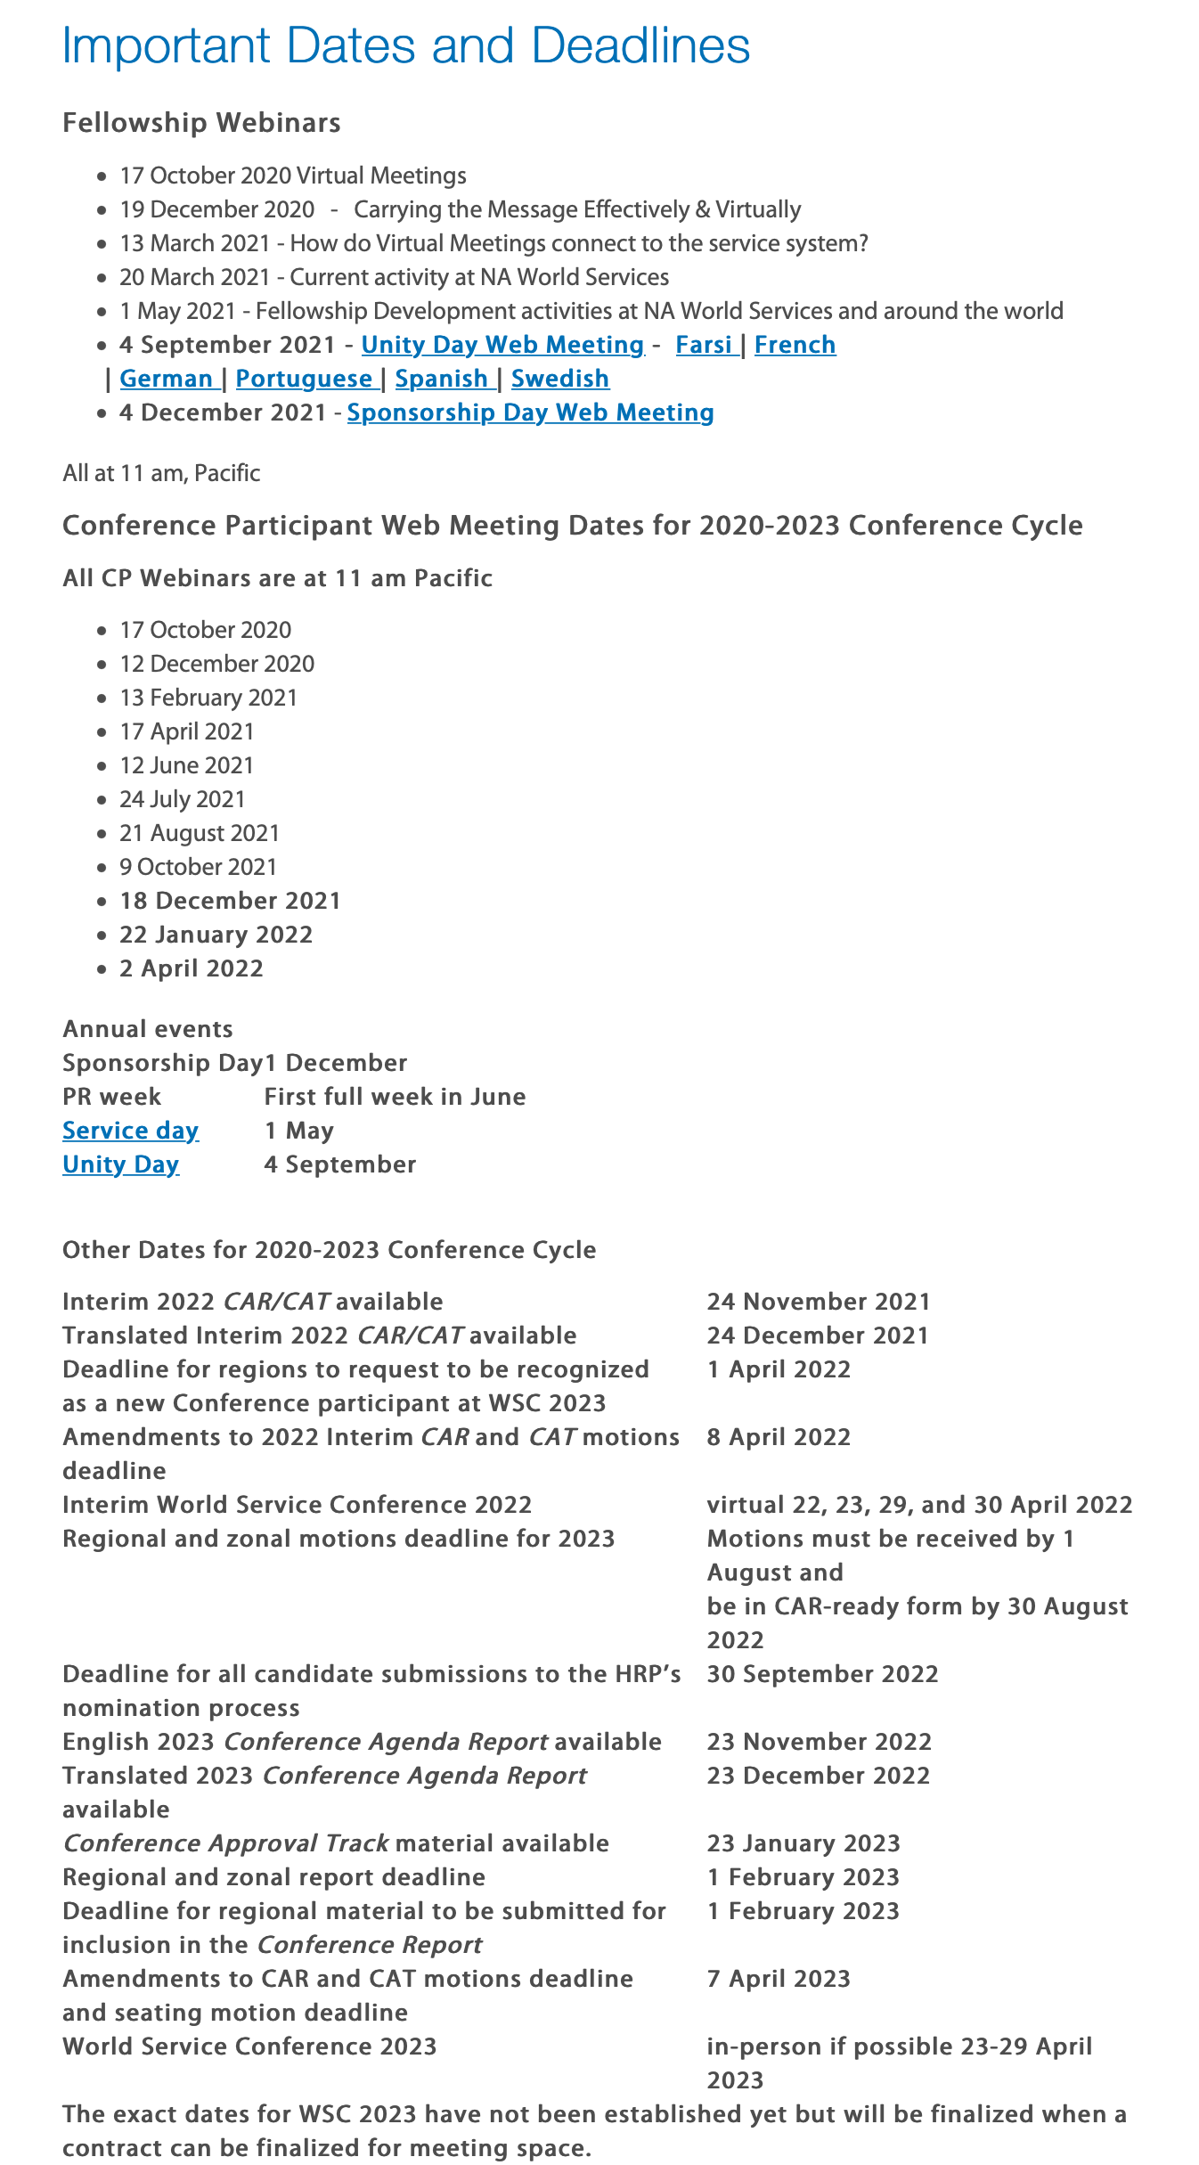
www.na.org/dates
www.na.org/conference
Deadline for amendments to all motions is April 8
wb@na.org
Notes:
Dates and deadlines for the conference cycle through to WSC 2023 can be found on the important dates and deadlines page www.na.org/dates and in the draft of A Guide to World Services in NA posted on the conference page at www.na.org/conference.
The deadline for amendments to all motions is April 8th. All regions and zones that intend to offer amendments are encouraged to contact the World Board at wb@na.org as soon as possible.

Slide 4
?
What about the World Service Conference after 2023?
?
Notes:
There are many unanswered questions about the future of the World Service Conference after the 2023 meeting. If we get through the business at the 2022 meeting, we intend to spend the remainder of the time discussing some of these questions. We posted a number of questions in the ICC that delegates will be discussing in January. We will continue to keep members posted as this conversation evolves.

Slide 5
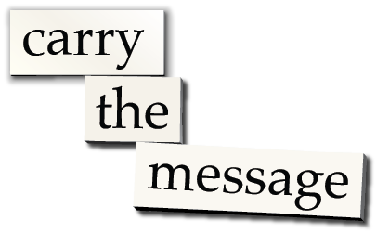
NAWS projects this cycle
Information on both projects in Interim CAR/CAT
SPAD motion in PowerPoint #1
Notes:
Now we want to turn to a short review of some of the work since WSC 2020. The two big NAWS projects this cycle have been the Spiritual Principle a Day book, and the Local Service Toolbox project, which has been focused on virtual meetings. The ICC contains more detailed information about both of these projects. The SPAD book motion is covered in PowerPoint number one. There is no motion from the Toolbox Project, but here are a few highlights of what has been achieved since WSC 2020.

Slide 6
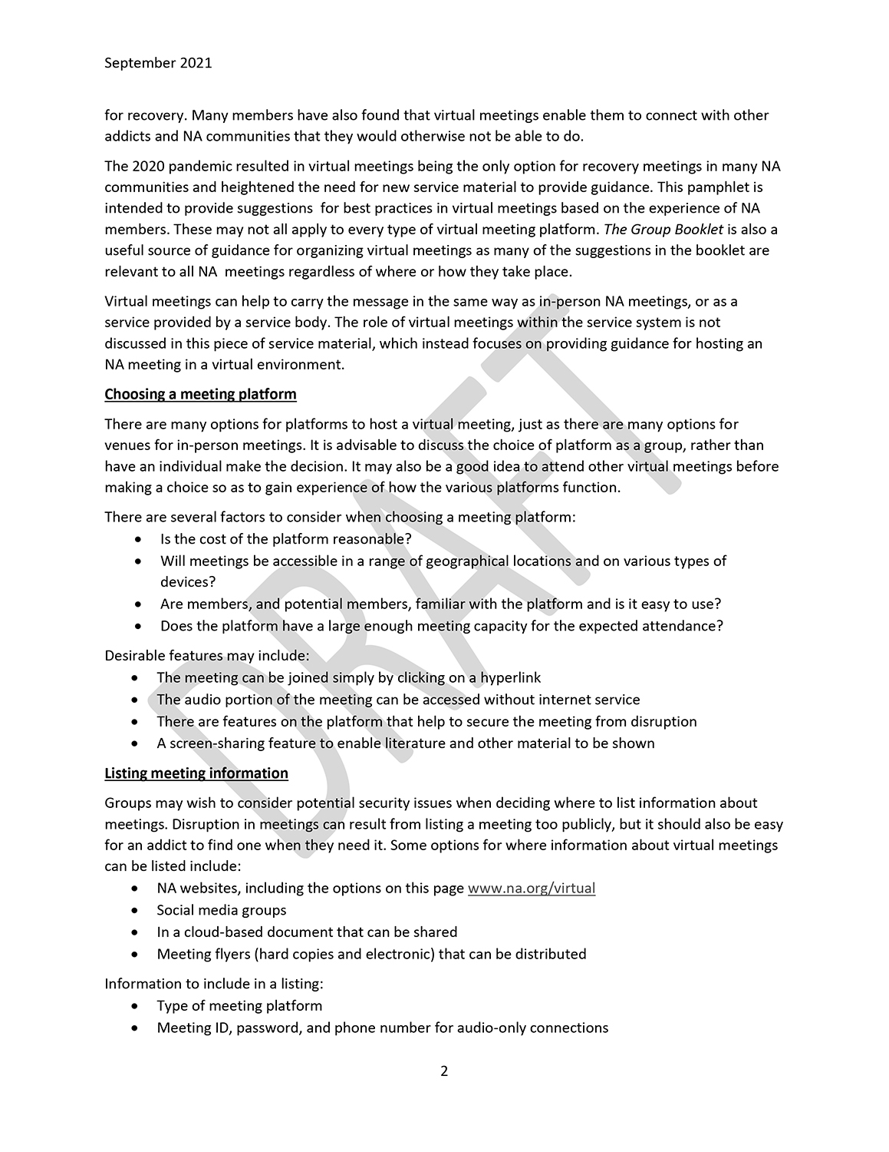
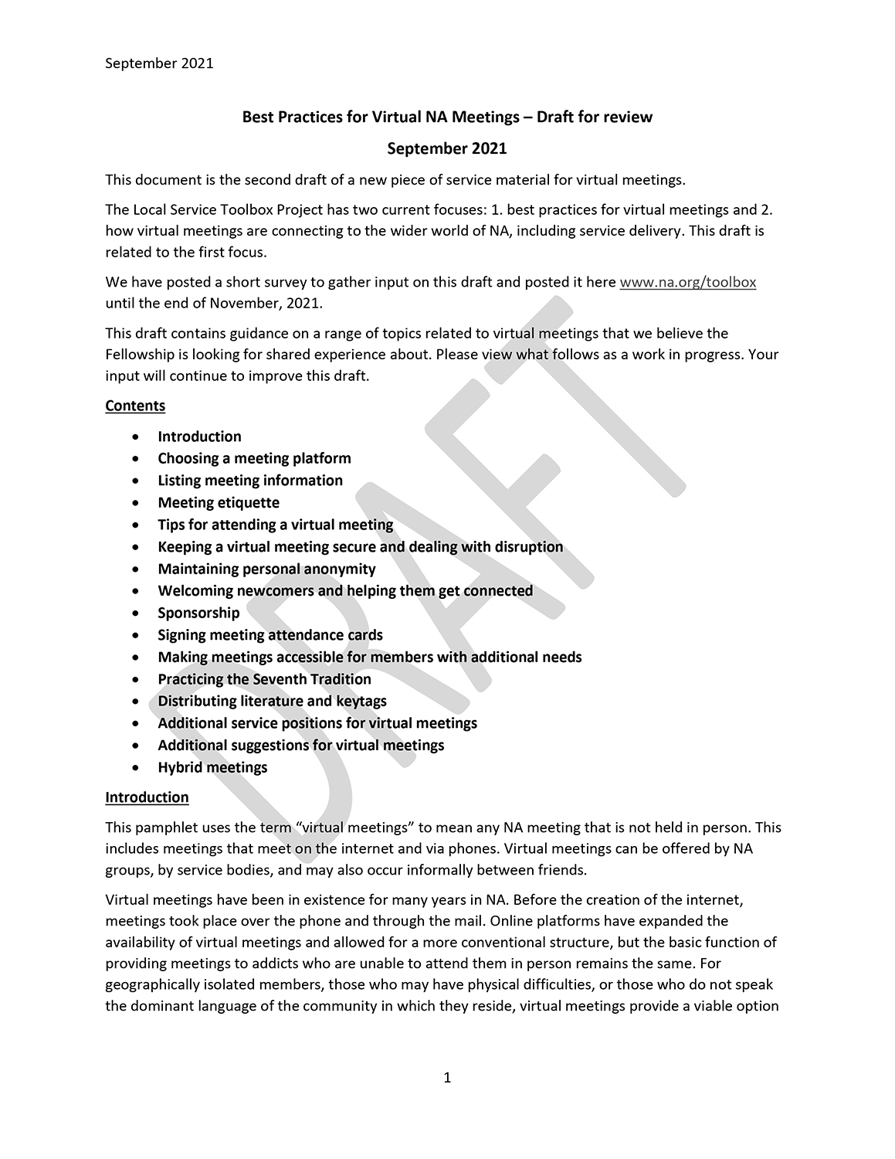
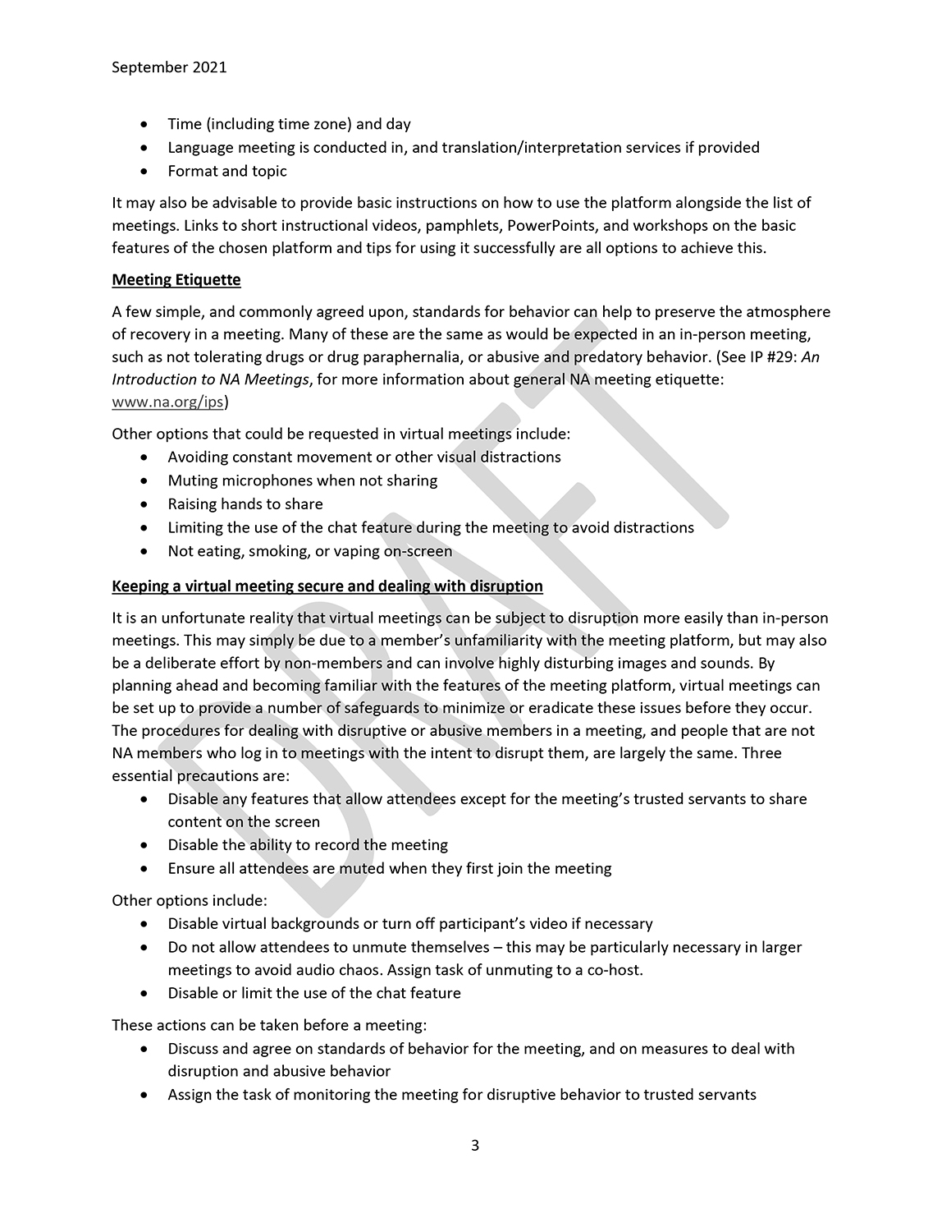
CONTENTS
Choosing a meeting platform
Listing meeting information
Meeting etiquette
Tips for attending a virtual meeting
Keeping a virtual meeting secure and dealing with disruption
Maintaining personal anonymity
Welcoming newcomers and helping them get connected
Sponsorship
Signing meeting attendance cards
Making meetings accessible for members with additional needs
Practicing the Seventh Tradition
Distributing literature and keytags
Additional service positions for virtual meetings
Additional suggestions for virtual meetings
Hybrid meetings
Find “Virtual Meeting Basics” at www.na.org/toolbox
Notes:
By the time the 2022 meeting of the WSC takes place, we intend to have published a finalized draft of Virtual Meeting Basics, which will join the library of other “Basics” service material. Input is being gathered on the draft via a survey that will be available until the end of 2021, so by the time you see this PowerPoint or watch this video, we will probably be reviewing that input for revisions to the draft. Both the draft and the survey are posted at www.na.org/toolbox in multiple languages.
The draft offers practical guidance on running virtual meetings, including getting the meeting set up and listed, and ensuring it runs smoothly. It offers best practices on some of the topics NA World Services gets asked about most frequently – including keeping meetings secure from disruption, ensuring a safe and welcoming atmosphere, practicing the Seventh Tradition, and verifying meeting attendance.

Slide 7
Notes:
NA meetings have taken place over the phone and on the internet for many years, and since March 2020 many of us have become more familiar with attending meetings virtually. One of the questions we are frequently asked is whether a group that meets virtually can be considered an NA group. We posted a survey in five languages in March 2021 that posed this question to the Fellowship. Of the over 4,200 responses we received, more than 80% said they believe virtual meetings meet the criteria to be NA groups. Given these results, and the conversations we have had with delegates and other members, we intend to offer a motion on the issue to be considered at the 2023 WSC that we believe reflects the Fellowship’s conscience. In the meantime, the World Board encourages local service bodies to continue to recognize and embrace virtual meetings.

Slide 8
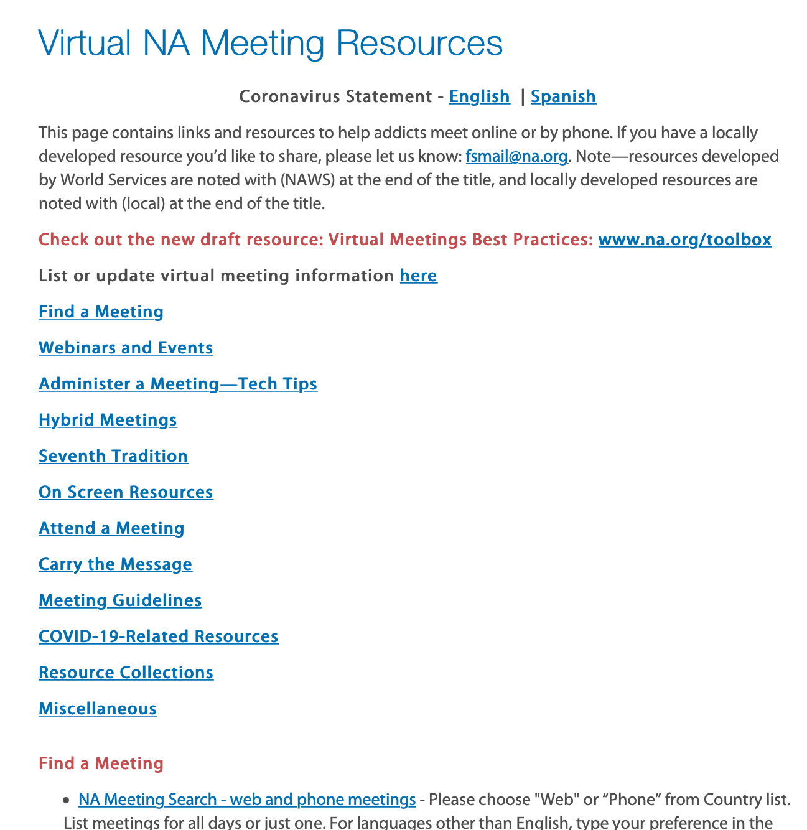
www.na.org/virtual
Notes:
In addition to the work of the Local Toolbox Project, we have done our best to support virtual meetings in other ways through the cycle so far. We created a webpage with resources devoted to virtual meetings and service efforts: www.na.org/virtual. The resources on this page are from World Services, local service bodies, and meetings and address many, many questions that we get from members and that we hear in the course of our own recovery. Please visit the page and continue to share your locally developed materials with us.

Slide 9
Highlights of work accomplished since March 2020:
Publishing a new pamphlet: IP #30, Mental Health and Recovery
Publishing 166 new translated titles and posted all IPs and booklets to na.org.
Continuing to organize quarterly web meetings for trusted servants doing Public Relations, Phonelines, Hospitals and Institutions, and Inmate Step Writing. More information is at www.na.org/webinar.
Gathering zonal trusted servants to talk about the role of zones and issues related to zonal delegates.
Continuing to ship free and subsidized literature around the world, averaging more than $440,000 annually for the last two fiscal years.
Starting an Instagram account for NA (@narcoticsanonymous) and another for NA conventions and events (@naglobalevents).
Notes:
Despite staffing and funding shortages, we have accomplished a lot since March 2020 and continue to support groups and service bodies in more than 140 countries speaking 91 languages.
These efforts include
Publishing a new pamphlet: IP #30, Mental Health and Recovery
Publishing 166 new translated titles and posted all IPs and booklets to na.org.
Continuing to organize quarterly web meetings for trusted servants doing Public Relations, Phonelines, Hospitals and Institutions, and Inmate Step Writing. More information is at www.na.org/webinar.
Gathering zonal trusted servants to talk about the role of zones and issues related to zonal delegates.
Continuing to ship free and subsidized literature around the world, averaging more than $440,000 annually for the last two fiscal years.
Starting an Instagram account for NA (@narcoticsanonymous) and another for NA conventions and events (@naglobalevents).

Slide 10
Highlights continued:
Answering thousands of emails and phone calls from members.
Launching a contribution page at www.na.org/contribute that we continue to improve.
Helping trusted servants in Florida, Ohio, Arizona, and Virginia work with correctional personnel to be able to provide tablets loaded with NA literature to inmates. And continuing to respond to contact from inmates with information and literature.
Registering and protecting NA’s copyrights and intellectual property in numerous countries.
Posting more audio versions of the Basic Text for free download (including English!): You can find them at www.na.org/audio.
Notes:
Answering thousands of emails and phone calls from members.
Launching a contribution page at www. na.org/contribute that we continue to improve.
Helping trusted servants in Florida, Ohio, Arizona, and Virginia work with correctional personnel to be able to provide tablets loaded with NA literature to inmates. And continuing to respond to contact from inmates with information and literature.
Registering and protecting NA’s copyrights and intellectual property in numerous countries.
Posting more audio versions of the Basic Text for free download (including English!): You can find them at www.na.org/audio.

Slide 11
Highlights – just a few more:
Creating a media page with some of our graphical resources including an ever-growing collection of videos: www.na.org/media.
Creating a virtual meetings resource page at www.na.org/virtual, and continuing to collect and post local resources there and on and the local service resources page at www.na.org/localresources, including a new section called Addressing Predatory, Disruptive, or Violent behavior.
Responding to requests to participate virtually in service bodies and events around the world.
Don’t forget the Annual Report for the best comprehensive record of our activities in a given fiscal year: www.na.org/ar.
Notes:
Creating a media page with some of our graphical resources including an ever-growing collection of videos: www.na.org/media.
Creating a virtual meetings resource page at www.na.org/virtual, and continuing to collect and post local resources there and on and the local service resources page at www.na.org/localresources, including a new section called Addressing Predatory, Disruptive, or Violent behavior.
Responding to requests to participate virtually in service bodies and events around the world.
That’s a lot, and there’s so much more. The Annual Report is the best comprehensive record of our activities in a given fiscal year. You can find it at www.na.org/ar.

Slide 12
www.na.org/contribute
Notes:
To continue to provide these services in the face of the pandemic has been a challenge. The global shutdown in March 2020 reduced NAWS literature income by around 85% as groups stopped meeting in person. For years, we have known our reliance on the sale of literature to fund services is not sustainable, and overnight we were forced to deal with that reality. Immediate action was taken to reduce staff. At the beginning of the 2020 fiscal year we had 46 staff in our Chatsworth office and that number was 19 by the end of June. We have reduced all other expenses where possible, but the long term solution is to change the way we fund the services NAWS provides.
The “Invest in Our Vision’ essay in the ICC offers more detail, but to put it simply, we are asking for the support of the Fellowship. We have been amazed at the progress we have made and we still have a ways to go. Please review the essay in the ICC and visit www.na.org/contribute to be a part of this effort.

Slide 13
Other PowerPoints and videos available online
ICC and SPAD draft can be downloaded. Hard copies of SPAD draft can be ordered from NA World Services
www.na.org/conference
worldboard@na.org
Notes:
We hope this PowerPoint has helped in your discussion of this material. Please note that there are other PowerPoints that focus on other ICC contents, available online at www.na.org/conference.
We welcome your questions and your feedback at worldboard@na.org.

